Slide 1
Generative AI Explained

Slide 2
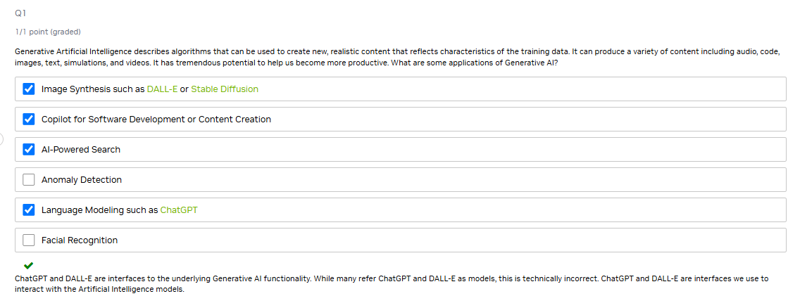

Slide 3
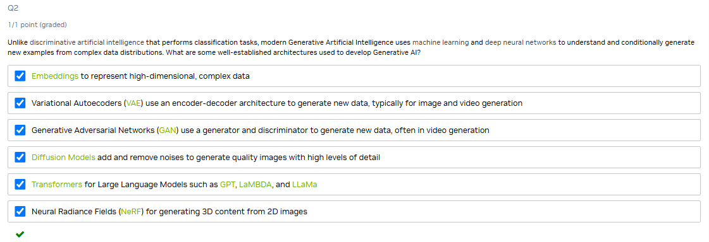

Slide 4
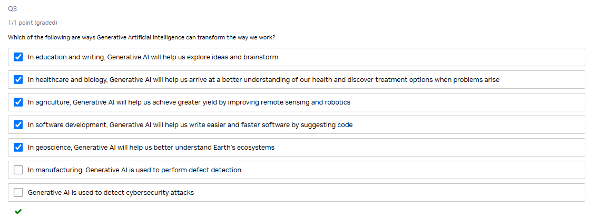

Slide 5
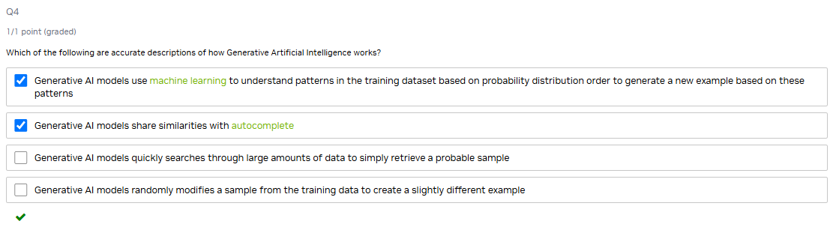

Slide 6
Applications of Generative AI - Language

Slide 7
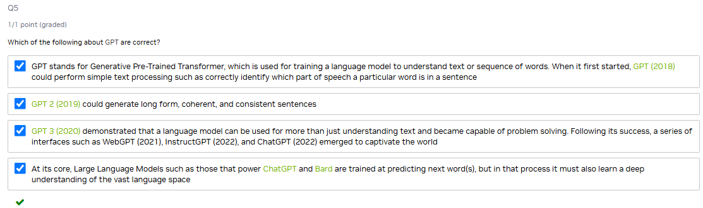

Slide 8
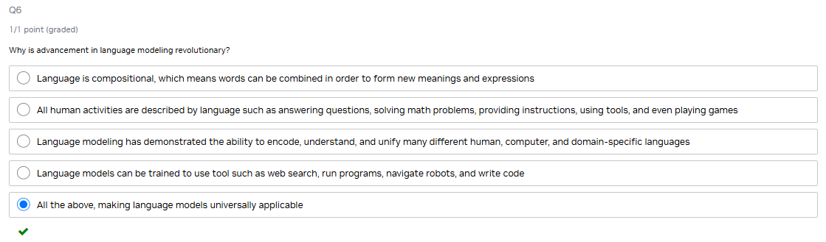

Slide 9
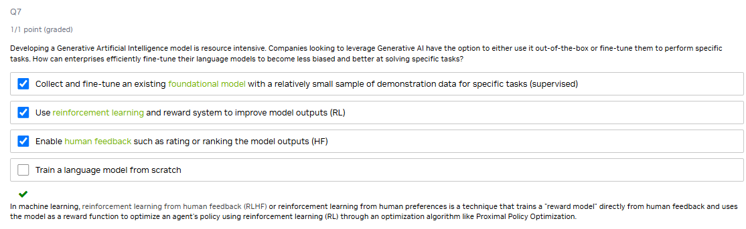

Slide 10
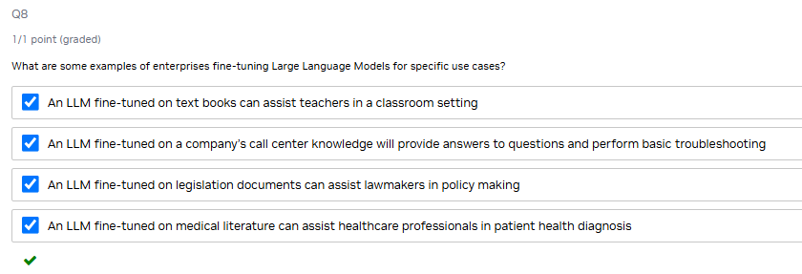

Slide 11
Applications of Generative AI - Other Modalities

Slide 12
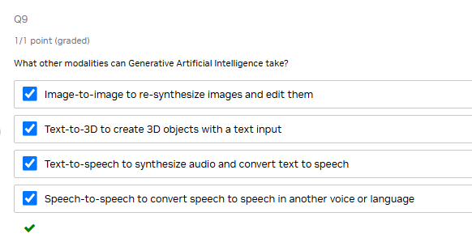
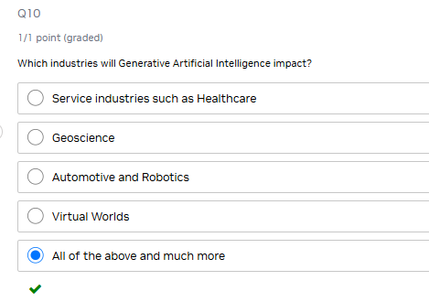
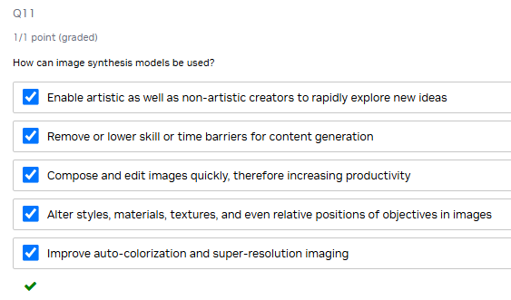
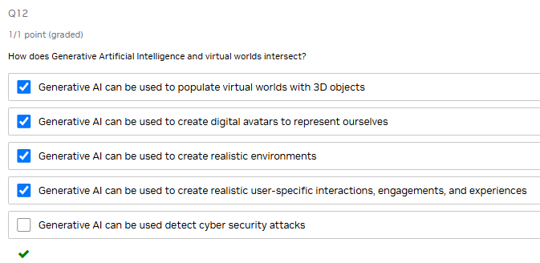

Slide 13
Challenges and Opportunities of Generative AI

Slide 14
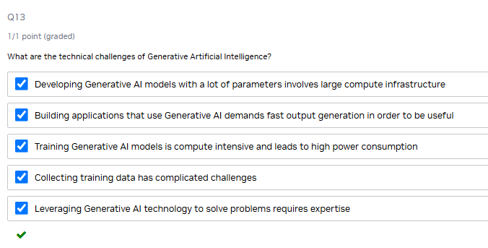
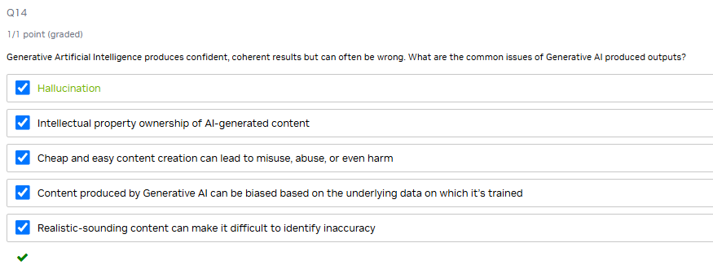

Slide 15
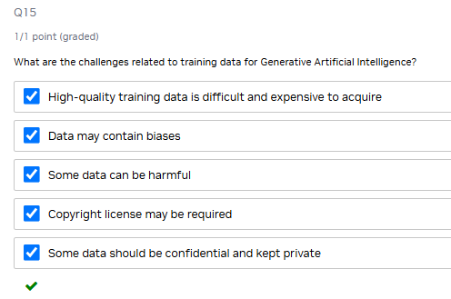
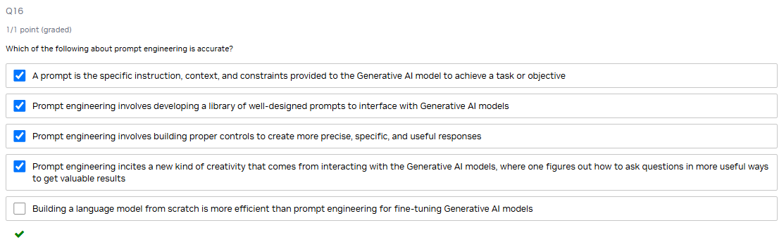

Slide 16
Summary

Slide 17
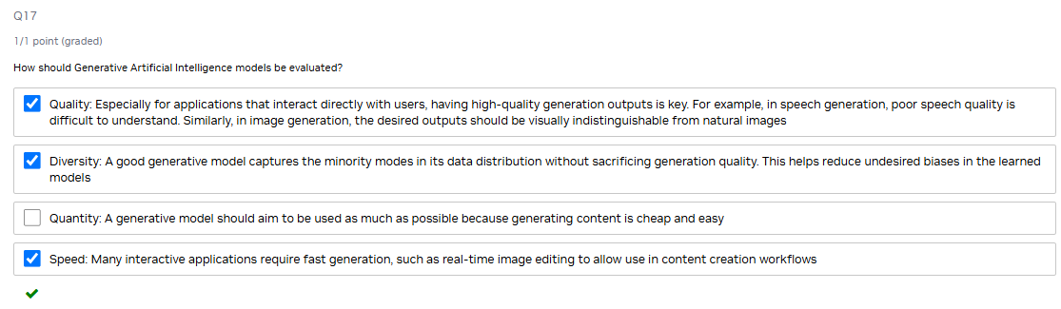
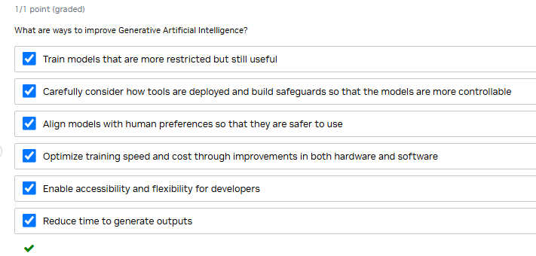

Slide 18
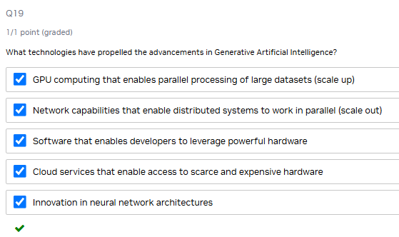
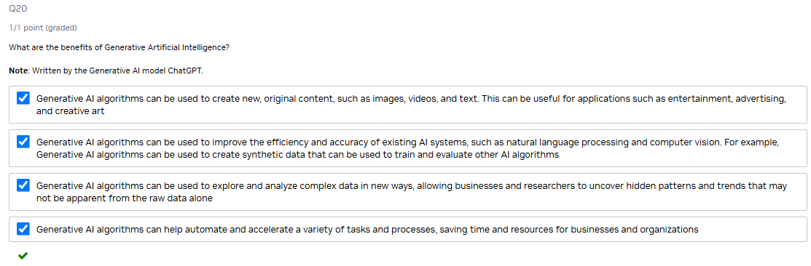

Slide 19
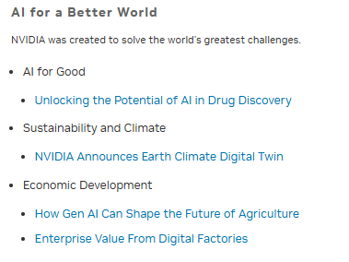
https://web-assets.bcg.com/86/e5/19d29e2246c7935e179db8257dd5/unlocking-the-potential-of-ai-in-drug-discovery-vf.pdf
https://nvidianews.nvidia.com/news/nvidia-announces-earth-climate-digital-twin
https://www.mckinsey.com/industries/agriculture/our-insights/from-bytes-to-bushels-how-gen-ai-can-shape-the-future-of-agriculture
https://www.mckinsey.com/capabilities/operations/our-insights/industrys-fast-mover-advantage-enterprise-value-from-digital-factories

