Slide 1


4 Introduction to Physics-Informed Neural Networks
Leon Herrmann
Stefan Kollmannsberger
Chair of Data Engineering in Construction
Bauhaus-Universität Weimar
Deep Learning in Computational Mechanics – an introductory course, Herrmann et al. 2025
website
book
Notes:
generated with https://www.the-qrcode-generator.com/

Slide 2
Contents
3 Neural Networks
4.1 Overview
4.2 Data-Driven Inference
4.2.1 One-Dimensional Static Model
4.2.2 Two-Dimensional Static Model
4.3 Data-Driven Identification
5 Advanced Physics-Informed Neural Networks

Slide 3

4.1 Overview
Data-driven solvers (such as the surrogate for strain distributions in Chapter 3) require data
Limited data availability
Breakeven threshold limits applicability
Incorporation of governing laws into neural networks to improve generalization with less data:
Physics-informed learning
Via the neural network architecture (by constraining the learnable space, i.e., strong enforcement; see Chapter 3 & 7)
Through training (via penalty terms in the cost function, i.e., weak enforcement/regularization; see Chapters 4 & 5)
Physics-informed neural networks (PINNs):
Solving differential equations through the minimization of the their residual (using gradient-based optimization)
$$τ=\frac{T_{data}+T_{train}}{T_{simulation}+T_{surrogate}}$$
Physics-informed neural networks: A deep learning framework for solving forward and inverse problems involving nonlinear partial differential equations, Raissi et al. 2019

Slide 4
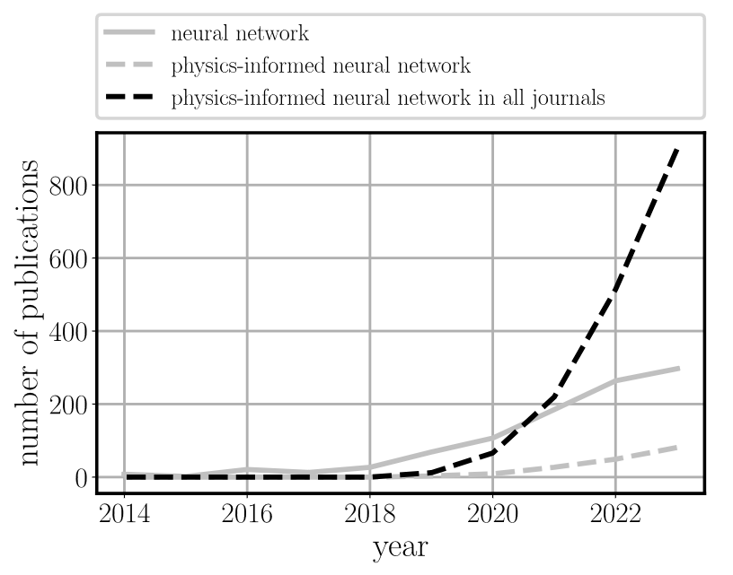
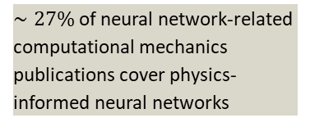
4.1 Overview – Motivation
$∼27\%$ of neural network-related computational mechanics publications cover physics-informed neural networks
Spoiler:
currently not competitive to classical methods in practically all engineering scenarios
possibly advantages in combination with other techniques
maybe: Future potential (given breakthroughs in fundamental research in machine learning)
Why do we cover physics-informed neural networks (PINNs) at all?
One of the first deep learning techniques beyond pure supervised learning
Immense popularity despite significant (and not widely known) shortcomings
Importantly:
Introduction of various concepts with value beyond physics-informed neural networks
Physics-informed neural networks: A deep learning framework for solving forward and inverse problems involving nonlinear partial differential equations, Raissi et al. 2019

Slide 5
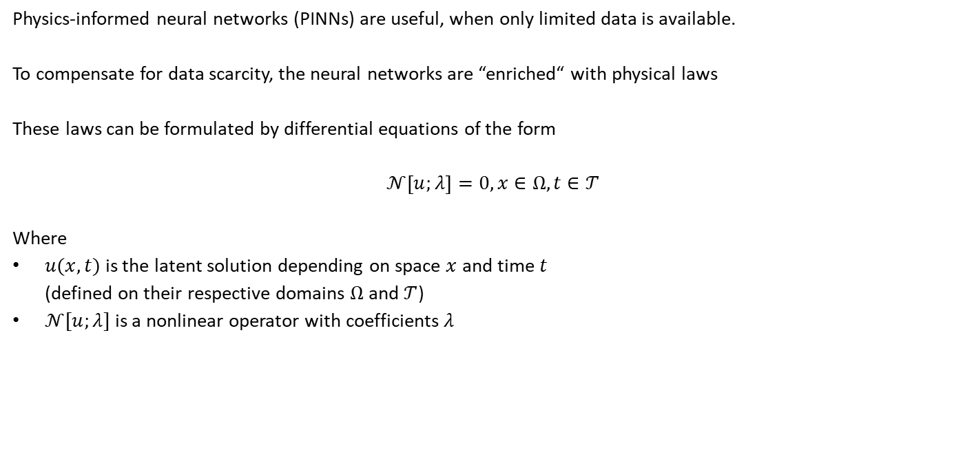
4.1 Overview
Physics-informed neural networks (PINNs) are useful, when only limited data is available.
To compensate for data scarcity, the neural networks are “enriched“ with physical laws
These laws can be formulated by differential equations of the form
$$𝒩\left[u;λ\right]=0, x∈Ω, t∈𝒯$$
Where
$u(x,t)$ is the latent solution depending on space $x$ and time $t$ (defined on their respective domains $Ω$ and $𝒯$)
$𝒩[u;λ]$ is a nonlinear operator with coefficients $λ$

Slide 6
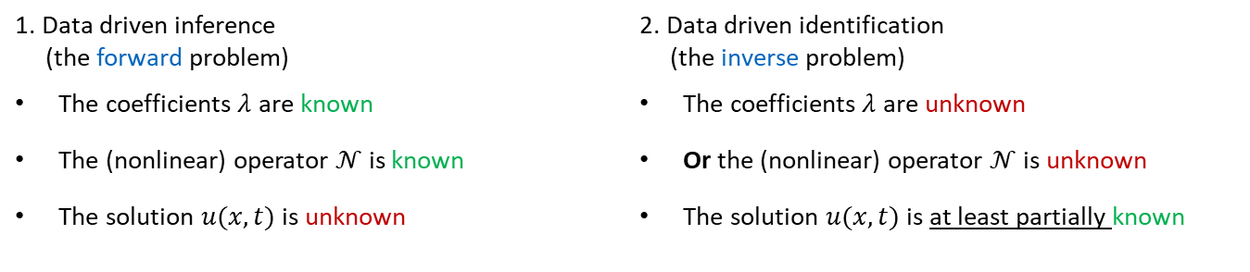

4.1 Overview
$$𝒩\left[u;λ\right]=0, x∈Ω, t∈𝒯$$
The two main use cases of PINNs are:
For simplicity, let us now assume that the changes of $u$ with respect to time are zero, then
$$𝒩\left[u;λ\right]=0, x∈Ω$$
Where
$$u(x)$$
1. Data driven inference (the forward problem) | 2. Data driven identification (the inverse problem)
The coefficients $λ$ are known | The coefficients $λ$ are unknown
The (nonlinear) operator $𝒩$ is known | Or the (nonlinear) operator $𝒩$ is unknown
The solution $u(x,t)$ is unknown | The solution $u(x,t)$ is at least partially known

Slide 7
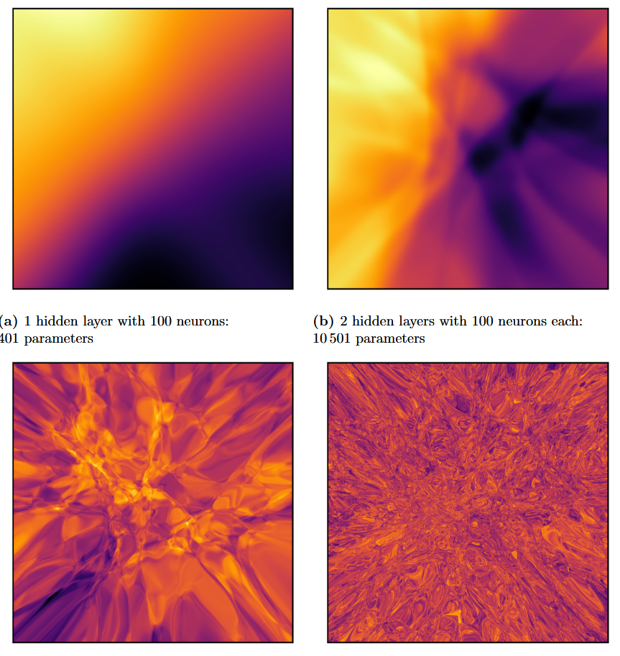

4.1 Overview
We now remember the following essentials from the previous lectures
Chapter 3.2: Fully connected neural networks
can represent any (continuous) function $\hat{y}=f_{NN}\left(x\right)$

Slide 8
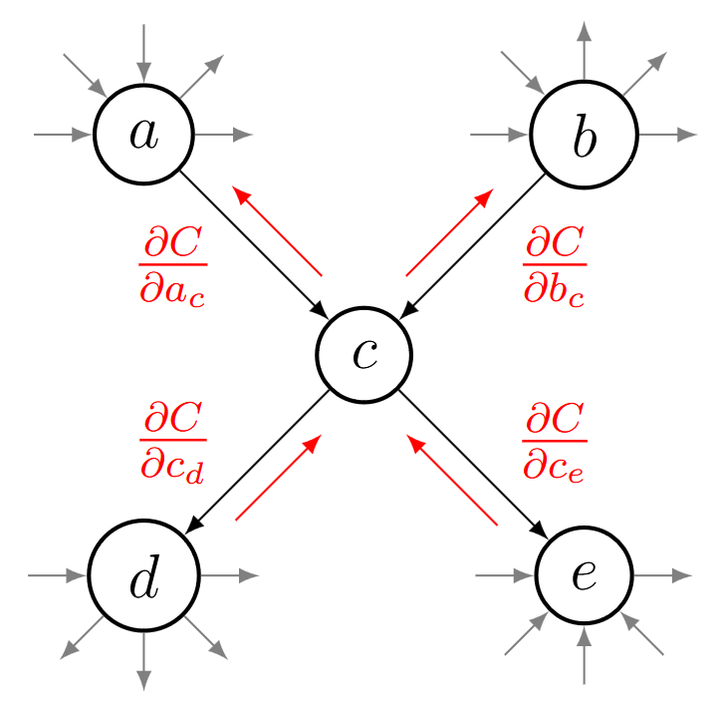

4.1 Overview
We now remember the following essentials from the previous lectures
Chapter 3.3: Differentiation
Given an output $\hat{y}=f_{NN}\left(x\right)$, the derivatives of the output $\hat{y}$ (or cost $C$) can be computed with respect to both
The neural network parameters $Θ$
The inputs $x$ (see 3.4.2)

Slide 9
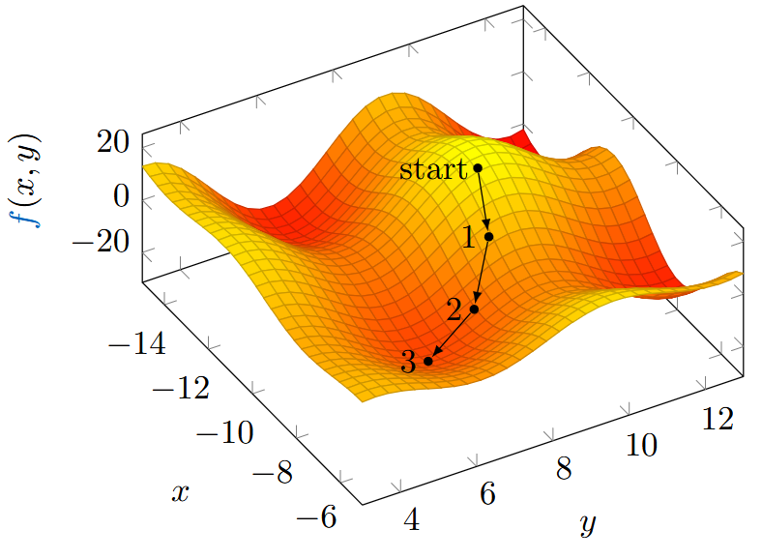

4.1 Overview
Therefore, we can
Set up a network to approximate the solution $u(x)$
Compute the derivative of the solution $u(x)$ with respect to its input $x$ for
$$𝒩\left[u;λ\right]=0, x∈Ω, t∈𝒯$$
Compute a loss function (residual of the differential equation)
And derive it with respect to $Θ$
Use a gradient-based optimizer to minimize that residual

Slide 10
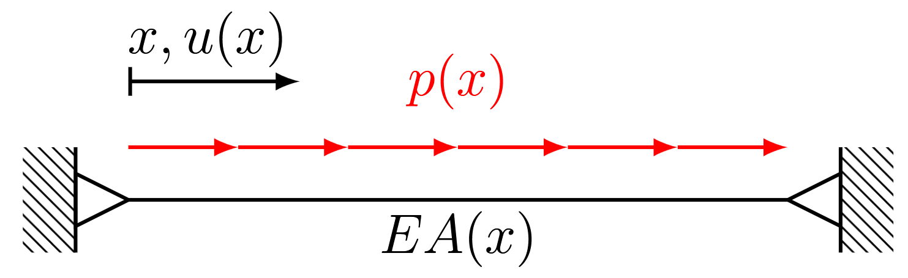


4.2 Data-Driven Inference
4.2.1 A one-dimensional static model problem
Where
$$𝒩\left[u\right]=\frac{d}{dx}\left(EA\frac{du}{dx}\right)+p=0 x∈Ω$$
$EA\frac{du}{dx}=F x∈Γ_{N}$
$$u=g x∈Γ_{D}$$
$$𝒩\left[u;λ\right]=0, x∈Ω, t∈𝒯$$
Neumann boundary conditions
Dirichlet boundary conditions

Slide 11
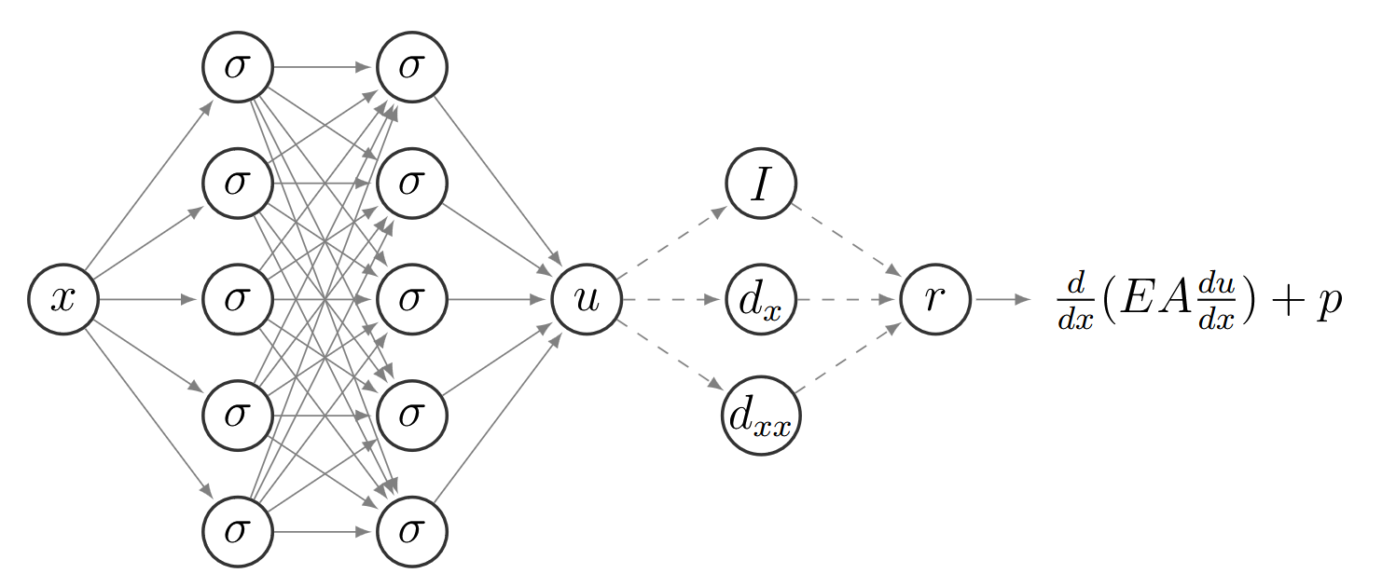

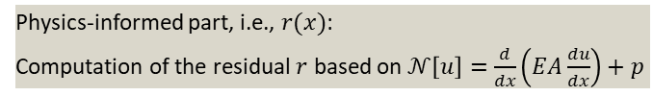
4.2 Data-Driven Inference
Conceptual point of view
Fully connected neural network $u_{NN}(x)$:
Approximates the solution
Physics-informed part, i.e., $r(x)$:
Computation of the residual $r$ based on $𝒩\left[u\right]=\frac{d}{dx}\left(EA\frac{du}{dx}\right)+p$

Slide 12
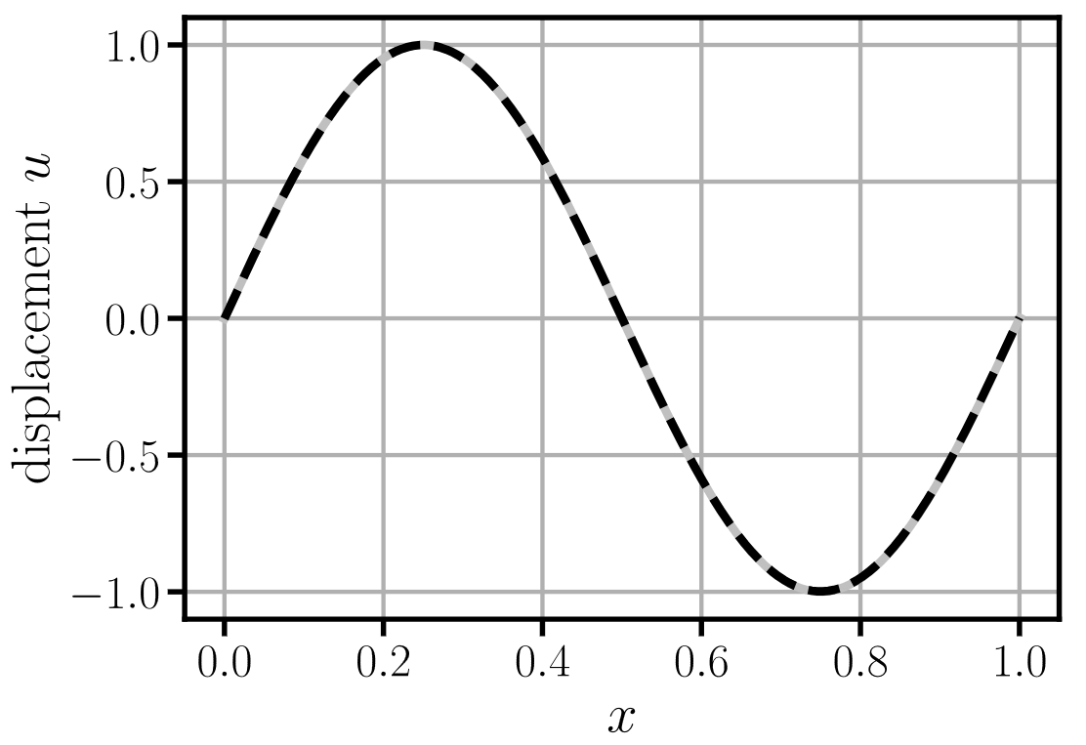

4.2 Data-Driven Inference – Manufactured Solution
The static model problem: a manufactured solution (even more specific)
$$𝒩\left[u\right]=\frac{d}{dx}\left(EA\frac{du}{dx}\right)+p=0$$
Choose zero-Dirichlet boundary conditions, i.e.,
$$u\left(0\right)=u\left(1\right)=0$$
Assume the following solution with the domain
$u\left(x\right)=sin(2πx)$ obeys the Dirichlet boundary conditions
Insert into differential equation
$p\left(x\right)=4π^{2}sin(2πx)$ is the corresponding load
Problem to be solved:
Use the distributed load $p(x)$ and the boundary conditions $u\left(0\right)=u\left(1\right)=0$ to reconstruct the (unknown) solution$u$

Slide 13
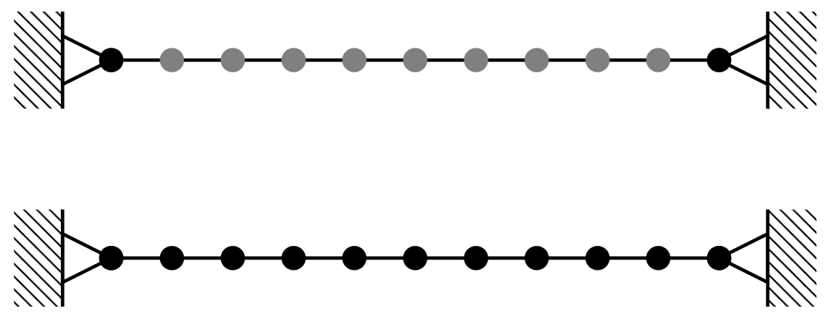




4.2 Data-Driven Inference – Cost
This is carried out by minimizing the cost function
$$C=ℒ_{B}+ℒ_{R}$$
Where
$$\hat{r}\left(u\left(x\right)\right)={\left.\frac{d}{dx}\left(EA\frac{du}{dx}\right)\right|}_{x}+p(x)$$
Boundary loss:
$$ℒ_{B}=\frac{1}{m_{B}}\sum_{i=1}^{m_{B}}{{\left(u_{NN}\left({\tilde{x}}_{B}^{i}\right)−{\tilde{u}}_{B}^{i}\right)}^{2}}$$
$m_{B}$: labeled data points at the boundary of the domain ${\left\{{\tilde{x}}_{B}^{i}, {\tilde{u}}_{B}^{i}\right\}}_{i=1}^{m_{B}}$
Approximation error at known data points (could also be $ℒ_{u}$ without boundary data)
Residual of PDE loss:
$$ℒ_{R}=\frac{1}{m_{R}}\sum_{i=1}^{m_{R}}{{\left(\hat{r}(u_{NN}\left(x_{R}^{i}\right))\right)}^{2}}$$
$m_{R}$: set of collocation points ${\left\{x_{R}^{i}\right\}}_{i=1}^{m_{R}}$
Approximation error at domain/collocation points

Slide 14
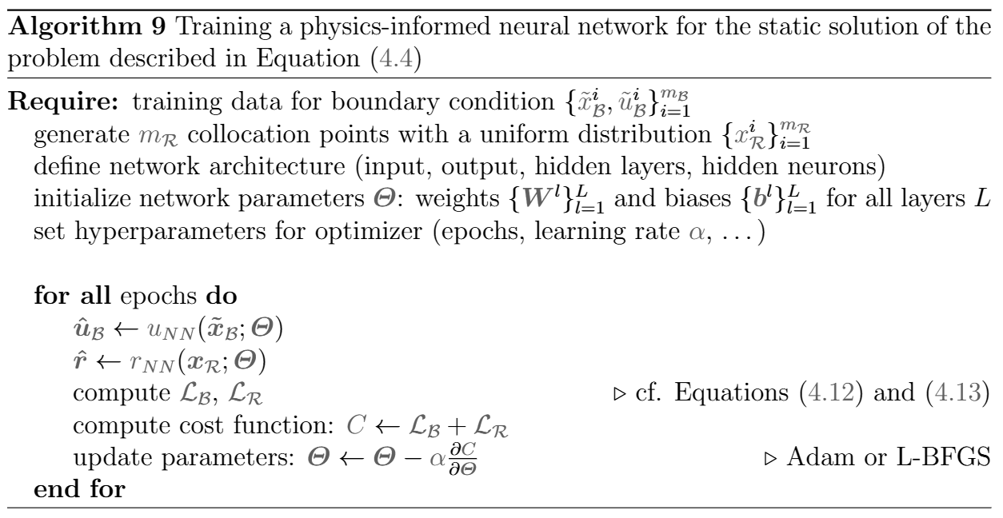
4.2 Data-Driven Inference – Algorithm
General algorithm

Slide 15
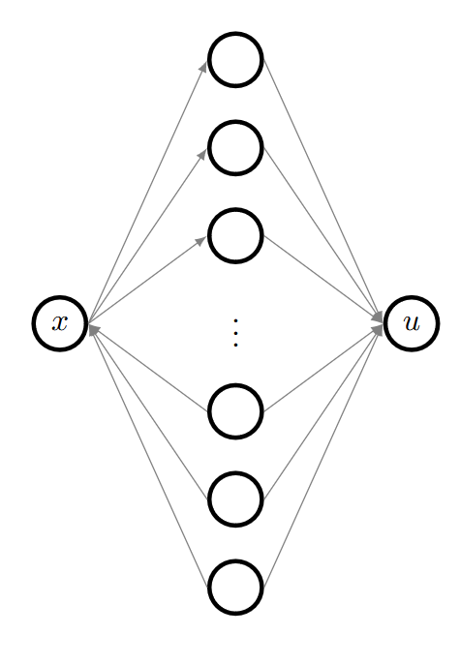
4.2 Data-Driven Inference – PyTorch
Neural network architecture
model = torch.nn.Sequential(torch.nn.Linear(inputDim, hiddenDim),
torch.nn.Tanh(),
torch.nn.Linear(hiddenDim, outputDim))
Prediction
uPred = model(torch.tensor([0.5]))
Helper function for gradient computation
def getDerivative(y, x):
dydx = grad(y, x, torch.ones_like(y),
create_graph=True,
retain_graph=True)[0]
return dydx

Slide 16
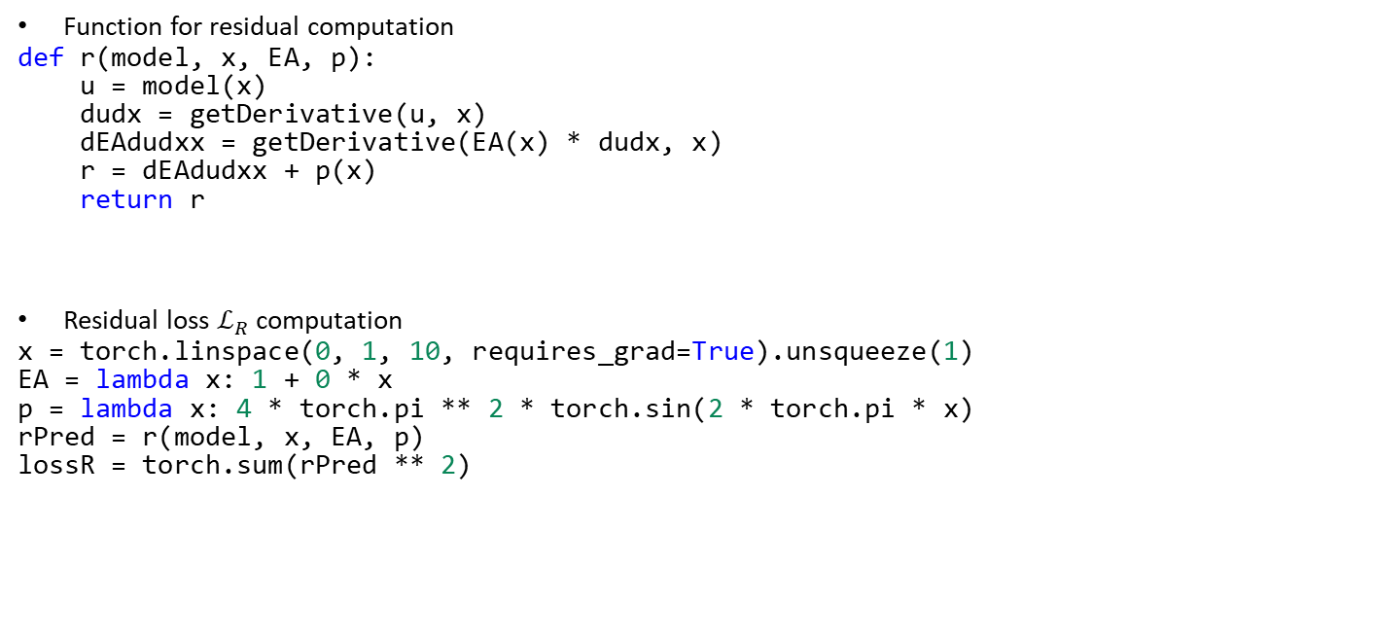


4.2 Data-Driven Inference – PyTorch
Function for residual computation
def r(model, x, EA, p):
u = model(x)
dudx = getDerivative(u, x)
dEAdudxx = getDerivative(EA(x) * dudx, x)
r = dEAdudxx + p(x)
return r
Residual loss $ℒ_{R}$ computation
x = torch.linspace(0, 1, 10, requires_grad=True).unsqueeze(1)
EA = lambda x: 1 + 0 * x
p = lambda x: 4 * torch.pi ** 2 * torch.sin(2 * torch.pi * x)
rPred = r(model, x, EA, p)
lossR = torch.sum(rPred ** 2)
Remember the manufactured solution $u\left(x\right)=sin(2πx)$
with the load$p\left(x\right)=4π^{2}sin(2πx)$
$$ℒ_{R}=\frac{1}{m_{R}}\sum_{i=1}^{m_{R}}{{\left(\hat{r}(u_{NN}\left(x_{R}^{i}\right))\right)}^{2}}$$

Slide 17


4.2 Data-Driven Inference – PyTorch
Boundary loss $ℒ_{B}$ computation
u0 = 0
u1 = 0
u0Pred = model(torch.tensor([0.]))
u1Pred = model(torch.tensor([1.]))
lossB = (u0Pred – u0) ** 2 + (u1Pred – u1) ** 2
Training according to gradient-based optimization from Chapter 3 using cost $C$
cost = lossR + lossB
$$ℒ_{B}=\frac{1}{m_{B}}\sum_{i=1}^{m_{B}}{{\left(u_{NN}\left({\tilde{x}}_{B}^{i}\right)−{\tilde{u}}_{B}^{i}\right)}^{2}}$$

Slide 18
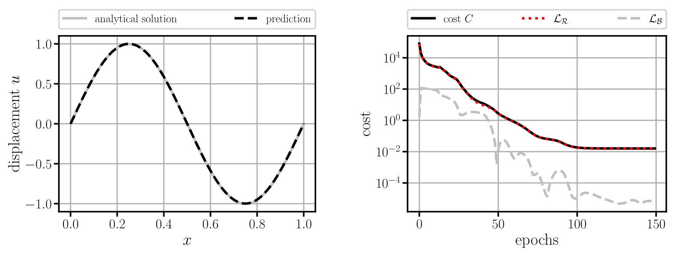

4.2.1 One-Dimensional Static Model
Results after 50 epochs with Adam
Differences in magnitude between $ℒ_{R}$ and $ℒ_{B}→$ delay/prevention of convergence; possible remedies:
Weighting factors between the terms
Satisfaction of Dirichlet boundary conditions a priori
Will be covered in detail in Chapter 5

Slide 19
Exercises
E.14 Physics-Informed Neural Network for a Static Bar (P & C)
Apply a physics-informed neural network to a static bar problem. Start with constructing a manufactured solution to verify your implementation.
E.16 Normalization and Weighting (C)
Scale the manufactured solution of your physics-informed neural network from E.14 and observe how convergence is affected, i.e., the importance of normalization. In addition, introduce weighting factors between the loss terms.

Slide 20
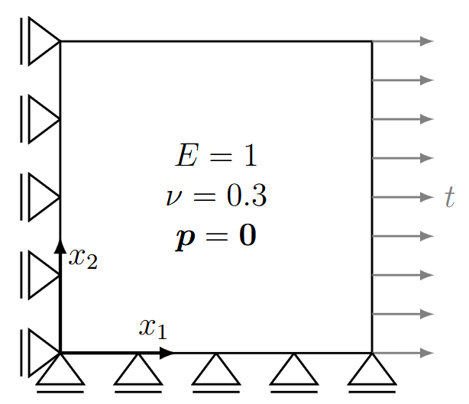
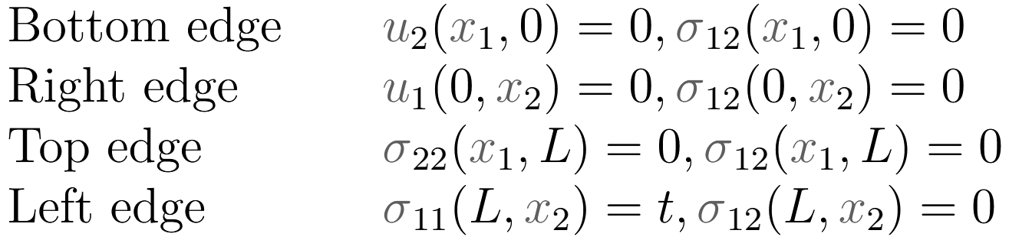
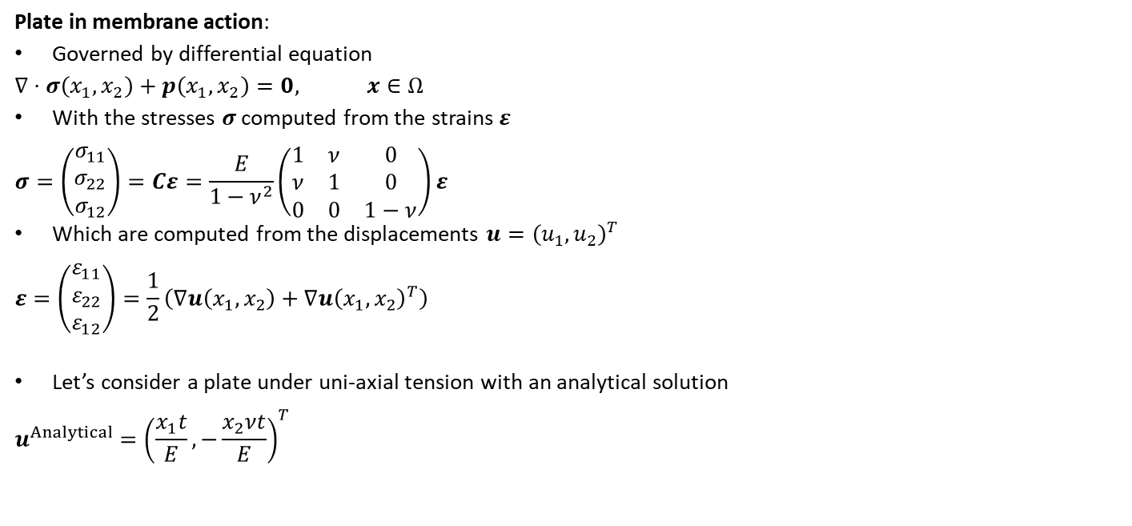
4.2.2 Two-Dimensional Static Model
Plate in membrane action:
Governed by differential equation
$$∇⋅σ\left(x_{1},x_{2}\right)+p\left(x_{1},x_{2}\right)=0, x∈Ω$$
With the stresses $σ$ computed from the strains $ε$
$$σ=\left(\begin{matrix}σ_{11} \\ σ_{22} \\ σ_{12}\end{matrix}\right)=Cε=\frac{E}{1−ν^{2}}\left(\begin{matrix}1 & ν & 0 \\ ν & 1 & 0 \\ 0 & 0 & 1−ν\end{matrix}\right)ε$$
Which are computed from the displacements $u={\left(u_{1},u_{2}\right)}^{T}$
$$ε=\left(\begin{matrix}ε_{11} \\ ε_{22} \\ ε_{12}\end{matrix}\right)=\frac{1}{2}\left(∇u\left(x_{1},x_{2}\right)+∇u{\left(x_{1},x_{2}\right)}^{T}\right)$$
Let’s consider a plate under uni-axial tension with an analytical solution
$$u^{Analytical}={\left(\frac{x_{1}t}{E}, −\frac{x_{2}νt}{E}\right)}^{T}$$
Assuming plane stress
Boundary conditions

Slide 21
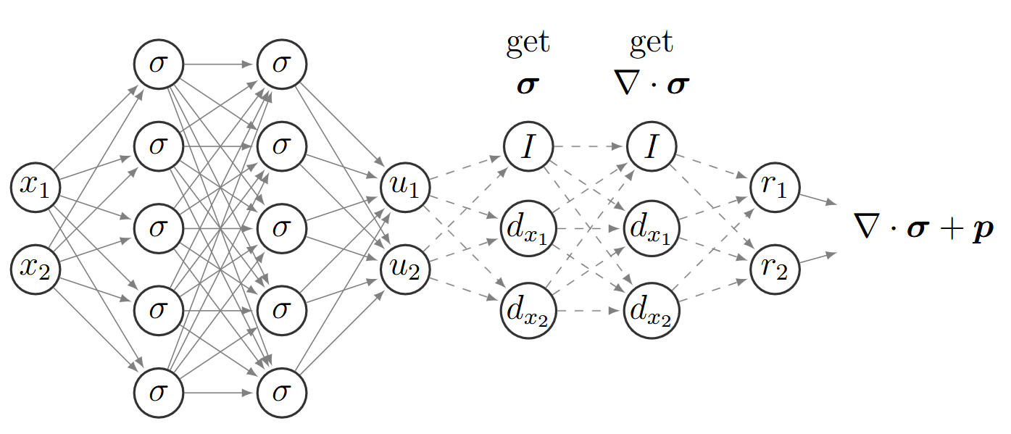
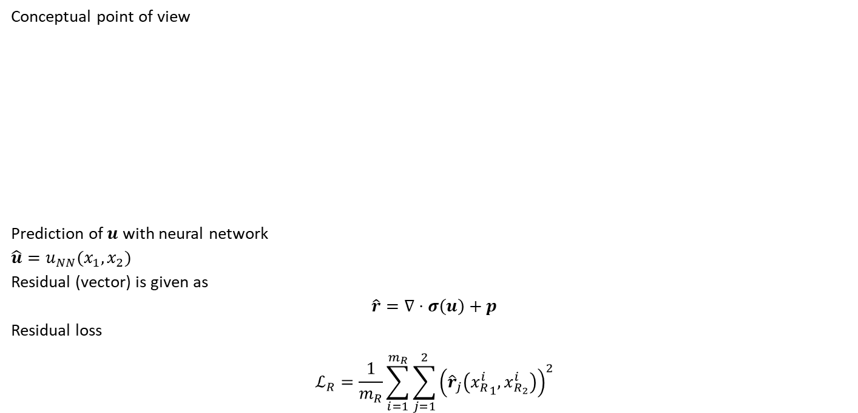
4.2.2 Two-Dimensional Static Model
Conceptual point of view
Prediction of $u$ with neural network
$$\hat{u}=u_{NN}(x_{1},x_{2})$$
Residual (vector) is given as
$$\hat{r}=∇⋅σ\left(u\right)+p$$
Residual loss
$$ℒ_{R}=\frac{1}{m_{R}}\sum_{i=1}^{m_{R}}{\sum_{j=1}^{2}{{\left({\hat{r}}_{j}\left({x_{R}^{i}}_{1},x_{R_{2}}^{i}\right)\right)}^{2}}}$$

Slide 22
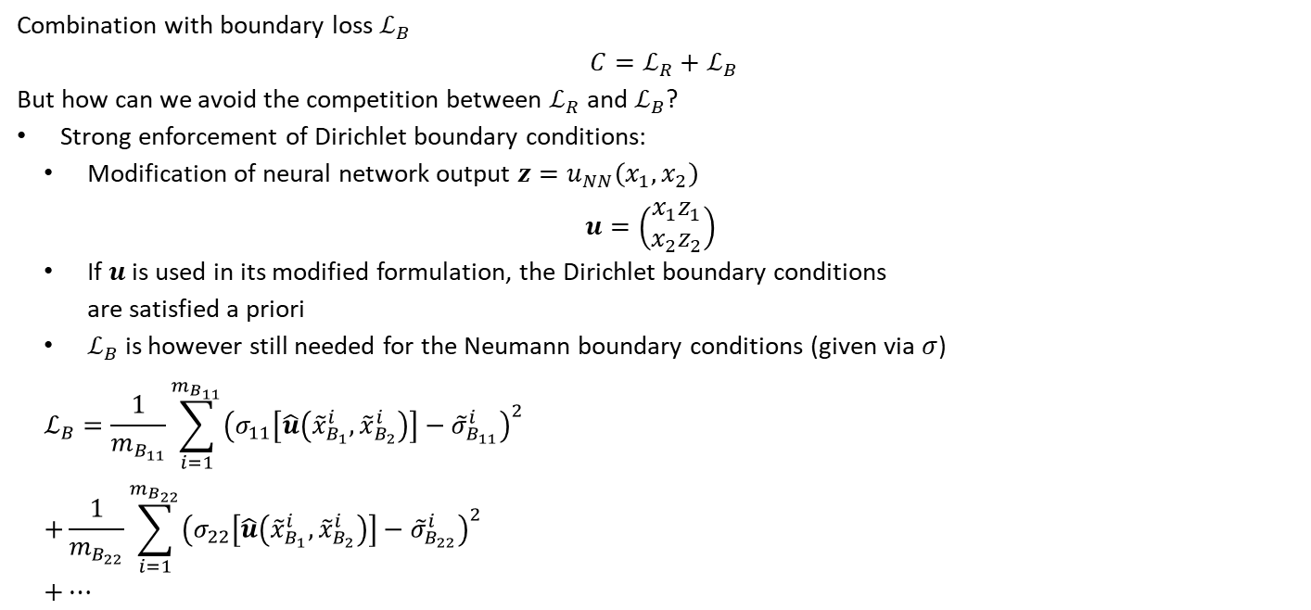
4.2.2 Two-Dimensional Static Model
Combination with boundary loss $ℒ_{B}$
$$C=ℒ_{R}+ℒ_{B}$$
But how can we avoid the competition between $ℒ_{R}$ and $ℒ_{B}$?
Strong enforcement of Dirichlet boundary conditions:
Modification of neural network output $z=u_{NN}\left(x_{1},x_{2}\right)$
$$u=\left(\begin{matrix}x_{1}z_{1} \\ x_{2}z_{2}\end{matrix}\right)$$
If $u$ is used in its modified formulation, the Dirichlet boundary conditions are satisfied a priori
$ℒ_{B}$ is however still needed for the Neumann boundary conditions (given via $σ$)
$$ℒ_{B}=\frac{1}{m_{B_{11}}}\sum_{i=1}^{m_{B_{11}}}{{\left(σ_{11}\left[\hat{u}\left({\tilde{x}}_{B_{1}}^{i},{\tilde{x}}_{B_{2}}^{i}\right)\right]−{\tilde{σ}}_{B_{11}}^{i}\right)}^{2}} \\ +\frac{1}{m_{B_{22}}}\sum_{i=1}^{m_{B_{22}}}{{\left(σ_{22}\left[\hat{u}\left({\tilde{x}}_{B_{1}}^{i},{\tilde{x}}_{B_{2}}^{i}\right)\right]−{\tilde{σ}}_{B_{22}}^{i}\right)}^{2}} \\ +…$$
Boundary conditions

Slide 23
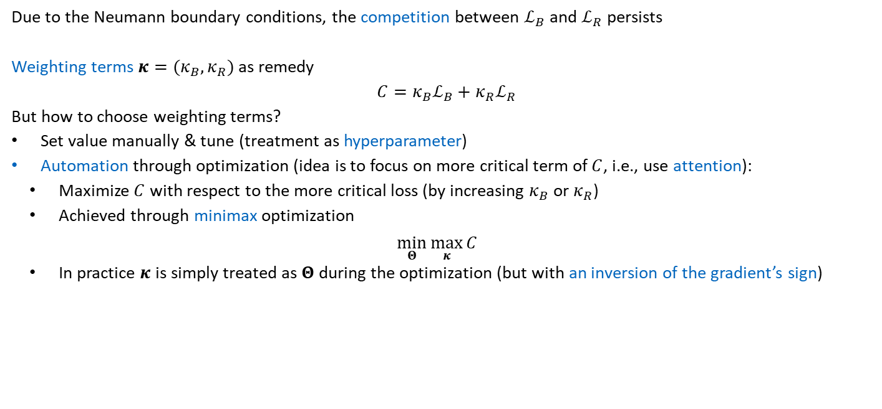
4.2.2 Two-Dimensional Static Model
Due to the Neumann boundary conditions, the competition between $ℒ_{B}$ and $ℒ_{R}$ persists
Weighting terms $κ=(κ_{B},κ_{R})$ as remedy
$$C=κ_{B}ℒ_{B}+κ_{R}ℒ_{R}$$
But how to choose weighting terms?
Set value manually & tune (treatment as hyperparameter)
Automation through optimization (idea is to focus on more critical term of $C$, i.e., use attention):
Maximize $C$ with respect to the more critical loss (by increasing $κ_{B}$ or $κ_{R}$)
Achieved through minimax optimization
$$\min_{Θ}{\max_{κ}{C}}$$
In practice $κ$ is simply treated as $Θ$ during the optimization (but with an inversion of the gradient’s sign)

Slide 24
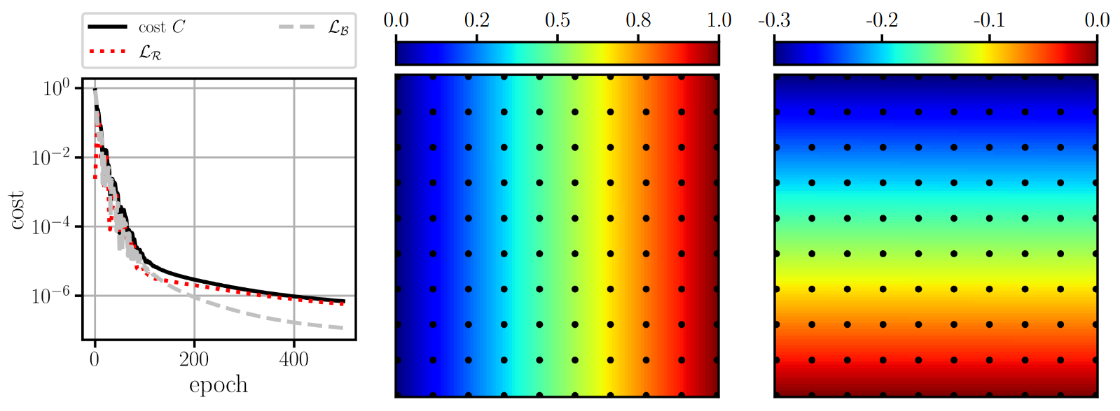


4.2.2 Two-Dimensional Static Model
Results after 500 epochs with Adam
How does the prediction (& computational effort) hold up in comparison to the finite element method?
$${\hat{u}}_{1}$$
$${\hat{u}}_{2}$$

Slide 25
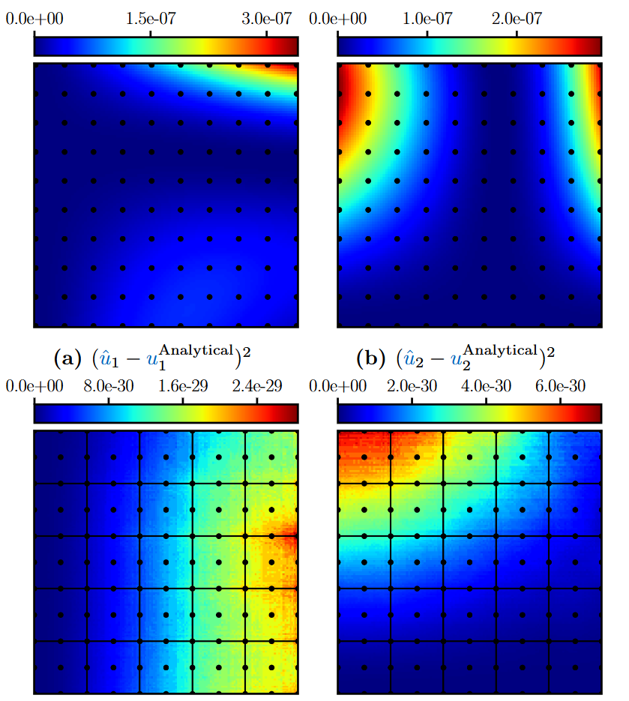

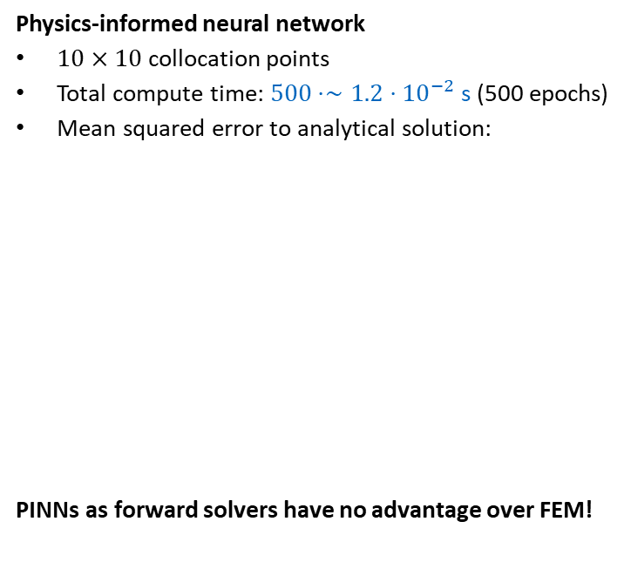


4.2.2 Two-Dimensional Static Model
Physics-informed neural network
$10×10$ collocation points
Total compute time: $500⋅∼1.2⋅{10}^{−2}$ s (500 epochs)
Mean squared error to analytical solution:
PINNs as forward solvers have no advantage over FEM!
Finite element method
$5×5$ elements with $p=2$ ($242$ degrees of freedom)
Total compute time: $∼9.1⋅{10}^{−3}$ s
Mean squared error to analytical solution:
shown for linear elasticity (benefits might be possible for nonlinear or high-dimensional problems)
$${\hat{u}}_{1}$$
$${\hat{u}}_{2}$$
$${\hat{u}}_{1}$$
$${\hat{u}}_{2}$$

Slide 26
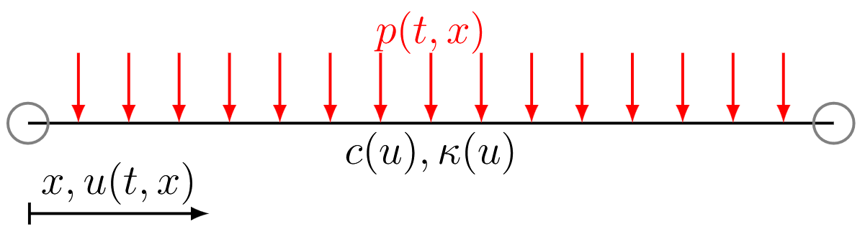
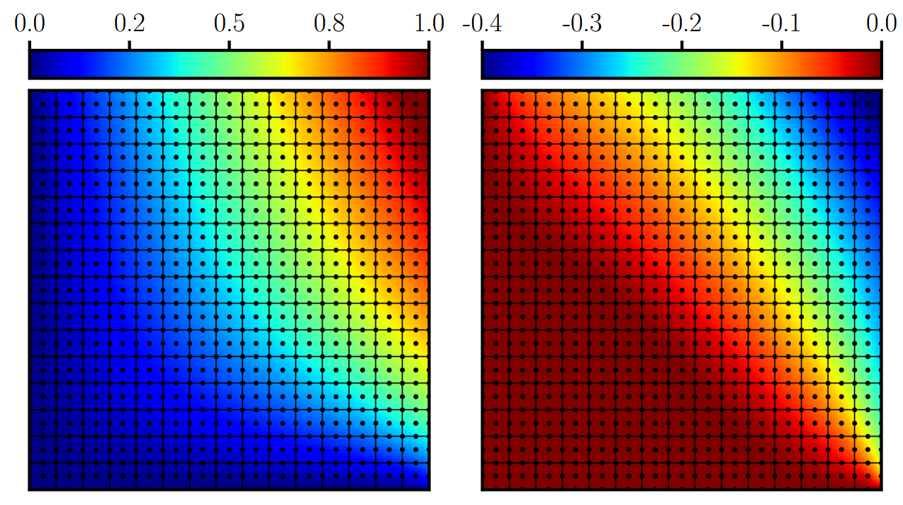
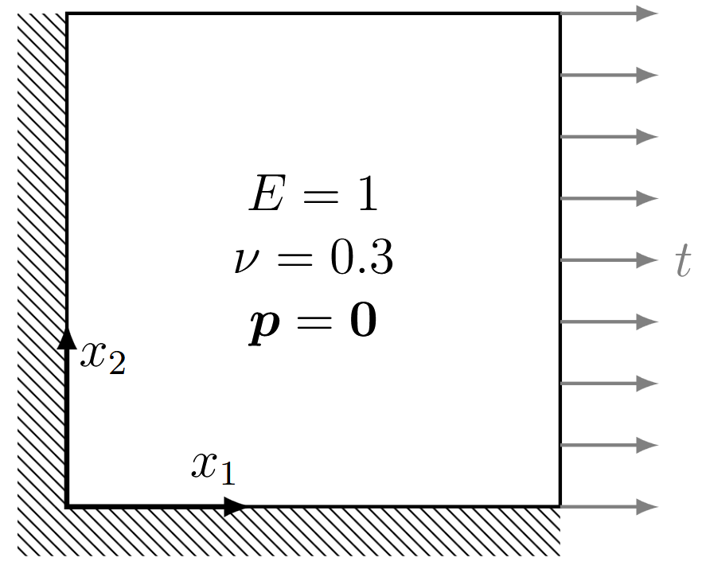
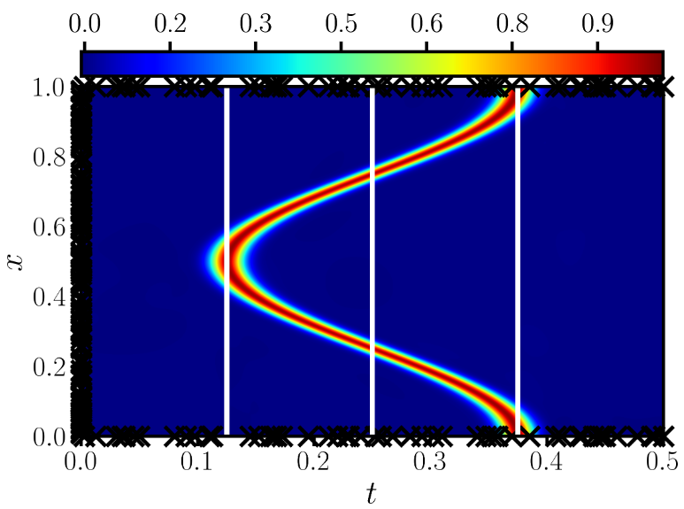
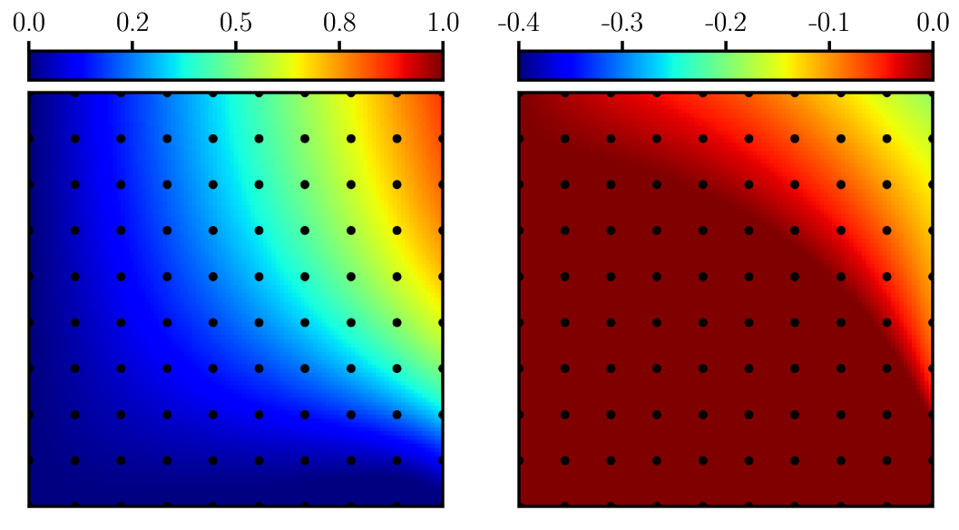




4.2 Data-Driven Inference
Two-dimensional static model with different loading
Finite element solution as reference ($∼8.3⋅{10}^{−2}$ s)
PINN prediction after 5‘000 epochs ($∼7⋅{10}^{2}$ s)
Continuous-Time Model (4.2.3): Nonlinear heat equation
PINN (temperature) prediction after 5’000 epochs ($∼6.6⋅{10}^{2}$ s)
Required extensive tuning (with special loss weighting term)
$$u_{1}$$
$$u_{2}$$
Stress concentration is not captured by the PINN
$${\hat{u}}_{1}$$
$${\hat{u}}_{2}$$

Slide 27
Exercises
E.17 Physics-Informed Neural Network for a Plate in Membrane Action (C)
Apply a physics-informed neural network to a plate in membrane action and compare the results with reference solutions obtained with the finite element method. Tune the neural network to improve convergence.

Slide 28
4.3 Data-Driven Identification
$$𝒩\left[u;λ\right]=0, x∈Ω, t∈𝒯$$
The two main use cases of PINNs are:
For simplicity, let us now assume that the changes of $u$ with respect to time are zero, then
$$𝒩\left[u;λ\right]=0, x∈Ω$$
Where
$$u(x)$$
1. Data driven inference (the forward problem) | 2. Data driven identification (the inverse problem)
The coefficients $λ$ are known | The coefficients $λ$ are unknown
The (nonlinear) operator $𝒩$ is known | Or the (nonlinear) operator $𝒩$ is unknown
The solution $u(x,t)$ is unknown | The solution $u(x,t)$ is at least partially known

Slide 29
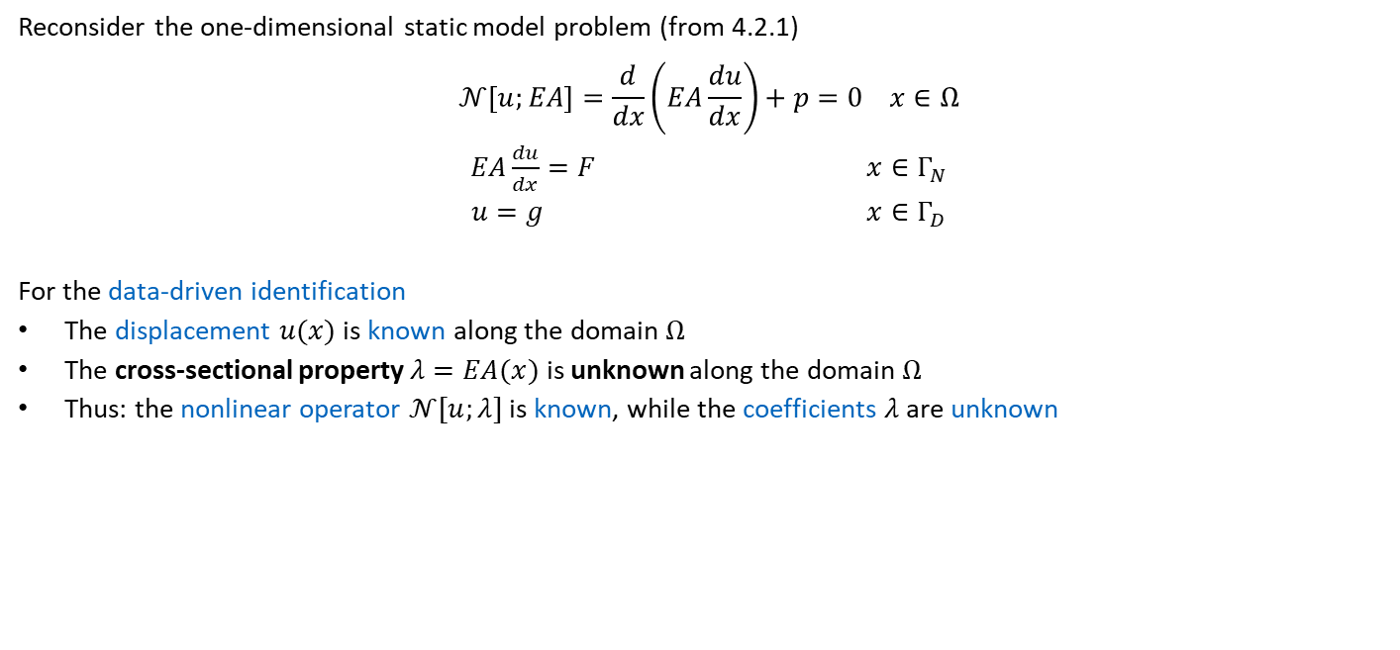
4.3 Data-Driven Identification
Reconsider the one-dimensional static model problem (from 4.2.1)
$$𝒩\left[u;EA\right]=\frac{d}{dx}\left(EA\frac{du}{dx}\right)+p=0 x∈Ω$$
$EA\frac{du}{dx}=F x∈Γ_{N}$
$$u=g x∈Γ_{D}$$
For the data-driven identification
The displacement $u(x)$ is known along the domain $Ω$
The cross-sectional property $λ=EA(x)$ is unknown along the domain $Ω$
Thus: the nonlinear operator $𝒩[u;λ]$ is known, while the coefficients $λ$ are unknown

Slide 30
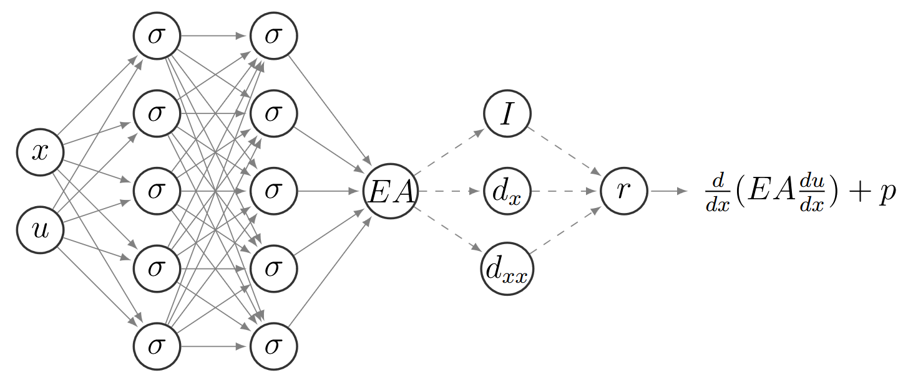

4.3 Data-Driven Identification
Conceptual point of view
Prediction of the inverse quantity (the coefficients $λ)$ via a neural network
$$\hat{EA}\left(x\right)=EA_{NN}(x)$$
Computation of the residual $r$ based on $𝒩\left[u\right]$
$$r=\frac{d}{dx}\left(\hat{EA}\frac{du}{dx}\right)+p$$

Slide 31
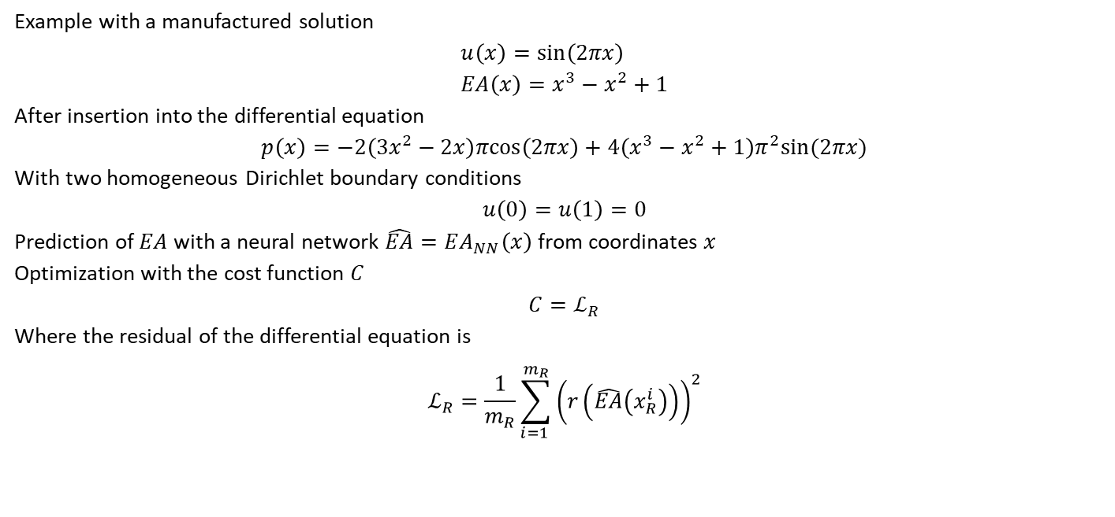
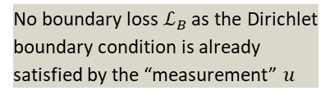
4.3 Data-Driven Identification
Example with a manufactured solution
$$u\left(x\right)=sin\left(2πx\right) \\ EA\left(x\right)=x^{3}−x^{2}+1$$
After insertion into the differential equation
$$p\left(x\right)=−2\left(3x^{2}−2x\right)πcos\left(2πx\right)+4\left(x^{3}−x^{2}+1\right)π^{2}sin(2πx)$$
With two homogeneous Dirichlet boundary conditions
$$u\left(0\right)=u\left(1\right)=0$$
Prediction of $EA$ with a neural network $\hat{EA}=EA_{NN}\left(x\right)$ from coordinates $x$
Optimization with the cost function $C$
$$C=ℒ_{R}$$
Where the residual of the differential equation is
$$ℒ_{R}=\frac{1}{m_{R}}\sum_{i=1 }^{m_{R}}{{\left(r\left(\hat{EA}\left(x_{R}^{i}\right)\right)\right)}^{2}}$$
No boundary loss $ℒ_{B}$ as the Dirichlet boundary condition is already satisfied by the “measurement” $u$

Slide 32


4.3 Data-Driven Identification
Results after 5‘000 epochs with Adam
Physics-informed neural networks can be useful for data-driven identification (inverse problems) if full-field solution data is available (i.e., $u(x)$ in the entire domain $Ω$) $→$ More details will follow in Chapter 9

Slide 33

Exercises
E.15 Data-Driven Identification using Physics-Informed Neural Networks for a Static Bar (P & C)
Apply a physics-informed neural network to a static bar problem. Specifically, the aim is to identify the cross-sectional properties $EA(x)$ given the solution $u(x)$. Start with constructing a manufactured solution to verify your implementation.

Slide 34
Contents
3 Neural Networks
4.1 Overview
4.2 Data-Driven Inference
4.2.1 One-Dimensional Static Model
4.2.2 Two-Dimensional Static Model
4.3 Data-Driven Identification
5 Advanced Physics-Informed Neural Networks

Slide 35
4 Introduction to Physics-Informed Neural Networks
Leon Herrmann
Stefan Kollmannsberger
Chair of Data Engineering in Construction
Bauhaus-Universität Weimar
Deep Learning in Computational Mechanics – an introductory course, Herrmann et al. 2025
website
book
Notes:
generated with https://www.the-qrcode-generator.com/

