Slide 1


6 Machine Learning in Computational Mechanics
Leon Herrmann
Stefan Kollmannsberger
Chair of Data Engineering in Construction
Bauhaus-Universität Weimar
Deep Learning in Computational Mechanics – an introductory course, Herrmann et al. 2025
website
book
Notes:
generated with https://www.the-qrcode-generator.com/

Slide 2
Contents
5 Advanced Physics-Informed Neural Networks
6.1.1 Singular Value Decomposition
6.2 Reduced Order Models
6.3 Sparse Identification of Non-Linear Dynamical Systems – SINDy
6.4 Clustering
6.5 Support Vector Machines
7 Material Modeling with Neural Networks

Slide 3
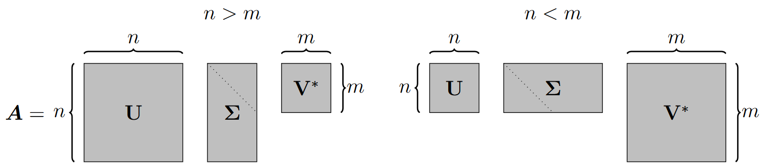

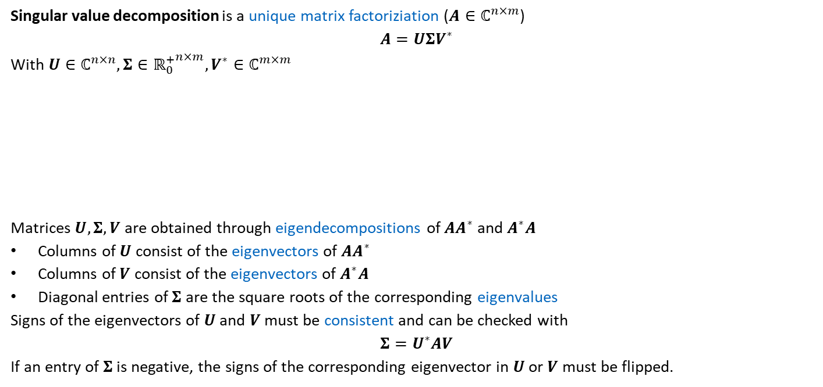


6.1.1 Singular Value Decomposition
Singular value decomposition is a unique matrix factoriziation ($A∈ℂ^{n×m}$)
$$A=UΣV^{∗}$$
With $U∈ℂ^{n×n},Σ∈{ℝ_{0}^{+}}^{n×m},V^{∗}∈ℂ^{m×m}$
Matrices $U, Σ, V$ are obtained through eigendecompositions of $AA^{∗}$ and $A^{∗}A$
Columns of $U$ consist of the eigenvectors of $AA^{∗}$
Columns of $V$ consist of the eigenvectors of $A^{∗}A$
Diagonal entries of $Σ$ are the square roots of the corresponding eigenvalues
Signs of the eigenvectors of $U$ and $V$ must be consistent and can be checked with
$$Σ=U^{∗}AV$$
If an entry of $Σ$ is negative, the signs of the corresponding eigenvector in $U$ or $V$ must be flipped.
$V^{∗}$ is the conjugate transpose of $V$
$U, V$ are unitary matrices, i.e., $U^{∗}U=I, V^{∗}V=I$ (for real matrices: orthogonal matrices)
Non-zero eigenvalues of $AA^{∗}$ and $A^{∗}A$ are the same

Slide 4
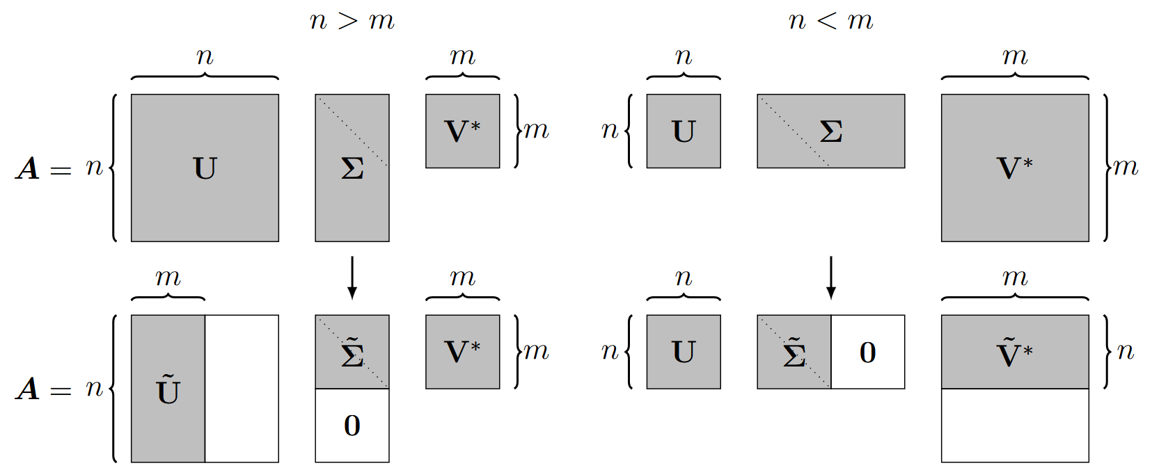

6.1.1 Singular Value Decomposition
Singular value decomposition as dimensionality reduction technique
Economy singular value decomposition
Exact reconstruction of $A$ with truncated $U, Σ, V$ (for $n≠m$)
$$for n>m A=\tilde{U}\tilde{Σ}V^{∗} \\ for n<m A=U\tilde{Σ}{\tilde{V}}^{∗}$$
Truncated singular value decomposition: truncation of $U, Σ, V$ beyond the mismatch in dimensionality

Slide 5
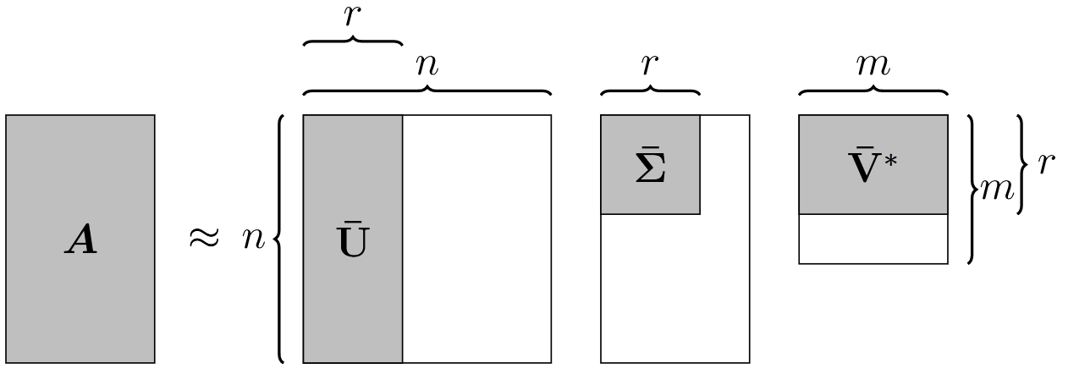

6.1.1 Singular Value Decomposition
Truncated singular value decomposition: truncation of $U, Σ, V$ beyond the mismatch in dimensionality
$\overline{U}∈ℂ^{n×r},\overline{Σ}∈{ℝ_{0}^{+}}^{r×r},\overline{V}∈ℂ^{m×r}$ are truncated up to $r^{th}$ singular value
Reconstruction is now approximative!
$$A≈\overline{U}\overline{Σ}{\overline{V}}^{∗}$$
The truncated singular value decomposition enables dimensionality reduction
Principal components analysis is a related dimensionality reduction technique (see 6.1.2)

Slide 6
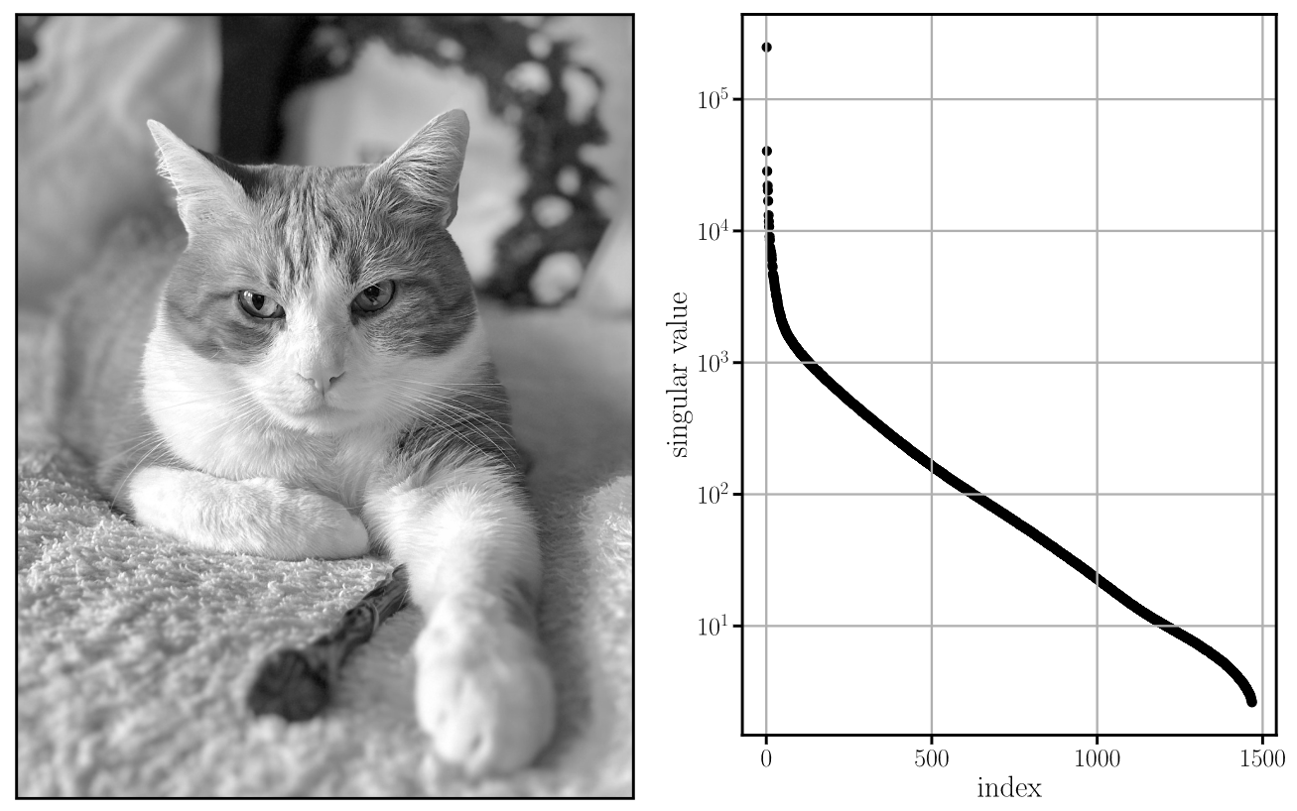



6.1.1.1 Image Compression
Image compression as example of dimensionality reduction with singular value decomposition
Gray-scale image as matrix with pixel entries in $x_{1}$ and $x_{2}$ direction
Truncated singular value decomposition leads to $nr+rr+mr$ values instead of $nm$ values
Original image ($1^{′}868×1468$)
Singular values (diagonal entries of $Σ$)

Slide 7
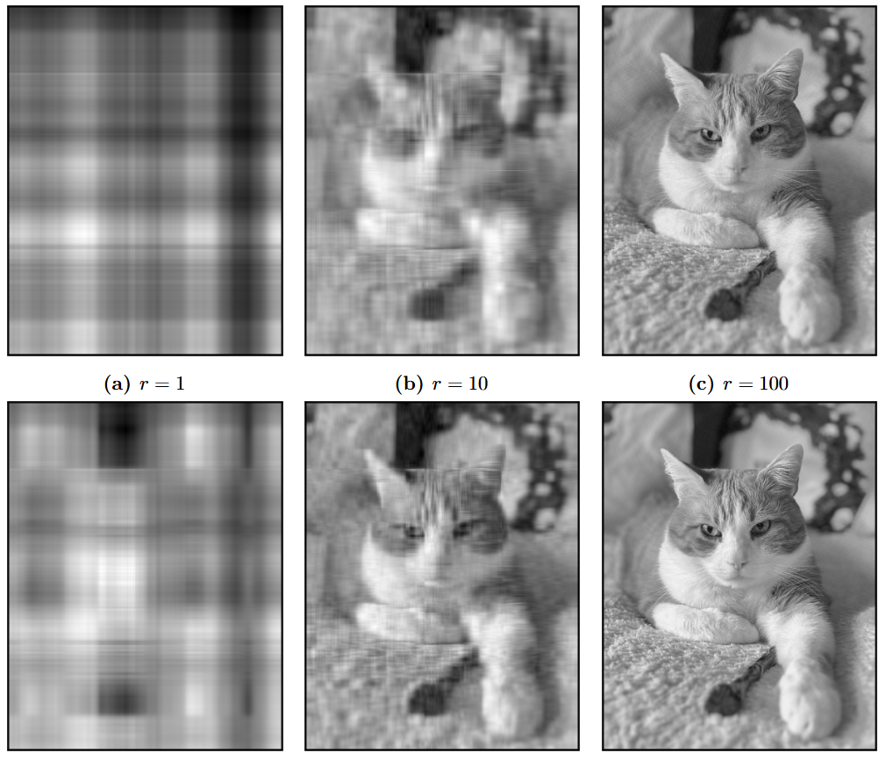







6.1.1.1 Image Compression
Low-dimensional procedure for the characterization of human faces, Sirovich et al. 1987
Further compression possible if multiple images are considered simultaneously, i.e., a common compression, e.g., eigenfaces from a library of faces can reconstruct yet unseen faces
Compression ratios for $r=1, 2, 10, 20, 100, 200$: $$0.116\%, 0.243\%, 1.22\%, 2.43\%, 12.5\%, 25.8\%$$
$$r=1$$
$$r=10$$
$$r=100$$
$$r=2$$
$$r=20$$
$$r=200$$

Slide 8
Exercises
E.22 Singular Value Decomposition (P & C)
First, perform a singular value decomposition on a given matrix. Next implement a general singular value decomposition and apply it to an image.

Slide 9
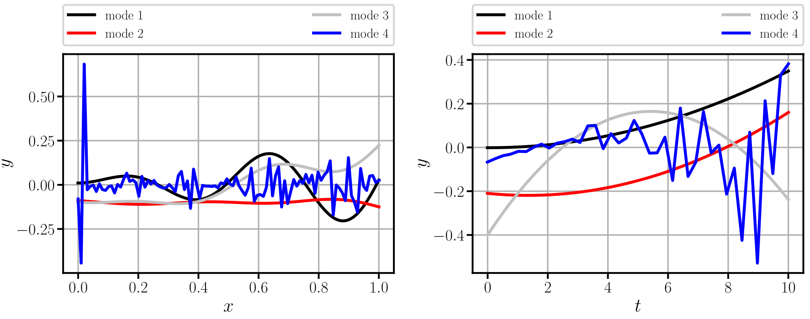
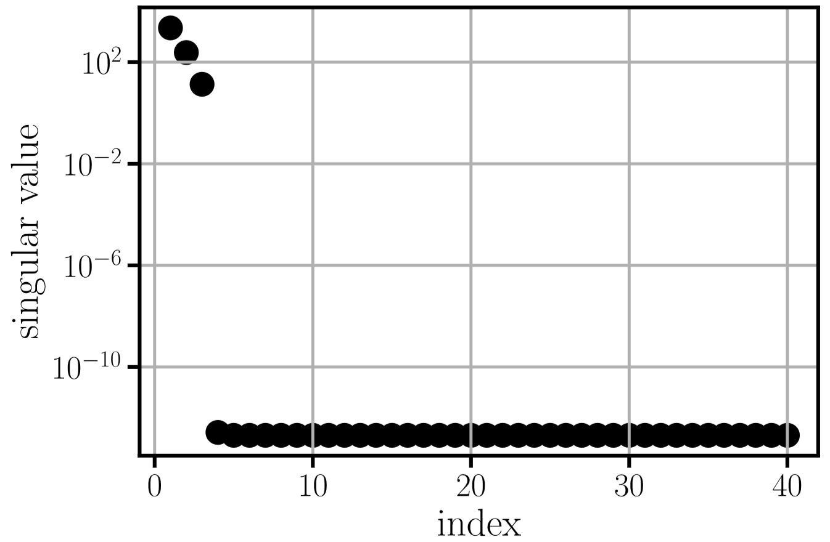
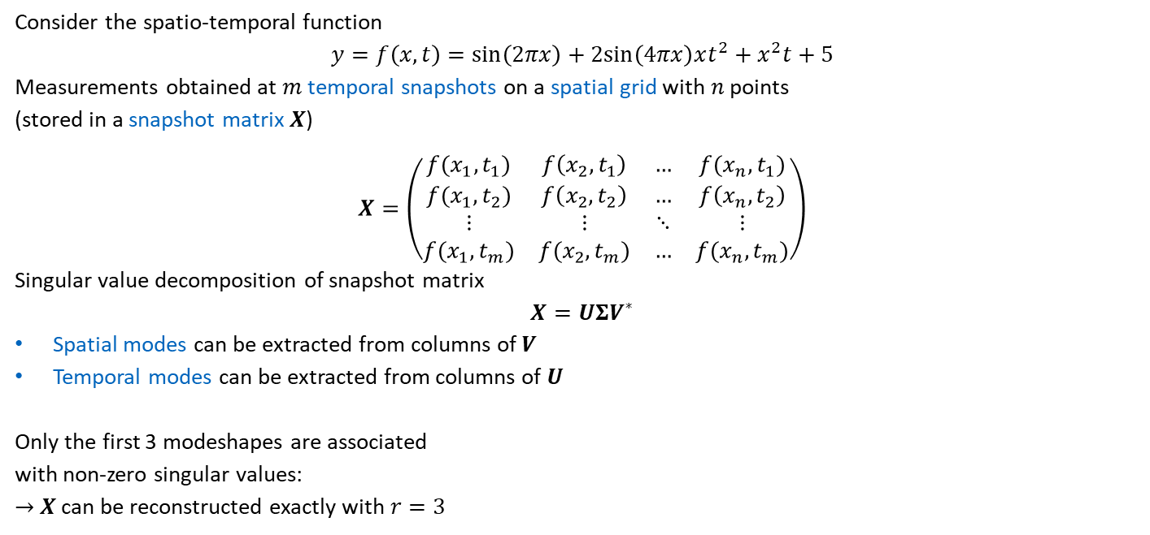
6.1.1.2 Identification of a Reduced Basis
Consider the spatio-temporal function
$$y=f\left(x,t\right)=sin\left(2πx\right)+2sin\left(4πx\right)xt^{2}+x^{2}t+5$$
Measurements obtained at $m$ temporal snapshots on a spatial grid with $n$ points
(stored in a snapshot matrix $X$)
$$X=\left(\begin{matrix}f(x_{1},t_{1}) & f\left(x_{2},t_{1}\right) & … & f(x_{n},t_{1}) \\ f(x_{1},t_{2}) & f\left(x_{2},t_{2}\right) & … & f\left(x_{n},t_{2}\right) \\ ⋮ & ⋮ & ⋱ & ⋮ \\ f(x_{1},t_{m}) & f(x_{2},t_{m}) & … & f(x_{n},t_{m})\end{matrix}\right)$$
Singular value decomposition of snapshot matrix
$$X=UΣV^{∗}$$
Spatial modes can be extracted from columns of $V$
Temporal modes can be extracted from columns of $U$
Only the first 3 modeshapes are associated with non-zero singular values:
$→$ $X$ can be reconstructed exactly with $r=3$

Slide 10
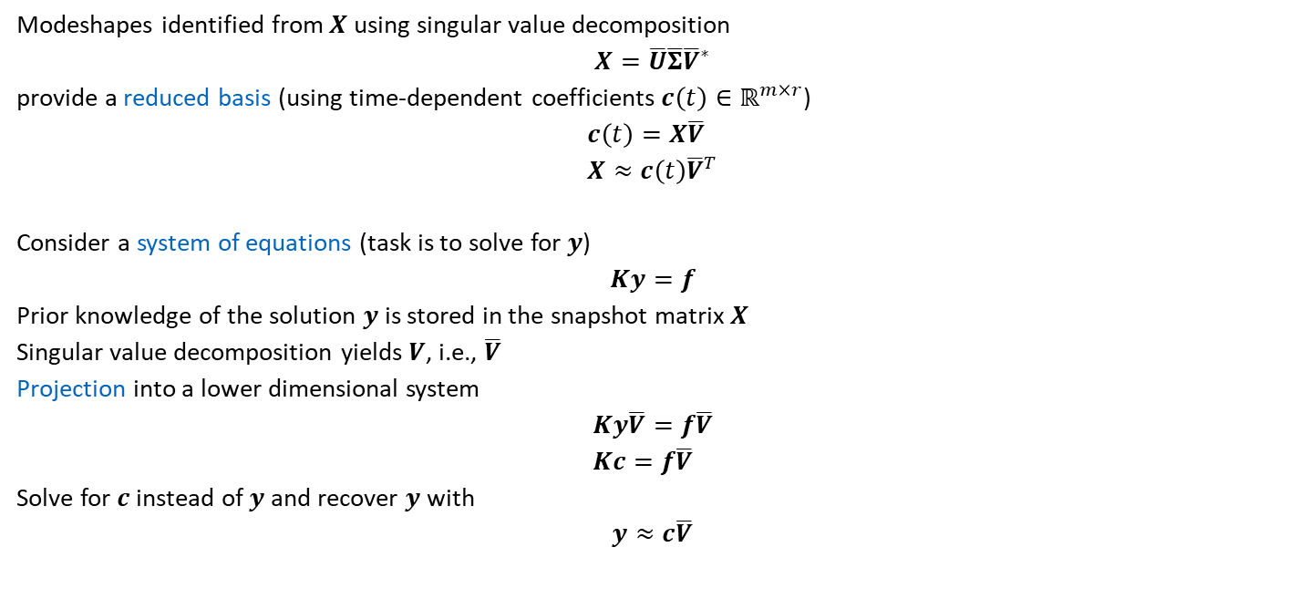
6.1.1.2 Identification of a Reduced Basis
Modeshapes identified from $X$ using singular value decomposition
$$X=\overline{U}\overline{Σ}{\overline{V}}^{∗}$$
provide a reduced basis (using time-dependent coefficients $c\left(t\right)∈ℝ^{m×r}$)
$$c\left(t\right)=X\overline{V} \\ X≈c\left(t\right){\overline{V}}^{T}$$
Consider a system of equations (task is to solve for $y$)
$$Ky=f$$
Prior knowledge of the solution $y$ is stored in the snapshot matrix $X$
Singular value decomposition yields $V$, i.e., $\overline{V}$
Projection into a lower dimensional system
$$Ky\overline{V}=f\overline{V} \\ Kc=f\overline{V}$$
Solve for $c$ instead of $y$ and recover $y$ with
$$y≈c\overline{V}$$
Exploiting the orthonormal property of $V$ ($V^{∗}V=I$)

Slide 11
Exercises
E.23 Introduction to Reduced Order Models (C)
Sample a basic spatio-temporal function and extract the essential spatial and temporal modes using a singular value decomposition

Slide 12

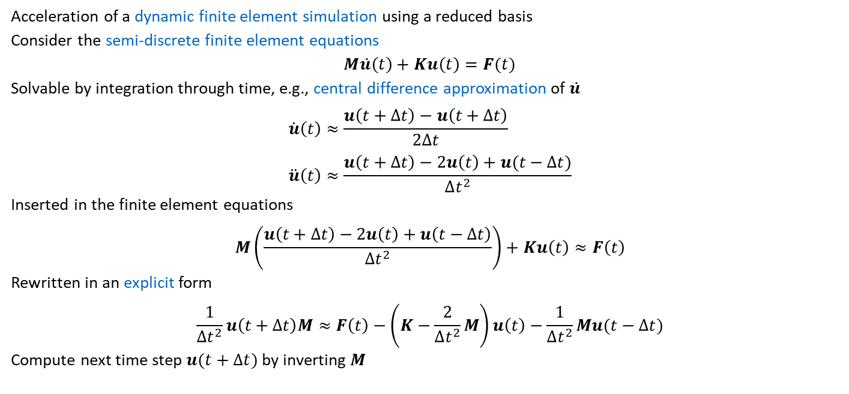
6.2 Reduced Order Models
Acceleration of a dynamic finite element simulation using a reduced basis
Consider the semi-discrete finite element equations
$$M\ddot{u}\left(t\right)+Ku\left(t\right)=F(t)$$
Solvable by integration through time, e.g., central difference approximation of $\ddot{u}$
$$\dot{u}\left(t\right)≈\frac{u\left(t+Δt\right)−u\left(t+Δt\right)}{2Δt} \\ \ddot{u}\left(t\right)≈\frac{u\left(t+Δt\right)−2u\left(t\right)+u(t−Δt)}{Δt^{2}}$$
Inserted in the finite element equations
$$M\left(\frac{u\left(t+Δt\right)−2u\left(t\right)+u\left(t−Δt\right)}{Δt^{2}}\right)+Ku\left(t\right)≈F\left(t\right)$$
Rewritten in an explicit form
$$\frac{1}{Δt^{2}}u\left(t+Δt\right)M≈F\left(t\right)−\left(K−\frac{2}{Δt^{2}}M\right)u\left(t\right)−\frac{1}{Δt^{2}}Mu(t−Δt)$$
Compute next time step $u(t+Δt)$ by inverting $M$
$M$ is the mass matrix, $K$ is the stiffness matrix, $F$ is the source vector

Slide 13

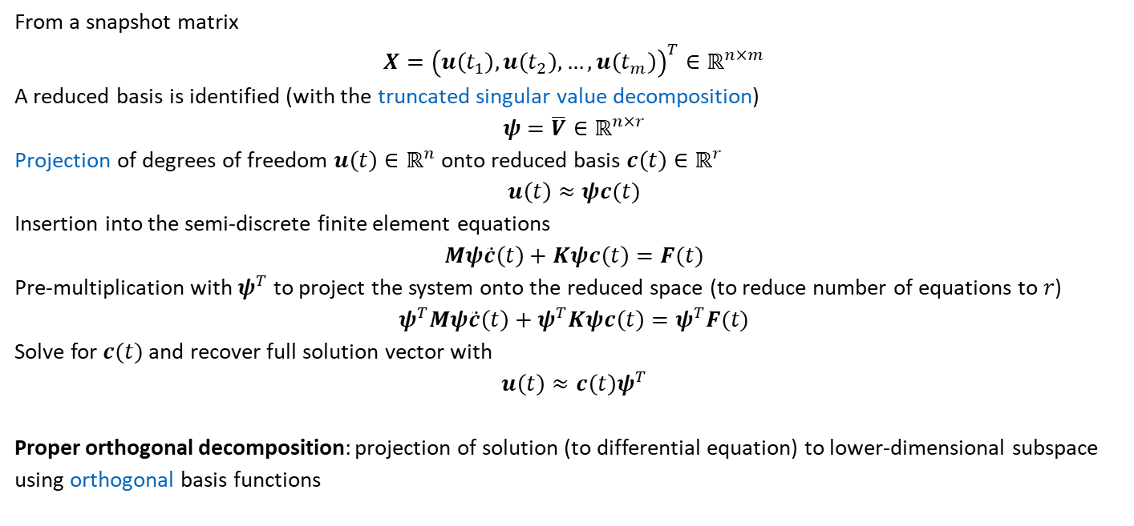
6.2.2 Reduced Order Modeling with Finite Elements
From a snapshot matrix
$$X={\left(u\left(t_{1}\right),u\left(t_{2}\right),…,u\left(t_{m}\right)\right)}^{T}∈ℝ^{n×m}$$
A reduced basis is identified (with the truncated singular value decomposition)
$$ψ=\overline{V}∈ℝ^{n×r}$$
Projection of degrees of freedom $u\left(t\right)∈ℝ^{n}$ onto reduced basis $c\left(t\right)∈ℝ^{r}$
$$u\left(t\right)≈ψc(t)$$
Insertion into the semi-discrete finite element equations
$$Mψ\ddot{c}\left(t\right)+Kψc\left(t\right)=F(t)$$
Pre-multiplication with $ψ^{T}$ to project the system onto the reduced space (to reduce number of equations to $r$)
$$ψ^{T}Mψ\ddot{c}\left(t\right)+ψ^{T}Kψc\left(t\right)=ψ^{T}F(t)$$
Solve for $c(t)$ and recover full solution vector with
$$u\left(t\right)≈c\left(t\right)ψ^{T}$$
Proper orthogonal decomposition: projection of solution (to differential equation) to lower-dimensional subspace using orthogonal basis functions
$r$ degrees of freedom with $n$ equations

Slide 14
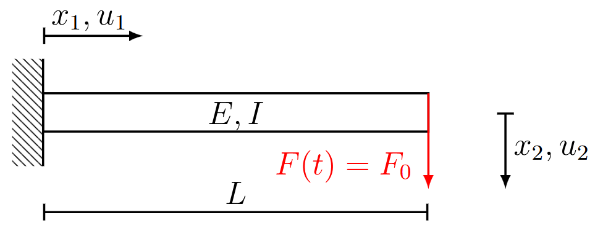
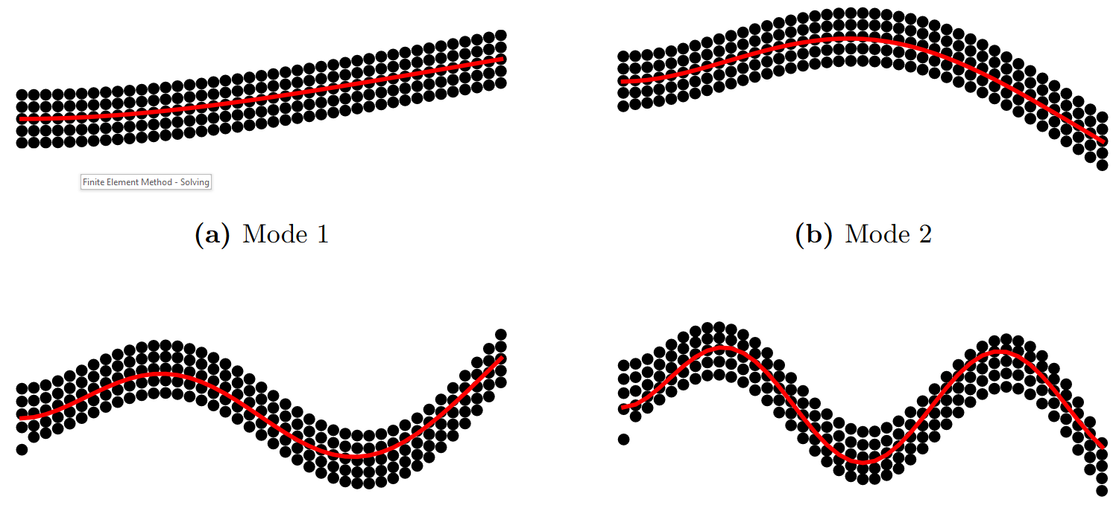

6.2.3 Cantilever Beam
Simulation of a cantilever beam with two-dimensional finite elements
Full finite element simulation for $m=5000$ timesteps with $n=410$ degrees of freedom $→X$
Singular value decomposition on $X$ to obtain reduced basis $ψ=\overline{V}$
Identification of the first four mode shapes of an Euler-Bernoulli beam
$$m_{n}\left(x_{1}\right)=cosh\left(β_{n}x_{1}\right)−cos\left(β_{n}x_{1}\right)−σ_{n}\left(sinh\left(β_{n}x_{1}\right)−sin\left(β_{n}x_{1}\right)\right)$$

Slide 15
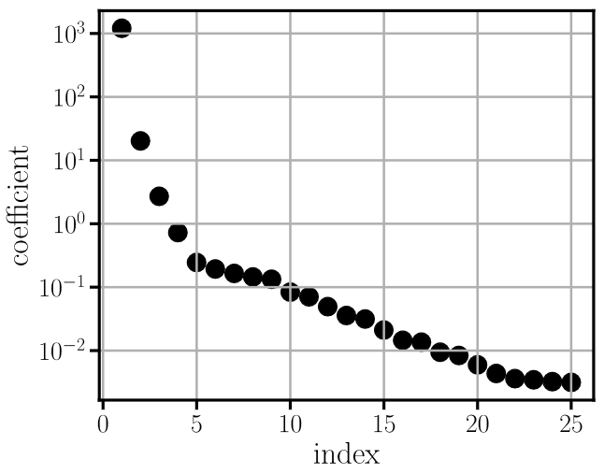
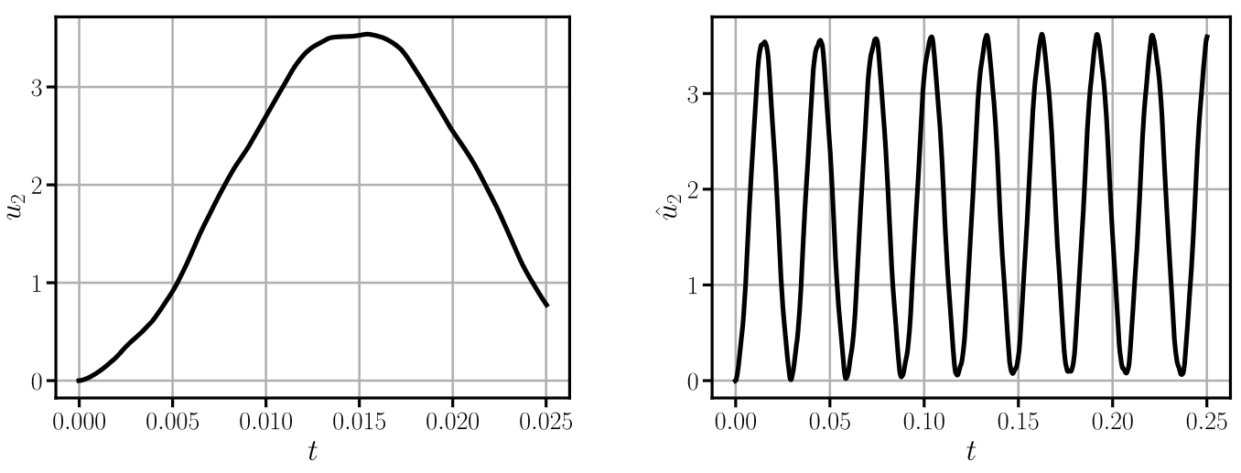



6.2.3 Cantilever Beam
From the singular values, a truncation level of $r=5$ is selected (reducing the system from $410×410$ to $5×5$)
Full system: $2.87⋅{10}^{−3}$ s per time step
Reduced system: $1.65⋅{10}^{−4}$ s per time step
Measurement for snapshot matrix $X$
Simulation with reduced order model

Slide 16
Exercises
E.24 Reduced Order Models with Finite Elements (C)
Modify a finite element code to incorporate a reduced order model. After collecting a snapshot matrix and performing a singular value decomposition, the reduced basis is to be applied within the system of equations.

Slide 17

6.3 SINDy
Discovering governing equations from data: Sparse identification of nonlinear dynamical systems, Brunton et al. 2015
SINDy: Sparse Identification of Non-Linear Dynamical Systems
The goal of SINDy is the discovery of sparse dynamical system models described by systems of differential equations of the form
$$\frac{d}{dt}x\left(t\right)=f(x\left(t\right))$$
Where $x\left(t\right)={\left(x_{1}\left(t\right), x_{2}\left(t\right),…,x_{m}\left(t\right)\right)}^{T}$

Slide 18

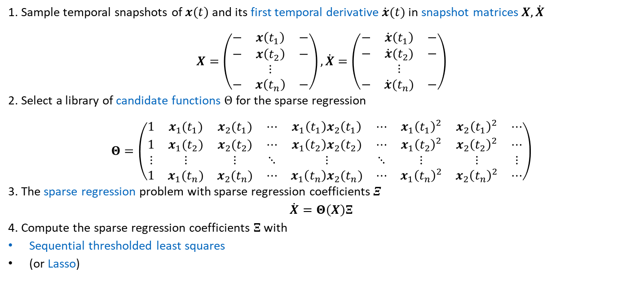
6.3 SINDy
1. Sample temporal snapshots of $x\left(t\right)$ and its first temporal derivative $\dot{x}(t)$ in snapshot matrices $X, \dot{X}$
$$X=\left(\begin{matrix}− & x\left(t_{1}\right) & − \\ − & x\left(t_{2}\right) & − \\ & ⋮ & \\ − & x\left(t_{n}\right) & −\end{matrix}\right),\dot{X}=\left(\begin{matrix}− & \dot{x}\left(t_{1}\right) & − \\ − & \dot{x}(t_{2}) & − \\ & ⋮ & \\ − & \dot{x}(t_{n}) & −\end{matrix}\right)$$
2. Select a library of candidate functions $Θ$ for the sparse regression
$$Θ=\left(\begin{matrix}1 & x_{1}(t_{1}) & x_{2}(t_{1}) & ⋯ & x_{1}\left(t_{1}\right)x_{2}\left(t_{1}\right) & ⋯ & x_{1}{\left(t_{1}\right)}^{2} & x_{2}{\left(t_{1}\right)}^{2} & ⋯ \\ 1 & x_{1}(t_{2}) & x_{2}(t_{2}) & ⋯ & x_{1}\left(t_{2}\right)x_{2}(t_{2}) & ⋯ & x_{1}{\left(t_{2}\right)}^{2} & x_{2}{\left(t_{2}\right)}^{2} & ⋯ \\ ⋮ & ⋮ & ⋮ & ⋱ & ⋮ & ⋱ & ⋮ & ⋮ & ⋮ \\ 1 & x_{1}(t_{n}) & x_{2}(t_{n}) & ⋯ & x_{1}\left(t_{n}\right)x_{2}(t_{n}) & ⋯ & x_{1}{\left(t_{n}\right)}^{2} & x_{2}{\left(t_{n}\right)}^{2} & ⋯\end{matrix}\right)$$
3. The sparse regression problem with sparse regression coefficients $Ξ$
$$\dot{X}=Θ\left(X\right)Ξ$$
4. Compute the sparse regression coefficients $Ξ$ with
Sequential thresholded least squares
(or Lasso)
If the temporal derivatives $\dot{x}(t)$ are unavailable, numerical schemes can be used
Least squares with a $L^{1}$ penalty to promote sparsity

Slide 19
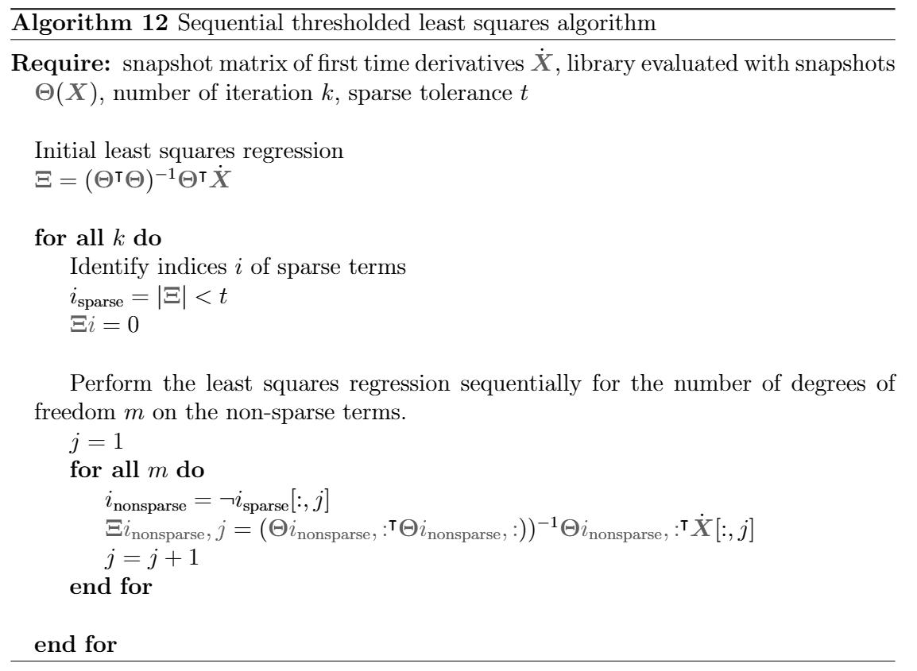

6.3 SINDy – Sequential Thresholded Least Squares
The regression is solved iteratively with least squares. In each iteration the coefficients smaller than a threshold $t$ are set to zero. This results in a sparse coefficient matrix

Slide 20

6.3.1 Learning a Differential Equation
A system of differential equations is given as
$${\dot{x}}_{1}=−x_{1}+2x_{2} \\ {\dot{x}}_{2}=−x_{1}+x_{2}$$
With the initial conditions
$$x_{1}\left(0\right)=1 \\ x_{2}\left(0\right)=1$$
And with the solution
$$x_{1}\left(t\right)=sin\left(t\right)+cos\left(t\right) \\ x_{2}\left(t\right)=cos(t)$$
The goal of SINDy is to find the underlying differential equation with snapshots of the solution $x_{1}\left(t\right), x_{2}\left(t\right)$

Slide 21
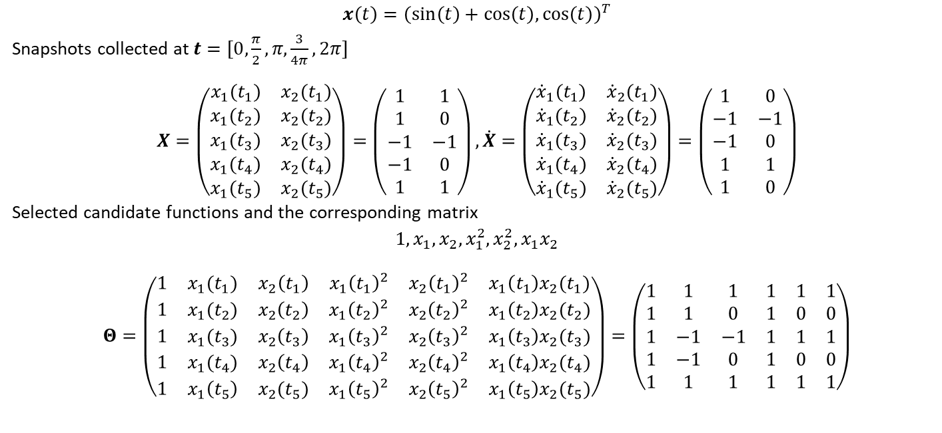
6.3.1 Learning a Differential Equation
$$x\left(t\right)={\left(\sin\left(t\right)+cos\left(t\right),\cos\left(t\right)\right)}^{T}$$
Snapshots collected at $t=[0,\frac{π}{2},π,\frac{3}{4π},2π]$
$$X=\left(\begin{matrix}x_{1}(t_{1}) & x_{2}(t_{1}) \\ x_{1}(t_{2}) & x_{2}(t_{2}) \\ x_{1}(t_{3}) & x_{2}(t_{3}) \\ x_{1}(t_{4}) & x_{2}(t_{4}) \\ x_{1}(t_{5}) & x_{2}(t_{5})\end{matrix}\right)=\left(\begin{matrix}1 & 1 \\ 1 & 0 \\ −1 & −1 \\ −1 & 0 \\ 1 & 1\end{matrix}\right),\dot{X}=\left(\begin{matrix}{\dot{x}}_{1}(t_{1}) & {\dot{x}}_{2}(t_{1}) \\ {\dot{x}}_{1}(t_{2}) & {\dot{x}}_{2}(t_{2}) \\ {\dot{x}}_{1}(t_{3}) & {\dot{x}}_{2}(t_{3}) \\ {\dot{x}}_{1}(t_{4}) & {\dot{x}}_{2}(t_{4}) \\ {\dot{x}}_{1}(t_{5}) & {\dot{x}}_{2}(t_{5})\end{matrix}\right)=\left(\begin{matrix}1 & 0 \\ −1 & −1 \\ −1 & 0 \\ 1 & 1 \\ 1 & 0\end{matrix}\right)$$
Selected candidate functions and the corresponding matrix
$$1, x_{1}, x_{2}, x_{1}^{2}, x_{2}^{2}, x_{1}x_{2}$$
$$Θ=\left(\begin{matrix}1 & x_{1}(t_{1}) & x_{2}\left(t_{1}\right) & x_{1}{\left(t_{1}\right)}^{2} & x_{2}{\left(t_{1}\right)}^{2} & x_{1}\left(t_{1}\right)x_{2}(t_{1}) \\ 1 & x_{1}(t_{2}) & x_{2}\left(t_{2}\right) & x_{1}{\left(t_{2}\right)}^{2} & x_{2}{\left(t_{2}\right)}^{2} & x_{1}\left(t_{2}\right)x_{2}(t_{2}) \\ 1 & x_{1}(t_{3}) & x_{2}\left(t_{3}\right) & x_{1}{\left(t_{3}\right)}^{2} & x_{2}{\left(t_{3}\right)}^{2} & x_{1}\left(t_{3}\right)x_{2}(t_{3}) \\ 1 & x_{1}(t_{4}) & x_{2}\left(t_{4}\right) & x_{1}{\left(t_{4}\right)}^{2} & x_{2}{\left(t_{4}\right)}^{2} & x_{1}\left(t_{4}\right)x_{2}(t_{4}) \\ 1 & x_{1}\left(t_{5}\right) & x_{2}(t_{5}) & x_{1}{\left(t_{5}\right)}^{2} & x_{2}{\left(t_{5}\right)}^{2} & x_{1}\left(t_{5}\right)x_{2}(t_{5})\end{matrix}\right)=\left(\begin{matrix}1 & 1 & 1 & 1 & 1 & 1 \\ 1 & 1 & 0 & 1 & 0 & 0 \\ 1 & −1 & −1 & 1 & 1 & 1 \\ 1 & −1 & 0 & 1 & 0 & 0 \\ 1 & 1 & 1 & 1 & 1 & 1\end{matrix}\right)$$

Slide 22
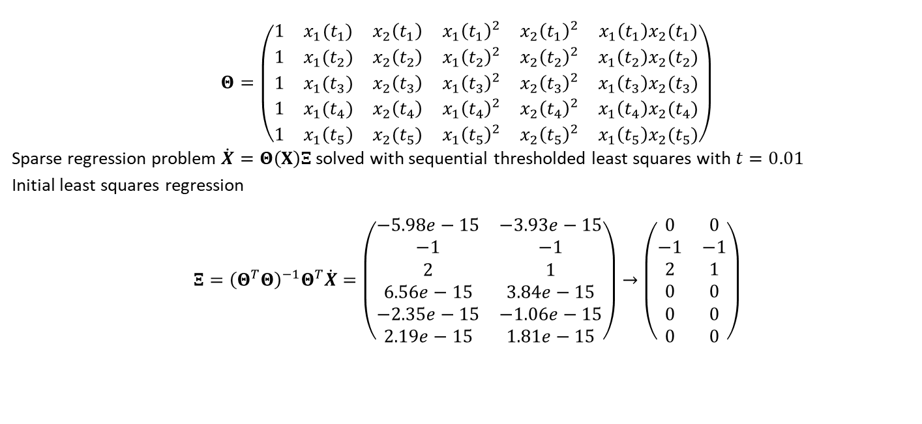
6.3.1 Learning a Differential Equation
$$Θ=\left(\begin{matrix}1 & x_{1}(t_{1}) & x_{2}\left(t_{1}\right) & x_{1}{\left(t_{1}\right)}^{2} & x_{2}{\left(t_{1}\right)}^{2} & x_{1}\left(t_{1}\right)x_{2}(t_{1}) \\ 1 & x_{1}(t_{2}) & x_{2}\left(t_{2}\right) & x_{1}{\left(t_{2}\right)}^{2} & x_{2}{\left(t_{2}\right)}^{2} & x_{1}\left(t_{2}\right)x_{2}(t_{2}) \\ 1 & x_{1}(t_{3}) & x_{2}\left(t_{3}\right) & x_{1}{\left(t_{3}\right)}^{2} & x_{2}{\left(t_{3}\right)}^{2} & x_{1}\left(t_{3}\right)x_{2}(t_{3}) \\ 1 & x_{1}(t_{4}) & x_{2}\left(t_{4}\right) & x_{1}{\left(t_{4}\right)}^{2} & x_{2}{\left(t_{4}\right)}^{2} & x_{1}\left(t_{4}\right)x_{2}(t_{4}) \\ 1 & x_{1}\left(t_{5}\right) & x_{2}(t_{5}) & x_{1}{\left(t_{5}\right)}^{2} & x_{2}{\left(t_{5}\right)}^{2} & x_{1}\left(t_{5}\right)x_{2}(t_{5})\end{matrix}\right)$$
Sparse regression problem $\dot{X}=Θ\left(X\right)Ξ$ solved with sequential thresholded least squares with $t=0.01$
Initial least squares regression
$$Ξ={\left(Θ^{T}Θ\right)}^{−1}Θ^{T}\dot{X}=\left(\begin{matrix}−5.98e−15 & −3.93e−15 \\ −1 & −1 \\ 2 & 1 \\ 6.56e−15 & 3.84e−15 \\ −2.35e−15 & −1.06e−15 \\ 2.19e−15 & 1.81e−15\end{matrix}\right)→\left(\begin{matrix}0 & 0 \\ −1 & −1 \\ 2 & 1 \\ 0 & 0 \\ 0 & 0 \\ 0 & 0\end{matrix}\right)$$

Slide 23
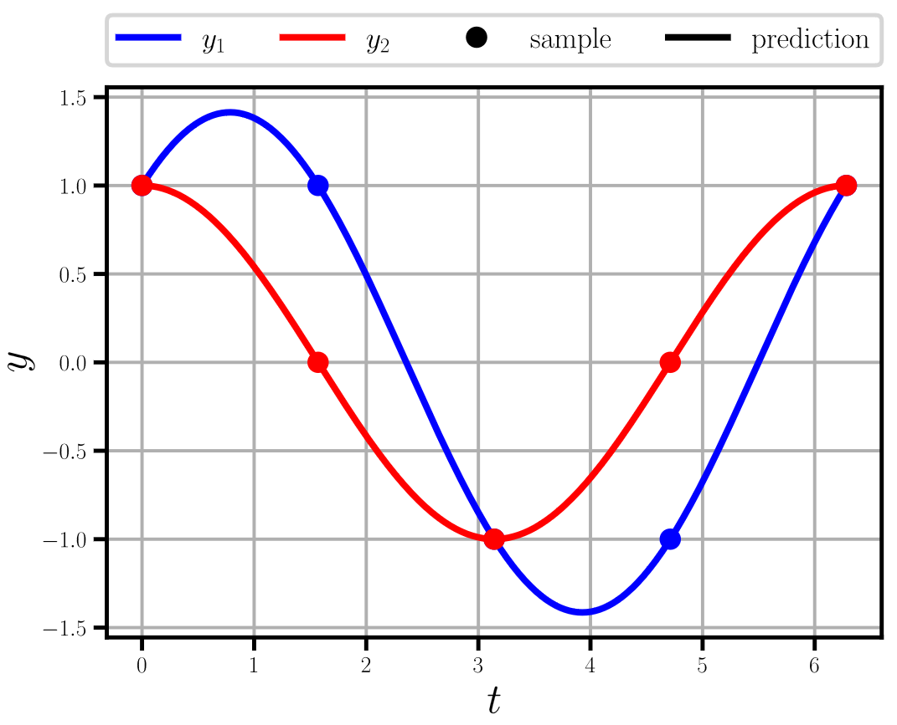
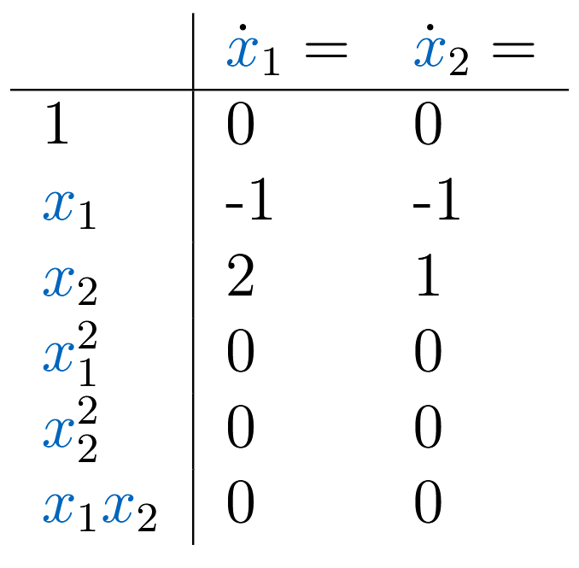

6.3.1 Learning a Differential Equation
Recovered system
Original system
$${\dot{x}}_{1}=−x_{1}+2x_{2} \\ {\dot{x}}_{2}=−x_{1}+x_{2}$$

Slide 24
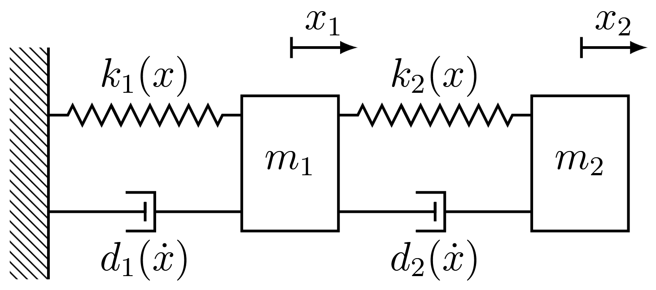

6.3.2 Structural Dynamics Model
A two degree of freedom mass-spring-damper model
Governing equations obtained from equilibrium
$$m_{1}{\ddot{x}}_{1}+k_{1}\left(x_{1}\right)+d_{1}\left({\dot{x}}_{1}\right)+k_{2}\left(x_{1}−x_{2}\right)+d_{2}\left({\dot{x}}_{1}−{\dot{x}}_{2}\right)=0 \\ m_{2}{\ddot{x}}_{2}+k_{2}\left(x_{2}−x_{1}\right)+d_{2}\left({\dot{x}}_{2}−{\dot{x}}_{1}\right)=0$$
And initial conditions
$$x_{1}\left(0\right)=x_{1_{0}}, {\dot{x}}_{1}\left(0\right)={\dot{x}}_{1_{0}},x_{2}\left(0\right)=x_{2_{0}},{\dot{x}}_{2}\left(0\right)={\dot{x}}_{2_{0}}$$

Slide 25
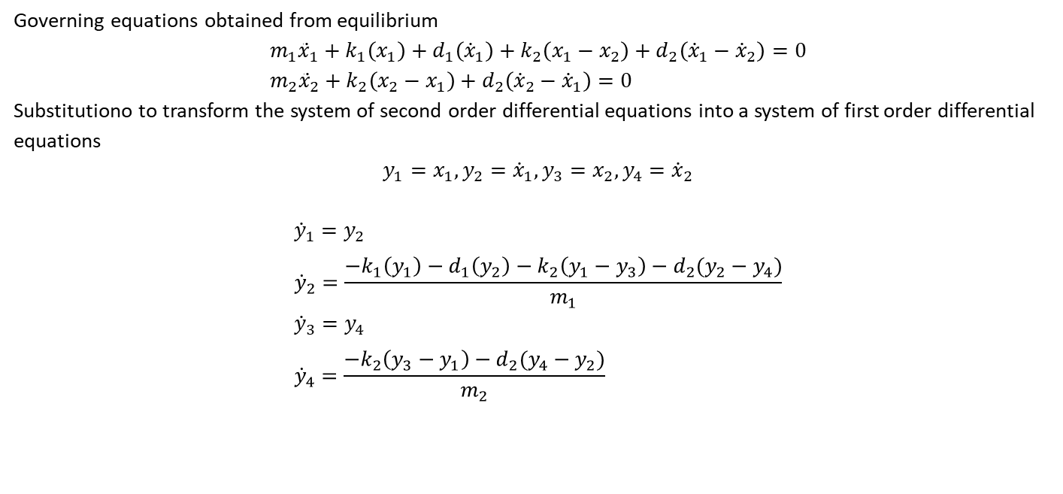
6.3.2 Structural Dynamics Model
Governing equations obtained from equilibrium
$$m_{1}{\ddot{x}}_{1}+k_{1}\left(x_{1}\right)+d_{1}\left({\dot{x}}_{1}\right)+k_{2}\left(x_{1}−x_{2}\right)+d_{2}\left({\dot{x}}_{1}−{\dot{x}}_{2}\right)=0 \\ m_{2}{\ddot{x}}_{2}+k_{2}\left(x_{2}−x_{1}\right)+d_{2}\left({\dot{x}}_{2}−{\dot{x}}_{1}\right)=0$$
Substitutiono to transform the system of second order differential equations into a system of first order differential equations
$$y_{1}=x_{1},y_{2}={\dot{x}}_{1},y_{3}=x_{2},y_{4}={\dot{x}}_{2}$$
$${\dot{y}}_{1}=y_{2} \\ {\dot{y}}_{2}=\frac{−k_{1}\left(y_{1}\right)−d_{1}\left(y_{2}\right)−k_{2}\left(y_{1}−y_{3}\right)−d_{2}(y_{2}−y_{4})}{m_{1}} \\ {\dot{y}}_{3}=y_{4} \\ {\dot{y}}_{4}=\frac{−k_{2}\left(y_{3}−y_{1}\right)−d_{2}(y_{4}−y_{2})}{m_{2}}$$
Any higher order system of differential equations can be rewritten in terms of a system of first order differential equations

Slide 26
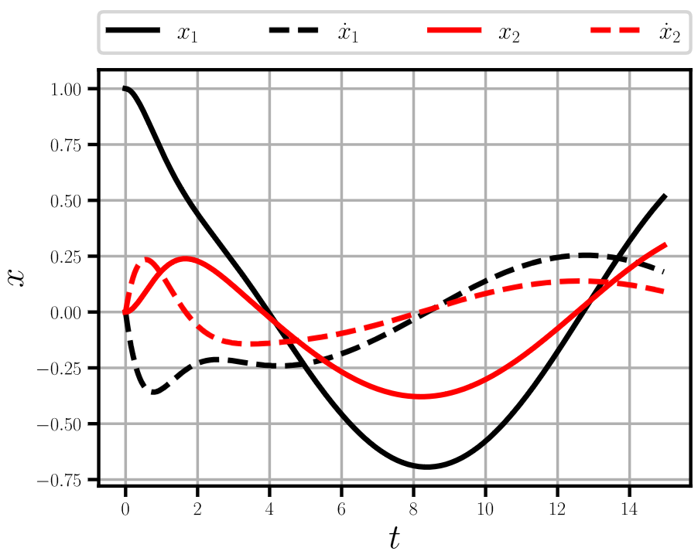
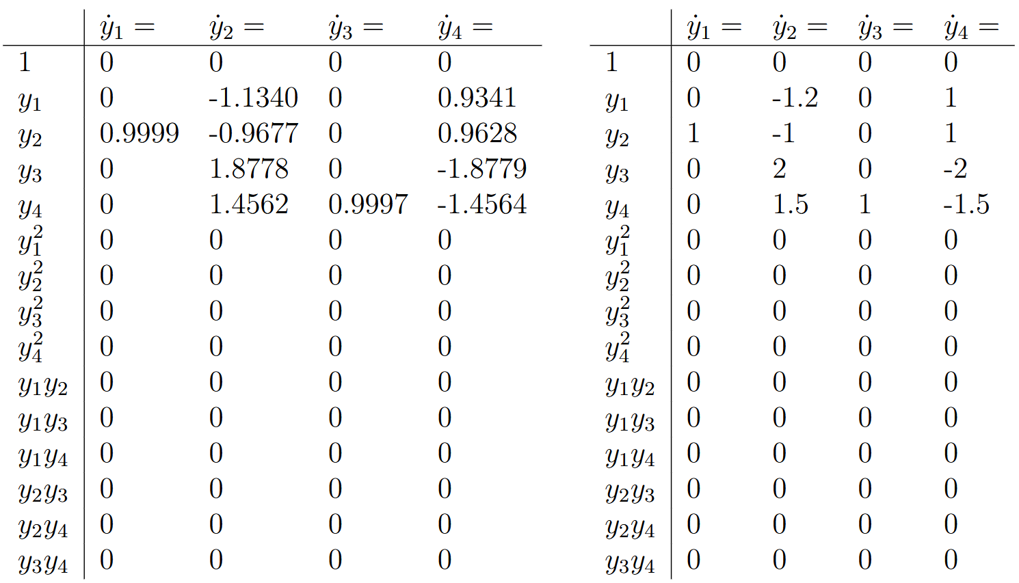
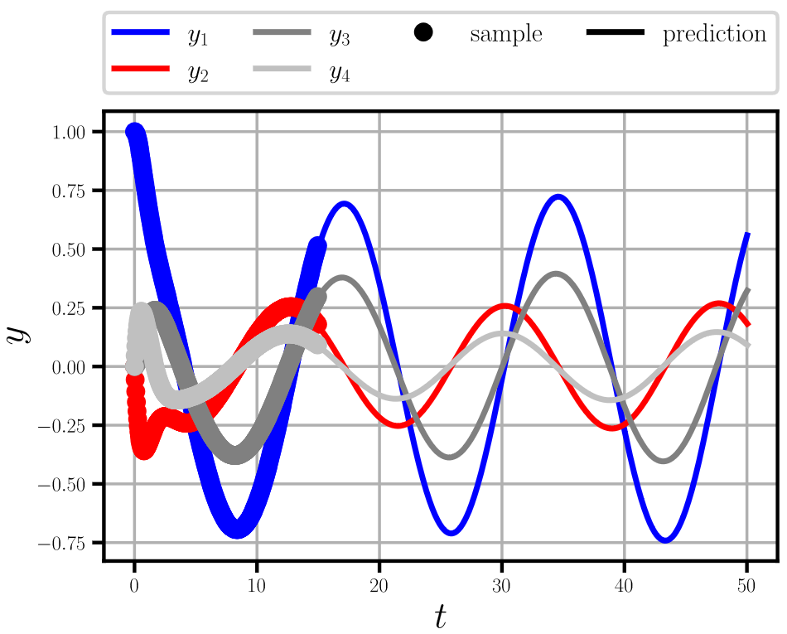

6.3.2 Structural Dynamics Model – Linear
Assuming linear springs and dampers
$$k_{i}\left(x\right)=K_{i}x \\ d_{i}\left(\dot{x}\right)=D_{i}\dot{x}$$
Example values $K_{1}=2, K_{2}=4, D_{1}=2,D_{2}=3, m_{1}=5,m_{2}=2$ SINDy estimation with 300 snapshots and the original system
Measurement
Prediction with SINDy

Slide 27
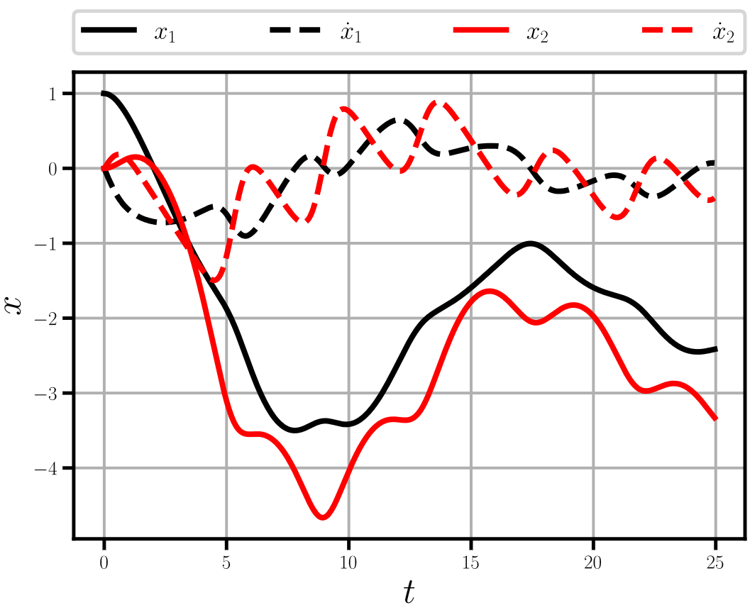
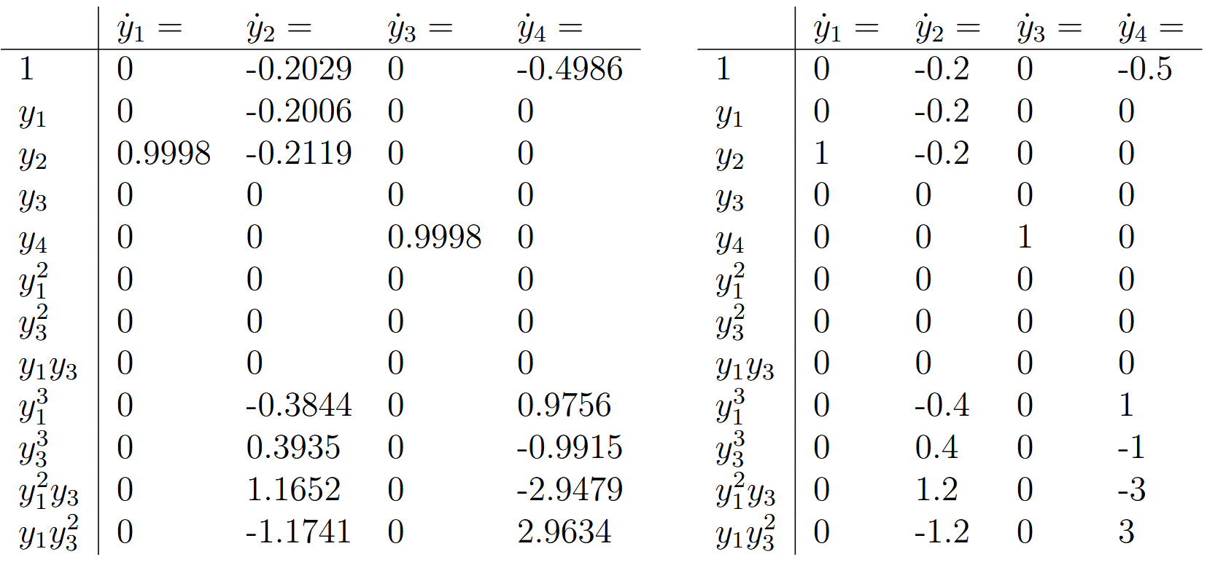
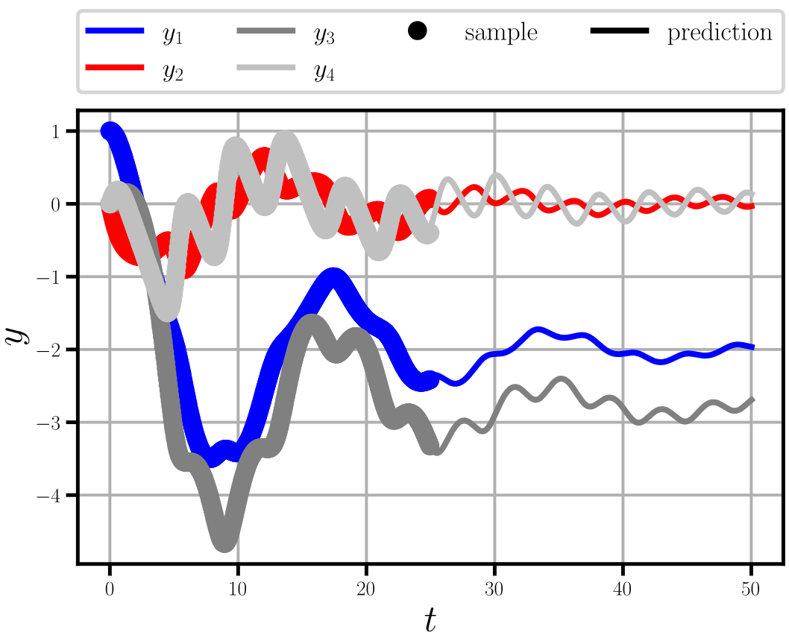

6.3.2 Structural Dynamics Model – Linear
SINDy is made for nonlinear dynamics
Nonlinear springs and dampers
$$k_{1}\left(x\right)=x, k_{2}\left(x\right)=2x^{3} \\ d_{1}\left(\dot{x}\right)=\dot{x},d_{2}\left(\dot{x}\right)=1 \\ m_{1}=5,m_{2}=2$$ SINDy estimation with 500 snapshots and the original system
Measurement
Prediction with SINDy

Slide 28
Exercises
E.25 Introduction to SINDy (P & C)
Apply SINDy to a simple system of first order differential equations using pen-and-paper. Next implement SINDy and the sequential thresholded least sqaures algorithm and recompute the pen-and-paper computations.
E.26 SINDy for Structural Dynamics (P & C)
Apply the implementation of SINDy to a two-degree-of-freedom example from structural dynamics.

Slide 29
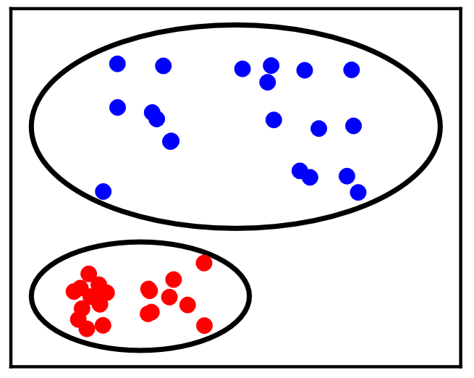
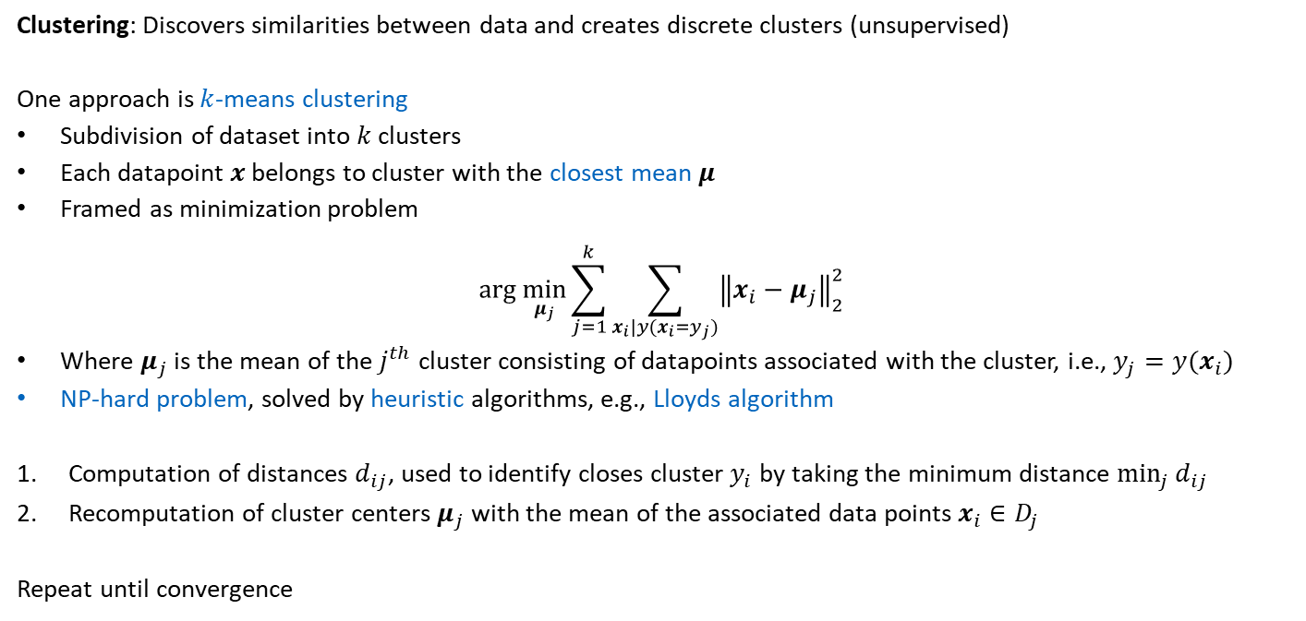
6.4 Clustering
Clustering: Discovers similarities between data and creates discrete clusters (unsupervised)
One approach is $k$-means clustering
Subdivision of dataset into $k$ clusters
Each datapoint $x$belongs to cluster with the closest mean $μ$
Framed as minimization problem
$$arg \min_{μ_{j}}{\sum_{j=1}^{k}{\sum_{x_{i}|y(x_{i}=y_{j})}^{ }{{\left\|x_{i}−μ_{j}\right\|}_{2}^{2}}}}$$
Where $μ_{j}$ is the mean of the $j^{th}$ cluster consisting of datapoints associated with the cluster, i.e., $y_{j}=y(x_{i})$
NP-hard problem, solved by heuristic algorithms, e.g., Lloyds algorithm
Computation of distances $d_{ij}$, used to identify closes cluster $y_{i}$ by taking the minimum distance $\min_{j}{d_{ij}}$
Recomputation of cluster centers $μ_{j}$ with the mean of the associated data points $x_{i}∈D_{j}$
Repeat until convergence

Slide 30
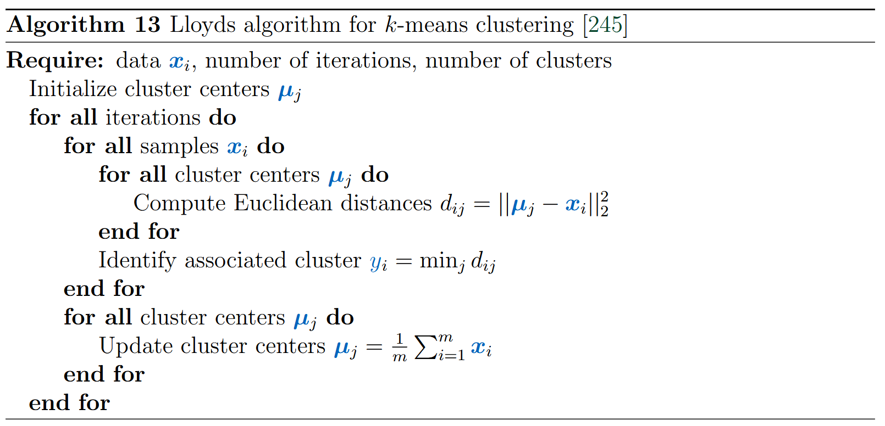
6.4 Clustering – Lloyds algorithm

Slide 31
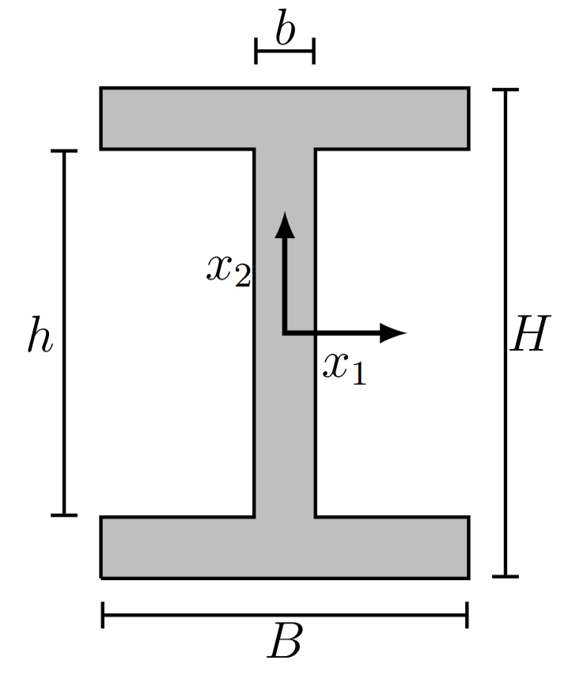
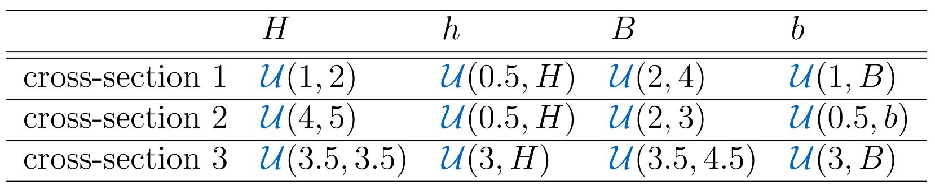

6.4.1 Cross-Section Clustering
Consider the cross-section of an I-beam with the properties
$$I_{1}=\frac{bh^{3}}{12}+\frac{B}{12}\left(H^{3}−h^{3}\right) \\ I_{2}=\frac{b^{3}h}{12}+\frac{B^{3}}{12}\left(H−h\right) \\ A=HB−h(B−b)$$
Assuming three different cross-sections (with different distributions)
Can we identify the three different cross-sections from the three properties, $I_{1},I_{2}, A$?

Slide 32
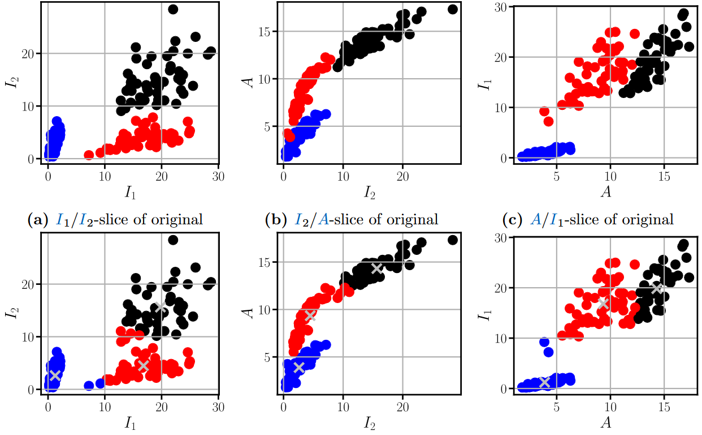




6.4.1 Cross-Section Clustering
$k$-means clustering with Lloyds algorithm
Original cross-sections
$I_{1}/I_{2}$ slice
$I_{2}/A$ slice
$A/I_{1}$ slice
Identified cross-sections with clustering
Cluster centers are indicated by silver centers

Slide 33






6.4.1 Cross-Section Clustering
Evolution of cluster identification in $I_{1}/I_{2}$-slice (initial guess + three iterations
Iteration 0: $86\%$
Iteration 1: $94\%$
Iteration 2: $95\%$
Iteration 3: $95\%$

Slide 34



6.5 Support Vector Machines
Classification: Prediction of a discrete category via a mapping between input and a (discrete) category
Support vector machines as classification algorithm
Binary classifier, i.e., (-1 and 1)
Predecessor of neural networks
Linear support vector machines construct a hyperplane between two categories
$$w⋅x+b=0$$
Hyperplane should maximize margin between closest points to the hyperplane
Minimal margin
Maximal margin

Slide 35

6.5 Support Vector Machines
Prediction $\hat{y}$ is made depending on what side of the plane the datapoint $x$ lies
$$\hat{y}=sign(w⋅x+b)$$
Optimization is formulated
1. Correct classification of data
$$ℒ\left({\tilde{y}}_{i},\hat{y}\left({\tilde{x}}_{i}\right)\right)=\left\{\begin{aligned}0 if {\tilde{y}}_{i}=sign(w⋅{\tilde{x}}_{i}+b) \\ 1 if {\tilde{y}}_{i}≠sign(w⋅{\tilde{x}}_{i}+b)\end{aligned}\right.$$
With the constraint
$$\min_{i}\left|{\tilde{x}}_{i}⋅w\right|=1$$
2. Maximization of the margin
$$C=\sum_{i=1}^{m}{ℒ\left({\tilde{y}}_{i},\hat{y}\left({\tilde{x}}_{i}\right)\right)+\frac{1}{2}{\left\|w\right\|}^{2}}$$
Loss $ℒ\left({\tilde{y}}_{i},\hat{y}\left({\tilde{x}}_{i}\right)\right)$ is not differentiable and therefore exchanged with the differentiable Hinge loss function
$$ℒ_{H}\left({\tilde{y}}_{i},\hat{y}\left({\tilde{x}}_{i}\right)\right)=max(0, 1−{\tilde{y}}_{i}{\hat{y}}_{i})$$
Optimization via gradient-based optimization determines optimal hyperplane
Mislabeling a datapoint increases the loss by one
Ensures that closest data points (support vectors) are at a standardized distance
Achieved by the regularization term

Slide 36


6.5 Support Vector Machines – Examples
Linear support vector machine applied to the cross-section example
Nonlinear support vector machine enabled by projection to higher-dimensional space
$$e\left(x_{1},x_{2}\right)={\left(x_{1},x_{2},sin\left(πx_{1}\right),sin\left(2πx_{1}\right)\right)}^{T}$$

Slide 37
Contents
5 Advanced Physics-Informed Neural Networks
6.1.1 Singular Value Decomposition
6.2 Reduced Order Models
6.3 Sparse Identification of Non-Linear Dynamical Systems – SINDy
6.4 Clustering
6.5 Support Vector Machines
7 Material Modeling with Neural Networks

Slide 38
6 Machine Learning in Computational Mechanics
Leon Herrmann
Stefan Kollmannsberger
Chair of Data Engineering in Construction
Bauhaus-Universität Weimar
Deep Learning in Computational Mechanics – an introductory course, Herrmann et al. 2025
website
book
Notes:
generated with https://www.the-qrcode-generator.com/

