Slide 1
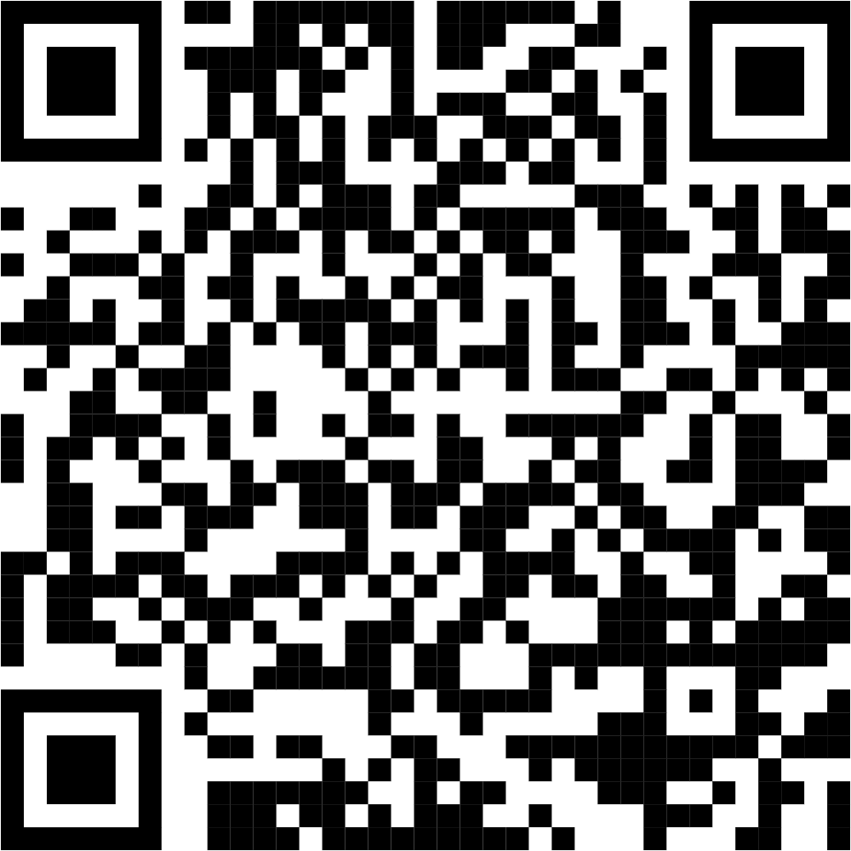
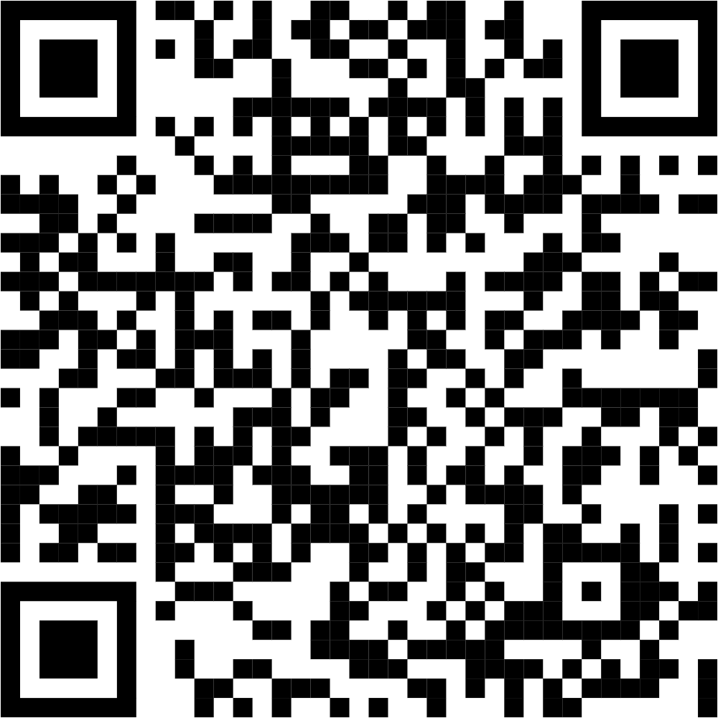
8 Generative Artificial Intelligence
Leon Herrmann
Stefan Kollmannsberger
Chair of Data Engineering in Construction
Bauhaus-Universität Weimar
Deep Learning in Computational Mechanics – an introductory course, Herrmann et al. 2025
website
book
Notes:
generated with https://www.the-qrcode-generator.com/

Slide 2
Contents
7 Material Modeling with Neural Networks
8.1 Autoencoders
8.2 Variational Autoencoder
8.4 Autoencoders in Computer Vision: U-Net
8.3 Generative Adversarial Networks
8.5 Diffusion Models
8.6 Transformers
8.7 Applications in Computational Mechanics
8.7.1 Data Generation
8.7.3 Anomaly Detection
8.7.4 Conditional Generation
9 Inverse Problems & Deep Learning

Slide 3
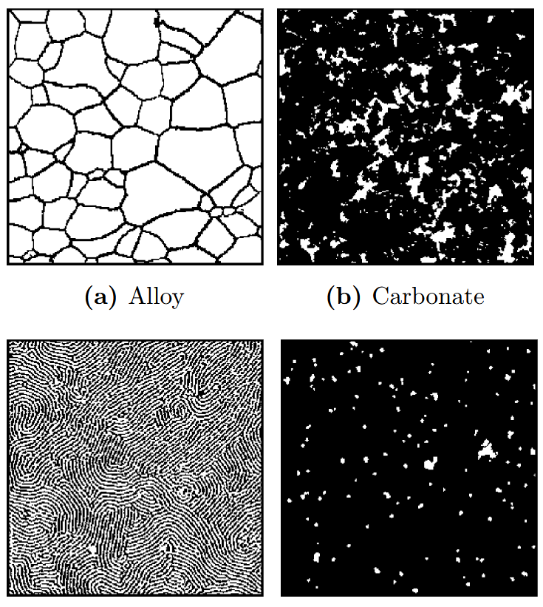
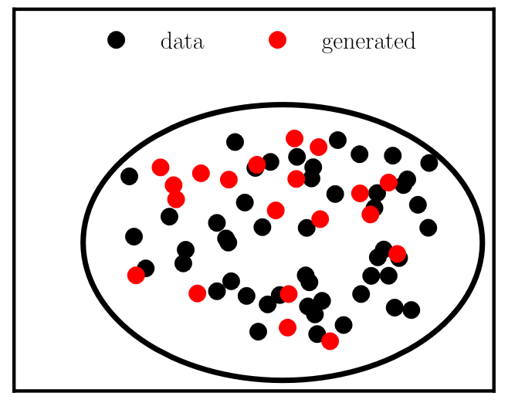
8 Generative Artificial Intelligence
Generative modeling
Generate new data points that resemble a given dataset (without simply reproducing given data points)
Example: Generate new rim designs given a set of rims
Variational autoencoders, generative adversarial networks, diffusion models, flow-based models, transformer models

Slide 4
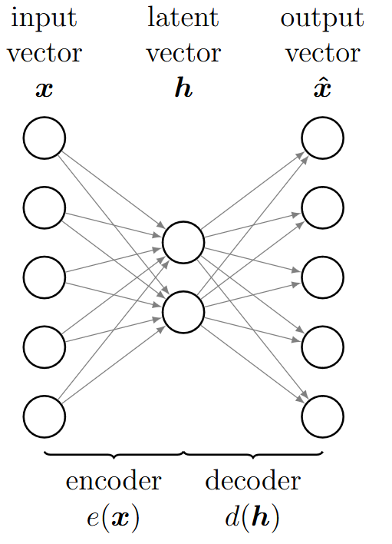
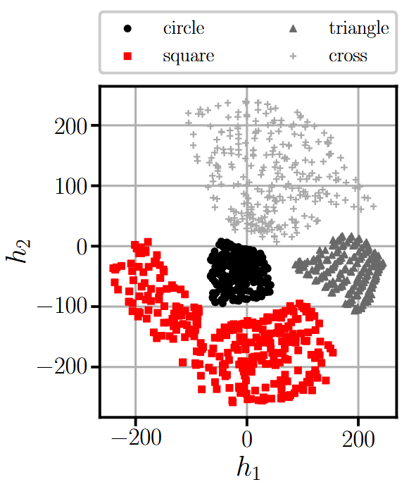
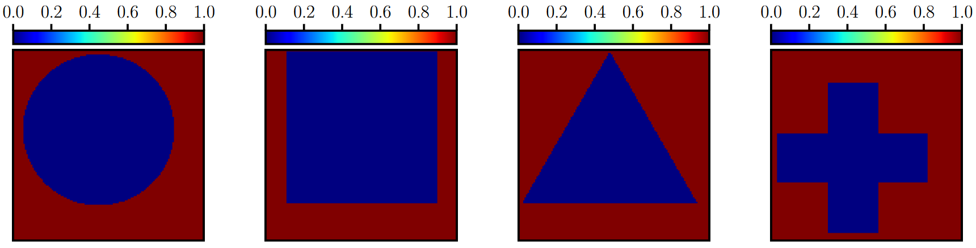

8.1 Autoencoders
Autoencoders learn a compression (and the corresponding decompression)
Encoder $e$ projects data from high-dimensional input $x$ to low-dimensional latent space $h$
Decoder $d$ reconstructs $x$ from the latent space $h$, i.e., $\hat{x}=d(e\left(x\right))$
Cost function
$$C={\left\|d\left(e\left(x\right)\right)−x\right\|}^{2}$$
Autoencoders are problematic for generation, due to discontinuities between different objects in the latent space
This is a dimensionality reduction technique (and not a generative model):
Generation is theoretically possible by randomly sampling the latent space & decoding it

Slide 5
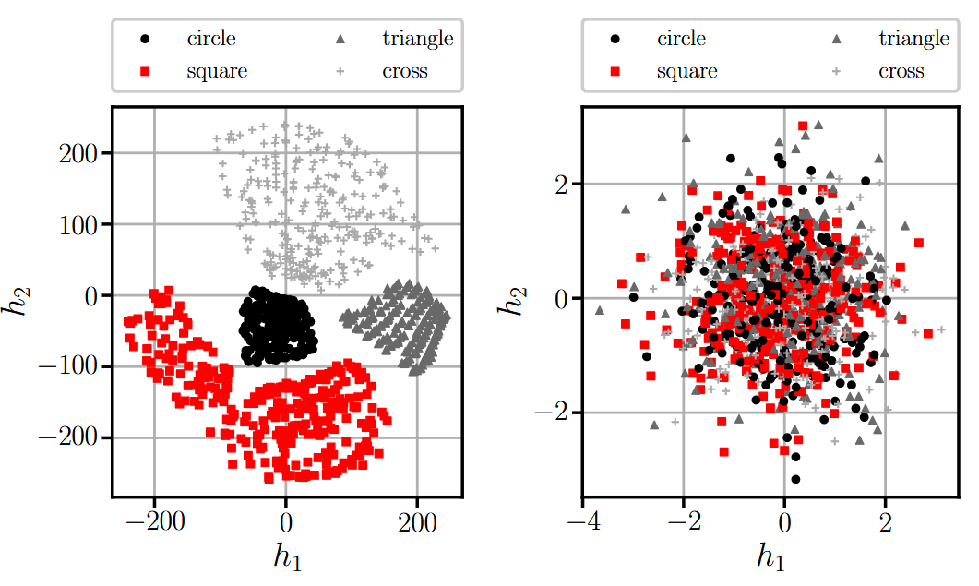
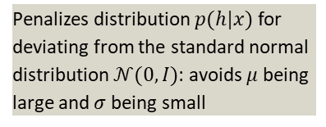
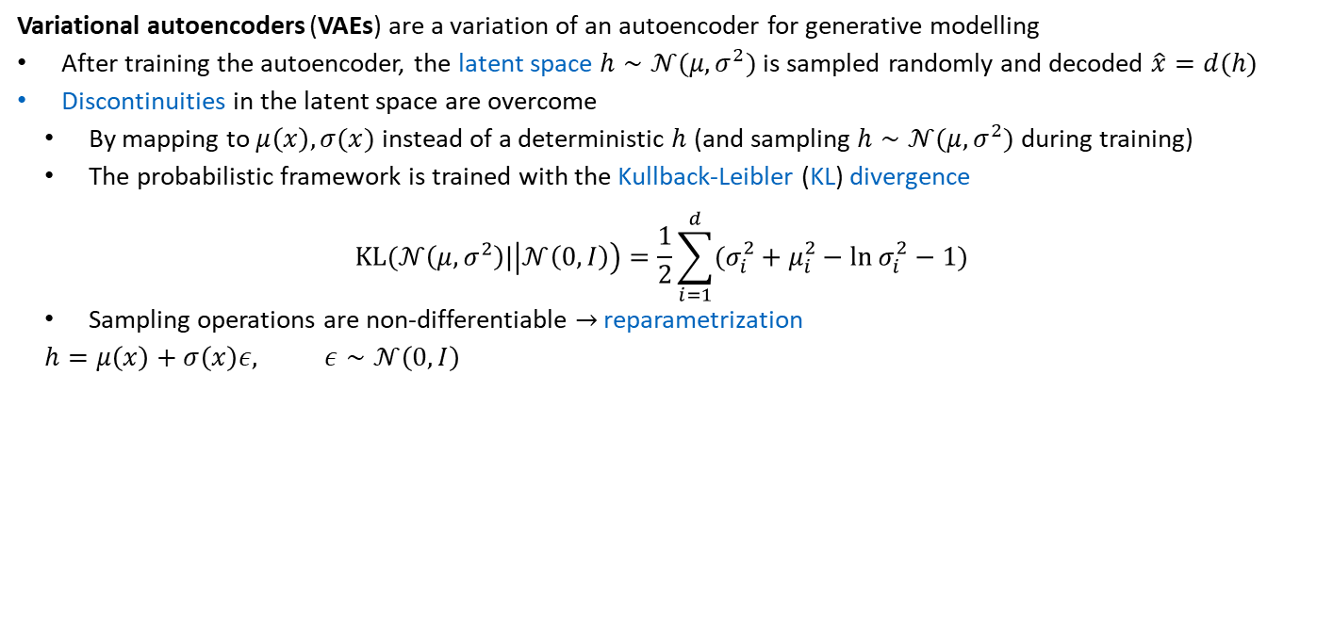
8.2 Variational Autoencoder
Variational autoencoders (VAEs) are a variation of an autoencoder for generative modelling
After training the autoencoder, the latent space $h∼𝒩(μ,σ^{2})$ is sampled randomly and decoded $\hat{x}=d(h)$
Discontinuities in the latent space are overcome
By mapping to $μ\left(x\right), σ(x)$ instead of a deterministic $h$ (and sampling $h∼𝒩(μ,σ^{2})$ during training)
The probabilistic framework is trained with the Kullback-Leibler (KL) divergence
$$KL(𝒩\left(μ,σ^{2}\right)|\left|𝒩\left(0,I\right)\right)=\frac{1}{2}\sum_{i=1}^{d}{(σ_{i}^{2}+μ_{i}^{2}−ln σ_{i}^{2}−1)}$$
Sampling operations are non-differentiable $→$ reparametrization
$$h=μ\left(x\right)+σ\left(x\right)ε, ε∼𝒩\left(0,I\right)$$
$μ$ is the mean and $σ$ the standard deviation of a normal distribution
Penalizes distribution $p(h|x)$ for deviating from the standard normal distribution $𝒩(0,I)$: avoids $μ$ being large and $σ$ being small
Trained with reconstruction loss
Trained with Kullback-Leibler divergence
Encodings are distributed randomly around zero (and entangled)

Slide 6
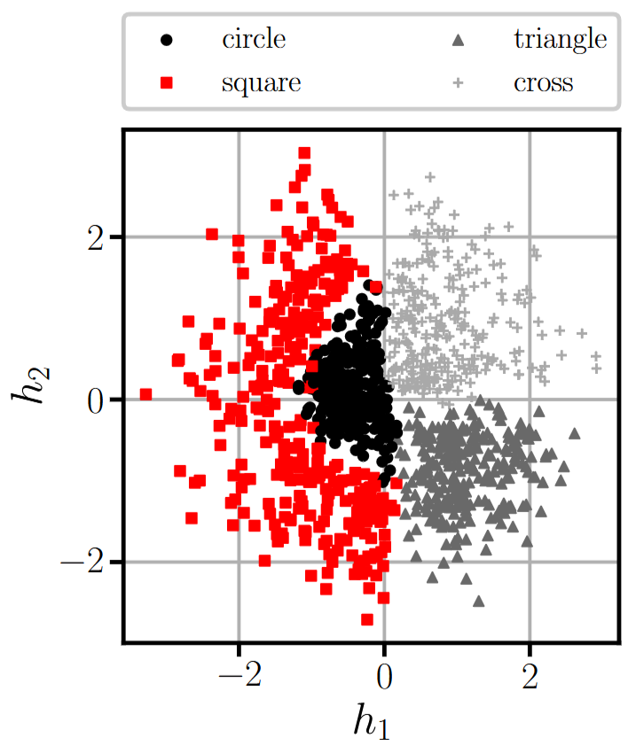
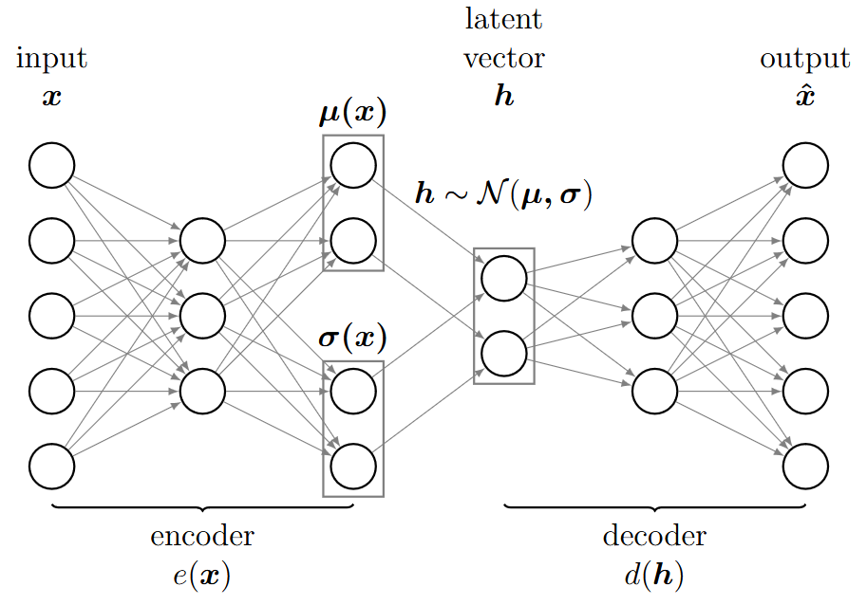

8.2 Variational Autoencoder
Cost function of variational autoencoder as combination between reconstruction loss & Kullback-Leibler divergence
$$C={\left\|x−\hat{x}\right\|}^{2}+KL(𝒩\left(μ\left(x\right), σ\right), 𝒩\left(0,I\right))$$
where the latent space prediction is made as $h=μ\left(x\right)+σ\left(x\right)ε, ε∼𝒩(0,I)$
Disentangled and continuous latent space (with meaningful clusters centered around zero)

Slide 7
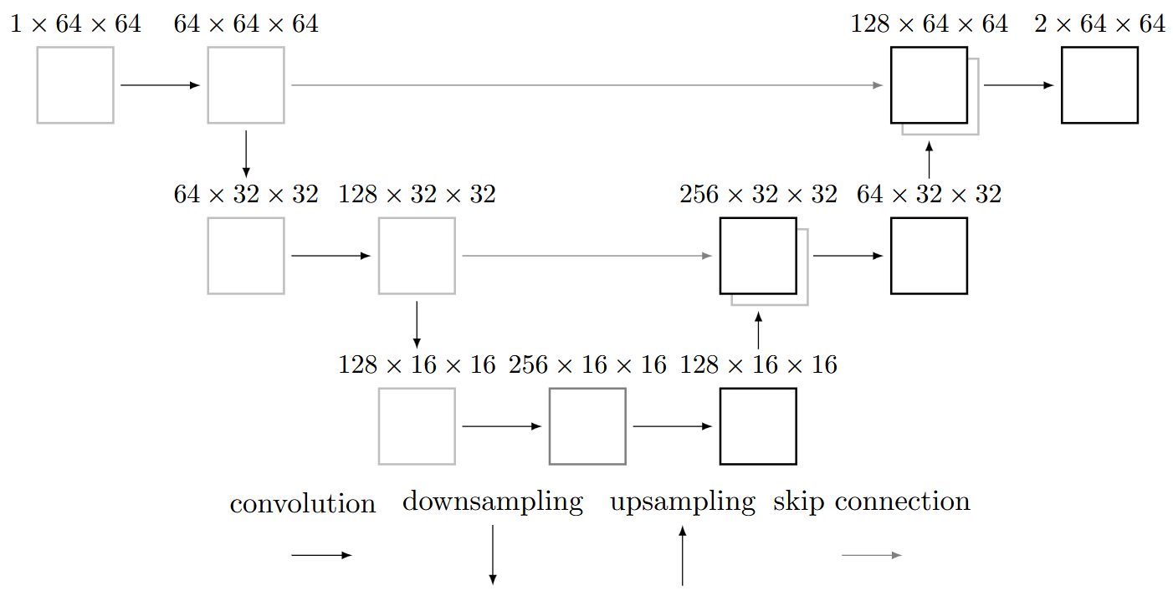
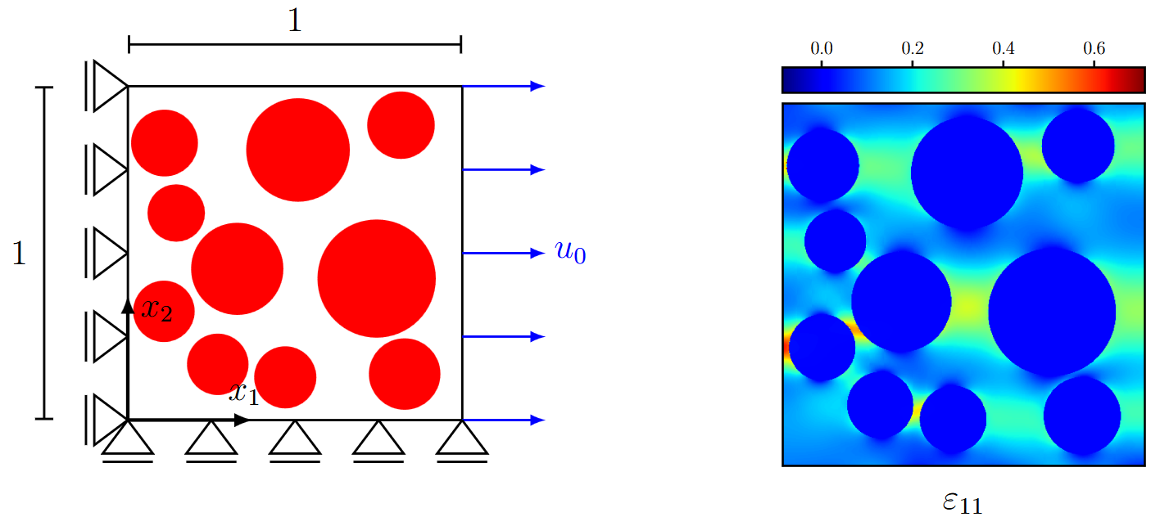
8.4 Autoencoders in Computer Vision: U-Net
U-Net: Convolutional Networks for Biomedical Image Segmentation, Ronneberger et al. 2015
Autoencoders for surrogate modeling
Extract the essence of the input
(Potentially) have to reconstruct important features
U-Net
Encodes the input to a latent space
Adds skip connections
Features do not have to be relearnt
Avoids vanishing/exploding gradients
Example (learning strain distributions) from Chapter 3

Slide 8
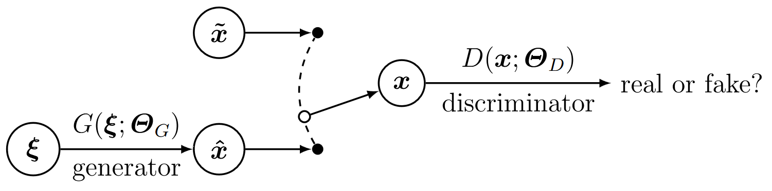
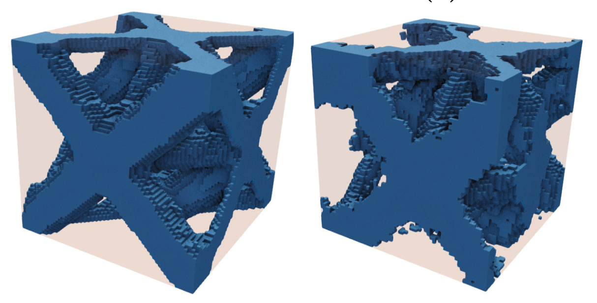


8.3 Generative Adversarial Networks
Generative Adversarial Nets, Goodfellow et al. 2014
Generative adversarial networks (GANs) learn to generate data through a two-player game
The generator $G_{NN}(ξ;Θ_{G})$ creates fake samples $\hat{x}$ from random noise $ξ$
The discriminator $D_{NN}(x;Θ_{D})$ assesses if a sample $x$ is real or fake (i.e., generated by $G_{NN})$
This is quantified by the predicted probability score $\hat{p}=D_{NN}(x;Θ_{D})$
Thus: the generator aims to fool the discriminator
The two-player game is formulated with the cost function
$$C=\frac{1}{m_{D}}\sum_{i=1}^{m_{D}}{log\left(D_{NN}\left({\tilde{x}}_{i};Θ_{D}\right)\right)+\frac{1}{m_{G}}\sum_{i=1}^{m_{G}}{log(1−D_{NN}\left(G_{NN}\left(ξ_{i};Θ_{G}\right);Θ_{D}\right))}}$$
Handled with a minimax optimization $\min_{Θ_{G}}{\max_{Θ_{D}}{C}}$
Reference cell & generated cell
Convergence is reached when $\hat{p}=0.5$ for all samples

Slide 9
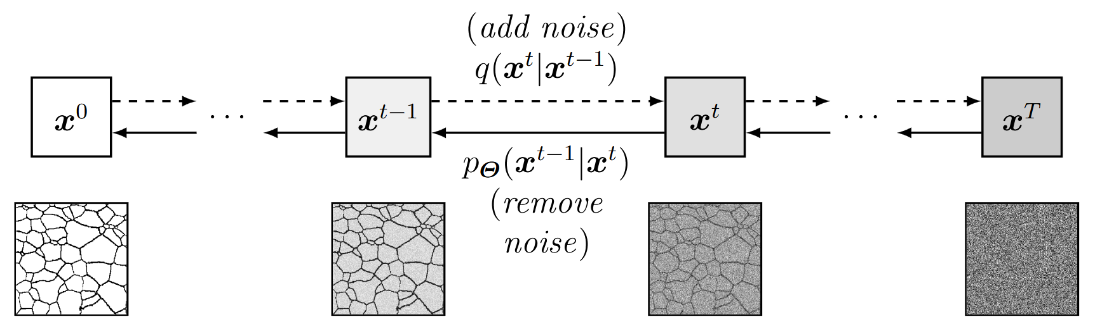


8.5 Diffusion Models
Diffusion models learn to reverse a gradual noising procedure
A forward diffusion process $q$ (slowly adds random noise to data $x$)
$$q\left(x^{t} | x^{t−1}\right)=𝒩(x^{t};\sqrt{1−β^{t}}x^{t−1},β^{t}I)$$
A reverse denoising diffusion process $p_{Θ}$ (a neural network learns to reverse the diffusion process)
$$p_{Θ}\left(x^{t−1} | x^{t}\right)=𝒩\left(x^{t−1};μ_{Θ}\left(x^{t},t\right),Σ_{Θ}\left(x^{t},t\right)\right) \\ p_{Θ}\left(x^{0:T}\right)=p(x^{T})\prod_{t=1}^{T}{p_{Θ}(x^{t−1}|x^{t})}$$
$μ_{Θ}, Σ_{Θ}$ can be described by neural networks

Slide 10
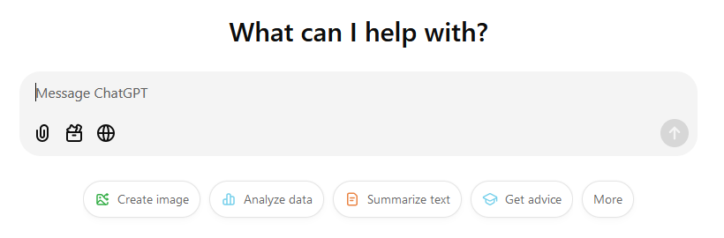
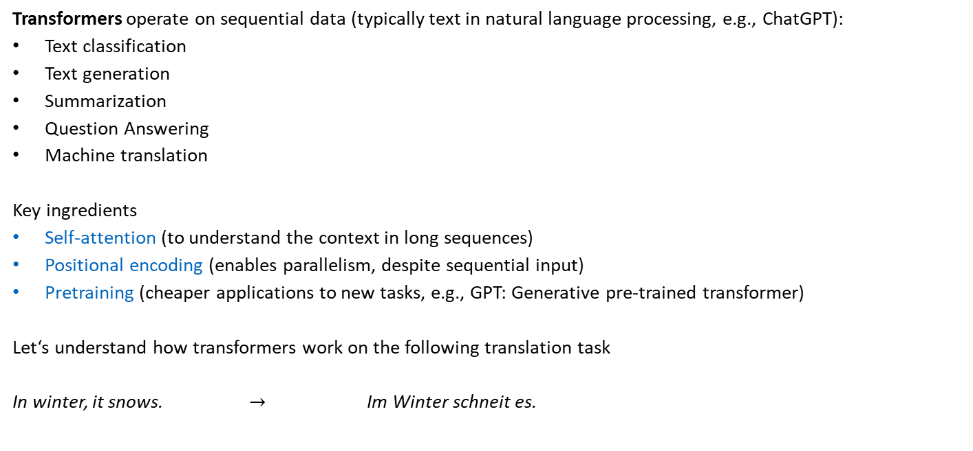
8.6 Transformers
Attention Is All You Need, Vaswani et al. 2017
Transformers operate on sequential data (typically text in natural language processing, e.g., ChatGPT):
Text classification
Text generation
Summarization
Question Answering
Machine translation
Key ingredients
Self-attention (to understand the context in long sequences)
Positional encoding (enables parallelism, despite sequential input)
Pretraining (cheaper applications to new tasks, e.g., GPT: Generative pre-trained transformer)
Let‘s understand how transformers work on the following translation task
In winter, it snows. $→$ Im Winter schneit es.

Slide 11
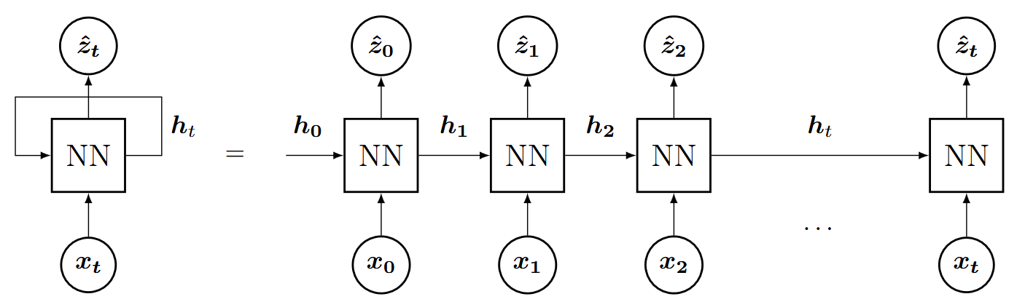
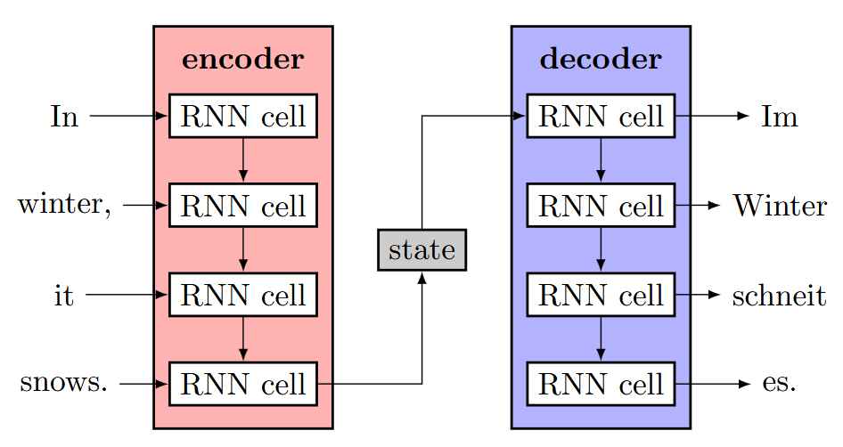
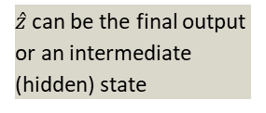
8.6 Transformers
Natural Language Processing with Transformers, Tunstall et al. 2022
In natural language processing, the state-of-the-art before transformers were recurrent neural networks (& variants)
The translation task could be handled by an encoder-decoder architecture (using two RNNs)
Problems:
For long inputs, the hidden state cannot capture the meaning of the entire sequence
The forward propagation cannot be parallelized
$\hat{z}$ can be the final output or an intermediate (hidden) state

Slide 12
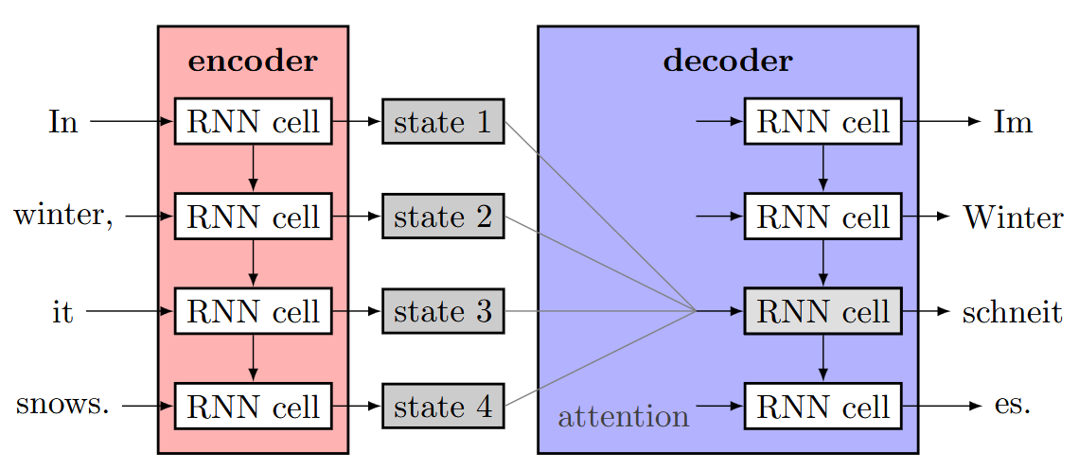
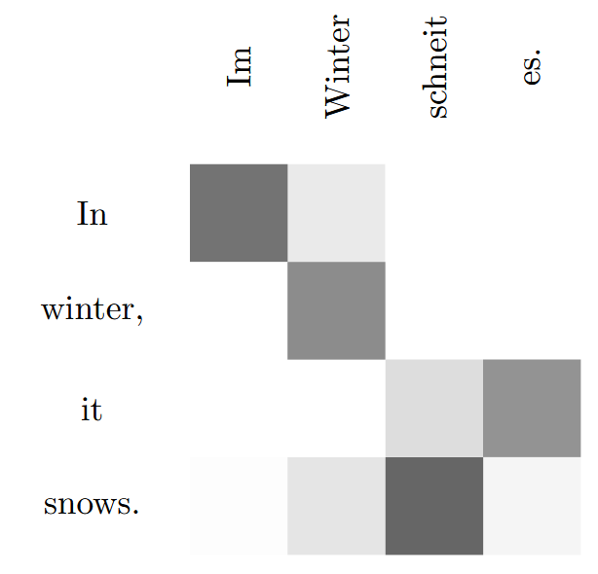
8.6 Transformers
Natural Language Processing with Transformers, Tunstall et al. 2022
To handle long-range dependencies, attention is introduced within the decoder
An attention map is applied between every hidden state (each token, i.e., word) and each RNN cell of the output
Problem:
The forward propagation cannot be parallelized
Exemplary attention map between input and output

Slide 13
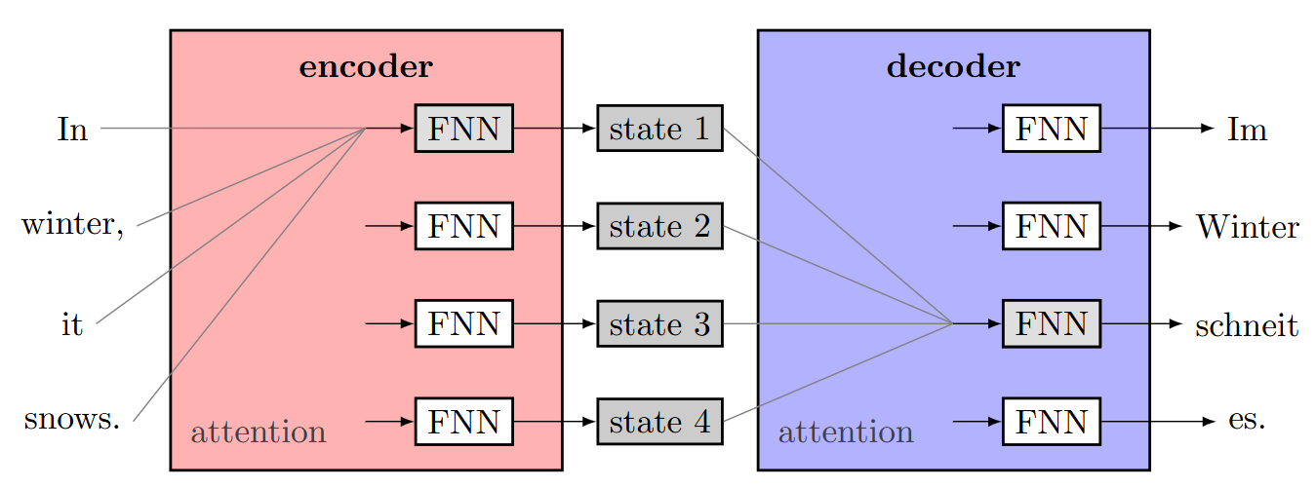
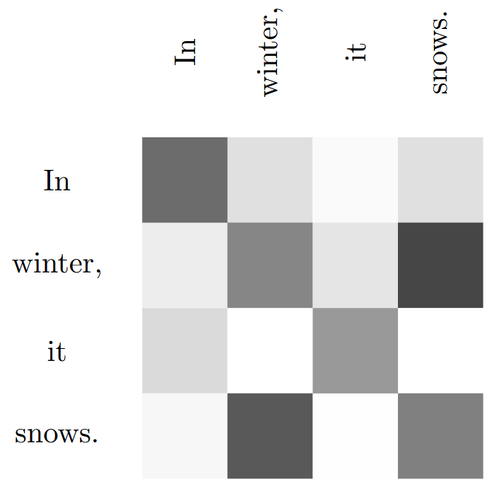
8.6 Transformers
Natural Language Processing with Transformers, Tunstall et al. 2022
An additional attention mechanism in the encoder enables parallelism
Because each output token (decoder) attends to every input token (encoder), this mechanism is known as
cross-attention.
But what about self-attention?
In self-attention, each token attends to every other token in the same sequence, capturing context and relationships between them.

Slide 14
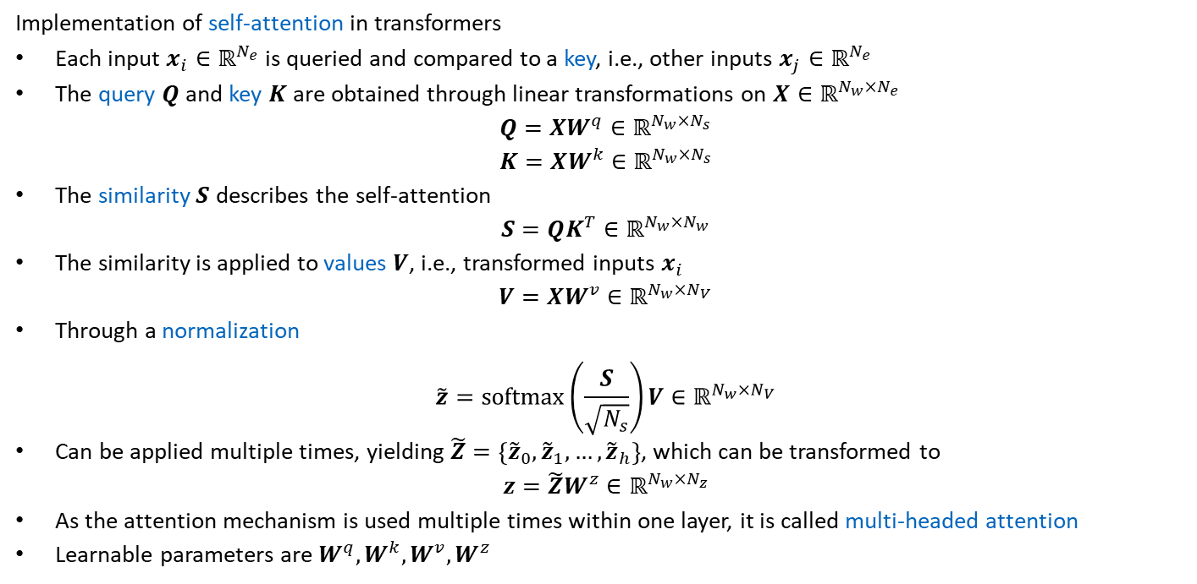


8.6 Transformers
Implementation of self-attention in transformers
Each input $x_{i}∈ℝ^{N_{e}}$ is queried and compared to a key, i.e., other inputs $x_{j}∈ℝ^{N_{e}}$
The query $Q$and key $K$are obtained through linear transformations on $X∈ℝ^{N_{w}×N_{e}}$
$$Q=XW^{q}∈ℝ^{N_{w}×N_{s}} \\ K=XW^{k}∈ℝ^{N_{w}×N_{s}}$$
The similarity $S$ describes the self-attention
$$S=QK^{T}∈ℝ^{N_{w}×N_{w}}$$
The similarity is applied to values $V$, i.e., transformed inputs $x_{i}$
$$V=XW^{v}∈ℝ^{N_{w}×N_{V}}$$
Through a normalization
$$\tilde{z}=softmax\left(\frac{S}{\sqrt{N_{s}}}\right)V∈ℝ^{N_{w}×N_{V}}$$
Can be applied multiple times, yielding $\tilde{Z}=\left\{{\tilde{z}}_{0},{\tilde{z}}_{1},…,{\tilde{z}}_{h}\right\}$, which can be transformed to
$$z=\tilde{Z}W^{z}∈ℝ^{N_{w}×N_{z}}$$
As the attention mechanism is used multiple times within one layer, it is called multi-headed attention
Learnable parameters are $W^{q}, W^{k}, W^{v}, W^{z}$
If key and query act on the same sequence: self-attention
Else: attention
Without softmax: unbounded
Softmax transforms $S$ into a probability distribution
Similarity matrix $S$
Notes:
Query: Each word/token is „queried“/considered: „What information do I want from the rest of the sentence?“
Achieved through the key: Each word (including the queried word): „What kind of information can I offer?“
Similarity: -> if key and query match strongly -> word‘s value information is incorporated more heavily into its new representation

Slide 15
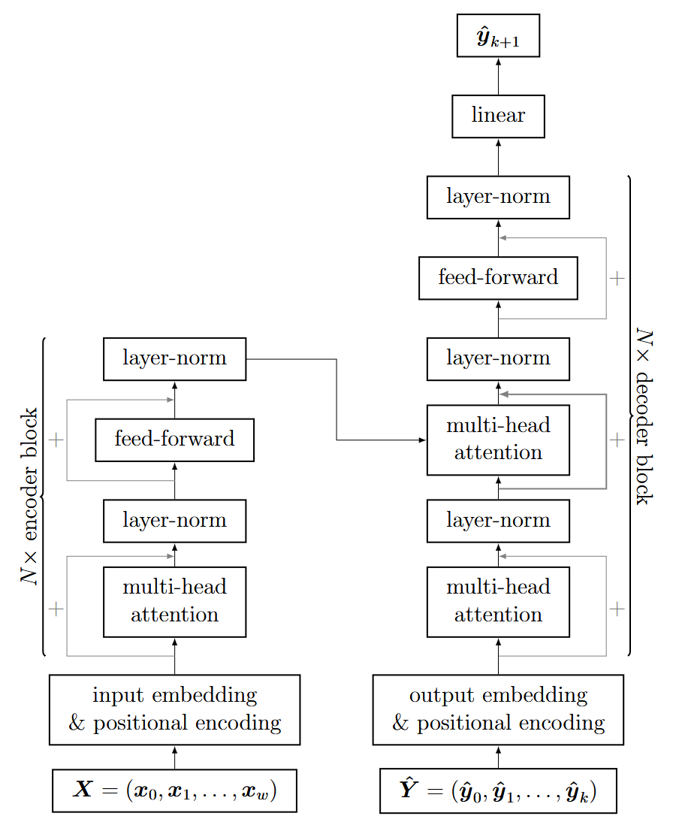
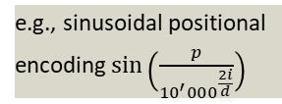
8.6 Transformers
Attention Is All You Need, Vaswani et al. 2017
Multi-headed self-attention layers are combined with
Normalization layers, feed-forward layers, skip connections
Positional encoding:
Extends input/output with unique positional identifier
Input embedding (how to encode words):
Word2Vec, learnable
In the original transformer formulation an encoder-decoder architecture was proposed:
Encoder-only: text classification, extractive question answering
Decoder-only: text generation, auto- regressive question answering
Encoder-decoder: machine translation, speech processing, data to text
e.g., sinusoidal positional encoding $sin\left(\frac{p}{{10}^{′}{000}^{\frac{2i}{d}}}\right)$
Notes:
Word2Vec examples: King – Man + Woman = Queen
Paris – France + Germany = Berlin
d: total embedding size
i: dimension index
p: position in sequence

Slide 16
8.6 Transformers
https://github.com/meta-llama/llama/blob/main/MODEL_CARD.md
Pretraining: Perform a training on a larger and more general dataset
e.g., predict next word from previous words (get text from internet)
Domain adaption: Perform a second training on specific dataset
e.g., (hand-crafted) Q&A texts to build a chatbot, or adaption to another language
Fine-tuning: combination with additional neural networks for specific task
e.g., classification layer appended to the hidden state, or using only the decoder for chatbots
Pretraining is the most expensive part
 | parameters | model size | training time (on 2048 GPUs) | training cost
Llama 7B | 7B | 28 GB | 4 days | 0.1 M $
Llama 13B | 13B | 52 GB | 8 days | 0.2 M $
Llama 70B | 70B | 280 GB | 35 days | 1.1 M $
GPT-3 | 165B | 700 GB | 17 days | 4.6 M $
GPT-4 | 100B-10T? | 400 GB-40 TB | ? | ?

Slide 17
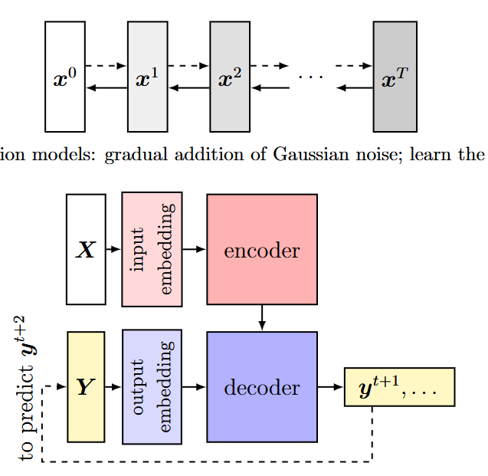
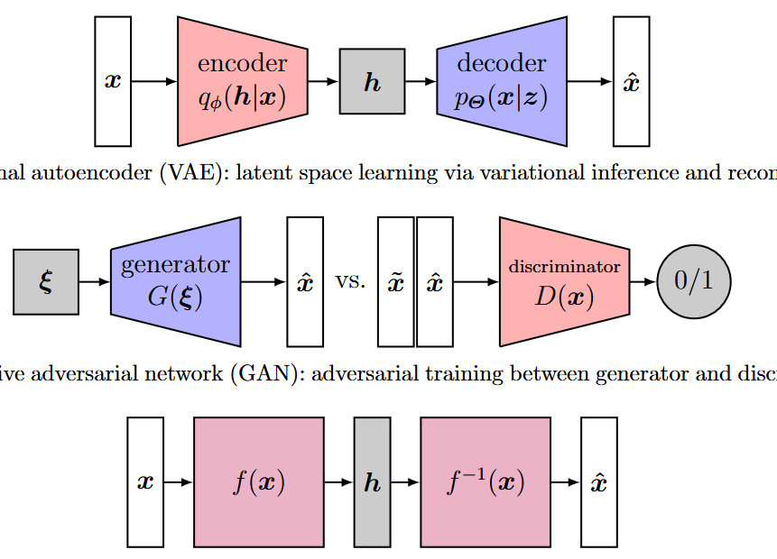
8 Generative Artificial Intelligence
What is what?
Notes:
Flow-based models:
-series of invertible transformations to map a simple probability distribution (like a Gaussian) into the complex data distribution.
-Each transformation is invertible -> straightforward to compute exact likelihoods and generate new samples by running the transformations in reverse.

Slide 18
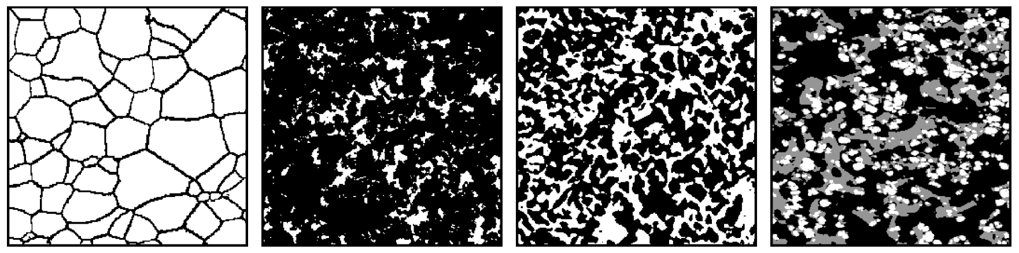
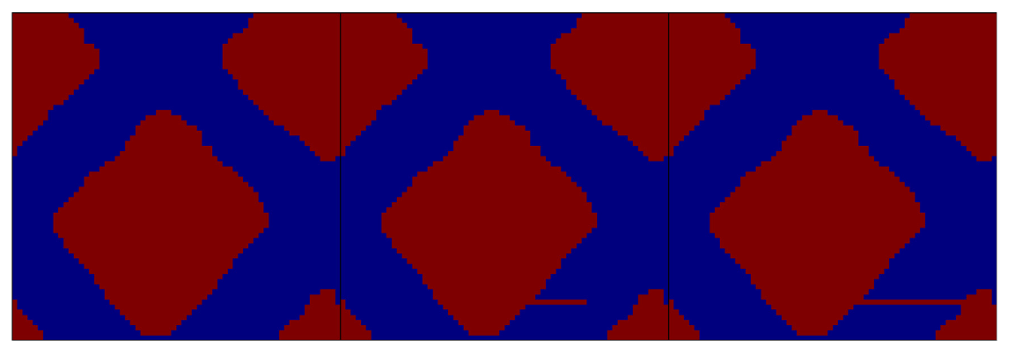
8.7 Applications in Computational Mechanics
8.7.1 Data Generation
For surrogate models
As surrogate models
8.7.2 Generative Design & Design Optimization
Nonlinear dimensionality reduction (optimization on latent vectors)
Enforcement of exotic constraints
Novelty, aesthetics, manufacturability, creativity, …
Inverse design
8.7.3 Anomaly Detection
If generation is not possible, it must be an anomaly!
8.7.4 Conditional Generation
Additional inputs to generative models (but still multiple outputs)
8.7.5 Surrogate Modeling
Transformer architectures as surrogates
U-Net

Slide 19
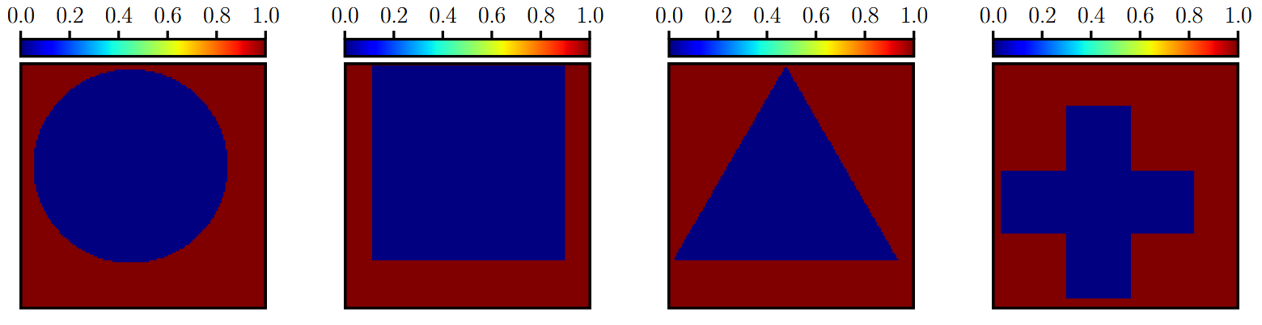
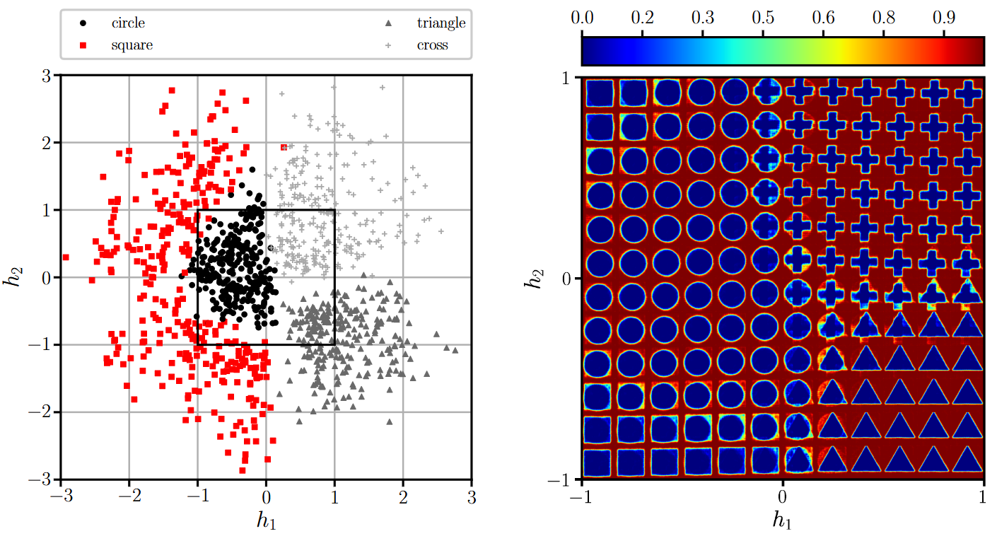
8.7.1 Data Generation
Shape generation with variational autoencoders
Training with
Reconstruction loss
Kullback-Leibler divergence
Latent space
Interpolation of the latent space

Slide 20
Exercises
E.28 Variational Autoencoder (C)
Apply a variational autoencoder to a simple data generation task. The task consists of generating basic shapes; circles, triangles, squares and crosses. Explore the latent space distribution and the effect of the Kullback-Leibler divergence.

Slide 21
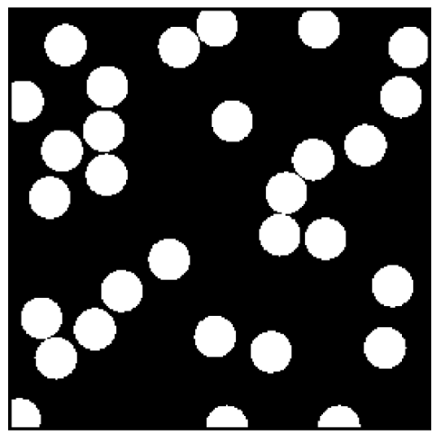
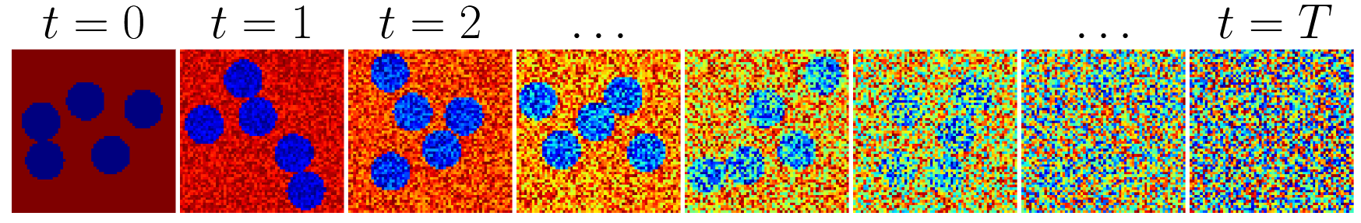
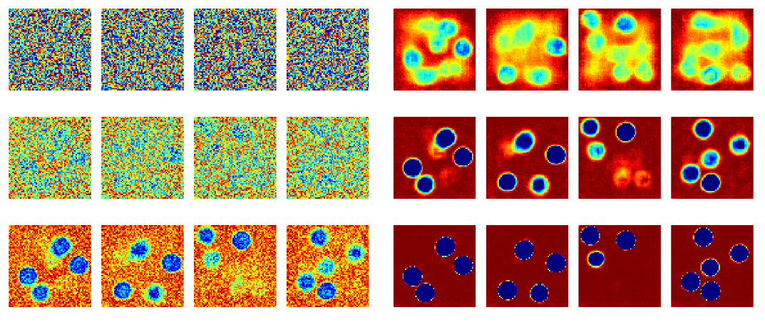
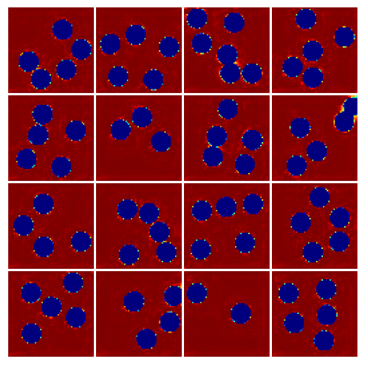



8.7.1 Data Generation
Fiber distribution generation with diffusion model
Forward diffusion process
Learned reverse denoising process
After 40 denoising steps
1
$$n−2$$
2
$$n−1$$
3
$$n$$

Slide 22
Exercises
E.30 Diffusion models (C)
Apply a diffusion model to a simple data generation task. The task consists of generating simple fiber matrix microstructures.

Slide 23
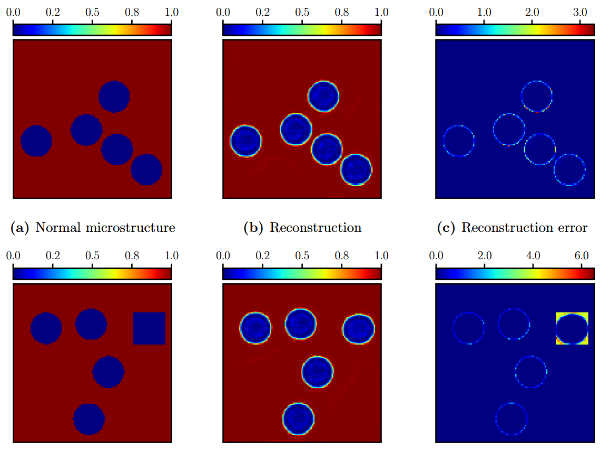
8.7.3.1 Autoencoders for Anomaly Detection
Training of autoencoder on ”normal data”, i.e., without anomalies
Detection of outliers
In latent space
By inability to reconstruct the input image
input
Prediction
Reconstruction error
Deep Learning for Anomaly Detection: A Review, Pang et al. 2021

Slide 24
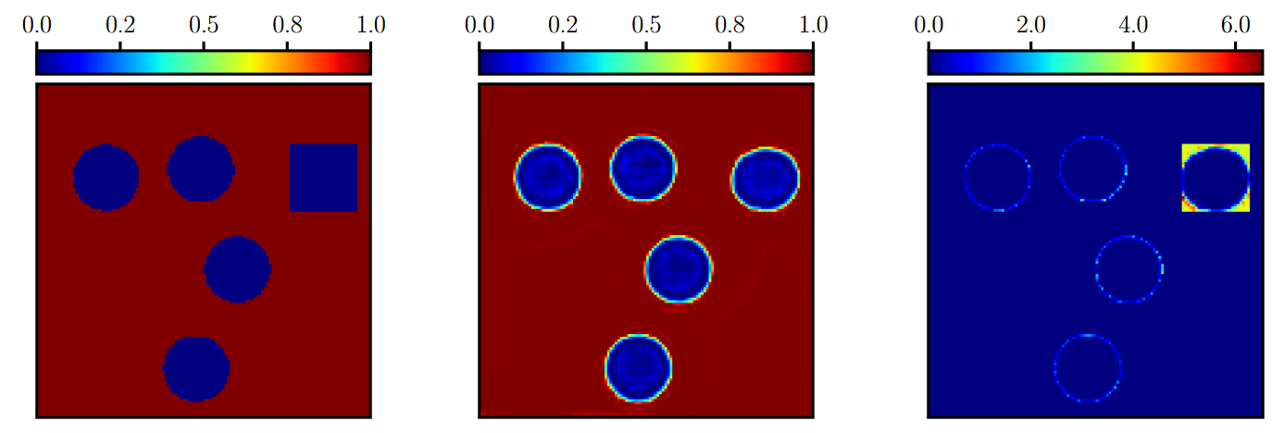
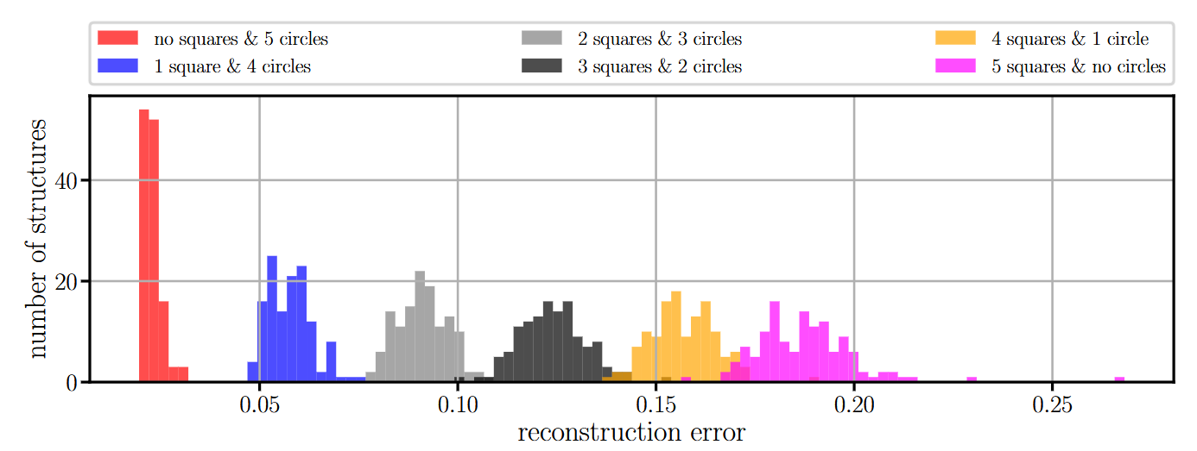
8.7.3.1 Autoencoders for Anomaly Detection
Statistical evaluation

Slide 25
Exercises
E.27 Autoencoder (C)
Apply an autoencoder as an anomaly detector. First train the autoencoder on normal data (using a dataset consisting of randomly distributed circles). Next apply the autoencoder to anomolous data (using a dataset consisting of randomly distributed circles and squares). Compare the reconstruction errors with those obtained with normal data.

Slide 26
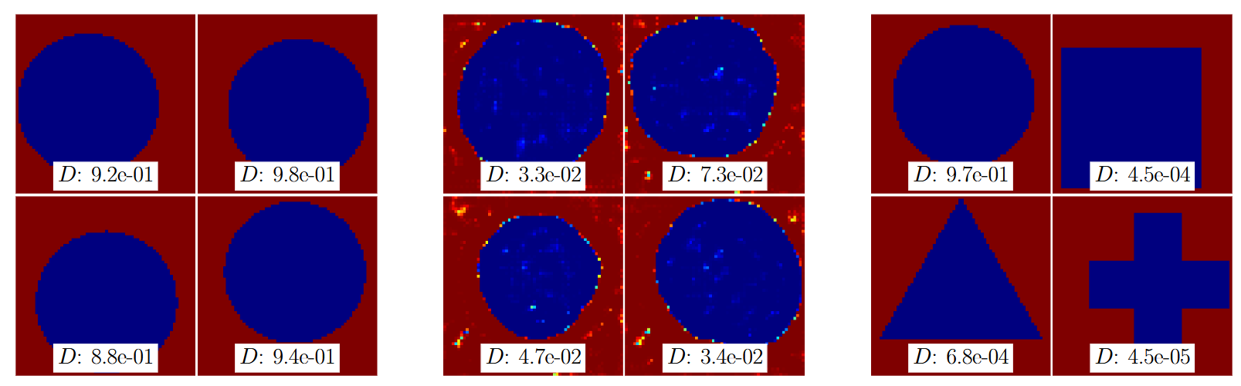
8.7.3.2 Generative Adversarial Networks for Anomaly Detection
Generative adversarial networks enable outlier detection and property monitoring for additive manufacturing of complex structures, Henkes et al. 2024
Training of generative adversarial network on ”normal data”, i.e., without anomalies
Detection of outliers
By inability to reconstruct the input image from noise (requires optimization with respect to input)
Through the discriminator
Discriminator cannot distinguish between real & fake ”normal data”
Anomalies outside of ”normal data” distribution are detectable
Diffusion models can be used similarly
Real ”normal data”
Fake ”normal data”
Anomoulous data

Slide 27
Exercises
E.29 Generative Adversarial Network (C)
Apply a generative adversarial network as an anomaly detector. First train the generative adversarial network on normal data (using a dataset consiting of circles). Next apply the trained discriminator to anomalous data (using a dataset consisting of squares, triangles, and crosses). Compare the discriminator score to the scores obtained with normal data.

Slide 28
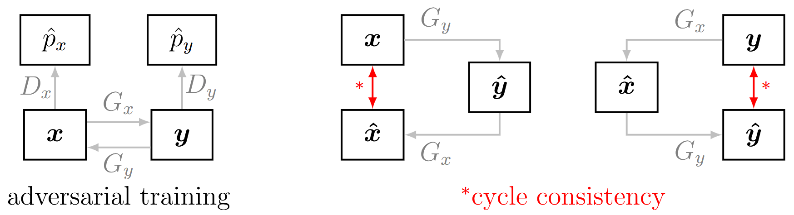
8.7.4 Conditional Generation
Conditional adversarial networks
Include inputs & labeled outputs (supervised)
InfoGANs
Include latent code as input & disentanglement loss term (unsupervised)
Variational autoencoder generative adversarial networks
Autoencoder architecture for the GAN generator
CycleGANs
tempoGAN (for temporal data, e.g., video)
Temporal coherence is assessed by second discriminator

Slide 29
Contents
7 Material Modeling with Neural Networks
8.1 Autoencoders
8.2 Variational Autoencoder
8.4 Autoencoders in Computer Vision: U-Net
8.3 Generative Adversarial Networks
8.5 Diffusion Models
8.6 Transformers
8.7 Applications in Computational Mechanics
8.7.1 Data Generation
8.7.3 Anomaly Detection
8.7.4 Conditional Generation
9 Inverse Problems & Deep Learning

Slide 30
8 Generative Artificial Intelligence
Leon Herrmann
Stefan Kollmannsberger
Chair of Data Engineering in Construction
Bauhaus-Universität Weimar
Deep Learning in Computational Mechanics – an introductory course, Herrmann et al. 2025
website
book
Notes:
generated with https://www.the-qrcode-generator.com/

