Slide 1


1 Computational Mechanics Meets Artificial Intelligence
Leon Herrmann
Stefan Kollmannsberger
Chair of Data Engineering in Construction
Bauhaus-Universität Weimar
Deep Learning in Computational Mechanics – an introductory course, Herrmann et al. 2025
website
book
Notes:
generated with https://www.the-qrcode-generator.com/

Slide 2
Contents
1 Computational Mechanics Meets Artificial Intelligence (& Introduction to PyTorch):
What is Artificial Intelligence?
History of Artificial Intelligence
Recent Achievements of Artificial Intelligence
Artificial Intelligence in Science
Challenges
Computational Mechanics Meets Artificial Intelligence
2 Fundamental Concepts of Machine Learning
3 Neural Networks
4 Introduction to Physics-Informed Neural Networks
5 Advanced Physics-Informed Neural Networks
6 Machine Learning in Computational Mechanics
7 Material Modeling with Neural Networks
8 Generative Artificial Intelligence
9 Inverse Problems & Deep Learning
10 Methodological Overview of Deep Learning in Computational Mechanics
11 The Future of Deep Learning in Computational Mechanics

Slide 3
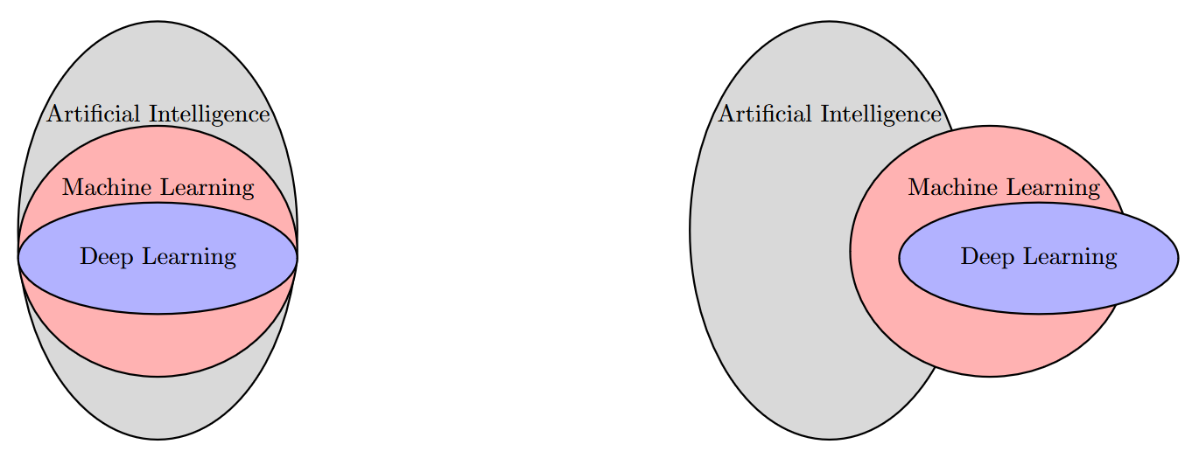
What is Artificial Intelligence?
Artificial Intelligence: A Modern Approach, Norvig et al. 2020
Artificial Intelligence
“Intelligence exhibited by machines/computers“
(Total) Turing test requires: natural language processing, knowledge representation, automated reasoning, machine learning, (computer vision, robotics)
Intelligence
Human or rational?
Intelligent thoughts or intelligent behavior?
Machine Learning
“Learn from data & generalize to unseen data (without explicit instructions)”
Deep Learning
“Training (deep) neural networks”
Or?
Inspired by Rebekka Woldseth, author of ”On the use of artificial neural networks in topology optimisation”

Slide 4
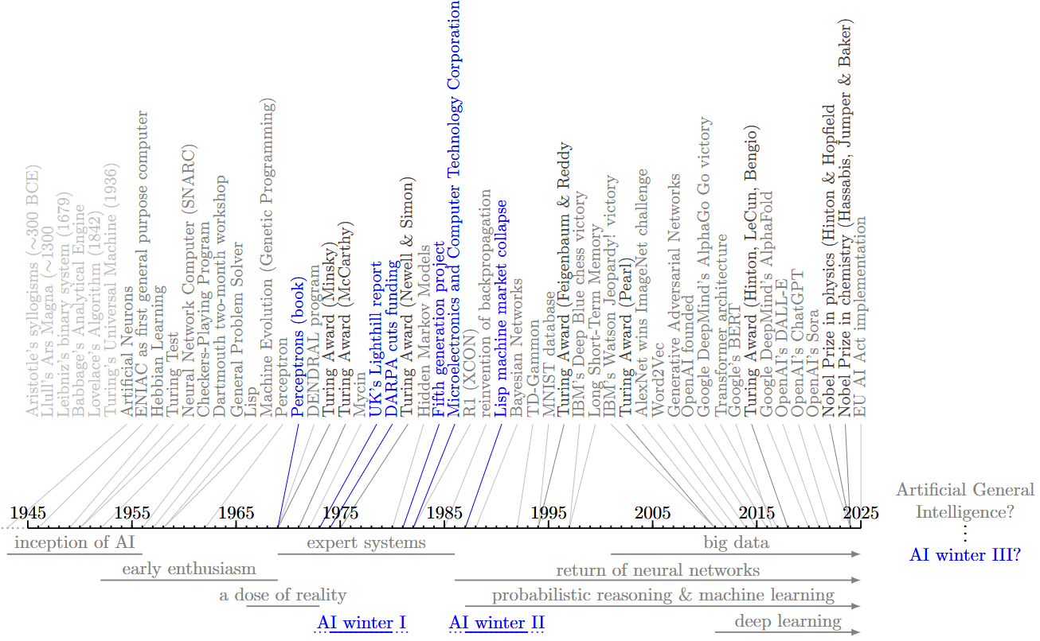
History of Artificial Intelligence
Artificial Intelligence: A Modern Approach, Norvig et al. 2020
Superintelligence: Paths, Dangers, Strategies, Bostrom 2014

Slide 5
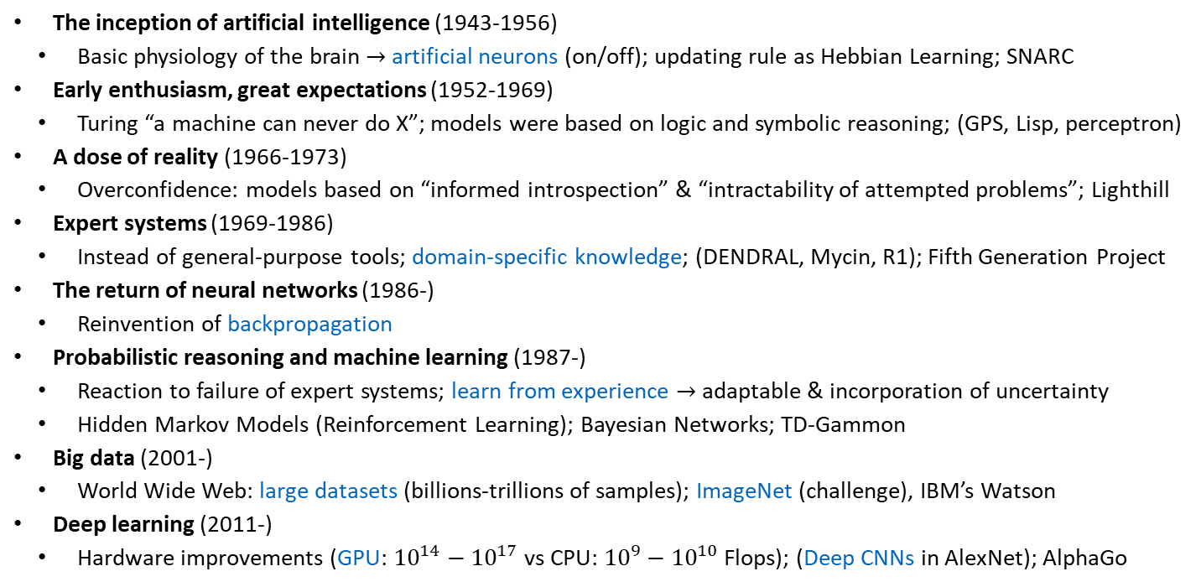
History of Artificial Intelligence
Artificial Intelligence: A Modern Approach, Norvig et al. 2020
The inception of artificial intelligence (1943-1956)
Basic physiology of the brain $→$ artificial neurons (on/off); updating rule as Hebbian Learning; SNARC
Early enthusiasm, great expectations (1952-1969)
Turing “a machine can never do X”; models were based on logic and symbolic reasoning; (GPS, Lisp, perceptron)
A dose of reality (1966-1973)
Overconfidence: models based on “informed introspection” & “intractability of attempted problems”; Lighthill
Expert systems (1969-1986)
Instead of general-purpose tools; domain-specific knowledge; (DENDRAL, Mycin, R1); Fifth Generation Project
The return of neural networks (1986-)
Reinvention of backpropagation
Probabilistic reasoning and machine learning (1987-)
Reaction to failure of expert systems; learn from experience $→$ adaptable & incorporation of uncertainty
Hidden Markov Models (Reinforcement Learning); Bayesian Networks; TD-Gammon
Big data (2001-)
World Wide Web: large datasets (billions-trillions of samples); ImageNet (challenge), IBM’s Watson
Deep learning (2011-)
Hardware improvements (GPU: ${10}^{14}−{10}^{17}$vs CPU: ${10}^{9}−{10}^{10}$ Flops); (Deep CNNs in AlexNet); AlphaGo
Notes:
- Hebbian learning: neurons that are active simultangously, i.e., x_i and x_j: wiring is increased for the future by increasing weight connection w_ij (pre-synaptic and post-synaptic): “plausible explanation of biological system learning”, “foundations”, “memory, pattern recognition, neural adaption” (still relevant in neuroscience and cognitive science)
- SNARC: (Stochastic Neural Analog Reinforcement Calculator): 3000 vacuum tubes & automatic pilot mechanism (from B-24 bomber) to simulate 40 neurons
- A machine can never do X: be kind, resourceful, beautiful, friendly, have initative, have a sense of humor, tell right from wrong, make mistakes, fall in love, enjoy strawberries and cream, make someone fall in love with it, learn from experience, use words properly, be the subject of its own thought, have as much diversity of behavior as man, do something really new
GPS: general problem solver
Lisp: (list processing)
Perceptron: via perceptron learning rule (errors are subtracted from weights), possible as it is only one layer
Overconfidence: e.g., beating the world chess champion within 10 years (achieved 40 years later)
Informed introspection: problems were usually already solved
Computational complexity was not considered (theoretical considerations)
Lighthill report: “utter failure to achieve grandiose objectives” (only toy problems): followed by DARPA cut (unforeseeable benefits)
Perceptrons book: pinpoints limitations of perceptrons at the time “could be shown to learn anything they were capable of representing, they could represent very little” (in principle backpropagation already existed)
DENDRAL: organic chemistry: analyzed molecular structure via chemistry rules & heuristic search
Mycin: diagnosis of bacterial infections/recommendation of antibiotic treatments (if-then rules)
R1: configuring computer systems (compatibility, configuration process, etc.)
Fifth generation project (Japan 10 year plan, 1.3 billion dollars in today money), MCC as response from the US 1 year later, Alvey report in UK
Problem: hardcoded (not adaptable, could not learn from experience) + could not handle uncertainty
Lisp machine market collapse (specialized hardware running only on language Lisp) -> desktop computers made these obsolete
Backpropagation: independent reinvention of four groups

Slide 6
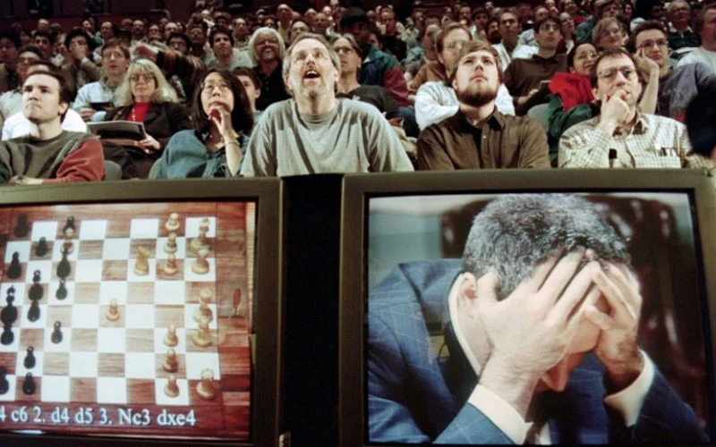

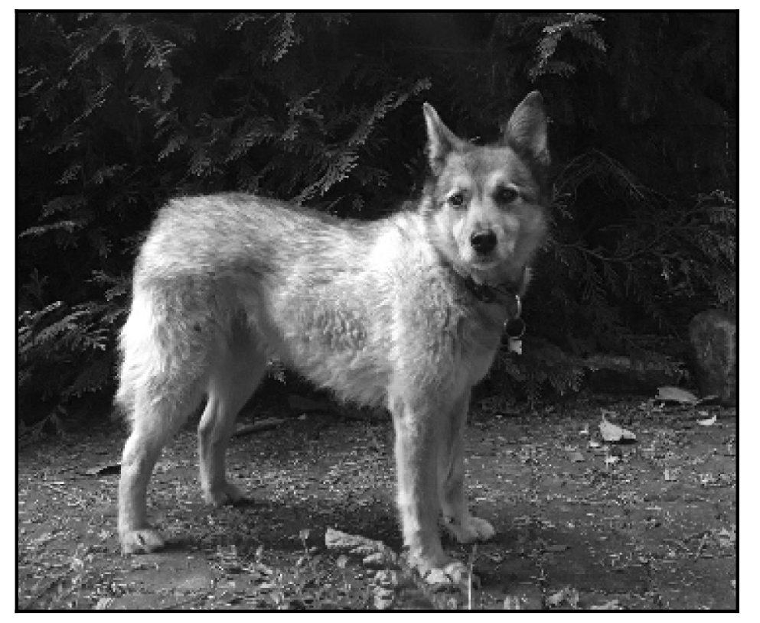
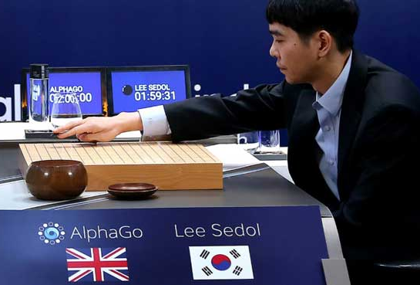
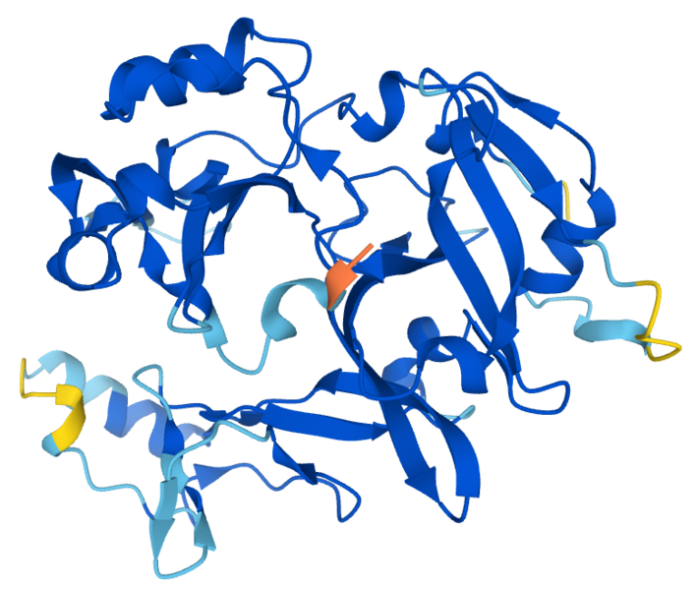
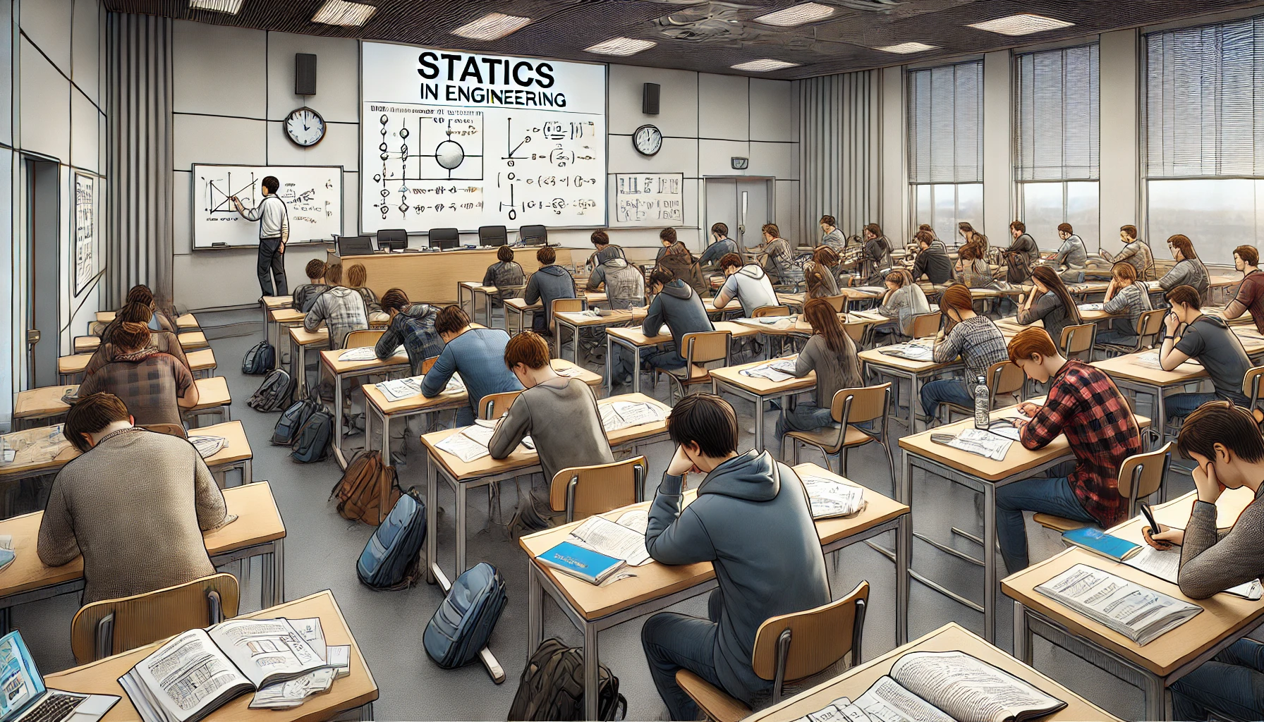

Recent Achievements in Artificial Intelligence
https://media.freemalaysiatoday.com/wp-content/uploads/ 2022/05/lifestyle-garry-emel-pic-110522.jpg
Cats versus dogs
https://media.freemalaysiatoday.com/wp-content/uploads/2016/03/AlphaGo.jpg
https://commons.wikimedia.org/wiki/File:C12orf29_AlphaFold.png
Notes:
DeepBlue: (hardcoded/no ML, but more advanced than expert systems?)

Slide 7
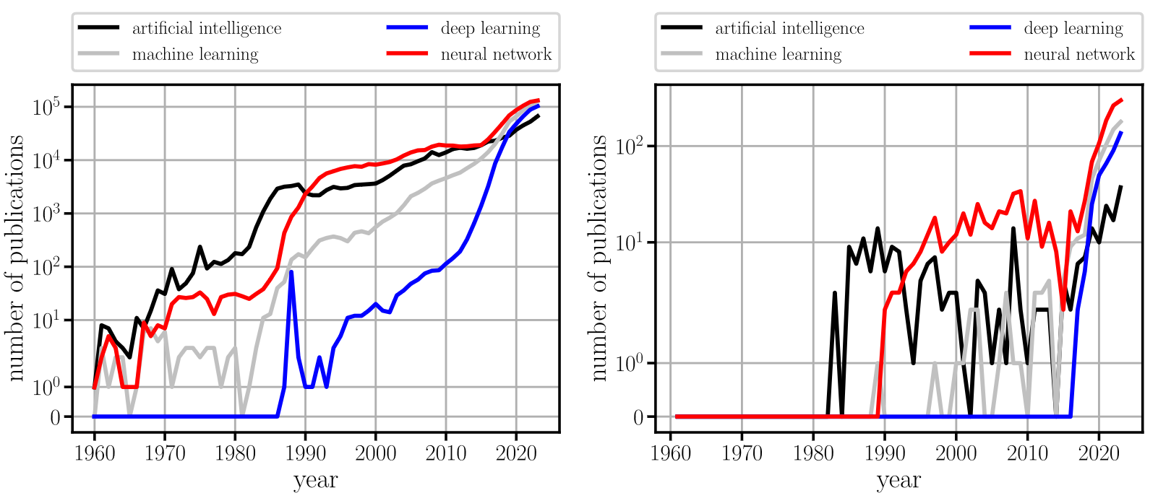
Artificial Intelligence in Science
Check www.aitracker.org for other trends
Publications in all fields
Publications in computational mechanics

Slide 8
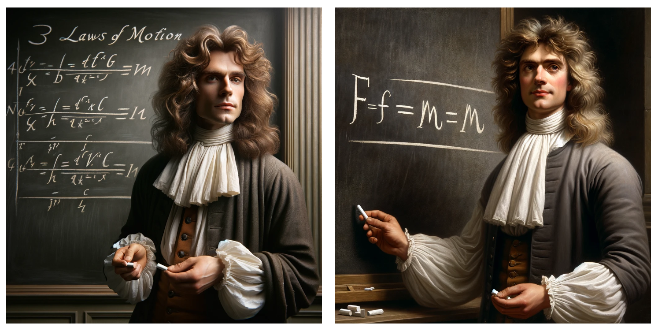
Challenges
“Generate an image of Isaac Newton in front of a blackboard on which his three laws are written in mathematical notation and chalk.“
Follow-up: “The laws on the blackboard are incorrect. Please add the correct formulations. If you are unable to do so, simply focus on the second law, which is F=m*a.”
Generated with DALL-E-3

Slide 9
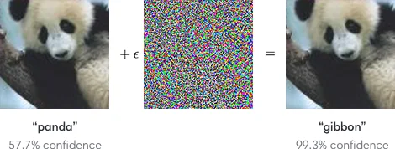

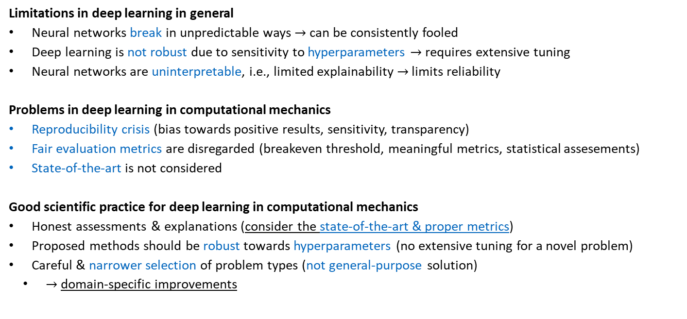
Challenges
https://openai.com/index/attacking-machine-learning-with-adversarial-examples/
Limitations in deep learning in general
Neural networks break in unpredictable ways $→$ can be consistently fooled
Deep learning is not robust due to sensitivity to hyperparameters $→$ requires extensive tuning
Neural networks are uninterpretable, i.e., limited explainability $→$ limits reliability
Problems in deep learning in computational mechanics
Reproducibility crisis (bias towards positive results, sensitivity, transparency)
Fair evaluation metrics are disregarded (breakeven threshold, meaningful metrics, statistical assesements)
State-of-the-art is not considered
Good scientific practice for deep learning in computational mechanics
Honest assessments & explanations (consider the state-of-the-art & proper metrics)
Proposed methods should be robust towards hyperparameters (no extensive tuning for a novel problem)
Careful & narrower selection of problem types (not general-purpose solution)
$→$ domain-specific improvements
See chapter 11 for details
$$τ=\frac{T_{data}+T_{train}}{T_{simulation}−T_{surrogate}}$$
Towards a meaningful integration of neural networks in computational solid mechanics, Herrmann 2025

Slide 10
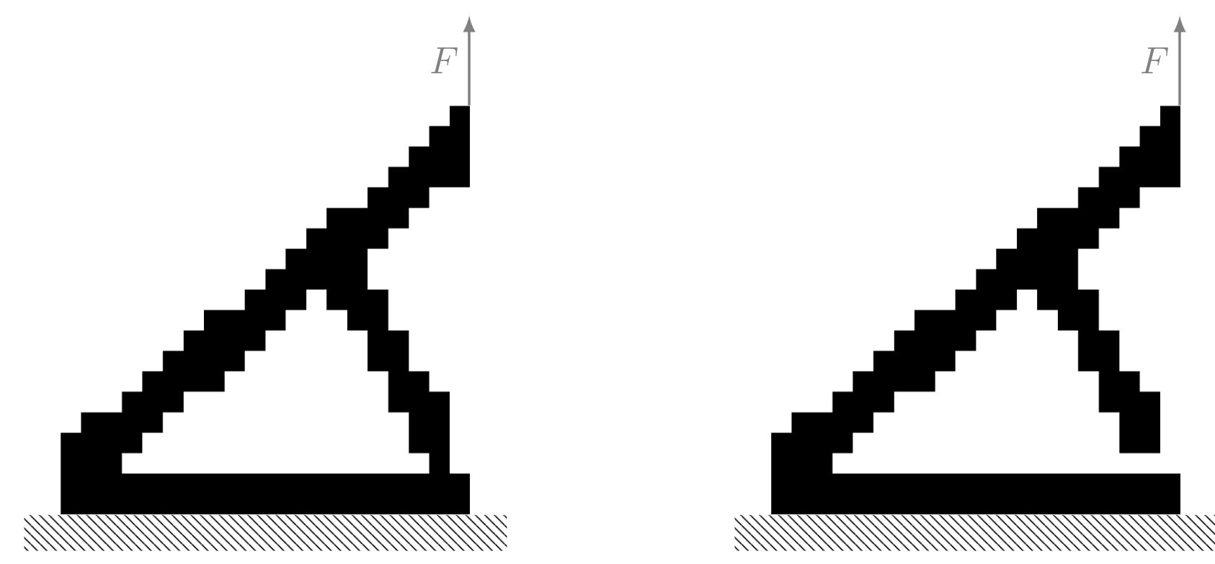



Example from topology optimization
The mean squared error
$$MSE=\frac{1}{m}\sum_{i=1}^{m}{{\left(x_{{left}_{i}}−x_{{right}_{i}}\right)}^{2}}$$
between the two structures is very small ($2.5⋅{10}^{−3})$, due to one pixel difference.
Structural compliance (inverse of stiffness)
$$c=F^{T}u$$
Is different by one order of magnitude
For more details, see Chapter 9
compliance$=351$
compliance$=4729$

Slide 11
Computational Mechanics Meets Artificial Intelligence
Computational Mechanics
Exemplary tasks
Efficient solutions techniques for forward problems, e.g., finite element, difference, and volume
Identification tasks (inverse problems), e.g., inferring material distribution/properties from measurements
Optimization, e.g., finding the optimal material distribution that maximizes stiffness
Machine Learning
Where can machine learning be applied in computational mechanics?
Identification of mathematical models from data (instead of relying on hand-crafted models)
Acceleration of forward solvers and optimizers
Streamlining of pipelines to avoid human experts within the processes
Abstraction of physical systems (reality) through simplified mathematical models (often differential equations), which are discretized and solved numerically for insight into real-world behavior
Machine Learning, Mitchell 1997
”a computer program is said to learn from experience E with respect to some class of tasks T and performance measure P, if its performance at tasks T, as measured by P, improves with experience E”

Slide 12
Computational Mechanics Meets Artificial Intelligence
Deep learning in computational mechanics: a review, Herrmann et al. 2024
Simulation substitution
Data-driven modelling
Physics-informed learning
Simulation enhancement
Discretizations as neural networks
Generative approaches
Deep reinforcement learning
Simulation with graph neural networks; DMD; Transfer learning
Hamiltonian/Lagrangian neural networks; SINDy; (PINNs)
Input-convex neural networks for material modeling; EUCLID; Neural networks as ansatz function of inverse quantities; Superresolution; Differentiable physics
Hardware acceleration with GPUs; (HiDeNN)
Generative design; Realistic data generation; Anomaly detection; Transformers for natural language processing
Control engineering tasks: autonomous flight; robots;
Alternative gradient-free optimizer

Slide 13
Contents
1 Computational Mechanics Meets Artificial Intelligence (& Introduction to PyTorch):
What is Artificial Intelligence?
History of Artificial Intelligence
Recent Achievements of Artificial Intelligence
Artificial Intelligence in Science
Challenges
Computational Mechanics Meets Artificial Intelligence
2 Fundamental Concepts of Machine Learning
3 Neural Networks
4 Introduction to Physics-Informed Neural Networks
5 Advanced Physics-Informed Neural Networks
6 Machine Learning in Computational Mechanics
7 Material Modeling with Neural Networks
8 Generative Artificial Intelligence
9 Inverse Problems & Deep Learning
10 Methodological Overview of Deep Learning in Computational Mechanics
11 The Future of Deep Learning in Computational Mechanics

Slide 14
1 Computational Mechanics Meets Artificial Intelligence
Leon Herrmann
Stefan Kollmannsberger
Chair of Data Engineering in Construction
Bauhaus-Universität Weimar
Deep Learning in Computational Mechanics – an introductory course, Herrmann et al. 2025
website
book
Notes:
generated with https://www.the-qrcode-generator.com/

