Slide 1


1 Computational Mechanics Meets Artificial Intelligence: PyTorch
Leon Herrmann
Stefan Kollmannsberger
Chair of Data Engineering in Construction
Bauhaus-Universität Weimar
Deep Learning in Computational Mechanics – an introductory course, Herrmann et al. 2025
website
book
Notes:
generated with https://www.the-qrcode-generator.com/

Slide 2
Contents
1 Computational Mechanics Meets Artificial Intelligence (& Introduction to PyTorch):
Installation
Python Basics (NumPy, SciPy & Matplotlib)
Introduction to PyTorch (Tensor Manipulation & Gradient Computation)
2 Fundamental Concepts of Machine Learning
3 Neural Networks
4 Introduction to Physics-Informed Neural Networks
5 Advanced Physics-Informed Neural Networks
6 Machine Learning in Computational Mechanics
7 Material Modeling with Neural Networks
8 Generative Artificial Intelligence
9 Inverse Problems & Deep Learning
10 Methodological Overview of Deep Learning in Computational Mechanics
11 The Future of Deep Learning in Computational Mechanics

Slide 3

Installation
Download Anaconda from https://www.anaconda.com/products/individual
Install Anaconda
Open the Anaconda Navigator
In the ”Home” tab
Install Spyder
Install JupyterLab

Slide 4
Installation of modules via command prompt
Open the Anaconda prompt
Install PyTorch (tensors and neural networks)
conda install pytorch cpuonly -c pytorch
(or conda install pytorch -c pytorch if you have a GPU)
Install SciPy (scientific computing)
conda install -c anaconda scipy
Install Matplotlib (visualization)
conda install -c conda-forge matplotlib
Modules that will be used in the course and are preinstalled with the default anaconda installation
NumPy (arrays and matrices)
Pillow (imaging)
(If not)
conda install -c anaconda numpy
conda install -c anaconda pillow

Slide 5
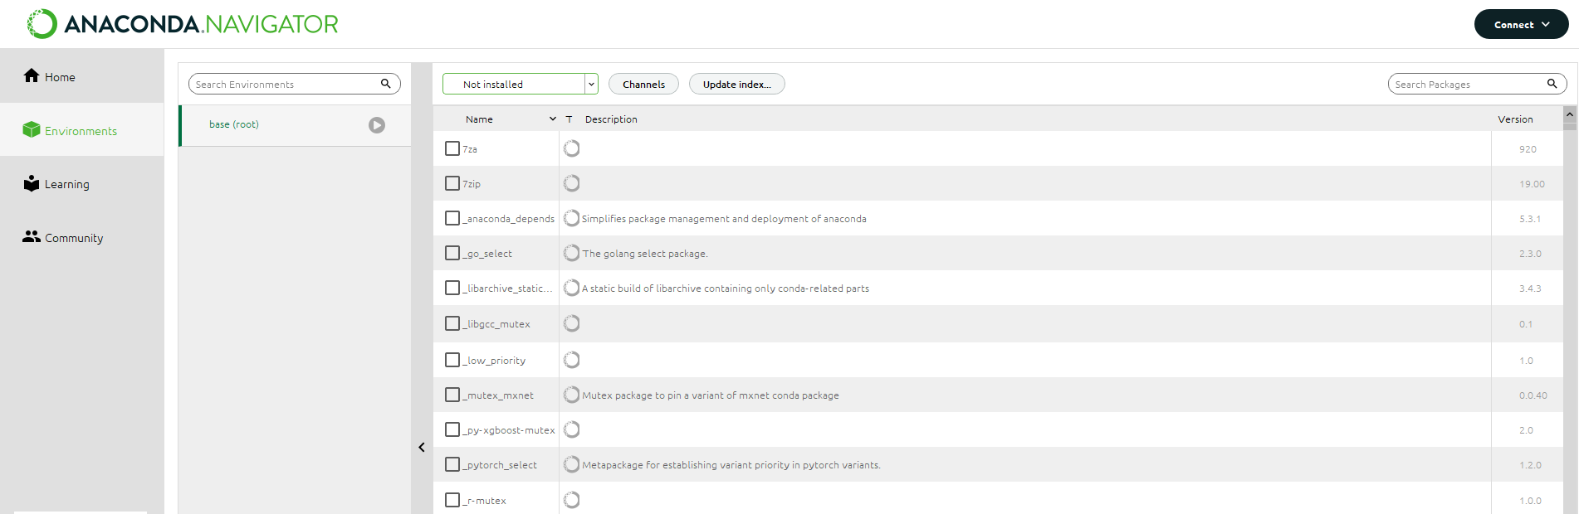
Alternatively – Installation of Modules via GUI
In the ”Environment” tab
Navigate to the base (root) and toggle to the ”Not installed” modules
Select and install the modules (with the Apply button)
PyTorch
SciPy

Slide 6

Introduction to Python
This is not a course on Python.
For an introduction to the basics of Python, see https://docs.python.org/3/tutorial/index.html

Slide 7
Arrays in Python with NumPy
NumPy is a library for multi-dimensional arrays and matrices in Python
Good introduction available at https://numpy.org/doc/stable/user/absolute_beginners.html
Import of the library
import numpy as np
Array creation
a = np.zeros((5,5)) # array filled with zeros (5, 5)
b = np.ones(5) # array filled with ones (5)
c = np.array([1,2,3,4,5]) # array created from a list (5)
d = np.linspace(0,1,10) # linearly spaced array in range [0,1] (10)
Array transformations
np.concatenate((b,c), axis=0) # concatenation of arrays b and c
np.reshape(a, 25) # reshape into an array of dimension (25)
a.flatten() # flattens an array the dimension (25)

Slide 8
Arrays in Python with NumPy
Indexing
In Python the index starts at 0 and thus ends at n-1
c = np.array([1,2,3,4,5])
c[-1] # last element
c[:2] # the first two elements (excluding i=2)
c[2:] # elements from the three onward (including i=2)
c[1:3] # second element until third element (i=1,2)
c[::2] # every second element starting from i=0
c[::-1] # flips the order of the elements
Linear Algebra
np.dot(b,c) # vector product
np.matmul(a,b) # matrix multiplication
Elementwise math operations (most math expressions from the math library are available)
np.sin(d*np.pi) # elementwise application of the sine
b*c # elementwise multiplication of vectors b and c

Slide 9
Classes in Python
A class is an extensible program-code-template for creating objects
Good introduction to classes in Python at https://docs.python.org/3/tutorial/classes.html
Basic class outline in Python
class MyClass:
def __init__(self, y): # constructor
self.a = y # member variable a
def f(self, b): # member function
return self.a + b
Instantiation of MyClass
x = MyClass(3) # construction
x.a # acess of member variable a
x.f(2) # call on member function f

Slide 10
Lambda Functions in Python
Lambda functions are a convenient way of expressing functions.
Basic lambda syntax in Python
f = lambda x : x**2 + 3
f(2) # calling the lambda function
This is equivalent to defining the function as
def f(x):
return x**2 + 3
Lambda syntax for multiple inputs
g = lambda x, y : x * y
g(2, 3) # calling the lambda function

Slide 11
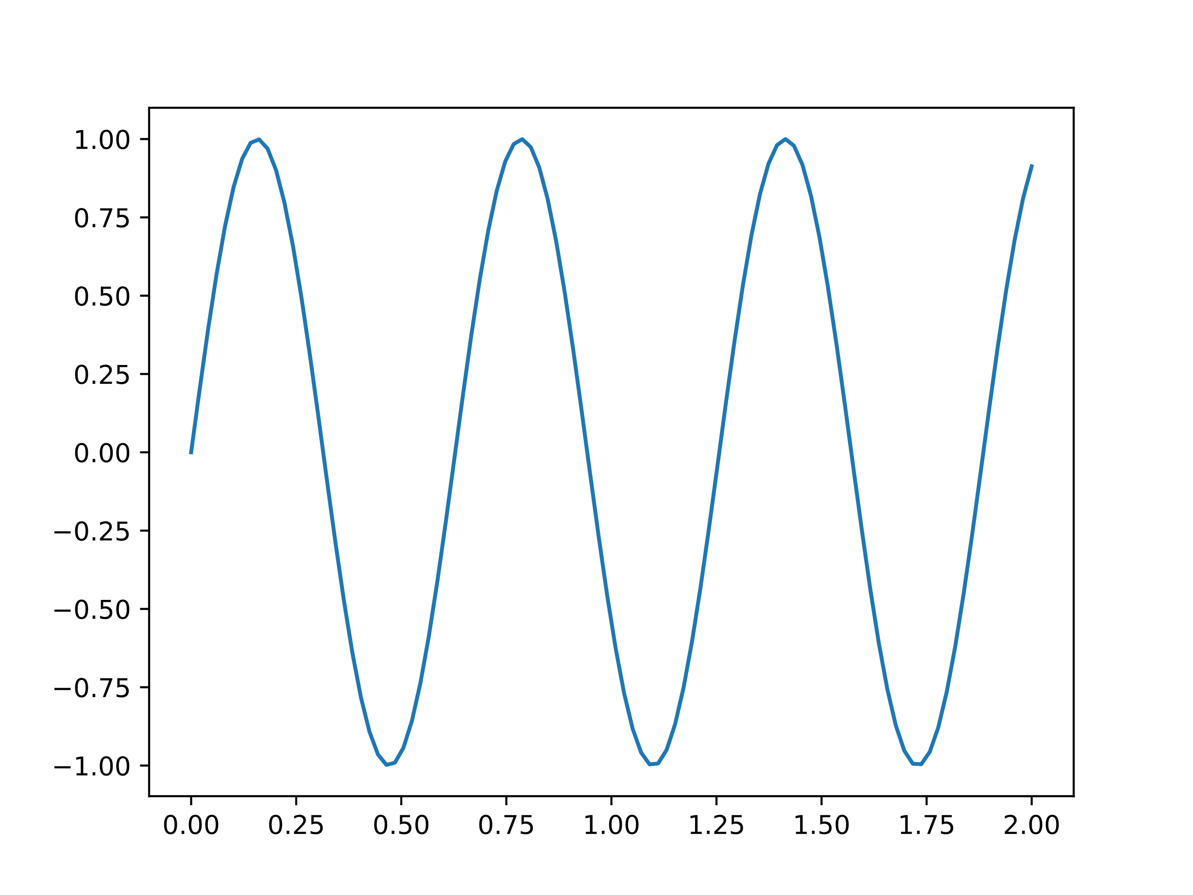
Plotting in Python with Matplotlib
Matplotlib is a plotting library for Python
Good introduction available at https://matplotlib.org/stable/tutorials/introductory/usage.html
Basic 2d plot
import matplotlib.pyplot as plt
import numpy as np
f = lambda x : np.sin(x)
x = np.linspace(0, 2, 100)
plt.plot(x, f(x))

Slide 12
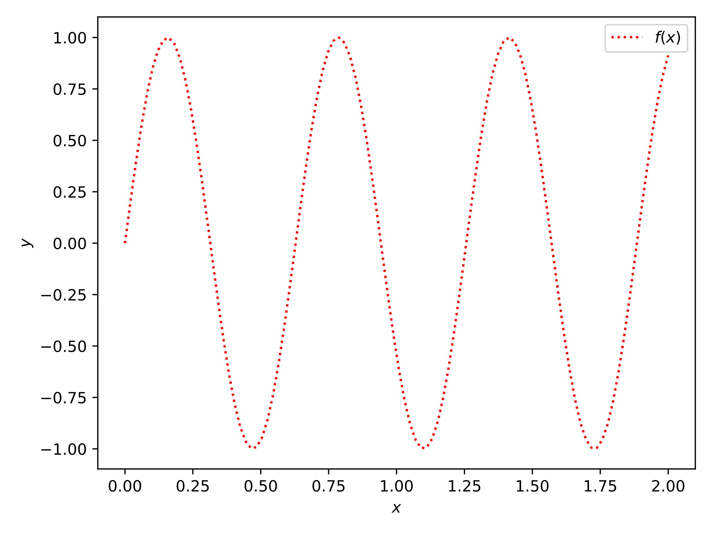
Plotting in Python with Matplotlib
For more control, an object-oriented interface is typically used
f = lambda x : np.sin(x)
x = np.linspace(0, 2, 100)
fig, ax = plt.subplots()
ax.set_xlabel("$x$")
ax.set_ylabel("$y$")
ax.plot(x, f(x), linestyle=':’,
color='r', label="$f(x)$")
ax.legend()
fig.tight_layout()
plt.show()
For more options for lineplots, see https://matplotlib.org/stable/api/_as_gen/matplotlib.pyplot.plot.html

Slide 13
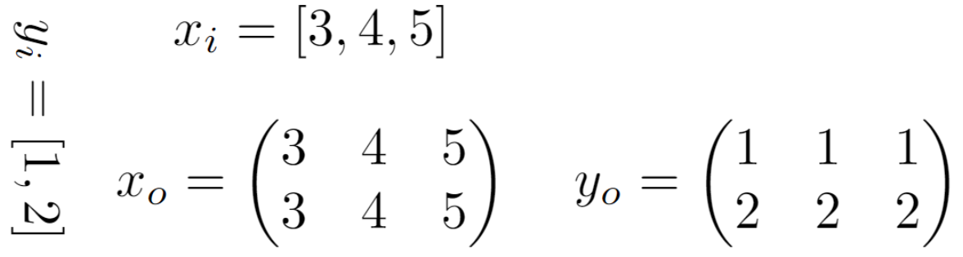
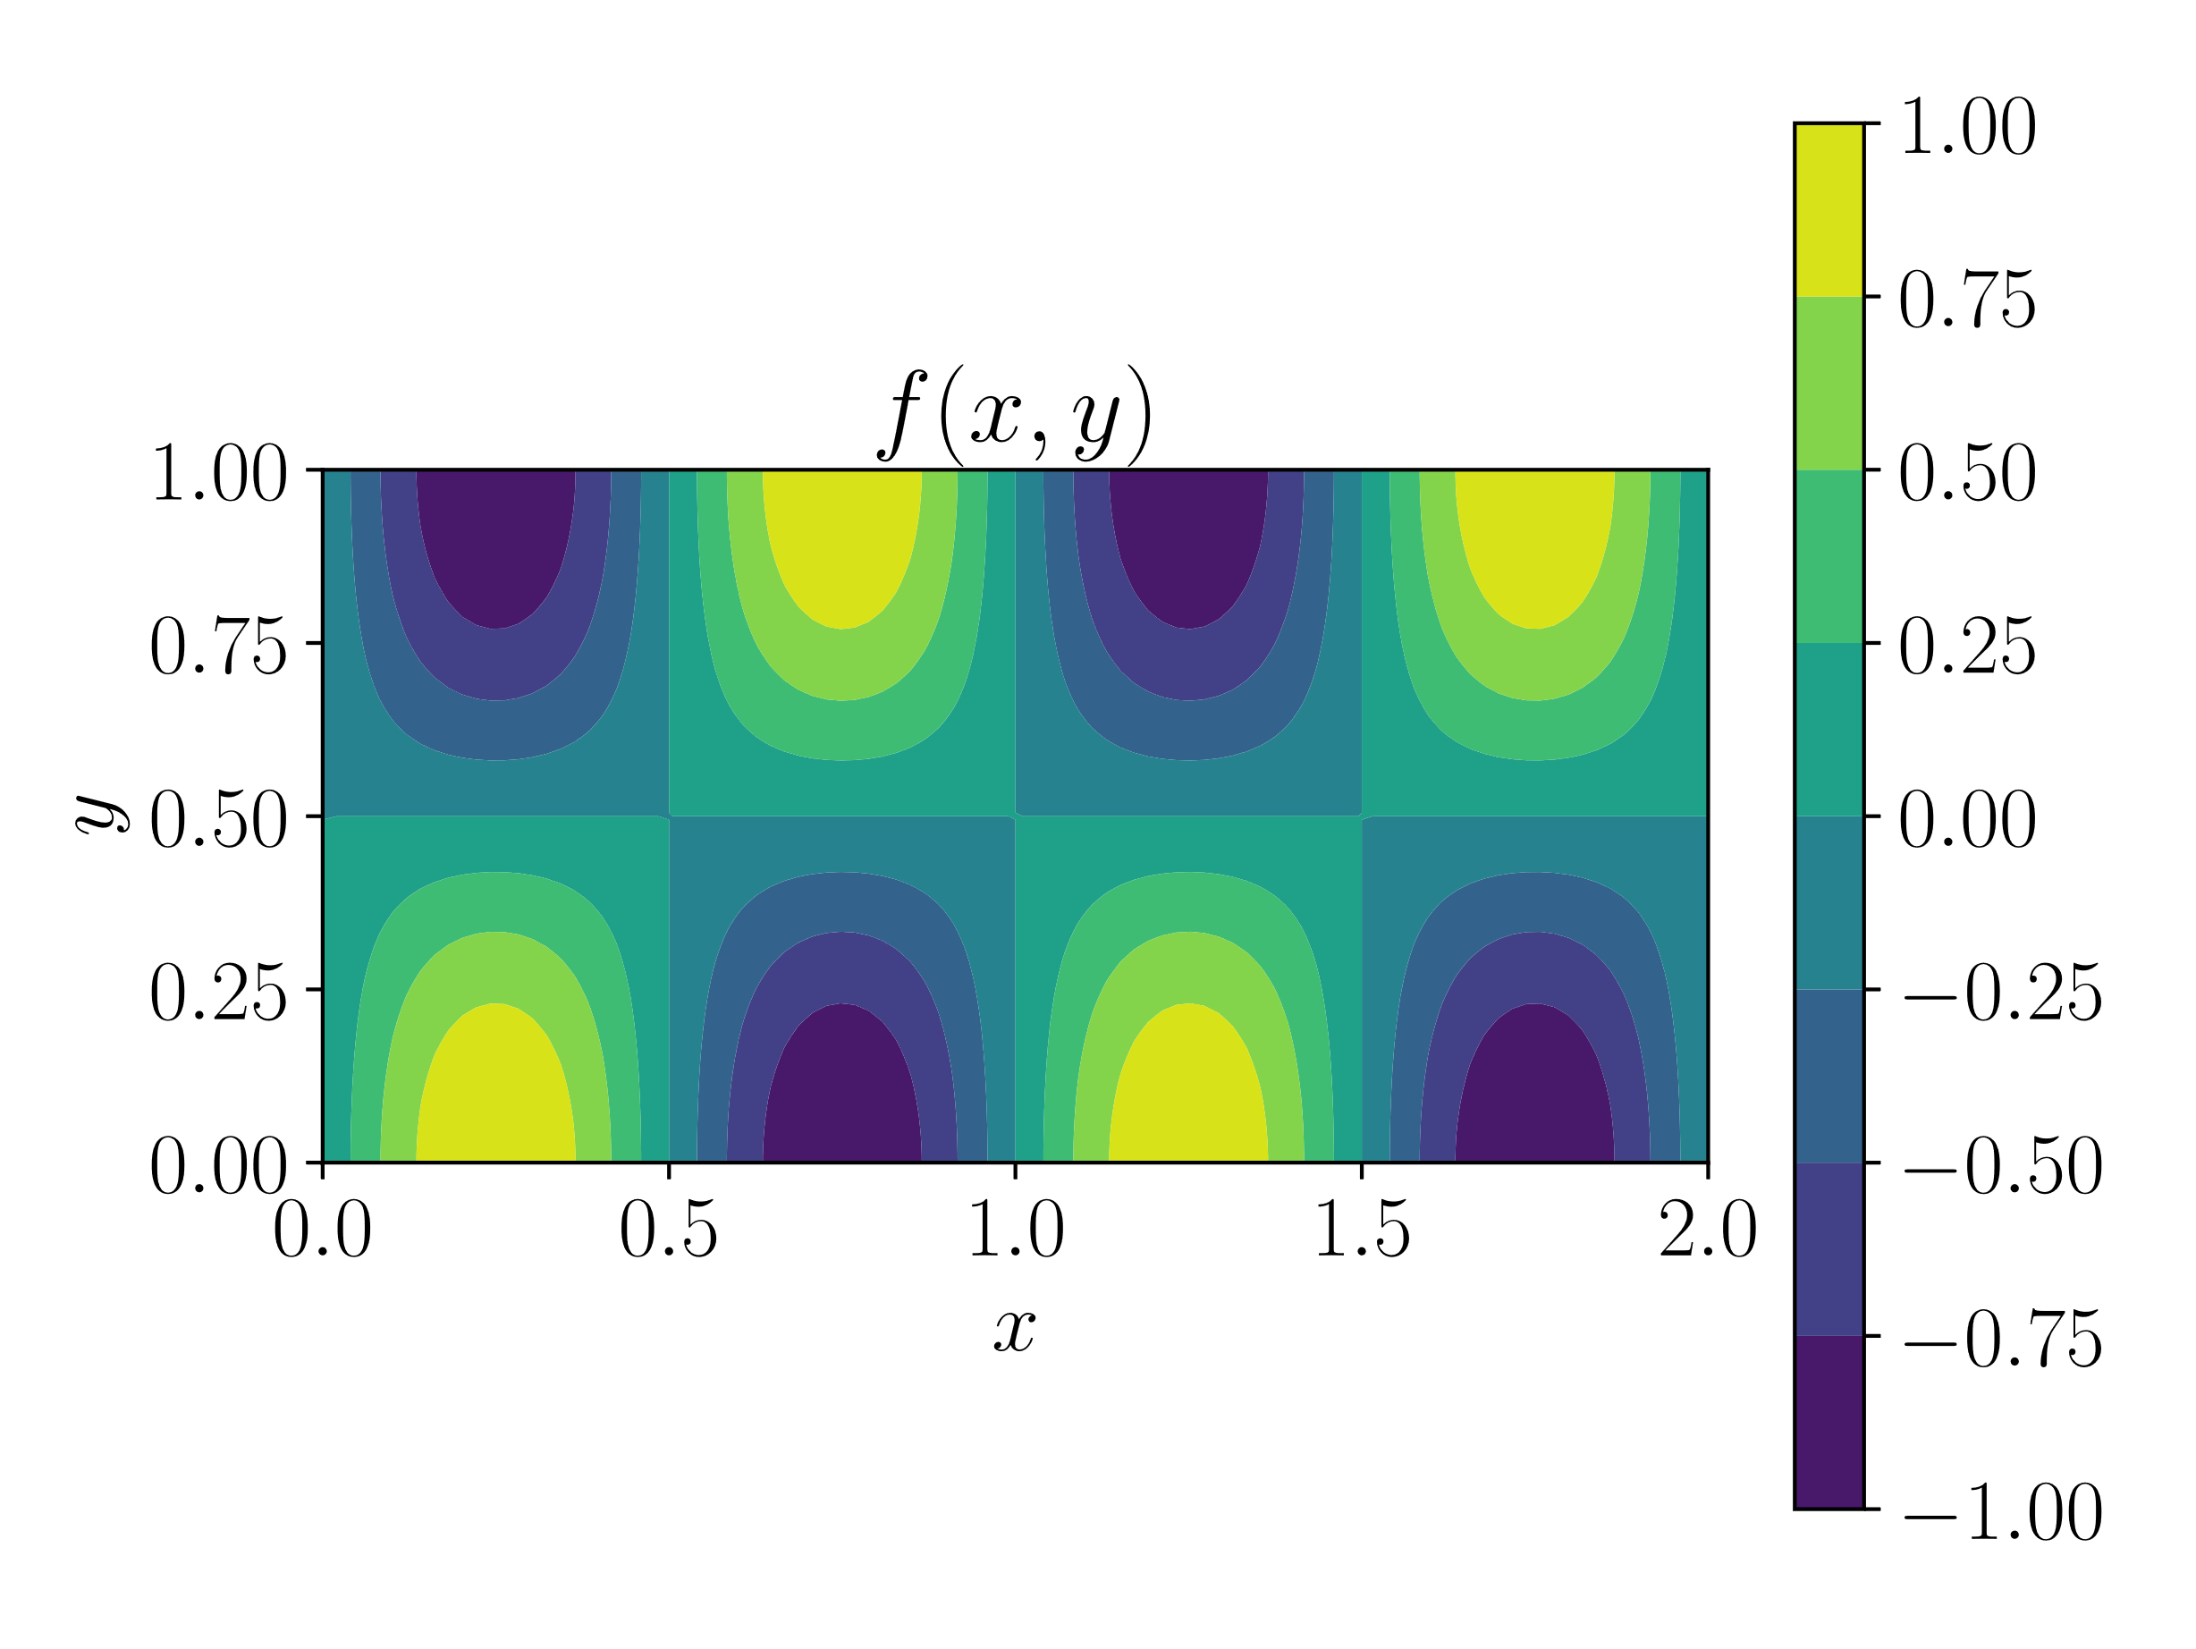
Plotting in Python with Matplotlib
meshgrid
Contourplots
x = np.linspace(0, 2, 100)
y = np.linspace(0, 1, 100)
x, y = np.meshgrid(x, y)
g = lambda x, y : np.sin(2*np.pi*x)*np.cos(np.pi*y)
fig, ax = plt.subplots()
ax.set_aspect(‘equal’)
ax.set_xlabel("$x$")
ax.set_ylabel("$y$")
ax.set_title("$f(x, y)$")
cp = ax.contourf(x, y, g(x, y))
fig.colorbar(cp)
fig.tight_layout()
plt.show()

Slide 14
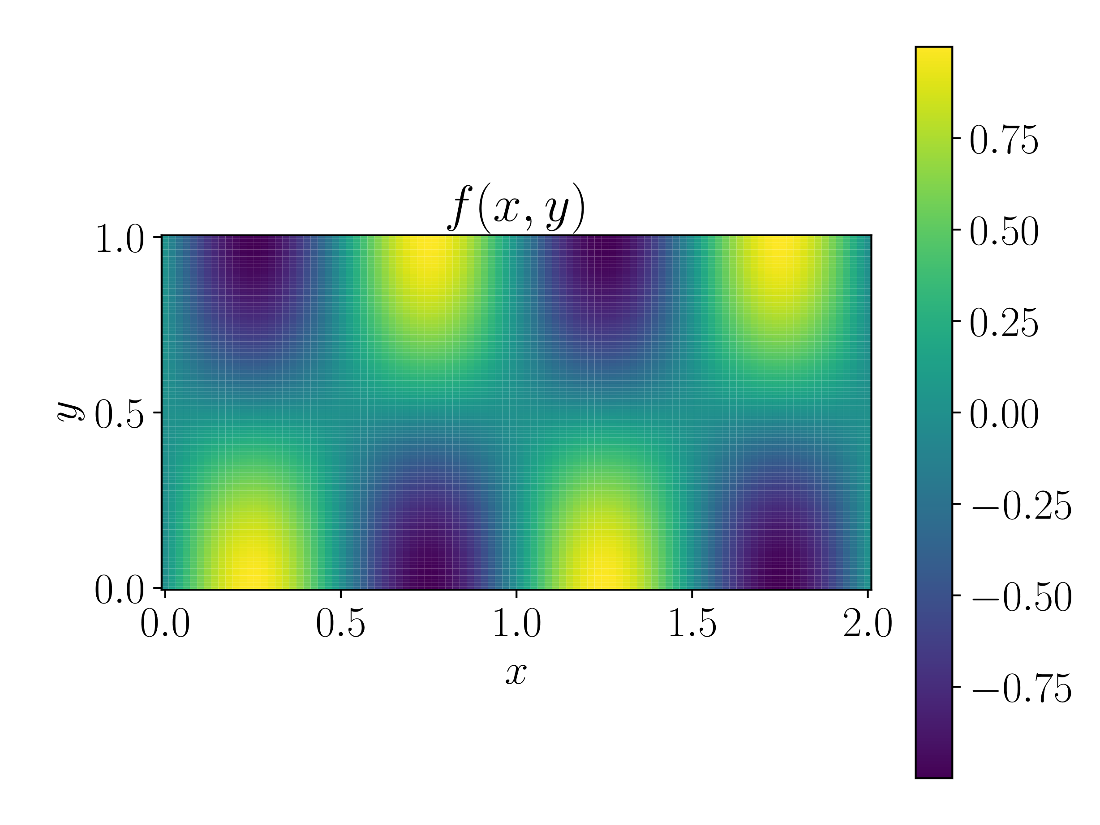
Plotting in Python with Matplotlib
meshgrid
Pseudocolorplot (no interpolation)
x = np.linspace(0, 2, 100)
y = np.linspace(0, 1, 100)
x, y = np.meshgrid(x, y)
g = lambda x, y : np.sin(2*np.pi*x)*np.cos(np.pi*y)
fig, ax = plt.subplots()
ax.set_aspect(‘equal’)
ax.set_xlabel("$x$")
ax.set_ylabel("$y$")
ax.set_title("$f(x, y)$")
cp = ax.pcolormesh(x, y, g(x, y))
fig.colorbar(cp)
fig.tight_layout()
plt.show()

Slide 15
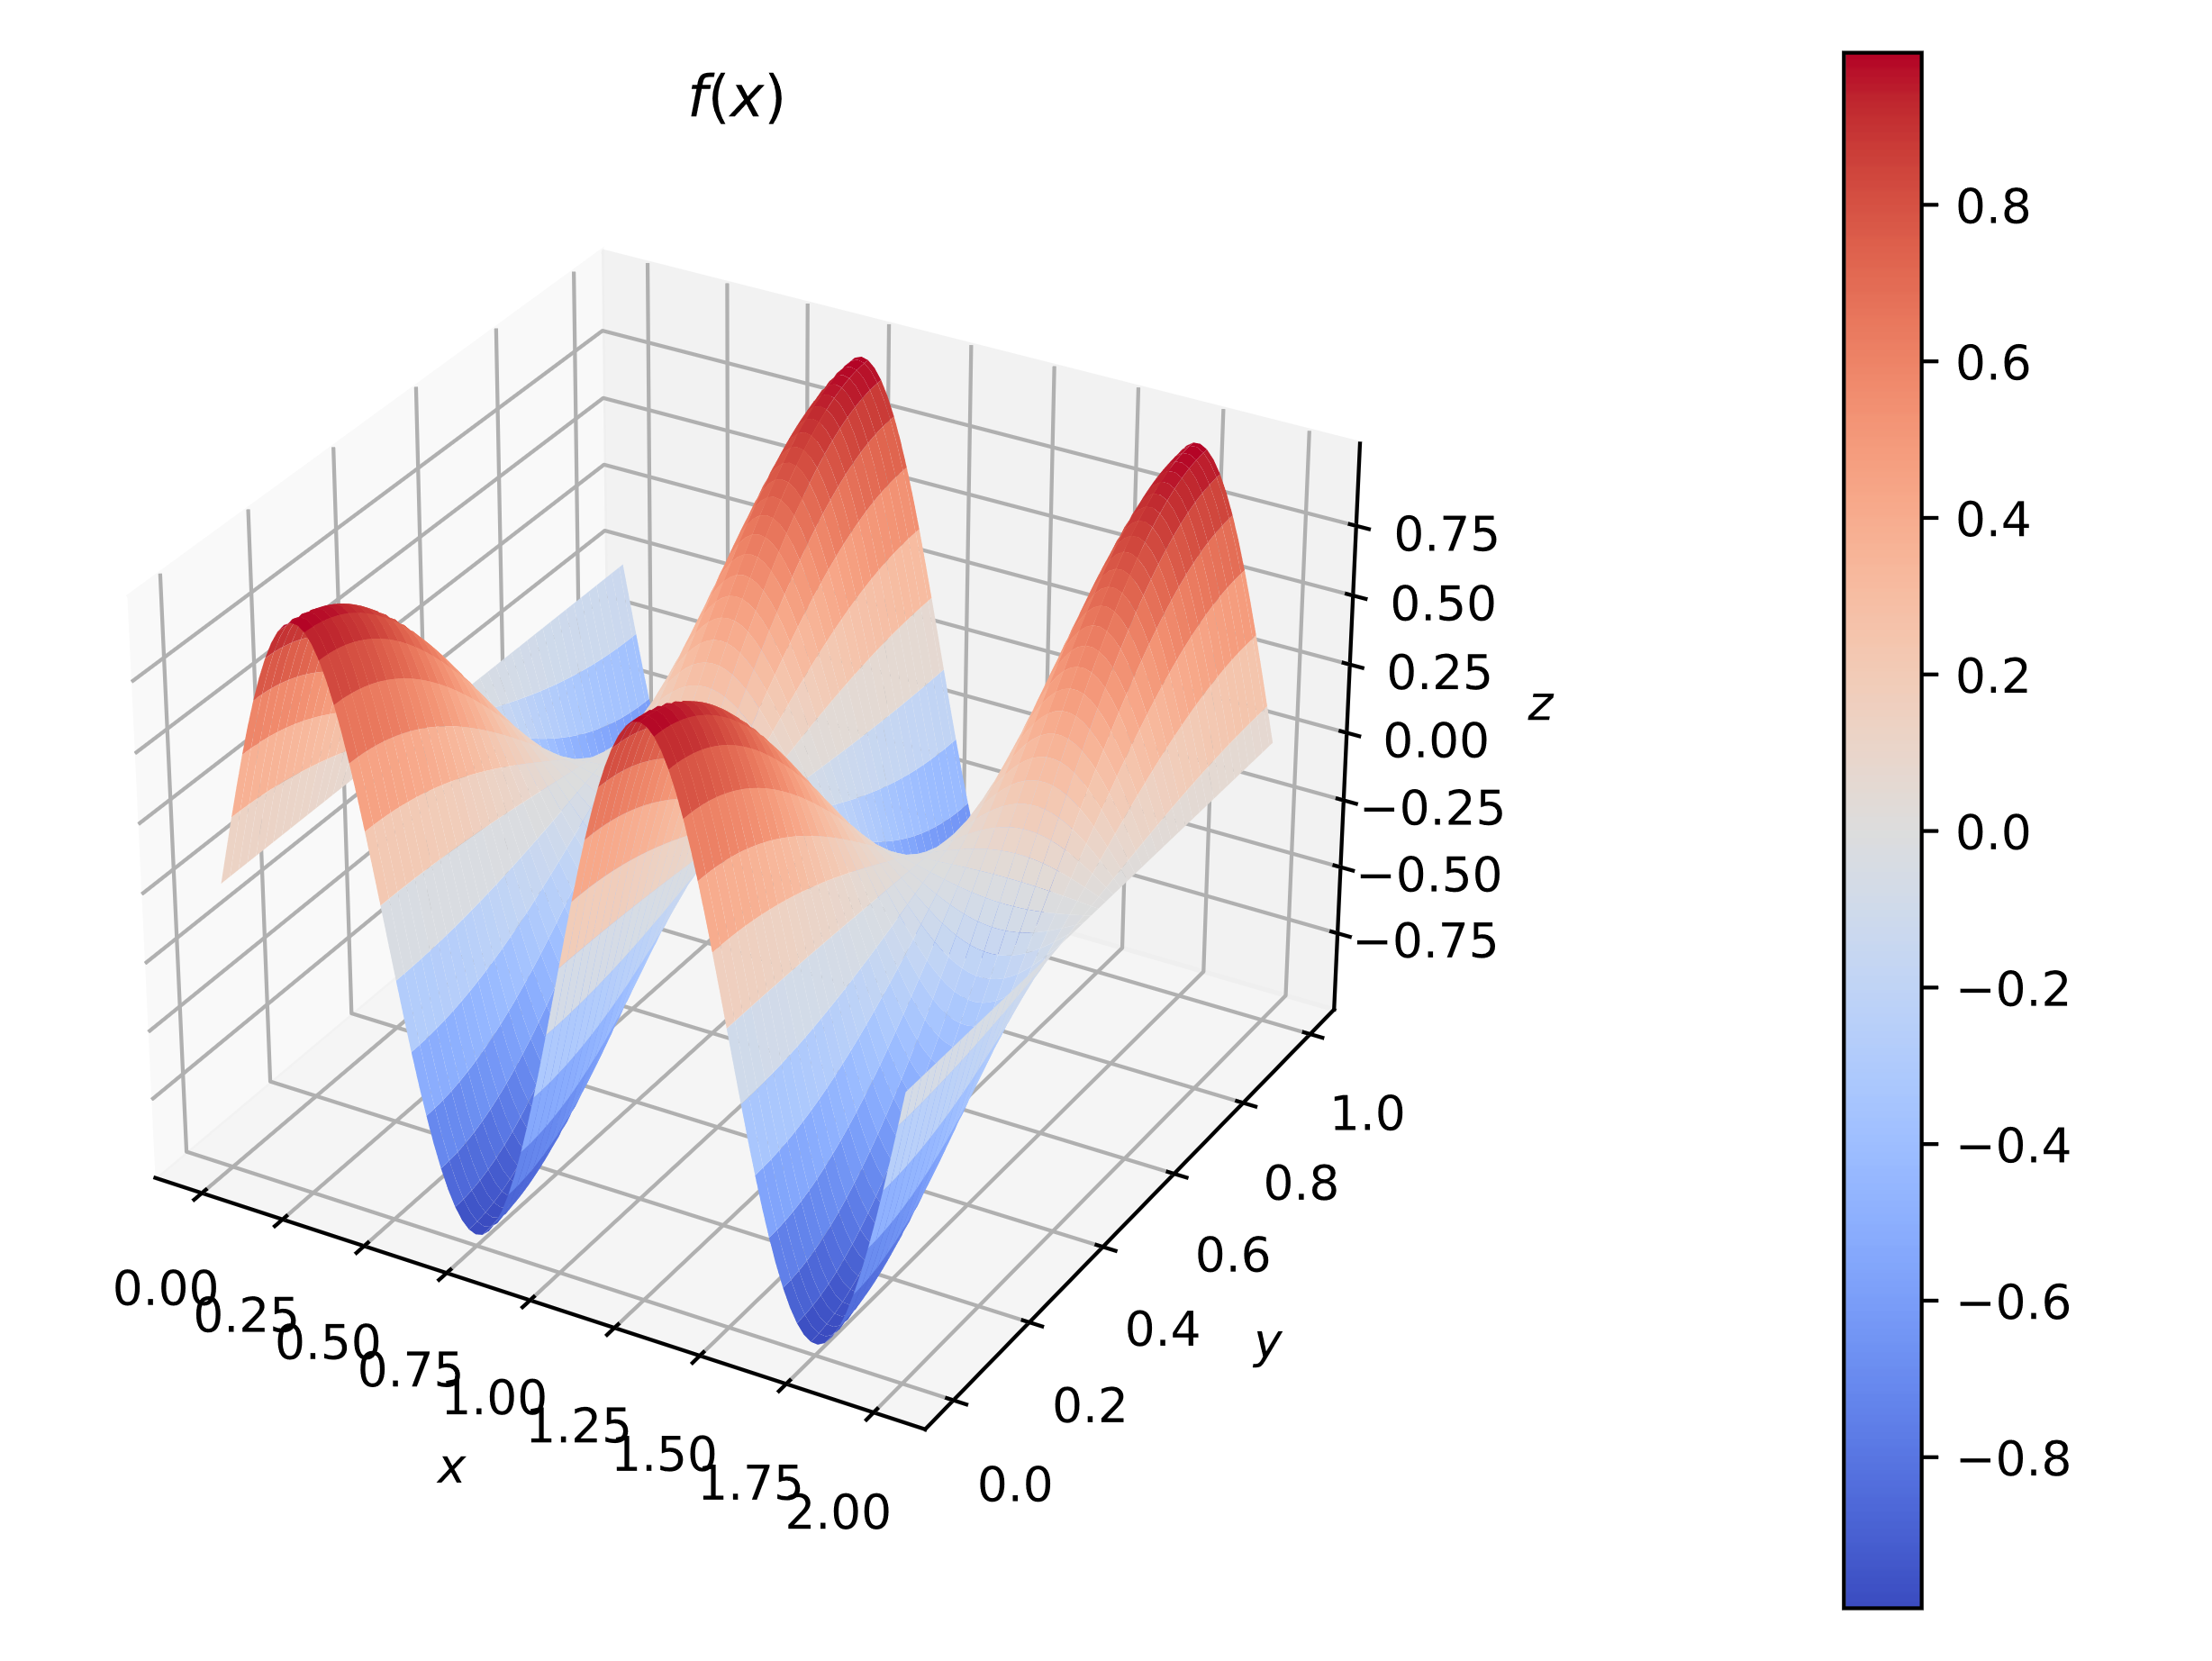
Plotting in Python with Matplotlib
Surfaceplots
fig = plt.figure()
ax = fig.add_subplot(projection=‘3d’)
ax.set_xlabel("$x$")
ax.set_ylabel("$y$")
ax.set_zlabel("$z$")
ax.set_title("$f(x)$")
cp = ax.plot_surface(x, y, g(x, y), cmap=plt.cm.coolwarm,
antialiased=False)
fig.colorbar(cp, pad=0.2, ticks=np.linspace(-0.8, 0.8, 9)
fig.tight_layout()
plt.show()

Slide 16
Scientific Computing in Python with SciPy
SciPy is a Python library for scientific computing
It contains modules for
Optimization
Linear algebra
Integration
Interpolation
FFT
ODE solvers
Image processing
And many more
It will be used in the last part of the course, when talking about data-driven approaches
For an introduction to the library, check out https://scipy.github.io/devdocs/tutorial/index.html

Slide 17

What is PyTorch
Open source machine learning library
Primarily developed by Facebooks’s AI Research lab
Used in softwares, such as Tesla’s autopilot, Disney’s face recognition, OpenAI’s projects
Two high-level features
Tensor computing with acceleration via GPU’s (similar to numpy)
Neural networks with automatic differentiation
Introductory tutorial: https://pytorch.org/tutorials/beginner/nlp/pytorch_tutorial.html
Find help here: https://pytorch.org/docs/
Alternative libraries: Tensorflow, Keras
In Python:
import torch

Slide 18
Computing with Tensors – Creation
Creation of arbitrary tensors
a = torch.tensor([[0., 2., 4.], [3., 4., 2.]]) # shape (2, 3)
b = torch.zeros(3, 3, 3) # shape (3, 3, 3)
c = torch.linspace(0, 1, 10) # shape (10)
Indexing
print(a[0, 0]) # to access first element
a[:, 0] # to access first order tensor in the second dimension
b[0, :, :] # to access first second order tensor
b[-1, -1, -1] # to access last element
a[1:3, 0] # to access last two elements of the first first order tensor
Functions operating on tensors take one or multiple tensors as input and return the modified tensor
Useful operations
print(a) #print the tensor to console
a.shape or a.size()
torch.cat((a, b[0, :, :]),0) # concatenation in dimension 0

Slide 19
Computing with Tensors – Manipulation
a = torch.tensor([[0., 2., 4.], [3., 4., 2.]]) # (2, 3)
b = torch.zeros(3, 3) # (3, 3) c = torch.tensor([[[0., 1.], [4., 2.]], [[2., 3.], [3., 2.]]]) #(2,2,2)
d = torch.ones(1,4) # (1, 4)
Useful operations in general
torch.cat((a, b),0) # concatenation in dimension 0
torch.transpose(a, 0, 1) # dimensions 0 and 1 are transposed
torch.permute(c, (2, 1, 0)) # dimensions 0 and 2 are permuted
torch.reshape(c, (1, 8)) # or c.view(1, 8) reshape to shape (1, 8)
torch.unsqueeze(a, 0) # creates an additional empty dimension (1, 2, 3)
torch.squeeze(d, 0) # removes first empty dimension (4)
torch.flatten(c) # flattens c (8)
torch.ones_like(c) # creates a tensor of ones with the shape of c
torch.cos(a) # cosine, mathematical operations as in numpy: apply cos()
to each entry

Slide 20
Computing with Tensors – Manipulation
Often the same Pytorch functions can be called in two ways
torch.flatten(c) or c.flatten()
Creating a grid
x = torch.linspace(0, 1, 10) # (10)
y = torch.linspace(0, 2, 5) # (5)
x, y = torch.meshgrid(x, y) # creates a grid (10,5)
Conversion to and from numpy
import numpy as np
a = np.array([2., 3.])
b = torch.from_numpy(a) # convert numpy array to tensor
b.numpy() # convert tensor to numpy array

Slide 21
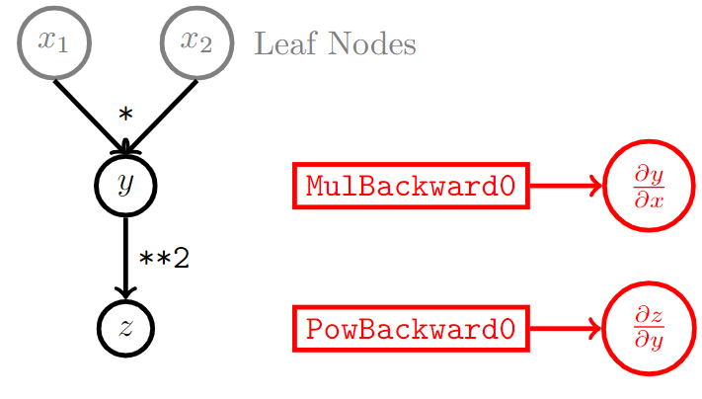
Computing with Tensors – Gradient
The computation of gradients occurs via automatic differentiation by constructing a computational graph
The construction of the computational graph is enabled with requires_grad = True
x.requires_grad = True
y = torch.tensor([0.], requires_grad = True)
The computational graph saves all operations as function handles, e.g. MulBackward0 for the first multiplication that occurs in the graph
Each node, i.e. tensor of the graph contains
data # tensor
requires_grad # boolean for gradient
grad # gradient
grad_fn # function handle
is_leaf # boolean for leaf nodes

Slide 22
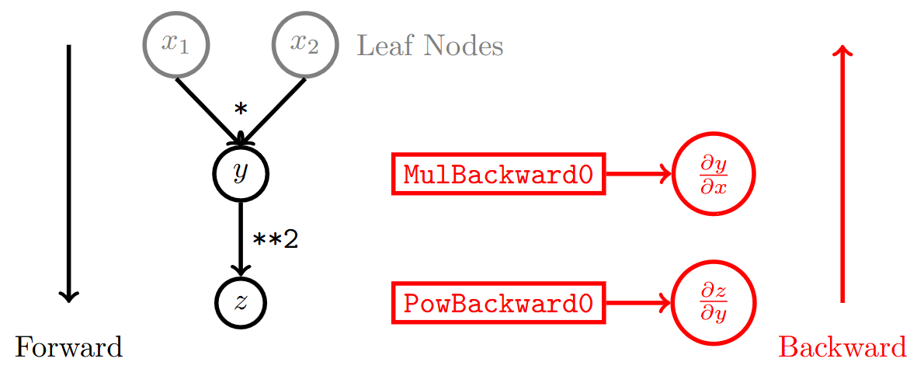
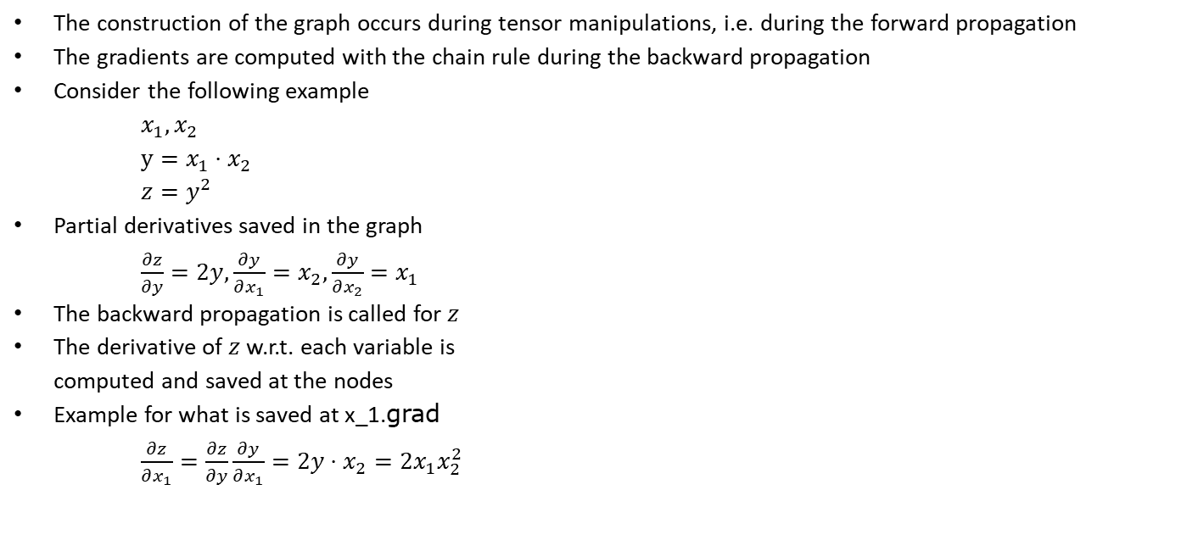
Computing with Tensors – Gradient
The construction of the graph occurs during tensor manipulations, i.e. during the forward propagation
The gradients are computed with the chain rule during the backward propagation
Consider the following example
$x_{1}, x_{2}$ $y=x_{1}⋅x_{2}$ $z=y^{2}$
Partial derivatives saved in the graph
$\frac{∂z}{∂y}=2y,\frac{∂y}{∂x_{1}}=x_{2},\frac{∂y}{∂x_{2}}=x_{1}$
The backward propagation is called for $z$
The derivative of $z$w.r.t. each variable is computed and saved at the nodes
Example for what is saved at x_1.grad
$\frac{∂z}{∂x_{1}}=\frac{∂z}{∂y}\frac{∂y}{∂x_{1}}=2y⋅x_{2}=2x_{1}x_{2}^{2}$

Slide 23
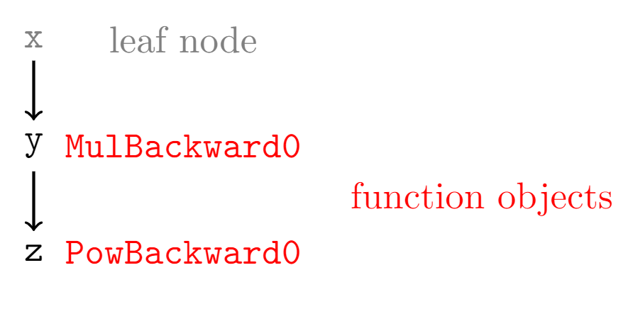
Computing with Tensors – Gradient
The gradient of each tensor can be computed with automatic differentiation
By building up a computational graph with each tensor manipulation
Using the backward propagation (an algorithm to compute the gradient, more on this in Chapter 3)
Manipulation Corresponding Graph
x = torch.tensor([1.], requires_grad=True)
y = 2 * x
z = y ** 2
Print out x, y, z to check the function objects or use x.grad_fn
A tutorial for more details: https://pytorch.org/tutorials/beginner/blitz/autograd_tutorial.html

Slide 24
Computing with Tensors – Gradient
Sampling
x = torch.linspace(0., 1., 10)
x.requires_grad = True # initiates the graph
Manipulation (to see the function objects, print out y and z )
y = 2 * x
z = y ** 2
The backward propagation only saves the gradients at the leaf node. To save the gradient at non-leaf nodes, this must be specified
y.retain_grad()
Backward propagation computes the partial derivatives of z with respect to all operations and saves them at the leaf nodes x unless specified otherwise as e.g. y
z.backward(torch.ones_like(z), retain_graph=True)
Access the gradients
dz_dx = x.grad # gradient of z with respect to x (here 8x)
dz_dy = y.grad # gradient of z with respect to y (here 2y so 4x)

Slide 25
Computing with Tensors – Gradient
Alternative more convenient gradient computation with autograd (complete code below)
import torch
from torch.autograd import grad
x = torch.linspace(0., 1., 10)
x.requires_grad = True # initiates the graph
y = 2 * x
z = y ** 2
dz_dx = grad(z, x, torch.ones_like(z), retain_graph=True)[0]
dz_dy = grad(z, y, torch.ones_like(z), retain_graph=True)[0]
Detachement from graph (important for performance, conversion to numpy, and plotting)
z.detach()
Plotting with matplotlib
import matplotlib.pyplot as plt
plt.plot(x.detach(), dz_dx.detach())

Slide 26
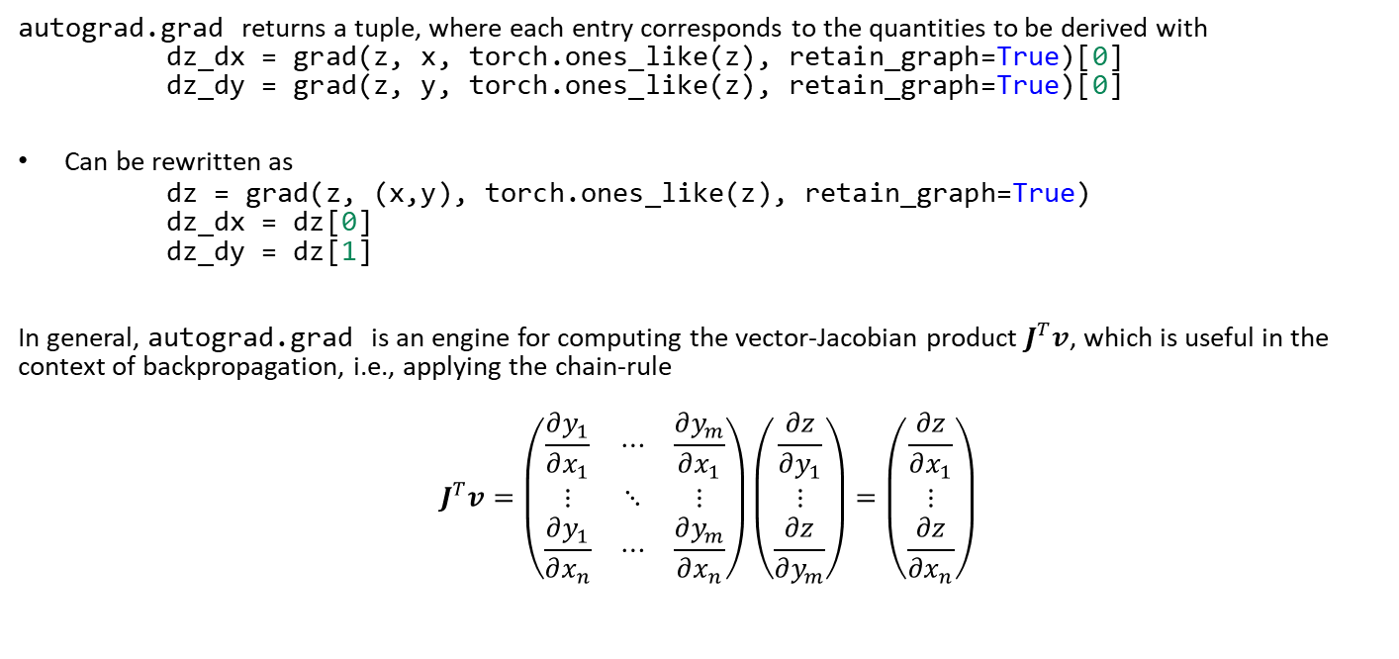
Computing with Tensors – Gradient
autograd.grad returns a tuple, where each entry corresponds to the quantities to be derived with
dz_dx = grad(z, x, torch.ones_like(z), retain_graph=True)[0]
dz_dy = grad(z, y, torch.ones_like(z), retain_graph=True)[0]
Can be rewritten as
dz = grad(z, (x,y), torch.ones_like(z), retain_graph=True)
dz_dx = dz[0]
dz_dy = dz[1]
In general, autograd.grad is an engine for computing the vector-Jacobian product $J^{T}v$, which is useful in the context of backpropagation, i.e., applying the chain-rule
$$J^{T}v=\left(\begin{matrix}\frac{∂y_{1}}{∂x_{1}} & ⋯ & \frac{∂y_{m}}{∂x_{1}} \\ ⋮ & ⋱ & ⋮ \\ \frac{∂y_{1}}{∂x_{n}} & ⋯ & \frac{∂y_{m}}{∂x_{n}}\end{matrix}\right)\left(\begin{matrix}\frac{∂z}{∂y_{1}} \\ ⋮ \\ \frac{∂z}{∂y_{m}}\end{matrix}\right)=\left(\begin{matrix}\frac{∂z}{∂x_{1}} \\ ⋮ \\ \frac{∂z}{∂x_{n}}\end{matrix}\right)$$

Slide 27
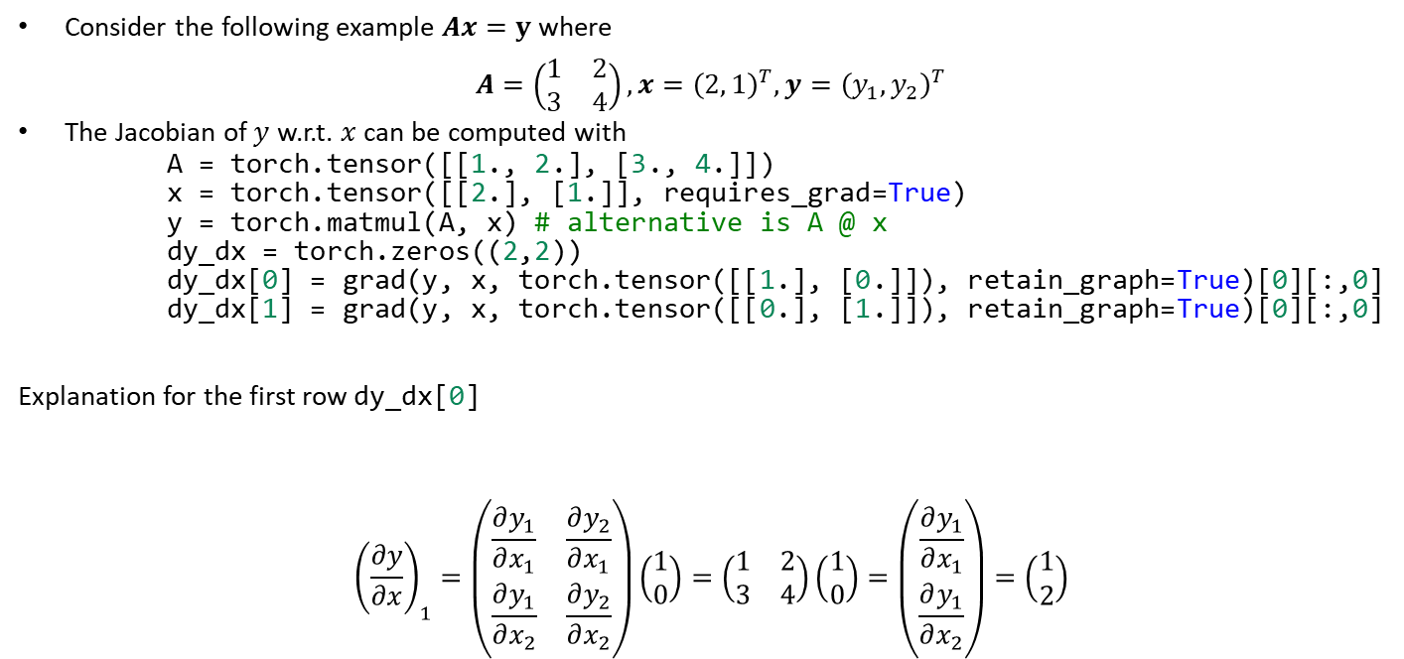
Computing with Tensors – Gradient
Consider the following example $Ax=y$ where
$$A=\left(\begin{matrix}1 & 2 \\ 3 & 4\end{matrix}\right), x={\left(2, 1\right)}^{T}, y={\left(y_{1}, y_{2}\right)}^{T}$$
The Jacobian of $y$ w.r.t. $x$ can be computed with
A = torch.tensor([[1., 2.], [3., 4.]])
x = torch.tensor([[2.], [1.]], requires_grad=True)
y = torch.matmul(A, x) # alternative is A @ x
dy_dx = torch.zeros((2,2))
dy_dx[0] = grad(y, x, torch.tensor([[1.], [0.]]), retain_graph=True)[0][:,0]
dy_dx[1] = grad(y, x, torch.tensor([[0.], [1.]]), retain_graph=True)[0][:,0]
Explanation for the first row dy_dx[0]
$${\left(\frac{∂y}{∂x}\right)}_{1}=\left(\begin{matrix}\frac{∂y_{1}}{∂x_{1}} & \frac{∂y_{2}}{∂x_{1}} \\ \frac{∂y_{1}}{∂x_{2}} & \frac{∂y_{2}}{∂x_{2}}\end{matrix}\right)\left(\begin{matrix}1 \\ 0\end{matrix}\right)=\left(\begin{matrix}1 & 2 \\ 3 & 4\end{matrix}\right)\left(\begin{matrix}1 \\ 0\end{matrix}\right)=\left(\begin{matrix}\frac{∂y_{1}}{∂x_{1}} \\ \frac{∂y_{1}}{∂x_{2}}\end{matrix}\right)=\left(\begin{matrix}1 \\ 2\end{matrix}\right)$$

Slide 28
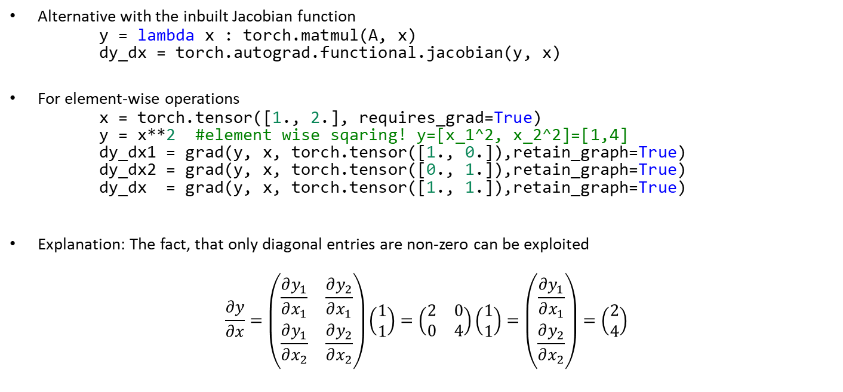
Computing with Tensors – Gradient
Alternative with the inbuilt Jacobian function
y = lambda x : torch.matmul(A, x)
dy_dx = torch.autograd.functional.jacobian(y, x)
For element-wise operations
x = torch.tensor([1., 2.], requires_grad=True)
y = x**2 #element wise sqaring! y=[x_1^2, x_2^2]=[1,4]
dy_dx1 = grad(y, x, torch.tensor([1., 0.]),retain_graph=True)
dy_dx2 = grad(y, x, torch.tensor([0., 1.]),retain_graph=True)
dy_dx = grad(y, x, torch.tensor([1., 1.]),retain_graph=True)
Explanation: The fact, that only diagonal entries are non-zero can be exploited
$$\frac{∂y}{∂x}=\left(\begin{matrix}\frac{∂y_{1}}{∂x_{1}} & \frac{∂y_{2}}{∂x_{1}} \\ \frac{∂y_{1}}{∂x_{2}} & \frac{∂y_{2}}{∂x_{2}}\end{matrix}\right)\left(\begin{matrix}1 \\ 1\end{matrix}\right)=\left(\begin{matrix}2 & 0 \\ 0 & 4\end{matrix}\right)\left(\begin{matrix}1 \\ 1\end{matrix}\right)=\left(\begin{matrix}\frac{∂y_{1}}{∂x_{1}} \\ \frac{∂y_{2}}{∂x_{2}}\end{matrix}\right)=\left(\begin{matrix}2 \\ 4\end{matrix}\right)$$

Slide 29
Exercises
E.1 Introduction to PyTorch (C)
Familiarize yourself with the PyTorch syntax, including tensor initialization & manipulation, gradient computation, neural networks, GPU acceleration.
E.2 Computing Stress Fields with Tensors (C)
Given a displacement field, compute the corresponding stress field using automatic differentiation.
E.3 Stress Fields from Perceptrons (C)
Given a displacement field expressed via a perceptron, compute the corresponding stress field using automatic differentiation.

Slide 30
Contents
1 Computational Mechanics Meets Artificial Intelligence (& Introduction to PyTorch):
Installation
Python Basics (NumPy, SciPy & Matplotlib)
Introduction to PyTorch (Tensor Manipulation & Gradient Computation)
2 Fundamental Concepts of Machine Learning
3 Neural Networks
4 Introduction to Physics-Informed Neural Networks
5 Advanced Physics-Informed Neural Networks
6 Machine Learning in Computational Mechanics
7 Material Modeling with Neural Networks
8 Generative Artificial Intelligence
9 Inverse Problems & Deep Learning
10 Methodological Overview of Deep Learning in Computational Mechanics
11 The Future of Deep Learning in Computational Mechanics

Slide 31
1 Computational Mechanics Meets Artificial Intelligence: PyTorch
Leon Herrmann
Stefan Kollmannsberger
Chair of Data Engineering in Construction
Bauhaus-Universität Weimar
Deep Learning in Computational Mechanics – an introductory course, Herrmann et al. 2025
website
book

