Slide 1
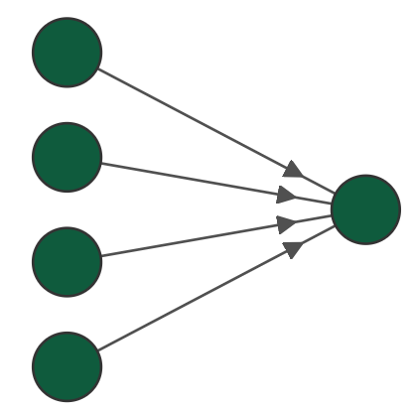
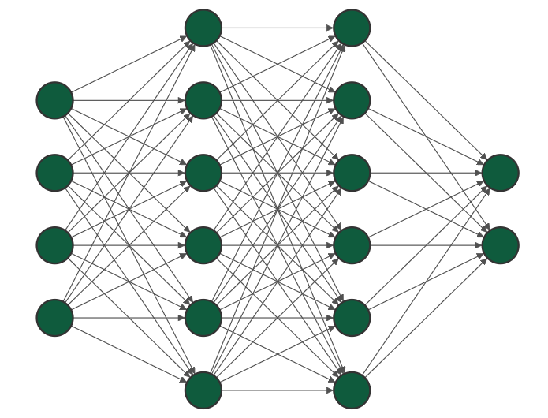













Uma breve ideia das NNs - Arquitetura
PINN em Mecânica Computacional
Q2.2025 – Paulo Silva
$$x_{0}$$
$$w_{0}$$
$$x_{1}$$
$$w_{1}$$
$$x$$
$$y$$
$$u$$
$$y$$
$$w_{n}$$
$$x_{n}$$
$$z$$
$$v$$
$$t$$

Slide 2
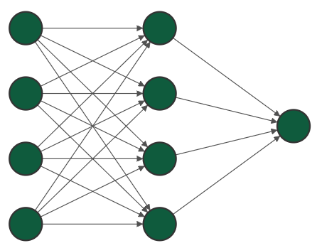
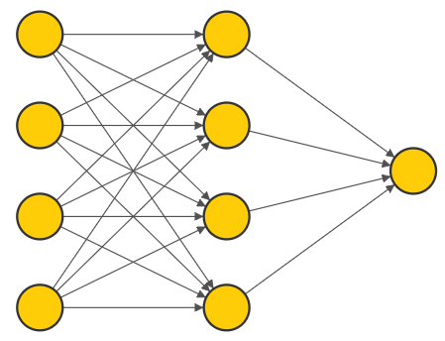



$$v$$
$$x$$
$$a$$

Slide 3
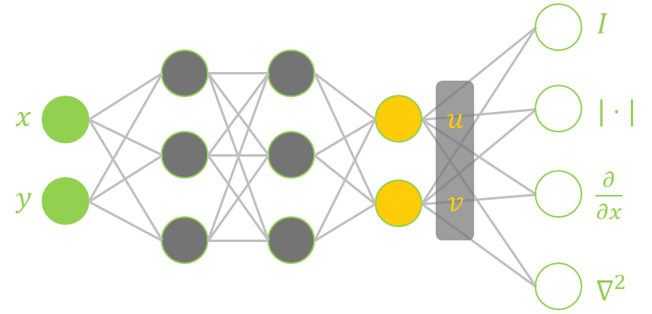

Slide 4








$$I$$
$$x$$
$$u$$
$$|⋅|$$
$$y$$
$$v$$
$\frac{∂}{∂x}$
$$∇^{2}$$

Slide 5
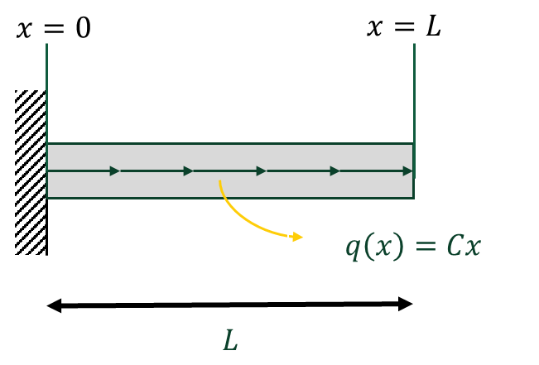




$$x=0$$
$$x=L$$
$$q\left(x\right)=Cx$$
$$L$$

Slide 6
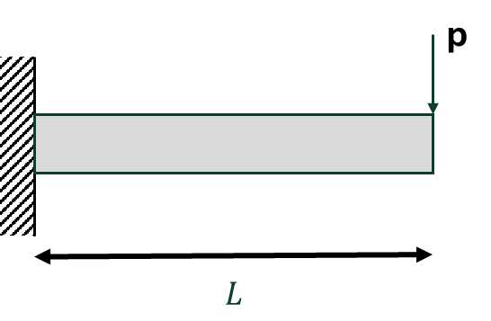
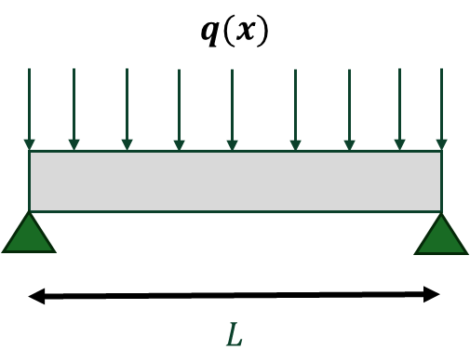



a)
p
$$L$$
b)
$$q(x)$$
$$L$$

Slide 7
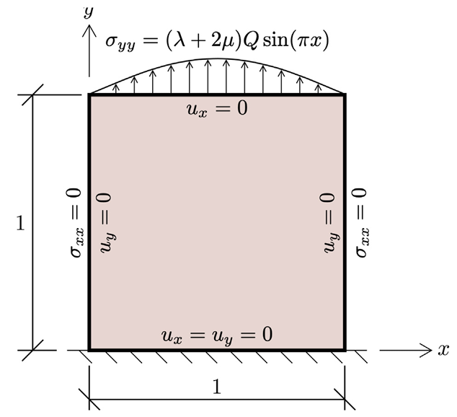






$$y$$
$σ_{yy}=2e\left(λ+2μ\right)Q\left(x−x^{2}\right)$
$$u_{x}=0$$
$$u_{y}=0$$
$$u_{y}=0$$
$$u_{x}=u_{y}=0$$

Slide 8
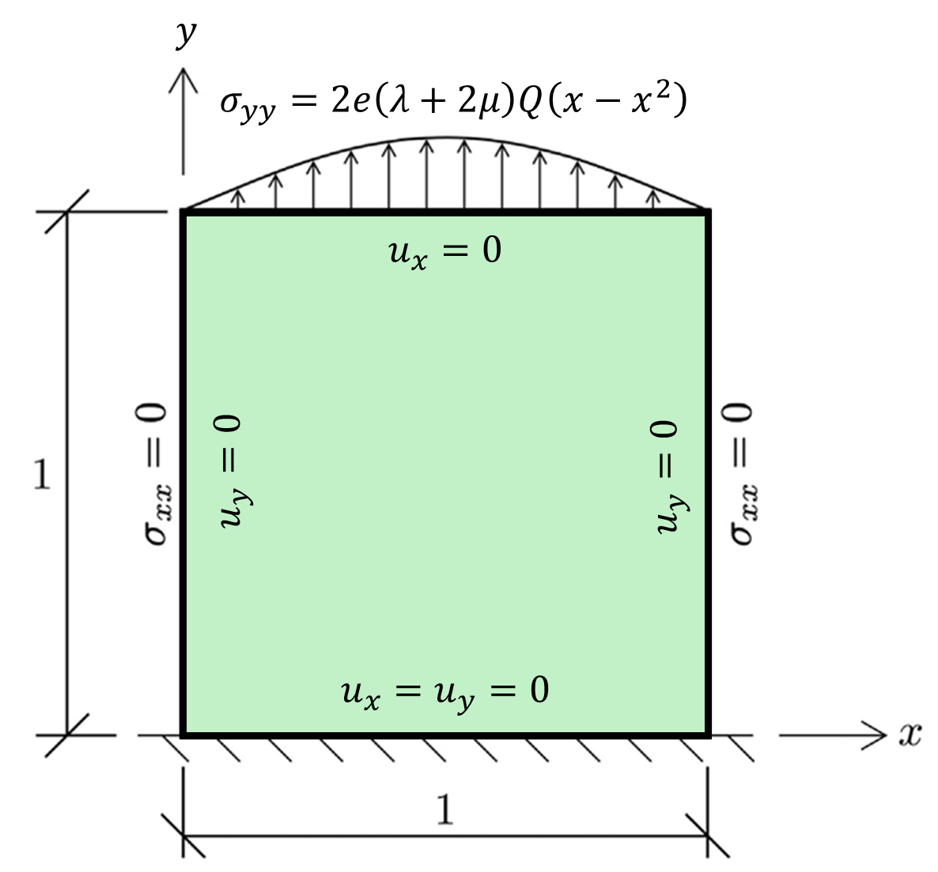

Slide 9
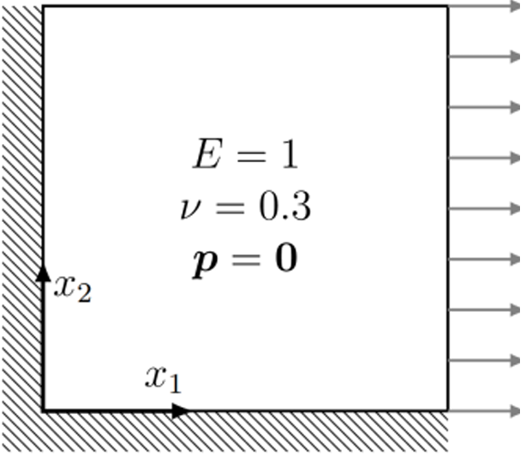
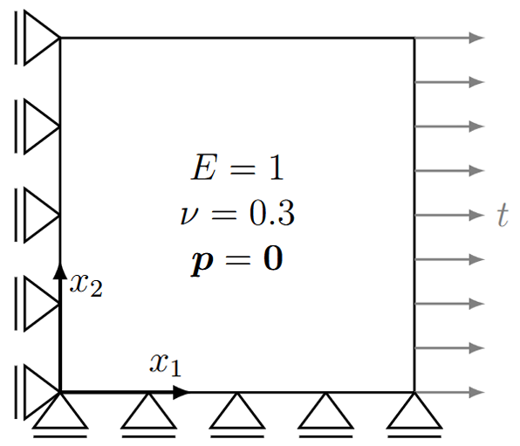


a)
b)
$$σ_{xx}\left(L,y\right)$$
$$σ_{xx}(L,y)$$

Slide 10
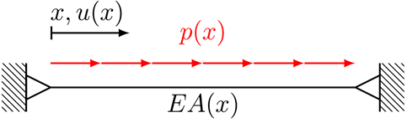


$$w(x)$$
$$L$$

Slide 11
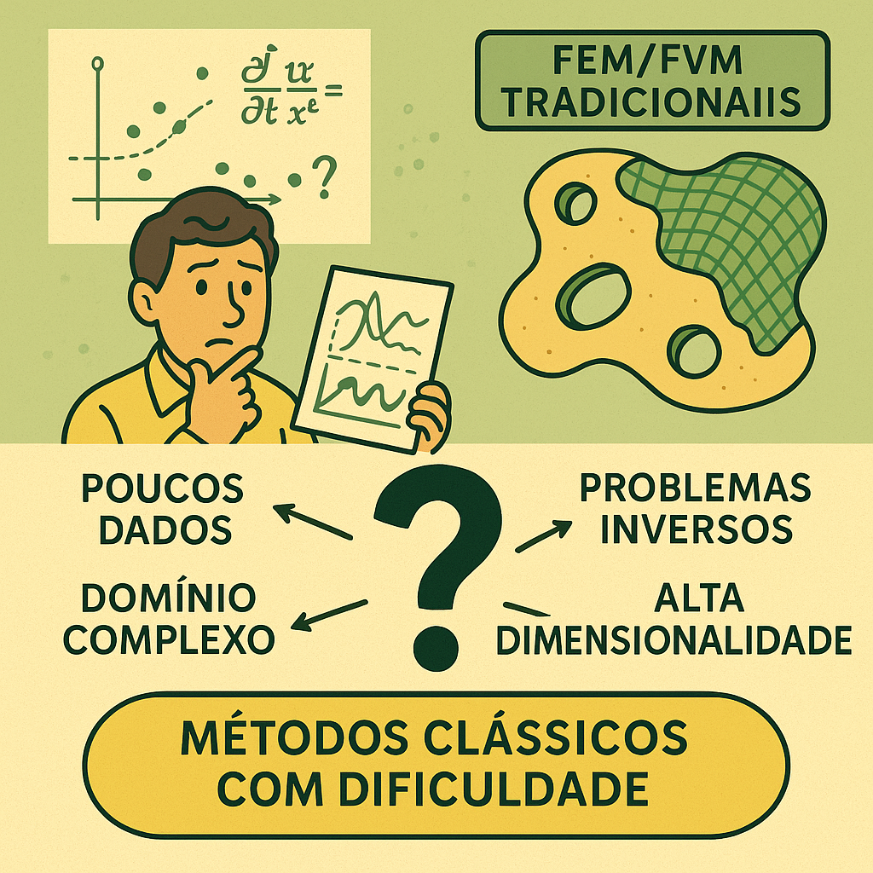

$$\frac{∂x}{∂t}=$$
MDF/MEF/MVF
TRADICIONAIS

Slide 12
