Slide 1

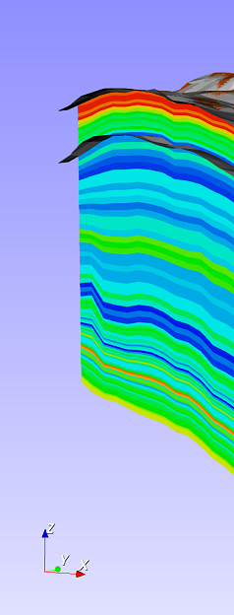
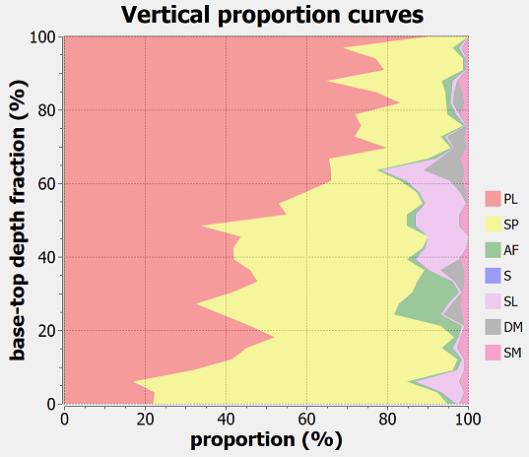
Proportion of

Slide 2
data location
data bounding box
resulting grid geometry
grid origin location

Slide 3
data location
N
data bounding box
resulting grid geometry
grid origin location:
Xmin, Ymin, Zmin
Ysize
Xsize
nX = 3; nY = 3; nZ = 1

Slide 4
Z
actual model
X,Y
W
1.0
what GSLib works with
eroded cells
0.0
U,V
0.0
1.0

Slide 5
Y
J indexes
2D Cartesian grid with
top and base variables
Z
Z = top values
2
cell 2
cell 3
cell 12
cell 13
cell 8
cell 9
1
cell 4
cell 5
cell 1
cell 0
cell 0
cell 1
cells of the
1st horizon slice
Z = base values
0
number of horizon slices = 4
proportional depths between top and base
0
1
2
I indexes
X
X, Y = cell centers of the Cartesian grid with top and base values
X

Slide 6
J direction
[3]
[2]
[7]
[6]
[0]
[1]
I direction
[4]
[5]
K direction

Slide 7
primary data in point set
secondary data grid
primary data in point set
vertical
case for MM1
case for MM2
horizontal

Slide 8
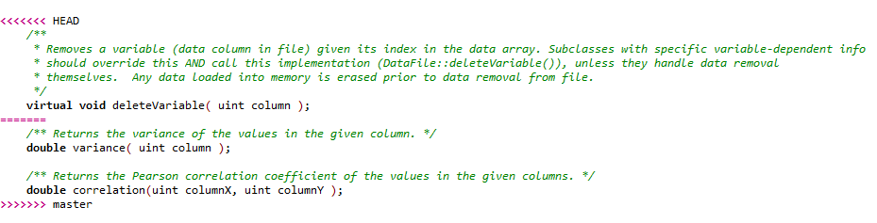
Part in your local branch
Part coming from remote or the other branch

Slide 9
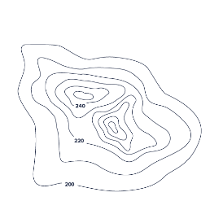
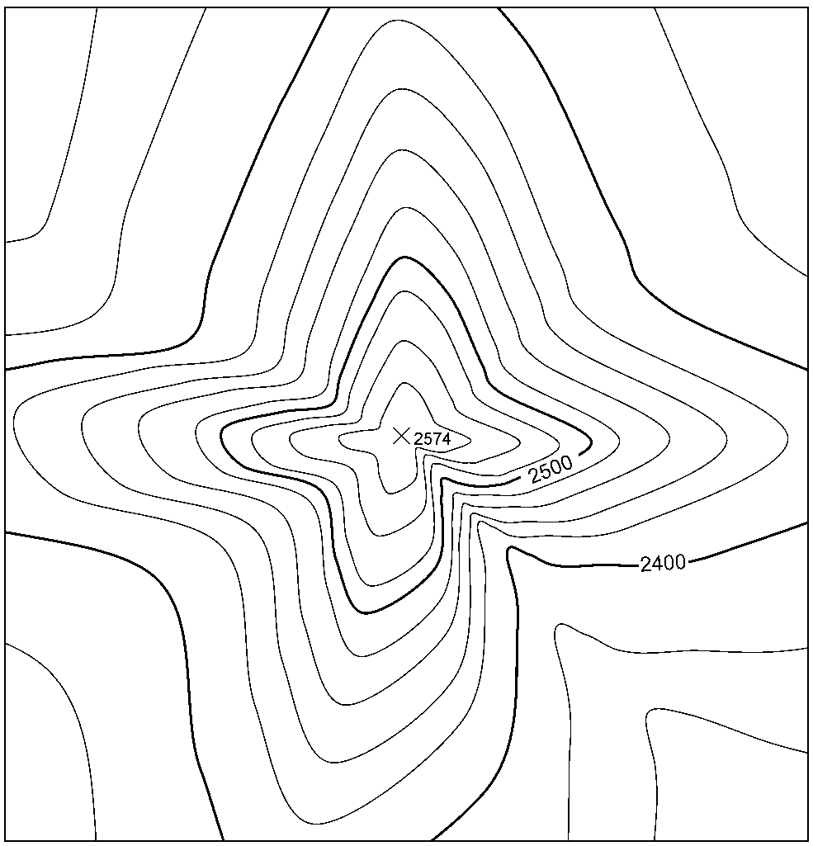
Theorem of
Convolution
Data grid
phase grid (φ)
FFT
real part grid (a)
||z|| = z ∙ z* =
(a+bi)(a-bi)=
a²+b²
imaginary part grid (b)
Covariance
grid
RFFT
zeroes grid (zero phase)
Desired
structure
SVD Analysis
Filtered structure
φ (must be entirely zeroed)
FFT
magnitude grid (|z|)
RFFT
Fourier Integral
Method

Slide 10
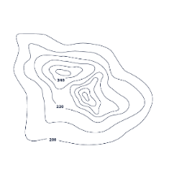
φ zero
M
||z|| = z ∙ z* =
(a+bi)(a-bi)=
a²+b²
variographic
map
real part (a)
RFFT
FFT
imaginary part (b)
phase (φ)
m geological
factors
(variographic structures)
SVD
φ zero
n fundamental
factors
Objective function
√
Σ
m
RFFT
FFT
m
g₁ = a₁₁f₁ + a₁₂f₂ + ... + a_{1n}f_{n}
g₂ = a₂₁f₁ + a₂₂f₂ + ... + a_{2n}f_{n}
...
g_{m} = a_{m1}f₁ + a_{m2}f₂ + ... + a_{mn}f_{n}
[a]_{mn}
value
M_{g}
magnitude (|z|)
[w]_{mn}=[0]_{mn}
[a] = A^{Ɨ}B+(I-A^{Ɨ}A)[w]
optimization step
otimization loop
update paramaters [w]

Slide 11
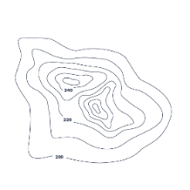

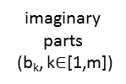
M
n fundamental factors
m geological factors
imaginary
parts
(b_{k}, k$∈$[1,m])
g₁ = a₁₁f₁ + a₁₂f₂ + ... + a_{1n}f_{n}
g₂ = a₂₁f₁ + a₂₂f₂ + ... + a_{2n}f_{n}
...
g_{m} = a_{m1}f₁ + a_{m2}f₂ + ... + a_{mn}f_{n}
Cov_{k} (z_{k}) =‖z_{k}‖
= z_{k} ∙ z_{k}* =
(a_{k}+b_{k}i)(a_{k}-b_{k}i)
= a_{k}²+b_{k}²
*
FFT
m
m
m
m
real parts
(a_{k}, k$∈$[1,m])
m
m
[a]_{mn}
m
zero φ
RFFT
[w]_{mn}=[0]_{mn}
[a] = A^{Ɨ}B+(I-A^{Ɨ}A)[w]
m
update parameters [w]
* SVD or spectrum partitioning
m varmaps
optimization step
optimization loop
N045E
m
objective function
a
ellipse
fit
Marching
Squares
m
b
m
m
m
m sets of elipses with
geometric parameters
m sets of
isocontours
discard malformed
isocontours

Slide 12
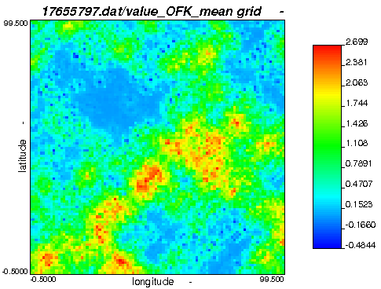
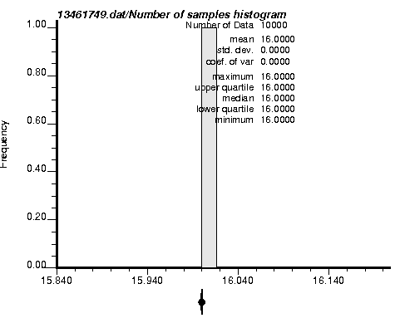
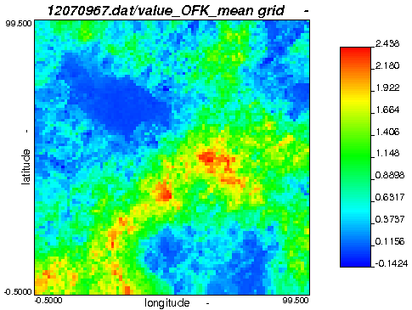
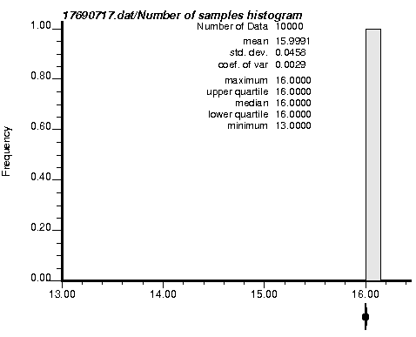
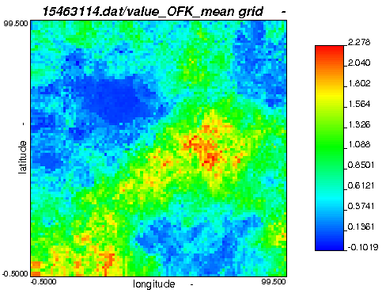
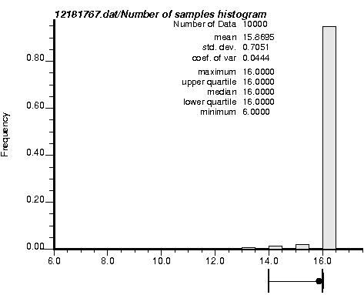
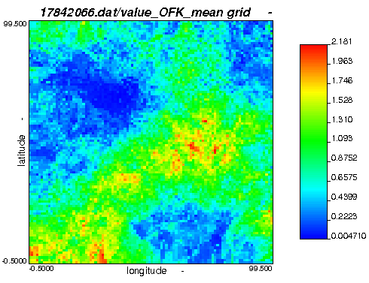
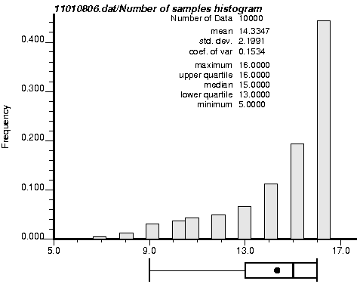
sample
spacing:
0.0
sample
spacing:
2.0
sample
spacing:
3.0
sample
spacing:
4.0

Slide 13
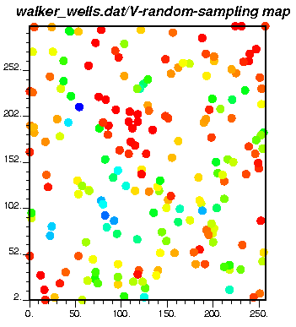
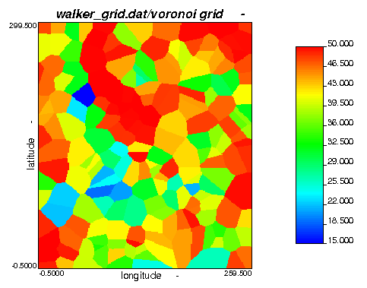

Slide 14
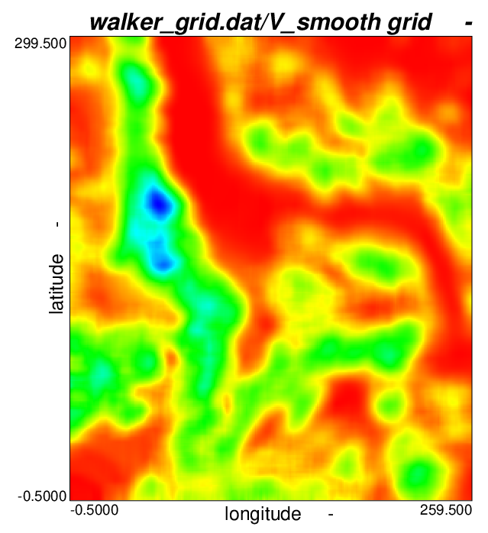
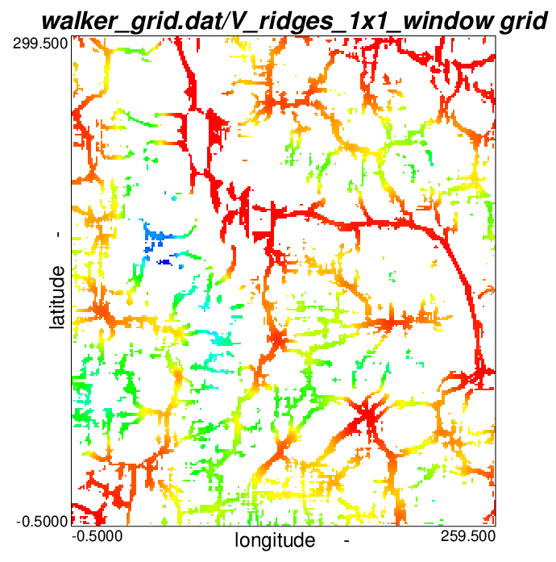

Slide 15
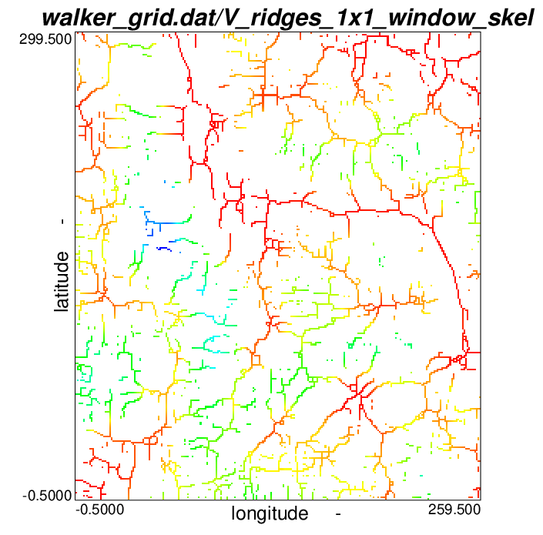

Slide 16
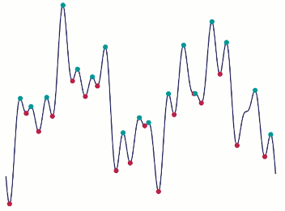
value
x

Slide 17
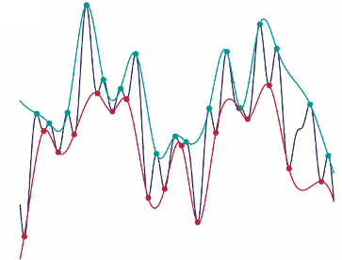
value
x

Slide 18
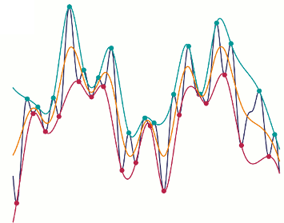
value
x

Slide 19
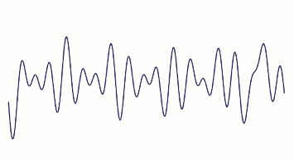
value
x

Slide 20
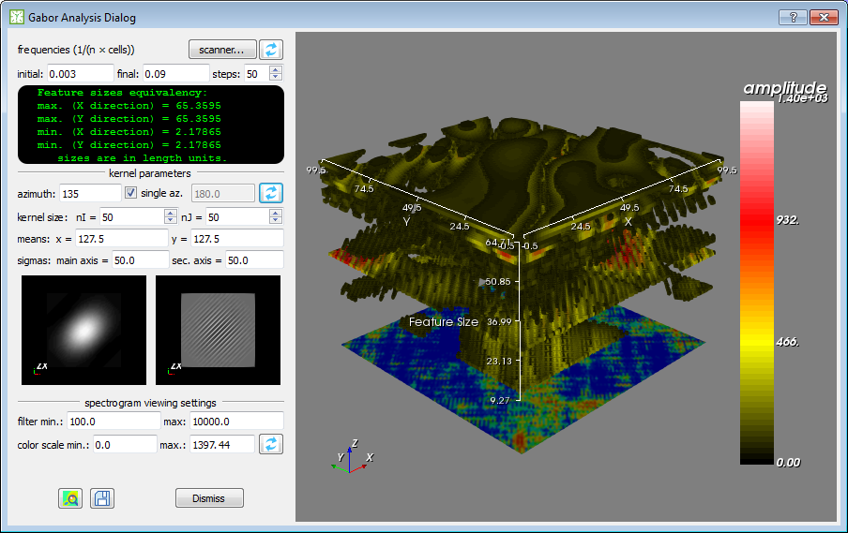
D1: kernel frequency to spatial size conversion display
B1: opens the scanner dialog
B2: computes and displays Gabor space
D2: Gabor space display
B3: refresh
kernel displays
D3: kernel displays (min. and max. frequencies)
B4: updates Gabor space display
B6: saves filtered result to file
B5: computes and displays the filtered result

Slide 21
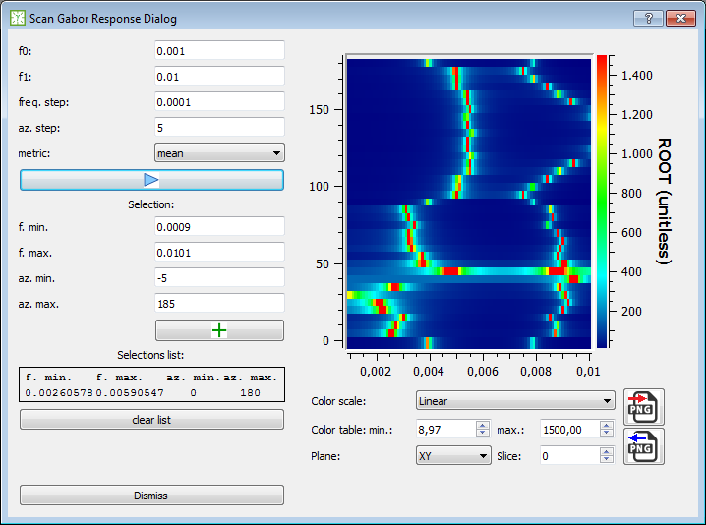
azimuth scale
mean response amplitude
frequency scale

Slide 22
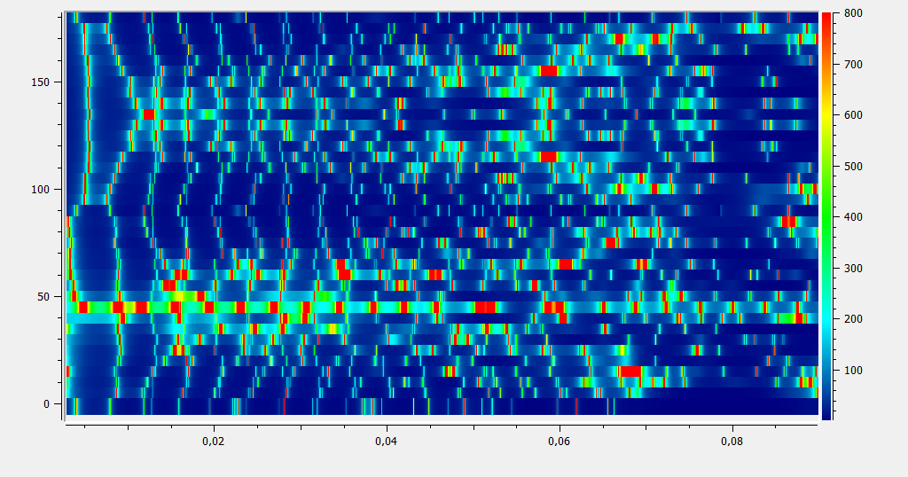
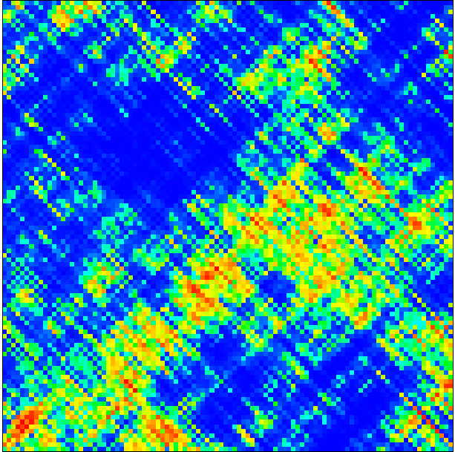
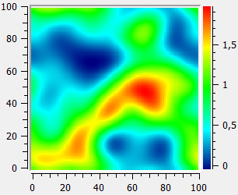
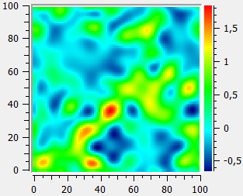
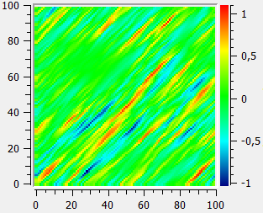
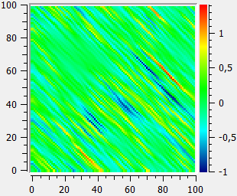
(c)
response amplitude
azimuth
(d)
(a)
(b)
frequency
(a)
(b)
(c)
(d)

Slide 23
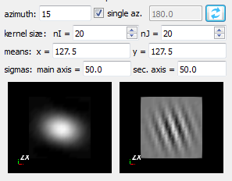

Slide 24
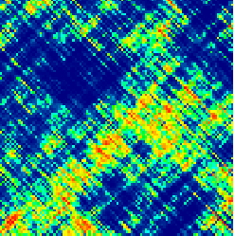
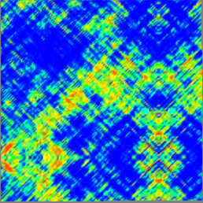
grid with arbitrary size
mirror-padded square grid with a power-of-2
size compatible with DWT algorithm

Slide 25
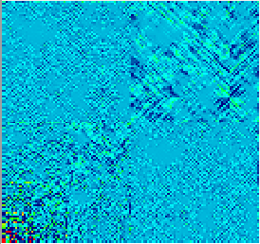
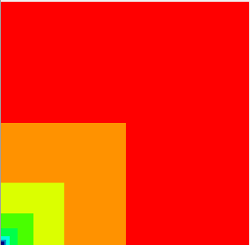

a 128 × 128 DWT raw output
levels 0 – 6 (log₂(128)-1)
directions 1, 2 and 3
first cell (bottom-left) stores the smoothing factor (global mean)
direction 1 = N–S; direction 2 = diagonals; direction 3 = E–W

Slide 26
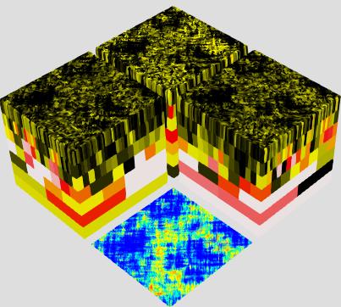
scalogram cube for
direction 2 (diagonals)
a 128 × 128 DWT raw output
scalogram cube for
direction 1 (N–S)
scalogram cube for
direction 3 (E–W)
6
5
4
3
2
1
0
levels of detail
level 6, direction 3
squared and mirror-padded input grid

Slide 27
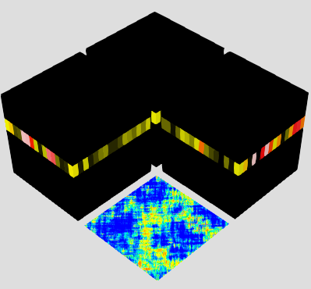

Slide 28
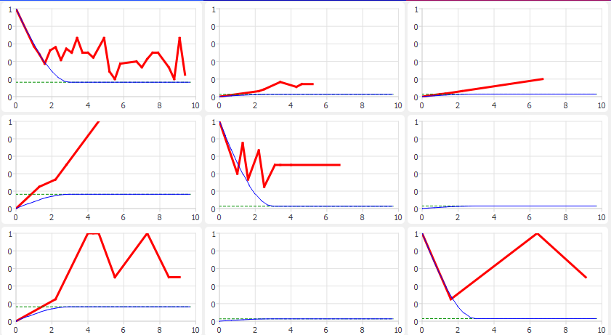
(...)
gradational field = 12.5
gradational field = 11.0
gradational field = 12.0
succession distance = +1.0
(...)
probability of = 10%; = 50% = 2% ...

Slide 29
z
gradational field = 14.0
Z = -7008.7
y
gradational field = 11.0
Z = -7010.1
x
∆Z = +1.4
resulting succession distance
∆gradational field = +3.0

Slide 30
Traditional approach
“chasing the data”
Bayesian approach
realizations define small uncertainty band
around the current model
realizations reflect uncertainty of model
decreasing as more data arrive
time/number of observations
model parameter space
model parameter space
= deterministic model fit to data
= uncertain model around data

Slide 31



start
Is there prior facies?
no
yes
Get transition probabilities from FTM
Get facies probabilities from PDF
Draw facies
Draw thickness
Thickness distribution of
the drawn facies
Impute drawn facies along drawn thickness
yes
Is there uninformed thickness still?
no
end

Slide 32
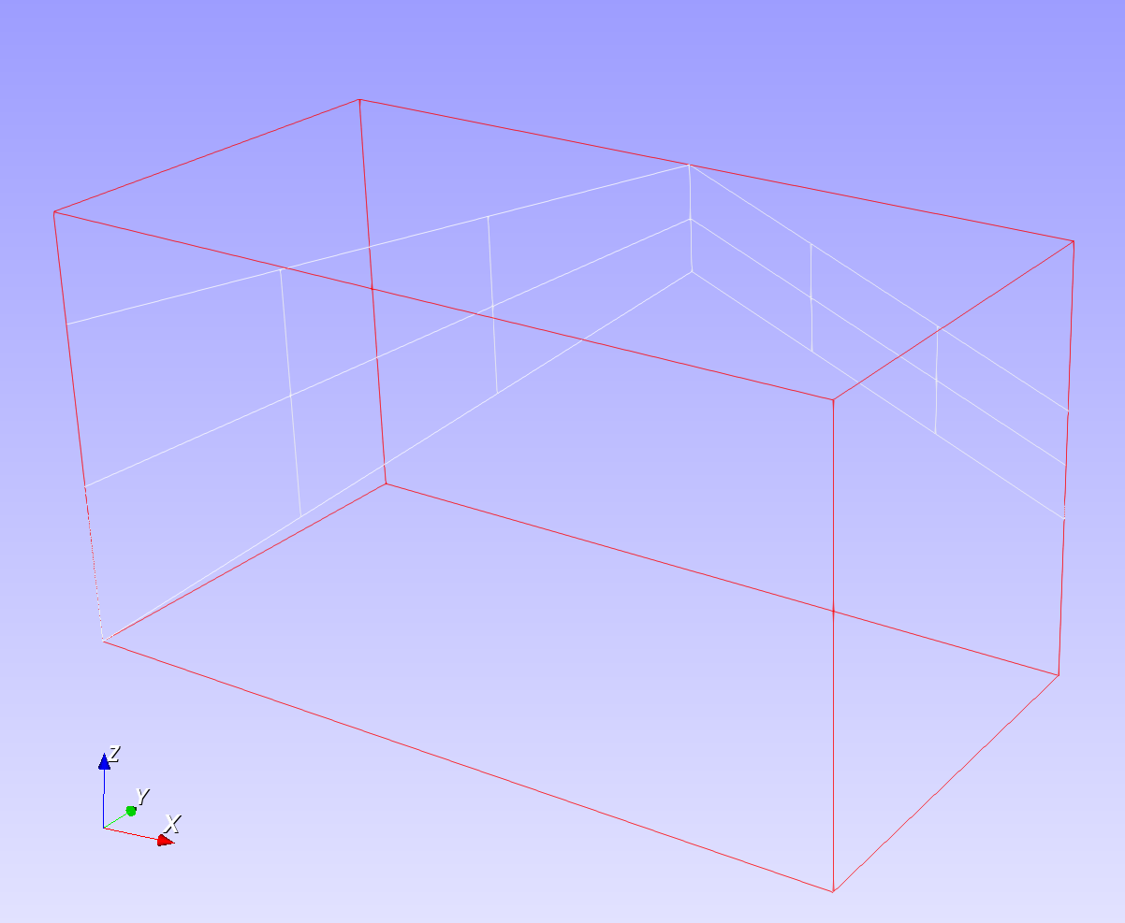
Z1 of 1st location
grid column 3
grid slice 1
grid slice 0
grid column 0
2nd XY location
grid column 5
Z2 of 1st location
Last XY location
1st XY location

