Slide 1
IHM Stefanini Case
Mining Study
Paulo Casmal, Data Scientist

Slide 2
Agenda
01 Introduction
02 Literature Review
03 Exploratory Data Analysis
04 Results
05 Next Steps

Slide 3
Agenda
01 Introduction
02 Literature Review
03 Exploratory Data Analysis
04 Results
05 Next Steps

Slide 4
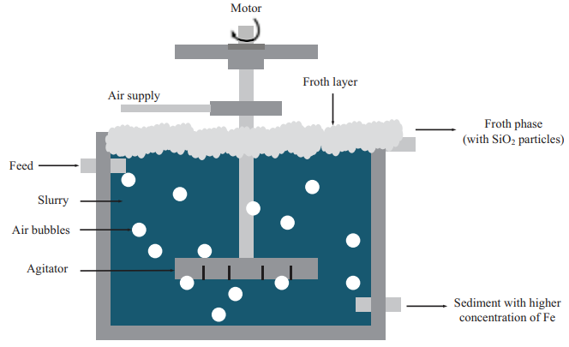
Introduction
Why?
Laboratory data is generated on an hourly basis, which can delay feedback or even mislead operational decisions in the mining process, potentially resulting in economic and/or environmental impacts.
Therefore, it is crucial to monitor process changes directly in the field and in near real time. Key points to consider include:
The target variable cannot be used, as it is obtained from laboratory analysis;
It is essential to understand how far into the future the prediction remains useful for operational decision-making.
The froth flotation process. [1]

Slide 5
Agenda
01 Introduction
02 Literature Review
03 Exploratory Data Analysis
04 Results
05 Next Steps

Slide 6
Literature Review
9
Most closely related works:
Year | Name | Model Used | Performance
2021 | Assessing Machine learning-based approaches for Silica concentration estimation in Iron Froth Flotation. | Random Forest; LSTM; Gated Recurrent Network. | MAE: 0.07 (LSTM); MSE: 0.01(LSTM).
2023 | Developing a data-driven soft sensor to predict silicate impurity in iron ore flotation concentrate | Random Forest; Multi-layer Perceptron; Rigde Regression. | R2: 0.965 (RF); MAE: 0.09 (RF).
2022 | Machine Learning Based Estimation of Silicon Concentration in Froth Flotation Process | Random Forest; Extreme Gradient Boost; Suport Vector Machines. | R2: 0.997 (RF) MAE: 0.06 (SVR); MSE: 0.003(RF).
2025 | Time-series Prediction of Silicon Content in Froth Flotation Based on MI-PCA and Improved LSTM | Recurrent Neural Network; LSTM; Extreme Gradient Boost. | MAE: 0.47 (LSTM); RMSE: 0.71 (LSTM).
2021 | Prediction of Silica Impurity Using Deep Learning Techniques for Mining Environment | LSTM; Random Forest; Mutiple Linear Regression. | ‘Good results’ according to the author. :D
Selected Articles
Publishers:
IEEE;
Elselvier;
Nature;
+...

Slide 7
Agenda
01 Introduction
02 Literature Review
03 Exploratory Data Analysis
04 Results
05 Next Steps

Slide 8
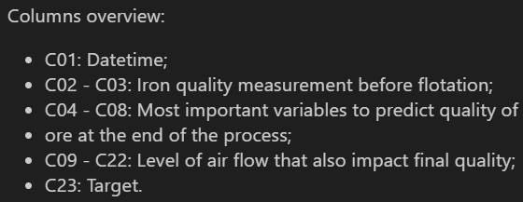
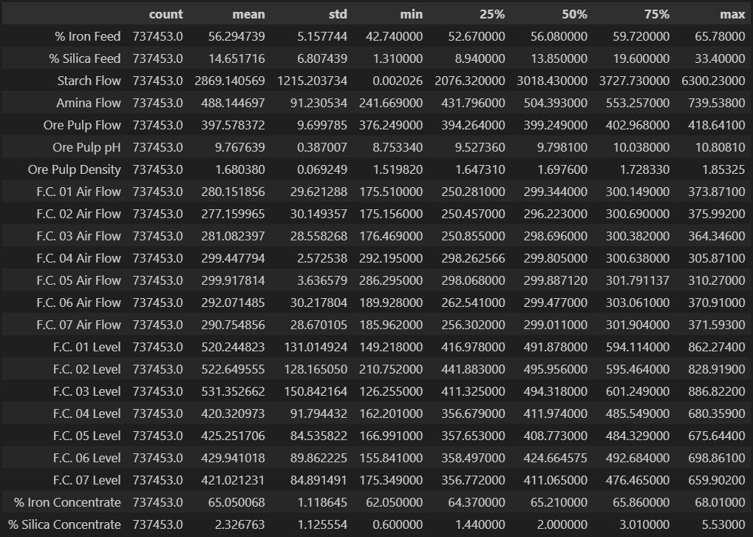
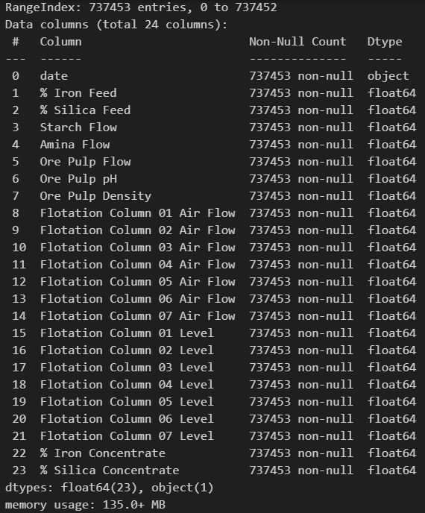

Exploratory Data Analysis

Slide 9

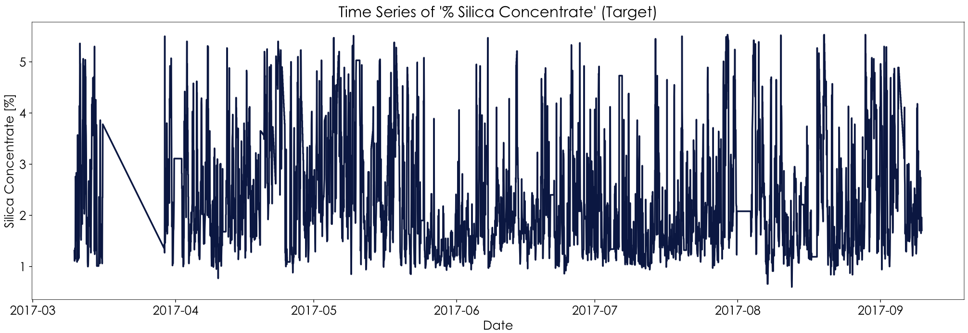
Exploratory Data Analysis
Target Variable - Stationarity:
ADF Statistic: -69.42
Variance must be constant
Can’t present seasonalities
Mean must be constant
Addapted from [4]

Slide 10
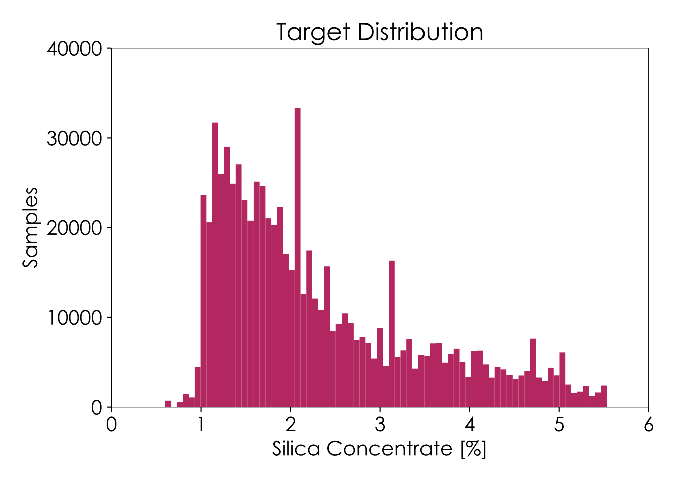
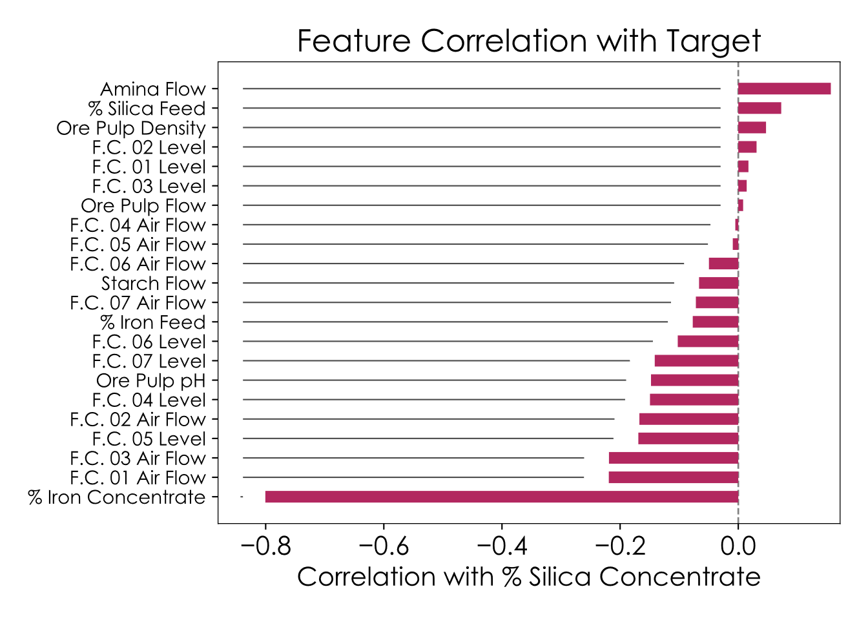
Exploratory Data Analysis
Addapted from [1]

Slide 11
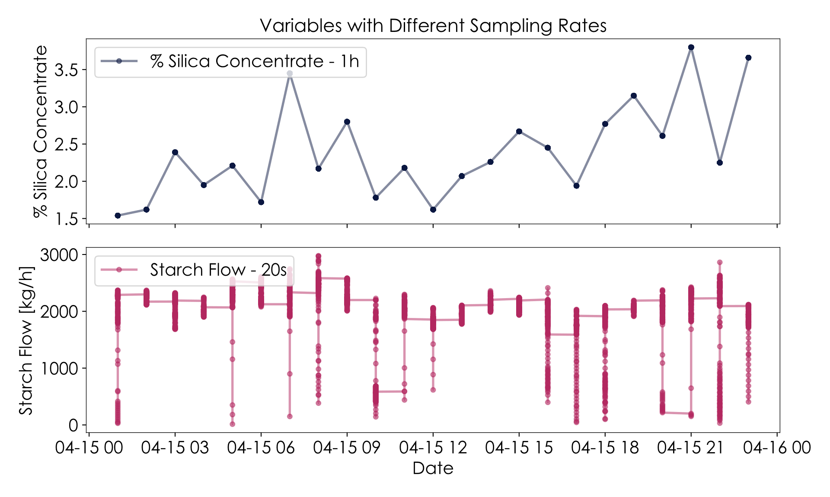
Exploratory Data Analysis
Sample rate:

Slide 12
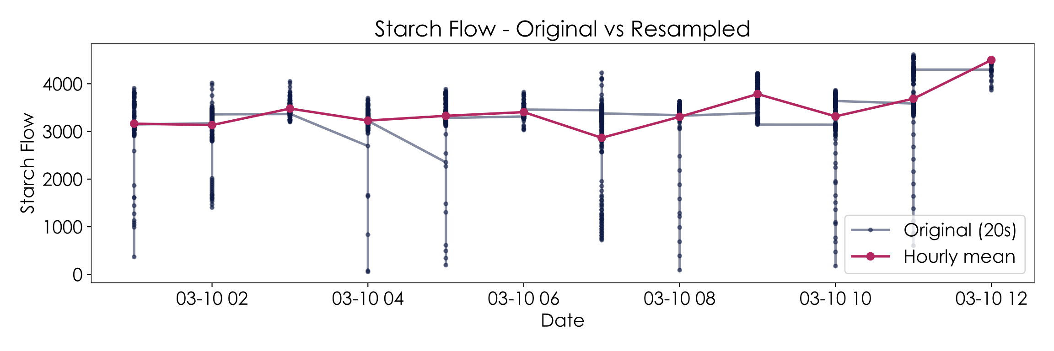
Exploratory Data Analysis
Sample rate:

Slide 13
Agenda
01 Introduction
02 Literature Review
03 Exploratory Data Analysis
04 Results
05 Next Steps

Slide 14
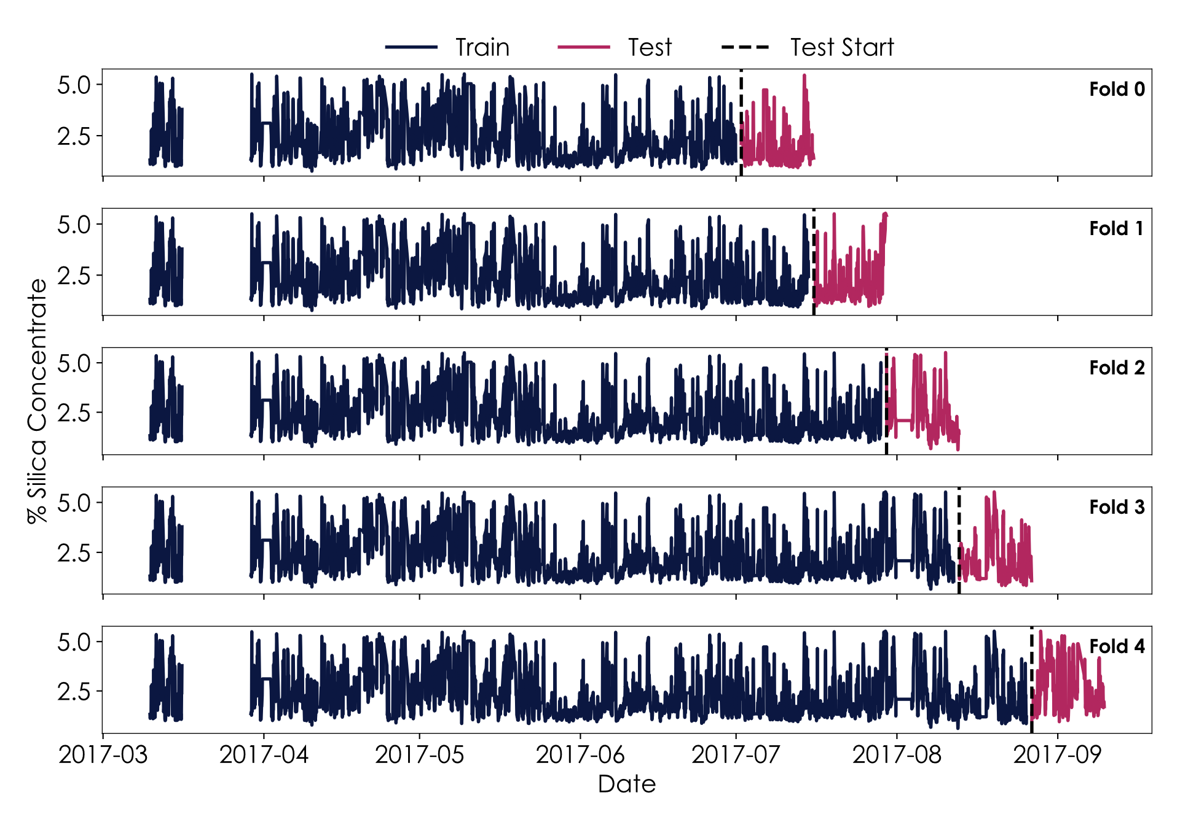
Data Treatment
Cross-validation – Time series split:

Slide 15
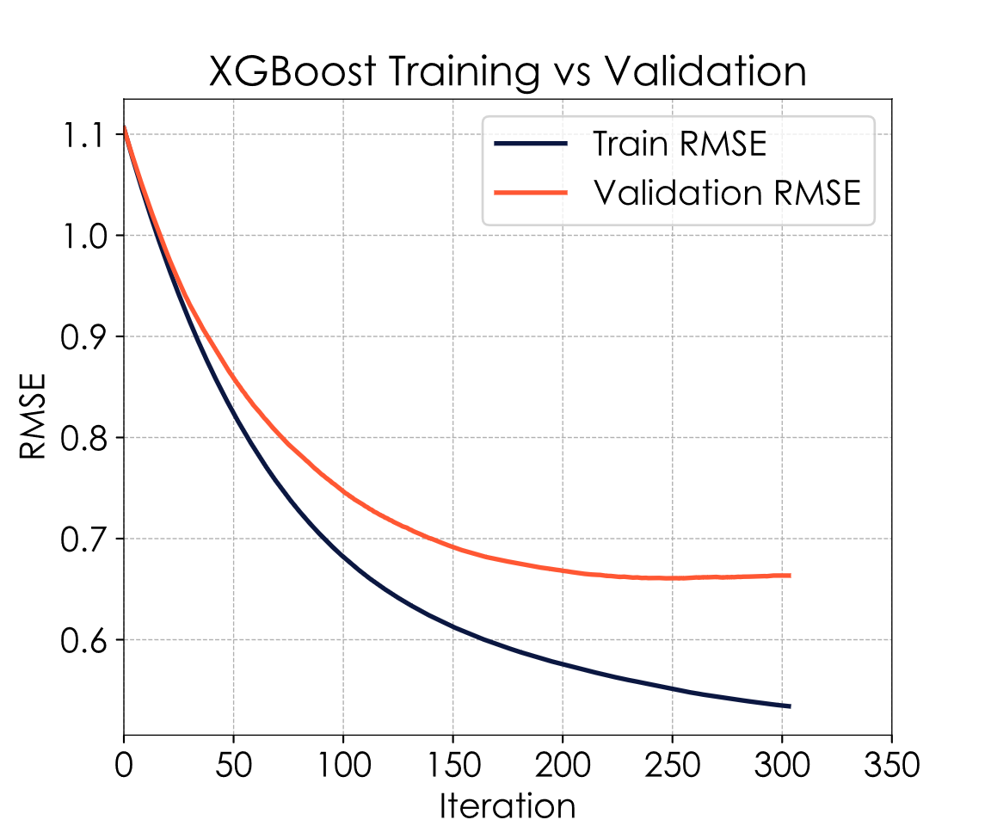
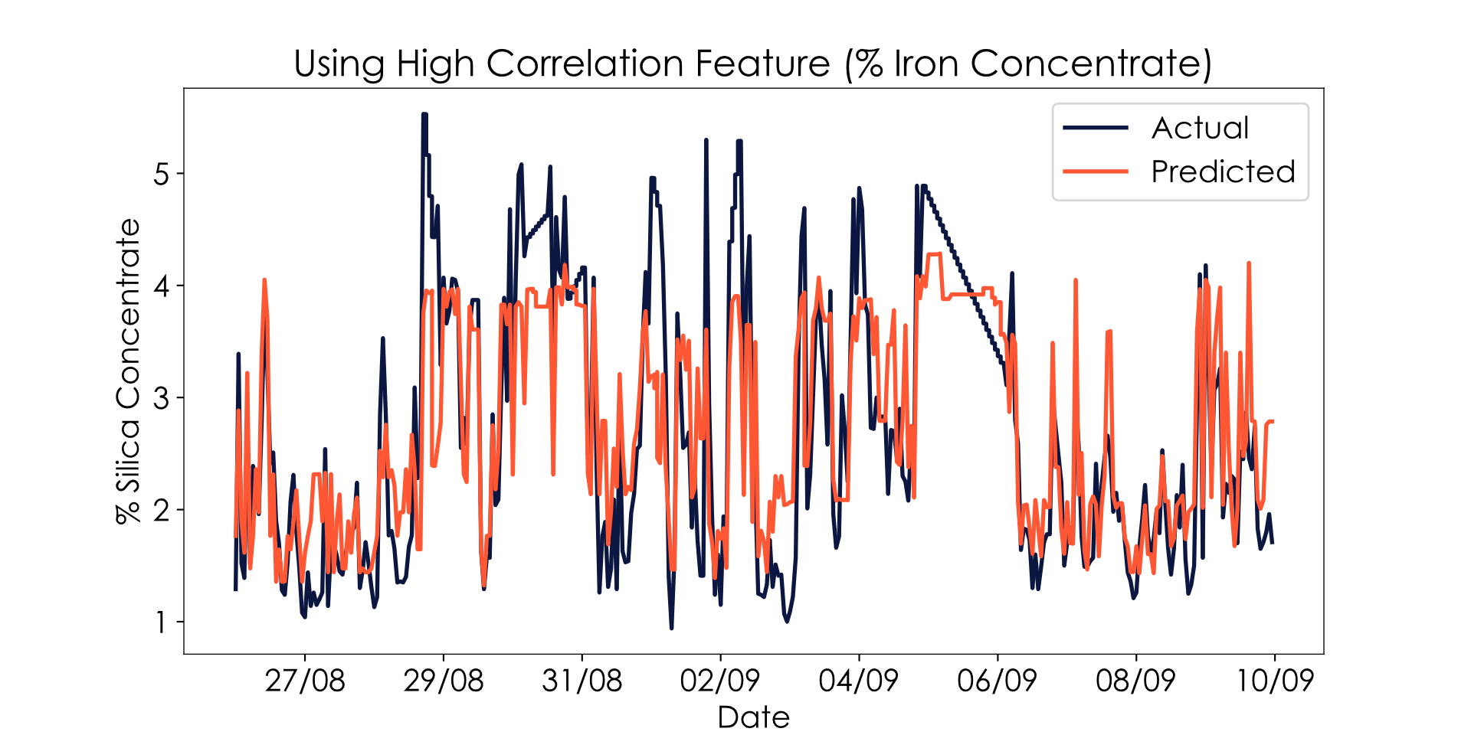
Baseline Model
Using High Correlation Variable:

Slide 16
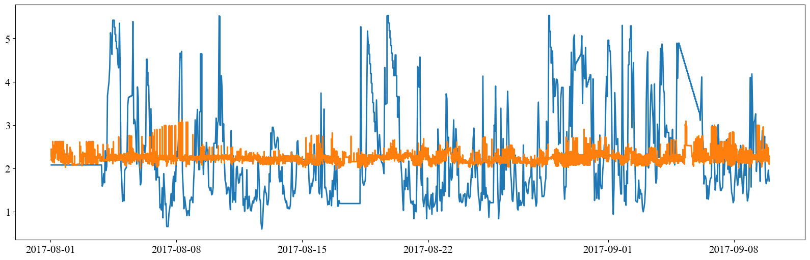
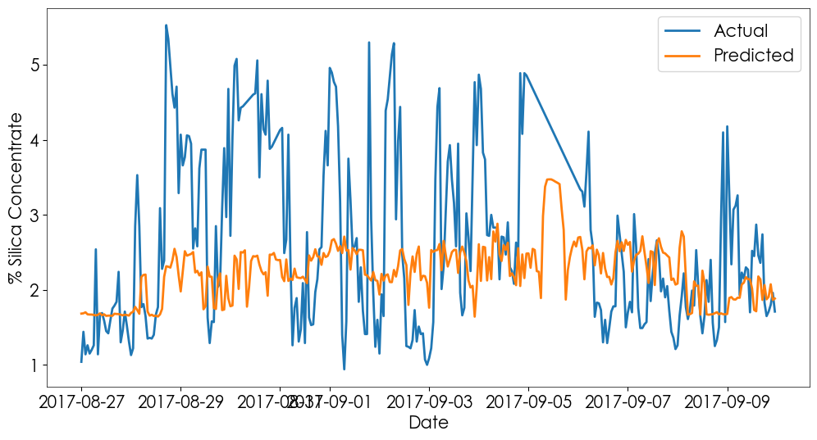
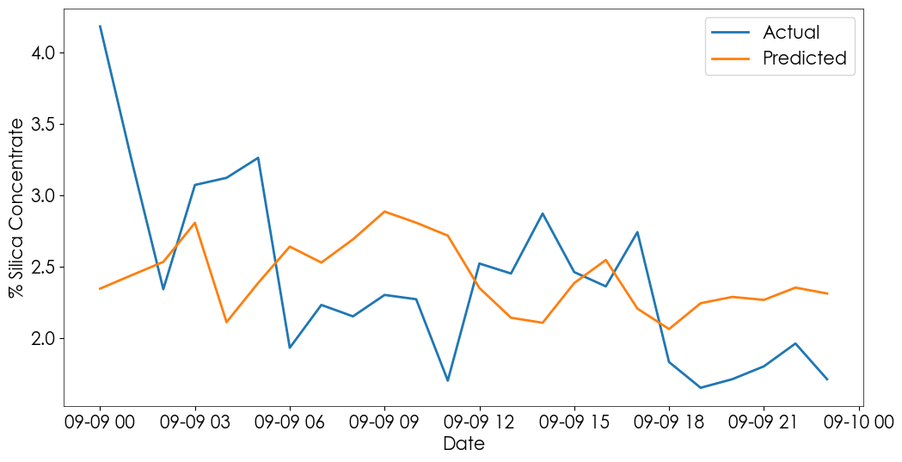
First Model
Models Results
MAE: 0.87
Attempts without ‘% Silica C.’ and ‘% Iron C.’:
Random Forest
Alternatives tested:
Models without Standard Scaler and PCA;
Ensemble (Random Forest & XGB);
LSTM;
Conventional train test split;
Without resampling the dataset;
Many others...
MAE: 0.95
R2: -0.06
LSTM
MAE: 0.56
R2: -0.19

Slide 17
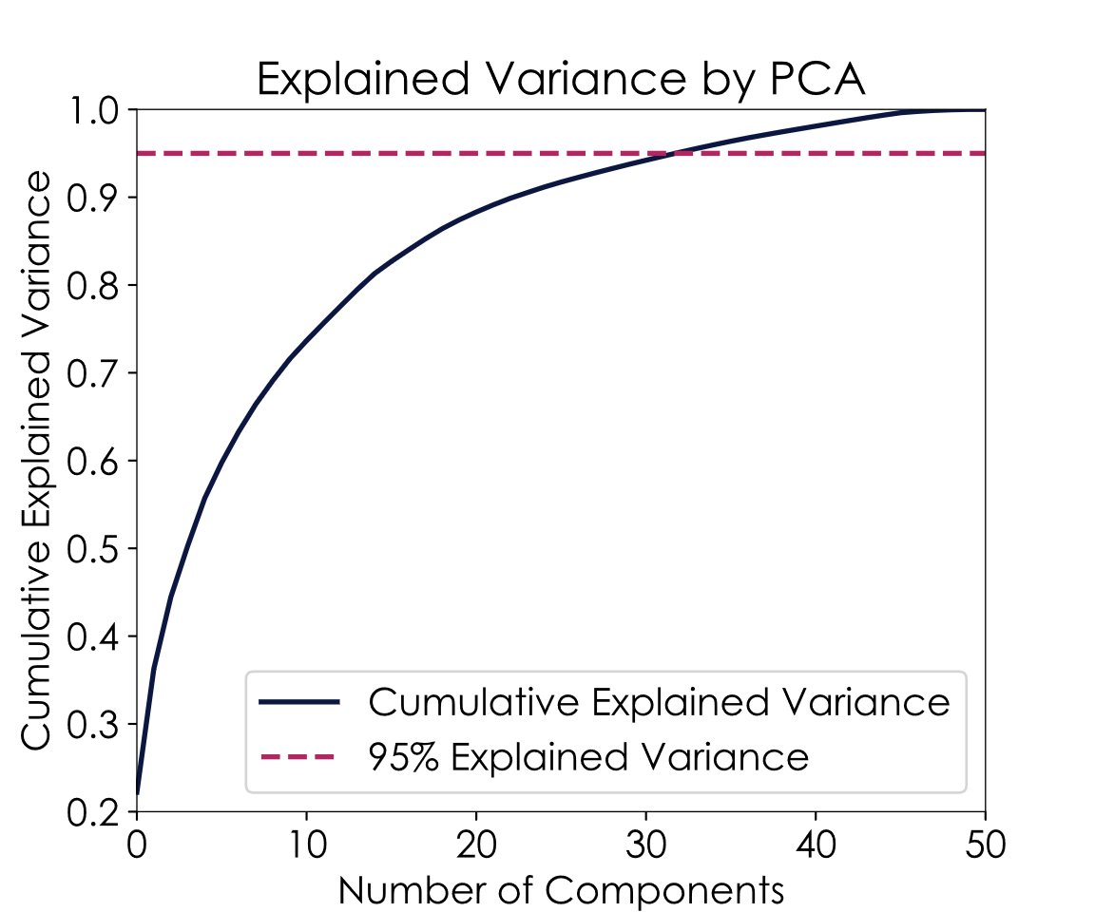
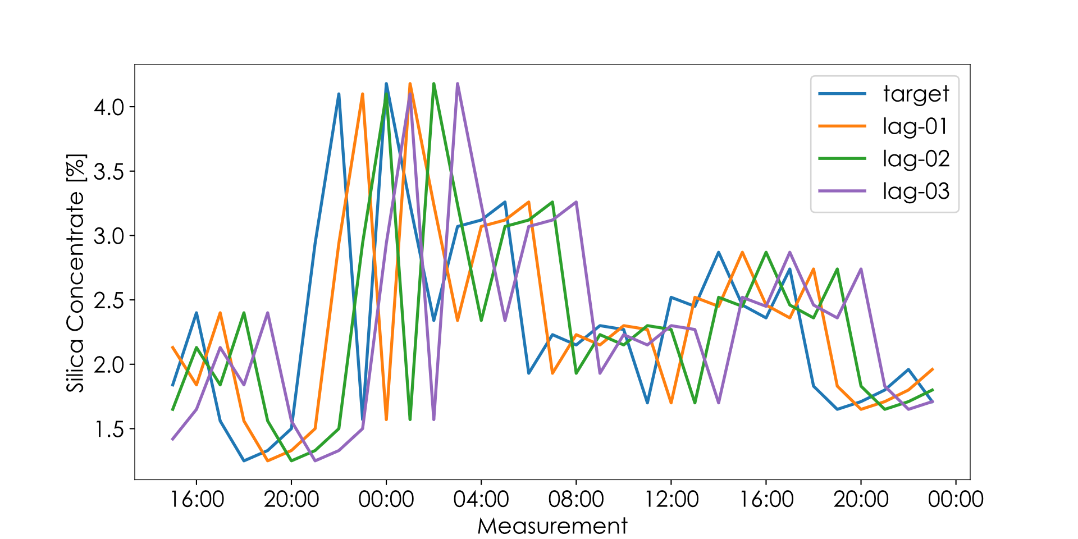
Data Treatment
PCA + Lag Features:

Slide 18
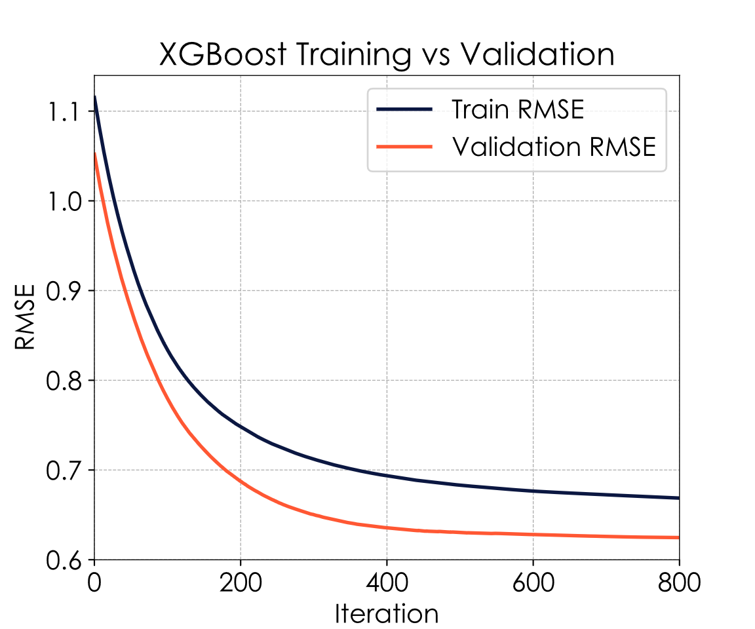
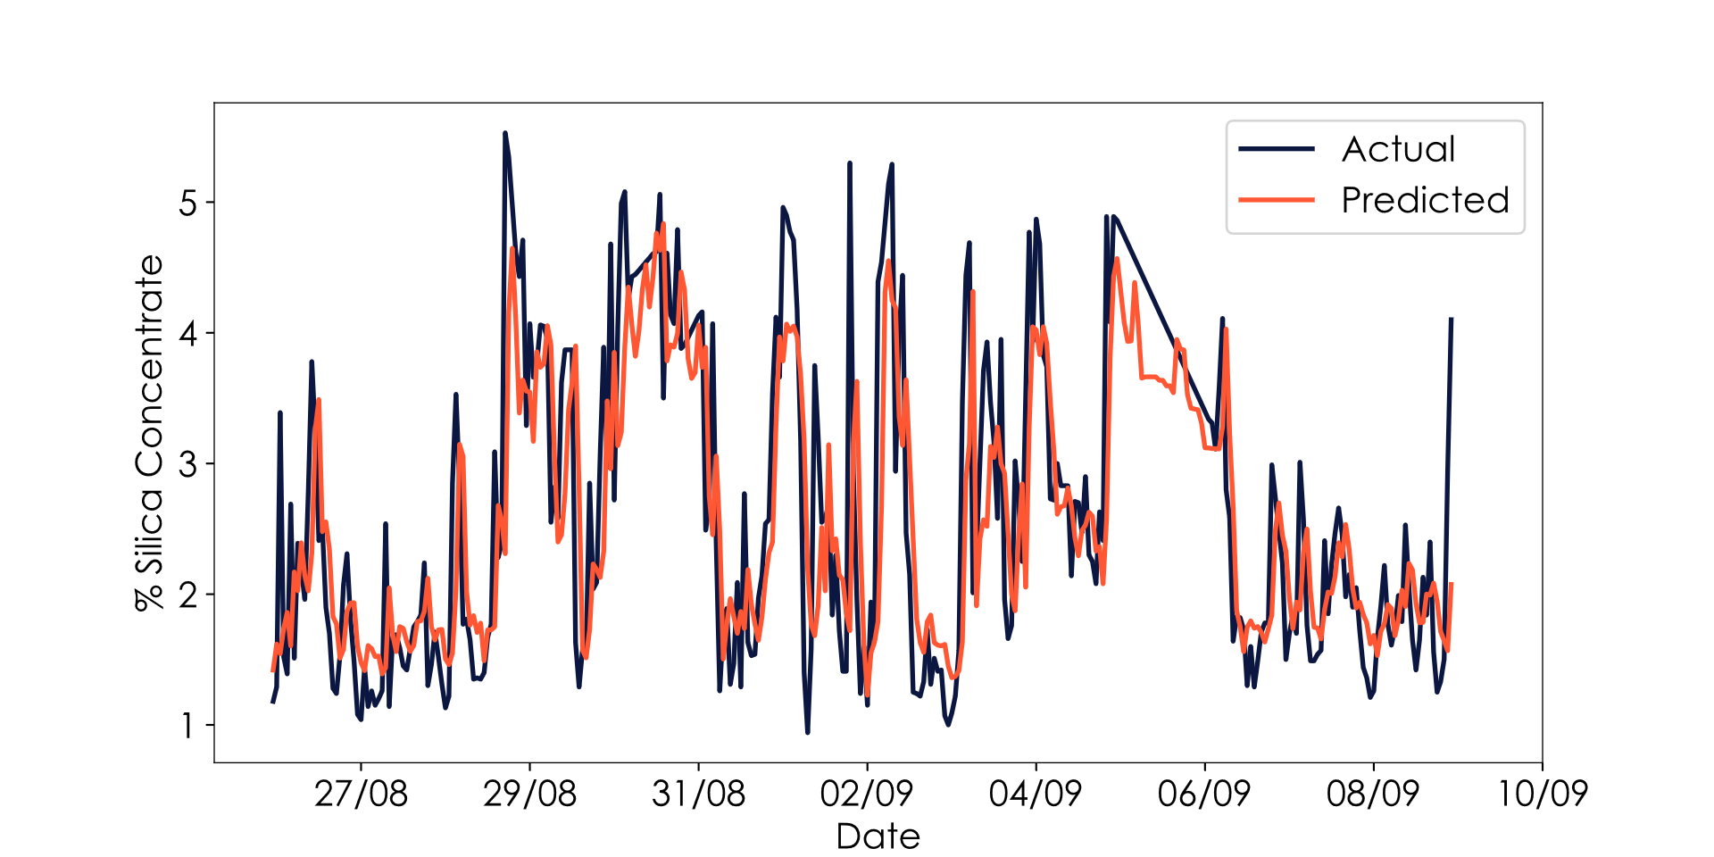
Model Results
Addition of lag features:
df = df[['lag-1’, ..., 'lag-9', '% Silica Concentrate']]
RMSE: 0.74
MAE: 0.52
R2: 0.62

Slide 19
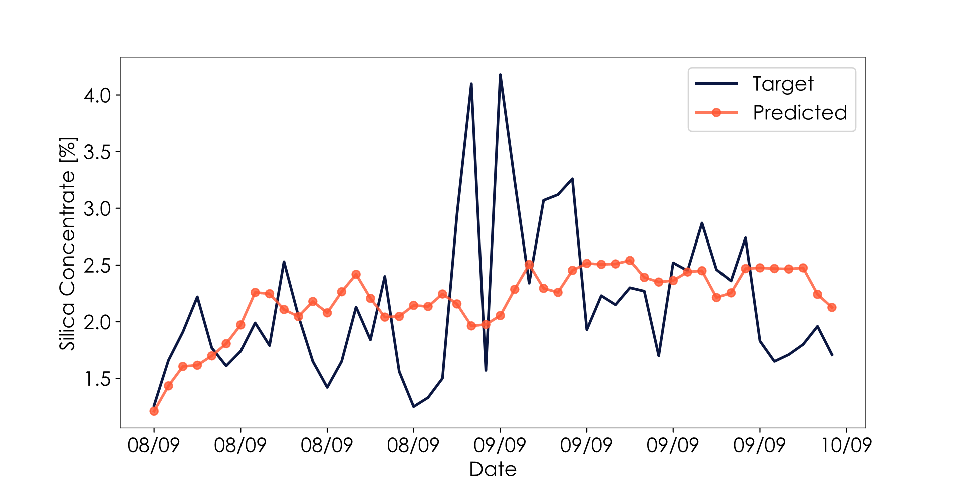
Results
Predicting the future:
bias

Slide 20
Agenda
01 Introduction
02 Literature Review
03 Exploratory Data Analysis
04 Results
05 Next Steps

Slide 21
Next Steps
Hyperparameter tuning – grid Search;
Deeper feature engineering;
Moving statistics (max, min, std...);
Test other models (MLP, GRU, SVMs...);
Deeper literature survey to find best practices, insights...;

Slide 22
References
Papers:
CHEN, Jiaqi, et al. Time-Series Prediction of Silicon Content in Froth Flotation Based on MI-PCA and Improved LSTM. In: 2025 44th Chinese Control Conference (CCC). IEEE, 2025. p. 1279-1284.
PURAL, Yusuf Enes. Developing a data-driven soft sensor to predict silicate impurity in iron ore flotation concentrate. Physicochemical Problems of Mineral Processing, 2023, 59.5.
MONTANARES, Mauricio, et al. Assessing machine learning-based approaches for silica concentration estimation in iron froth flotation. In: 2021 IEEE International Conference on Automation/XXIV Congress of the Chilean Association of Automatic Control (ICA-ACCA). IEEE, 2021. p. 1-6.
HARSHA, Sanda Sri; PRASAD, K. Venkata; RAGHUVEER, Katragadda. Prediction of Silica Impurity Using Deep Learning Techniques for Mining Environment. REVISTA GEINTEC-GESTAO INOVACAO E TECNOLOGIAS, 2021, 11.3: 506-517.
NAGARJUNA, P.; ANANTHAN, T. Machine Learning Based Estimation of Silicon Concentration in Froth Flotation Process. In: 2022 IEEE 3rd Global Conference for Advancement in Technology (GCAT). IEEE, 2022. p. 1-6.
https://www.youtube.com/watch?v=oY-j2Wof51c
https://www.youtube.com/watch?v=z3ZnOW-S550&t=974s
https://www.youtube.com/watch?v=S8tpSG6Q2H0
Videos:

Slide 23
Thanks!

