Slide 1
Face Recognition Door Lock System with RISC-V
Paulo Fidalgo
Wagner Pedrosa

Slide 2
Context
CTM Summer Internships at OET (Optic Electronics Technology) center
Integration of hardware and software in IoT (Internet of Things) applications
ESP32-CAM with RISC-V
Real-time face recognition

Slide 3
Objectives
Design and build a door lock system using the ESP32-CAM
Apply face recognition software to enable secure access control
Develop a user-friendly interface for the system to allow easy management
Conduct testing and debugging to ensure the system is reliable and secure
Document the development process to facilitate future modifications
Provide guidelines for installation, operation and maintenance of the system

Slide 4
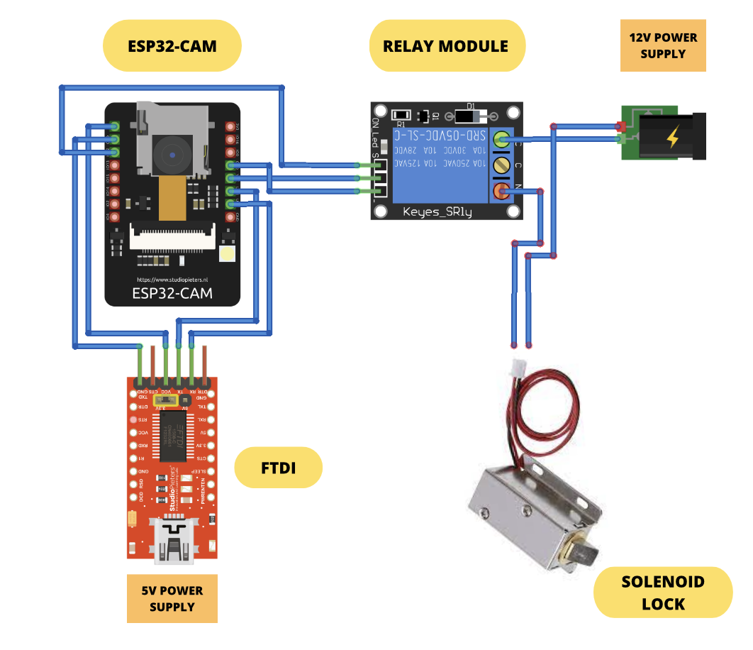
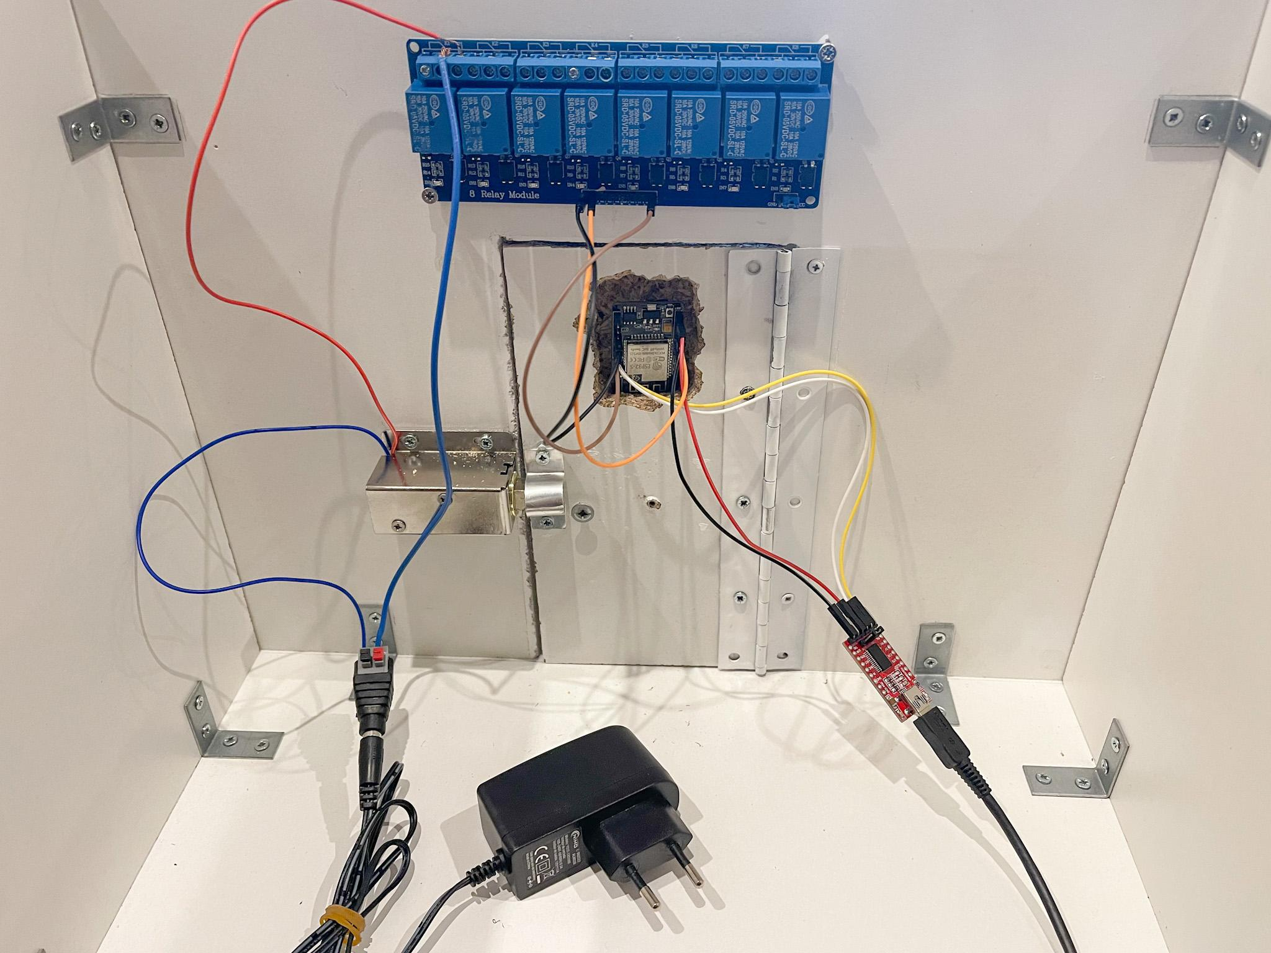
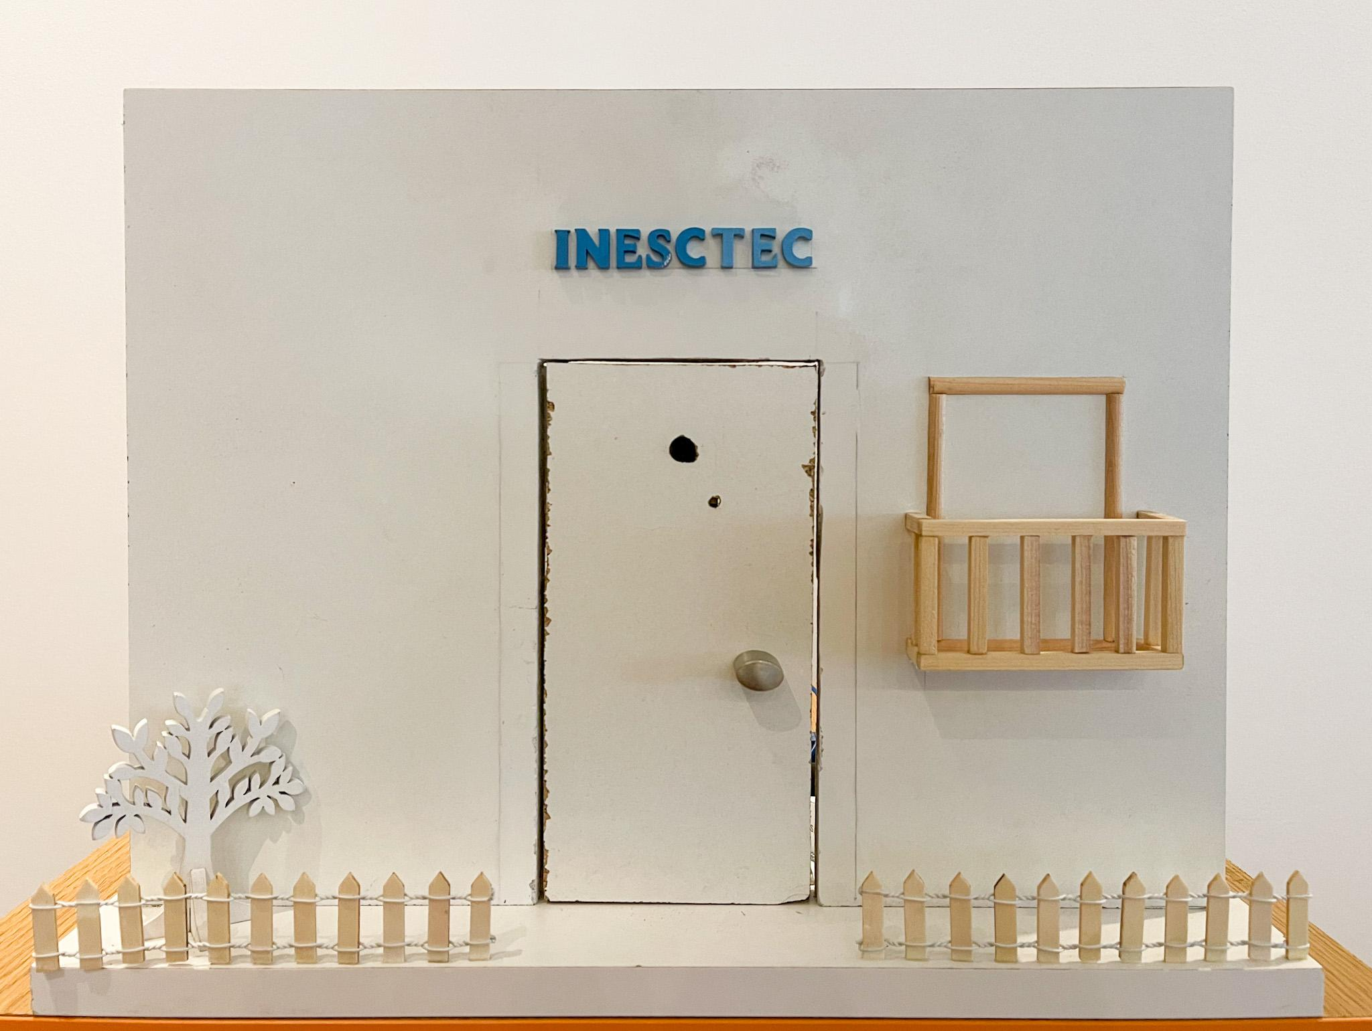
Developed Work - Circuit

Slide 5
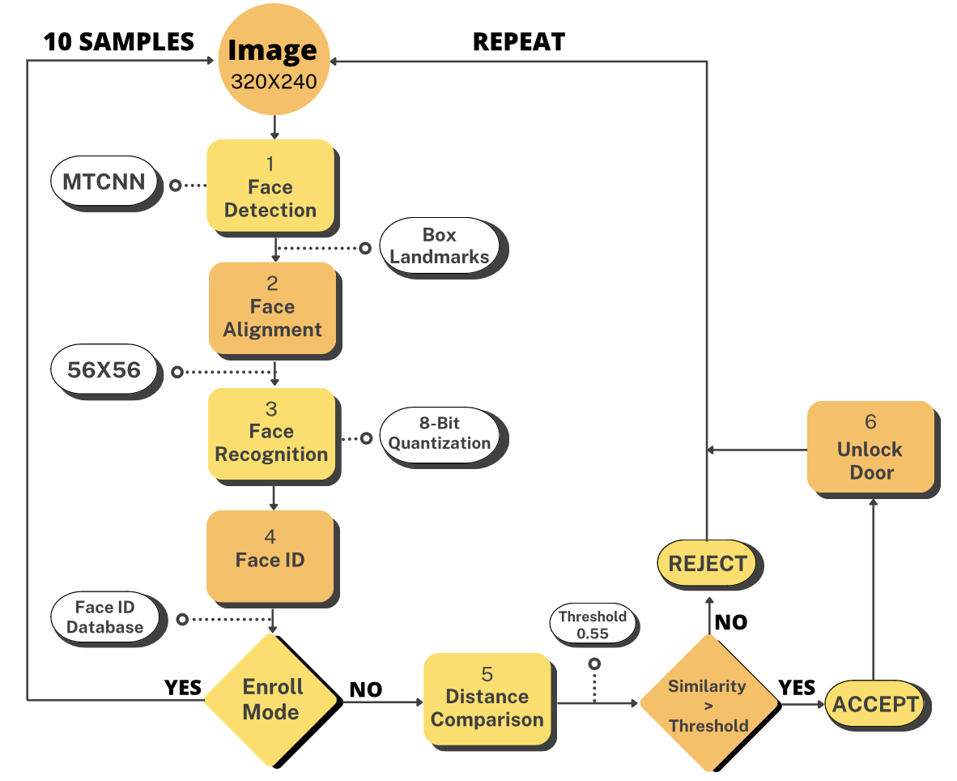
Developed Work - Algorithm Pipeline

Slide 6
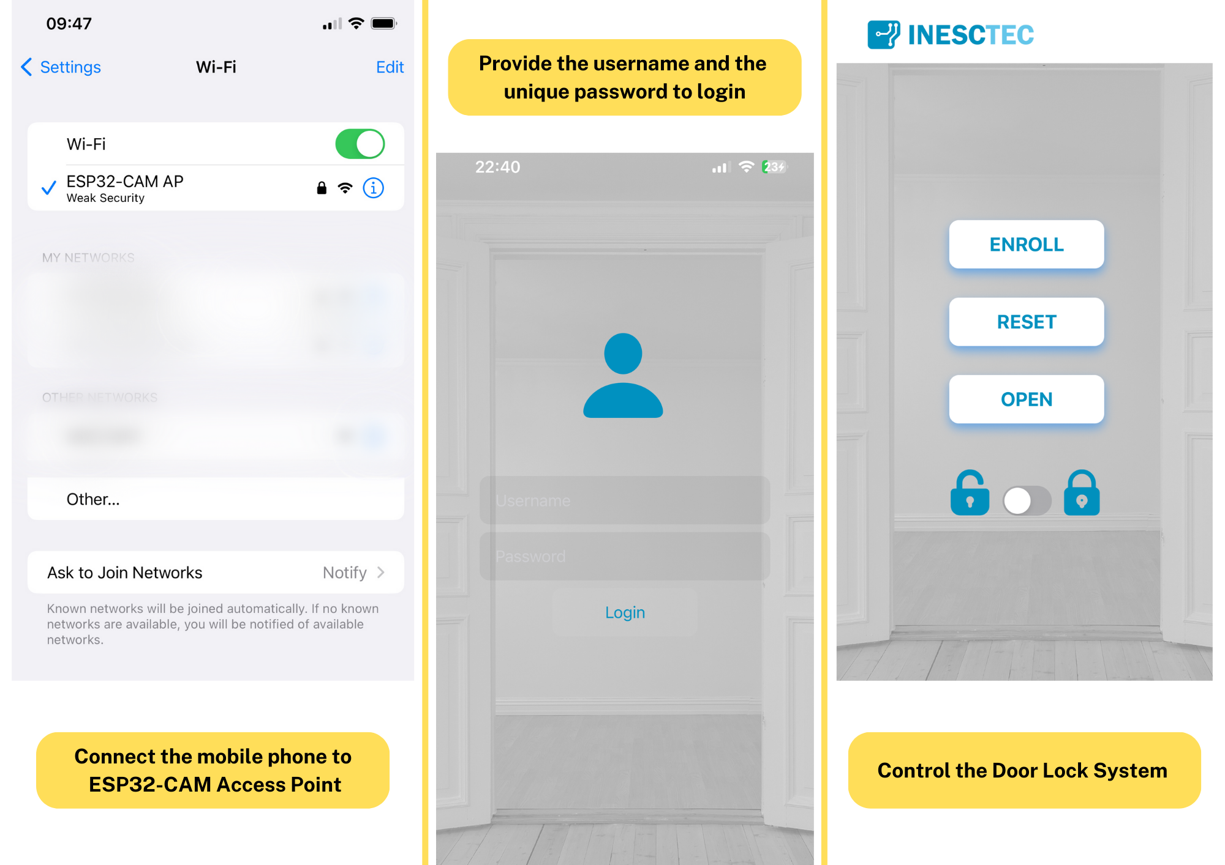
Developed Work - Mobile App

Slide 7
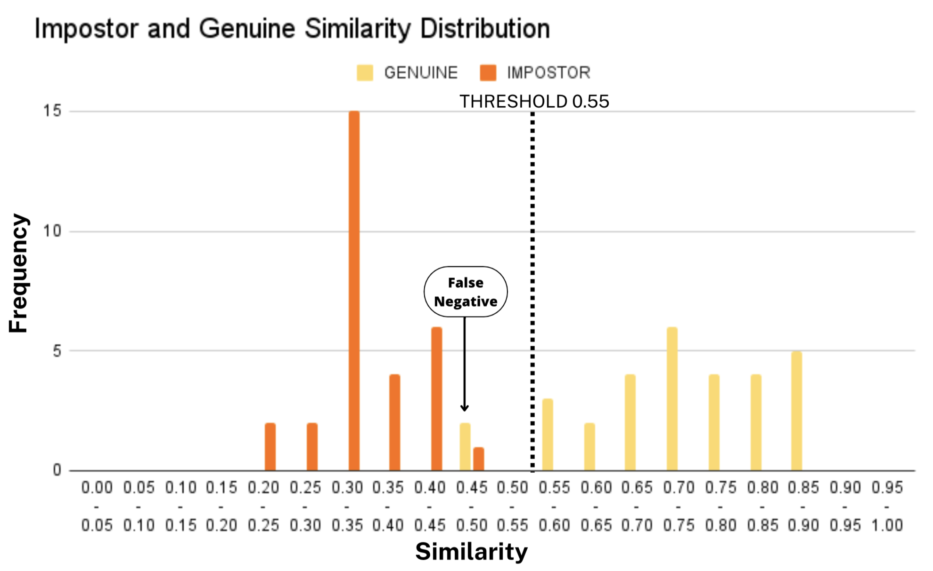
Results - Face Recognition Error
Training: 10 Genuine enrolled with 10 samples each
Test:
20 Identities (10 genuine and 10 impostors)
Same distance from camera, lighting conditions and background
Randomly presented a person to the camera and got the corresponding similarity value
Three times for each person
Results:
Close distributions
Cases of False Negative
No False Positive
Genuine:
Maximum: 0.88
Minimum: 0.45
Impostor:
Maximum: 0.45
Minimum: 0.20

Slide 8
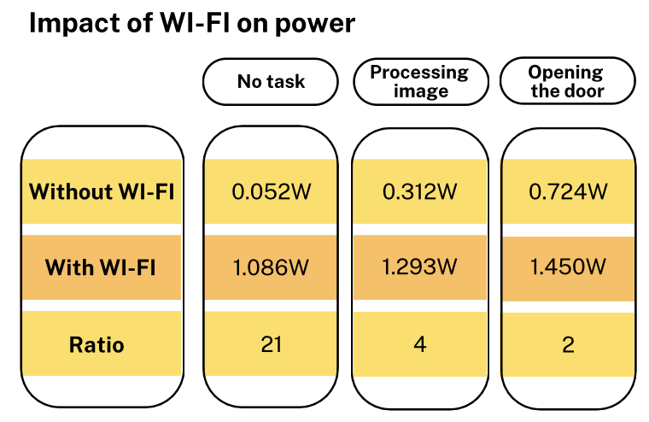
Results - Energy Consumption
Test:
A multimeter was used to measure current and tension of both 5V and 12V circuits
Each value was calculated using the “Power Equation” P (W) = V (V) * I (A)
Results:
Constant tension in ESP circuit: 5.17V
Constant current for each task
The image takes approximately 8s to be processed
Door lock circuit consumption: 6W for 5s when opened
Wi-Fi has a significant impact on power

Slide 9
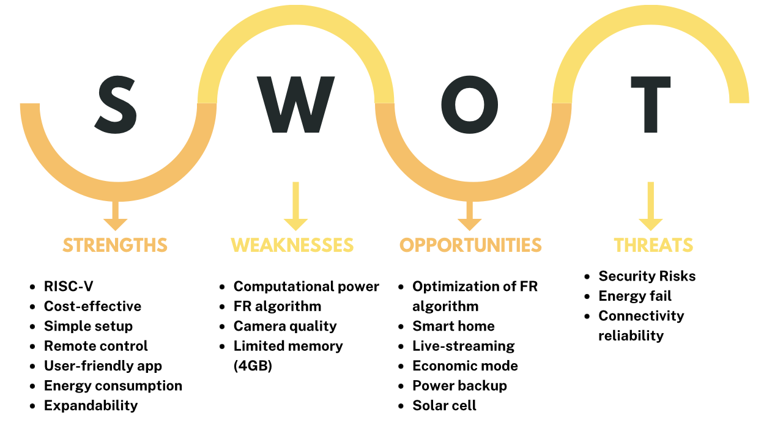
Conclusions

