Slide 1
Persistence
Need to support two persistence mechanism
In memory (for testing)
DB using Hibernate ORM / JPA
Hide that detail from the rest of the code
Several repositories
Factory of repositories according to the persistence stratgey
Factory of repositories Factory to hide the logic of which alternative to use
May use configuration file
Abstract Factory Pattern

Slide 2
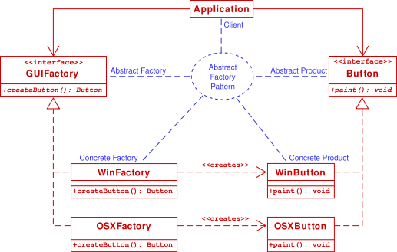
Abstract Factory Pattern
PersistenceFactory
RepositoryFactory
ExpenseRepository
InMemoryRepositoryFactory
InMemoryExpenseRepository
HibernateRepositoryFactory
HibernateExpenseRepository

Slide 3
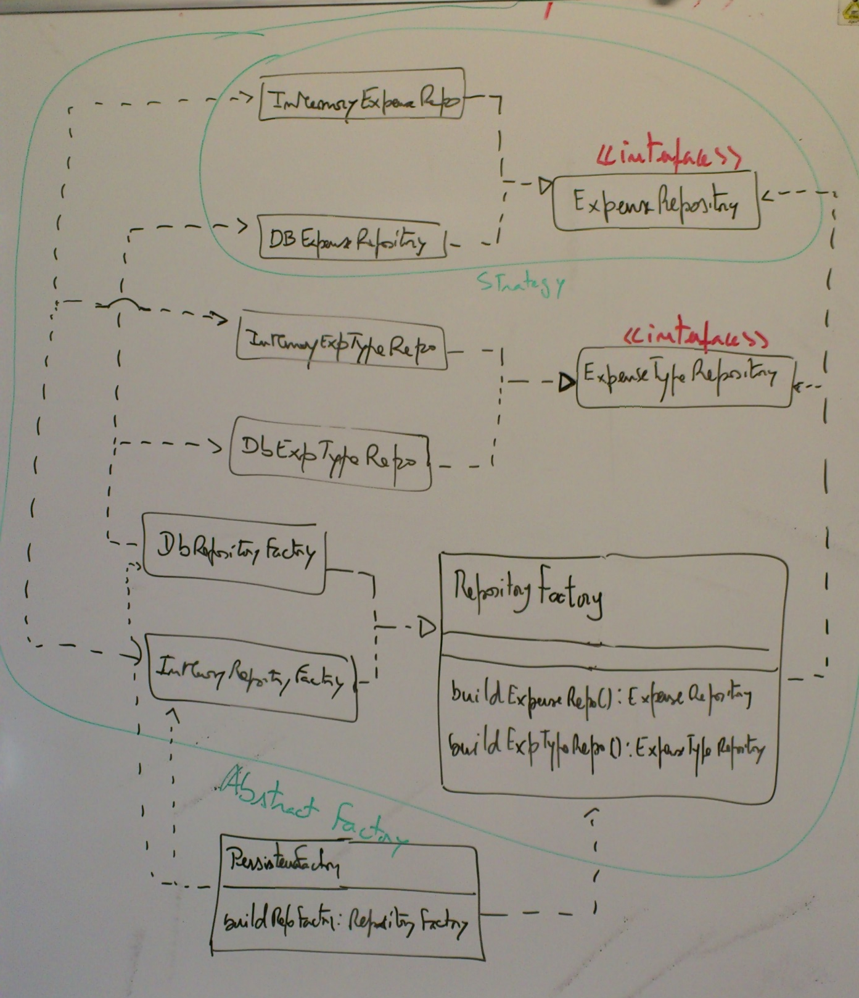
interface
singleton

Slide 4
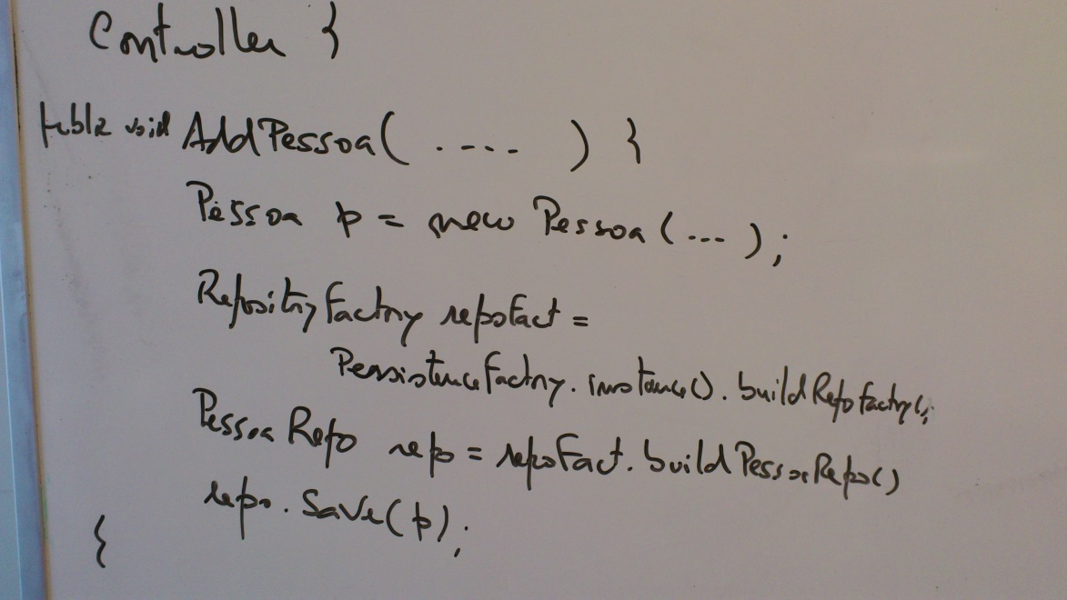
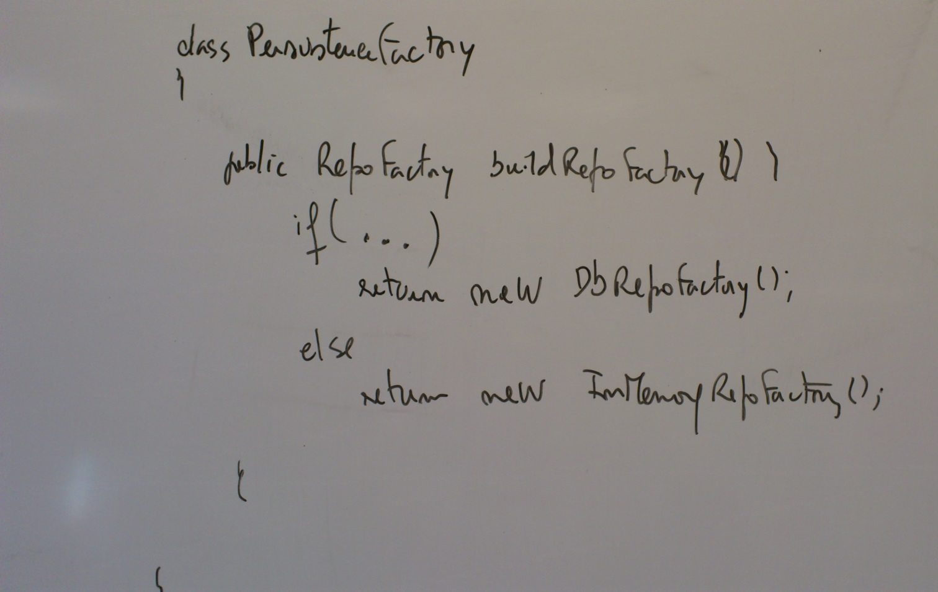
Could be based on a properties file.
Eventually using reflection to create the object

Slide 5
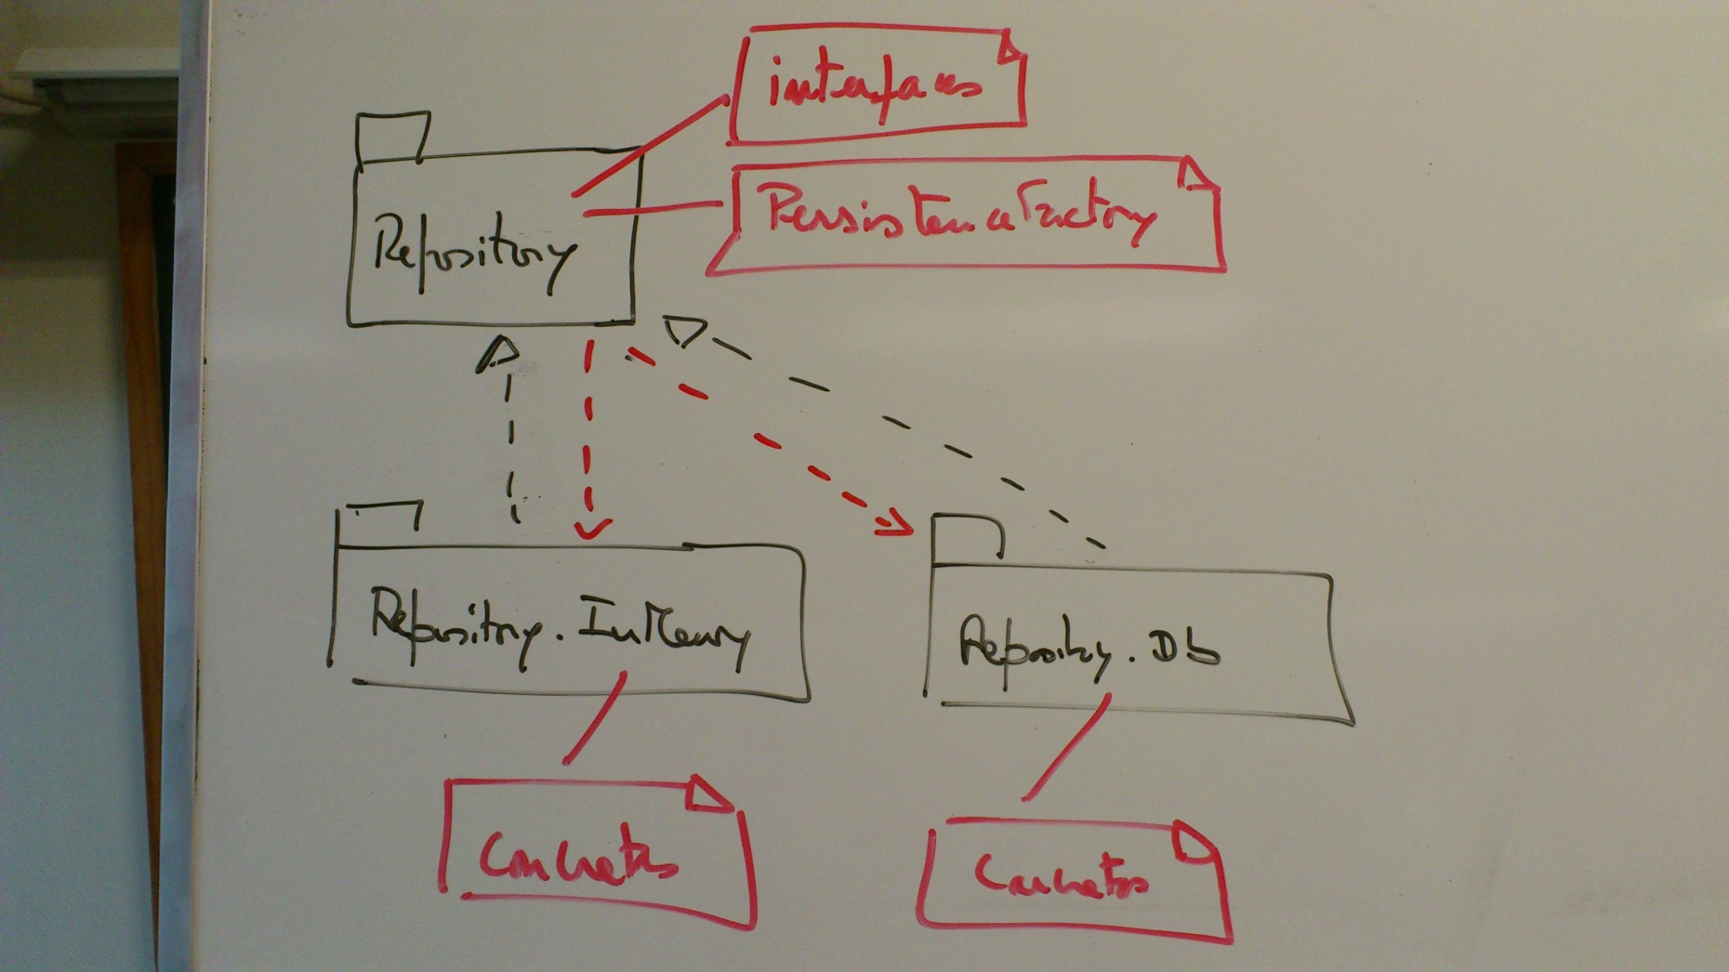
Package structure

