Slide 1
EAPLI Framework

Slide 2
What it is
Standard application framework developed in the scope of the course unit “Engenharia de Aplicações” at Instituto Superior de Engenharia do Porto http://www.isep.ipp.pt

Slide 3
Components
Core
  Domain driven design
  Persistence
  Utilities
  Simple Console Presentation framework
Infrastructure Authz
Infrastructure Pub/Sub
  Event publishing and dispatching

Slide 4
Dependencies
Apache Commons Logging
JPA
Spring Data JPA
Spring Framework dependency injection

Slide 5
Core

Slide 6
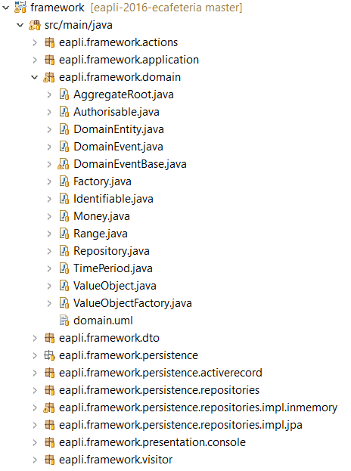
DDD
Domain objects
  Money
  Range
  Time period
DDD pattern interfaces
  ValueObject
  DomainEntity
  AggregateRoot
Notes:
3 packages principais
Model – classes utilitárias que podem ser usadas em qq modelo, ex., «value object» Money
Patterns – essencialmente interfaces para “marcação” de classes DDD. Possui subpackage com implementações auxiliares
Persistence.jpa – classe utilitária JpaRepository

Slide 7
Standard patterns
Actions, a.k.a Command
Memento
Visitor
DTO

Slide 8
Utilities
Console
  Helper console reading functions
DateTime
  Simplifies manipulation of dates and times thru java Calendar
Files
  File manipulation helper
Math
  Sample math utility
Strings
  String manipulation

Slide 9
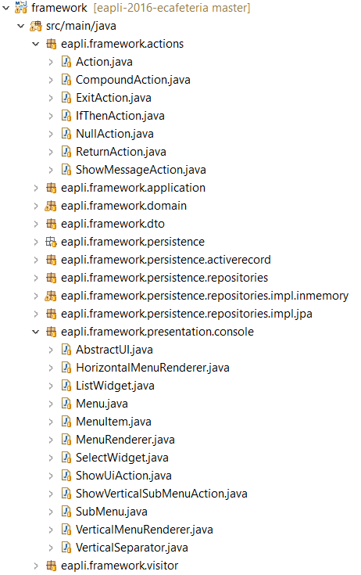
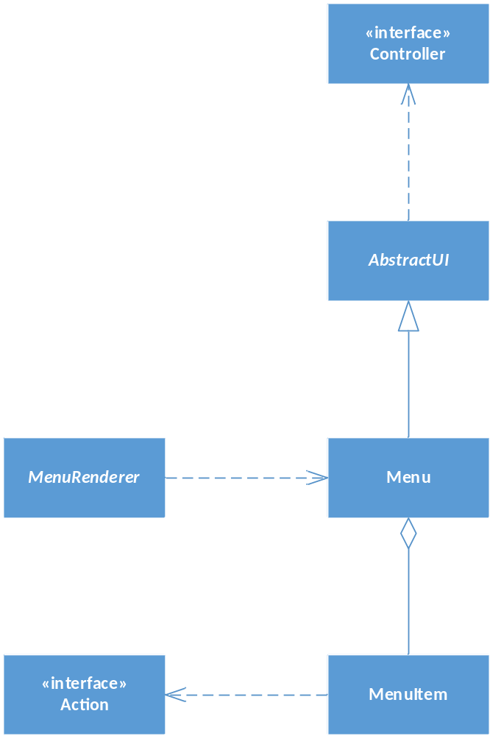
Presentation
Notes:
3 packages principais
Model – classes utilitárias que podem ser usadas em qq modelo, ex., «value object» Money
Patterns – essencialmente interfaces para “marcação” de classes DDD. Possui subpackage com implementações auxiliares
Persistence.jpa – classe utilitária JpaRepository

Slide 10
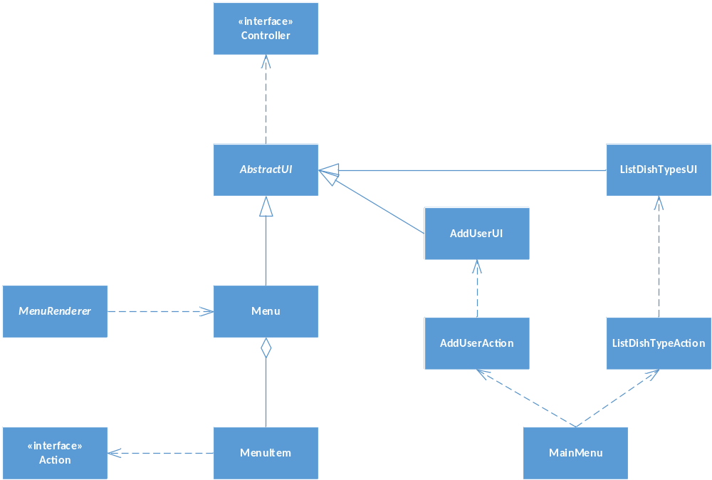
Presentation

Slide 11
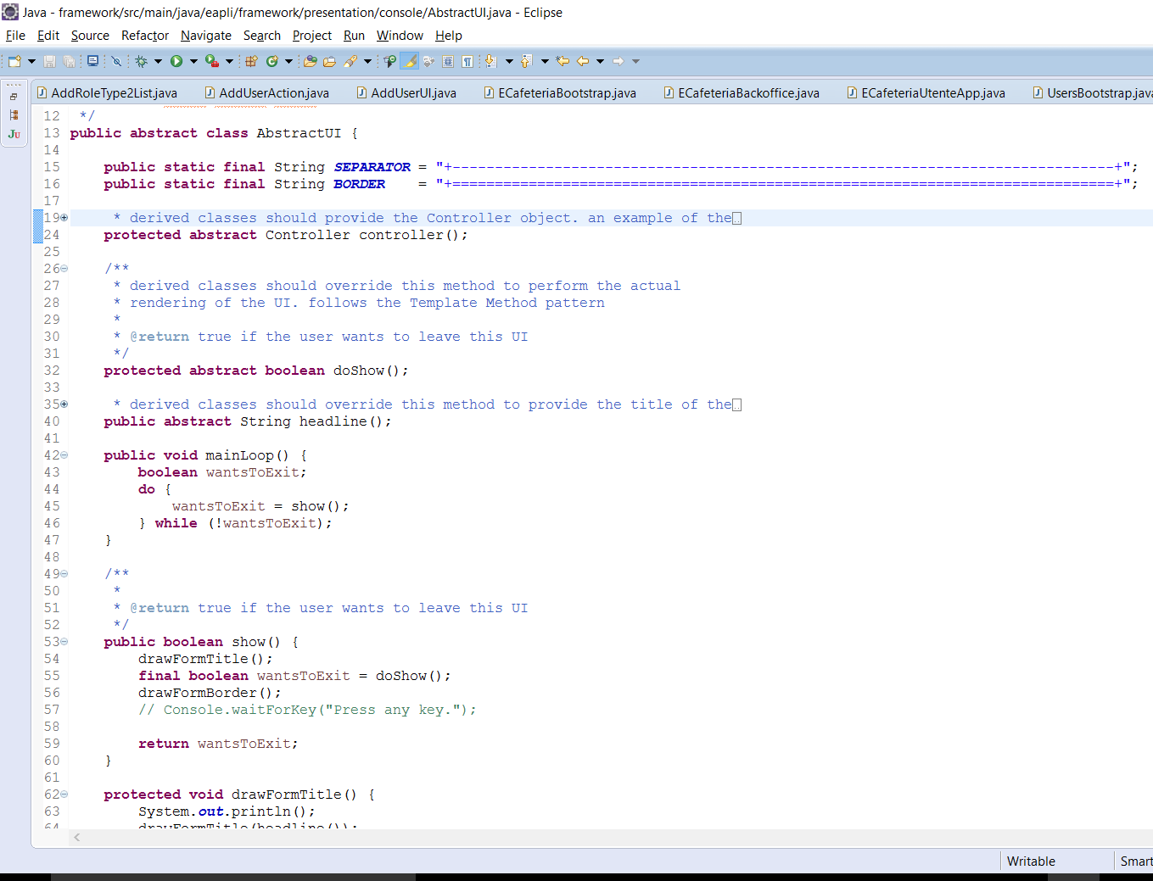

Slide 12
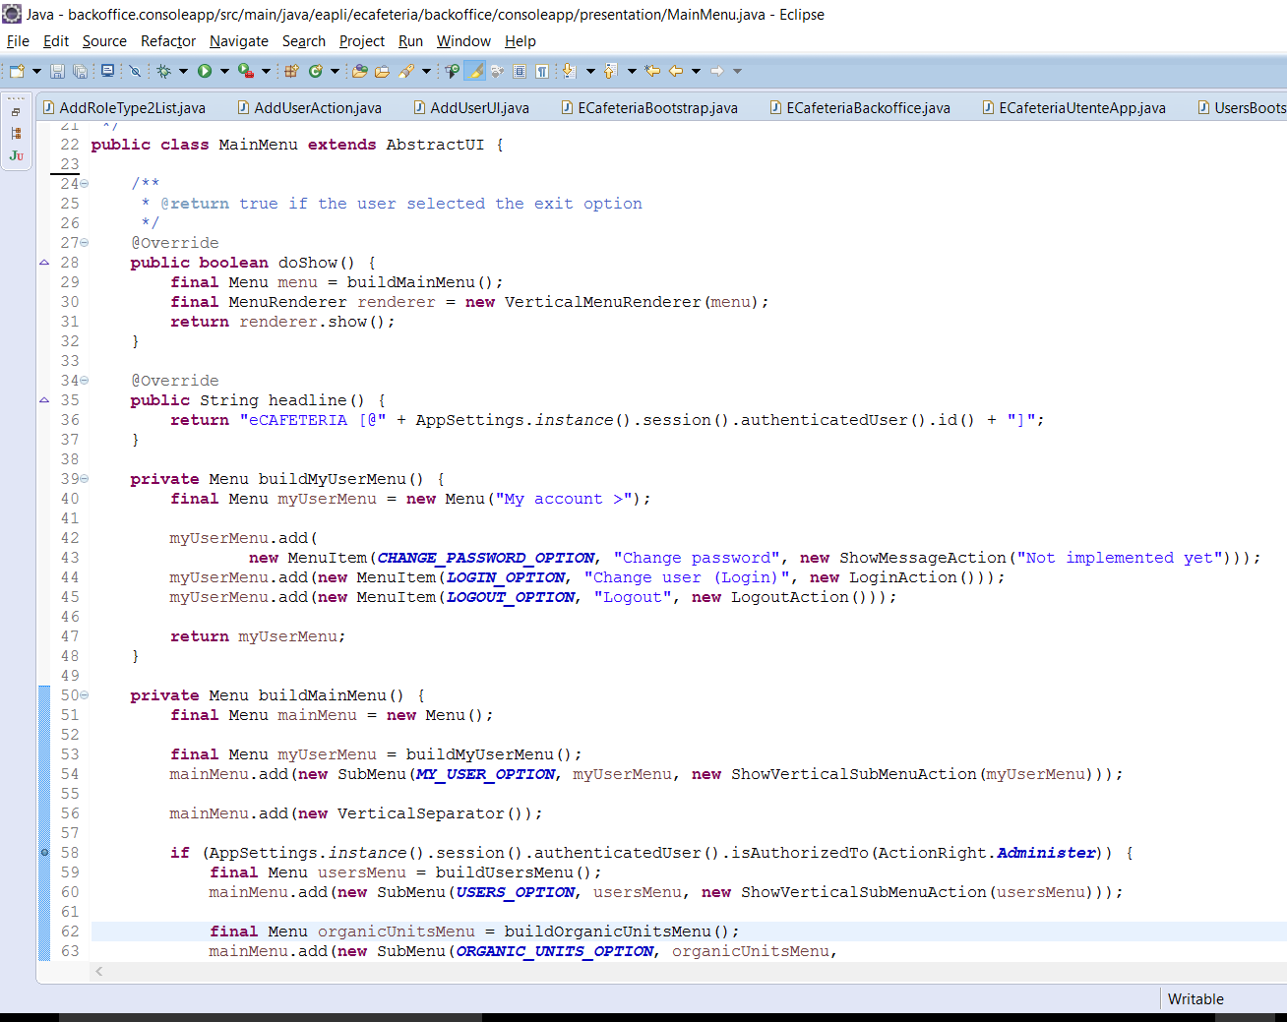

Slide 13
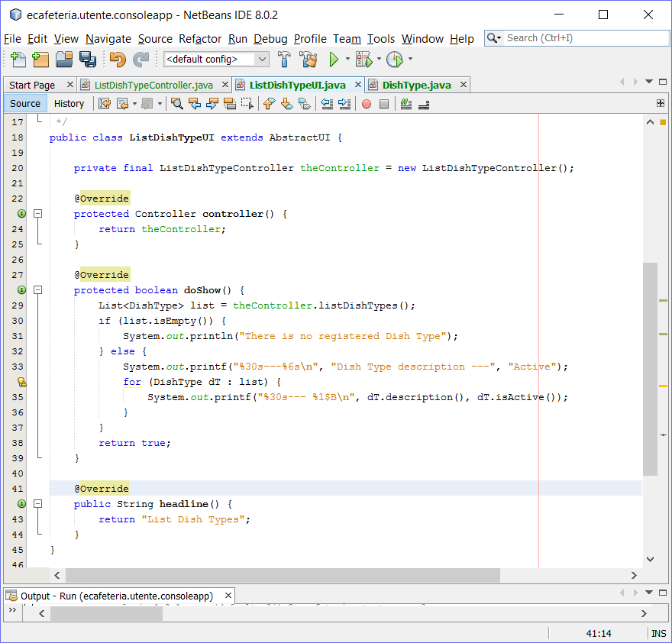

Slide 14
Core
Persistence

Slide 15
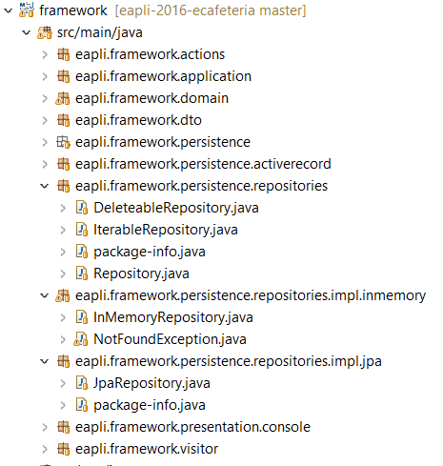
Persistence
Persistence
  Repository interfaces
Implementations
  JPA
  InMemory
  Spring Data JPA
Notes:
3 packages principais
Model – classes utilitárias que podem ser usadas em qq modelo, ex., «value object» Money
Patterns – essencialmente interfaces para “marcação” de classes DDD. Possui subpackage com implementações auxiliares
Persistence.jpa – classe utilitária JpaRepository

Slide 16
Repositories
DataRepository
TransactionalContext
Interfaces for describing repository functionalities and transactions

Slide 17
Persistence
Controller needs to access the repositories
But we have three repository implementations
  In memory
  Relational database thru JPA
  Relational database thru SpringData
Hide persistence details from rest of the code
  Interfaces
  Dependency injection or Factories
Notes:
Necessidade de suportar duas persistências
Em memória
BD usando ORM JPA
Esconder este pormenor do restante código
Vários repositórios (um por agregado)
Fábrica para os repositórios de acordo com tipo de persistência
Fábrica de fábricas para esconder lógica de criação de qual o tipo de persistência a usar
Abstract Factory Pattern

Slide 18
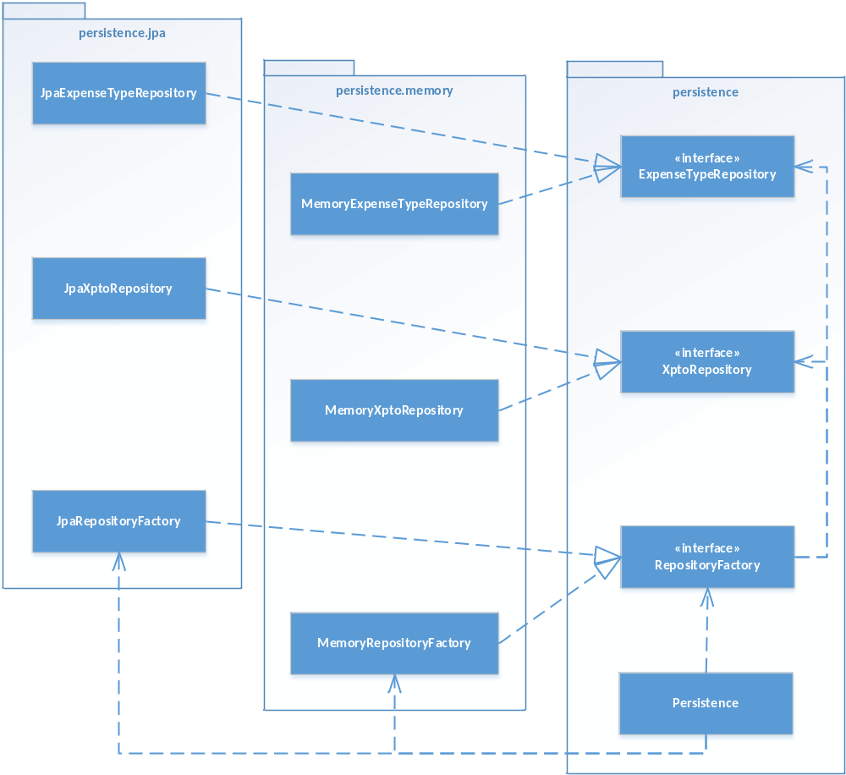
Notes:
Each repository is defined by an interface that is the well known contract to the rest of the application. We will have one repository per domain aggregate.
Since we have interfaces we need a factory to hide the details of the concrete object to create. E.g., ExpenseTypeRepositoryFactory
Since we have several repositories we group their creation in a single factory (i.e., RepositoryFactory) to avoid duplication of code, i.e., each factory would have the decision code to choose which implementation to create. This way the JpaFactory knows it only creates Jpa implementations

Slide 19
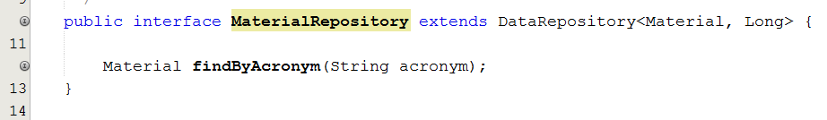
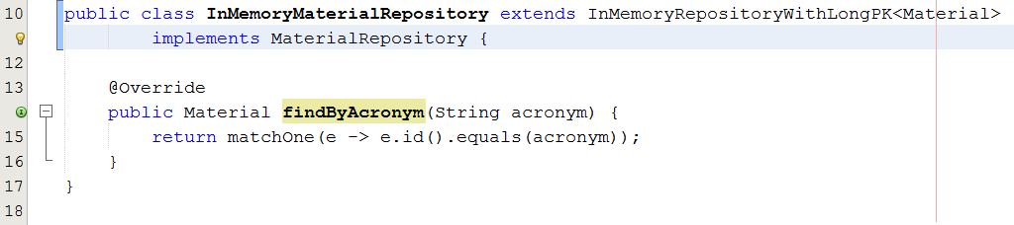
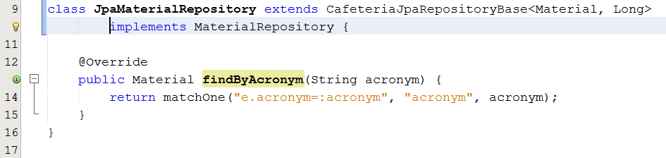
Example

Slide 20
In memory Repositories
InMemoryBaseRepository
InMemoryBaseRepositorywithLongPK
For pedagogical testing purposes only!

Slide 21
JPA Repositories
JpaBaseRepository
  Generic repository implementation that expects the entity manager factory to be injected by a container, e.g., web server
JpaNotRunningInContainerBaseRepository
  For scenarios where the code is not running in a container but transaction is managed by the outside, e.g., controller
JpaTransactionalBaseRepository
  For scenarios not running in a container but transactions are created and committed by each repository method; the connection is also closed automatically in each method.
JpaAutoTxRepository
  Dual behaviour to either have outside transactional control or explicit transaction in each method

Slide 22
Spring Data JPA repositories

Slide 23
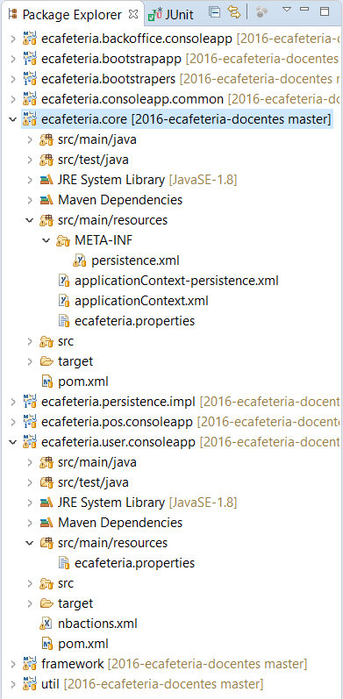
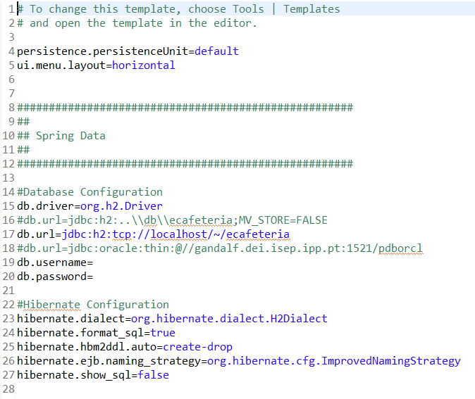
Resources

Slide 24
applicationContext.xml

Slide 25
applicationContext-persistence.xml

Slide 26
Transaction control
Preferably use a container and managed transaction context, e.g., spring
Optionally control the transaction yourself

Slide 27
Transaction control #1
Managed repositories, e.g., Spring Framework
  Spring will load the repositories
  Spring will control the transactional context

Slide 28
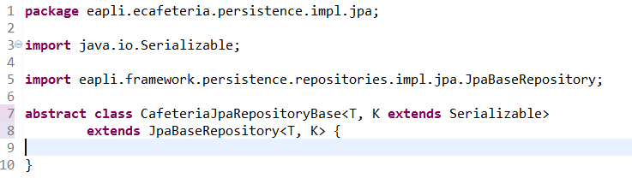
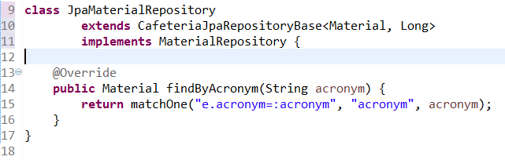
All JPA repositories extend JpaBaseRepository to use spring transactional control

Slide 29
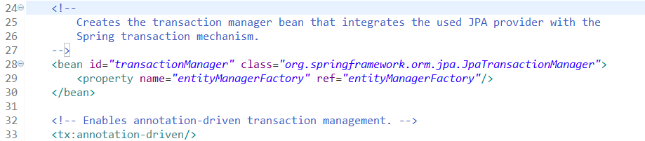
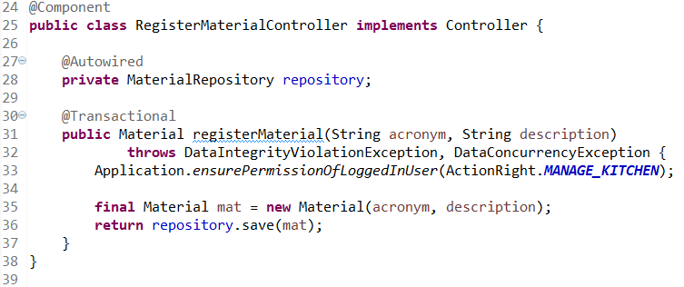
Spring Transactional control

Slide 30
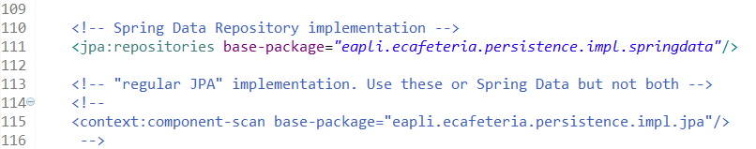
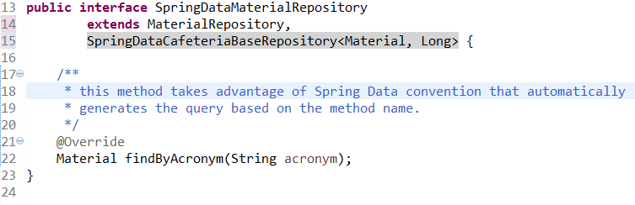
SpringData repositories (1)

Slide 31
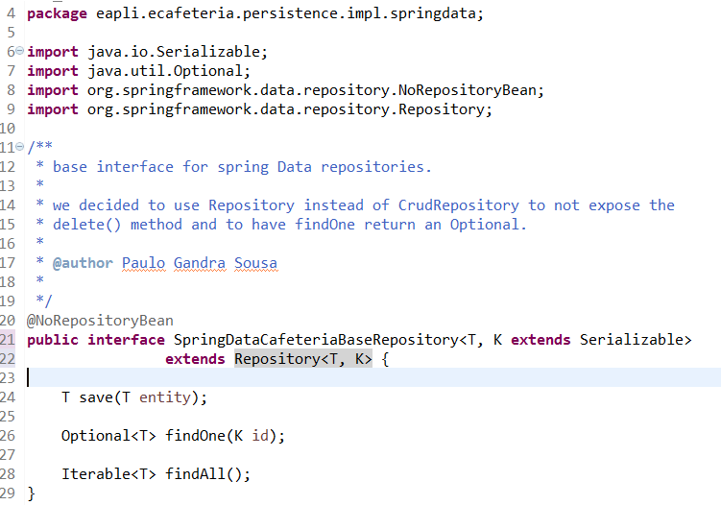
SpringData repositories (2)

Slide 32
Transaction control #2
Control the transaction yourself using helper classes in the persistence package

Slide 33
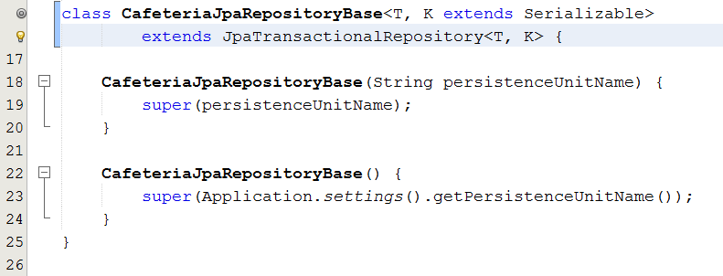
Full transaction control by the repository

Slide 34
Transaction control outside of the repository (1)
Accepting a signup request needs to
  Create a system user
  Create a cafeteria user
  Change the status of the signup request
Three different aggregates!

Slide 35
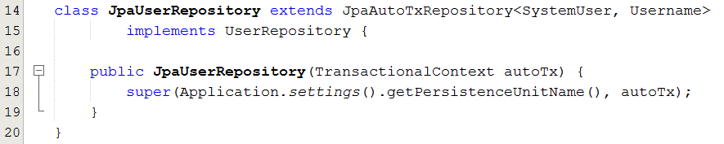
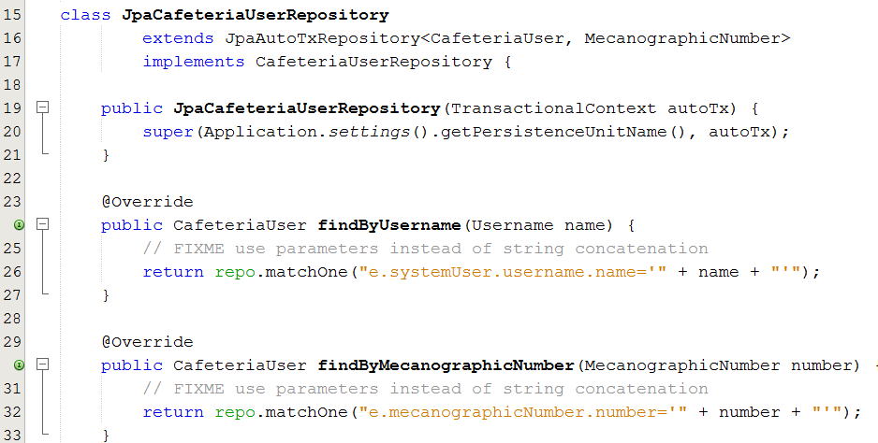
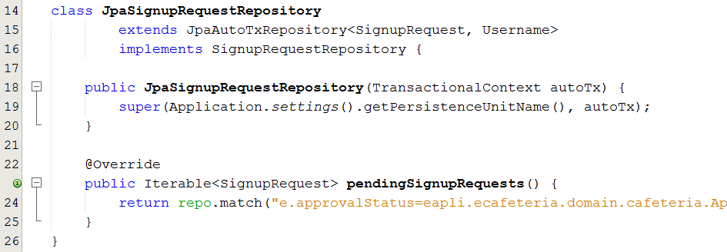
Transaction control (2): use JpaAutoTxRepository

Slide 36
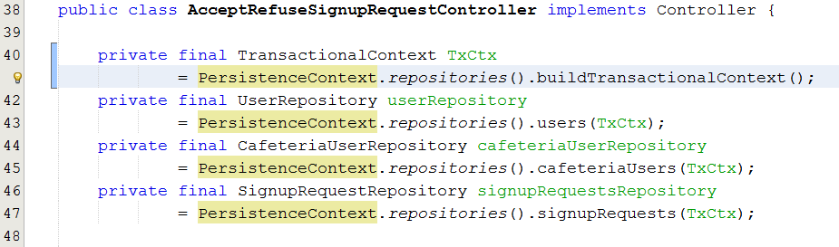
Transaction control (3): explicit control by the controller

Slide 37
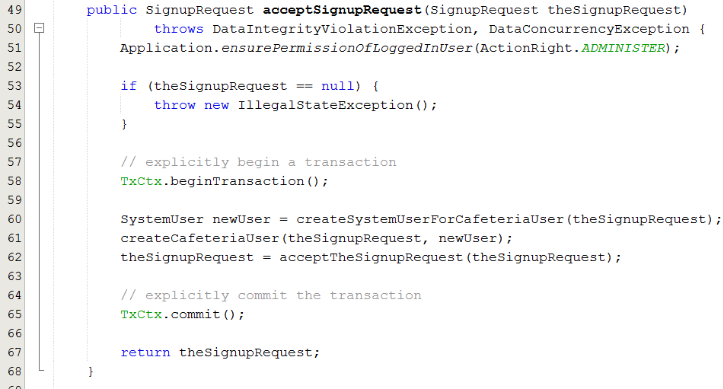
Transaction control (3): explicit control by the controller

Slide 38
Infrastructure Authz

Slide 39
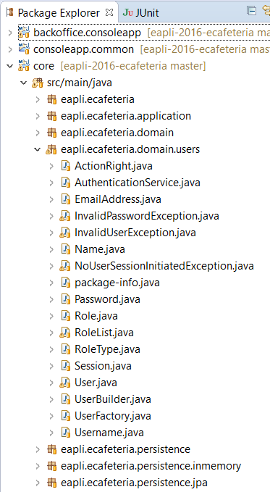
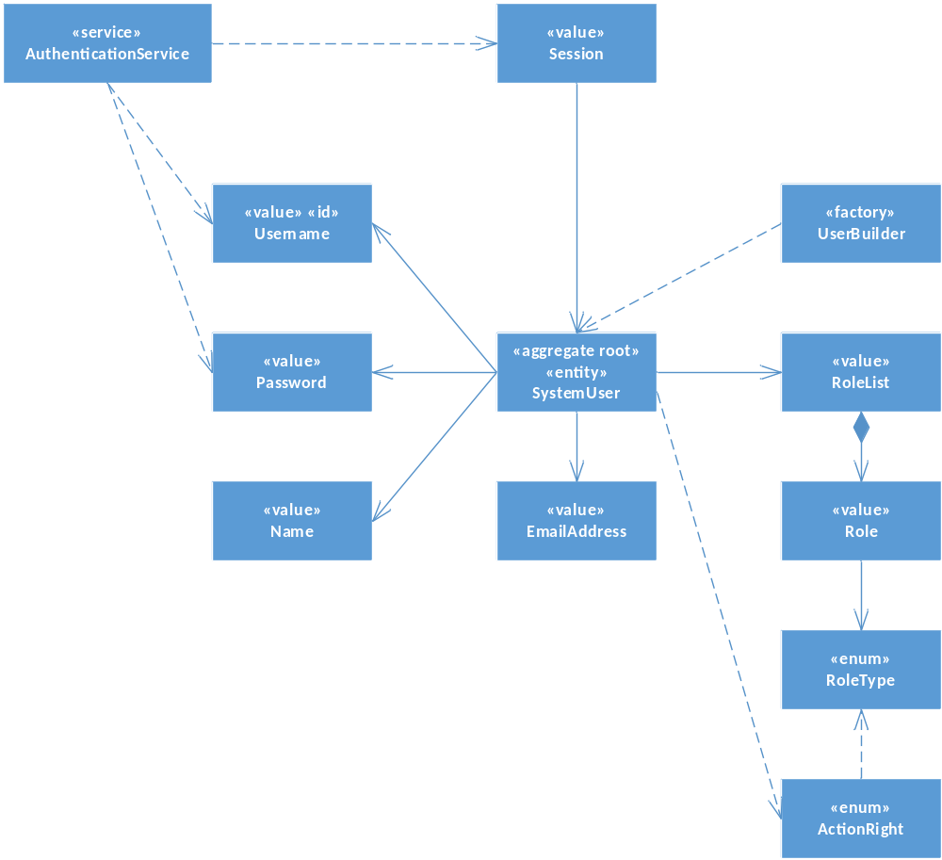
User model

Slide 40
Domain invariants
@Test
public void ensurePasswordHasAtLeastOneDigitAnd6CharactersLong() {
new Password("abcdefgh1");
}
@Test(expected = IllegalArgumentException.class)
public void ensurePasswordsSmallerThan6CharactersAreNotAllowed() {
new Password("ab1c");
}
@Test(expected = IllegalArgumentException.class)
public void ensurePasswordsWithoutDigitsAreNotAllowed() {
new Password("abcdefgh");
}

Slide 41
Domain
public class Password {
…
public Password(String password) {
if (!meetsMinimumRequirements(password)) {
throw new IllegalStateException();
}
thePassword = password;
}
private boolean meetsMinimumRequirements(String password) {
if (Strings.isNullOrEmpty(password)
|| password.length() < 6)
|| !Strings.containsDigit(password))
{
return false;
}
return true;
}
Notes:
Extrato faltam aqui alguns métodos. Devem ver o código fonte completo

Slide 42
Infrastructure Pub/Sub

Slide 44
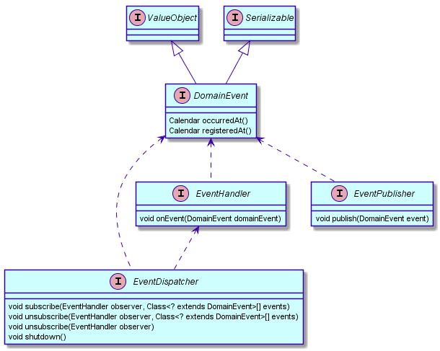
Abstract service

Slide 45
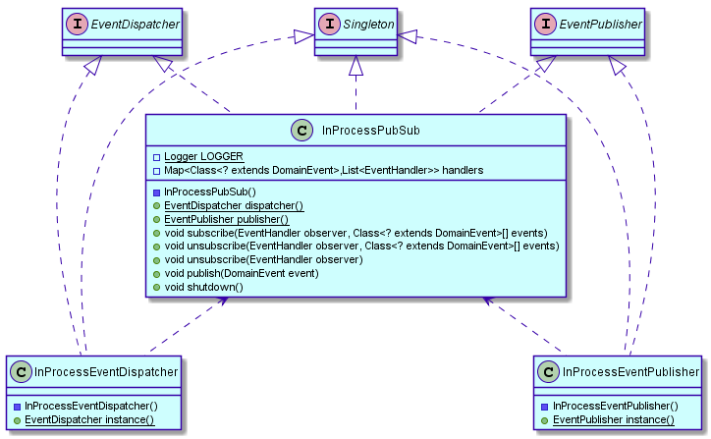
In Process

Slide 46
In Process
Client code uses InProcessEventPublisher or InProcessEventDispatcher via static instance() method or via dependency injection

Slide 47
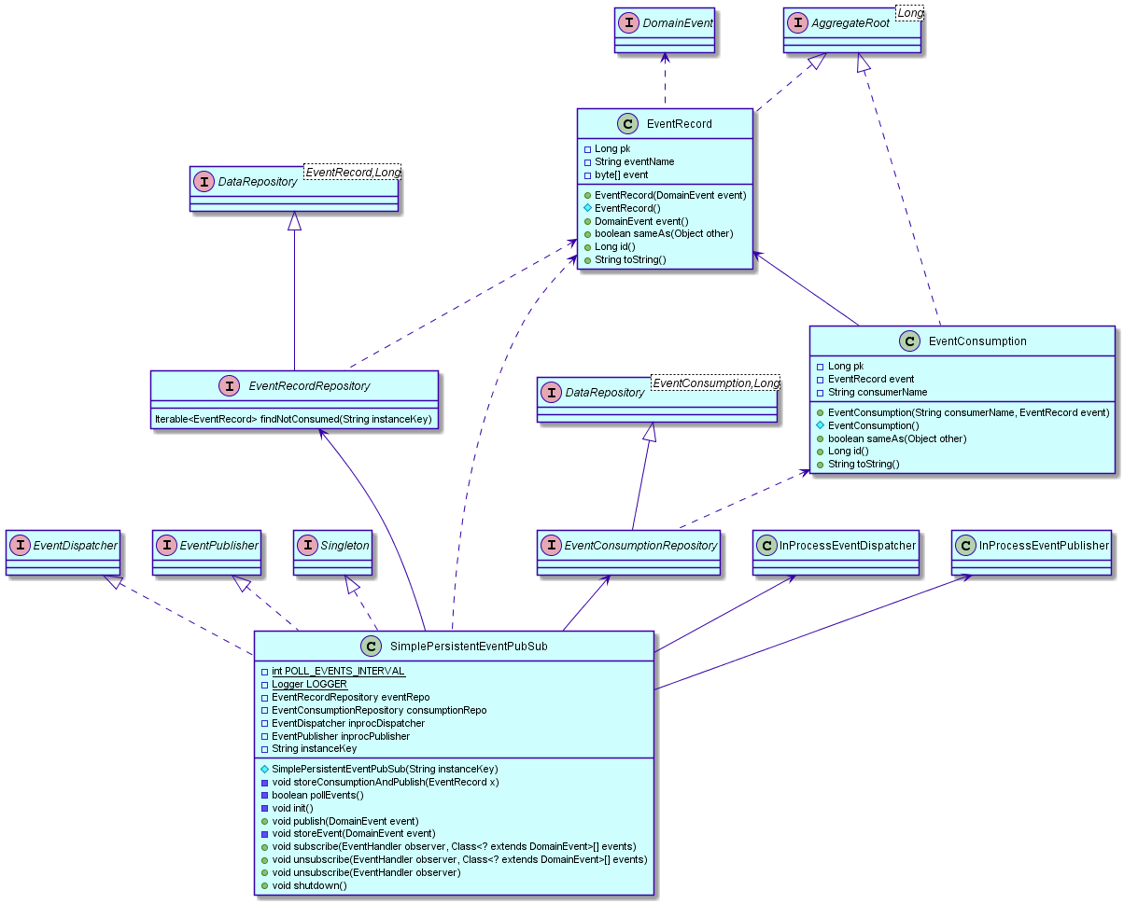
Simple Persistent

Slide 48
Simple Persistent
Use only via dependency injection
Domain entities must be registered in persistence.xml

Slide 50
Build
Maven
  Dependency manager
  Artifact (jar) repository
  Build automation
  Other tasks, e.g., deploy, run
Works for Eclipse, InteliJ, Netbeans
Pom.xml

Slide 51
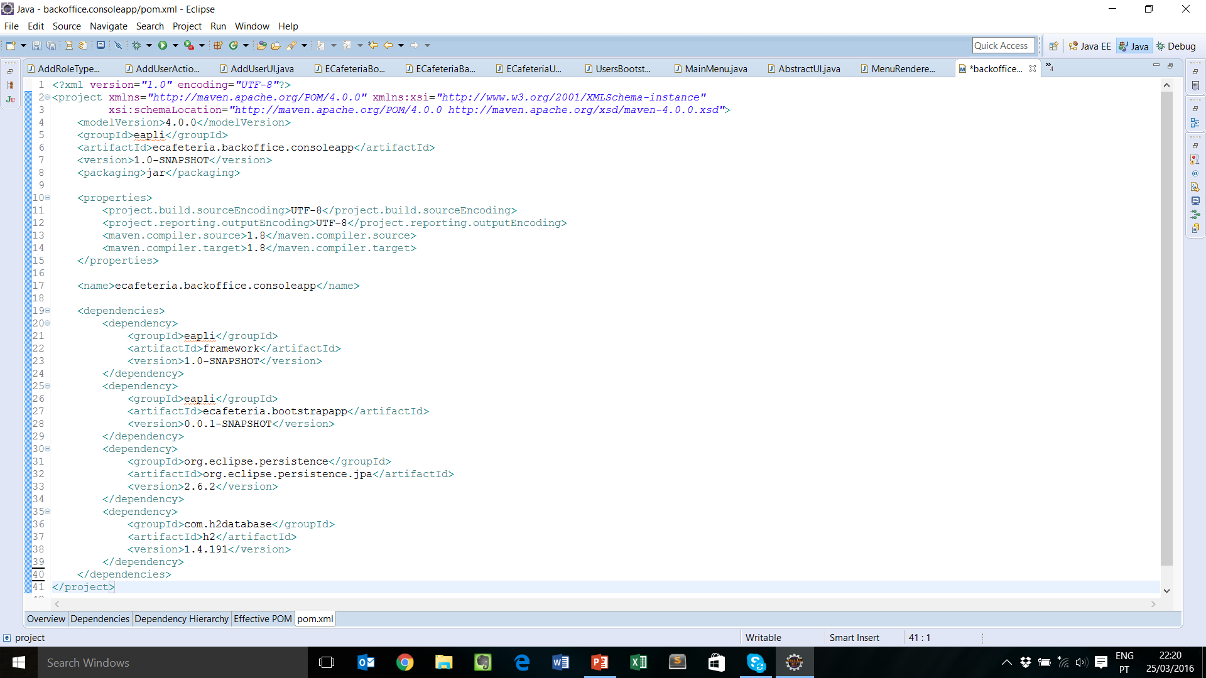

Slide 52
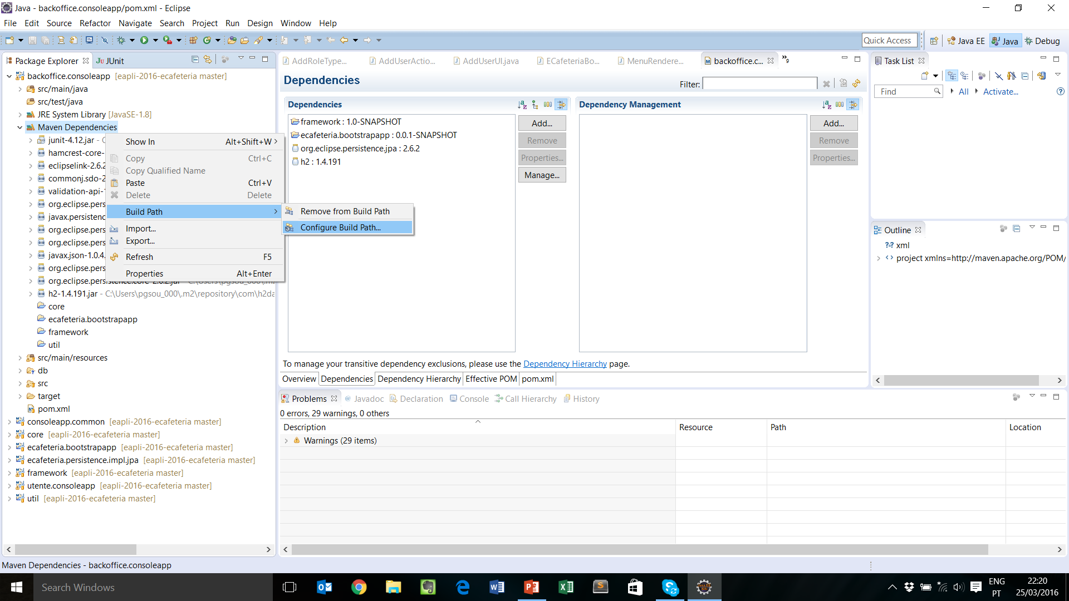
Build

