Slide 1
Sales

Slide 2
Preamble
Sample Sales Data, Order Info, Sales, Customer, Shipping, etc., Used for Segmentation, Customer Analytics, Clustering and More. Inspired for retail analytics. This was originally used for Pentaho DI Kettle, But I found the set could be useful for Sales Simulation training.
Originally Written by María Carina Roldán, Pentaho Community Member, BI consultant (Assert Solutions), Argentina. This work is licensed under the Creative Commons Attribution-Noncommercial-Share Alike 3.0 Unported License. Modified by Gus Segura June 2014.
Original datasource available at https://www.kaggle.com/datasets/kyanyoga/sample-sales-data

Slide 3
Some of our customers
Baane Mini Imports – our oldest and most faithful customer. With us since the begining.
Euro Shopping Channel – our newest customer which was recently acquired by XPTO

Slide 4
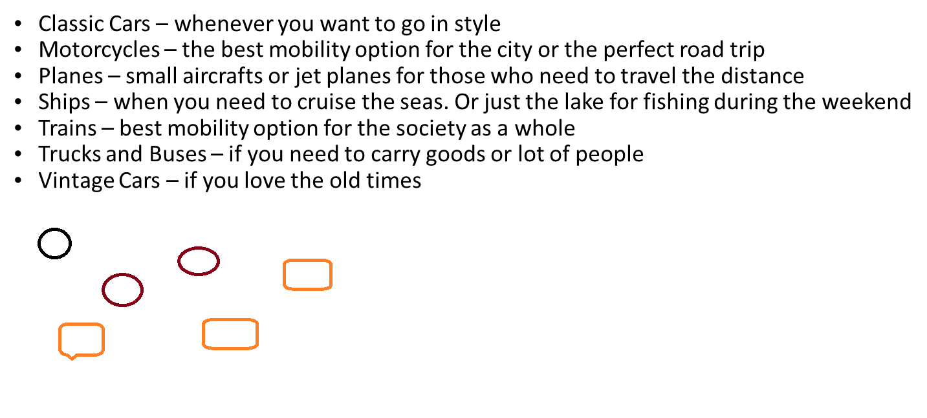
Our product lines
Notes:
This is an image

Slide 5
Total sales per product line
Sum of subtotal | Column Labels
Row Labels | Classic Cars | Motorcycles | Planes | Ships | Trains | Trucks and Buses | Vintage Cars | Grand Total
2023 | 1104942,24 | 310176,51 | 242883,3 | 233746,81 | 70955,24 | 359819,43 | 575626,41 | 2898149,94
2024 | 1335951,93 | 468423,82 | 459210,25 | 324998,78 | 102157,7 | 440763,39 | 782195 | 3913700,87
2025 | 527652,23 | 192485,96 | 175848,66 | 119194,81 | 30691,32 | 146772,36 | 286390,64 | 1479035,98
Grand Total | 2968546,4 | 971086,29 | 877942,21 | 677940,4 | 203804,26 | 947355,18 | 1644212,05 | 8290886,79

