Slide 1
Probes for DOTS
(Ditributed OT Test Suite)
Gomes Costa Paulo Junior
24.08.2026
Prof: Steiner Rico
Expert: Gil Beauge
Infotronics

Slide 2
Contents
Context
Objectives
Hardware analysis
Dual-environment system
Requirements
Probe architecture
Interface with the coordinator
Capabilities
Validation
Conclusion
Future perspectives

Slide 3




Context
OT environments play a critical role in the industry.
Numerous functional and security tests
  Defined
  Executed in a repeatable manner
  Documented
Solution: Distributed OT Test Suite
Manual intervention
Difficult to reproduce
Time consumming
Human error

Slide 4





Objectives
Devlop the probe
Register with a coordinator
Announce the list of its capabilities and configurable parameters
Receiving and executing commands
Support configuration and saves them
Maintain local logs

Slide 5
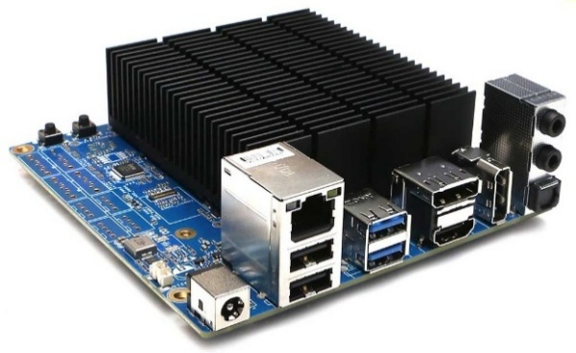
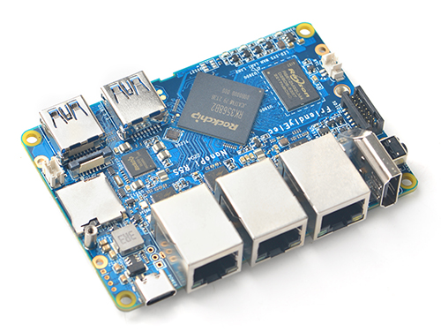
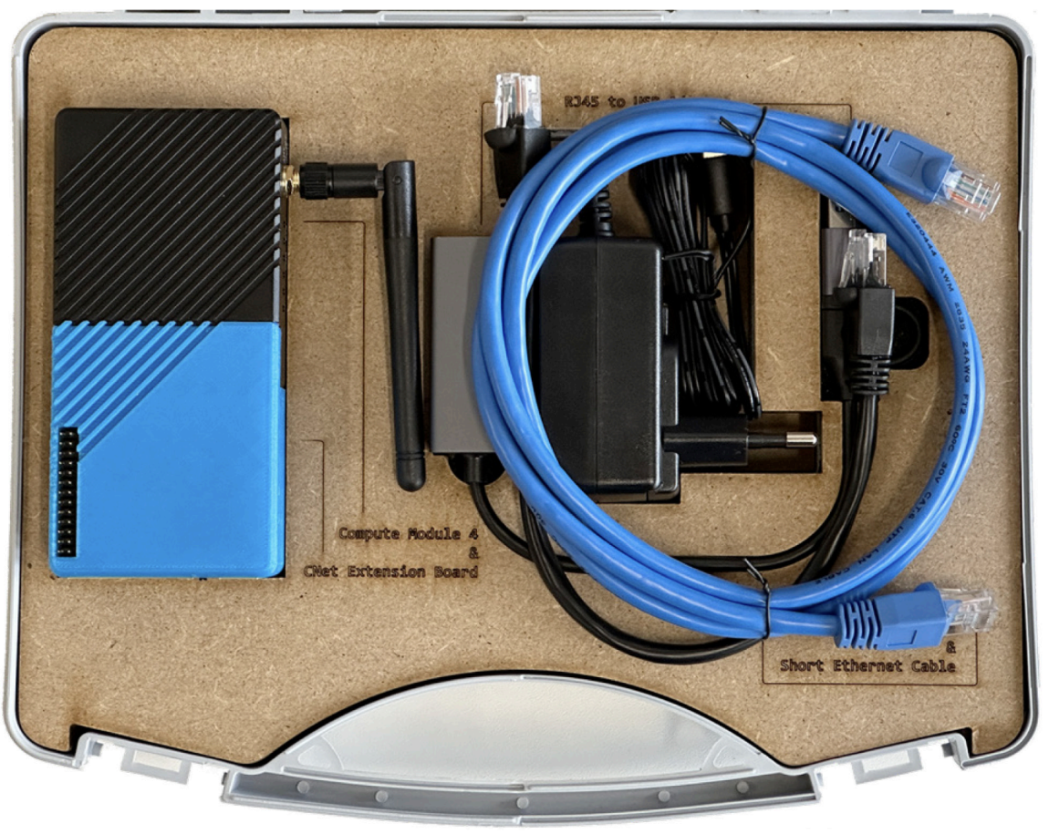
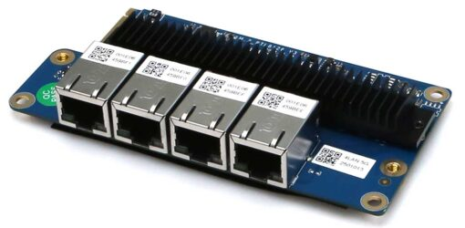
Hardware analysis
Requirements : 3 Ethernet ports and compatible with Linux
NanoPi R5S
Odroid H4 + Netcard 3
Raspberry Pi 4
Images sources:
NanoPi R5S : https://wiki.friendlyelec.com/wiki/index.php/NanoPi_R5S
Odroid H4 : https://www.hardkernel.com/shop/odroid-h4/
Netcard 3 : https://www.hardkernel.com/shop/netcard3-for-h-series/
Raspberry Pi 4 : Socket Programming Lab – cours de CNet

Slide 6
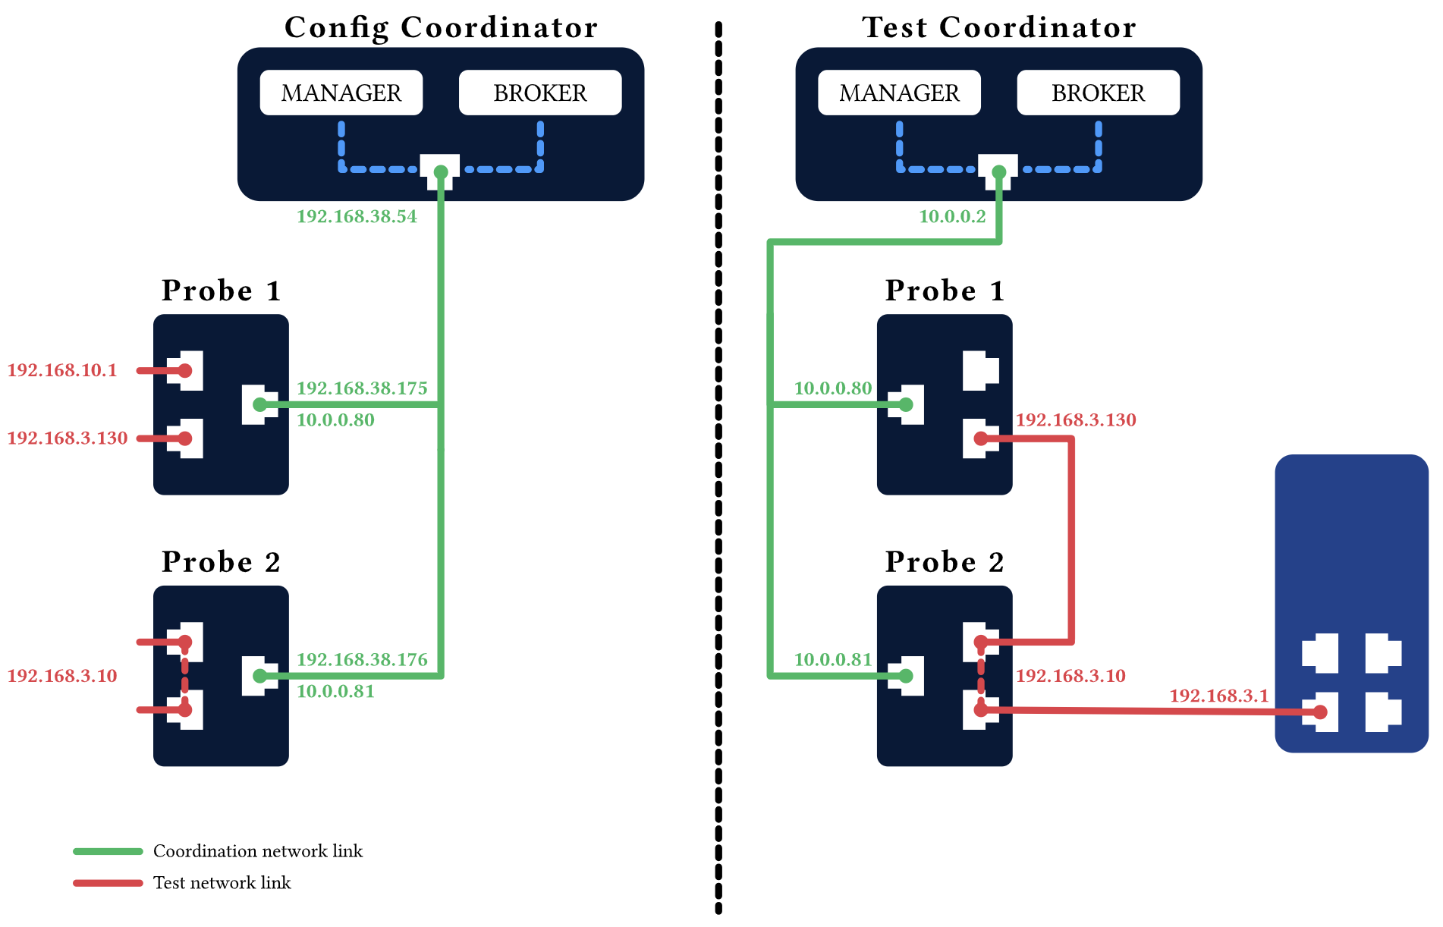
Dual-environment system

Slide 7
Requirements
Main objectives
Register with the coordinator
Announce list of capabilities and configuration parameters
Execute commands
Apply configuration and saves them
Dynamic integration
Dynamically generate the coordinator web interface
Commands and configuration
Complete definition
No coordinator changes
Simplify functionality addition
Network configuration
Bridge the two test interfaces
Static and dynamic IP adresses
Environment adaptation
Broker detection
Apply required configuration

Slide 8
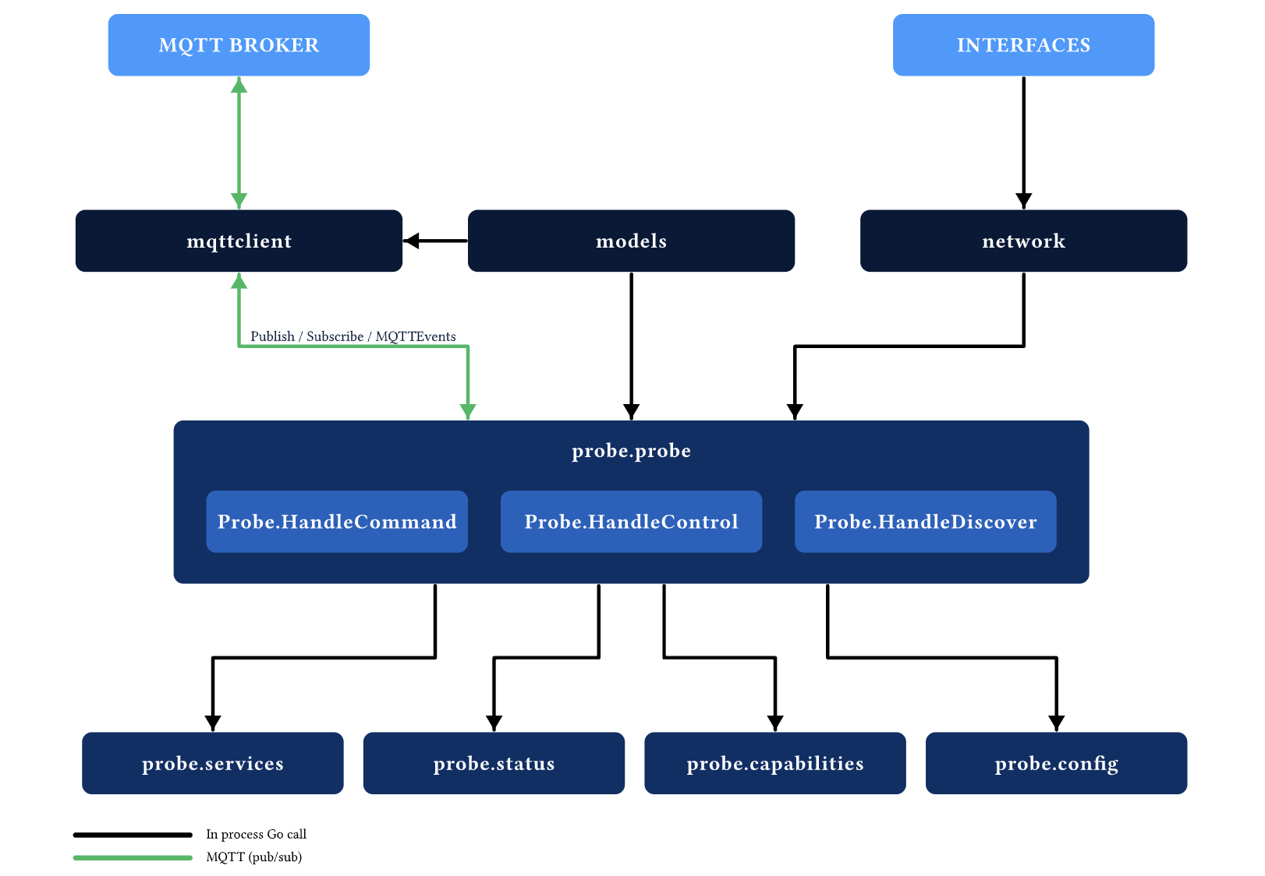
Probe architecture

Slide 9
Probe architecture – Main packages
Pacakge | Responsability
mqttclient | This package implements the MQTT client used to communicate with the MQTT broker.
network | This package handles the probe's network interfaces.
models | This package defines the data structures used for all MQTT messages exchanged by the probe.
probe | The probe package contains the main execution logic and relies on the mqttclient, network, and models packages to perform its operations.

Slide 10
Probe architecture – Internal packages
Package | Responsability
probe | Contains the core logic of the probe
services | Contains the implementations of the different command supported by the probe.
status | Handles the periodic sending of status messages to report the current state of the probe.
capabilities | Contains the definitions of all commands supported by the probe.
config | Handles the probe configuration parameters as well as their persistence in a JSON configuration file.

Slide 11
Interface with the coordinator
Topic | Direction | Prupose
probes/discover | Coordinator → Probe | The coordinator ask every probe to announce itself
probes/announce | Probe → Coordinator | The probe announce is presence
probes/{probe_id}/status | Probe → Coordinator | The probe send peridoic message that inform the coordinator that the probe is still online
probes/{probe_id}/control | Coordinator → Probe | Send a configuration request
probes/{probe_id}/command | Coordinator → Probe | Send a command request
probes/{probe_id}/response | Probe → Coordinator | Answer a configuration request or a command request

Slide 12
Capabilities
The probe provides a set of network testing capabilities.
Capability | Purpose | Libraries
Ping | Verify network connectivity | pro-bing
Capture | Capture the traffic passing through a network interface. | gopacket
Port Scan | Identify the open ports | nmap
HTTP | Support generic HTTP request command | net/http
TCP / TCP echo server | Support sending generic TCP data | net
UDP / UDP echo server | Support sending generic UDP data | net
PCAP file sending | Reproduce predefined network traffic | gopacket/pcap

Slide 13
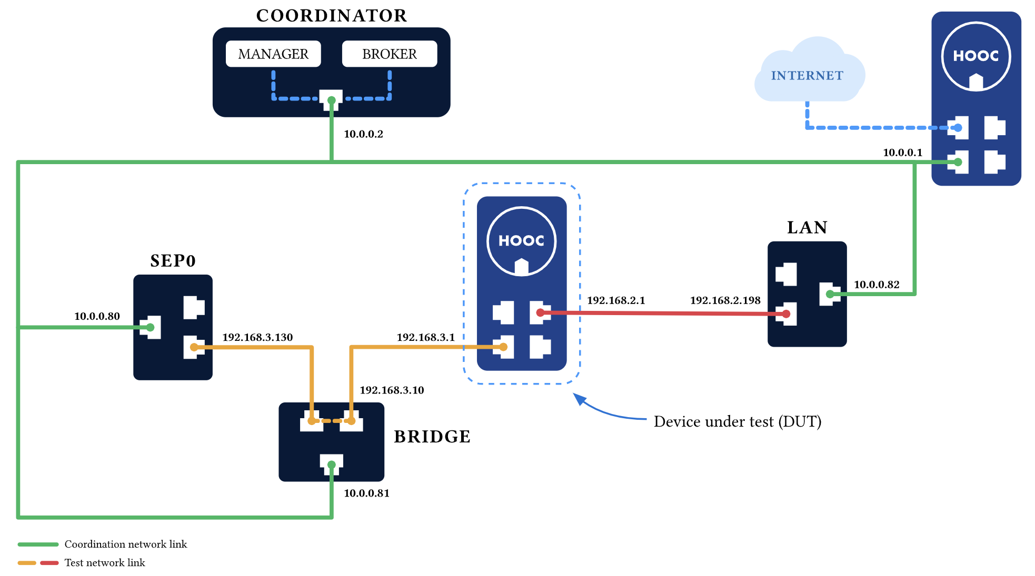
Test bench

Slide 14
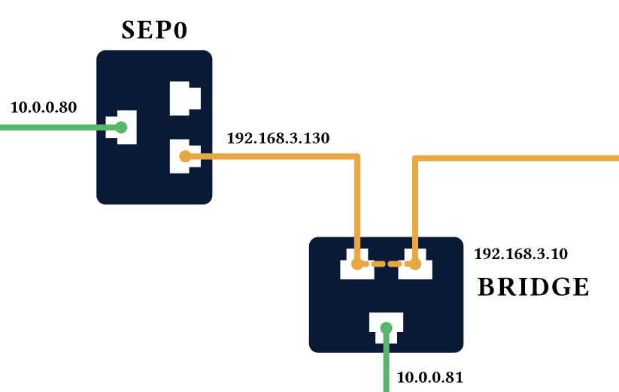
Limit tests – capture command
Objectif: Determine the maximum PCAP size the probe can process
PCAP file → Base64 → JSON → MQTT
Result: Maximum PCAP size ~325 MB
Limitation by MQTT protocole

Slide 15
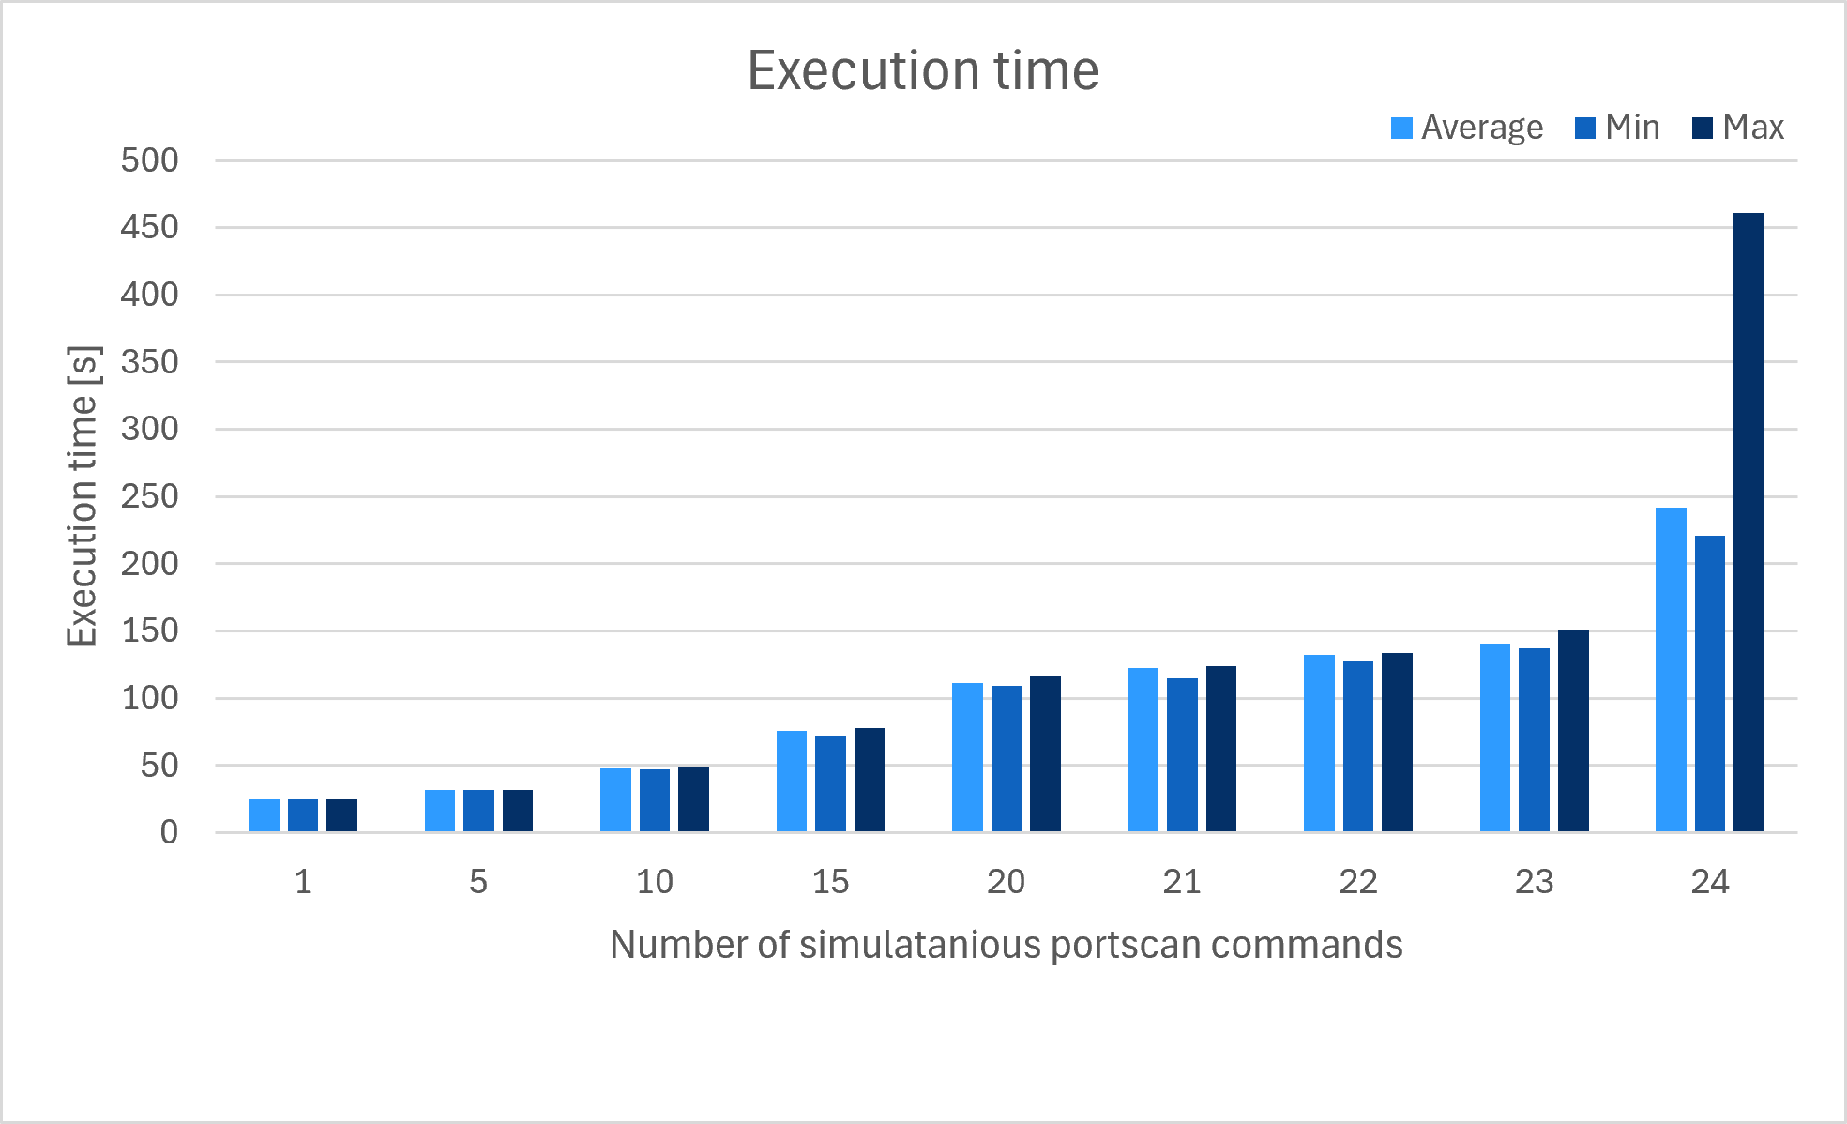
Limit tests – parallel command
Parallel portscan commands
Parallel ping commands
  With count = 100, Max = 200 commands
  With count = 10, Max = 250 commands
Parallel TCP / UDP commands

Slide 16
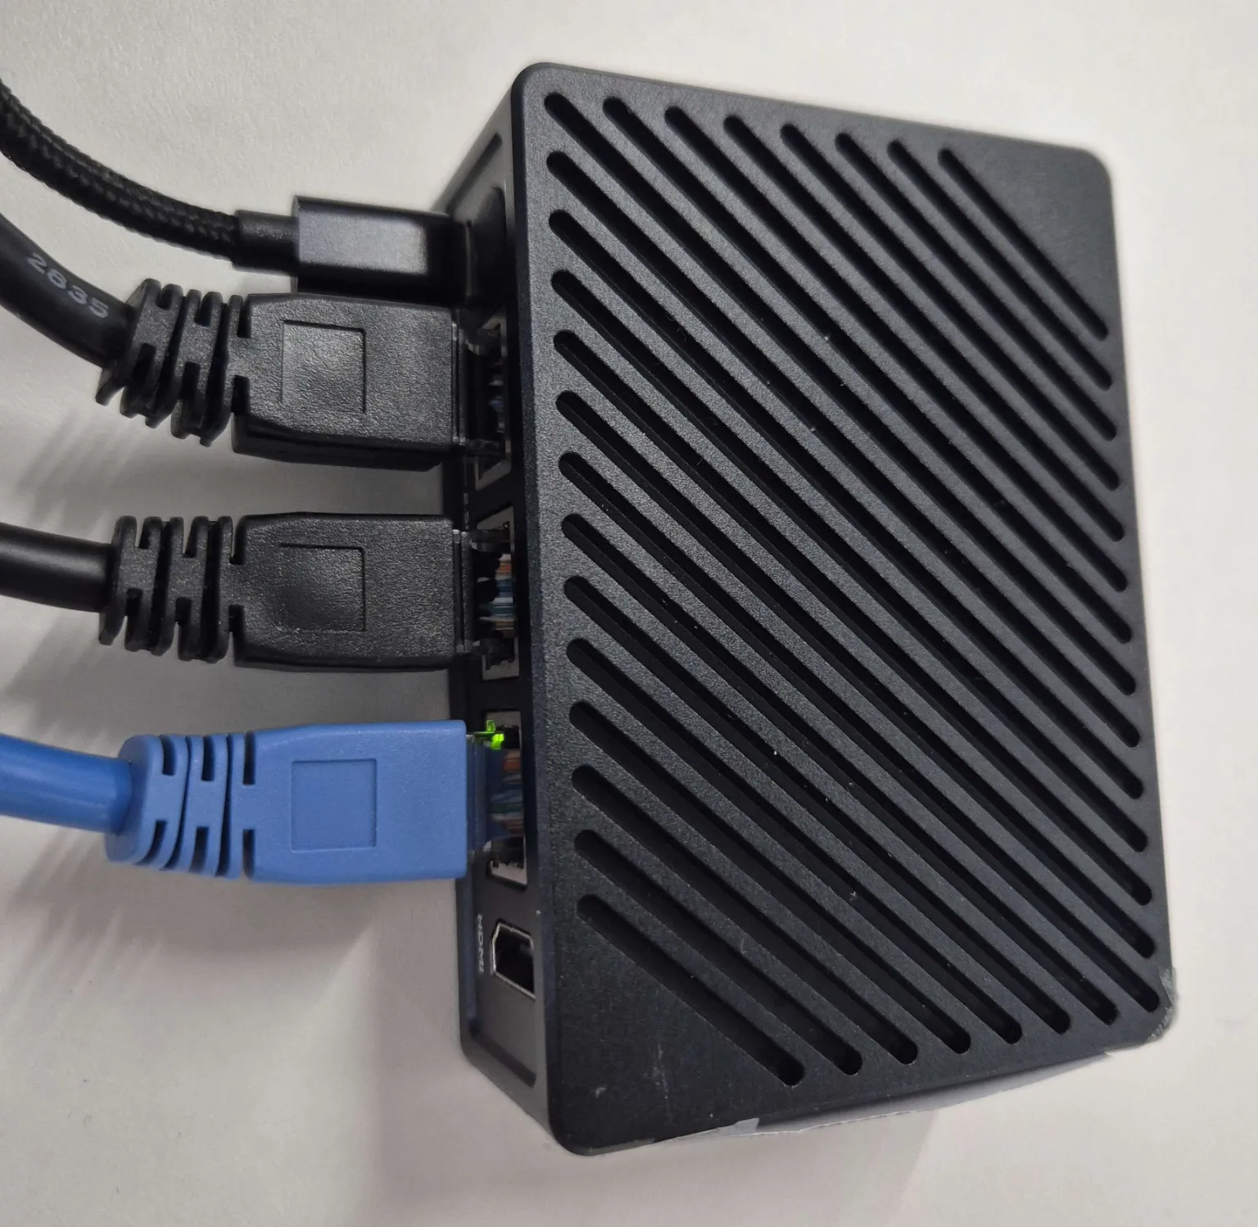
Conclusion
All the requirements were meet
Main objectives
Network configuration
Dynamic integration
Environment adaptation
Valdiation

Slide 17
Future perspectives
Extended network configuration
  Gateway for the test interfaces
  Custom DNS for each interface
PCAP file transfer in multiple parts
  Allow larger captures to be transferred
Additional test capabilities
  Cover more testing scenarios
  Probe more complete

Slide 18
Thank you for your attention!
Do you have any questions
Notes:
Thank you for your attention. I’m now available to answer any questions you may have.

