Slide 1
HSE Font
https://www.linkedin.com/in/ppaixao/
pssp25@hotmail.com

Slide 2
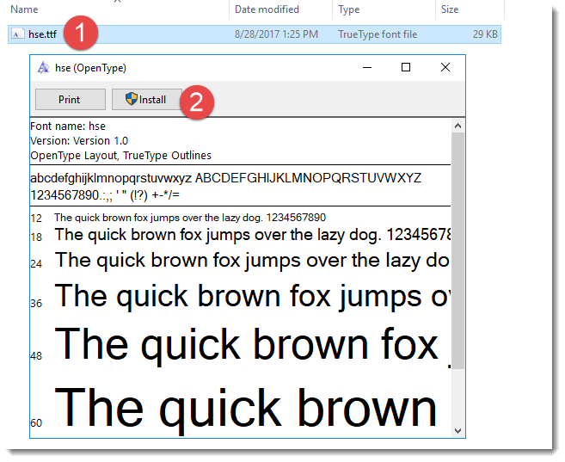
Download and Install
Download (ttf – True Type Font) from the following link:
https://github.com/PauloPaixao/hse-font/raw/master/font/hse.ttf
Double click the downloaded file: hse.ttf

Slide 3
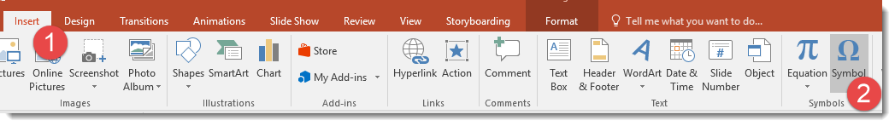
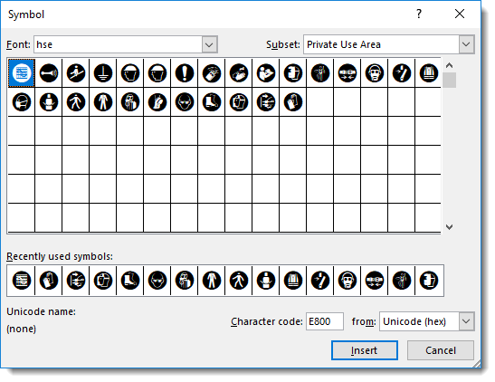
Using Font
From Word, Excel or PowerPoint
Click Insert
Select Symbol
Select font “hse”
Click the icon you want to use

Slide 4
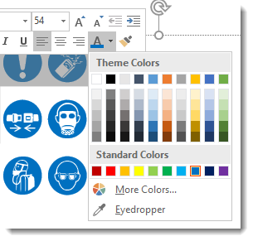
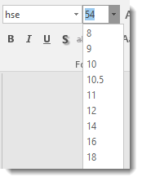
Insert Icons




Change Font Size
Change Color

Slide 5
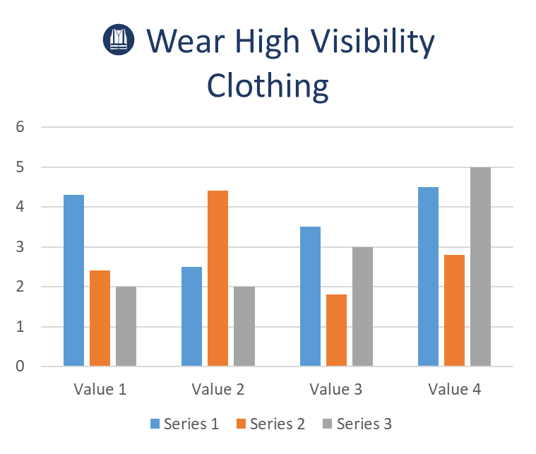
Use with Charts

