Slide 1


Slide 2
Mobile Game
Unity
Visual Studio
C# based scripts
Free assets
Some patience

Slide 3



Slide 4
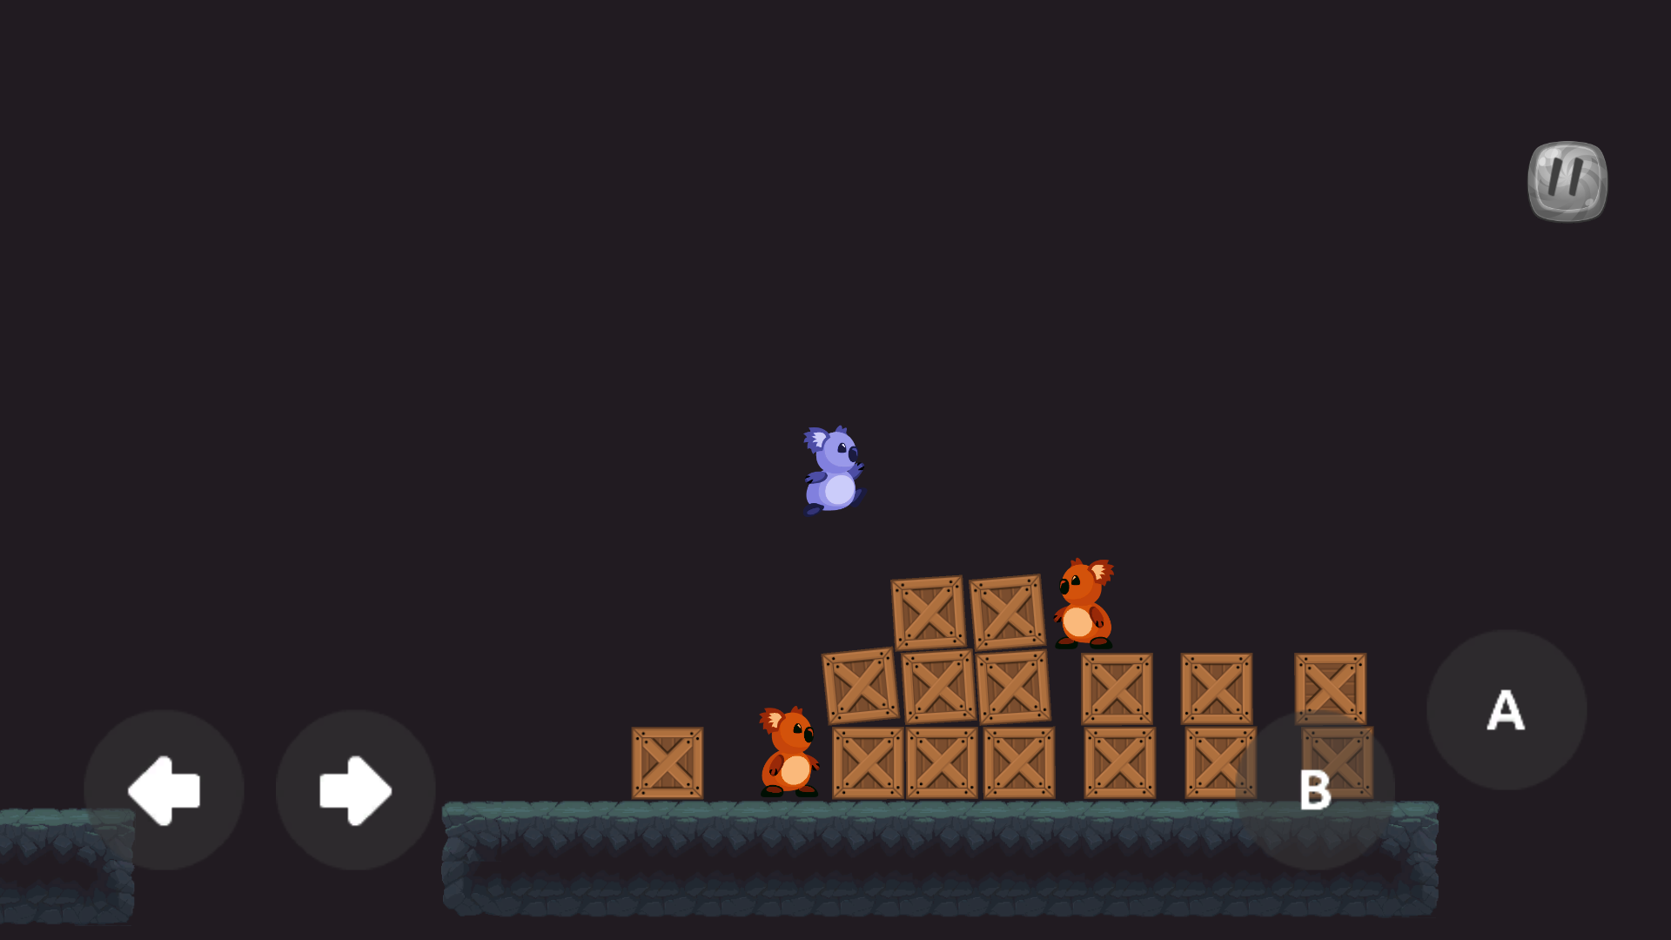

Slide 5



https://github.com/PauloPolaco/KaveKoala

Slide 6

Sprite based | 2D Platformer

Slide 7
Challenges
Make the game difficult but beatable
Playable on different form factors
Work on low end devices

Slide 8
Components
Sprite Renderer
Box Collider 2D
Line Collider 2D
Rigid Body 2D
Animator
Custom Scripts

Slide 9

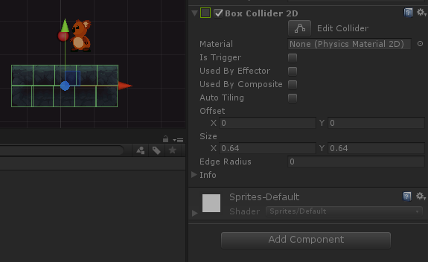
Box Collider

Slide 10
Box Collider vs. Line Collider
Box collider goes around entire object
Line collider great for:
Walls & floors
Stopping enemies
End of level
Dying when you fall off map
Add custom scripts for events

Slide 11
Scenes
Custom scene manager script
Cannot reload scenes with same state
Scenes must be loaded on top of each other

Slide 12
Prefabs
Pre-created or “prefabricated” objects
Have settings already predefined
Are clones of the same object in memory
Only used for bullet objects

Slide 13
Unity
It’s free for indie games
Comes with Visual Studio 2017
Only compiles 32-bit Android
Must download newer version for Android 64-bit
SDKs for each platform are separate downloads

Slide 14
Mobile Resources
Can load dynamic resources
They must be loaded from .\RESOURCES folder
Due to mobile platform packaging restrictions

Slide 15
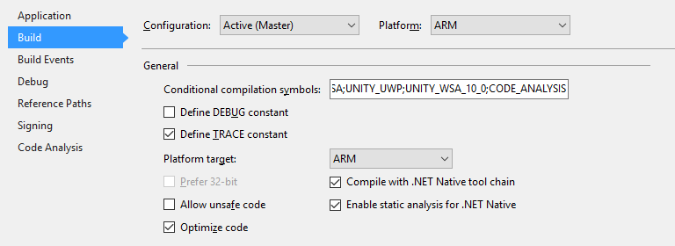
Build config must be MASTER
to pass WACK for Windows Store

Slide 16
Lets See The Code
https://github.com/PauloPolaco/KaveKoala

Slide 17
https://github.com/PauloPolaco/KaveKoala

