Slide 1


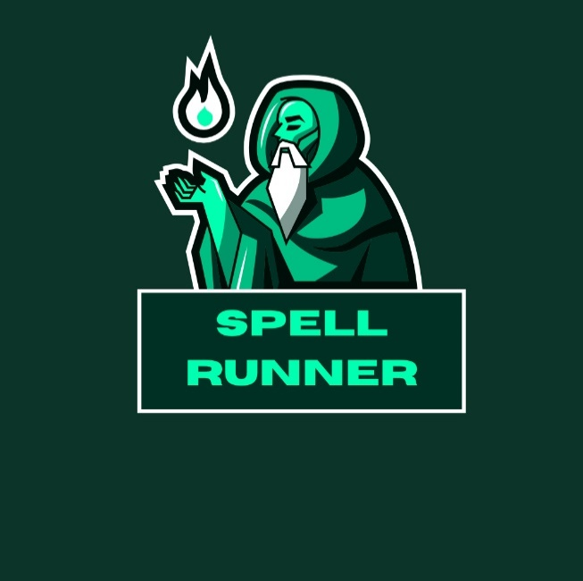
Spell Runner - Wizard VR
Software Engineering Department Braude College of Engineering
Capstone Project Phase B
Advisor:
PhD. Sulamy Moshe - MosheSu@braude.ac.il
Students:
Habib Ibrahim - Habib.Ibrahim@e.braude.ac.il
Vitaly Rofman - Vitaly.Rofman@e.braude.ac.il

Slide 2

Our Innovation
VR Game
Real–Time Machine Learning
Personalized Gaming

Slide 3

Development Process

Slide 4

Development Phases
Phase 1: Drawing in VR Environment
Phase 2: Training CNN Model
Phase 4: Gameplay, sound, graphics, enemies…
Phase 3: Communication between game and python process

Slide 5




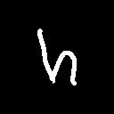
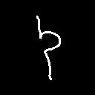

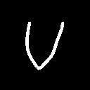


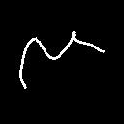
Phase 1: Drawing in 3D Environment and Dataset Creation
Drawing Using VR
Dataset
Main Classes
Class “others”

Slide 6

Phase 2: Training CNN model
Train New Model
Add Images
Test Model
Draw new images
Model predict new image
If prediction class is not correct, add image to dataset

Slide 7
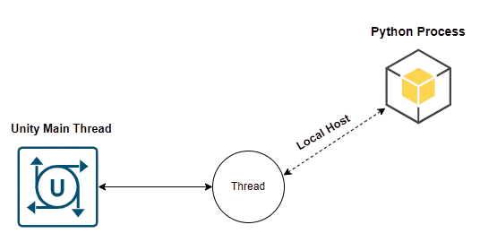
Phase 3: Communication between game and python process
Fine-Tuning Cycle
Draw
Send to Python Process
Model Predict
Return Predictions Array
Model Fit
Unity – ML Communication
ML
Game

Slide 8
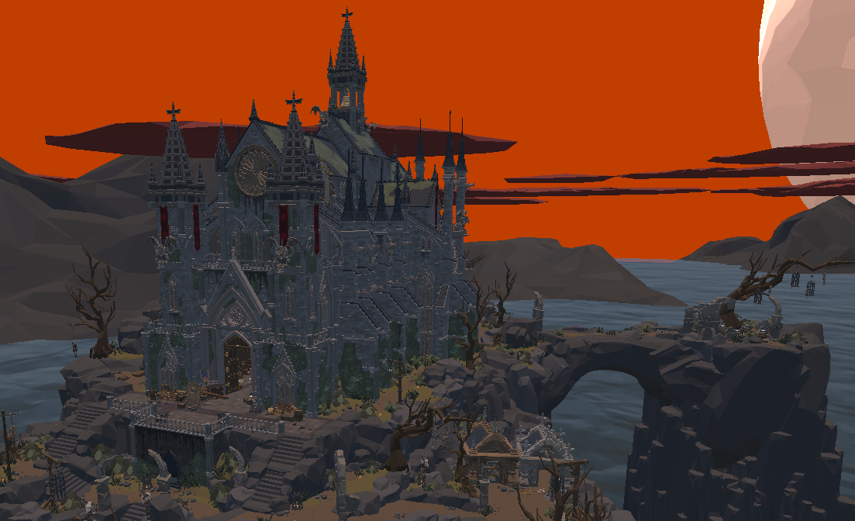
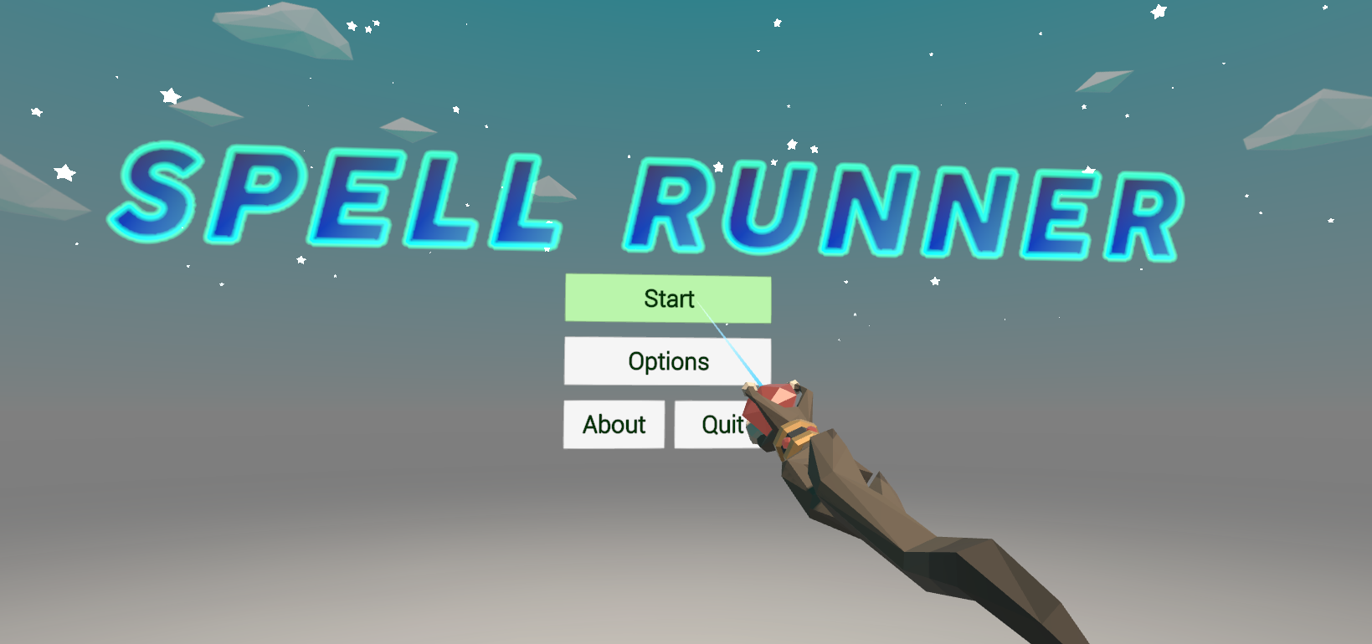
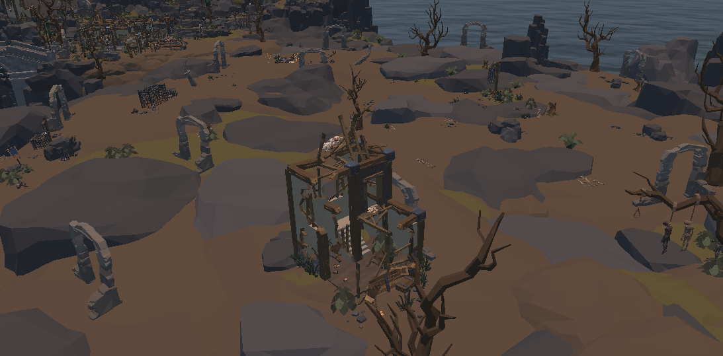
Phase 4: Gameplay, sound, graphics, enemies…
Game Scene
Menu Scene

Slide 9
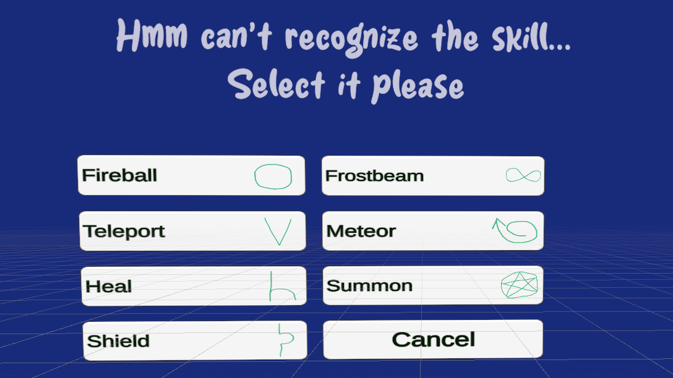
Model Fine-Tuning
Prediction
Accuracy > High Threshold
Apply Skill
Low Threshold< Accuracy < High Threshold
Fit Model
Apply Skill
Accuracy < Low Threshold
Player select class
Fit Model
Apply Skill
Player select class

Slide 10
Challenges and Solutions

Slide 11

Challenge 1: Preventing overfitting to a specific class during fine-tuning.
New Image (Skill 2 Type)
Batch Images Batch Labels
Fine-Tune Model
Skill 2

Slide 12

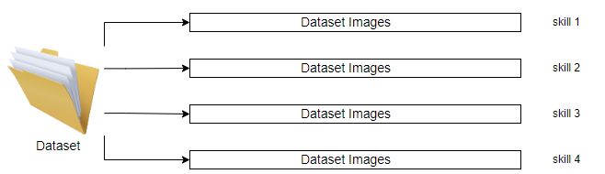
Challenge 1: Solution
Initial State

Slide 13
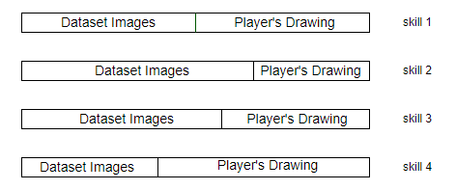



Challenge 1: Solution
New Image(Skill 2 Type)
Batch Images Batch Labels
Skill 2
Random
Skill 1
Random
Skill 3
Fine-Tune Model
Random
Skill 4
.
.
.
.
.
.
.
.
Learning

Slide 14
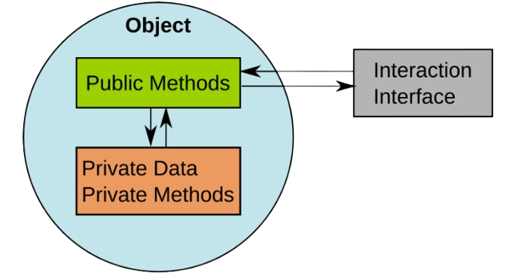
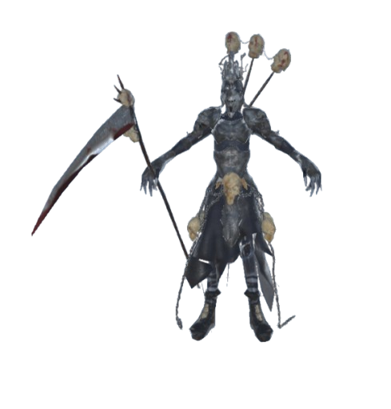
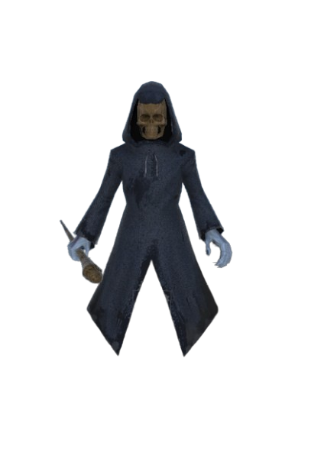
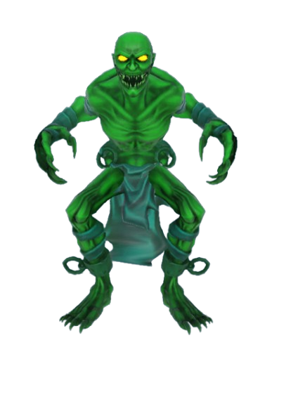
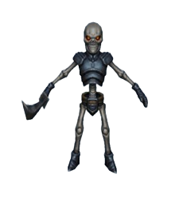
Challenge 2: Implementing a damage system for enemies.
IDamageable
Void TakeDamage (float damageAmount);

Slide 15


Testing
Test no. | Module | Test Description | Result
1 | Player Controller | Verifies player can draw when Python is ready. | Passed
2 | Player Controller | Checks game interface: main, pause, prediction, win/lose. | Passed
3 | Spell Cast System | Ensures spell casting triggers correct spell effect. | Passed
4 | Python Connector | Verifies Python process running and receiving data. | Passed
5 | Python Connector | Confirms correct CNN model opens for prediction. | Passed
6 | Enemies Controller | Tests enemy AI following player's current position. | Passed
7 | Feedback Controller | Checks data passed from 'BadPredictionMenu' selection. | Passed

Slide 16




Further Improvements
ML Agents
Cloud Technology
Advanced Graphics

Slide 17
THANK YOU!

Slide 18

REFRENCES
Bakkes, S., Tan, C.T. and Pisan, Y., 2012, July. Personalised gaming: a motivation and overview of literature. In Proceedings of the 8th Australasian Conference on Interactive Entertainment: Playing the System (pp. 1-10).
D. Charles, M. McNeill, M. McAlister, M. Black, A. Moore, K. Stringer, J. Kucklich, and A. Kerr. Player-centered design: Player modeling and adaptive digital games. In DiGRA, pages 285–298, 2005.
M. Riedl. Scalable personalization of interactive experiences through creative automation. Computers in Entertainment (CIE), 8(4):26, 2010.
Bakkes, S., Whiteson, S., Li, G., Vişniuc, G.V., Charitos, E., Heijne, N. and Swellengrebel, A., 2014, October. Challenge balancing for personalised game spaces. In 2014 IEEE Games Media Entertainment (pp. 1-8). IEEE.
https://www.britannica.com/technology/virtual-reality
https://www.meta.com/quest
https://www.ibm.com/topics/machine-learning
https://www.tensorflow.org/tutorials/images/cnn

