Slide 1

Introduction to PySpark
I N T R O D U C T I O N TO P YS PA R K
Benjamin Schmidt
Data Engineer

Slide 2

Meet your instructor
Almost a Decade of Data Experience with PySpark
Used PySpark for Machine Learning, ETL tasks, and much more more Enthusiastic teacher of new tools for all!
-

Slide 3

What is PySpark?
Distributed data processing: Designed to handle large datasets across clusters
Supports various data formats including CSV, Parquet, and JSON
SQL integration allows querying of data using both Python and SQL syntax Optimized for speed at scale

Slide 4
When would we use PySpark?
Big data analytics
Distributed data processing Real-time data streaming
Machine learning on large datasets
ETL and ELT pipelines
Working with diverse data sources:
CSV
JSON
Parquet
Many Many More

Slide 5


Spark cluster
Master Node
Manages the cluster, coordinates tasks,
and schedules jobs
Worker Nodes
Execute the tasks assigned by the master
Responsible for executing the actual computations and storing data in memory or disk

Slide 6
SparkSession
SparkSessions allow you to access your Spark cluster and are critical for using PySpark.
# Import SparkSession
from pyspark.sql import SparkSession
# Initialize a SparkSession
spark = SparkSession.builder.appName("MySparkApp").getOrCreate()
.builder() sets up a session
getOrCreate() creates or retrieves a session
.appName() helps manage multiple sessions

Slide 7
PySpark DataFrames
Similar to other DataFrames but
Optimized for PySpark
# Import and initialize a Spark session from pyspark.sql import SparkSession
spark = SparkSession.builder.appName("MySparkApp").getOrCreate()
# Create a DataFrame
census_df = spark.read.csv("census.csv",
["gender","age","zipcode","salary_range_usd","marriage_status"])
# Show the DataFrame census_df.show()

Slide 8
Let's practice!
I N T R O D U C T I O N TO P YS PA R K

Slide 9

Introduction to PySpark DataFrames
I N T R O D U C T I O N TO P YS PA R K
Benjamin Schmidt
Data Engineer

Slide 10
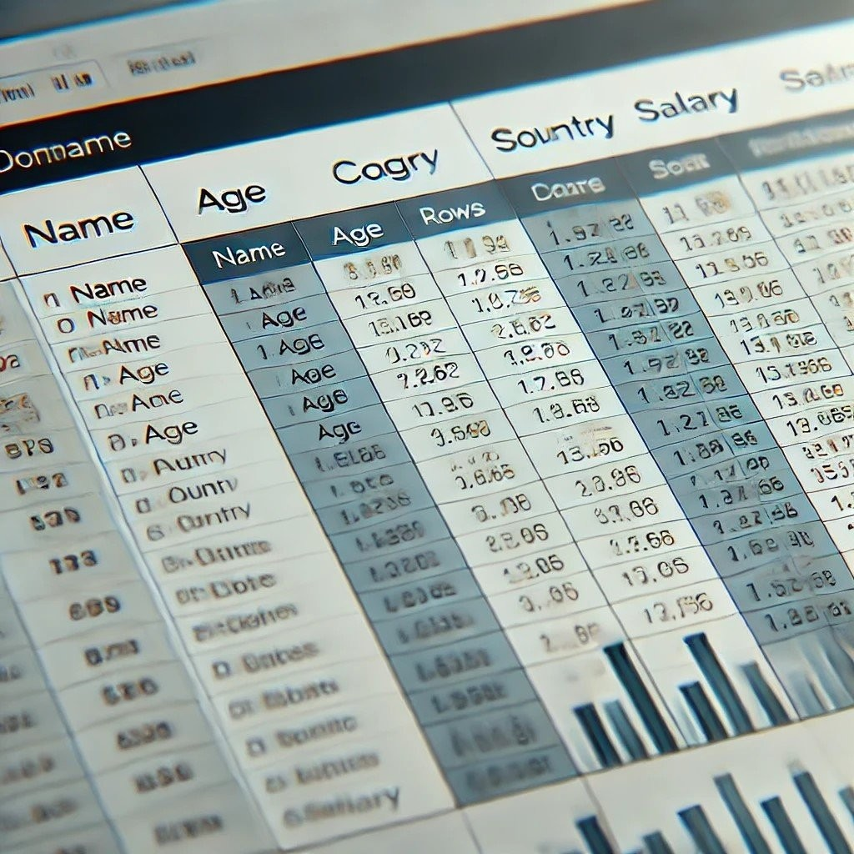
About DataFrames
DataFrames: Tabular format (rows/columns)
Supports SQL-like operations
Comparable to a Pandas Dataframe or a SQL TABLE Structured Data

Slide 11
Creating DataFrames from filestores
# Create a DataFrame from CSV
census_df = spark.read.csv('path/to/census.csv', header=True, inferSchema=True)

Slide 12
Printing the DataFrame
# Show the first 5 rows of the DataFrame census_df.show()
age | education.num | marital.status | occupation | income
0 90 | 9 | Widowed | ? | <=50K
1 82 | 9 | Widowed | Exec-managerial | <=50K
2 66 | 10 | Widowed | ? | <=50K
3 54 | 4 | Divorced | Machine-op-inspct | <=50K
4 41 | 10 | Separated | Prof-specialty | <=50K

Slide 13
Printing DataFrame Schema
# Show the schema census_df.printSchema() Output:
root
|-- | age: integer (nullable = true)
|-- | education.num: integer (nullable = true)
|-- | marital.status: string (nullable = true)
|-- | occupation: string (nullable = true)
|-- | income: string (nullable = true)

Slide 14
Basic analytics on PySpark DataFrames
# .count() will return the total row numbers in the DataFrame row_count = census_df.count()
print(f'Number of rows: {row_count}')
# groupby() allows the use of sql-like aggregations census_df.groupBy('gender').agg({'salary_usd': 'avg'}).show()
Other aggregate functions are:
sum()
min()
max()

Slide 15
Key functions for PySpark analytics
.select() : Selects specific columns from the DataFrame
.filter() : Filters rows based on specific conditions
.groupBy() : Groups rows based on one or more columns
.agg() : Applies aggregate functions to grouped data

Slide 16
Key Functions For Example
# Using filter and select, we can narrow down our DataFrame
filtered_census_df = census_df.filter(df['age'] filtered_census_df.show()
Output
+ + +
> 50).select('age', 'occupation')
|age| occupation |
+ + +
| | | 90| 82| | ?| Exec-managerial|
| | 66| | ?|
| | 54| | Machine-op-inspct|
+ + +

Slide 17
Let's practice!
I N T R O D U C T I O N TO P YS PA R K

Slide 18

More on Spark DataFrames
I N T R O D U C T I O N TO P YS PA R K
Benjamin Schmidt
Data Engineer

Slide 19
Creating DataFrames from various data sources
CSV Files: Common for structured, delimited data
JSON Files: Semi-structured, hierarchical data format
Parquet Files: Optimized for storage and querying, often used in data engineering
Example:
spark.read.csv("path/to/file.csv")
Example:
spark.read.json("path/to/file.json")
Example:
spark.read.parquet("path/to/file.parquet")
¹ https://spark.apache.org/docs/latest/api/python/reference/pyspark.pandas/api/pyspark.pandas.read_csv

Slide 20

Schema inference and manual schema definition
Spark can infer schemas from data with inferSchema=True
Manually define schema for better control - useful for fixed data structures

Slide 21
DataTypes in PySpark DataFrames
IntegerType : Whole numbers E.g., 1 , 3478 , -1890456
LongType: Larger whole numbers
E.g., 8-byte signed numbers, 922334775806
FloatType and DoubleType: Floating-point numbers for decimal values E.g., 3.14159
StringType: Used for text or string data
E.g., "This is an example of a string."
...

Slide 22
DataTypes Syntax for PySpark DataFrames
# Import the necessary types as classes from pyspark.sql.types import (StructType,
StructField, IntegerType, StringType, ArrayType)
# Construct the schema schema = StructType([
StructField("id", IntegerType(), True), StructField("name", StringType(), True), StructField("scores", ArrayType(IntegerType()), True)
])
# Set the schema
df = spark.createDataFrame(data, schema=schema)

Slide 23
DataFrame operations - selection and filtering
Use .select() to choose specific columns
Use .filter() or .where() to filter rows based on conditions Use .sort() to order by a collection of columns
# Select and show only the name and age columns df.select("name", "age").show()
# Filter on age > 30 df.filter(df["age"] > 30).show()
# Use Where to filter match a specific value df.where(df["age"] == 30).show()

Slide 24
Sorting and dropping missing values
Order data using .sort() or .orderBy()
Use na.drop() to remove rows with null values
# Sort using the age column df.sort("age", ascending=False).show()
# Drop missing values df.na.drop().show()

Slide 25
Cheatsheet
spark.read_json() : Load data from JSON
spark.read.schema() : Define schemas explicitly
.na.drop() : Drop rows with missing values
.select() , .filter() , .sort() , .orderBy() : Basic data manipulation functions

Slide 26
Let's practice!
I N T R O D U C T I O N TO P YS PA R K

