Slide 1
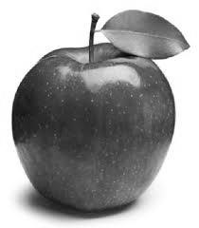
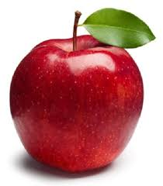

Slide 2
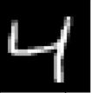
Autoencoders
Autoencoders goal is to learn a representation of the input in the latent space
28x28
28x28
n
Latent space
Encoder
Decoder
The “label” is the input itself

Slide 3


Variational Autoencoders
The latent space is composed of mean and std dev for a normal distribution
28x28
28x28
Latent space
$$μ$$
$$σ$$
Z
Encoder
Decoder
z is a random variable drawn from a normal distribution with average and standard deviation from the latent space

Slide 4
Conditional Variational Autoencoders
Adds the class label, or a “condition” (semi supervised?)
Allows the generation of samples for a particular class
28x28
28x28
Z
$$μ$$
$$σ$$
condition
condition (4)
Encoder
Decoder
The condition is fed to both the encoder and decoder

