Slide 1







In-Demand IT Skills Analysis: Programming and Databases
Paul-Édouard
2024-11-23

Slide 2



OUTLINE
Executive Summary
Introduction
Methodology
Results
Visualization – Charts
Dashboard
Discussion
Findings & Implications
Conclusion
Appendix

Slide 3

EXECUTIVE SUMMARY
Summary of methodology
Summary of all results
Data visualization
Key findings

Slide 4

INTRODUCTION
Objective:
Our primary goal is to gather and analyze data to pinpoint the top programming languages, database skills, and integrated development environments (IDEs) that will be crucial for our workforce in 2024. This analysis will help us understand where to focus our training and development efforts to remain competitive and meet the market demands.
Methodology:
Data Collection:
We’ve sourced data from multiple channels, including job postings, training portals, and industry surveys. This diverse dataset ensures a comprehensive view of the current trends.
Using web scraping and APIs, we’ve gathered data in various formats such as CSV files, Excel sheets, and databases.
Data Preparation:
Post data collection, we performed extensive data wrangling to clean and prepare the data for analysis. This step was crucial to ensure accuracy and reliability in our findings.
Data Analysis:
Applying advanced statistical techniques, we analyzed the dataset to extract meaningful insights. This included identifying the most sought-after programming languages and database skills.
Additionally, we explored the popularity of various IDEs to understand the tools developers are gravitating towards.
Visualization and Reporting:
Leveraging IBM Cognos Analytics, we’ve created a dynamic dashboard to visualize our findings. This tool will allow us to interactively explore the data and derive actionable insights.
Finally, I will present the key takeaways and recommendations based on our analysis.
Key Insights:
Top Programming Languages: Identifying the languages that are currently leading the market.
Top Database Skills: Highlighting the database technologies that are in high demand.
Popular IDEs: Understanding the development environments preferred by professionals.

Slide 5

METHODOLOGY
Data collection
Web scraping
Data exploration
Finding & removing duplicates
Finding & imputing missing values
Normalizing data
Data visualization

Slide 6
RESULTS
Technology | Number of Jobs
C | 25114
C# | 526
C++ | 506
Java | 3428
JavaScript | 2248
Python | 1173
Scala | 138
Oracle | 899
SQL Server | 423
MySQL Server | 0
PostgreSQL | 86
MongoDB | 208
Programming Language,Annual Average Salary | Language,Average Annual Salary
Swift | 130 801,00 $
Python | 114 383,00 $
C++ | 113 865,00 $
Javascript | 110 981,00 $
Java | 101 013,00 $
Go | 94 082,00 $
R | 92 037,00 $
C# | 88 726,00 $
SQL | 84 793,00 $
PHP | 84 727,00 $

Slide 7
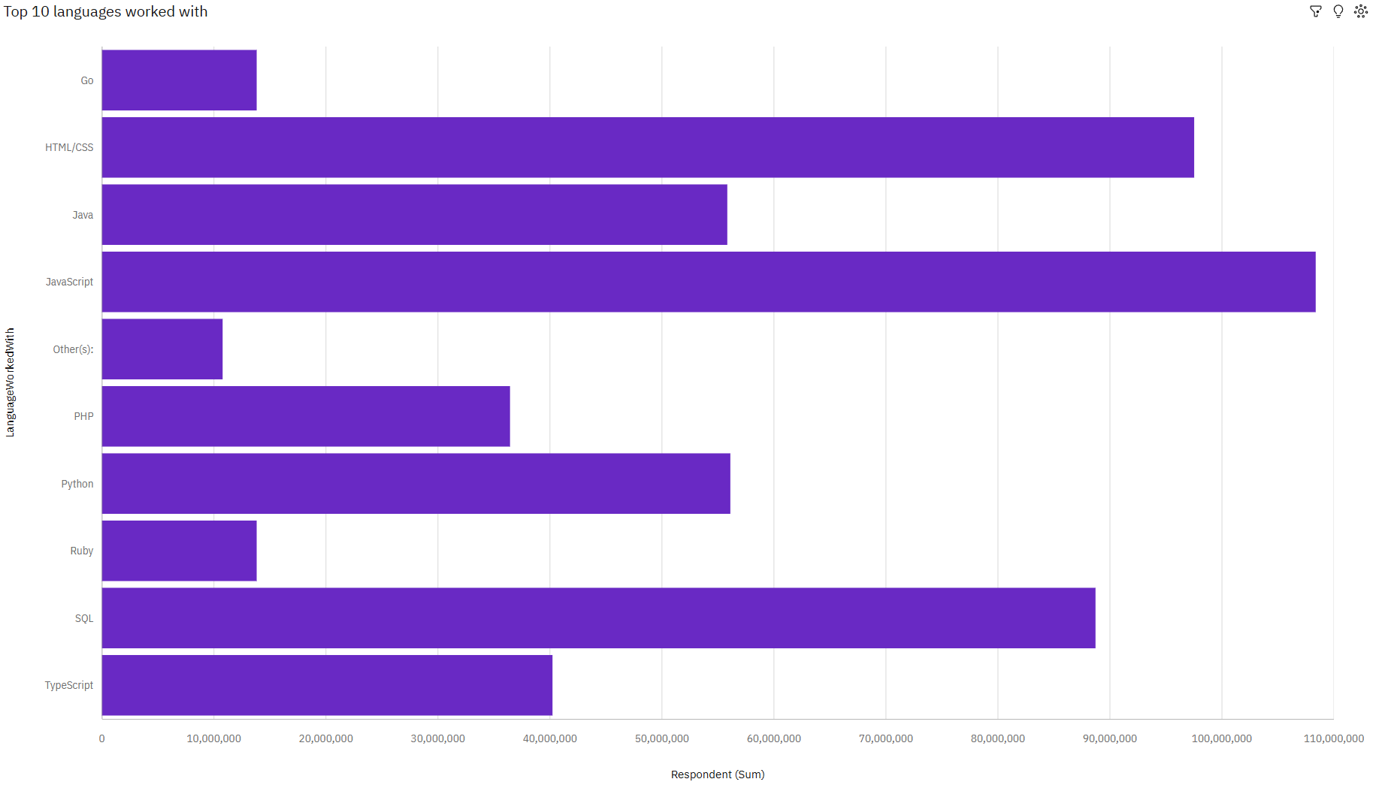
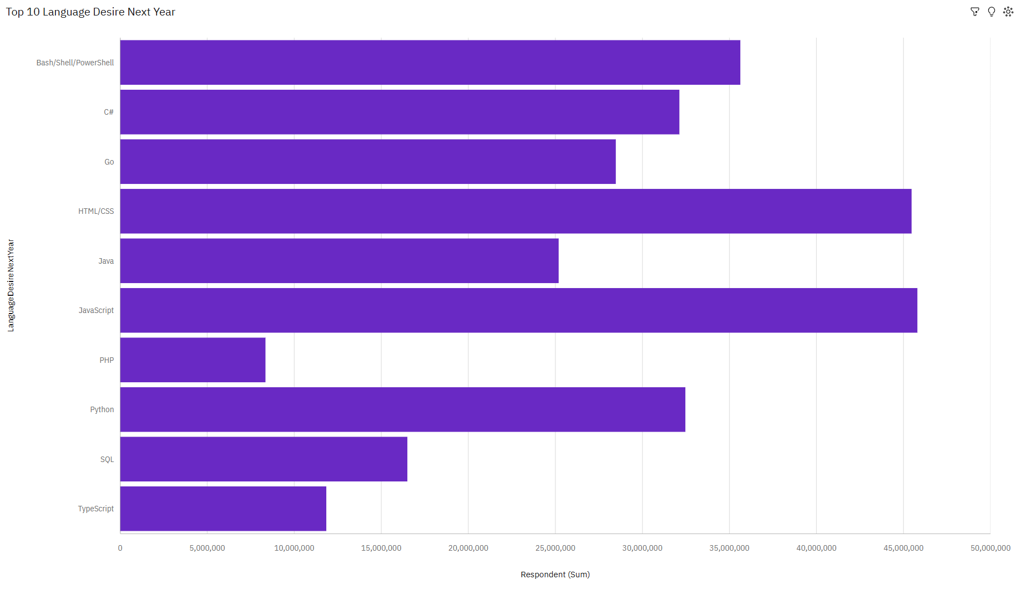
PROGRAMMING LANGUAGE TRENDS
Current Year
Next Year

Slide 8
PROGRAMMING LANGUAGE TRENDS - FINDINGS & IMPLICATIONS
Findings
JavaScript is the most popular
More wants to learn it
SQL is popular but less wants to learn it
Implications
High demand for JavaScript skills necessitates prioritizing hiring and training. Companies should invest in robust JavaScript tools and frameworks like React and Node.js. Continuous updates and performance optimization of JavaScript codebases are essential.
Training programs should expand to meet the growing interest in JavaScript. Businesses can offer in-house training to upskill employees. Leveraging community resources will support this learning.
A potential skill gap in SQL expertise may arise, necessitating targeted training programs. Companies should maintain existing SQL systems and integrate SQL with modern data technologies. Encouraging hybrid skills can bridge the gap.

Slide 9
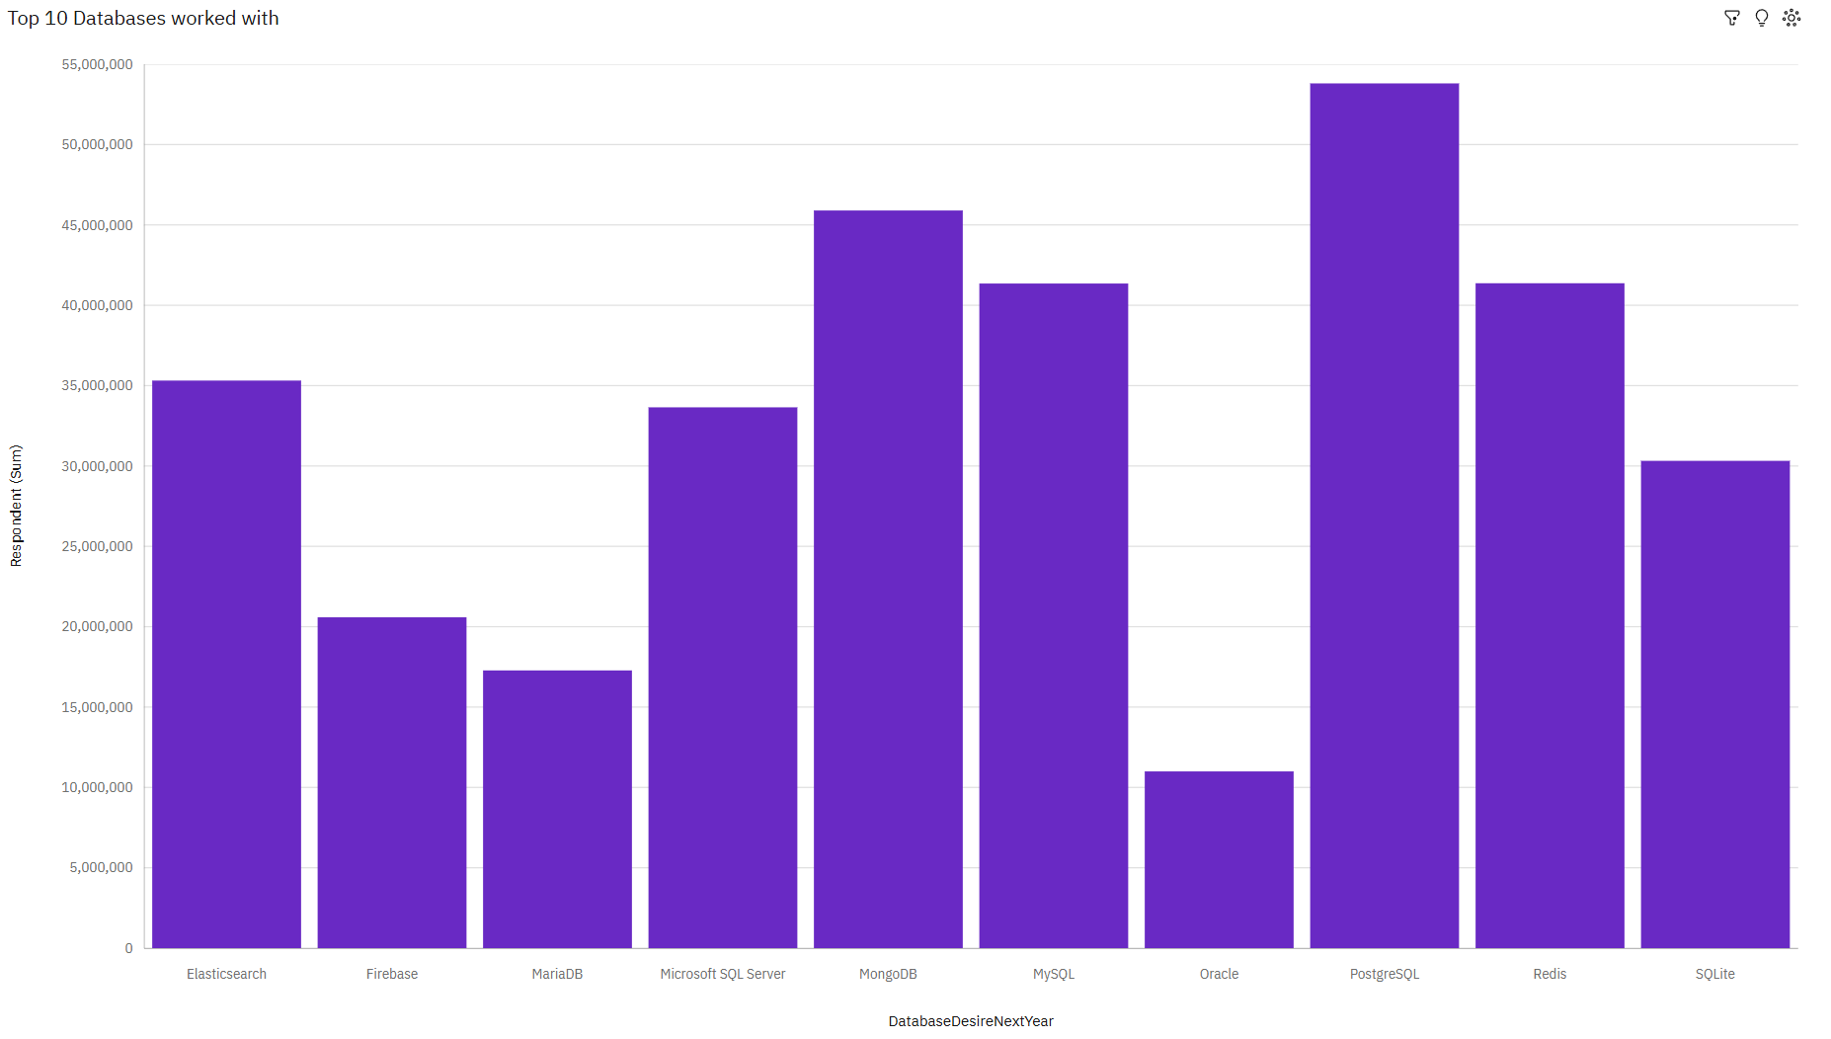
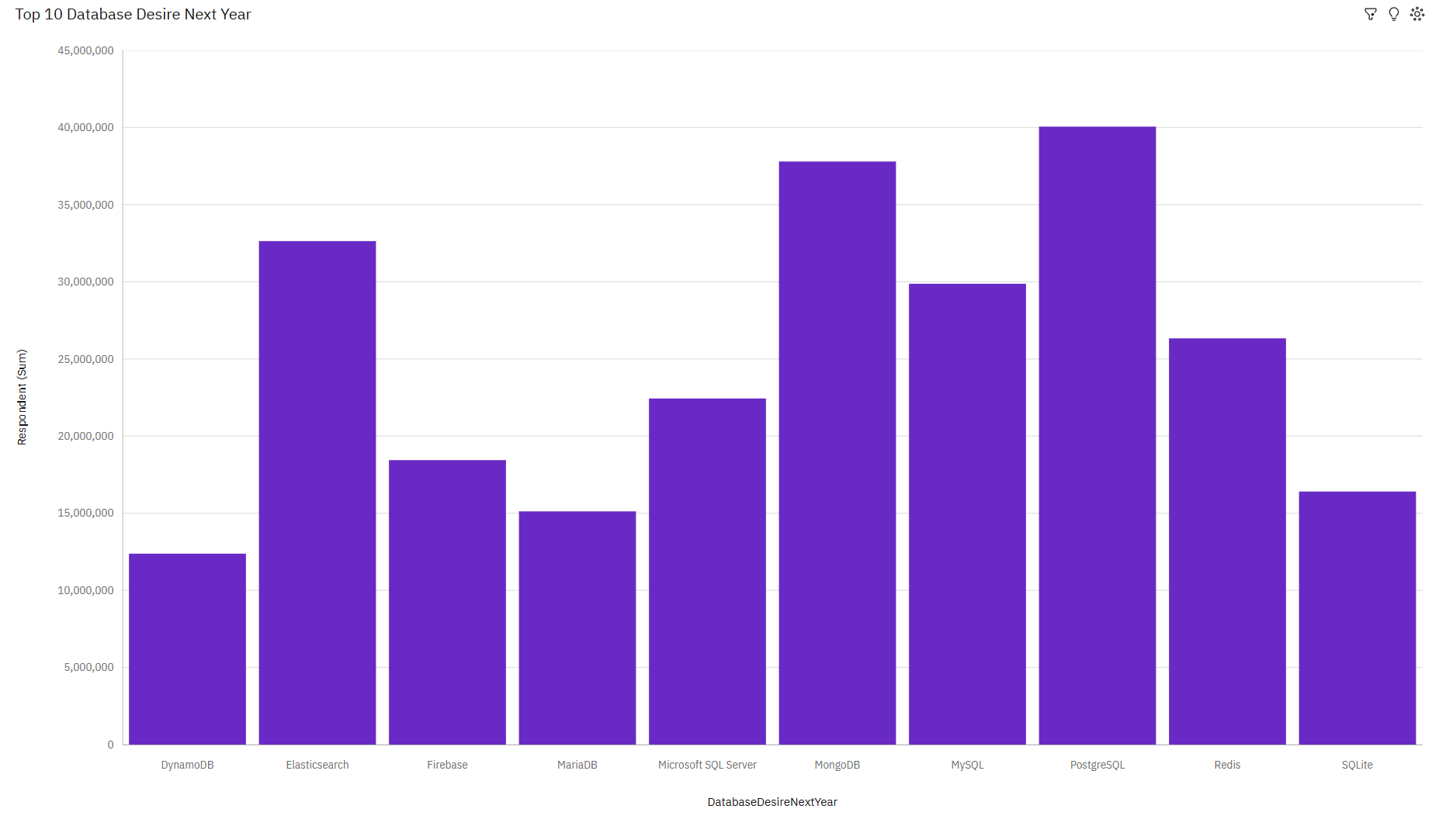
DATABASE TRENDS
Current Year
Next Year

Slide 10
DATABASE TRENDS - FINDINGS & IMPLICATIONS
Findings
PostgreSQL is the most popular
Most want to learn it
Oracle has the least and doesn’t appear in the top 10 desired to learn
Implications
High demand for PostgreSQL skills suggests businesses should prioritize its training and integration. Investment in PostgreSQL tools and support will be crucial for companies. PostgreSQL’s popularity can lead to a larger pool of experienced developers.
Growing interest in PostgreSQL presents opportunities for expanded educational programs. Companies can offer in-house PostgreSQL training to meet the learning demand. Encouraging PostgreSQL learning can enhance the technical capabilities of the workforce.
Oracle's limited usage and learning interest may indicate a shift towards other database technologies. Businesses might need to reconsider their investment in Oracle training and support. Companies using Oracle may face challenges in finding new talent proficient in its technology.

Slide 11

DASHBOARD
Current technology usage
Future technology trend
Demographics

Slide 12
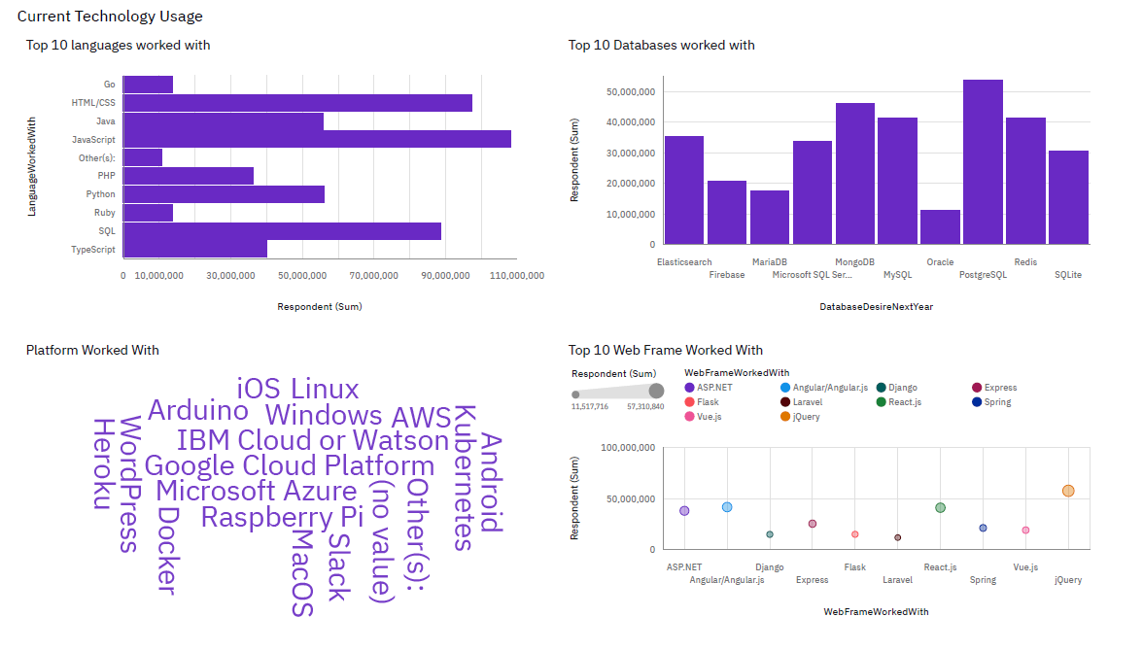
DASHBOARD TAB 1

Slide 13
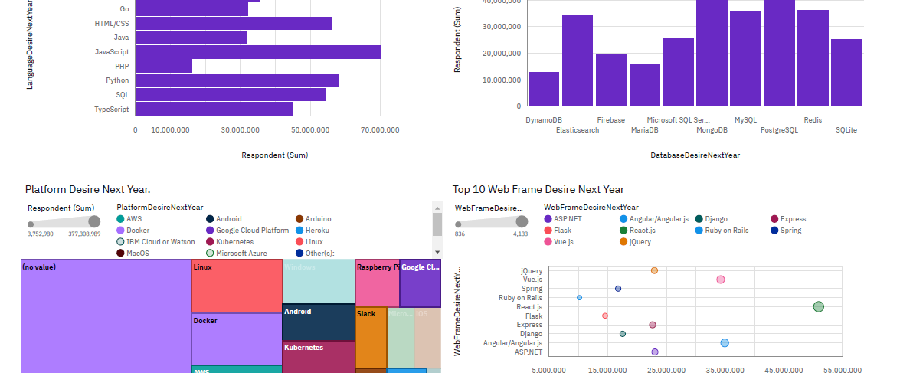
DASHBOARD TAB 2

Slide 14
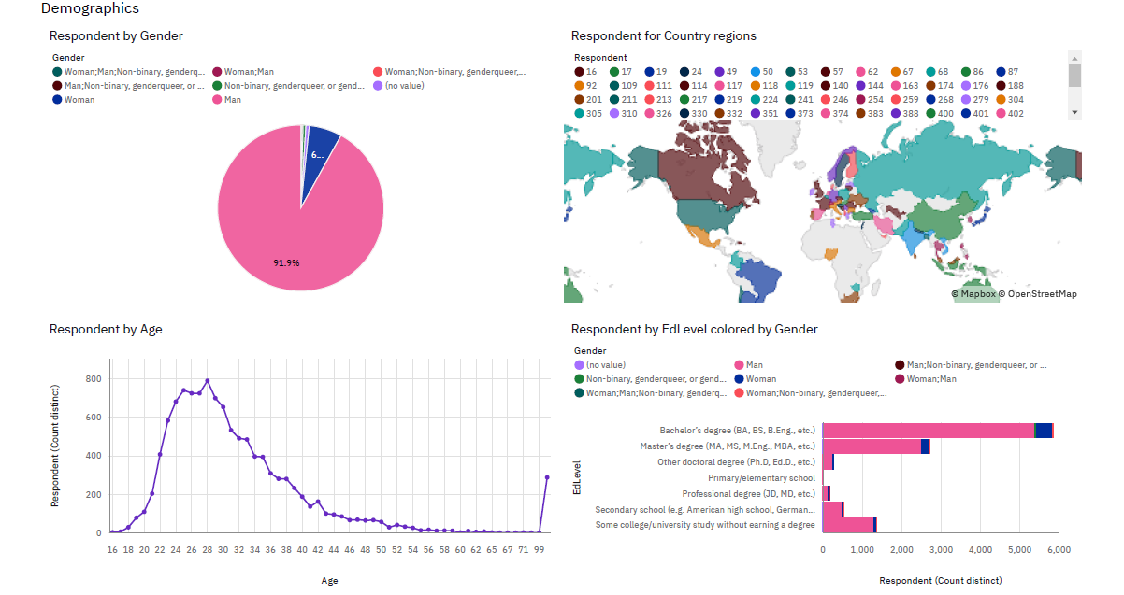
DASHBOARD TAB 3

Slide 15
DISCUSSION

Slide 16
OVERALL FINDINGS & IMPLICATIONS
Findings
Mainly men
People in their 20s
Most has a bachelor degree
Implications
The group is predominantly male, indicating a potential gender imbalance. This could impact team dynamics, perspectives, and inclusiveness within the group.
Most individuals are in their 20s, suggesting the group is relatively young. This might imply that they are early in their careers, potentially more adaptable to new technologies but with less experience compared to older colleagues.
The majority have a bachelor's degree, indicating a high level of formal education. This could reflect a strong foundation in theoretical knowledge and technical skills.

Slide 17

CONCLUSION
Workfield dominated by men
Most of them have a bachelor degree
Young workforce
JavaScript and PostgreSQL are respectively the most popular language and database

Slide 18

APPENDIX
Include any relevant additional charts, or tables that you may have created during the analysis phase.

Slide 19
JOB POSTINGS

Slide 20
POPULAR LANGUAGES

