Slide 1
A sleep tracking app for a better night's rest
KAVIDHARSHINI.R
710422104021

Slide 2
DESCRIPTION
1. Sleep Tracking: Monitor sleep duration, stages (light, deep, REM), and sleep cycles.
2. Sleep Score: Get a daily sleep score based on sleep quality, duration, and consistency.
3. Sleep Stage Tracking: Visualize sleep stages in real-time, identifying light, deep, and REM sleep.
4. Smart Alarms: Wake up during light sleep phases, feeling refreshed and energized.
5. Sleep Diary: Log sleep-related events, such as coffee consumption, exercise, or stress levels.
6. Personalized Recommendations: Receive tailored advice on sleep schedule, relaxation techniques, and sleep environment optimization.
7. Sleep Goals: Set and track sleep goals, monitoring progress over time.
8. Mood Tracking: Monitor emotions and energy levels, correlating them with sleep quality.
9. Relaxation Techniques: Access guided meditations, breathing exercises, and soothing sounds.
10. Integrations: Connect with popular health and fitness apps (e.g., Fitbit, Apple Health).

Slide 3
package com.example.projectoneimport androidx.test.platform.app.
InstrumentationRegistryimport androidx.test.ext.junit.runners.
AndroidJUnit4import org.junit.Testimport org.
junit.runner.RunWithimport org.
junit.Assert.
*/** * Instrumented test, which will execute on an Android device.
* * See [testing documentation](http://d.android.com/tools/testing). */@RunWith(AndroidJUnit4::class)
class ExampleInstrumentedTest
{
@Test fun useAppContext() {
// Context of the app under test.
val appContext = InstrumentationRegistry.getInstrumentation().
targetContext
assertEquals("com.example.projectone",
appContext.packageName) }}
Main Activity:

Slide 4
<?xml version="1.0"
encoding="utf-8"?>
<manifest xmlns:android="http:
//schemas.android.com/apk/res/android" xmlns:tools="http:
//schemas.android.com/tools"> <application
android:allowBackup="true" android:dataExtractionRules="@xml/data_extraction_rules" android:fullBackupContent="@xml/backup_rules" android:icon="@mipmap/ic_launcher"
android:label="@string/app_name"
android:supportsRtl="true"
android:theme="@style/Theme.ProjectOne"
tools:targetApi="31">
<activity
android:name=".TrackActivity"
android:exported="false"
android:label="@string/title_activity_track" android:theme="@style/Theme.ProjectOne" /> <activity

Slide 5
<activity android:name=".TrackActivity“
android:exported="false"
android:label="@string/title_activity_track" android:theme="@style/Theme.ProjectOne" />
<activity
android:name=".MainActivity"
android:exported="false"
android:label="@string/app_name" android:theme="@style/Theme.ProjectOne" />
<activity
android:name=".MainActivity2"
android:exported="false"
android:label="RegisterActivity" android:theme="@style/Theme.ProjectOne" />
<activity
android:name=".LoginActivity"
android:exported="true"
android:label="@string/app_name" android:theme="@style/Theme.ProjectOne">
<intent-filter>
<action android:name="android.intent.action.MAIN" />

Slide 6
Text(
fontSize = 36.sp,
fontWeight = FontWeight.ExtraBold,
fontFamily = FontFamily.Cursive,
color = Color.White,
text = "Login"
)
Spacer(modifier = Modifier.height(10.dp))
TextField(
value = username,
onValueChange = { username = it },
label = { Text("Username") },
modifier = Modifier.padding(10.dp)
.width(280.dp)
)
TextField(
value = password,
onValueChange = { password = it },

Slide 7
label = { Text("Password") },
modifier = Modifier.padding(10.dp)
.width(280.dp)
)
if (error.isNotEmpty()) {
Text(
text = error,
color = MaterialTheme.colors.error,
modifier = Modifier.padding(vertical = 16.dp)
)
}
Button(
onClick = {
if (username.isNotEmpty() && password.isNotEmpty()) {
val user = databaseHelper.getUserByUsername(username)
if (user != null && user.password == password) {
error = "Successfully log in"
context.startActivity(

Slide 8
Intent(
context,
MainPage::class.java
)
)
//onLoginSuccess()
}
if (user != null && user.password == "admin") {
error = "Successfully log in"
context.startActivity(
Intent(
context,
AdminActivity::class.java
)
)
}
else {
error = "Invalid username or password"
}

Slide 9
} else {
error = "Please fill all fields"
}
},
modifier = Modifier.padding(top = 16.dp)
) {
Text(text = "Login")
}
Row {
TextButton(onClick = {context.startActivity(
Intent(
context,
MainActivity::class.java
)
)}
)
{ Text(color = Color.White,text = "Sign up") }
TextButton(onClick = {
})
{
Spacer(modifier = Modifier.width(60.dp))
Text(color = Color.White,text = "Forget password?")

Slide 10
}
}
}
}
private fun startMainPage(context: Context) {
val intent = Intent(context, MainPage::class.java)
ContextCompat.startActivity(context, intent, null)
}
MAIN PAGE.KT
package com.example.snackordering
import android.annotation.SuppressLint
import android.content.Context
import android.os.Bundle
import android.widget.Toast
import androidx.activity.ComponentActivity
import androidx.activity.compose.setContent
import androidx.annotation.DrawableRes
import androidx.annotation.StringRes

Slide 11
import androidx.compose.foundation.Image
import androidx.compose.foundation.background
import androidx.compose.foundation.layout.*
import androidx.compose.foundation.shape.CircleShape
import androidx.compose.foundation.shape.RoundedCornerShape
import androidx.compose.material.*
import androidx.compose.material.icons.Icons
import androidx.compose.material.icons.filled.*
import androidx.compose.runtime.Composable
import androidx.compose.ui.Alignment
import androidx.compose.ui.Modifier
import androidx.compose.ui.draw.clip
import androidx.compose.ui.graphics.Color
import androidx.compose.foundation.lazy.LazyColumn
import androidx.compose.foundation.lazy.items
import androidx.compose.material.Text
import androidx.compose.ui.unit.dp
import androidx.compose.ui.graphics.RectangleShape
import androidx.compose.ui.layout.ContentScale
import androidx.compose.ui.platform.LocalContext

Slide 12
import androidx.compose.ui.res.painterResource
import androidx.compose.ui.res.stringResource
import androidx.compose.ui.text.font.FontWeight
import androidx.compose.ui.unit.sp
import androidx.core.content.ContextCompat.startActivity
import com.example.snackordering.ui.theme.SnackOrderingTheme
import android.content.Intent as Intent1
class MainPage : ComponentActivity() {
override fun onCreate(savedInstanceState: Bundle?) {
super.onCreate(savedInstanceState)
setContent {
SnackOrderingTheme {
// A surface container using the 'background' color from the theme
Surface(
modifier = Modifier.fillMaxSize(),
color = MaterialTheme.colors.background
) {

Slide 13
FinalView(this)
val context = LocalContext.current
//PopularFoodColumn(context)
}
}
}
}
}
@Composable
fun TopPart() {
Row(
modifier = Modifier
.fillMaxWidth()
.background(Color(0xffeceef0)), Arrangement.SpaceBetween
) {
Icon(
imageVector = Icons.Default.Add, contentDescription = "Menu Icon",

Slide 14
Modifier
.clip(CircleShape)
.size(40.dp),
tint = Color.Black,
)
Column(horizontalAlignment = Alignment.CenterHorizontally) {
Text(text = "Location", style = MaterialTheme.typography.subtitle1, color = Color.Black)
Row {
Icon(
imageVector = Icons.Default.LocationOn,
contentDescription = "Location",
tint = Color.Red,
)
Text(text = "Accra" , color = Color.Black)
}
}
Icon(
imageVector = Icons.Default.Notifications, contentDescription = "Notification Icon",

Slide 15
Modifier
.size(45.dp),
tint = Color.Black,
)
}
}
@Composable
fun CardPart() {
Card(modifier = Modifier.size(width = 310.dp, height = 150.dp), RoundedCornerShape(20.dp)) {
Row(modifier = Modifier.padding(10.dp), Arrangement.SpaceBetween) {
Column(verticalArrangement = Arrangement.spacedBy(12.dp)) {
Text(text = "Get Special Discounts")
Text(text = "up to 85%", style = MaterialTheme.typography.h5)
Button(onClick = {}, colors = ButtonDefaults.buttonColors(Color.White)) {
Text(text = "Claim voucher", color = MaterialTheme.colors.surface)
}
}
Image(
painter = painterResource(id = R.drawable.food_tip_im),
contentDescription = "Food Image", Modifier.size(width = 100.dp, height = 200.dp)
)

Slide 16
)
}
}
}
@Composable
fun PopularFood(
@DrawableRes drawable: Int,
@StringRes text1: Int,
context: Context
) {
Card(
modifier = Modifier
.padding(top=20.dp, bottom = 20.dp, start = 65.dp)
.width(250.dp)
) {

Slide 17
Column(
verticalArrangement = Arrangement.Top,
horizontalAlignment = Alignment.CenterHorizontally
) {
Spacer(modifier = Modifier.padding(vertical = 5.dp))
Row(
modifier = Modifier
.fillMaxWidth(0.7f), Arrangement.End
) {
Icon(
imageVector = Icons.Default.Star,
contentDescription = "Star Icon",
tint = Color.Yellow
)
Text(text = "4.3", fontWeight = FontWeight.Black)
}
Image(
painter = painterResource(id = drawable),
contentDescription = "Food Image",
contentScale = ContentScale.Crop,

Slide 18
modifier = Modifier
.size(100.dp)
.clip(CircleShape)
)
Text(text = stringResource(id = text1), fontWeight = FontWeight.Bold)
Row(modifier = Modifier.fillMaxWidth(0.7f), Arrangement.SpaceBetween) {
/*TODO Implement Prices for each card*/
Text(
text = "$50",
style = MaterialTheme.typography.h6,
fontWeight = FontWeight.Bold,
fontSize = 18.sp
)
IconButton(onClick = {
//var no=FoodList.lastIndex;
//Toast.
val intent = Intent1(context, TargetActivity::class.java)
context.startActivity(intent)

Slide 19
}) {
Icon(
imageVector = Icons.Default.ShoppingCart,
contentDescription = "shopping cart",
)
}
}
}
}
}
private val FoodList = listOf(
R.drawable.sandwish to R.string.sandwich,
R.drawable.sandwish to R.string.burgers,
R.drawable.pack to R.string.pack,
R.drawable.pasta to R.string.pasta,

Slide 20
R.drawable.tequila to R.string.tequila,
R.drawable.wine to R.string.wine,
R.drawable.salad to R.string.salad,
R.drawable.pop to R.string.popcorn
).map { DrawableStringPair(it.first, it.second) }
private data class DrawableStringPair(
@DrawableRes val drawable: Int,
@StringRes val text1: Int
)
@Composable
fun App(context: Context) {
Column(
modifier = Modifier
.fillMaxSize()
.background(Color(0xffeceef0))
.padding(10.dp),

Slide 21
verticalArrangement = Arrangement.Top,
horizontalAlignment = Alignment.CenterHorizontally
) {
Surface(modifier = Modifier, elevation = 5.dp) {
TopPart()
}
Spacer(modifier = Modifier.padding(10.dp))
CardPart()
Spacer(modifier = Modifier.padding(10.dp))
Row(modifier = Modifier.fillMaxWidth(), Arrangement.SpaceBetween) {
Text(text = "Popular Food", style = MaterialTheme.typography.h5, color = Color.Black)
Text(text = "view all", style = MaterialTheme.typography.subtitle1, color = Color.Black)
}
Spacer(modifier = Modifier.padding(10.dp))
PopularFoodColumn(context) // <- call the function with parentheses
}
}

Slide 22
@Composable
fun PopularFoodColumn(context: Context) {
LazyColumn(
modifier = Modifier.fillMaxSize(),
content = {
items(FoodList) { item ->
PopularFood(context = context,drawable = item.drawable, text1 = item.text1)
abstract class Context
}
},
verticalArrangement = Arrangement.spacedBy(16.dp))
}
@SuppressLint("UnusedMaterialScaffoldPaddingParameter")

Slide 23
@Composable
fun FinalView(mainPage: MainPage) {
SnackOrderingTheme {
Scaffold() {
val context = LocalContext.current
App(context)
}
}
}
ORDER.KT
package com.example.snackordering
import androidx.room.ColumnInfo
import androidx.room.Entity
import androidx.room.PrimaryKey
@Entity(tableName = "order_table")
data class Order(
@PrimaryKey(autoGenerate = true) val id: Int?,
@ColumnInfo(name = "quantity") val quantity: String?,
@ColumnInfo(name = "address") val address: String?,
)

Slide 24
String?,
@ColumnInfo(name = "address") val address: String?,
)
ORDERDAO.KT
package com.example.snackordering
import androidx.room.*
@Dao
interface OrderDao {
@Query("SELECT * FROM order_table WHERE address= :address")
suspend fun getOrderByAddress(address: String): Order?
@Insert(onConflict = OnConflictStrategy.REPLACE)
suspend fun insertOrder(order: Order)
@Update
suspend fun updateOrder(order: Order)
@Delete
suspend fun deleteOrder(order: Order)
}

Slide 25
ORDERDATABASE.KT
package com.example.snackordering
import android.content.Context
import androidx.room.Database
import androidx.room.Room
import androidx.room.RoomDatabase
@Database(entities = [Order::class], version = 1)
abstract class OrderDatabase : RoomDatabase() {
abstract fun orderDao(): OrderDao
companion object {
@Volatile
private var instance: OrderDatabase? = null
fun getDatabase(context: Context): OrderDatabase {
return instance ?: synchronized(this) {
val newInstance = Room.databaseBuilder(

Slide 26
context.applicationContext,
OrderDatabase::class.java,
"order_database"
).build()
instance = newInstance
newInstance
}
}
}
}
ORDER DATABASE HELPER.KT
package com.example.snackordering
import android.annotation.SuppressLint
import android.content.ContentValues
import android.content.Context
import android.database.Cursor

Slide 27
import android.database.sqlite.SQLiteDatabase
import android.database.sqlite.SQLiteOpenHelper
class OrderDatabaseHelper(context: Context) :
SQLiteOpenHelper(context, DATABASE_NAME, null,DATABASE_VERSION){
companion object {
private const val DATABASE_VERSION = 1
private const val DATABASE_NAME = "OrderDatabase.db"
private const val TABLE_NAME = "order_table"
private const val COLUMN_ID = "id"
private const val COLUMN_QUANTITY = "quantity"
private const val COLUMN_ADDRESS = "address"
}

Slide 28
override fun onCreate(db: SQLiteDatabase?) {
val createTable = "CREATE TABLE $TABLE_NAME (" +
"${COLUMN_ID} INTEGER PRIMARY KEY AUTOINCREMENT, " +
"${COLUMN_QUANTITY} Text, " +
"${COLUMN_ADDRESS} TEXT " +
")"
db?.execSQL(createTable)
}
override fun onUpgrade(db: SQLiteDatabase?, oldVersion: Int, newVersion: Int) {
db?.execSQL("DROP TABLE IF EXISTS $TABLE_NAME")
onCreate(db)
}
fun insertOrder(order: Order) {
val db = writableDatabase
val values = ContentValues()

Slide 29
values.put(COLUMN_QUANTITY, order.quantity)
values.put(COLUMN_ADDRESS, order.address)
db.insert(TABLE_NAME, null, values)
db.close()
}
@SuppressLint("Range")
fun getOrderByQuantity(quantity: String): Order? {
val db = readableDatabase
val cursor: Cursor = db.rawQuery("SELECT * FROM $TABLE_NAME WHERE $COLUMN_QUANTITY = ?",
arrayOf(quantity))
var order: Order? = null
if (cursor.moveToFirst()) {
order = Order(
id = cursor.getInt(cursor.getColumnIndex(COLUMN_ID)),
quantity = cursor.getString(cursor.getColumnIndex(COLUMN_QUANTITY)),
address = cursor.getString(cursor.getColumnIndex(COLUMN_ADDRESS)),
)
}

Slide 30
plugins { id 'com.android.application’
id 'org.jetbrains.kotlin.android’}
android { namespace 'com.example.projectone’
compileSdk 33 defaultConfig
{
applicationId "com.example.projectone"
minSdk 24
targetSdk 33
versionCode 1
versionName "1.0"
testInstrumentationRunner
"androidx.test.runner.AndroidJUnitRunner"
vectorDrawables {
useSupportLibrary true
} }
buildTypes { release {
minifyEnabled false
proguardFiles getDefaultProguardFile('proguard-android-optimize.txt’),
'proguard-rules.pro'

Slide 31
compileOptions { sourceCompatibility JavaVersion.
VERSION_1_8 targetCompatibility JavaVersion.VERSION_1_8
} kotlinOptions
{ jvmTarget = '1.8' }
buildFeatures { compose true }
composeOptions {
kotlinCompilerExtensionVersion '1.2.0’
}
packagingOptions {
resources {
excludes += '/META-INF/{AL2.0,LGPL2.1}' }
}}dependencies
{ implementation 'androidx.core:core-ktx:1.7.0’
implementation 'androidx.lifecycle:lifecycle-runtime-ktx:2.3.1’
implementation 'androidx.activity:activity-compose:1.3.1’
implementation 'androidx.room:room-common:2.5.0’
implementation 'androidx.room:room-ktx:2.5.0’
testImplementation 'junit:junit:4.13.2'
"androidx.compose.ui:ui-tooling:$compose_ui_version"
debugImplementation "androidx.compose.ui:ui-test-manifest:
$compose_ui_version"}

Slide 32
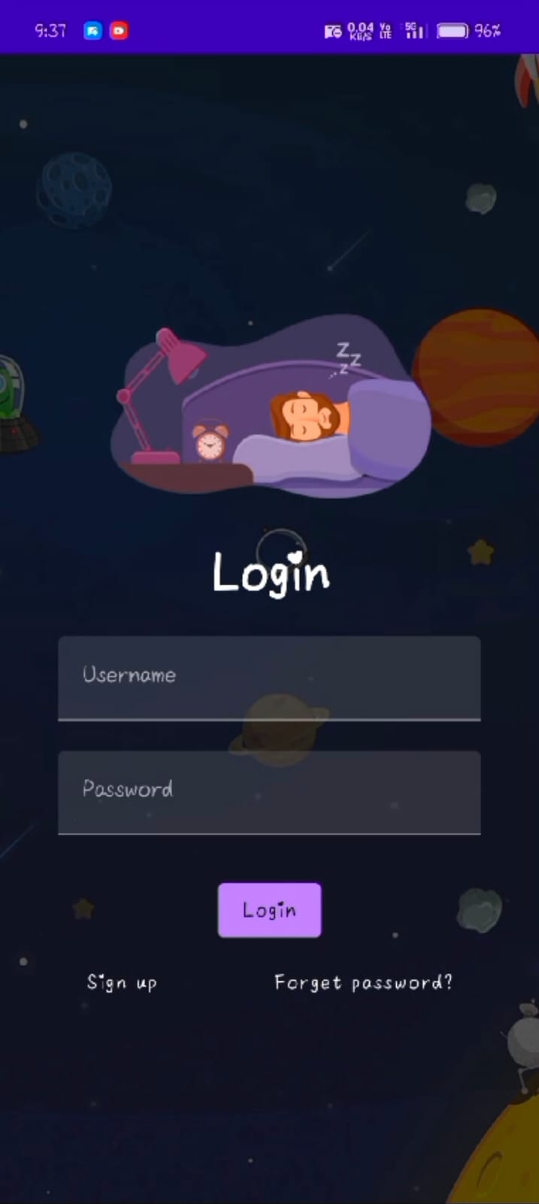
OUTPUT:

Slide 33
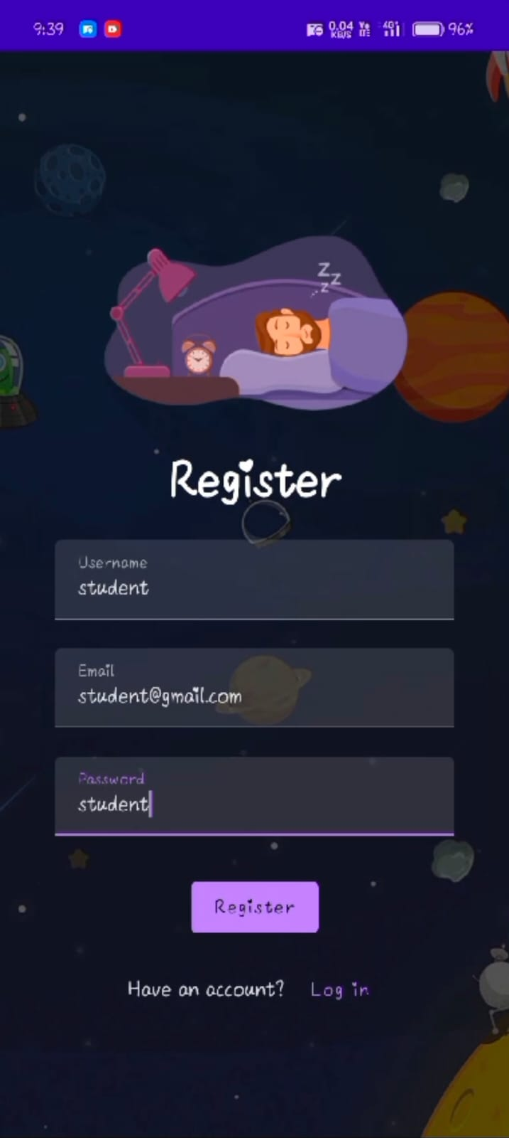

Slide 34
