Slide 1
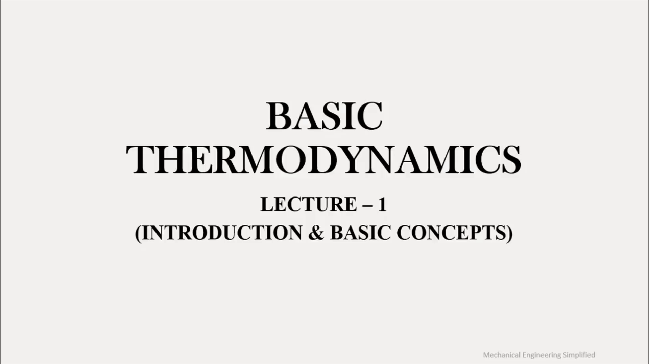
BASIC
THERMODYNAMICS LECTURE - 1
(INTRODUCTION & BASIC CONCEPTS)

Slide 2
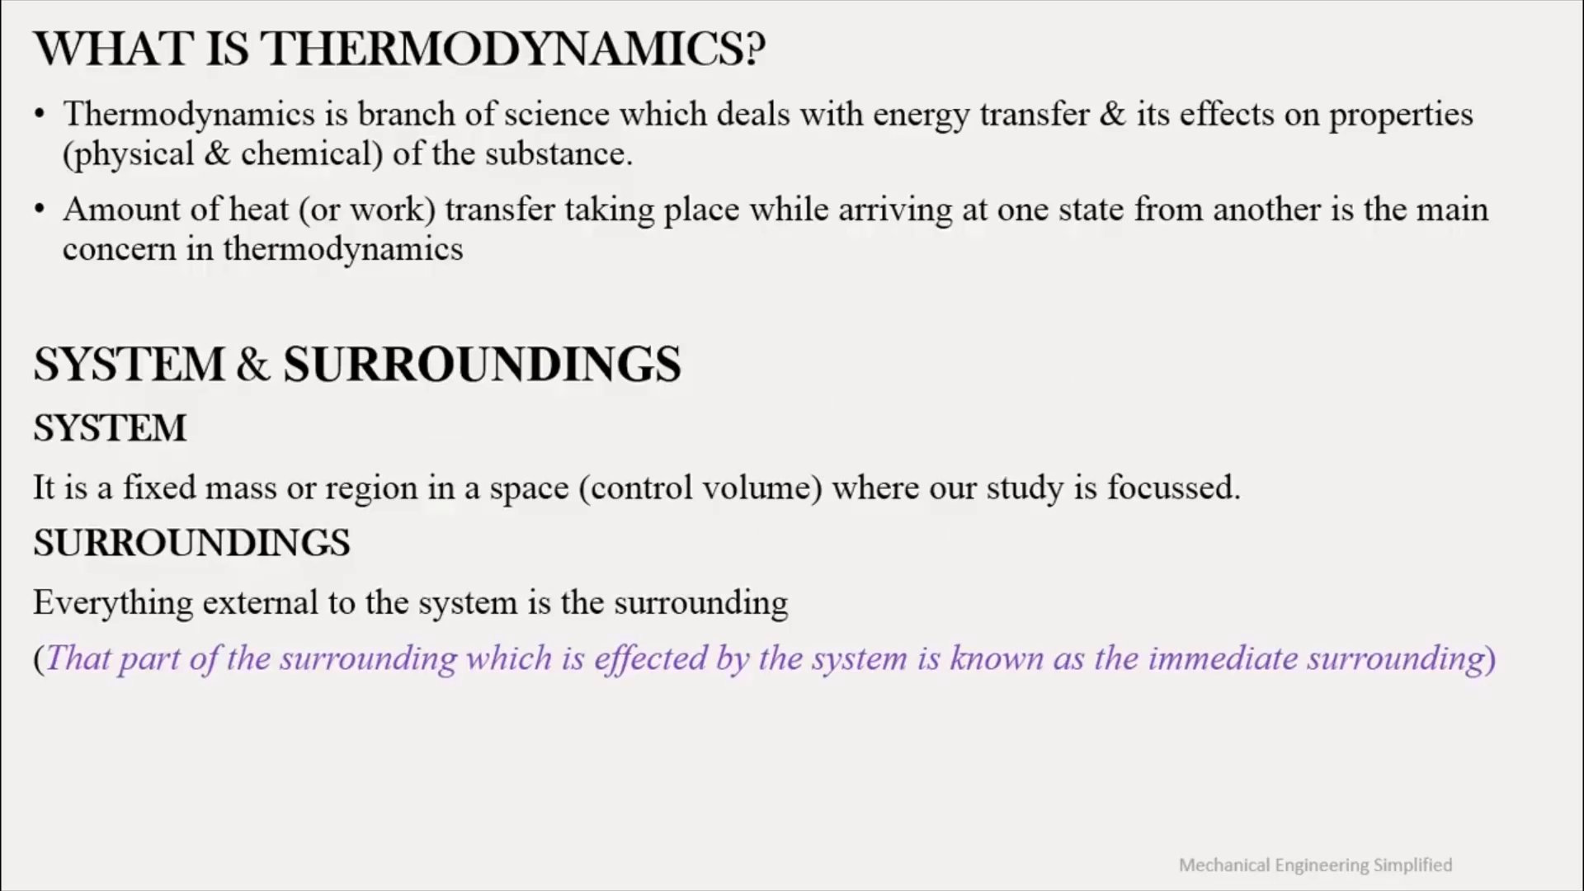
WHAT IS THERMODYNAMICS?
¢ Thermodynamics is branch of science which deals with energy transfer & its effects on properties
(physical & chemical) of the substance.
¢ Amount of heat (or work) transfer taking place while arriving at one state from another is the main
concern in thermodynamics
SYSTEM & SURROUNDINGS
SYSTEM
It is a fixed mass or region in a space (control volume) where our study is focussed.
SURROUNDINGS
Everything external to the system is the surrounding
(That part of the surrounding which is effected by the system is known as the immediate surrounding)

Slide 3
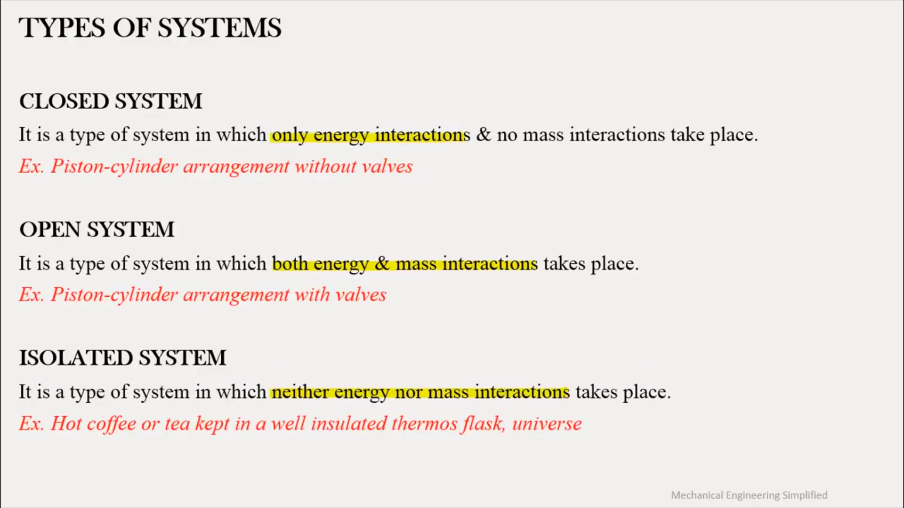
TYPES OF SYSTEMS
CLOSED SYSTEM
It is a type of system in which onlysenergyanteractions & no mass interactions take place.
Ex. Piston-cylinder arrangement without valves
OPEN SYSTEM
It is a type of system in which bothsenergy:Semassunteractions takes place.
Ex. Piston-cylinder arrangement with valves
ISOLATED SYSTEM
It is a type of system in which neitherenergynormassunteractions takes place.
Ex. Hot coffee or tea kept in a well insulated thermos flask, universe

