Slide 1
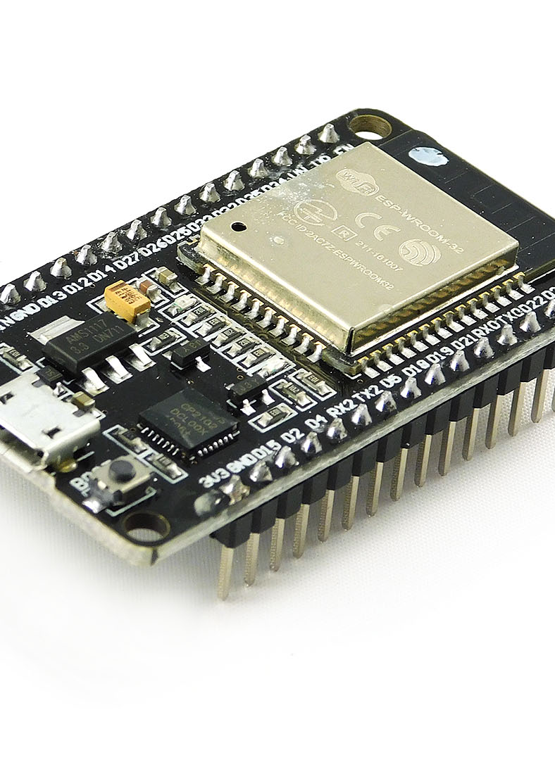
PROJECT PRESENTATION

Slide 2
PROJECT PRESENTATION BY:
NAME OF THE STUDENT:
1. PAUL SWADEEP PULIPAKA

Slide 3
TITLE OF THE PROJECT: INTERNET-CLOCK

Slide 4
INTRODUCTION:
In this project we will design an Internet Clock using ESP32 Wifi Module. We will fetch the time and data from the internet using the ESP32 controller. The internet time clock has a precision of 0.02 to 0.10 seconds. In some of the previous projects, I used the RTC Module like DS1307, DS3231 or PCF8563 to get the time. But what if there is no availability of any RTC Module. The next disadvantage of RTC Module is the poor accuracy as it requires manual adjustments over and over again to keep time/date synchronized.The solution here is to use the Network Time Protocol (NTP). If your ESP32 project has access to the Internet, you can get date and time (with precision within a few milliseconds of UTC) for FREE. You don’t need any additional hardware.The Network Time Protocol (NTP) is a networking protocol for clock synchronization between computer systems over packet-switched, variable-latency data networks.The protocol can be used to synchronize all networked devices to Coordinated Universal Time (UTC) within a few milliseconds, example 50 milliseconds over the public Internet.The NTP client initiates a time-request exchange with the NTP server.

Slide 5
As a result of this exchange, the client is able to calculate the link delay and its local offset and adjust its local clock to match the clock at the server’s computer.Once synchronized, the client updates the clock about once every 10 minutes, usually requiring only a single message exchange.
In addition to client-server synchronization. This transaction occurs via the User Datagram Protocol on port 123. We will use NTPClient Library first. This library connects the ESP32 WiFi to a time server, the server sends time information to the module.Then we have Time library which converts Unix timestamp (Unix epoch) into seconds, minutes, hours, day of the week, day, month and year

Slide 6
ESP32(Wi-fi module):
ESP32 is a series of low-cost, low-power system on a chip microcontrollers with integrated Wi-Fi and dual-mode Bluetooth.The ESP32 series employs a Tenslica Xtensa LX6 microprocessor in both dual-core and singlecore variations and includes built-in antenna switches, RF balun power amplifier, lownoise receive amplifier, filters, and power-manageme modules.

Slide 7
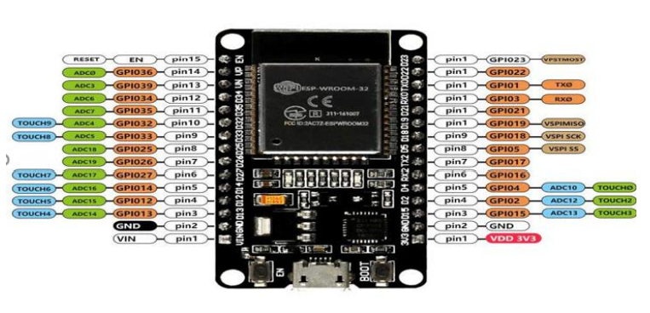
PIN DIAGRAM OF ESP32 Wi-Fi module.

Slide 8
COMPONENTS REQUIRED:
For doing this project we required some of the components like:
HARDWARE COMPONENTS:
1.ESP32(Wi-fi module):
2. Required number of Led’s
3.Breadboard
4.Jumper wires if required.
5.USB connector
SOFTWARE REQUIRED:
Arduino uno with esp32 installed libraries and tools et

Slide 9
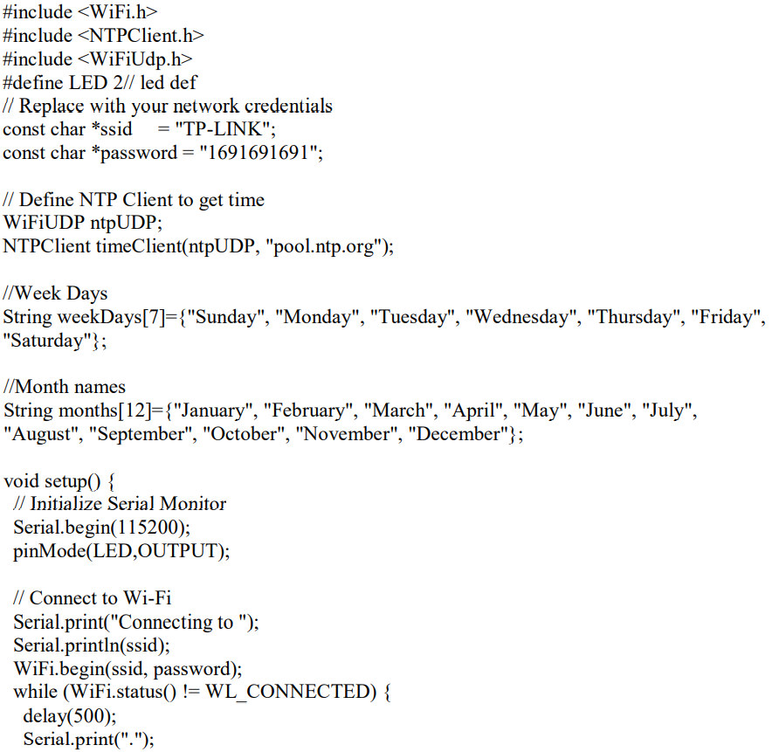
CODE IMPLEMENTATION:

Slide 10
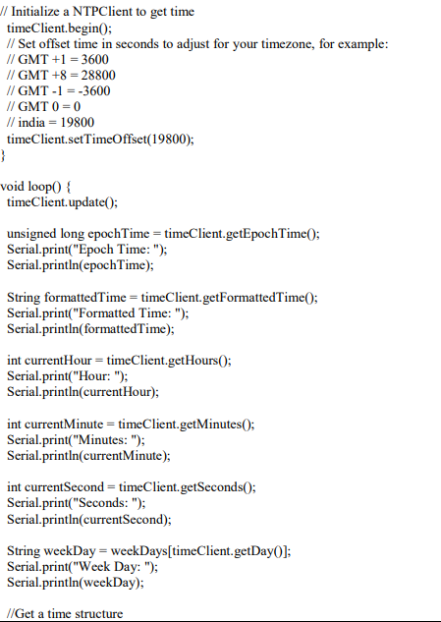

Slide 11
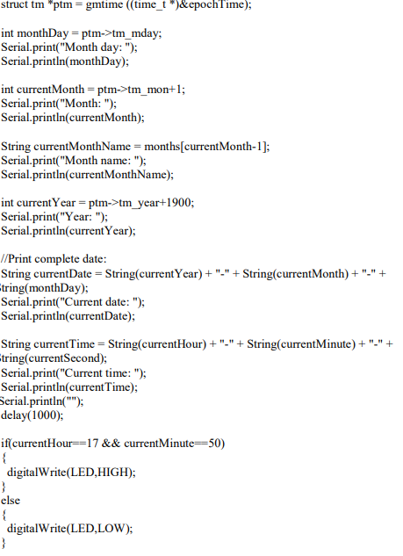

Slide 12
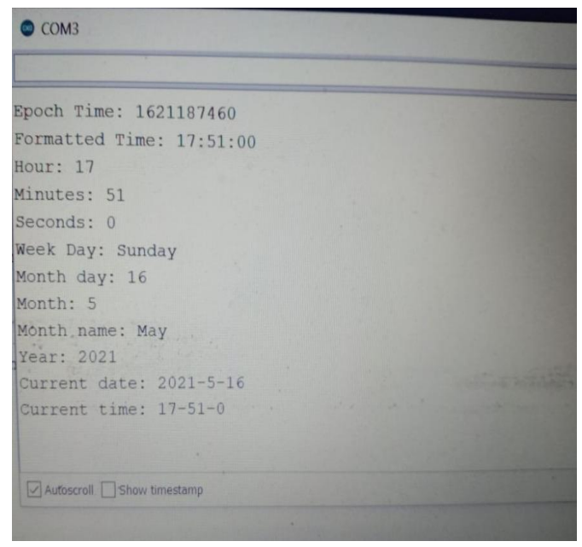
RESULTS :

Slide 13
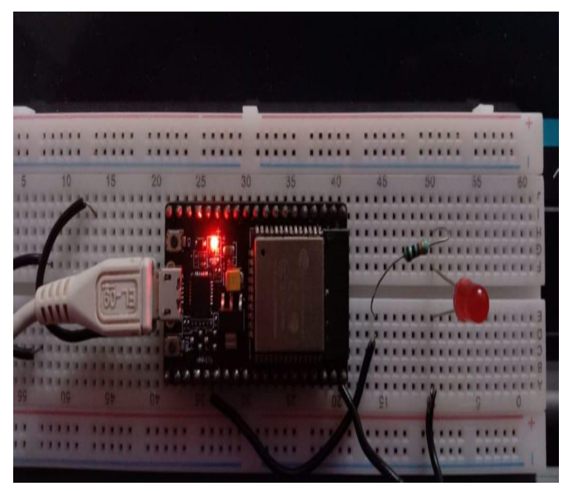

Slide 14
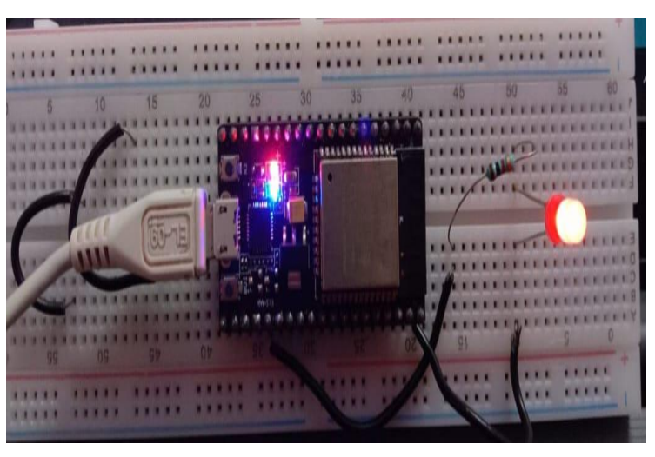

Slide 15
CONCLUSION:
By doing this project we came to a conclusion that we will fetch the time and data from the internet using the ESP32 controller. The internet time clock has a precision of 0.02 to 0.10 seconds. In some of the previous projects, we used the RTC Module like DS1307, DS3231 or PCF8563 to get the time. RTC Module is the poor accuracy as it requires manual adjustments over and over again to keep time/date synchronized.
So with the help of this project we can able to on or off the lights or Led’s or any other electrical devices by setting a specific time and period to such that at that instant of time and date the electrical devices will be off. Here the project undergoes an IoT based application. So here goes the conclusion of our project That is ” INTERNET CLOCK”

