Slide 1
RSA Microarchitecture
Rebekka Alve, Anders Kristoffersen, Palina Yermakova

Slide 2
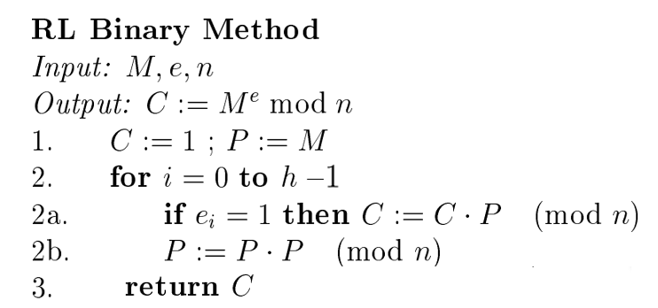
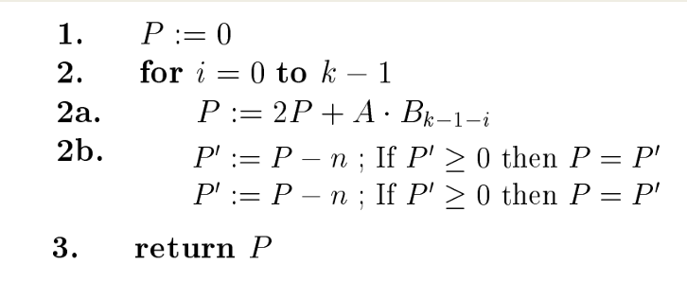
Implement: Me mod n
Exponentiation
Interleaving alorithm (Blakley)
Multiplication P = AB (mod n)
Reasons: Straight forward, easy to understand and implement

Slide 3
Microarchitecture

