Slide 1
RSA Microarchitecture
Rebekka Alve, Anders Kristoffersen, Palina Yermakova

Slide 2
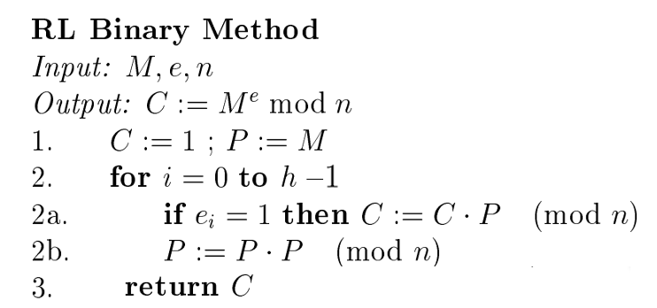
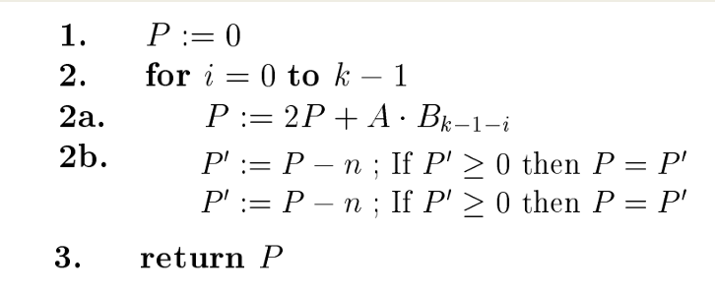
Implement: Me mod n
Exponentiation
Interleaving alorithm (Blakley)
Multiplication P = AB (mod n)
Reasons: Straight forward, easy to understand and implement

Slide 3
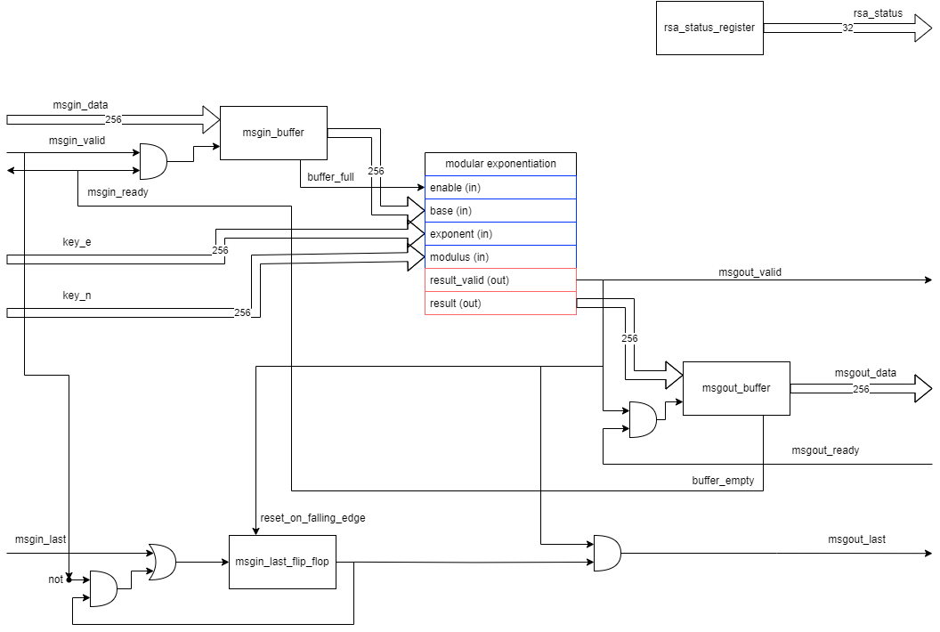
Highest Level

Slide 4
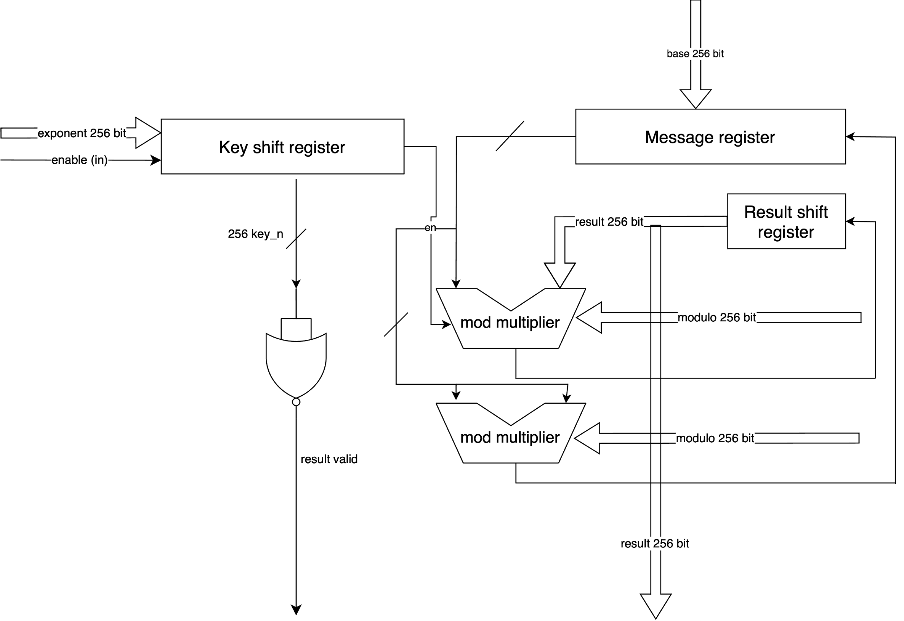
Exponentiation

Slide 5
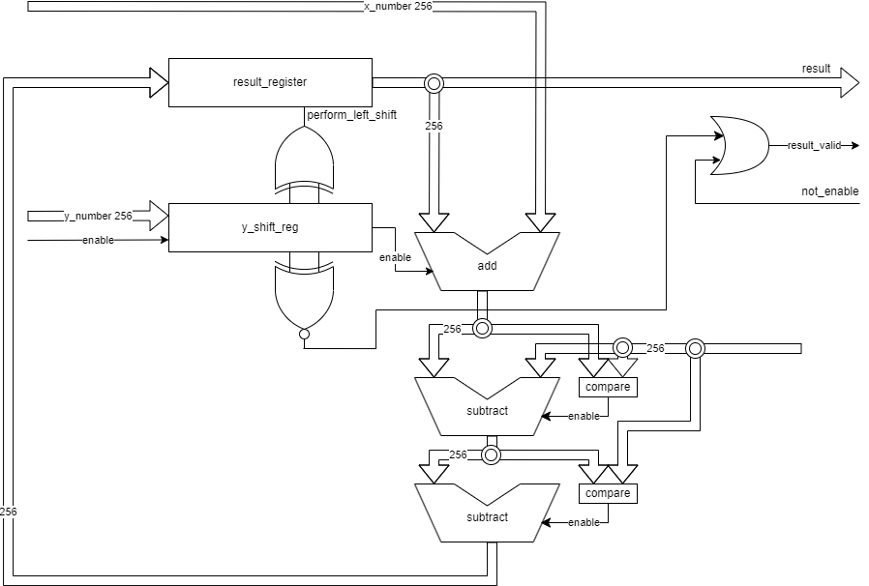
Multiplier

Slide 6
Estimated clock cycles for one encoding
High Level:
1: msgin_data, valid, ready (start)
1: msout_data, valid, ready (end)
Exponentiation and multiplication:
Goes through all bits in exponent (h cycles)
For each bit in exponent, multiplication is done (max h cycles)
O(h²): h is highest number of bits (max is 256 bits).
Overall clockcycles: 256*256 ≈ 65 000

