Slide 1
RSA Microarchitecture
Rebekka Alve, Anders Kristoffersen, Palina Yermakova

Slide 2
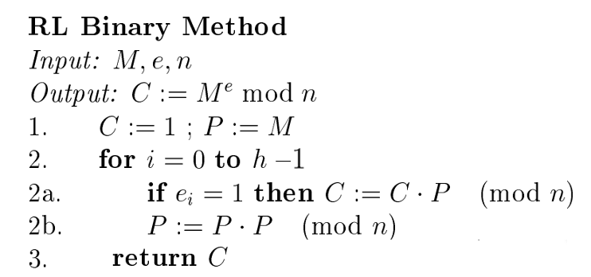
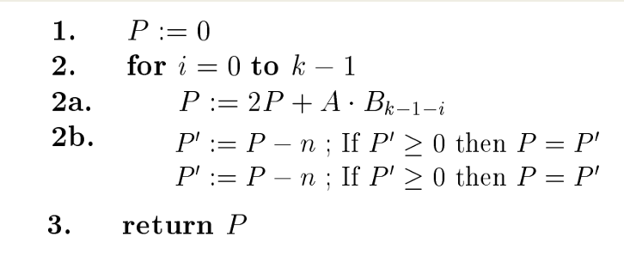
Implement: Me mod n
Exponentiation
Interleaving alorithm (Blakley)
Multiplication P = AB (mod n)
Reasons: Straight forward, easy to understand and implement

Slide 3
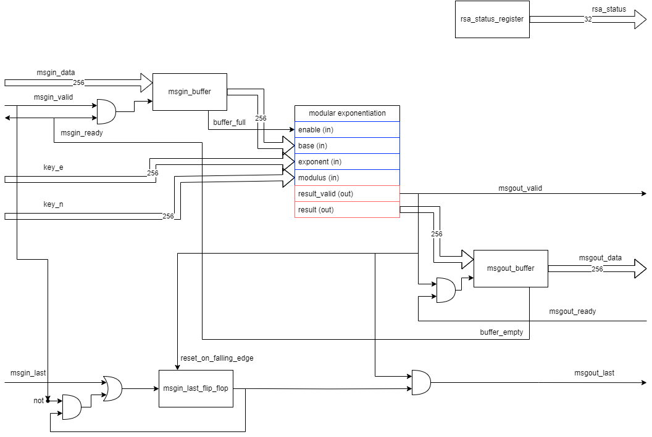
Highest Level

Slide 4
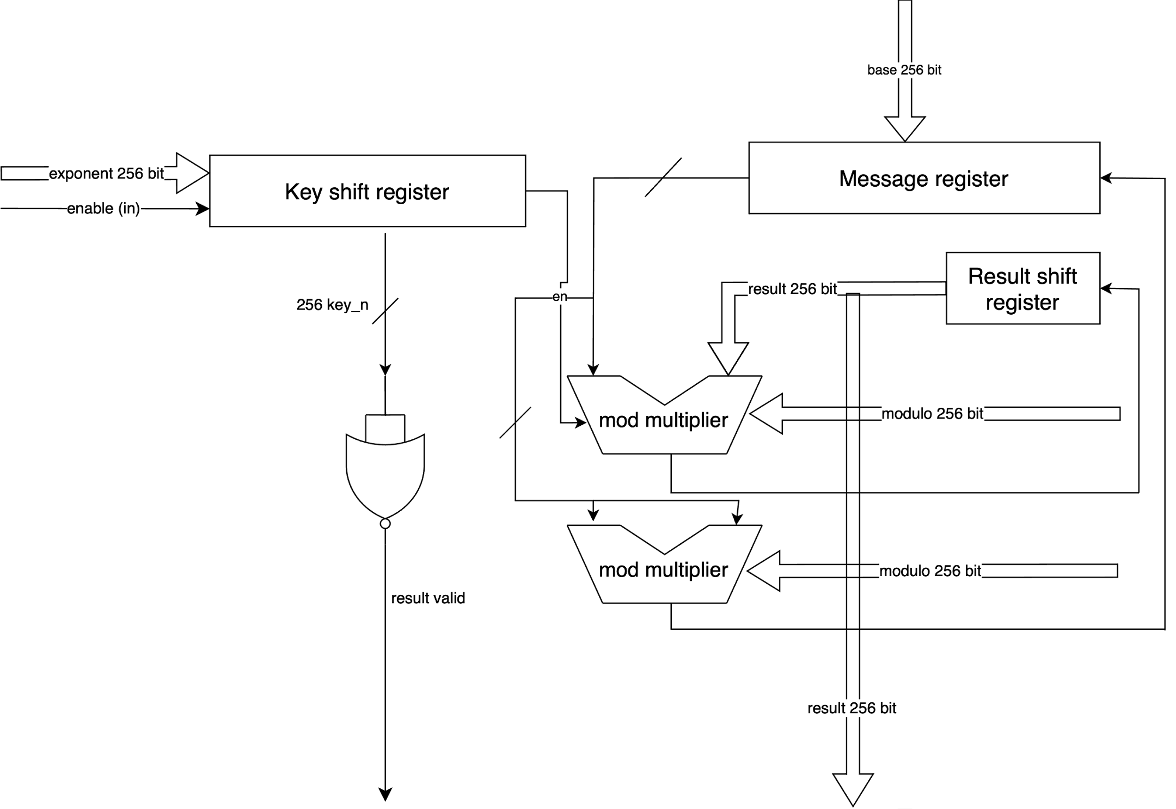
Exponentiation

Slide 5
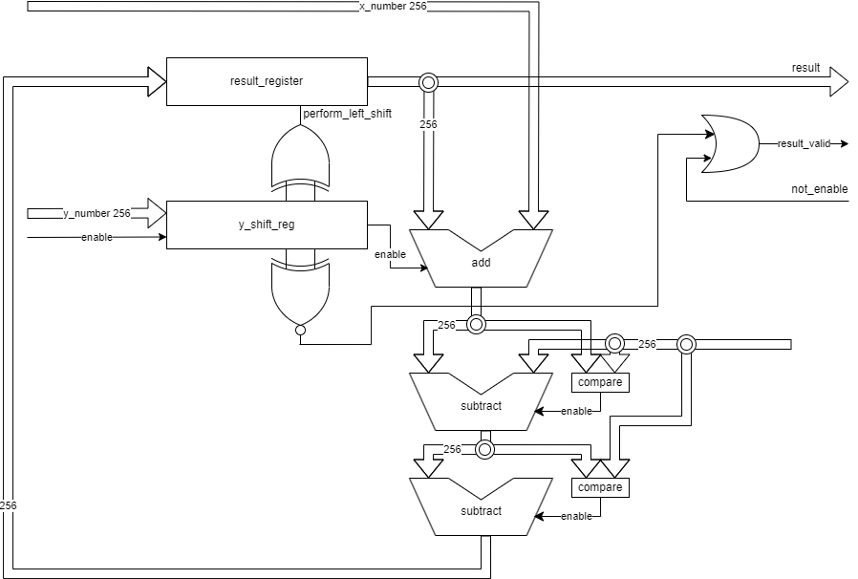
Multiplier

Slide 6
Estimated clock cycles for one encoding
High Level:
1: msgin_data, valid, ready (start)
1: msout_data, valid, ready (end)
Exponentiation
Goes through all bits in the exponent (max 256 cycles)
Multiplication
For each bit in exponent, multiplication is done (max 256 cycles)
Overall clockcycles: 256*256 + 2 ≈ 66 000

