Slide 1

Regression Modelling
Paul Mbugua
Ronnie Muriithi
Victor Gachie
Mercy Tegekson
Winnie Mauti
Robinson Mumo

Slide 2

Introduction
The real estate industry is complex and dynamic
Multiple players like homeowners, buyers, and real estate agents face the challenge of establishing the fair market value of a house
Inaccurate pricing affects both buyers and sellers
Utilizing a multilinear regression model can provide a data-driven solution to the challenge
We seek to provide a tool that assists stakeholders in determining house prices

Slide 3
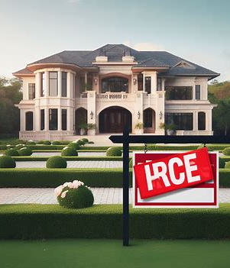
Challenges
Overpricing of houses given a lack of a robust housing pricing model
Overpricing causes the properties to remain unsold for long periods of time
Prospective buyers face the challenge of establishing a property best suiting their budget

Slide 4

Problem Statement
To develop a multilinear regression model with the highest possible accuracy to predict the house prices
To identify the key factors that affect house prices in King County, California
To analyze the performance of the model using metrics like mean squared error, R-squared, and residual analysis
To provide actionable recommendations to the Real Estate Agency so that they can improve their profitability and market share

Slide 5
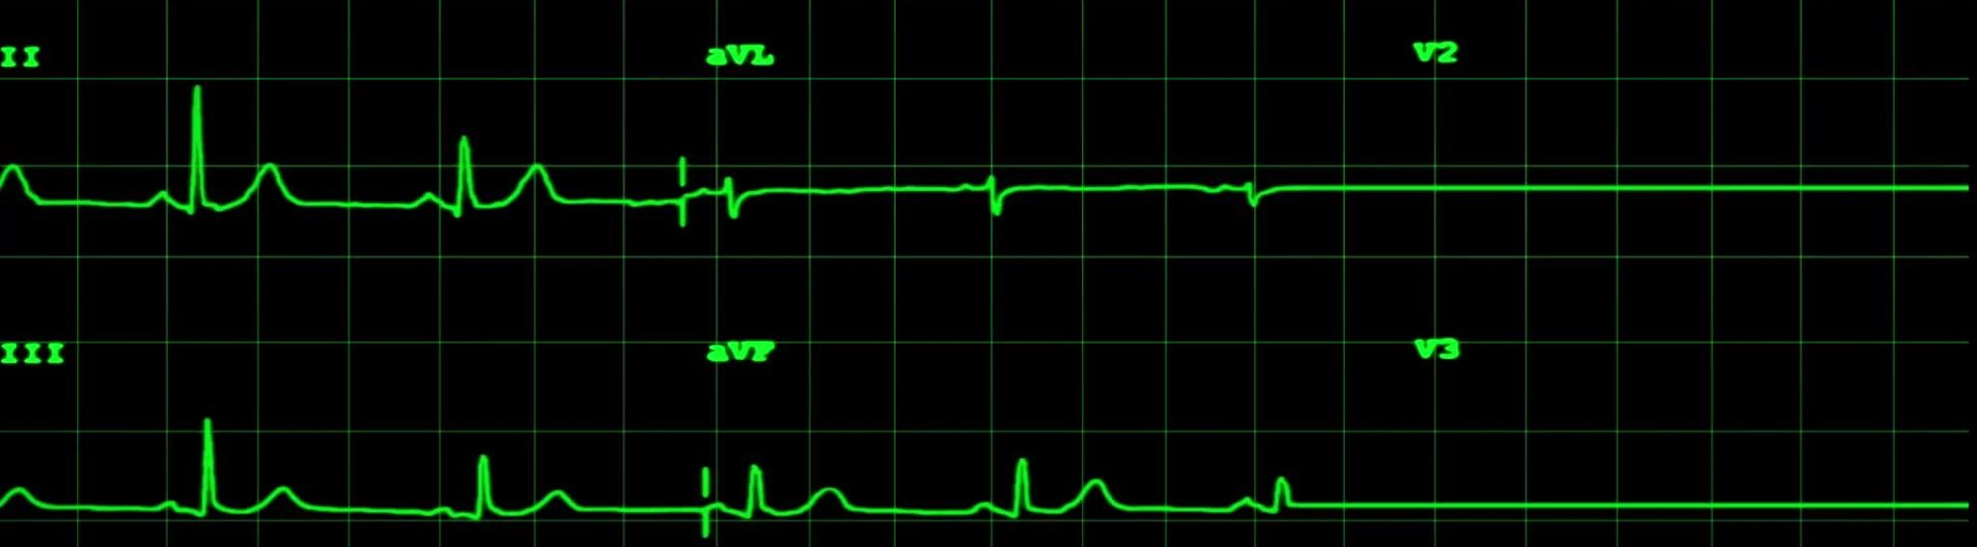
Baseline Model
The baseline model is a simple linear regression model of the form:
y = b0 + x*b1; So,
Price = $100,500 + 0.7434 * Average price per zip code
The model explains 46.01% of the variation in price
The root mean squared error, which means that the model’s predictions are off by about $124,066 in terms of house prices

Slide 6
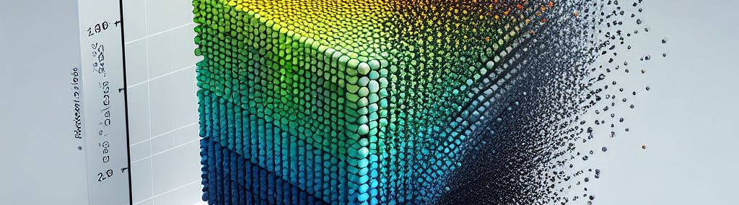
Multiple Linear Regression
The model is of the form
y = b0 + b1*X1 + b2*X2 + … + bn*Xn
Price = $491,419.84 + 0.2023 * Average price per zip code + 25,647.60 * square feet living + 114.98 * total square feet of the house - 69.62 * square feet of houses for the nearest 15 neighbors + 5783 * bathrooms + 1,292.73 * price per square feet + 7,220.67 * bedrooms - 1,802.29 * floors + 25,444.25 * view - 45.36 * square feet of the basement + 72,121.07 * has basement + 1,116.40 * year renovated - 2,191,957.02 * renovated + 62,300.17 * waterfront + 16,988.52 * condition

Slide 7

Performance of the Model
The model explained 90.4% variation in price
The mean absolute error was approximately $124,066 in terms of house prices
The RMSE in the model is approximately $71295
Interpretation: Similar to MAE, a lower RMSE is preferred

Slide 8
Interpretation of the Model
Model Overview The model predicts property prices with an intercept of $491,419
Key Factors Affecting Price Living Space: $25,790 increase per square foot. Bedrooms: $6,716.56 increase per bedroom. Bathrooms: $5,756.37 increase per bathroom. Year Renovated: $1,116.40 increase per year renovated
Influential Features Neighborhood View: $25,444.25 increase per unit. Basement: $72,121.07 increase for properties with a basement. Waterfront: $ 62,300.17 increase for properties with waterfront

Slide 9
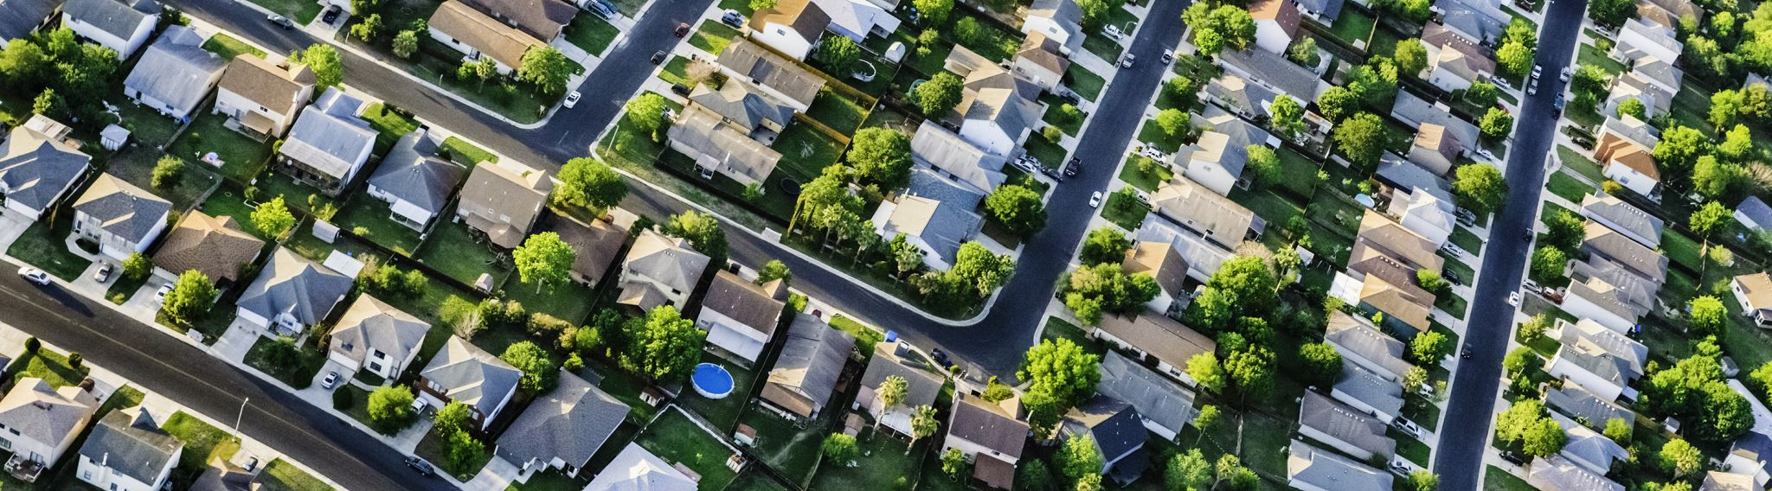
Recommendations
The Real Estate Agency should consider increasing the living spaces of the houses to improve their market values
They should consider investing in houses with a nice view
They should consider investing in properties with the basement
They should consider investing in houses with a waterfront

Slide 10
Conclusion
The real estate market is dynamic and complex
There is a need for a robust model that predicts the prices of the houses
We developed a multilinear regression model to explain the relationship between house prices and other variables
The Real Estate Agency should consider investing in houses with a nice view, large basement, and waterfront

