Slide 1
Speech and Language Processing
Lecture 2
Chapter 2 of SLP

Slide 2
Today
Finite-state methods
Speech and Language Processing - Jurafsky and Martin

Slide 3
Regular Expressions and Text Searching
Everybody does it
  Emacs, vi, perl, grep, etc..
Regular expressions are a compact textual representation of a set of strings representing a language.
Speech and Language Processing - Jurafsky and Martin

Slide 4
Example
Find all the instances of the word “the” in a text.
  /the/
  /[tT]he/
  /\b[tT]he\b/
Speech and Language Processing - Jurafsky and Martin

Slide 5
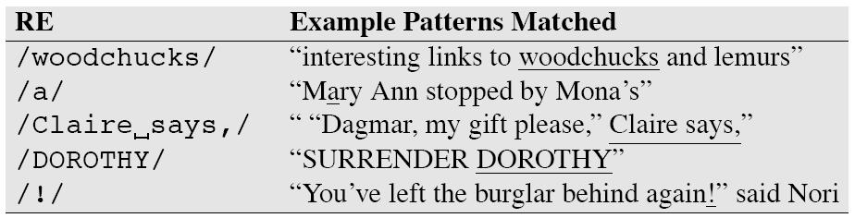
Simple RegEx
Speech and Language Processing - Jurafsky and Martin

Slide 6
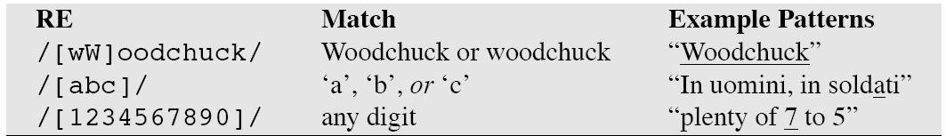
Use of brackets
Specify a disjunction of characters
Speech and Language Processing - Jurafsky and Martin

Slide 7
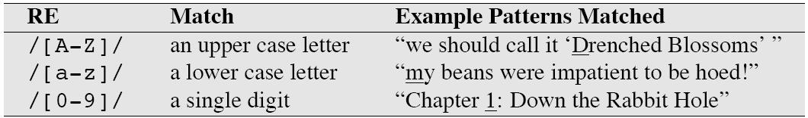
Use of brackets
To specify a range
Speech and Language Processing - Jurafsky and Martin

Slide 8
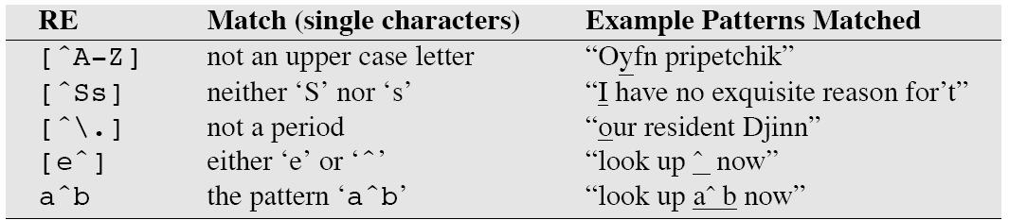
Use of the caret (^)
Negation
Or just to mean ^ literally
Speech and Language Processing - Jurafsky and Martin

Slide 9
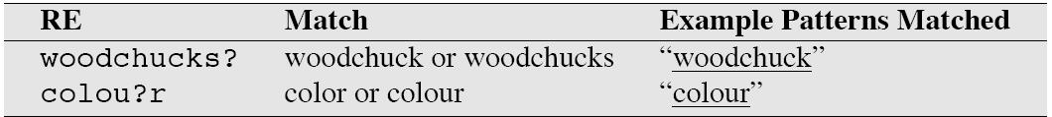
Optionality with ‘?’
Optionality of the previous expression
Speech and Language Processing - Jurafsky and Martin

Slide 10
Match any character
Use the period
It’s a wildcard expression
Speech and Language Processing - Jurafsky and Martin

Slide 11
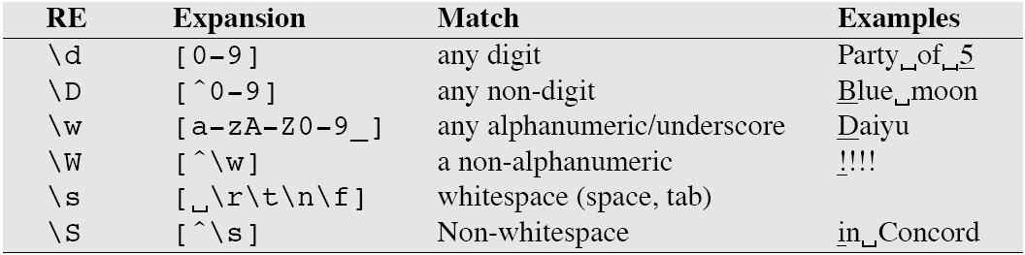
Aliases
Aliases for common sets of characters
Speech and Language Processing - Jurafsky and Martin

Slide 12
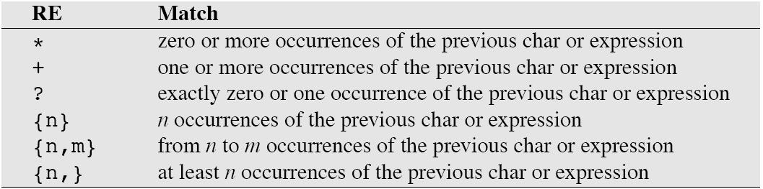
Counting operators
Speech and Language Processing - Jurafsky and Martin

Slide 13
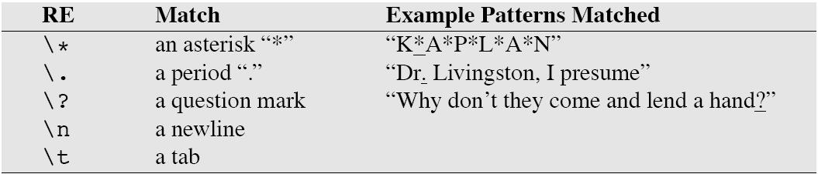
Escape special meaning
Some characters need to be backslashed
Speech and Language Processing - Jurafsky and Martin

Slide 14
Substitutions and Memory
Substitution (in Perl)
  s/colour/color
Memory
  Put brackets around all integers
  The 35 boxes -> the <35> boxes
  Put parentheses around the pattern
  Use the number operator \1 (\2, \3, \4)
  s/([0-9])+)/<\1>/
Memory feature not part of every RegEx language (and often considered ‘extended’ feature)
Speech and Language Processing - Jurafsky and Martin

Slide 15
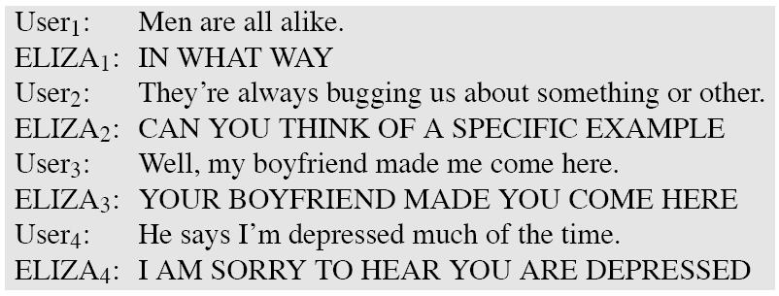
ELIZA
Can be implemented as a cascade of regular expressions
Change my -> your
Change I’m -> you are
Speech and Language Processing - Jurafsky and Martin

Slide 16

ELIZA in RegEx
Speech and Language Processing - Jurafsky and Martin

Slide 17
Finite State Automata
Regular expressions is a way to describe a finite-state automation (FSA)
Any regular expression can be implemented as a finite-state automation
Symmetrically, any finite-state automation can be described with a regular expression (equivalence)
Speech and Language Processing - Jurafsky and Martin

Slide 18
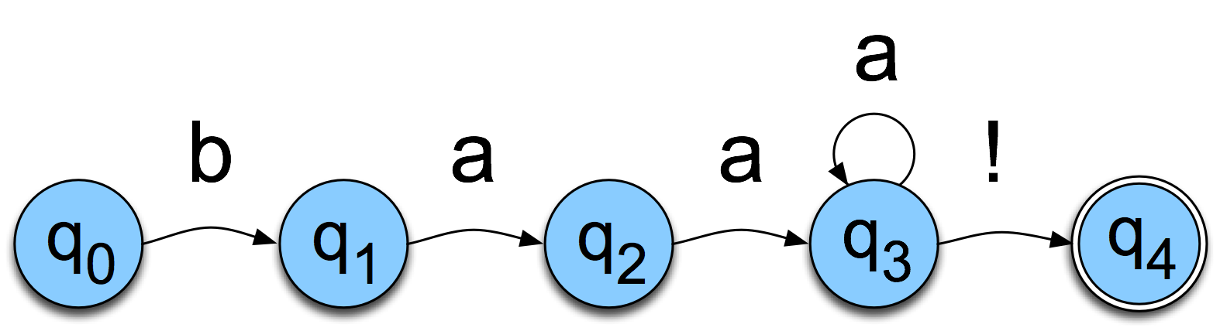
FSAs as Graphs
Sheep language
  /baa+!/
Speech and Language Processing - Jurafsky and Martin

Slide 19
Sheep FSA
We can say the following things about this machine
  It has 5 states
  b, a, and ! are in its alphabet
  q₀ is the start state
  q₄ is an accept state
  It has 5 transitions
Speech and Language Processing - Jurafsky and Martin

Slide 20
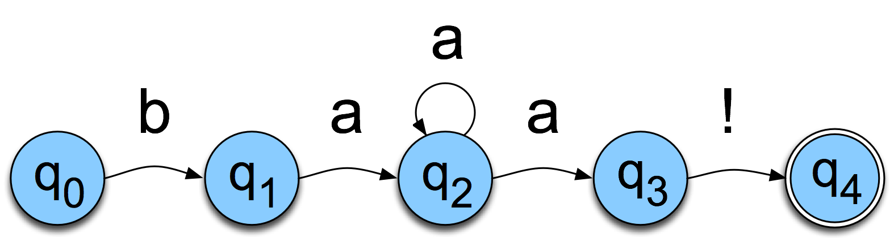
But Note
There are other machines that correspond to this same language (NFSA)
More on this soon
Speech and Language Processing - Jurafsky and Martin

Slide 21
More Formally
You can specify an FSA by enumerating the following things
  The set of states: Q
  A finite alphabet: Σ
  A start state
  A set of accept/final states
  A transition function that maps QxΣ to Q
Speech and Language Processing - Jurafsky and Martin

Slide 22
About Alphabets
Don’t take term alphabet word too narrowly
It just means we need a finite set of symbols in the input
These symbols can and will stand for bigger objects that can have internal structure (e.g. words)
Speech and Language Processing - Jurafsky and Martin

Slide 23
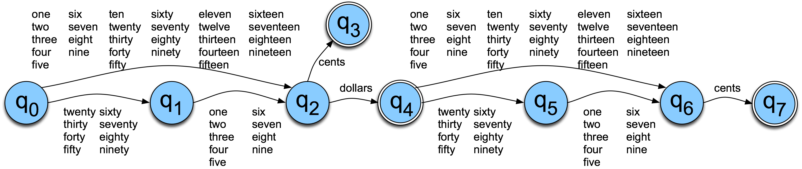
Dollars and Cents
Speech and Language Processing - Jurafsky and Martin

Slide 24
Yet Another View
The guts of FSAs can ultimately be represented as tables
 | b | a | ! | e
0 | 1
1 |  | 2
2 |  | 2,3
3 |  |  | 4
4
If you’re in state 1 and you’re looking at an a, go to state 2
Speech and Language Processing - Jurafsky and Martin

Slide 25
Recognition
Recognition is the process of determining if a string should be accepted by a machine
Or… it’s the process of determining if a string is in the language we’re defining with the machine
Or… it’s the process of determining if a regular expression matches a string
Those all amount the same thing in the end
Speech and Language Processing - Jurafsky and Martin

Slide 26
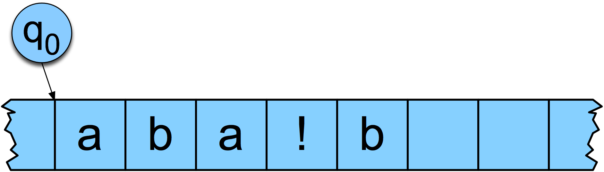
Recognition
Traditionally, (Turing’s notion) this process is depicted with a tape.
Speech and Language Processing - Jurafsky and Martin

Slide 27
Recognition
Simply a process of starting in the start state
Examining the current input
Consulting the table
Going to a new state and updating the tape pointer.
Until you run out of tape
Speech and Language Processing - Jurafsky and Martin

Slide 28
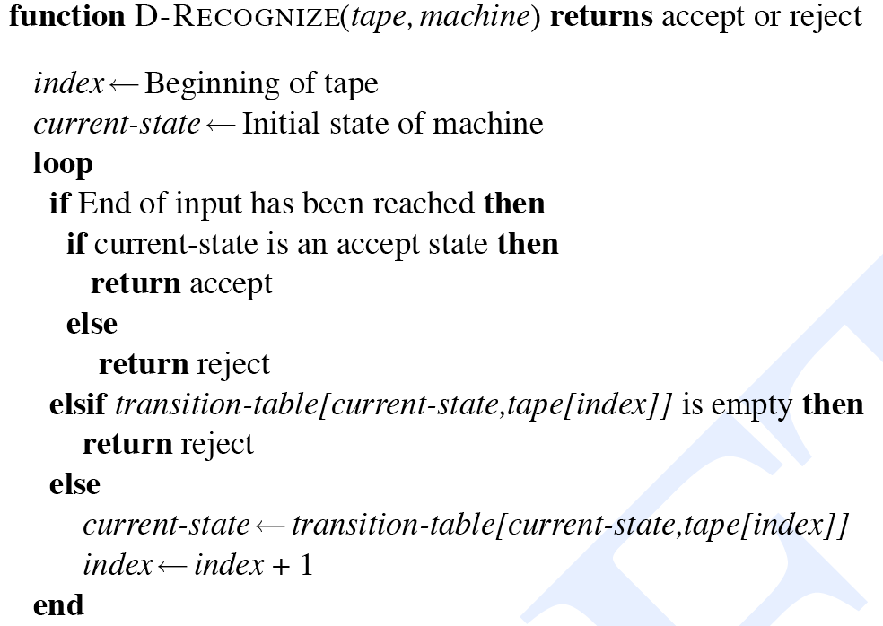
D-Recognize
Speech and Language Processing - Jurafsky and Martin

Slide 29
Key Points
Deterministic (D) means that at each point in processing there is always one unique thing to do (no choices).
D-recognize is a simple table-driven interpreter
The algorithm is universal for all unambiguous regular languages.
  To change the machine, you simply change the table.
Speech and Language Processing - Jurafsky and Martin

Slide 30
Key Points
Crudely therefore… matching strings with regular expressions (ala Perl, grep, etc.) is a matter of
  translating the regular expression into a machine (a table) and
  passing the table and the string to an interpreter
Speech and Language Processing - Jurafsky and Martin

Slide 31
Generative Formalisms
Formal Languages are sets of strings composed of symbols from a finite set of symbols
Finite-state automata define formal languages (without having to enumerate all the strings in the language)
The term Generative is based on the view that you can run the machine as a generator to get strings from the language.
Speech and Language Processing - Jurafsky and Martin

Slide 32
Generative Formalisms
FSAs can be viewed from two perspectives:
  Acceptors that can tell you if a string is in the language
  Generators to produce all and only the strings in the language
Speech and Language Processing - Jurafsky and Martin

Slide 33
Non-deterministic FSAs
Some operations (memory) require non-determinism (NFSA)
This is what we had before
Now add some non-determinism in state q₂
Speech and Language Processing - Jurafsky and Martin

Slide 34
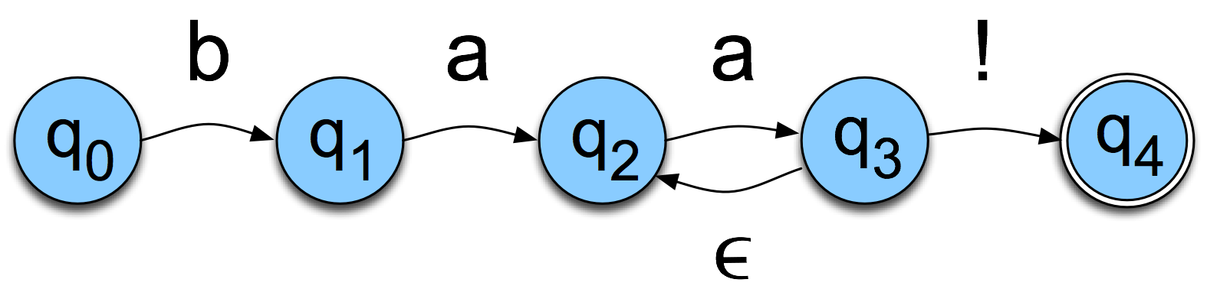
Non-Determinism cont.
Yet another technique
  Epsilon transitions
  When in state q₃, we can move to q₂ without looking at the input
Speech and Language Processing - Jurafsky and Martin

Slide 35
Equivalence
Non-deterministic machines can be converted to deterministic ones
That means that they have the same power; non-deterministic machines are not more powerful than deterministic ones in terms of the languages they can accept
Speech and Language Processing - Jurafsky and Martin

Slide 36
Summary
RegEx is a powerful language for pattern matching
Any RegEx can be realized as a finite-state automation (FSA)
Some operations (memory) require non-determinism (NFSA)
Any NFSA can be converted to DFSA
Any RegEx can automatically be compiled into a NFSA and hence into a FSA
FSAs have lots of applications in (e.g.) morphological processing
Speech and Language Processing - Jurafsky and Martin

