Slide 1
Basic Text Processing
Tokenization and
Sentence Segmentation

Slide 2
Basic Text Processing
Word tokenization

Slide 3
Text Normalization
Every NLP task needs to do text normalization:
Segmenting/tokenizing words in running text
Normalizing word formats
Segmenting sentences in running text

Slide 4
How many words?
I do uh main- mainly business data processing
Fragments, filled pauses
Seuss’s cat in the hat is different from other cats!
Lemma: same stem, part of speech, rough word sense
cat and cats = same lemma
Wordform: the full inflected surface form
cat and cats = different wordforms

Slide 5
How many words?
They picnicked by the pool, then lay back on the grass and looked at the stars
Type: an element of the vocabulary.
Token: an instance of that type in running text.
How many?
16 tokens
14 types
Ambiguity (e.g. San-Francisco: 1 or 2 words?)

Slide 6
How many words?
N = number of tokens
V = vocabulary = set of types
|V| is the size of the vocabulary
The larger the corpus, the more word
types we find
 | Tokens = N | Types = |V|
Switchboard phone conversations | 2.4 million | 20 thousand
Shakespeare | 884,000 | 31 thousand
Google N-grams | 1 trillion | 13 million

Slide 7
Zipf’s Law
Given some corpus of natural language utterances, the frequency of
any word is inversely proportional to its rank in the frequency table
Many types of data can be approximated with a Zipfian distribution
Zipfian distribution belongs to the family of power law probability distributions (so it’s a “power law”)
Named after American linguist George Kingsley Zipf who popularized it (though he did not originate it)

Slide 8
Zipf’s Law
The most frequent word will occur approximately twice as often as the second most frequent word, three times as often as the third most frequent word, etc…
Brown corpus stats (1 million words)
The word the is the most frequently occurring word (69,971 occurrences)
The word of is the second most frequent (36,411 occurrences)
The word and (28,852 occurences)
Only 135 vocabulary items are needed to account for half the Brown Corpus

Slide 9
Zipf’s Law
P_{n} ~ 1 / nª
n - rank in frequency table
a - close to 1
https://plus.maths.org/content/mystery-zipf

Slide 10
Other datasets
Similar relationship in many other rankings unrelated to language
Populations ranks for cities, corporation sizes, income rankings, ranks of people watching the same TV channel and so on.
Pareto distribution
A power-law probability distribution
A large portion of wealth is held by a small fraction of the population
The Pareto principle, or "80-20 rule”
80% of the wealth of a society is held by 20% of its population
The top 1 percent now owns 50.1 percent of the world's wealth (up from 45.5 percent in 2001)

Slide 11
Simple Tokenization in UNIX
(Inspired by Ken Church’s UNIX for Poets.)
Given a text file, output the word tokens and their frequencies
tr -sc ’A-Za-z’ ’\n’ < shakes.txt
| sort
| uniq –c
1945 A
72 AARON
19 ABBESS
5 ABBOT
... ...
Change all non-alpha to newlines
Sort in alphabetical order
Merge and count each type
25 Aaron
6 Abate
1 Abates
5 Abbess
6 Abbey
3 Abbot
.... …

Slide 12
The first step: tokenizing
tr -sc ’A-Za-z’ ’\n’ < shakes.txt | head
THE
SONNETS
by
William
Shakespeare
From
fairest
creatures
We
...

Slide 13
The second step: sorting
tr -sc ’A-Za-z’ ’\n’ < shakes.txt | sort | head
A
A
A
A
A
A
A
A
A
...

Slide 14
More counting
Merging upper and lower case
tr ‘A-Z’ ‘a-z’ < shakes.txt | tr –sc ‘A-Za-z’ ‘\n’ | sort | uniq –c
Sorting the counts
tr ‘A-Z’ ‘a-z’ < shakes.txt | tr –sc ‘A-Za-z’ ‘\n’ | sort | uniq –c | sort –n –r
23243 the
22225 i
18618 and
16339 to
15687 of
12780 a
12163 you
10839 my
10005 in
8954 d
What happened here?

Slide 15
Issues in Tokenization
Finland’s capital → Finland Finlands Finland’s ?
what’re, I’m, isn’t → What are, I am, is not
Hewlett-Packard → Hewlett Packard ?
state-of-the-art → state of the art ?
Lowercase → lower-case lowercase lower case ?
San Francisco → one token or two?
m.p.h., PhD. → ??

Slide 16
Tokenization: language issues
French
L'ensemble → one token or two?
L ? L’ ? Le ?
Want l’ensemble to match with un ensemble
German noun compounds are not segmented
Lebensversicherungsgesellschaftsangestellter
‘life insurance company employee’
German information retrieval needs compound splitter

Slide 17
Tokenization: language issues
Chinese and Japanese no spaces between words:
莎拉波娃现在居住在美国东南部的佛罗里达。
莎拉波娃 现在 居住 在 美国 东南部 的 佛罗里达
Sharapova now lives in US southeastern Florida
Further complicated in Japanese, with multiple alphabets intermingled
Dates/amounts in multiple formats
フォーチュン500社は情報不足のため時間あた$500K(約6,000万円)
Katakana
Hiragana
Kanji
Romaji
End-user can express query entirely in hiragana!

Slide 18
Word Tokenization in Chinese
Also called Word Segmentation
Chinese words are composed of characters
Characters are generally 1 syllable and 1 morpheme.
Average word is 2.4 characters long.
Standard baseline segmentation algorithm:
Maximum Matching (also called Greedy)

Slide 19
Maximum Matching Word Segmentation Algorithm
Given a wordlist of Chinese, and a string
Start a pointer at the beginning of the string
Find the longest word in dictionary that matches the string starting at pointer
Move the pointer over the word in string
Go to 2

Slide 20
Max-match segmentation illustration
Thecatinthehat
Thetabledownthere
Doesn’t generally work in English!
But works astonishingly well in Chinese
莎拉波娃现在居住在美国东南部的佛罗里达。
莎拉波娃 现在 居住 在 美国 东南部 的 佛罗里达
Modern probabilistic segmentation algorithms even better
the cat in the hat
the table down there
theta bled own there

Slide 21
Basic Text Processing
Word tokenization

Slide 22
Basic Text Processing
Word Normalization and Stemming

Slide 23
Normalization
Need to “normalize” terms
Information Retrieval: indexed text & query terms must have same form.
We want to match U.S.A. and USA
We implicitly define equivalence classes of terms
e.g., deleting periods in a term
Alternative: asymmetric expansion:
Enter: window Search: window, windows
Enter: windows Search: Windows, windows, window
Enter: Windows Search: Windows
Potentially more powerful, but less efficient

Slide 24
Case folding
Applications like IR: reduce all letters to lower case
Since users tend to use lower case
Possible exception: upper case in mid-sentence?
e.g., General Motors
Fed vs. fed
SAIL vs. sail
For sentiment analysis, MT, Information extraction
Case is helpful (US versus us is important)

Slide 25
Lemmatization
Reduce inflections or variant forms to base form
am, are, is → be
car, cars, car's, cars' → car
the boy's cars are different colors → the boy car be different color
Lemmatization: have to find correct dictionary headword form
Machine translation
Spanish quiero (‘I want’), quieres (‘you want’) same lemma as querer ‘want’

Slide 26
Morphology
Morphemes:
The small meaningful units that make up words
Stems: The core meaning-bearing units
Affixes: Bits and pieces that adhere to stems
Often with grammatical functions

Slide 27
Stemming
Reduce terms to their stems in information retrieval
Stemming is crude chopping of affixes
language dependent
e.g., automate(s), automatic, automation all reduced to automat.
for example compressed
and compression are both
accepted as equivalent to
compress.
for exampl compress and
compress ar both accept
as equival to compress

Slide 28
Basic Text Processing
Word Normalization and Stemming

Slide 29
Basic Text Processing
Sentence Segmentation and Decision Trees

Slide 30
Sentence Segmentation
!, ? are relatively unambiguous
Period “.” is quite ambiguous
Sentence boundary
Abbreviations like Inc. or Dr.
Numbers like .02% or 4.3
Build a binary classifier
Looks at a “.”
Decides EndOfSentence/NotEndOfSentence
Classifiers: hand-written rules, regular expressions, or machine-learning

Slide 31
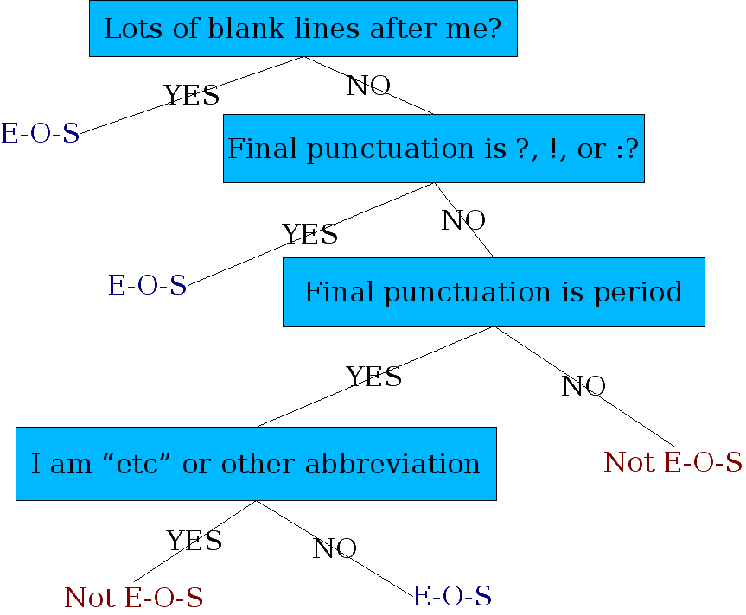
Determining if a word is end-of-sentence: a Decision Tree

Slide 32
More sophisticated decision tree features
Case of word with “.”: Upper, Lower, Cap, Number
Case of word after “.”: Upper, Lower, Cap, Number
Numeric features
Length of word with “.”
Probability (word with “.” occurs at end-of-s)
Probability (word after “.” occurs at beginning-of-s)

