Slide 1
Speech and Language Processing
Lecture 1
Chapter 1 of SLP

Slide 2
Natural Language Processing
We’re going to study what goes into getting computers to perform useful and interesting tasks involving human languages.
We are also concerned with the insights that such computational work gives us into human processing of language.
Speech and Language Processing - Jurafsky and Martin

Slide 3
Why Should You Care?
  An enormous amount of knowledge is now available in machine readable form as natural language text (e.g. EHR)
  Conversational agents are becoming an important form of human-computer communication (Siri etc.)
  Much of human-human communication is now mediated by computers (e.g. auto-complete)
Speech and Language Processing - Jurafsky and Martin

Slide 4









Commercial World
Lot’s of exciting stuff going on…
Powerset
Speech and Language Processing - Jurafsky and Martin

Slide 5


Commercial World
Lot’s of exciting stuff going on…
Speech and Language Processing - Jurafsky and Martin

Slide 6
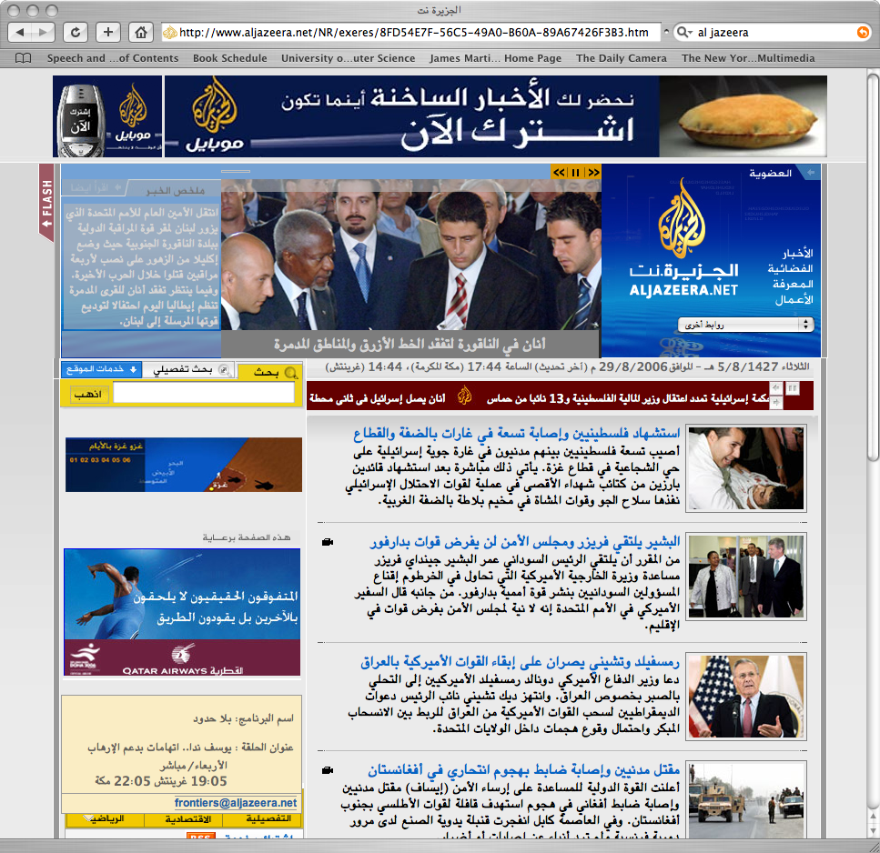
Google Translate
Speech and Language Processing - Jurafsky and Martin

Slide 7

Google Translate
Speech and Language Processing - Jurafsky and Martin

Slide 8
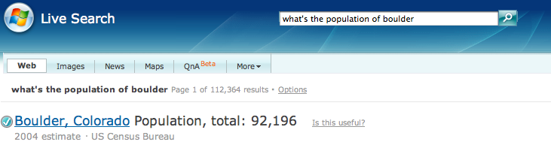
Web Q/A
Speech and Language Processing - Jurafsky and Martin

Slide 9
Weblog Analytics
Data-mining of Weblogs, discussion forums, message boards, user groups, and other forms of user generated media
  Product marketing information
  Political opinion tracking
  Social network analysis
  Buzz analysis (what’s hot, what topics are people talking about right now).
Speech and Language Processing - Jurafsky and Martin

Slide 10
Web Analytics
Speech and Language Processing - Jurafsky and Martin

Slide 11
Major Topics
Words
Syntax
Meaning
Discourse
5. Applications exploiting each
Speech and Language Processing - Jurafsky and Martin

Slide 12
Areas of Linguistics
Phonetics and Phonology (knowledge about linguistic sounds)
Morphology (knowledge of the meaningful components of words)
Syntax (knowledge of sentence structure)
Semantics (knowledge of meaning)
Pragmatics (knowledge of the relationship of meaning to the goals and intentions of the speaker)
Discourse (knowledge about linguistic units larger than a single utterance)
Speech and Language Processing - Jurafsky and Martin

Slide 13
Applications
First, what makes an application a language processing application (as opposed to any other piece of software)?
  An application that requires the use of knowledge about human languages
    Example: Is Unix wc (word count) an example of a language processing application?
Speech and Language Processing - Jurafsky and Martin

Slide 14
Applications
Word count?
  When it counts words: Yes
    To count words you need to know what a word is. That’s knowledge of language.
  When it counts lines and bytes: No
    Lines and bytes are computer artifacts, not linguistic entities
Speech and Language Processing - Jurafsky and Martin

Slide 15
Big Applications
Question answering
Conversational agents
Summarization
Machine translation
Speech and Language Processing - Jurafsky and Martin

Slide 16
Big Applications
These kinds of applications require a tremendous amount of knowledge of language.
Consider the following interaction with HAL the computer from 2001: A Space Odyssey
Speech and Language Processing - Jurafsky and Martin

Slide 17
HAL from 2001
Dave: Open the pod bay doors, Hal.
HAL: I’m sorry Dave, I’m afraid I can’t do that.
Space Odyssey
Speech and Language Processing - Jurafsky and Martin

Slide 18
What’s needed?
Speech recognition and synthesis
Knowledge of the English words involved
  What they mean
How groups of words clump
  What the clumps mean
Speech and Language Processing - Jurafsky and Martin

Slide 19
What’s needed?
Pragmatics (or dialog) knowledge
  It is polite to respond, even if you’re planning to kill someone.
  It is polite to pretend to want to be cooperative (I’m afraid, I can’t…)
Discource knowledge
  How many states were in the US that year?
  What year is that year? Need coreference resolution.
Speech and Language Processing - Jurafsky and Martin

Slide 20
Course Material
We’ll be intermingling discussions of
  Linguistic topics
    E.g. Morphology, syntax, discourse structure
  Formal systems
    E.g. Regular languages, context-free grammars
  Applications
    E.g. Machine translation, information extraction
Speech and Language Processing - Jurafsky and Martin

Slide 21
Topics
Introduction block
• Introduction
• Python
State machine block
• Regular expressions / finite state automata
• Morphology / finite state transducers
Probabilistic models
• Probability review
• Maximum likelihood estimation
• Naive Bayes
• Sentiment analysis
• POS tagging / HMM
Machine learning block
• Introduction (PML chapter 1)
• Sklearn tour (PML chapter 3)
• Model selection (PML chapter 6)
• Working with text (PML chapter 5)
• Clustering
Information retrieval block
• Sparse vectors
• Dense vectors
• Boolean IR
• Ranked IR
Speech and Language Processing - Jurafsky and Martin

Slide 22
Categories of Knowledge
Phonology
Morphology
Syntax
Semantics
Pragmatics
Discourse
Typically used in a pipeline manner
Speech and Language Processing - Jurafsky and Martin

Slide 23
Ambiguity
Computational linguists are obsessed with ambiguity
Ambiguity is a fundamental problem of computational linguistics
Resolving ambiguity is a crucial goal
Speech and Language Processing - Jurafsky and Martin

Slide 24
Ambiguity
Find at least 5 meanings of this sentence:
  I made her duck
Speech and Language Processing - Jurafsky and Martin

Slide 25
Ambiguity
Find at least 5 meanings of this sentence:
  I made her duck
I cooked waterfowl for her benefit (to eat)
I cooked waterfowl belonging to her
I created the (plaster?) duck she owns
I caused her to quickly lower her head or body
I waved my magic wand and turned her into undifferentiated waterfowl
Speech and Language Processing - Jurafsky and Martin

Slide 26
Ambiguity is Pervasive
I caused her to quickly lower her head or body
  Lexical category: “duck” can be a N or V
I cooked waterfowl belonging to her.
  Lexical category: “her” can be a possessive (“of her”) or dative (“for her”) pronoun
I made the (plaster) duck statue she owns
  Lexical Semantics: “make” can mean “create” or “cook”
Speech and Language Processing - Jurafsky and Martin

Slide 27
Ambiguity is Pervasive
Grammar: Make can be:
  Transitive: (verb has a noun direct object)
    I cooked [waterfowl belonging to her]
  Ditransitive: (verb has 2 noun objects)
    I made [her] (into) [undifferentiated waterfowl]
  Action-transitive (verb has a direct object and another verb)
    I caused [her] [to move her body]
Speech and Language Processing - Jurafsky and Martin

Slide 28
Ambiguity is Pervasive
Phonetics!
  I mate or duck
  I’m eight or duck
  Eye maid; her duck
  Aye mate, her duck
  I maid her duck
  I’m aid her duck
  I mate her duck
  I’m ate her duck
  I’m ate or duck
  I mate or duck
Speech and Language Processing - Jurafsky and Martin

Slide 29
Dealing with Ambiguity
Four possible approaches:
  Tightly coupled interaction among processing levels; knowledge from other levels can help decide among choices at ambiguous levels.
  Pipeline processing that ignores ambiguity as it occurs and hopes that other levels can eliminate incorrect structures.
Speech and Language Processing - Jurafsky and Martin

Slide 30
Dealing with Ambiguity
  Probabilistic approaches based on making the most likely choices
  Don’t do anything, maybe it won’t matter
    We’ll leave when the duck is ready to eat.
    The duck is ready to eat now.
      Does the “duck” ambiguity matter with respect to whether we can leave?
Speech and Language Processing - Jurafsky and Martin

