Slide 2
Fonts
  Instrument Sans
  Ui-sans-serif
  System-ui
  Sans-serif
  Apple Color Emoji
  Segoe UI Emoji
  Segoe UI Symbol
  Noto Color Emoji
Colors
  color-club-blue: #1e40af
  color-club-yellow: #fbbf24
  color-club-blue-light: #3b82f6
  --color-club-yellow-light: #fcd34d

Slide 3
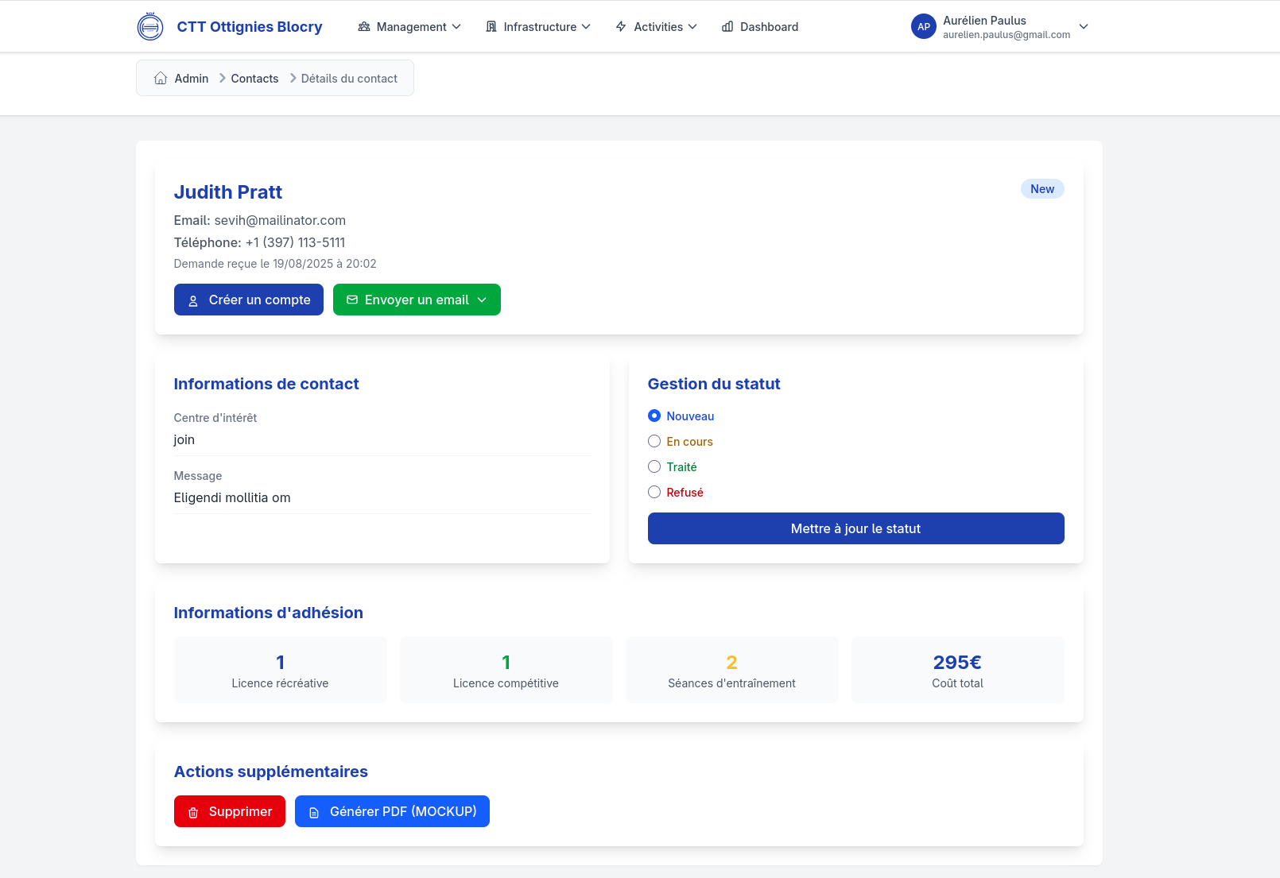
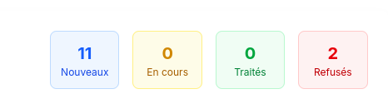
Indicateurs/stats
Indicateurs/stats
Action rapides
Contenu en grid
Action secondaires / complexes

