Slide 1
VOLUMETRIC ANALYSIS (Titration and Standard solution)
Sagina Maharjan

Slide 2
Titration
The process of determining the strength of unknown solution by using standard solution with the help of volume comparison is known as titration.
After titration, calculation is done with the help of Normality equation.
Standard solution: solution whose concentration /strength is known.
Unknown solution: solution whose concentration /strength is unknown.
Titrant: solution which is kept in burette
Titrand : solution which is kept in conical flask / titrating flask

Slide 3
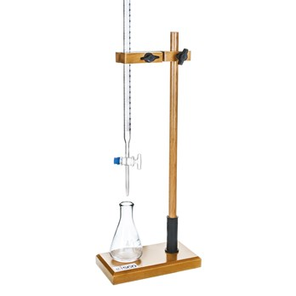
Titration
burette
Conical flask

Slide 4
Types of Titration
Acid-base Titration:
It is the process of determining the strength of unknown acid solution by using standard alkali solution or vice-versa with the help of volume comparison.
Eg: Titration of HCl against standard NaOH solution
HCl + NaOH NaCl + H₂O

Slide 5
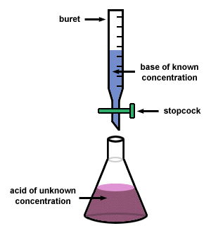
Types of Titration
burette
Conical flask

Slide 6
Types of Titration
Acidimetry:
It is the process of determining the strength of unknown alkali solution by using standard acid solution with the help of volume comparison.
Alkalimetry:
It is the process of determining the strength of unknown acid solution by using standard alkali solution with the help of volume comparison.

Slide 7
Types of Titration
2) Redox Titration:
It is the process of determining the strength of unknown oxidizing agent by using standard solution of reducing agent or vice-versa with the help of volume comparison.
Such titration involves change in oxidation no.
Eg: Titration of oxalic acid solution against KMNO₄ solution in acidic
medium
KMnO₄ + H₂SO₄ + C₂H₂O₄ K₂SO₄ + MnSO₄ + CO₂ + H₂O

Slide 8
Titration
End point:
The point at which indicator shows change in colour when acid solution is completely neutralized by alkali solution during titration is called end point.
It is the practical point.
Equivalence point:
The point at which acid solution is completely neutralized by alkali solution during titration is called equivalence point.
It is the theoretical point.

Slide 9
Titration
For ideal titration, the end point must coincide with equivalence point. However, it is not so practically and a small difference is seen.
The small difference between the end point and equivalence point during titration is known as Titration error.
Indicator :
substance used in titration to determine end point of titration
Types of Indicator:
Internal Indicator – phenolphthalein, methyl orange, methy red, starch
solution
Self indicator – KMnO₄

Slide 10
How Titration is done?
https://www.youtube.com/watch?v=YqfvRBJ-iPg
Setting up and Performing a Titration
https://www.youtube.com/watch?v=sFpFCPTDv2w

Slide 11
Standard solution
Standard solution: A solution of known concentration /strength
It is prepared either by using primary standard substance or secondary standard substance.
Primary standard substance :
It is the substance whose standard solution is prepared directly by dissolving known weight of substance in definite volume of solvent.
Eg: oxalic acid, NaCl, AgNO₃

Slide 12
Standard solution
Characteristics of Primary standard substance:
It should be pure and easily available.
Its composition should not change during storage.
It must have high equivalent weight.
It should not be hygroscopic.
It should be readily soluble in water and not decomposed by water.
Primary standard solution:
It is the solution which is prepared by using primary standard substance.

Slide 13
Standard solution
Secondary standard substance : It is the substance whose solution cannot be prepared directly by weighing and whose solution strength remains changing after a certain time.
For eg: HCl, NaOH
Secondary standard solution:
It is the solution which is prepared by using secondary standard substance.

Slide 14
Principle of Volumetric Analysis
Acid and base of same normality neutralize each other if they have same volume. Eg: 10 ml of 0.1 N HCl is completely neutralized by 10 ml of 0.1 N NaOH.
Concentration of a solution is inversely proportional to volume. If volume is increased by dilution, concentration decreases. Eg: 400 ml of 0.1 N HCl = 40 ml of 1 N HCl
When an acid is completely neutralized by base, normality equation becomes N₁ V₁ = N₂ V₂

