Slide 1
SURVEY2REPORT
Customer Satisfaction Q1
Automated findings from 200 cleaned responses
7 analysed columns · generated 15 October 2026

Slide 2
WHAT THE DATA SAYS
Key findings
• 200 responses across 7 analysed columns
• Most common churn_risk: high (35% of responses)
• Strongest relationship: nps_score ↔ satisfaction_1_5 (r = +0.91, strong positive)
• Highest annual_spend by churn_risk: low (3131.8) vs medium (1284.0)
• Highest support_tickets by plan: Pro (3.0) vs Enterprise (1.6)
• 25 extreme values in annual_spend worth verifying
customer_satisfaction_q1.csv · survey2report
2

Slide 3
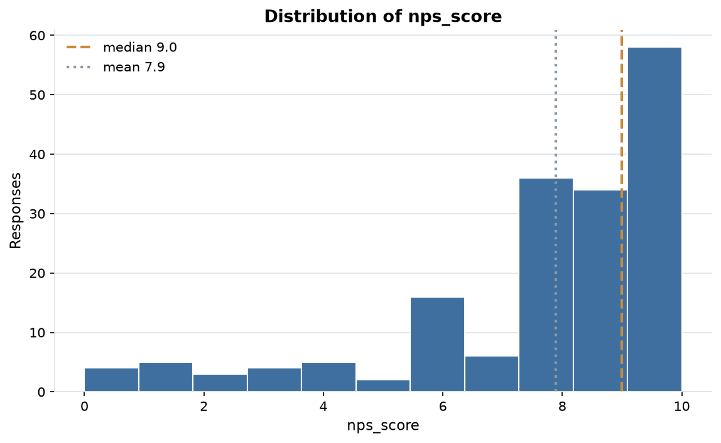
EVIDENCE
Distribution of nps_score
173 answers, median 9.0 and mean 7.9; the axis is clipped to the 1st-99th percentile so outliers cannot squash the shape.
customer_satisfaction_q1.csv · survey2report
3

Slide 4
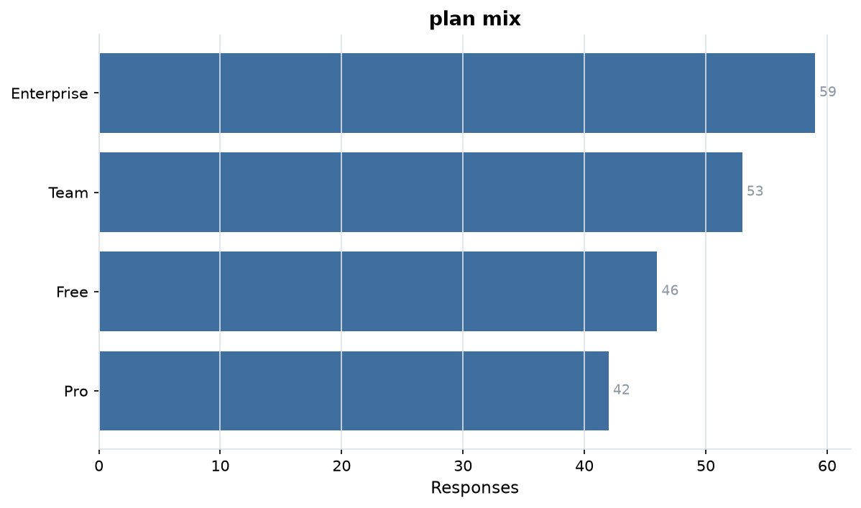
EVIDENCE
plan mix
4 levels over 200 answers; Enterprise is the largest group at 30%.
customer_satisfaction_q1.csv · survey2report
4

Slide 5
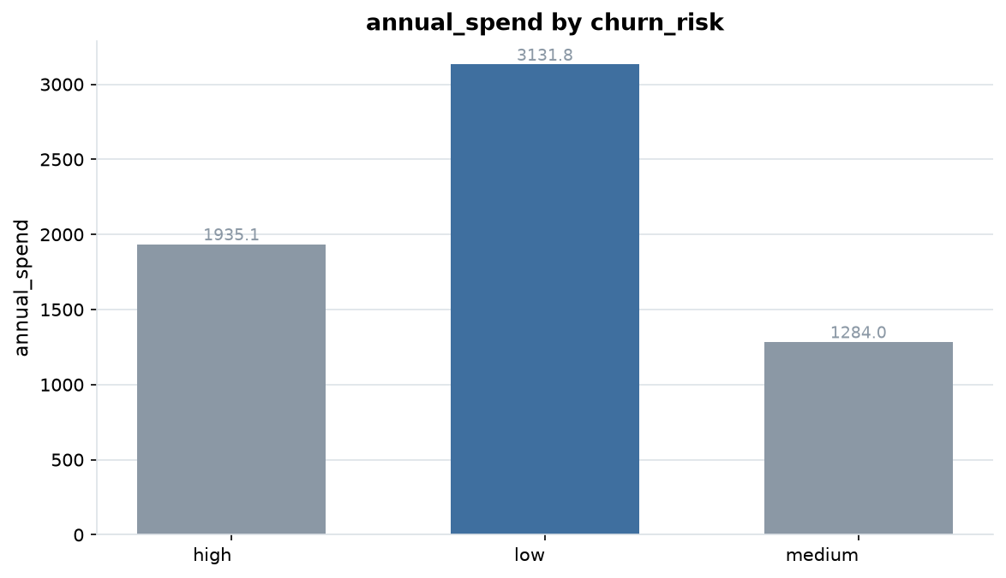
EVIDENCE
annual_spend by churn_risk
low averages 3131.8 against medium at 1284.0, a 89% gap.
customer_satisfaction_q1.csv · survey2report
5

Slide 6
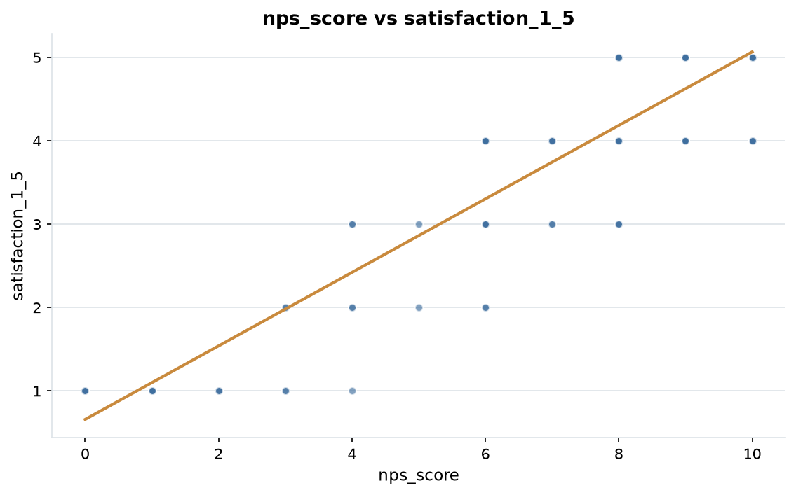
EVIDENCE
nps_score vs satisfaction_1_5
r = +0.91, a strong positive relationship.
customer_satisfaction_q1.csv · survey2report
6

Slide 7
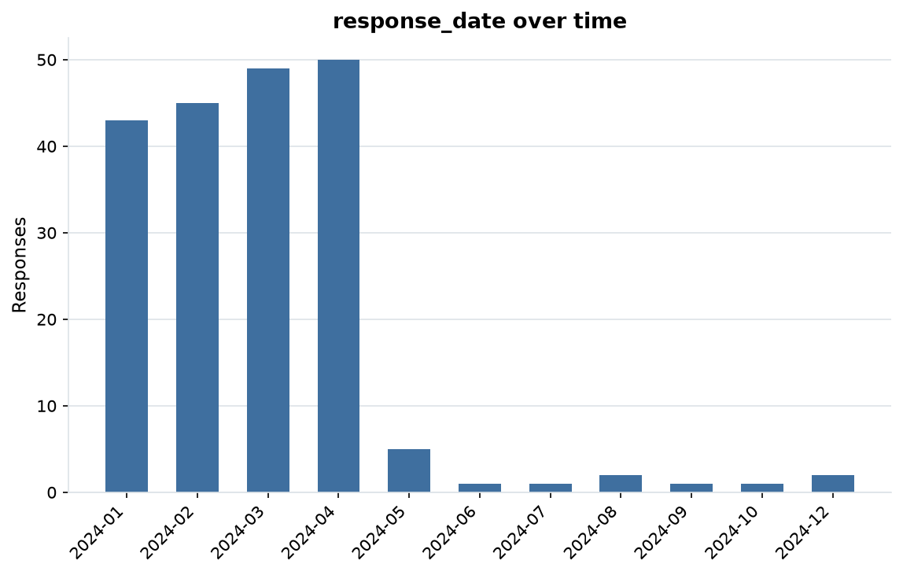
EVIDENCE
response_date over time
200 dated responses from 2024-01-04 to 2024-12-03 (334 days).
customer_satisfaction_q1.csv · survey2report
7

Slide 8
HOW THIS WAS PRODUCED
Methodology & data quality
• Each file is read as raw text; every column is typed as numeric, date, categorical or free text.
• Answers are repaired in place; each change is recorded with a count in cleaning_log.md.
• 208 raw rows became 200 analysis-ready rows (8 dropped)
• 11.8% of cells arrived missing; 12.0% remain after cleaning
• 8 exact duplicate rows were removed
• Charts and figures come from the cleaned table: 4 numeric, 2 categorical and 1 date columns.
customer_satisfaction_q1.csv · survey2report
8

Slide 9
SUMMARY STATISTICS
Appendix: metric detail
Column | N | Missing | Mean | Median | Min | Max
nps_score | 173 | 27 | 7.89 | 9.00 | 0.00 | 10.00
satisfaction_1_5 | 190 | 10 | 4.07 | 5.00 | 1.00 | 5.00
support_tickets | 167 | 33 | 2.16 | 1.00 | 0.00 | 8.00
annual_spend | 175 | 25 | 2,079.90 | 149.00 | 0.00 | 12,500.00
customer_satisfaction_q1.csv · survey2report
9

Slide 10
MOST COMMON ANSWERS
Appendix: category detail
Column | Levels | Most common | Share | Also common
plan | 4 | Enterprise | 30% | Team (53), Free (46), Pro (42)
churn_risk | 3 | high | 35% | medium (68), low (62)
customer_satisfaction_q1.csv · survey2report
10

Slide 11
SHOWING 10 OF 22 RECORDED ACTIONS
Appendix: cleaning log
Column | Issue found | Action taken | Cells
whole table | inconsistent header | renamed to snake_case | 4
customer_name | whitespace padding | stripped surrounding whitespace | 2
customer_name | sentinel missing value | treated as missing | 14
plan | whitespace padding | stripped surrounding whitespace | 44
nps_score | whitespace padding | stripped surrounding whitespace | 3
nps_score | sentinel missing value | treated as missing | 27
satisfaction_1_5 | whitespace padding | stripped surrounding whitespace | 1
satisfaction_1_5 | sentinel missing value | treated as missing | 10
support_tickets | whitespace padding | stripped surrounding whitespace | 3
support_tickets | sentinel missing value | treated as missing | 34
customer_satisfaction_q1.csv · survey2report
11

