Slide 1
SURVEY2REPORT
Employee Engagement 2024
Automated findings from 180 cleaned responses
7 analysed columns · generated 15 October 2026

Slide 2
WHAT THE DATA SAYS
Key findings
• 180 responses across 7 analysed columns
• Most common would_recommend: Yes (35% of responses)
• Strongest relationship: engagement_score ↔ manager_support (r = +0.88, strong positive)
• Highest tenure_yrs by department: Support (6.4) vs Marketing (4.3)
• Highest engagement_score by role: Individual Contributor (3.5) vs Team Lead (3.0)
• 7 duplicate rows were removed during cleaning
employee_engagement_2024.csv · survey2report
2

Slide 3
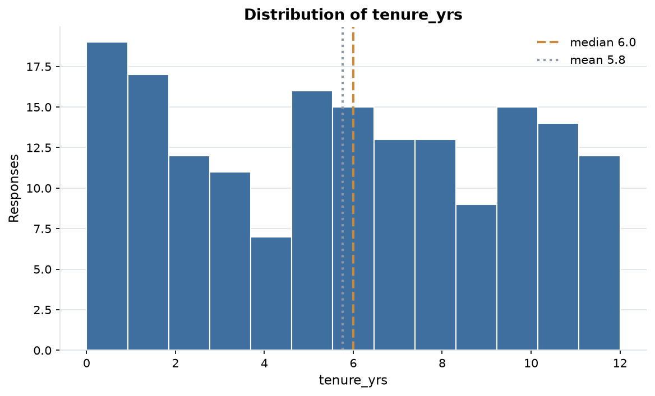
EVIDENCE
Distribution of tenure_yrs
173 answers, median 6.0 and mean 5.8; the axis is clipped to the 1st-99th percentile so outliers cannot squash the shape.
employee_engagement_2024.csv · survey2report
3

Slide 4
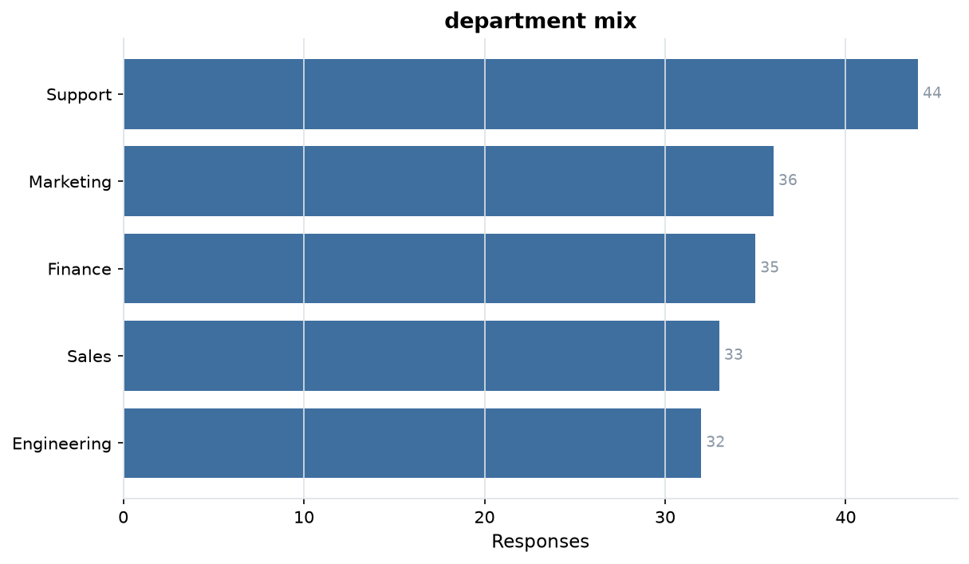
EVIDENCE
department mix
5 levels over 180 answers; Support is the largest group at 24%.
employee_engagement_2024.csv · survey2report
4

Slide 5
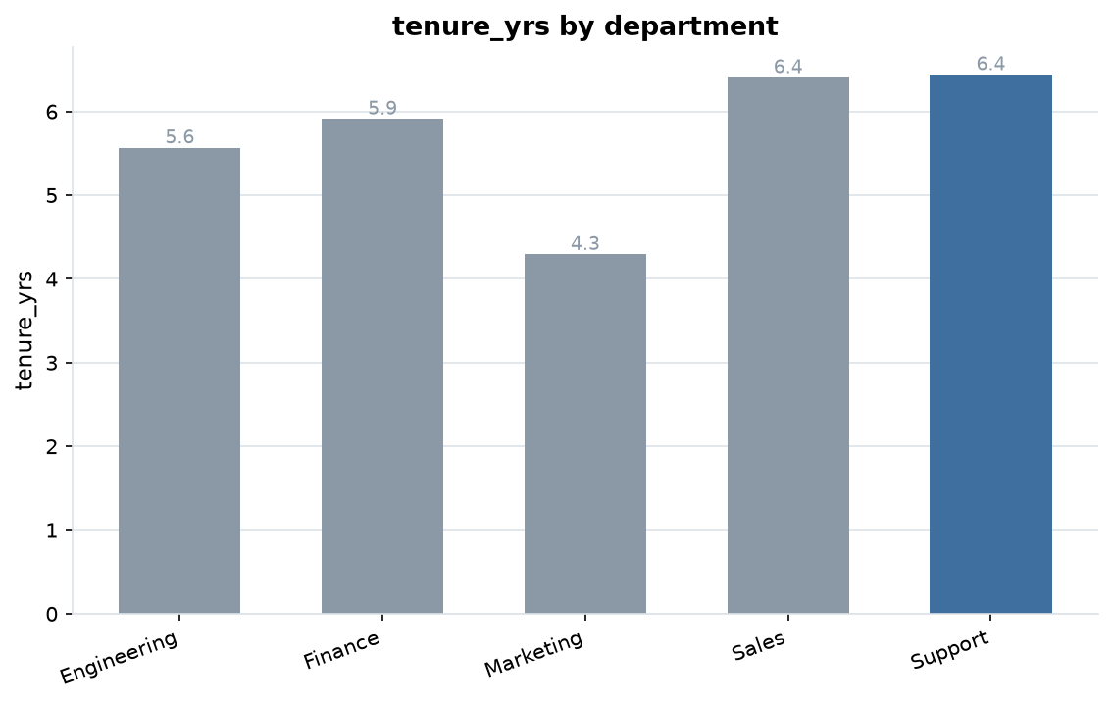
EVIDENCE
tenure_yrs by department
Support averages 6.4 against Marketing at 4.3, a 37% gap.
employee_engagement_2024.csv · survey2report
5

Slide 6
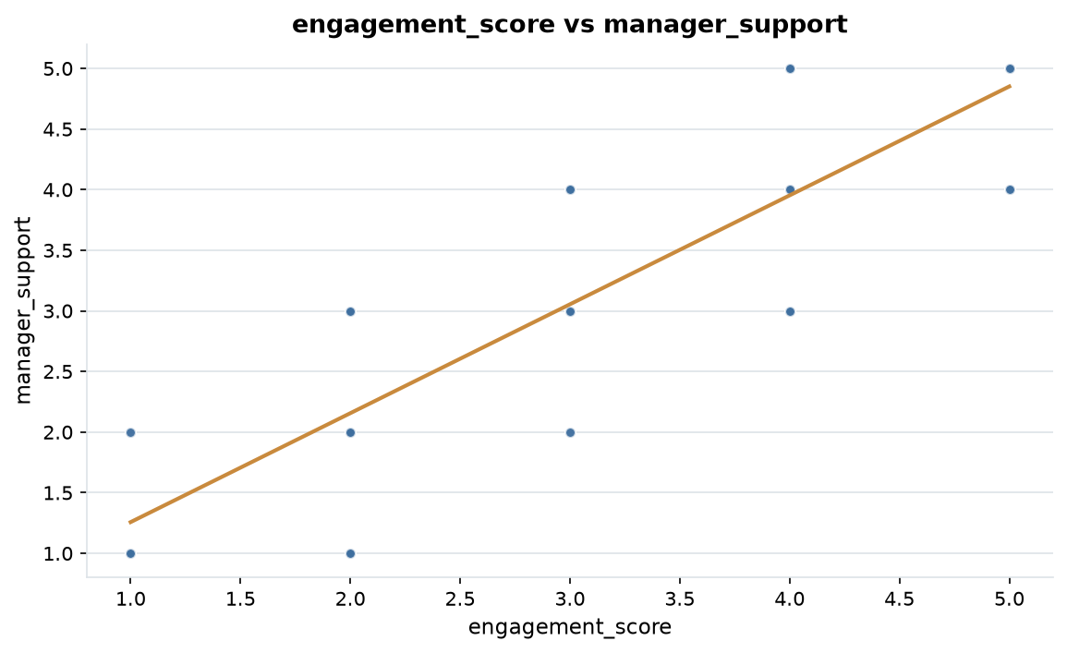
EVIDENCE
engagement_score vs manager_support
r = +0.88, a strong positive relationship.
employee_engagement_2024.csv · survey2report
6

Slide 7
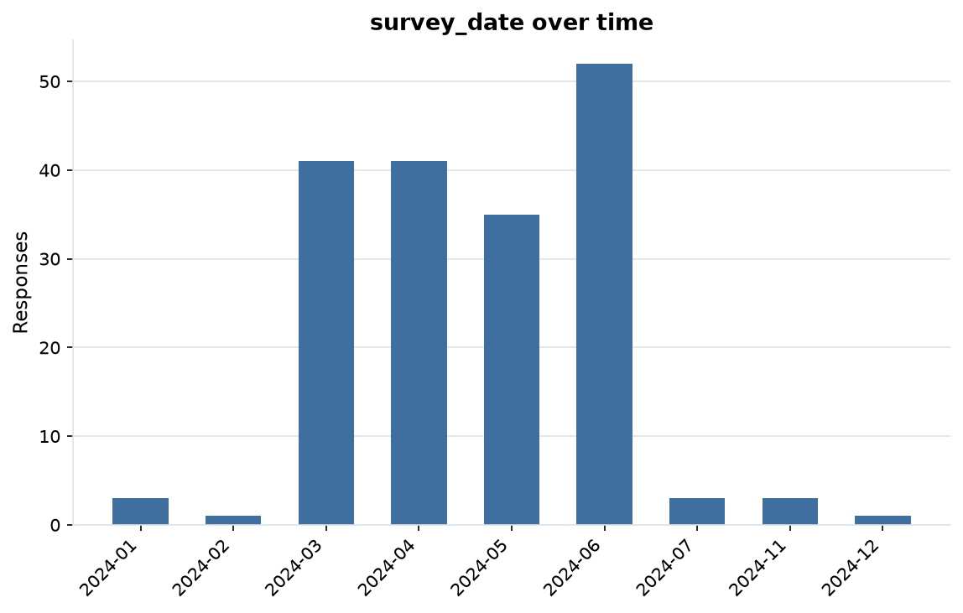
EVIDENCE
survey_date over time
180 dated responses from 2024-01-04 to 2024-12-05 (336 days).
employee_engagement_2024.csv · survey2report
7

Slide 8
HOW THIS WAS PRODUCED
Methodology & data quality
• Each file is read as raw text; every column is typed as numeric, date, categorical or free text.
• Answers are repaired in place; each change is recorded with a count in cleaning_log.md.
• 187 raw rows became 180 analysis-ready rows (7 dropped)
• 9.8% of cells arrived missing; 9.6% remain after cleaning
• 7 exact duplicate rows were removed
• Charts and figures come from the cleaned table: 3 numeric, 3 categorical and 1 date columns.
employee_engagement_2024.csv · survey2report
8

Slide 9
SUMMARY STATISTICS
Appendix: metric detail
Column | N | Missing | Mean | Median | Min | Max
tenure_yrs | 173 | 7 | 5.76 | 6.00 | 0.00 | 12.00
engagement_score | 165 | 15 | 3.30 | 4.00 | 1.00 | 5.00
manager_support | 156 | 24 | 3.30 | 3.00 | 1.00 | 5.00
employee_engagement_2024.csv · survey2report
9

Slide 10
MOST COMMON ANSWERS
Appendix: category detail
Column | Levels | Most common | Share | Also common
department | 5 | Support | 24% | Marketing (36), Finance (35), Sales (33)
role | 4 | Manager | 28% | Team Lead (45), Director (44), Individual Contributor (41)
would_recommend | 3 | Yes | 35% | Maybe (60), No (57)
employee_engagement_2024.csv · survey2report
10

Slide 11
SHOWING 10 OF 19 RECORDED ACTIONS
Appendix: cleaning log
Column | Issue found | Action taken | Cells
whole table | inconsistent header | renamed to snake_case | 6
department | whitespace padding | stripped surrounding whitespace | 24
tenure_yrs | whitespace padding | stripped surrounding whitespace | 2
tenure_yrs | sentinel missing value | treated as missing | 8
role | whitespace padding | stripped surrounding whitespace | 32
engagement_score | whitespace padding | stripped surrounding whitespace | 5
engagement_score | sentinel missing value | treated as missing | 17
manager_support | whitespace padding | stripped surrounding whitespace | 3
manager_support | sentinel missing value | treated as missing | 25
would_recommend | whitespace padding | stripped surrounding whitespace | 33
employee_engagement_2024.csv · survey2report
11

