Slide 1
SURVEY2REPORT
Event Feedback
Automated findings from 160 cleaned responses
6 analysed columns · generated 15 October 2026

Slide 2
WHAT THE DATA SAYS
Key findings
• 160 responses across 6 analysed columns
• Most common city: Lisbon (31% of responses)
• Strongest relationship: session_rating ↔ speaker_rating (r = +0.83, strong positive)
• Highest session_length_mins by would_attend_again: No (60.5) vs Definitely (47.5)
• Highest session_rating by city: Austin (3.5) vs Toronto (2.7)
• 5 duplicate rows were removed during cleaning
event_feedback.csv · survey2report
2

Slide 3
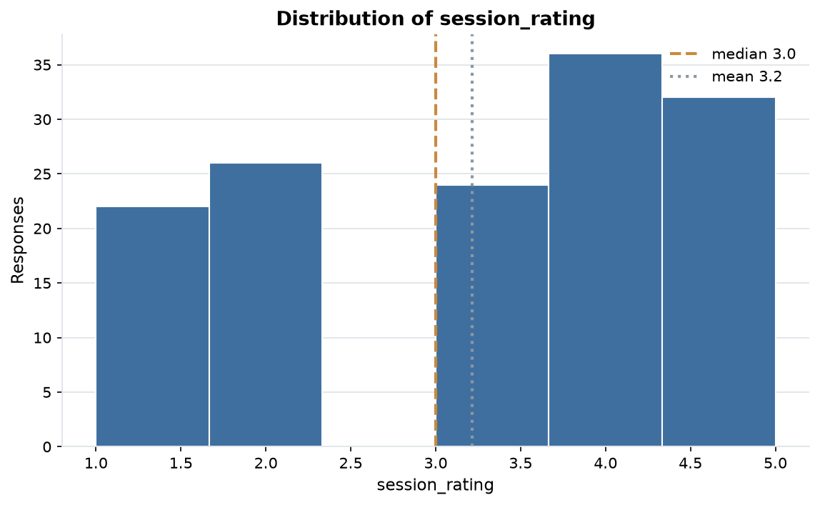
EVIDENCE
Distribution of session_rating
140 answers, median 3.0 and mean 3.2; the axis is clipped to the 1st-99th percentile so outliers cannot squash the shape.
event_feedback.csv · survey2report
3

Slide 4
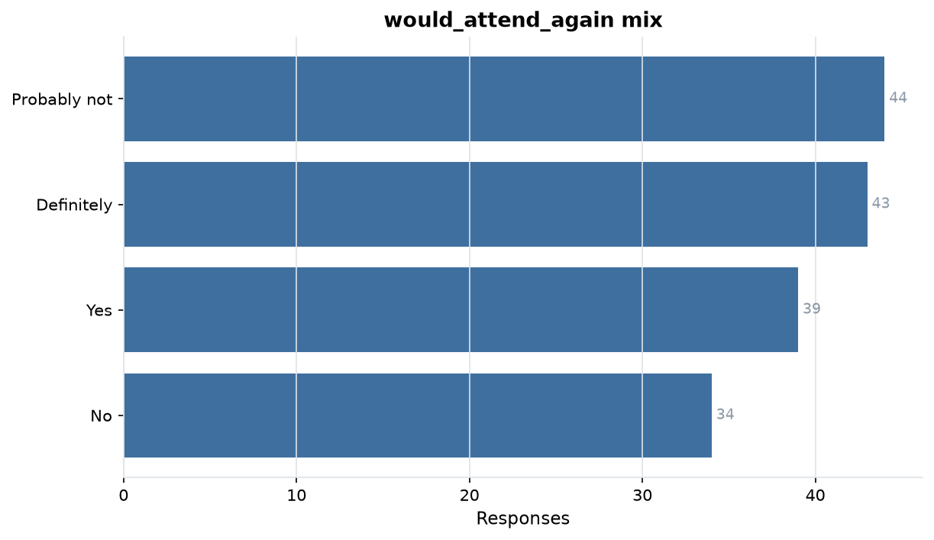
EVIDENCE
would_attend_again mix
4 levels over 160 answers; Probably not is the largest group at 28%.
event_feedback.csv · survey2report
4

Slide 5
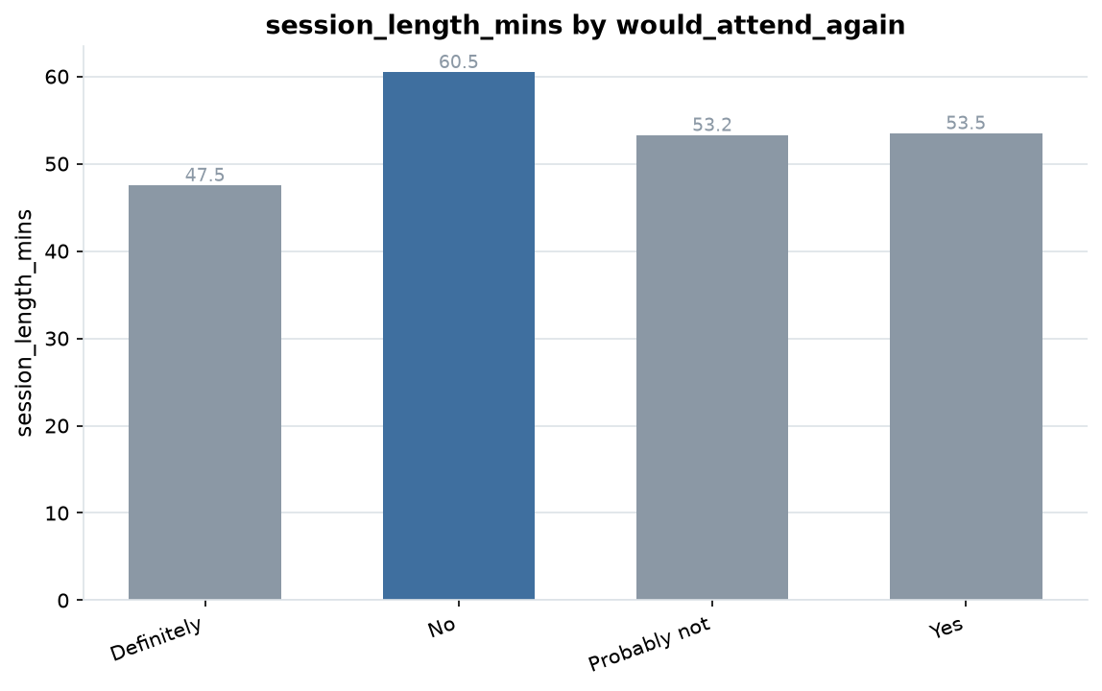
EVIDENCE
session_length_mins by would_attend_again
No averages 60.5 against Definitely at 47.5, a 24% gap.
event_feedback.csv · survey2report
5

Slide 6
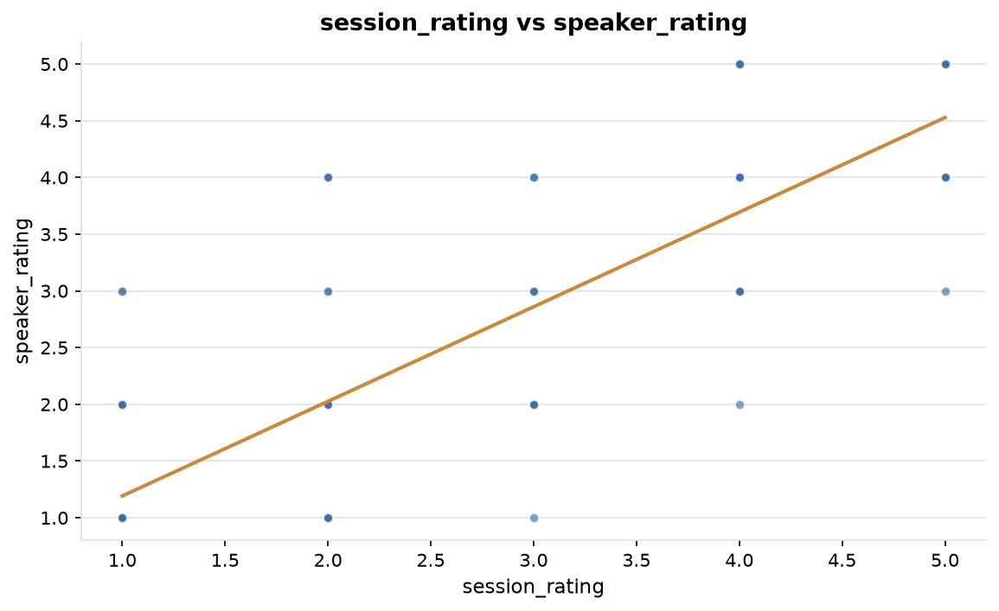
EVIDENCE
session_rating vs speaker_rating
r = +0.83, a strong positive relationship.
event_feedback.csv · survey2report
6

Slide 7
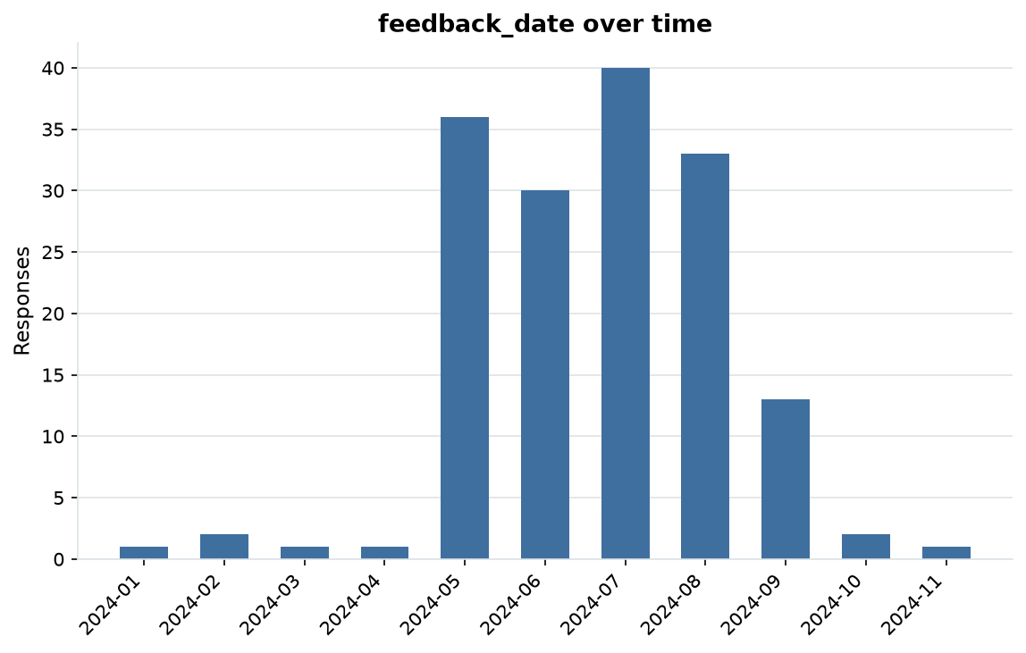
EVIDENCE
feedback_date over time
160 dated responses from 2024-01-09 to 2024-11-06 (302 days).
event_feedback.csv · survey2report
7

Slide 8
HOW THIS WAS PRODUCED
Methodology & data quality
• Each file is read as raw text; every column is typed as numeric, date, categorical or free text.
• Answers are repaired in place; each change is recorded with a count in cleaning_log.md.
• 166 raw rows became 160 analysis-ready rows (6 dropped)
• 13.4% of cells arrived missing; 12.8% remain after cleaning
• 5 exact duplicate rows were removed
• Charts and figures come from the cleaned table: 3 numeric, 2 categorical and 1 date columns.
event_feedback.csv · survey2report
8

Slide 9
SUMMARY STATISTICS
Appendix: metric detail
Column | N | Missing | Mean | Median | Min | Max
session_rating | 140 | 20 | 3.21 | 3.00 | 1.00 | 5.00
speaker_rating | 137 | 23 | 3.08 | 3.00 | 1.00 | 5.00
session_length_mins | 148 | 12 | 53.51 | 45.00 | 30.00 | 90.00
event_feedback.csv · survey2report
9

Slide 10
MOST COMMON ANSWERS
Appendix: category detail
Column | Levels | Most common | Share | Also common
would_attend_again | 4 | Probably not | 28% | Definitely (43), Yes (39), No (34)
city | 5 | Lisbon | 31% | Berlin (31), Bangalore (28), Toronto (27)
event_feedback.csv · survey2report
10

Slide 11
SHOWING 10 OF 23 RECORDED ACTIONS
Appendix: cleaning log
Column | Issue found | Action taken | Cells
whole table | inconsistent header | renamed to snake_case | 5
reg_id | sentinel missing value | treated as missing | 1
attendee_name | sentinel missing value | treated as missing | 10
session_rating | whitespace padding | stripped surrounding whitespace | 4
session_rating | sentinel missing value | treated as missing | 21
speaker_rating | whitespace padding | stripped surrounding whitespace | 2
speaker_rating | sentinel missing value | treated as missing | 25
would_attend_again | whitespace padding | stripped surrounding whitespace | 32
would_attend_again | sentinel missing value | treated as missing | 1
session_length_mins | whitespace padding | stripped surrounding whitespace | 5
event_feedback.csv · survey2report
11

