Slide 1
SURVEY2REPORT
Product Pricing Survey
Automated findings from 170 cleaned responses
7 analysed columns · generated 15 October 2026

Slide 2
WHAT THE DATA SAYS
Key findings
• 170 responses across 7 analysed columns
• Most common segment: Enterprise (26% of responses)
• Strongest relationship: willingness_to_pay ↔ price_shown (r = +0.96, strong positive)
• Highest willingness_to_pay by segment: Enterprise (254.0) vs Startup (34.8)
• Highest price_shown by segment: Enterprise (242.0) vs Startup (45.7)
• 7 duplicate rows were removed during cleaning
product_pricing_survey.csv · survey2report
2

Slide 3
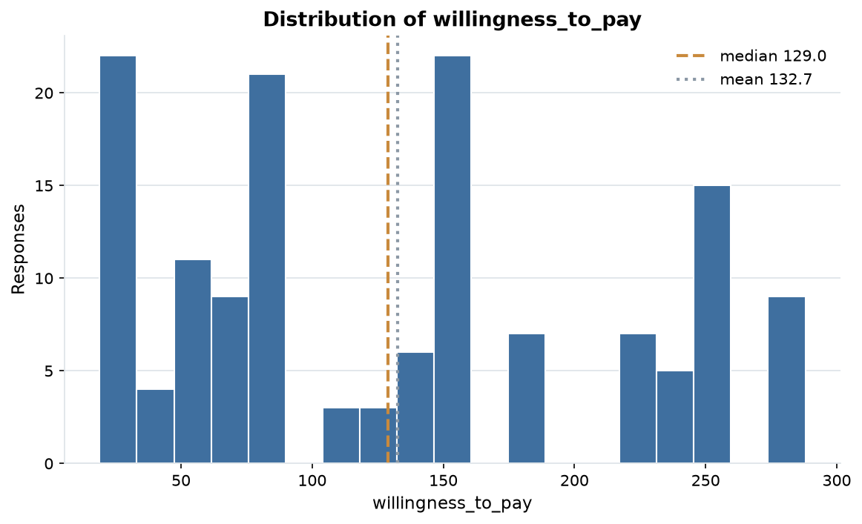
EVIDENCE
Distribution of willingness_to_pay
144 answers, median 129.0 and mean 132.7; the axis is clipped to the 1st-99th percentile so outliers cannot squash the shape.
product_pricing_survey.csv · survey2report
3

Slide 4
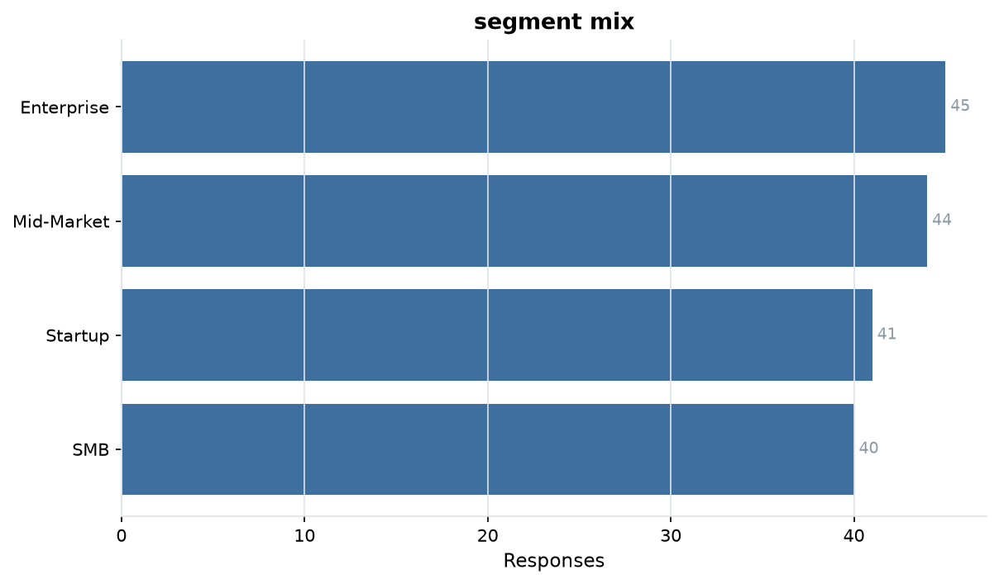
EVIDENCE
segment mix
4 levels over 170 answers; Enterprise is the largest group at 26%.
product_pricing_survey.csv · survey2report
4

Slide 5
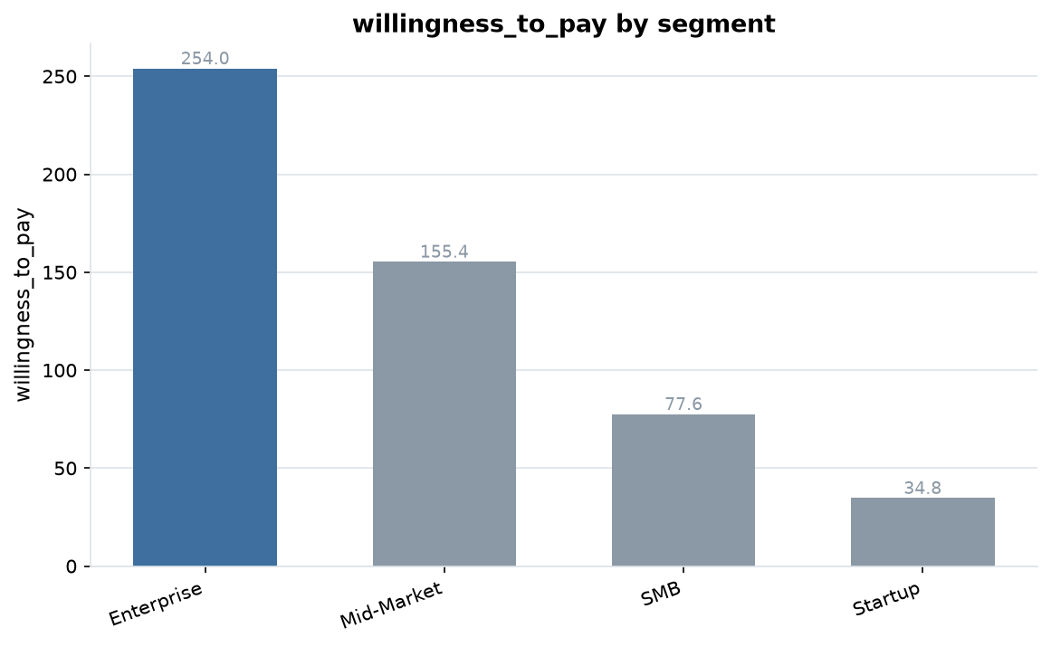
EVIDENCE
willingness_to_pay by segment
Enterprise averages 254.0 against Startup at 34.8, a 165% gap.
product_pricing_survey.csv · survey2report
5

Slide 6
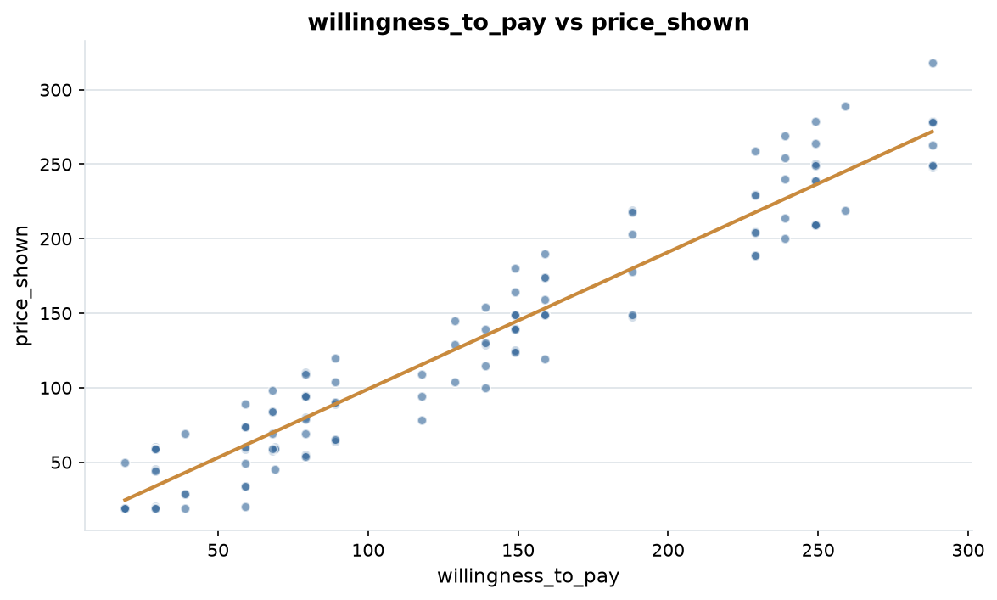
EVIDENCE
willingness_to_pay vs price_shown
r = +0.96, a strong positive relationship.
product_pricing_survey.csv · survey2report
6

Slide 7
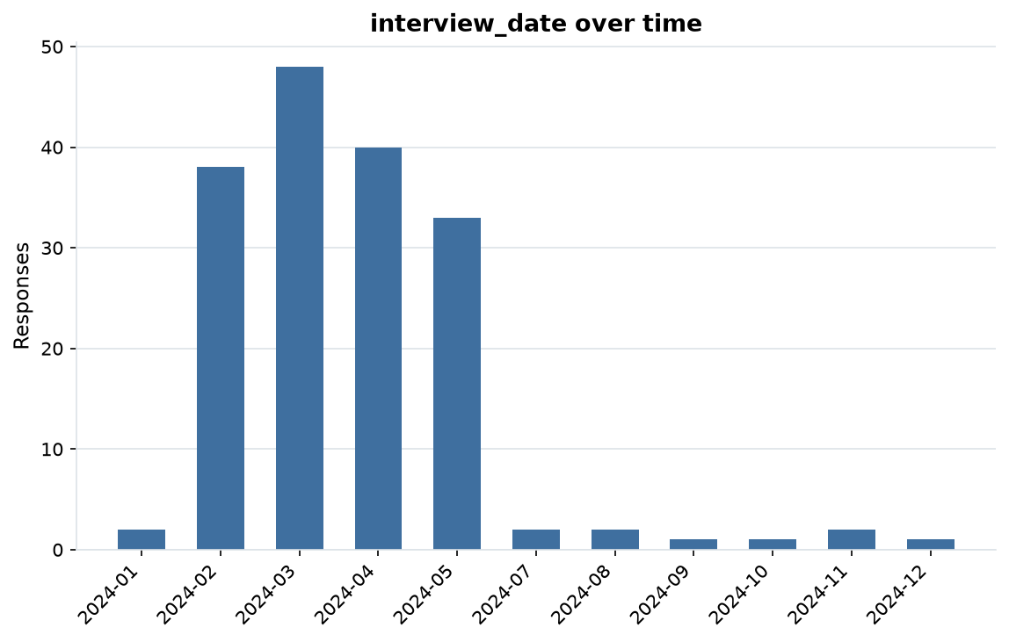
EVIDENCE
interview_date over time
170 dated responses from 2024-01-02 to 2024-12-02 (335 days).
product_pricing_survey.csv · survey2report
7

Slide 8
HOW THIS WAS PRODUCED
Methodology & data quality
• Each file is read as raw text; every column is typed as numeric, date, categorical or free text.
• Answers are repaired in place; each change is recorded with a count in cleaning_log.md.
• 177 raw rows became 170 analysis-ready rows (7 dropped)
• 12.1% of cells arrived missing; 12.2% remain after cleaning
• 7 exact duplicate rows were removed
• Charts and figures come from the cleaned table: 3 numeric, 3 categorical and 1 date columns.
product_pricing_survey.csv · survey2report
8

Slide 9
SUMMARY STATISTICS
Appendix: metric detail
Column | N | Missing | Mean | Median | Min | Max
willingness_to_pay | 144 | 26 | 132.72 | 129.00 | 19.00 | 288.00
price_shown | 159 | 11 | 132.66 | 119.00 | 19.00 | 318.00
discount_pct | 144 | 26 | 13.40 | 15.00 | 0.00 | 25.00
product_pricing_survey.csv · survey2report
9

Slide 10
MOST COMMON ANSWERS
Appendix: category detail
Column | Levels | Most common | Share | Also common
segment | 4 | Enterprise | 26% | Mid-Market (44), Startup (41), SMB (40)
purchase_intent | 5 | Likely | 22% | Very unlikely (38), Unlikely (37), Very likely (31)
decision_maker | 4 | unknown | 29% | Yes - VP (47), No (39), Yes (35)
product_pricing_survey.csv · survey2report
10

Slide 11
SHOWING 10 OF 21 RECORDED ACTIONS
Appendix: cleaning log
Column | Issue found | Action taken | Cells
whole table | inconsistent header | renamed to snake_case | 1
segment | whitespace padding | stripped surrounding whitespace | 35
willingness_to_pay | whitespace padding | stripped surrounding whitespace | 4
willingness_to_pay | sentinel missing value | treated as missing | 27
purchase_intent | whitespace padding | stripped surrounding whitespace | 39
price_shown | whitespace padding | stripped surrounding whitespace | 3
price_shown | sentinel missing value | treated as missing | 11
discount_pct | whitespace padding | stripped surrounding whitespace | 5
discount_pct | sentinel missing value | treated as missing | 27
decision_maker | whitespace padding | stripped surrounding whitespace | 29
product_pricing_survey.csv · survey2report
11

