Slide 1
SURVEY2REPORT
Public Health Checkup
Automated findings from 190 cleaned responses
7 analysed columns · generated 15 October 2026

Slide 2
WHAT THE DATA SAYS
Key findings
• 190 responses across 7 analysed columns
• Most common smoker: No (46% of responses)
• Strongest relationship: bmi ↔ exercise_days_per_week (r = -0.70, moderate negative)
• Highest exercise_days_per_week by sex: Non-binary (3.2) vs Male (2.8)
• Highest systolic_bp by sex: Male (141.3) vs Female (127.8)
• 2 extreme values in systolic_bp worth verifying
public_health_checkup.csv · survey2report
2

Slide 3
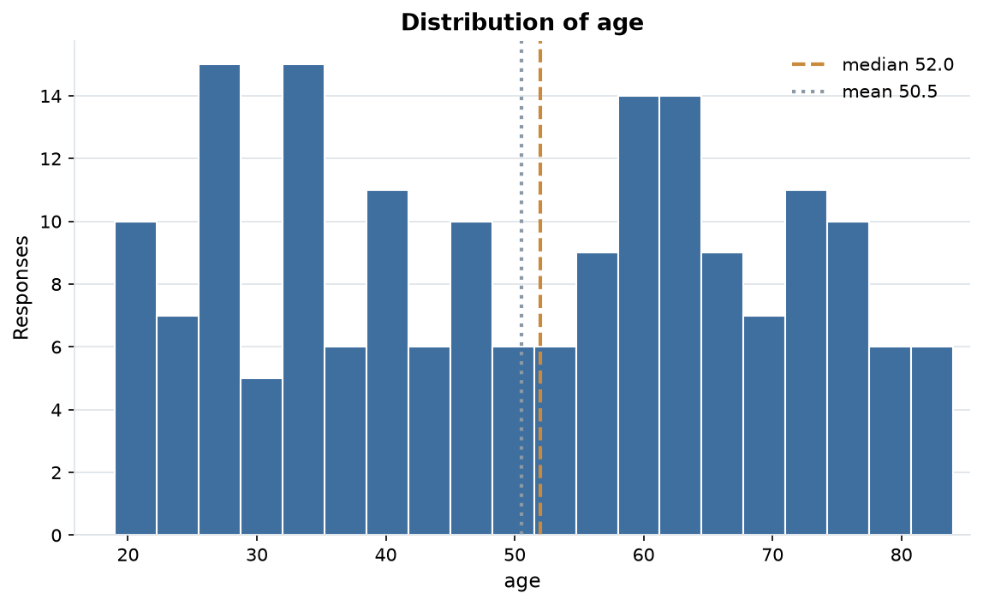
EVIDENCE
Distribution of age
183 answers, median 52.0 and mean 50.5; the axis is clipped to the 1st-99th percentile so outliers cannot squash the shape.
public_health_checkup.csv · survey2report
3

Slide 4
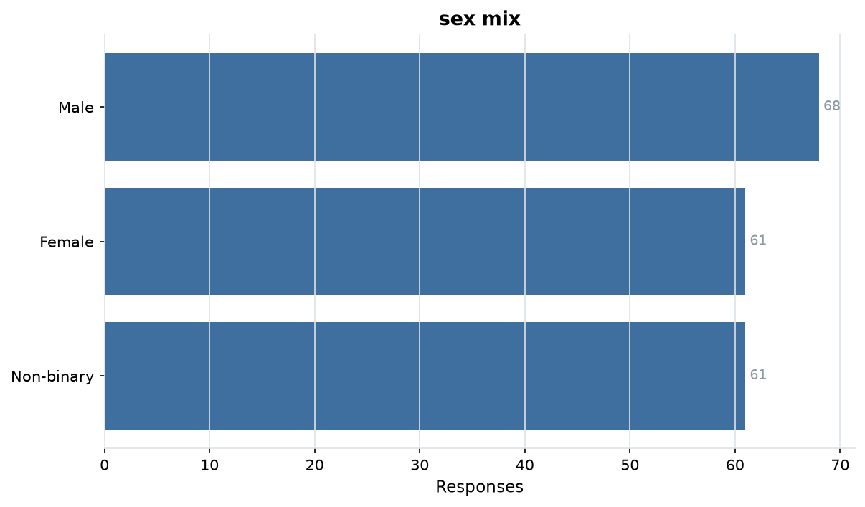
EVIDENCE
sex mix
3 levels over 190 answers; Male is the largest group at 36%.
public_health_checkup.csv · survey2report
4

Slide 5
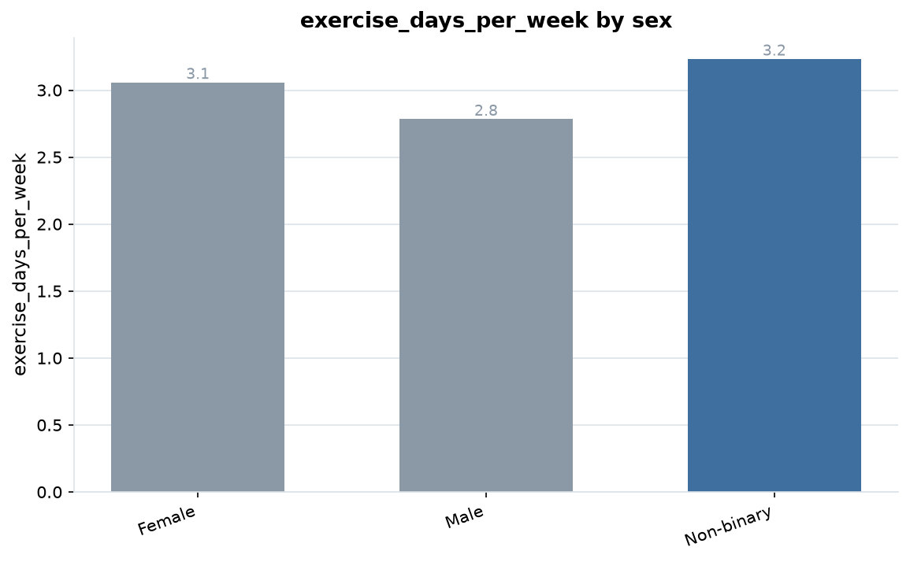
EVIDENCE
exercise_days_per_week by sex
Non-binary averages 3.2 against Male at 2.8, a 15% gap.
public_health_checkup.csv · survey2report
5

Slide 6
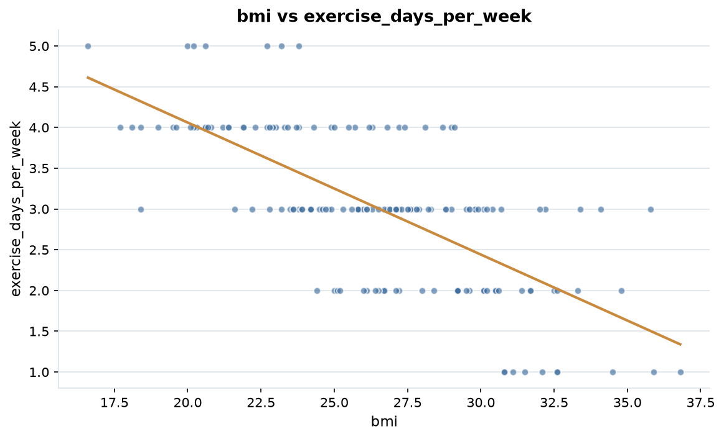
EVIDENCE
bmi vs exercise_days_per_week
r = -0.70, a moderate negative relationship.
public_health_checkup.csv · survey2report
6

Slide 7
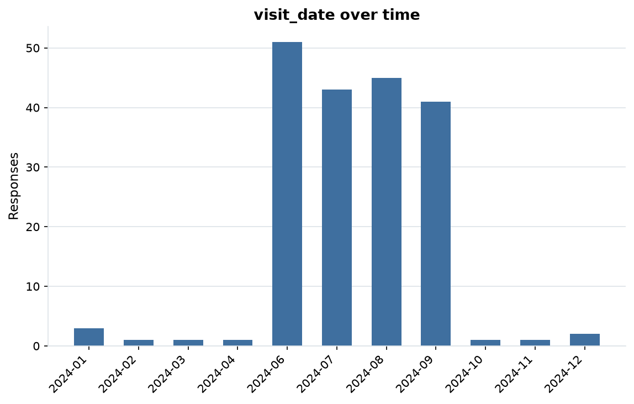
EVIDENCE
visit_date over time
190 dated responses from 2024-01-06 to 2024-12-07 (336 days).
public_health_checkup.csv · survey2report
7

Slide 8
HOW THIS WAS PRODUCED
Methodology & data quality
• Each file is read as raw text; every column is typed as numeric, date, categorical or free text.
• Answers are repaired in place; each change is recorded with a count in cleaning_log.md.
• 194 raw rows became 190 analysis-ready rows (4 dropped)
• 10.5% of cells arrived missing; 10.6% remain after cleaning
• 4 exact duplicate rows were removed
• Charts and figures come from the cleaned table: 4 numeric, 2 categorical and 1 date columns.
public_health_checkup.csv · survey2report
8

Slide 9
SUMMARY STATISTICS
Appendix: metric detail
Column | N | Missing | Mean | Median | Min | Max
age | 183 | 7 | 50.54 | 52.00 | 19.00 | 84.00
bmi | 177 | 13 | 26.41 | 26.50 | 16.40 | 36.80
systolic_bp | 185 | 5 | 133.27 | 128.00 | 88.00 | 999.00
exercise_days_per_week | 168 | 22 | 3.02 | 3.00 | 1.00 | 5.00
public_health_checkup.csv · survey2report
9

Slide 10
MOST COMMON ANSWERS
Appendix: category detail
Column | Levels | Most common | Share | Also common
sex | 3 | Male | 36% | Female (61), Non-binary (61)
smoker | 3 | No | 46% | Yes (78), Former (25)
public_health_checkup.csv · survey2report
10

Slide 11
SHOWING 10 OF 19 RECORDED ACTIONS
Appendix: cleaning log
Column | Issue found | Action taken | Cells
age | whitespace padding | stripped surrounding whitespace | 2
age | sentinel missing value | treated as missing | 7
sex | whitespace padding | stripped surrounding whitespace | 38
bmi | whitespace padding | stripped surrounding whitespace | 1
bmi | sentinel missing value | treated as missing | 13
systolic_bp | whitespace padding | stripped surrounding whitespace | 1
systolic_bp | sentinel missing value | treated as missing | 5
smoker | whitespace padding | stripped surrounding whitespace | 30
exercise_days_per_week | whitespace padding | stripped surrounding whitespace | 1
exercise_days_per_week | sentinel missing value | treated as missing | 22
public_health_checkup.csv · survey2report
11

