Slide 1
Courier Management System
Team No: 33
Krishna Praneeth 2620090037
Paurush Sirohi 2620090004
—
CSIT • KLH Bachupally • Faculty Mentor: Dr Gopikrishna

Slide 2
Abstract
Project Summary
This project demonstrates a simple courier tracking system using Java.
It accepts a parcel ID and shows the route from Warehouse to Sorting Hub and Customer Address.
Users can move between stops, check status, and confirm whether delivery is successful.

Slide 3
Understanding Problem Statement
Problem Statement
Customers need a simple way to know where their parcel is during delivery.
The system displays the parcel route and current status.
Objectives: accept a parcel ID, update parcel status, check progress, and record DELIVERED or FAILED_DELIVERY.

Slide 4
CO 1 Topics
Basic Java Input and Data
Scanner is used to read the parcel ID and menu choices.
A String array stores the delivery route: Warehouse, Sorting Hub, Customer Address.
These concepts help organise parcel information and user input.

Slide 5
CO 2 Topics
Loops and Selection
A while loop repeats the tracking menu until the user exits.
A switch statement handles actions such as moving to the next stop or checking status.
if-else checks the delivery confirmation and sets the final status.

Slide 6
CO 3 Topics
Methods and String Handling
equalsIgnoreCase() accepts responses such as YES, yes, or Yes.
Conditions validate user choices and delivery responses.
Clear status messages help the user understand the parcel's progress.

Slide 7
CO 4 Topics
Program Flow
Start by entering the parcel ID.
Display the current stop and status.
Allow the user to move forward, check status, or exit.
At the destination, confirm delivery and display the final result.

Slide 8
CO 5 Topics
Testing and Validation
Test with a sample parcel ID such as PKG1024.
Check that the route shows all three stops in order.
Try valid and invalid menu choices.
Confirm the program does not move beyond the final stop.

Slide 9
CO 6 Topics
Skills Demonstrated
Java input and output using Scanner.
Arrays and loops for route tracking.
switch and if-else for program decisions.
Input validation and status updates.
Applying programming concepts to a real-world problem.

Slide 10
Conclusion
Conclusion
The project models a parcel's journey from registration to delivery.
It demonstrates arrays, loops, switch-case, and conditional statements in Java.
Future improvements could include multiple parcels, delivery-time estimates, and saving tracking history to a database.

Slide 11
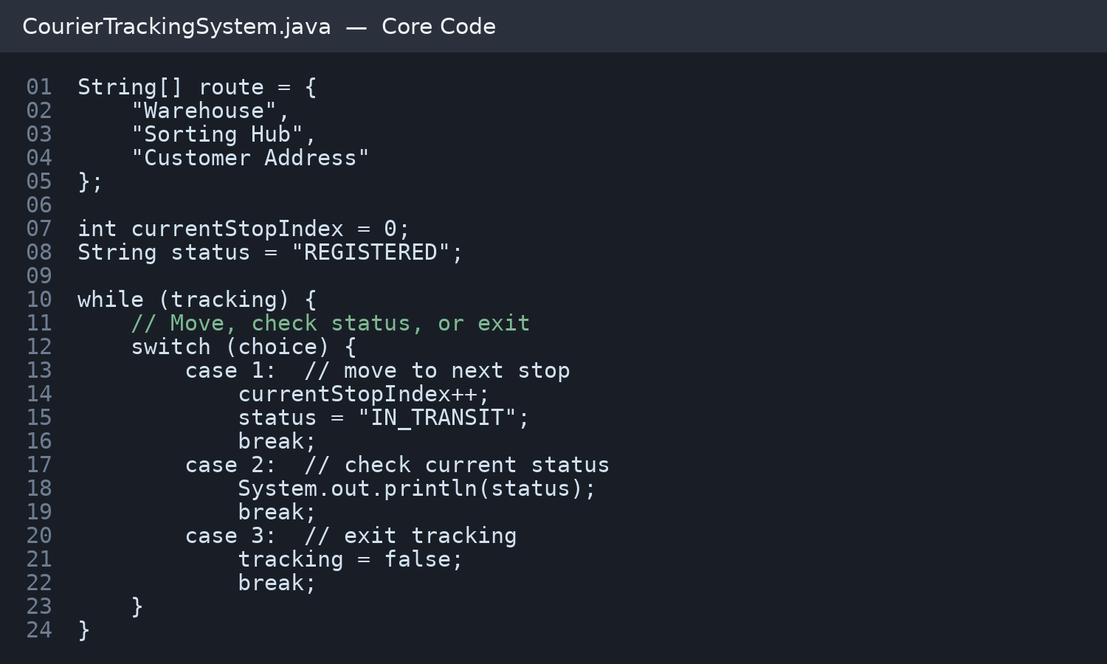
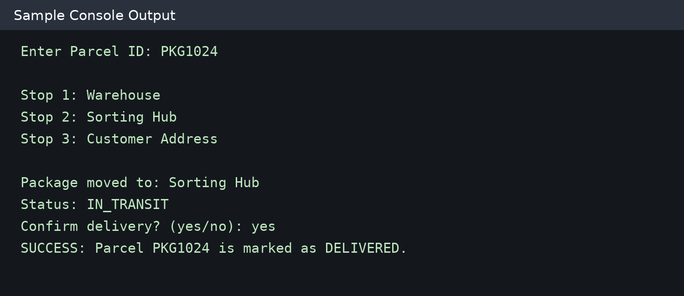
Screen Shots

Slide 12
Geo Tag Photo and GitHub Link

