Slide 1
COURIER ROUTE
TRACKING
Paurush Sirohi — 2620090004
Gubbala Krishna Praneeth — 2620090037
Department: CSIT
Faculty Guide: Gopi Krishna
Java-based console application

Slide 2
1. Introduction
2
📦
🧭
What is the project?
How it works
A simple Java application that tracks a parcel through a predefined courier route from the warehouse to the customer's address.
The user enters a parcel ID, views the assigned route, moves the parcel between stops, checks its status, and confirms delivery.
Courier Route Tracking • Paurush Sirohi & Gubbala Krishna Praneeth • CSIT

Slide 3
2. Problem Statement
3
• Courier parcels pass through multiple locations before reaching the customer.
• Without a simple tracking mechanism, the current location and delivery status can be difficult to monitor.
• The project provides a basic, interactive way to represent parcel movement and status updates.
• It demonstrates how Java can be used to model a real-world tracking process.
Courier Route Tracking • Paurush Sirohi & Gubbala Krishna Praneeth • CSIT

Slide 4
3. Objectives
4
01
02
03
Track parcel ID
Show route
Update movement
Identify each parcel using a unique ID.
Display Warehouse → Sorting Hub → Customer Address.
Move the parcel to the next stop through user input.
04
05
06
Check status
Confirm delivery
Practice Java
View the current delivery status at any point.
Mark the parcel as DELIVERED or FAILED DELIVERY.
Use arrays, loops, switch-case, Scanner and conditions.
Courier Route Tracking • Paurush Sirohi & Gubbala Krishna Praneeth • CSIT

Slide 5
4. Existing System
5
• Basic/manual tracking may depend on separate updates at each stage.
• Users may not have a simple view of the parcel's current stop and status.
• Status changes can be harder to represent consistently.
• A lightweight educational simulation helps demonstrate the core tracking workflow.
Courier Route Tracking • Paurush Sirohi & Gubbala Krishna Praneeth • CSIT

Slide 6
5. Proposed System
6
• A Java console-based courier tracking system.
• Stores the route in a String array: Warehouse, Sorting Hub and Customer Address.
• Uses Scanner for parcel ID and user actions.
• Uses a loop and switch-case to move the parcel or check its status.
• At the destination, the user confirms delivery and the final status is updated.
Courier Route Tracking • Paurush Sirohi & Gubbala Krishna Praneeth • CSIT

Slide 7
6. System Architecture
7
1
2
3
4
5
User Input
Route Data
Tracking Logic
Status Manager
Final Output
Parcel ID
Action
String array
3 stops
Loop + switch
Stop index
REGISTERED
IN_TRANSIT
DELIVERED /
FAILED DELIVERY
Flow: Input → Route → Tracking → Status → Delivery Result
Courier Route Tracking • Paurush Sirohi & Gubbala Krishna Praneeth • CSIT

Slide 8
7. Functionalities
8
Parcel ID
Assigned Route
Accepts the parcel number from the user.
Shows all three courier stops.
Move to Next Stop
Check Status
Advances the parcel through the route.
Displays the current status.
Delivery Confirmation
Failure Handling
Accepts yes/no confirmation at destination.
Sets status to FAILED DELIVERY when delivery is not confirmed.
Courier Route Tracking • Paurush Sirohi & Gubbala Krishna Praneeth • CSIT

Slide 9
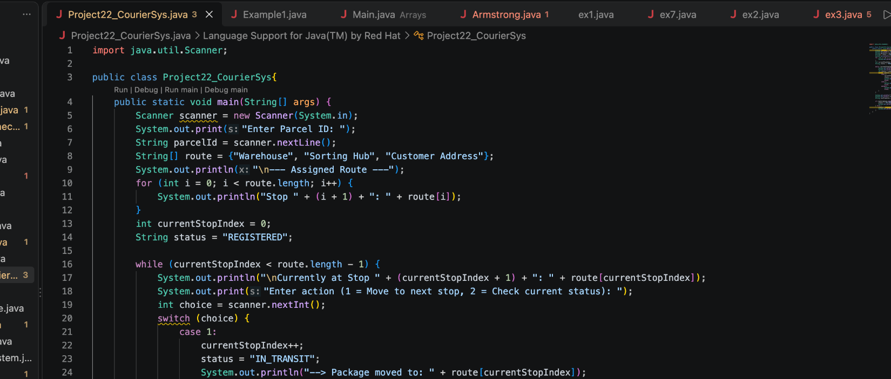
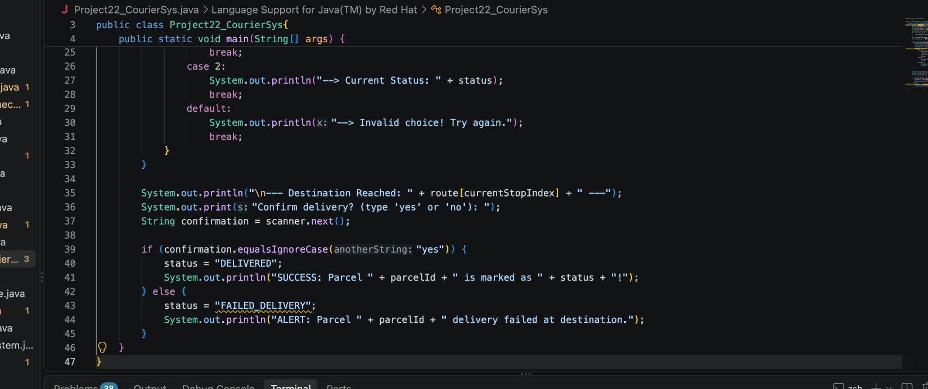
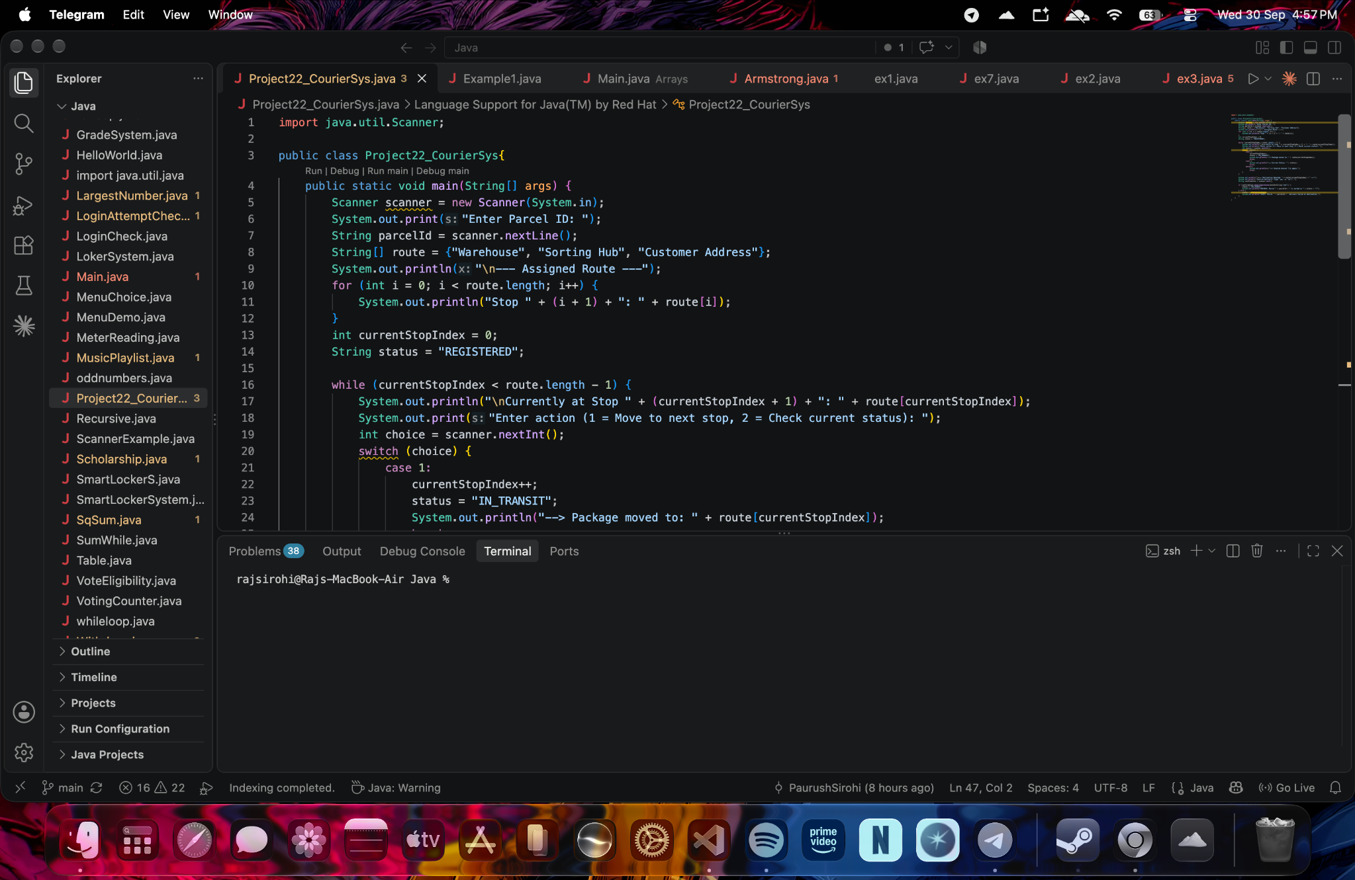
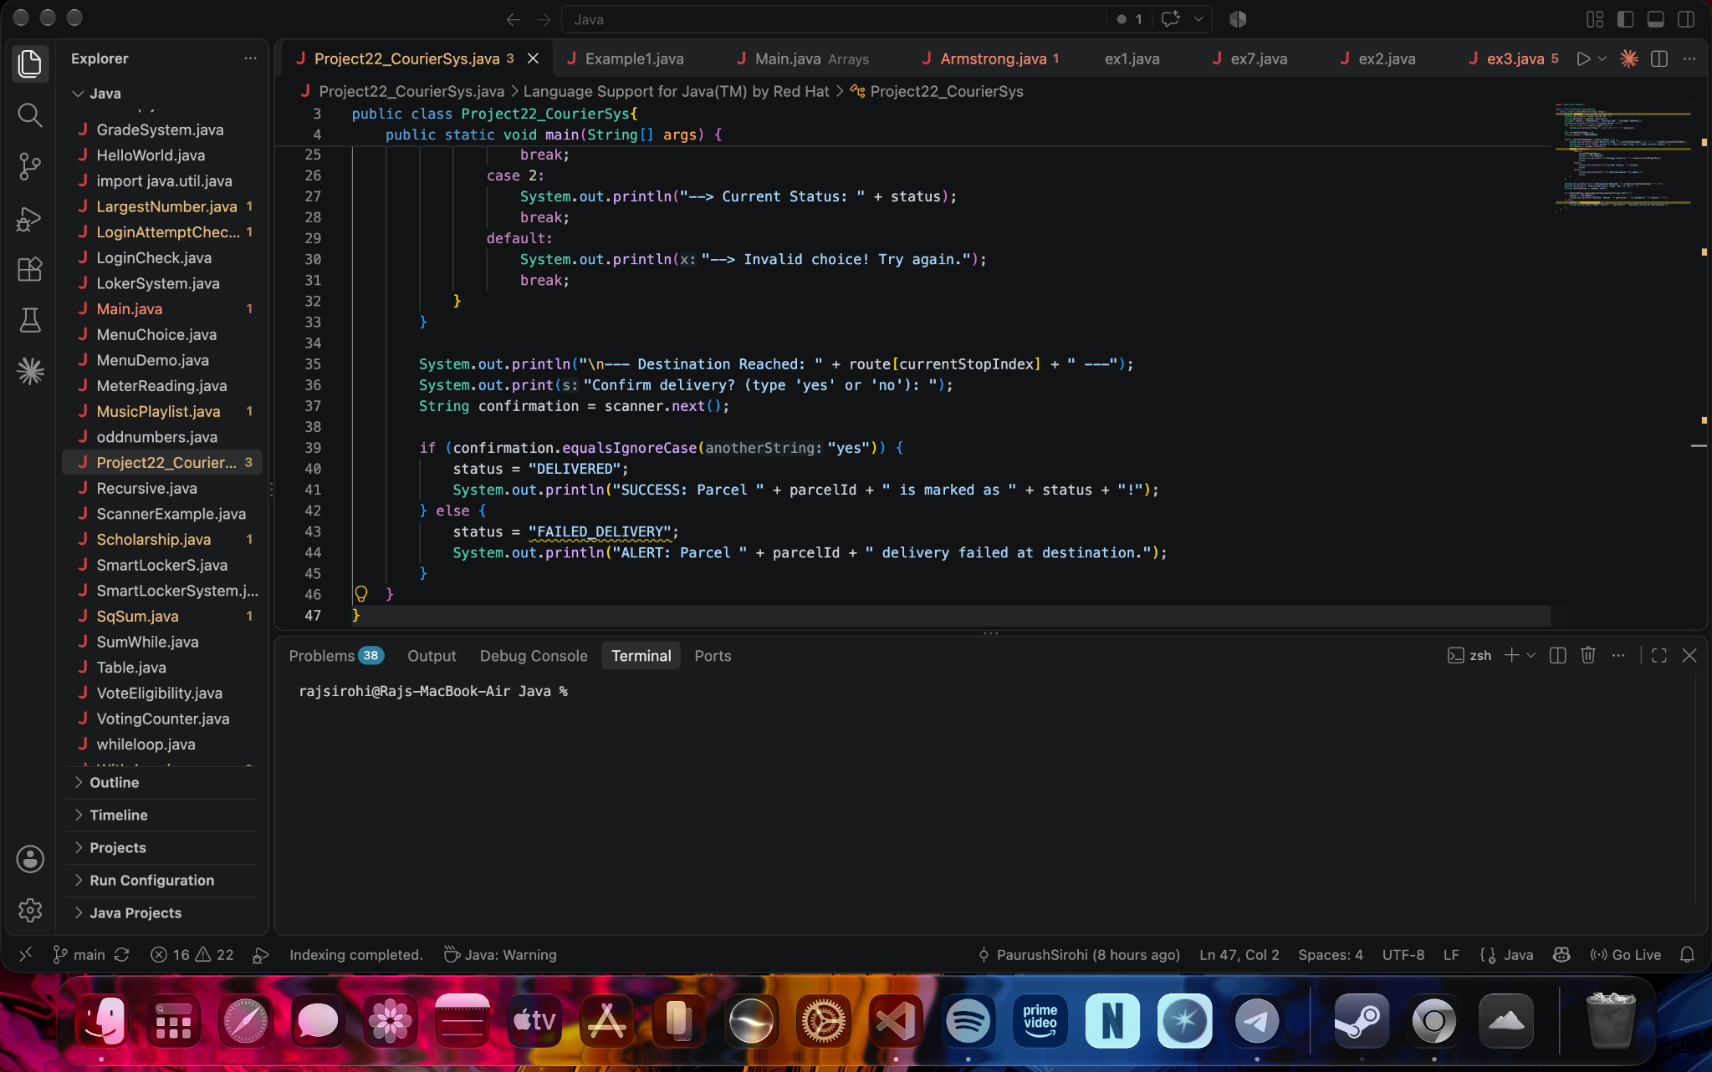
8. Implementation – Java Code Screenshots
9
Key concepts: Scanner • String array • while loop • switch-case • status variables • if/else
Courier Route Tracking • Paurush Sirohi & Gubbala Krishna Praneeth • CSIT

Slide 10
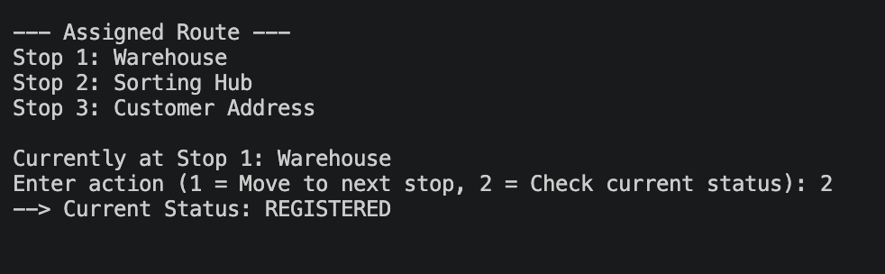
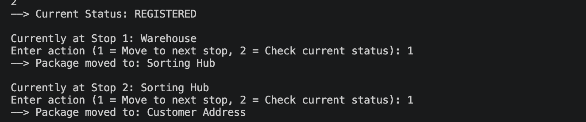
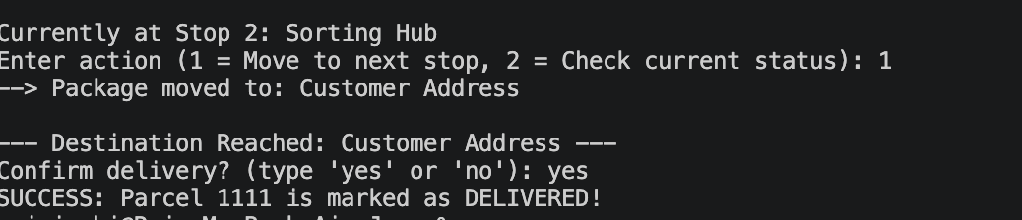
9. Output Screenshots
10
Courier Route Tracking • Paurush Sirohi & Gubbala Krishna Praneeth • CSIT

Slide 11
10. Future Scope
11
• Add a graphical user interface or web/mobile interface.
• Store parcel records in a database instead of using only runtime data.
• Add estimated delivery time and real-time location updates.
• Support multiple parcels and multiple delivery routes.
• Add login, notifications and delivery history.
Courier Route Tracking • Paurush Sirohi & Gubbala Krishna Praneeth • CSIT

Slide 12
11. Conclusion
12
• Courier Route Tracking demonstrates a complete basic parcel-tracking workflow using Java.
• The system represents route movement using an array and controls user interaction with loops and switch-case.
• It successfully tracks a parcel from registration through intermediate stops to the final delivery result.
• The project provides a foundation for developing a larger, database-driven courier tracking system.
Courier Route Tracking • Paurush Sirohi & Gubbala Krishna Praneeth • CSIT

Slide 13
THANK YOU
Paurush Sirohi • 2620090004
Gubbala Krishna Praneeth • 2620090037
Faculty Guide: Gopi Krishna
Courier Route Tracking • Java Project

