Slide 1
Sum-Product Probabilistic Language
The path to AI ‘fairness’?
Pauwel DE Wilde – Becode – Bouman 3.31

Slide 2


Sum-Product Expression
Boolian Algebra
And / Or / Not
=> AND = multiplication of the inputs
=> OR = Sum of the inputs

Slide 3

SPPL? what?
Probabilistic Programming language:
easier AI development
Carry out probabilistic inference
3000 times faster
Notes:
Development: successes in computer vision, common-sense data cleaning and automated data modelling
“Probabilistic inference” = work backward, finding probable explanations for observed data
3000 times faster than e.g. Gen or Pyro

Slide 4
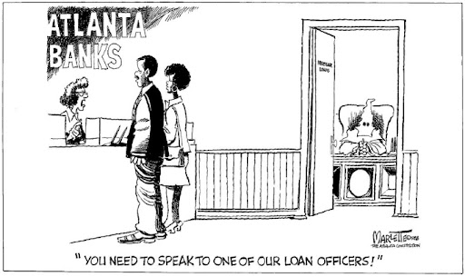
Example
Bank loans:
Probability for 40+?
Probability for single ladies?
Probability for immigrants?
=> SPPL answers fairness questions

Slide 5
Key: exact PI
Approximate probabilistic inference:
results include errors
Size of the errors unknown
=> Hard to characterize impact
=> Restrictions
Notes:
Tolerable in many AI applications, but not when social consequences are big

Slide 6
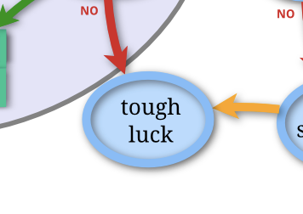
Why restriction?
Automated decision-making
Fairness analysis
Fit in sum-product expressions
Notes:
Imagine having a biassed robot deciding whether you get a job, loan, etc.

Slide 7

How restriction?
Limited set of models
Notes:
Models: still include a lot of AI algorithms, including decision tree classifiers

Slide 8


Slide 9
Restrictions
No unbounded loops
No multivariate numeric transformations
No arbitrary prior distributions on continuous parameters
Notes:
- Unbounded loop: where number of itterations is undefined
- Multivariate numeric transformations: standardization and normalization, e.g. log function
- Prior distributions: ‘Bayesloop’ -> concerns prior ‘knowledge’ of the system. A lot to explain, but it comes down to the exactness of the information you’re working with.

Slide 10
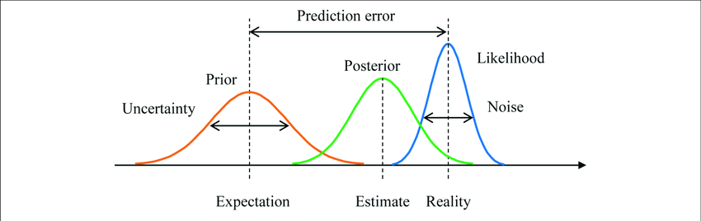
Consequences
Quick with decision trees
but incapable of dealing with neural networks, regressions with a prior prediction on real coefficients, …
Notes:
Not necessarily a problem, because systems that do are way slower and give inexact results
Prior on real coefficients: also complex and also has to do with either or not taking a sqrt of data.
A simple example of a real coefficient is: the 3 in 3x = []
Bayesloop results

Slide 11
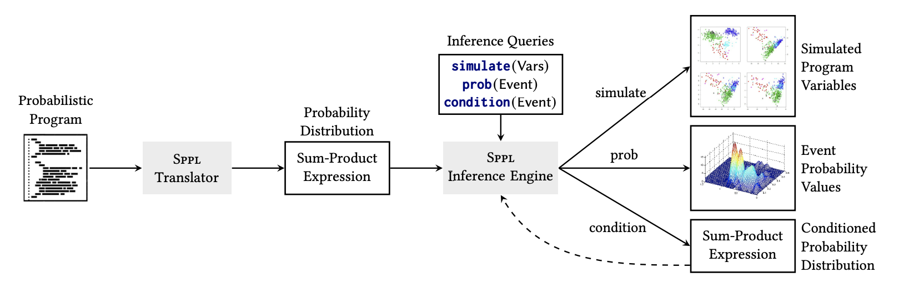
How does it work?
Notes:
Simulated variables: SPPL returns samples of program variables in accordance with their probability distribution
Probability of an event: SPPL returns this, as a predicate on program variables
Sum-Product Expression: SPPL returns another expression for the posterior distribution over the program variables, given that the specified event is True

Slide 12

I still have to dig deeper into it …
… but i’m here to answer questions!
Thank you all for your attention

Slide 13
Sources
Massachusetts Institute of Technology:
https://news.mit.edu/2021/exact-symbolic-artificial-intelligence-faster-better-assessment-ai-fairness-0809
https://arxiv.org/pdf/2010.03485.pdf
On prior coefficients:
https://www.ncbi.nlm.nih.gov/pmc/articles/PMC6745606/

