Slide 1
Property prices in Belgium
A work in progress

Slide 2
Decisions
New available databases
Outside space
Division per province

Slide 3
Decisions
Dropped columns
Seperate df’s by property type
Notes:
The type of sale
The 0/1 value for “fully equiped kitchen”
Facadecount

Slide 4
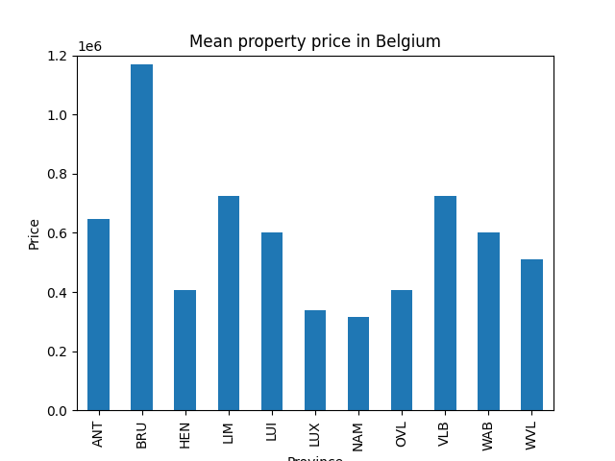
Visualization

Slide 5
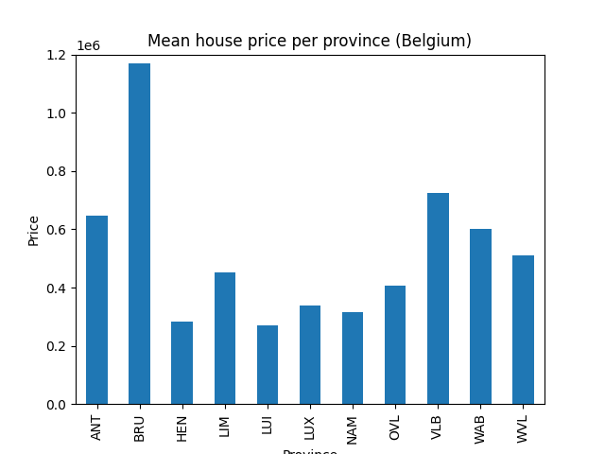
visualization

Slide 6

visualization

Slide 7
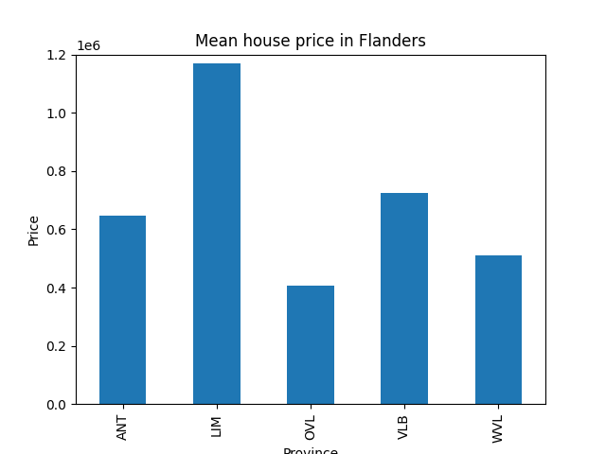
visualization

Slide 8

visualization

Slide 9
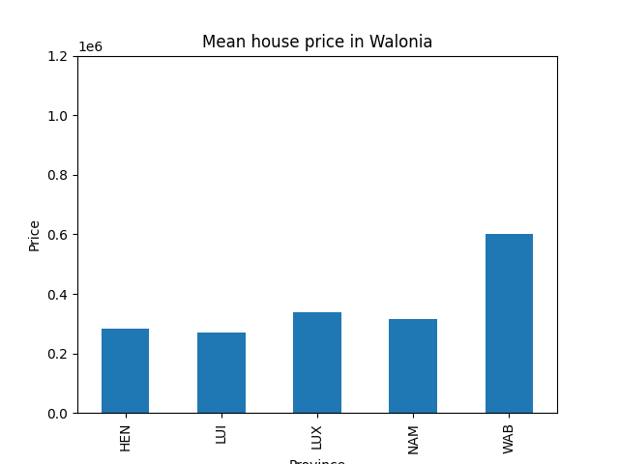
visualization

Slide 10
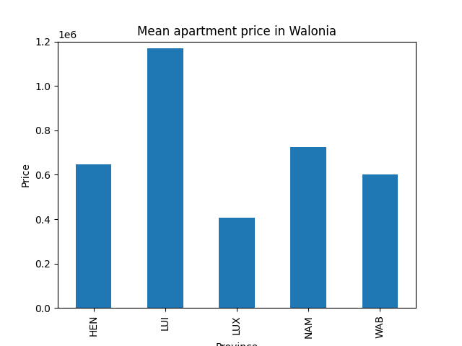
visualization

Slide 11
Possibilities
Plot per munacipility
Plot per subtype
Corelations
…

Slide 12
Q&A
Thank you for your time!

Slide 13
Issues
Initial database
Stubbornnes (regex)
Seaborn

