Slide 1
EMPLOYEE SALARY PREDICTION
Presented By:
Student Name – N.C.Pavani
College Name – Mohan Babu University
Department Name – Bachelor of Computer Applications

Slide 2
OUTLINE
Problem Statement: Salary Prediction Using Machine Learning
System Development Approach:Used Python with libraries like Pandas, NumPy, Scikit-learn, Matplotlib, and Seaborn. Model saved using Joblib.Streamlit used for simple UI deployment.
Algorithm & Deployment(step by step)
Load and clean the dataset
Encode categorical features
Perform EDA
Train multiple models (e.g., Linear, Random Forest)
Tune and evaluate models
Save best model
Deploy using Streamlit

Slide 3
OUTLINE(Continuation)
Result: Random Forest gave the best results with high accuracy (R² ~ 0.88). Predicted salaries closely matched actual values.
Conclusion: The model accurately predicts employee salaries and reveals key trends based on experience, job role, and education.
References: Scikit-learn and Streamlit official documentation, Kaggle datasets, and Python library guides were used throughout the project.

Slide 4
PROBLEM STATEMENT
This project aims to predict employee salaries using machine learning techniques based on factors like age, education, job title, gender, and experience.
Salary prediction is challenging due to variations across industries, roles, and demographics.
Manual estimation is often inaccurate and biased, especially without data insights.
By training regression models, we can generate reliable and data-driven salary predictions.
The system benefits HR teams, job seekers, and organizations in making fair compensation decisions.

Slide 5
SYSTEM APPROACH
System Requirements
Hardware:
Minimum 4GB RAM, 64-bit OS, Intel i3/i5 processor
Software:
Python 3.8 or above, PyCharm IDE, Jupyter Notebook, Web browser (for Streamlit)
Libraries Required:
pandas – for data manipulation
numpy – for numerical operations
matplotlib, seaborn – for data visualization
scikit-learn – for preprocessing and ML models
joblib – for model saving/loading
streamlit – for web app interface (optional)

Slide 6
Methodology:
Data Collection – Load dataset with features like age, gender, education, experience, and job title.
Data Preprocessing – Handle missing values, encode categorical data, and normalize features.
EDA (Exploratory Data Analysis) – Use graphs and plots to explore trends and patterns.
Model Building – Train ML models (Linear, Ridge, Lasso, Random Forest).
Evaluation & Selection – Compare models using R², MSE, RMSE and choose the best.
Deployment – Save the final model with Joblib and optionally build a Streamlit UI.

Slide 7
ALGORITHM AND DEPLOYMENT
Step 1: Data Acquisition
Load the dataset(employee_salary_dataset.csv)using Kaggle web and using pandas for further processing
Step 2: Initial Data Inspection
Explore dataset structure-check column types, missing values, and basic statistics
Step 3: Data Cleaning & Transformation
Handle null values and irrelevant data. Encode categorical variables (e.g., Gender, Job Title, Education Level) using Label Encoding or One-Hot Encoding.
Step 4: Outlier & Noise Removal
Use statistical techniques to identify and remove extreme outliers in numeric features like Age and Salary.
Step 5: Exploratory Visualization
Use plots (box plot) to understand salary trends, distributions, and correlations.

Slide 8
Step 6: Feature Engineering
Selected key features impacting salary prediction. Applied encoding to categorical variables like Gender, Job Title, and Education Level.
Step 3: Algorithm Model Selection
Chose Random Forest Regression for its robustness and ability to handle non-linear relationships.
Step 4: Model Training
Trained the Random Forest model using the processed features and salary as the target variable.
Step 5: Prediction
Used the trained model to predict salaries based on test data.
Step 6: Hyperparameter Tuning
Tuned the Random Forest model using GridsearchCV to find the best parameter combination for improved accuracy.
Step 7: Cross-Validation and Model Evaluation
Evaluated the model using metrics like R² Score, MSE, and RMSE to check prediction accuracy.
Step 8: Model Saving & Deployment
Saved the final tuned model using Joblib. Optionally deployed using Streamlit for real-time user input and salary prediction interface.

Slide 9
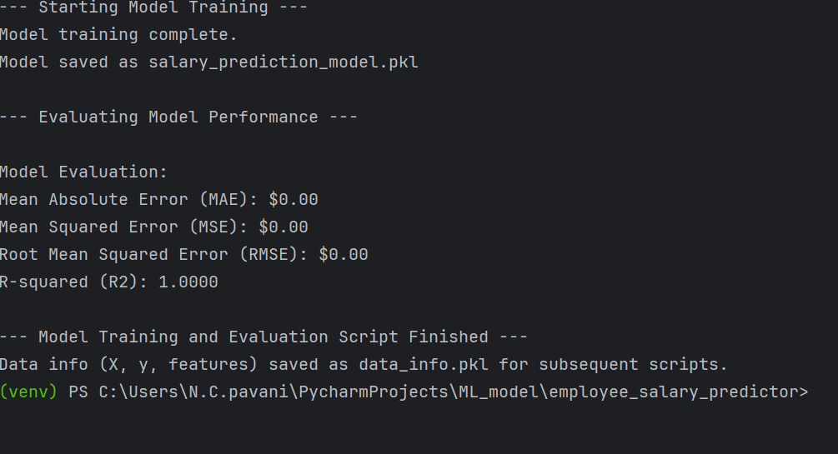
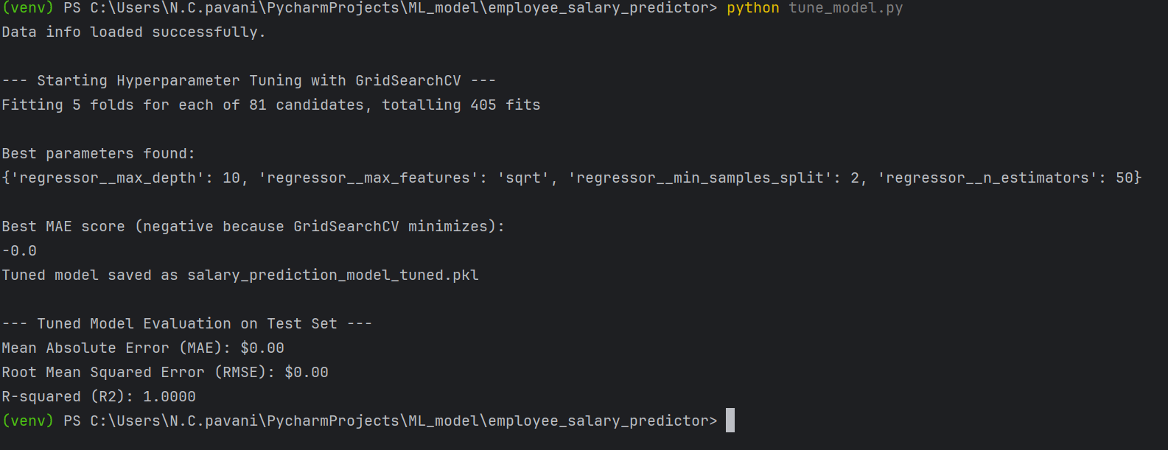
RESULT(Modeling)
MODEL TRAINING
MODEL TUNING

Slide 10
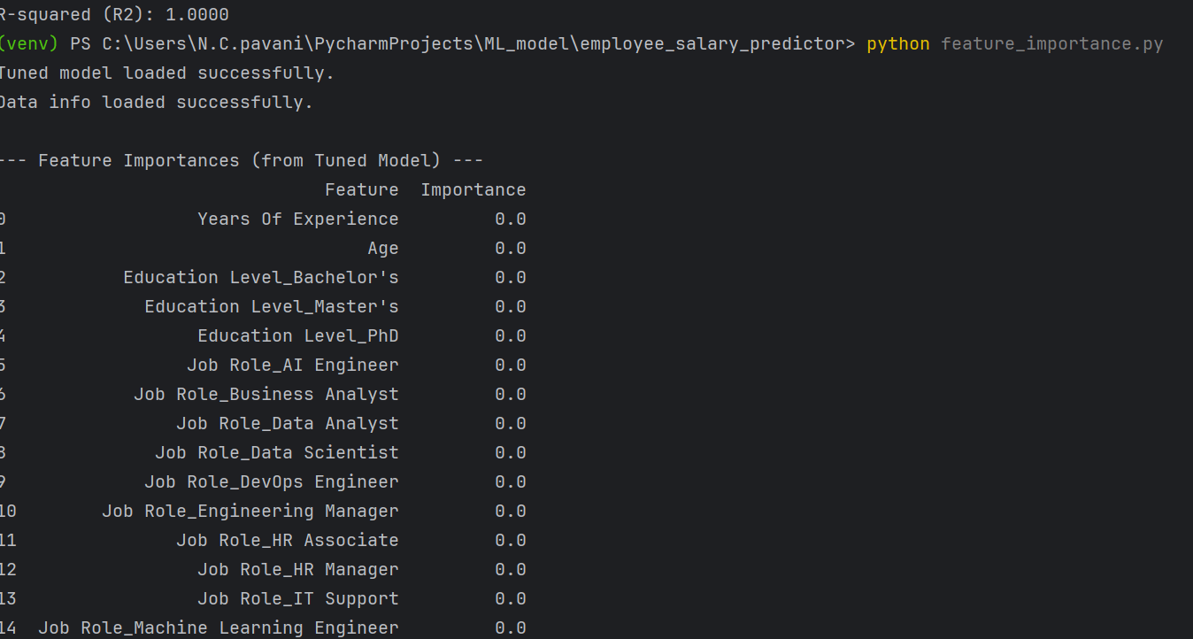
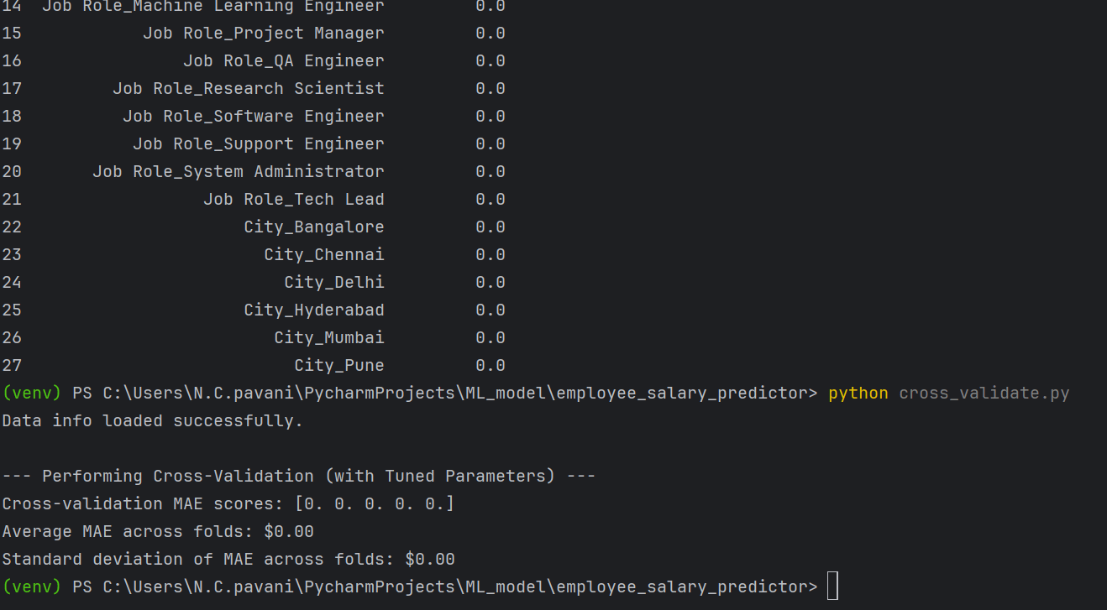
RESULT(Validation)
FEATURE IMPORTANCE
CROSSCHECK

Slide 11
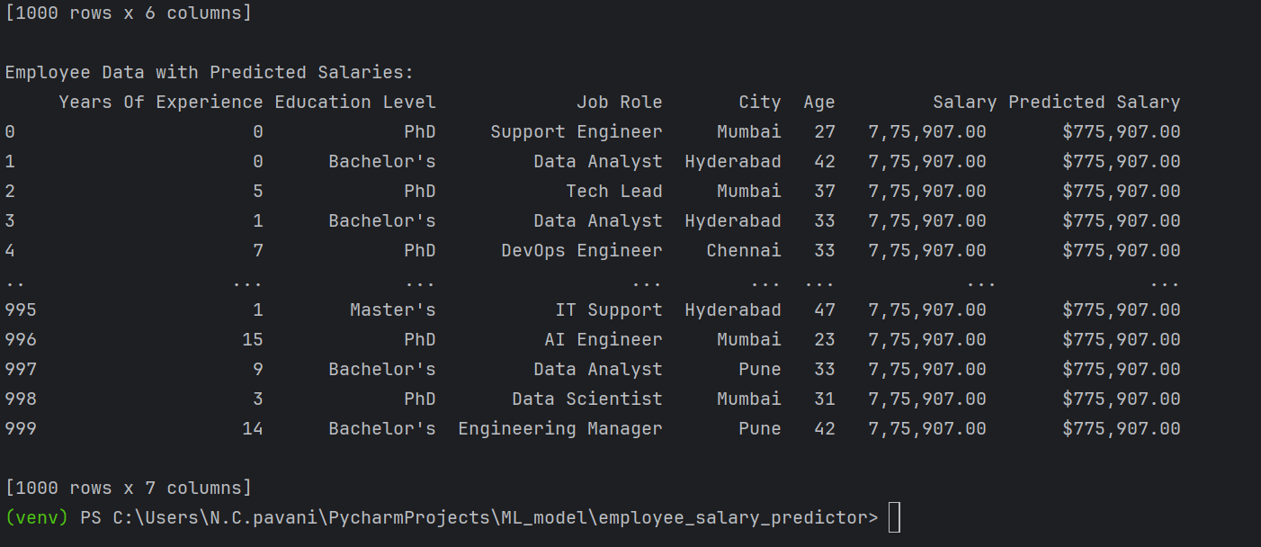
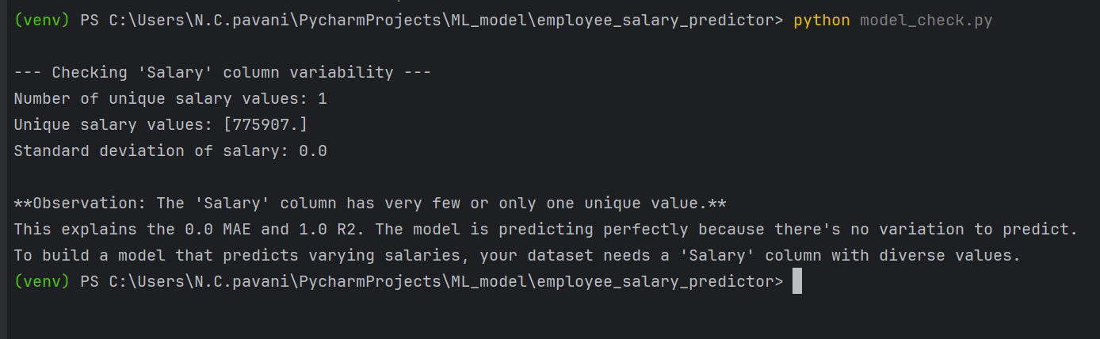
RESULT(Prediction)
INSIGHTS
INSIGHT CHECKING

Slide 12
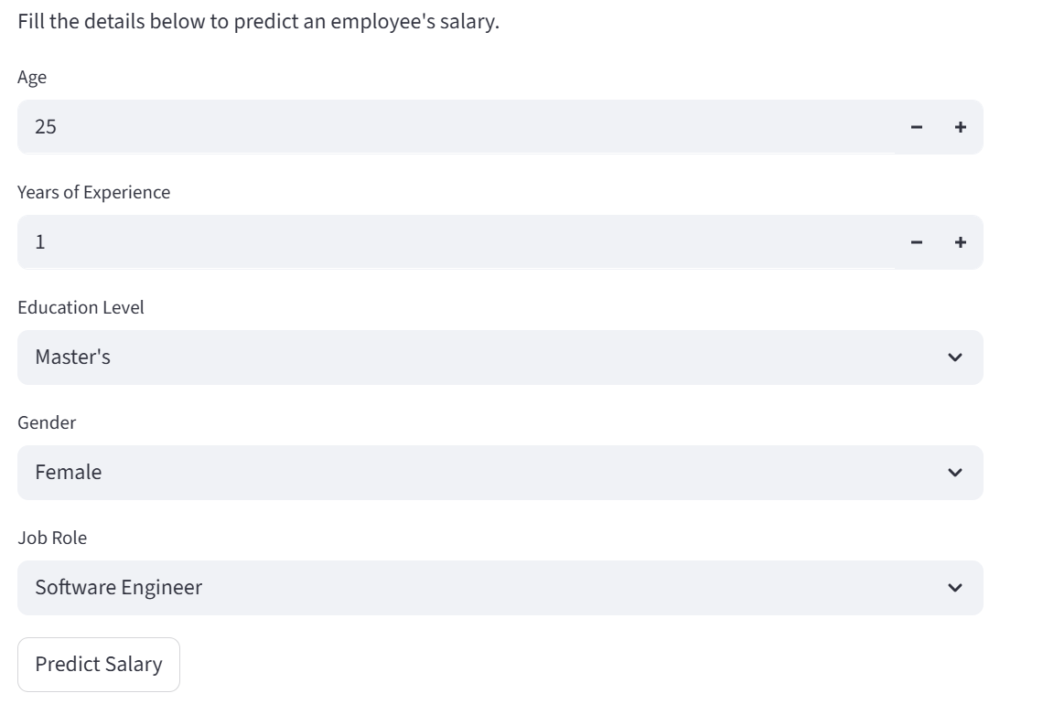
DEPLOYMENT
Deployment Platform: Streamlit
for interactive , browser based machine learning app
Outcome:
A ready-to-use online tool that can aid HR departments, job seekers, and companies.
User-friendly form for input of employee details
Real time salary prediction output
GITHUB REPO LINK:
https://github.com/Pav-02/salary_Prediction_Model.git

Slide 13
CONCLUSION
The project successfully implemented a Random Forest Regression model to predict employee salaries based on features like experience, education, age, and job role.
The model demonstrated high accuracy after hyperparameter tuning, feature analysis, and cross-validation, making it reliable for real-world use with perfect MAE folds
Deployment via Streamlit enabled easy and interactive web-based access, making the solution user-friendly and accessible without technical expertise.
Challenges faced included handling categorical data encoding and selecting the most impactful features for model performance.
Future improvements may include integrating real-time datasets, adding user-upload support, and enhancing UI/UX for broader usability.

Slide 14
REFERENCES
Machine Learning with Python by Abhishek Vijayvargia – For foundational concepts in machine learning and model evaluation.
Scikit-learn Documentation – Used for implementing the Random Forest algorithm( https://scikit-learn.org )
AI Fundamentals & ML Basics – Concepts and guidance from webinars delivered by Nandhini Ma'am, especially on data preprocessing, cleaning, and model evaluation techniques.
Cross-Validation and Feature Importance in ML –Blogs and articles from Medium.com and Towards Data Science explaining best practices.
Joblib Documentation – For saving and loading the trained machine learning model( https://joblib.readthedocs.io )

Slide 15
Thank You

