Slide 1
POETRY GENERATION WITH RNN
Presented By:
PAVAI B[513121104029]
THANTHAI PERIYAR GOVERNMENT INSTITUTE OF TECHNOLOGY,
VELLORE .

Slide 2
AGENDA:
Problem Statement
Project Overview
End users
Flow of the project
1. Data Preparation
2. Model Architecture &Training
3.Text generation
Usage of LSTM
Results
Conclusion

Slide 3
Problem Statement
Creative writing, particularly the art of poetry, poses significant challenges for writers, including the need for inspiration, mastery of language, and adherence to poetic conventions. This process requires a delicate balance of form, imagery, and emotion, often leading to writer's block and self-doubt among aspiring poets
These challenges highlight the need for innovative solutions to facilitate poetic expression and creativity. In this context, the introduction of AI-powered poem generation emerges as a promising solution.

Slide 4
Project Overview
Objective:
The project aims to develop an AI-powered system capable of generating poetry autonomously. Leveraging advanced machine learning algorithms, the system will analyze large corpora of poetry to learn the intricacies of poetic language, style, and structure. Subsequently, it will generate original and evocative verse, providing a source of inspiration and creativity for poets and enthusiasts alike.
Significance:
Innovation in Creative Writing : Offering new avenues for artistic expression and exploration.
Democratization of Poetry: Individuals from diverse backgrounds to engage in literary expression, fostering a more inclusive and vibrant literary community.
Cultural Preservation: The project contributes to the preservation and dissemination of cultural heritage and literary traditions.

Slide 5
END USERS
Creative Individuals: Including poetry enthusiasts, writers, artists, and performers who seek inspiration or creative prompts from generated poetry.
Educational and Professional Use: Encompassing educators, researchers, therapists, and language learners who utilize generated poetry for teaching, research, therapy, or language practice purposes.
Marketing and Digital Content: Involving marketers, advertisers, and digital content creators who integrate generated poetry into branding, advertising campaigns, or digital content strategies to engage audiences in unique ways.

Slide 6
Flow of the Project
1
Data Preparation
2
Model Architecture & Training
3
Text Generation

Slide 7
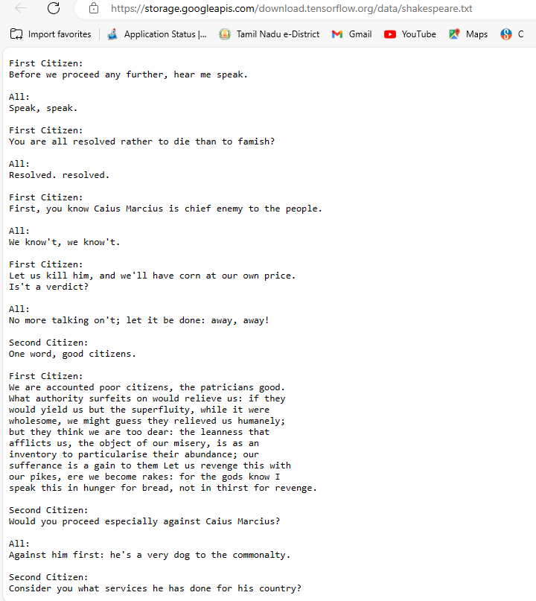
Data Preparation
Obtain and preprocess Shakespeare's text data, extracting a relevant subset for training.
Convert the text to lowercase and split it into input-output pairs with a fixed sequence length and step
Shakespeare's text data: https://storage.googleapis.com/download.tensorflow.org/data/shakespeare.txt

Slide 8
Model Architecture & Training
Design a sequential model using TensorFlow and Keras, comprising an LSTM layer followed by a dense layer with softmax activation.
Compile the model with appropriate loss and optimizer functions for training.
Train the model on the preprocessed input-output pairs using batch training with a specified batch size and number of epochs.
Optimize the model parameters to minimize the loss function and improve predictive performance.

Slide 9
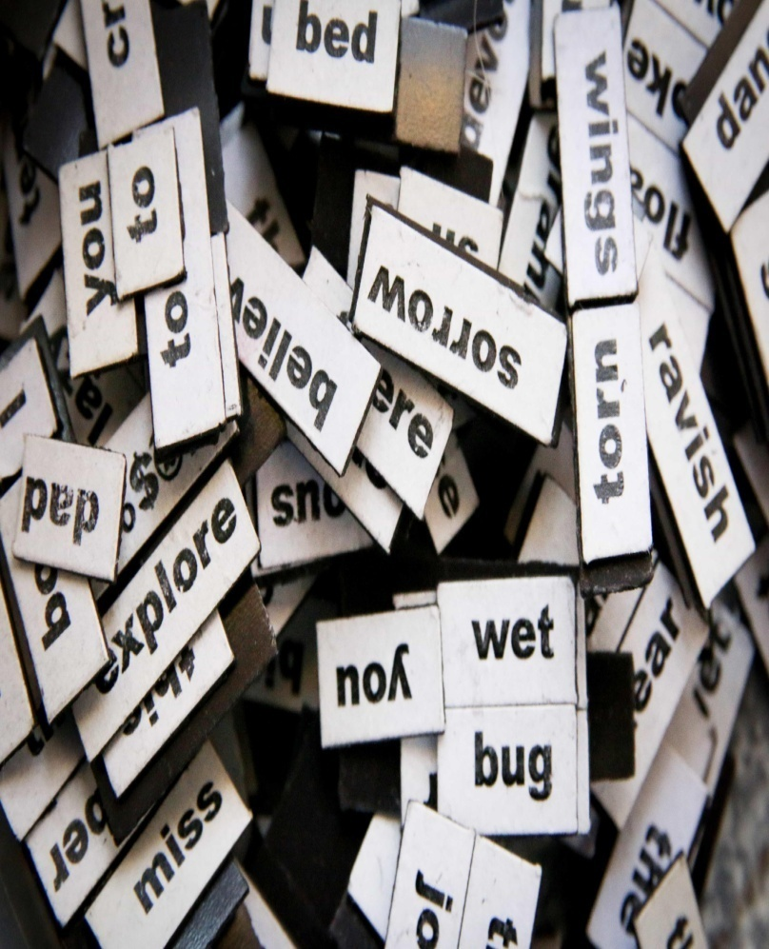
Text Generation
Implement functions for generating text using the trained model, incorporating temperature sampling to control the diversity and creativity of the generated text.
Generate text samples of desired length with varying temperature values to explore different styles and nuances in the generated text.

Slide 10
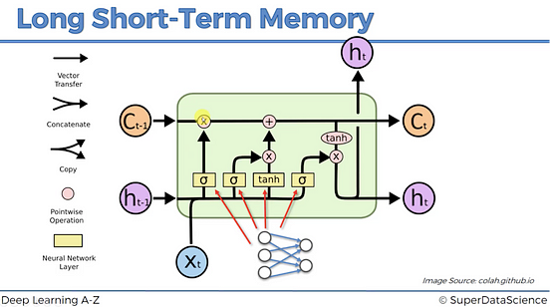
Usage of LSTM
Leveraging Long-Term Dependencies: LSTM models excel at capturing long-term dependencies in text data, enhancing the coherence and contextual relevance of generated text.
Enhanced Creativity and Coherence: By learning from sequential language patterns, LSTM models can generate text that is both creative and coherent, enriching the user experience.
Flexibility with Variable-Length Sequences: LSTM networks can handle input sequences of variable lengths, enabling the generation of text with varying lengths while maintaining quality and coherence.
Learning Hierarchical Representations: LSTM models learn hierarchical representations of text, capturing both low-level features and high-level patterns, resulting in nuanced and sophisticated text generation.
Adaptability to Diverse Text Data: LSTM models can be trained on diverse text datasets, making them adaptable to different writing styles, genres, and sources of text data.

Slide 11
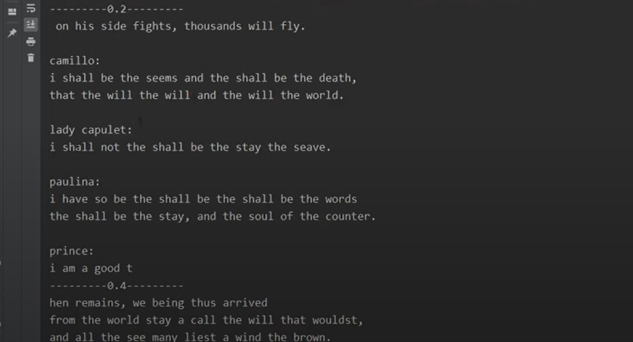
RESULTS
Colab NOTEBOOK:
https://colab.research.google.com/drive/1ZgLLntcF2eaaV_cAmvGNra7Jsj-SssS0

Slide 12
Conclusion
In conclusion, the utilization of LSTM models in text generation represents a significant advancement in artificial intelligence, offering a multitude of benefits and opportunities for innovation in creative writing and natural language processing.
Through their ability to capture long-term dependencies, enhance creativity and coherence, and adapt to diverse text data, LSTM models have revolutionized the landscape of text generation, enabling the creation of compelling and contextually rich content.
As we continue to explore the potential of LSTM models and other advanced neural network architectures, we open new horizons for creativity, communication, and expression in the digital age.

Slide 13
REFERENCES:
1.https://www.tensorflow.org/
2.https://keras.io/
3.https://numpy.org/
4.https://en.wikipedia.org/wiki/Recurrent_neural_network
5.https://en.wikipedia.org/wiki/Long_short-term_memory

