Slide 1
Legacy website ui modernization
Developed BY : g PAVALAN
b.E cse – hackathon participant

Slide 2
Domain : web / mobile application – smart automation
Problem description :
Recreate a legary website using only HTML and CSS with a modern, visually enhanced, and user - friendly interface while preserving its original structure.

Slide 3
Solution explanation
Many legacy websites suffer from outdated UI Designs, poor responsiveness, and lack of user – friendly navigation. These Issues negatively impact user experiences and accessibility.

Slide 4
My solution
I’m create a new UI website to modern, clean and responsive user interface using only HTML, CSS and Simple Logic Javascript, while maintaining the original content structure.

Slide 5
Key improvements
Modern Layout using flexbox
Improved typography and color scheme
Responsive Design for Mobile, Tablet and desktop
Card-based section with hover effects
Clean navigation bar.

Slide 6
Tools & technologies used
FRONTEND TECHNOLOGIES :
HTML 5 – Website Structure
CSS3 – Styling, Layout, Responsiveness
JAVASCRIPT – Interactive Website of User Friendly.

Slide 7
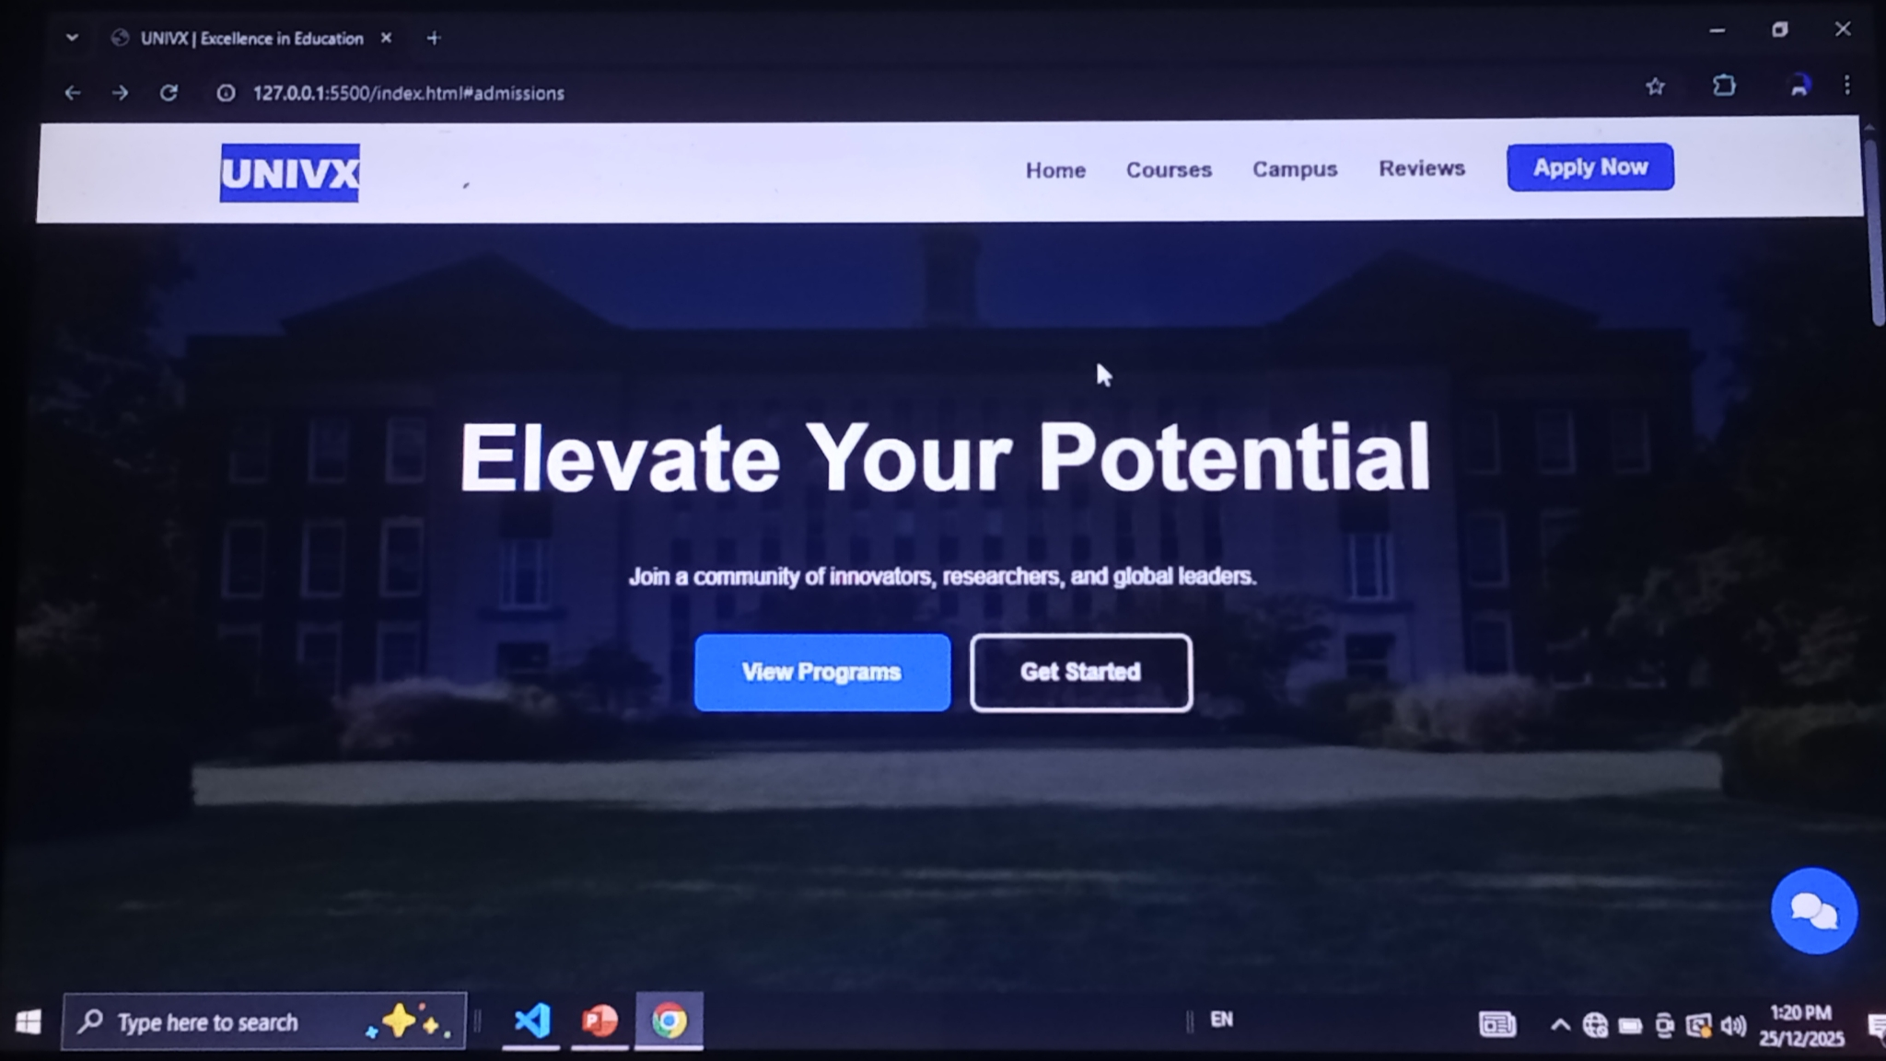
PROJECT SCREENSHOTS

Slide 8
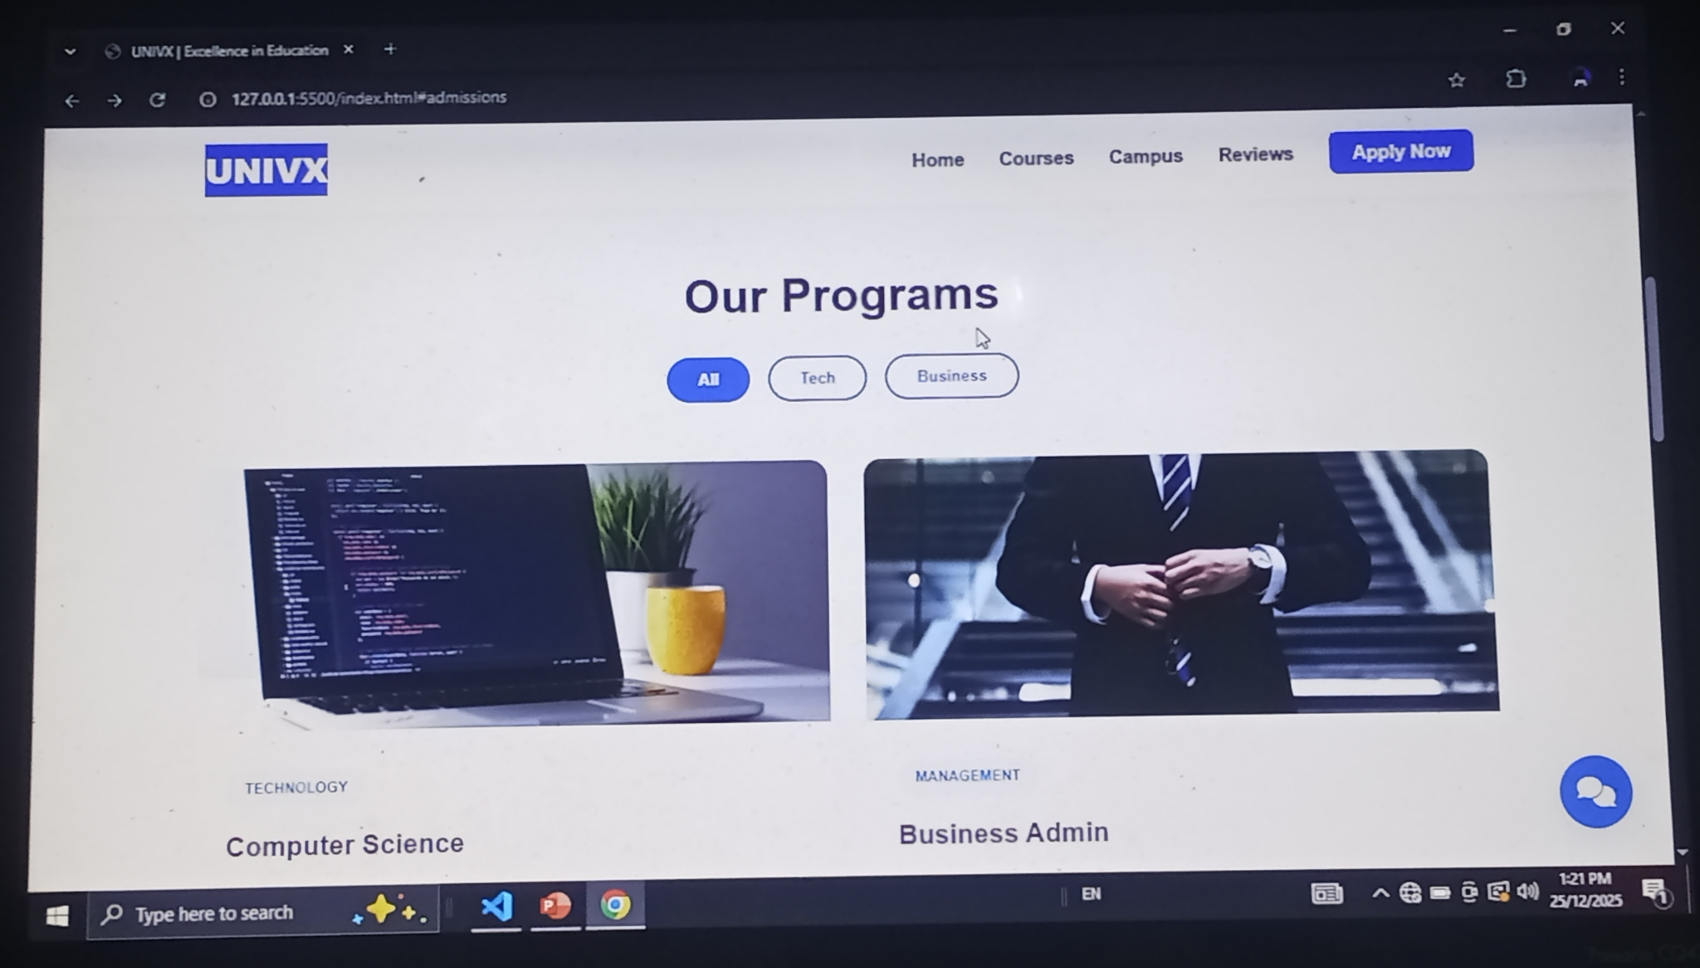

Slide 9
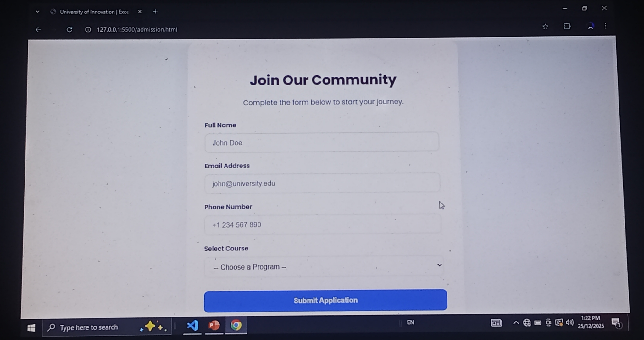

Slide 10
Future enhancement
I’m Maintained a Large Amount of Database to store a information using SQL (or) NoSQL.
Implements the payment gateway to interaction of college required fees.
To build a High Level Security for communicate confidential Message to Student Information.

Slide 11
conclusion
This project successfully demonstrates how a legacy website can be modernization using only HTML and CSS. The Solution enhances usability, visual appeal, and responsiveness while preserving the original structure, making it’s suitable for real-world applications.

