Slide 1
Kyoto Protocol
An Overview of Global Climate Agreements
- Mittapalli Pavan
21311A6629

Slide 2


Agenda
Kyoto
# Introduction
# Objectives and Greenhouse Gases
# Achievements, Challenges, and Paris Agreement
# Objectives and Greenhouse Gases
# Future Outlook and Conclusion

Slide 3
Introduction
The Kyoto Protocol, created in 1997, is an important global agreement. It asks developed countries to reduce their greenhouse gas emissions. The idea is to share responsibilities and encourage cleaner practices. Though it has received some criticism, it played a key role in setting the stage for later agreements, showing the world's commitment to fighting climate change.
# Date of adoption: Dec 11, 1997
# Entered into force: Feb 16, 2005

Slide 4
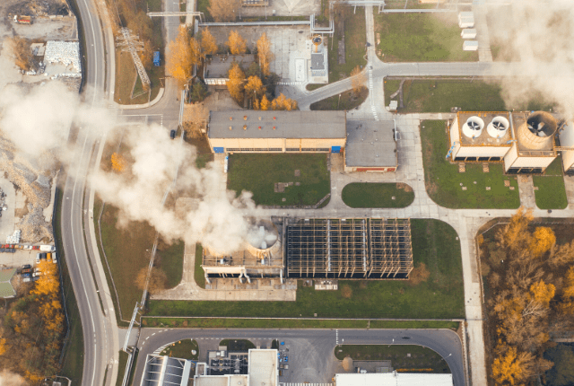
Objectives and Greenhouse Gases
Reduce greenhouse gas emissions, stabilize atmospheric concentrations
Covered gases: CO2, CH4, N2O, HFCs, PFCs, SF6

Slide 5

Achievements, Challenges, and Paris Agreement
Achievements: The Kyoto Protocol successfully reduced global emissions, prompting industries to adopt cleaner practices and technologies. This commitment marks a significant step in combating climate change.
Challenges: Despite successes, some nations faced difficulties meeting targets, revealing the need for ongoing innovation. Challenges highlighted the complex nature of addressing climate change globally.
Paris Agreement as a Successor: The Paris Agreement, introduced in 2015, expands on Kyoto's efforts, involving countries worldwide in setting and achieving climate goals. It embraces a more inclusive and adaptable approach to combatting climate change on a global scale.

Slide 6
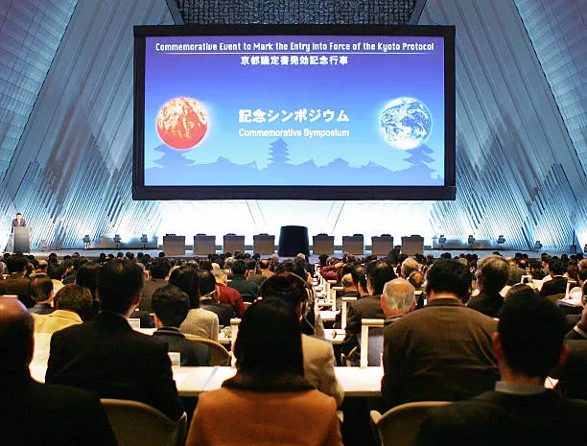

Commitment Periods and Mechanisms
1. International Emissions Trading
2. Clean Development Mechanism (CDM)
3. Joint implementation (JI)
Are the three market-based mechanisms to meet their targets.

Slide 7
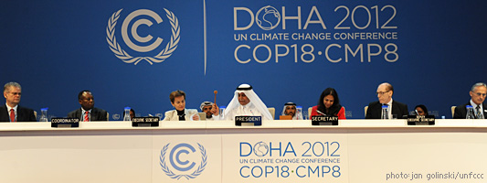
Future Outlook and Conclusion
Recap and Conclusion:
Kyoto Protocol and subsequent agreements signify global collaboration and commitment to addressing climate change for a sustainable future.
Current State (2020s):
Role of Countries:
Nations pivotal in reducing emissions, promoting sustainability, and adapting to climate impacts.
Ongoing global climate agreements shape the contemporary approach to climate action a Hayashi​

Slide 8
Thank you
- Mittapalli Pavan

