Slide 1




Dr.Ranjit K.N
Hod CSE Dept
Maharaja Institute of Technology Thandavapura
(Approved by AICTE, New Delhi and Affiliated to VTU, Belagavi)
Department of Computer Science and Engineering
(NBA Accredited for the Academic Year 2024 – 2027)
PROJECT
on
BLOCK CHAIN BASED NATIONAL
DIGITAL CURRENCY(NDC)
Ganesh A Kashyap 4MN21CS018
Pavan M V 4MN21CS033
UNDER THE GUIDANCE OF:
Shashank v Kashyap 4MN21CS045
Prof. Madhu B
Asst. Professor
Dept of CSE
Dhananjaya G 4MN22CS400

Slide 2
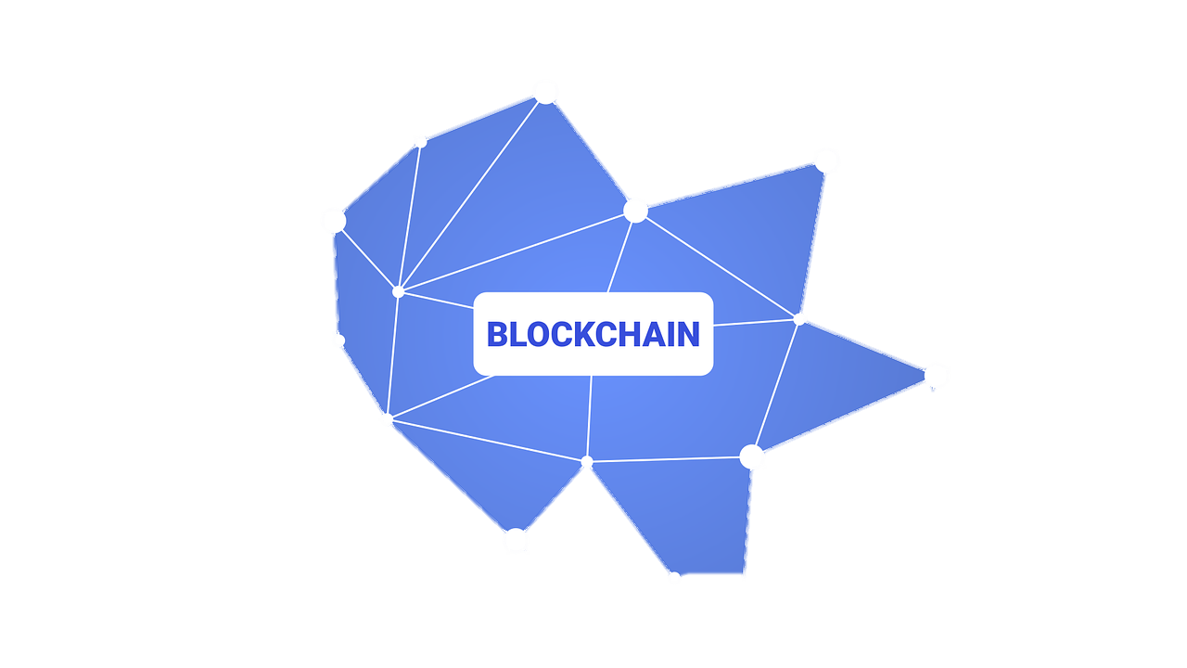

CONTENT
INTRODUCTION
PROBLEM STATEMENT
EXISTING SYSTEM
PROPOSED SYSTEM
SOFTWARE DEVELOPMENT GUIDE

Slide 3



INTRODUCTION
Blockchain-Powered & State-Backed Digital Currency
NDCs provide a secure, transparent, and efficient alternative to physical cash.
Unlike cryptocurrencies, they are government-regulated while benefiting from decentralization.
Next-Generation Financial Infrastructure
Utilizes blockchain, smart contracts, and DeFi for scalability and security.
Ensures instant transactions, reduced fraud, and enhanced financial inclusion.
Regulatory Oversight with Technological Innovation
Maintains government control while enabling tamper-proof transactions.
Adheres to compliance regulations while improving accessibility and efficiency.
Future-Proof Digital Economy
Integrates cryptographic security, cross-border compatibility, and automation.
Provides a fast, accessible, and scalable alternative to traditional fiat currencies.

Slide 4
Problem Statement
Lack of Transparency and Security in Fund Management – Traditional financial systems rely on centralized control and manual record-keeping, making them vulnerable to tampering, inefficiencies, and corruption, which leads to fund misallocation and difficulty in ensuring proper utilization.

Slide 5
Why the Problem Statement is Important
The problem statement is important because it highlights critical issues in financial management, such as lack of transparency, corruption, and inefficiencies, which lead to resource misallocation and financial losses.
Addressing this problem ensures accountability, enhances trust, and improves the efficiency of fund distribution, ultimately benefiting organizations, governments, and beneficiaries by ensuring that funds reach their intended purpose without interference.

Slide 6



Existing System Drawbacks
Lack of Transparency – Centralized financial systems make it difficult to track fund flow, leading to corruption and mismanagement.
Manual & Inefficient Auditing – Traditional financial systems rely on manual processes, making auditing slow and prone to errors or manipulation.
High Intermediary Involvement – Multiple intermediaries in transactions increase costs, delays, and opportunities for fund diversion.
Security Vulnerabilities – Centralized databases are susceptible to cyberattacks, fraud, and unauthorized modifications.
Delayed Transactions – Government and financial processes often involve bureaucratic delays, affecting real-time fund utilization.
Lack of Real-Time Tracking – No real-time visibility into fund distribution results in inefficiencies and misallocation.

Slide 7

Proposed System
1 Decentralization & Elimination of Intermediaries: Drawback Overcome: Traditional banking systems rely on centralized institutions that can be slow, expensive, and prone to failure. Solution:
Blockchain removes the need for central authorities, making transactions peer-to-peer (P2P).
Eliminates bank failures, excessive fees, and processing delays.
2 Enhanced Security & Fraud Prevention: Drawback Overcome: Traditional digital payment systems are vulnerable to hacking, identity theft, and double spending. Solution:
Uses cryptographic encryption & consensus mechanisms (PoW/PoS) to prevent fraud.
Transactions are immutable, meaning they cannot be altered or deleted.

Slide 8
3 Transparency & Traceability: Drawback Overcome: Cash transactions allow money laundering, corruption, and tax evasion due to a lack of transparency. Solution:
Every transaction is recorded on the blockchain, making it publicly verifiable.
Ensures end-to-end transparency while maintaining user privacy.
4 Improved Monetary Policy Control: Drawback Overcome: Traditional cash-based economies make it hard for central banks to track and control money supply. Solution:
Blockchain-based NDC allows real-time monitoring of circulation.
Authorities can control inflation, prevent black money circulation, and stabilize the economy.

Slide 9
Implementation of digital currency in India
Initiative | Year | Description | Factors Affecting Popularity
e-RUPI | 2021 | A digital voucher system launched by the Indian government to facilitate cashless payment solutions for specific services. | Limited awareness and adoption due to its targeted use cases and lack of widespread merchant acceptance.
Digital Rupee (e₹) | 2022 | The Reserve Bank of India's Central Bank Digital Currency (CBDC) pilot aimed at providing a digital alternative to physical cash. | Initial enthusiasm waned due to limited accessibility and integration with existing payment platforms.
Fintech Participation in e₹ | 2024 | Expansion of the e₹ pilot to include fintech companies like Google Pay, PhonePe, Amazon Pay, and Cred to boost adoption. | Despite efforts, e₹ transactions declined, reflecting challenges in user engagement and competition with established payment methods.
Revolut's Entry into India | 2025 (planned) | European fintech company Revolut's planned launch in India, aiming to offer digital financial services. | Market entry challenges include competition with established local players and regulatory compliance.
Cryptocurrency Adoption | Ongoing | The use of decentralized digital currencies like Bitcoin and Ethereum in India. | Regulatory uncertainties and potential legal restrictions have hindered widespread adoption.

Slide 10
Cause for decline in the use and implementation of Digital coin
Internal political factors have significantly influenced the trajectory of digital currency adoption in India. The interplay between various governmental bodies, regulatory authorities, and financial institutions has created a complex environment for digital currencies.
Key Developments:
2018: The Reserve Bank of India (RBI) imposed a banking ban on cryptocurrency transactions, prohibiting banks from facilitating services related to digital currencies. This move was influenced by concerns over financial stability and potential misuse of cryptocurrencies.
2020: The Supreme Court of India lifted the RBI's ban, allowing banks to resume services for cryptocurrency transactions. This decision highlighted the ongoing debate and differing perspectives within India's political and financial sectors regarding digital currencies.
2021: The Indian government introduced the Cryptocurrency and Regulation of Official Digital Currency Bill, aiming to create a framework for an official digital currency while proposing a ban on private cryptocurrencies. This legislative move underscored internal policy divisions and uncertainties surrounding the regulation of digital assets.
2022: The RBI launched a pilot for the Digital Rupee (e₹), India's Central Bank Digital Currency (CBDC). Despite this initiative, internal debates and cautious approaches within political and financial institutions have contributed to limited public adoption and awareness.
These events illustrate that internal political dynamics, including regulatory hesitations and policy debates, have played a crucial role in shaping the adoption and popularity of digital currencies in India.
India Reassesses Cryptocurrency Stance Amid Global Regulatory Shifts
https://www.clayfin.com/blogs/indias-central-bank-digital-currency-cbdc-opportunities-and-challenges/
https://www.reuters.com/technology/india-reviewing-crypto-position-due-global-changes-senior-official-says-2025-02-02/
https://www.reuters.com/technology/coinbase-eyes-re-entry-into-india-techcrunch-reports-2025-02-13/

Slide 11
SOFTWARE DEVELOPMENT GUIDE
Security & Encryption
Use AES-256 encryption for data storage and TLS 1.3 for secure communication.
Implement multi-signature wallets to prevent unauthorized transactions.
Ensure smart contract security by auditing for vulnerabilities like reentrancy attacks.
Scalability & Performance
Optimize block validation time to ensure fast transactions.
Use Layer-2 scaling solutions (like Rollups) to reduce congestion.
Implement efficient consensus mechanisms (e.g., Proof-of-Stake for better efficiency).
Data Integrity & Transparency
Store transaction history in a tamper-proof blockchain ledger.
Implement zero-knowledge proofs (ZKPs) for privacy without compromising transparency.
Use hashing (SHA-256) to ensure data immutability.

Slide 12
SOFTWARE DEVELOPMENT GUIDE
Compliance & Legal Considerations
Follow GDPR and data protection laws for user privacy.
Ensure interoperability with existing financial systems (e.g., SWIFT, UPI, etc.).
Fault Tolerance & Recovery
Implement automatic rollback mechanisms for failed transactions.
Maintain a redundant node system to ensure uptime.
Regularly update backup strategies to prevent data loss.

Slide 13

QUESTIONS
THANKYOU

