Slide 1

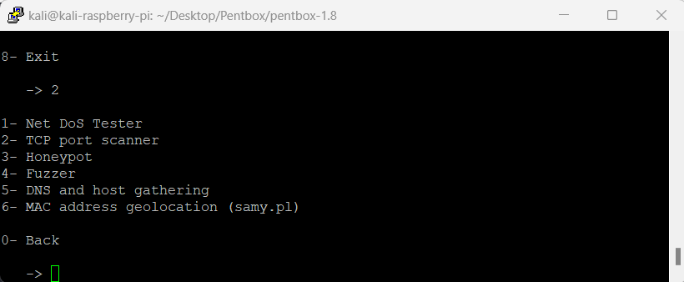

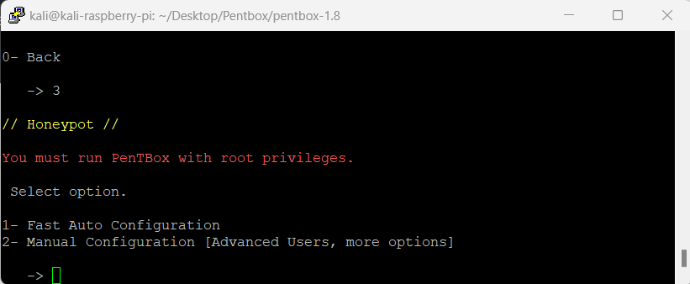
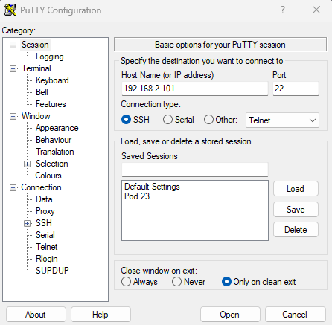
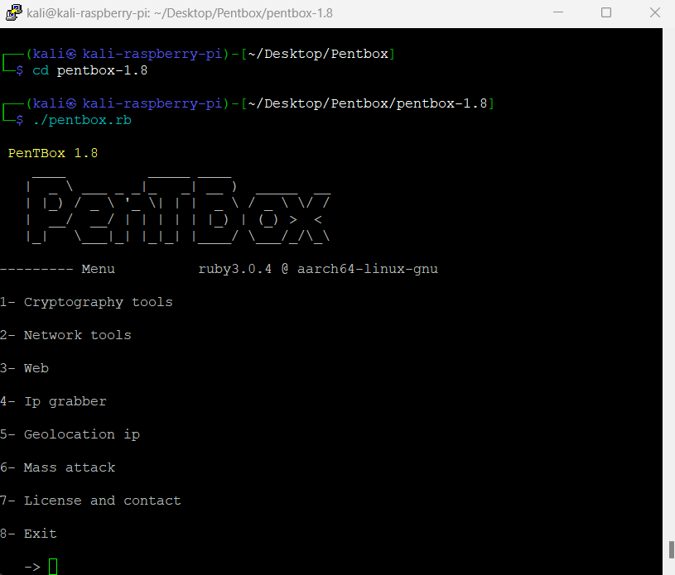
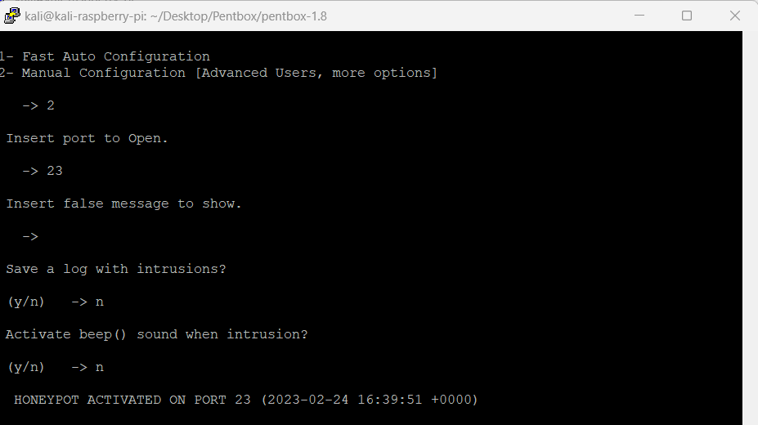

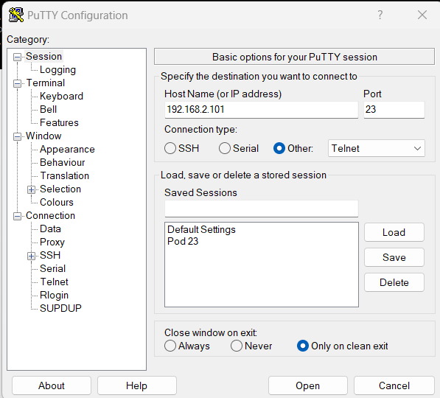
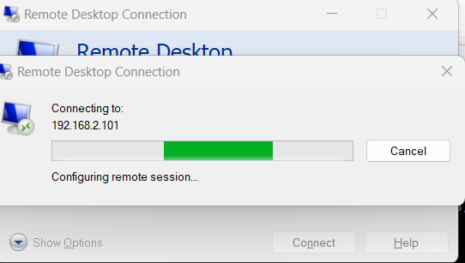
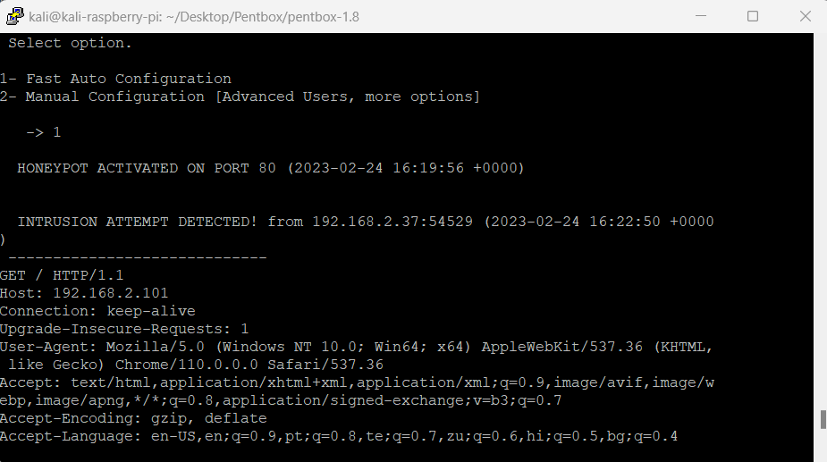
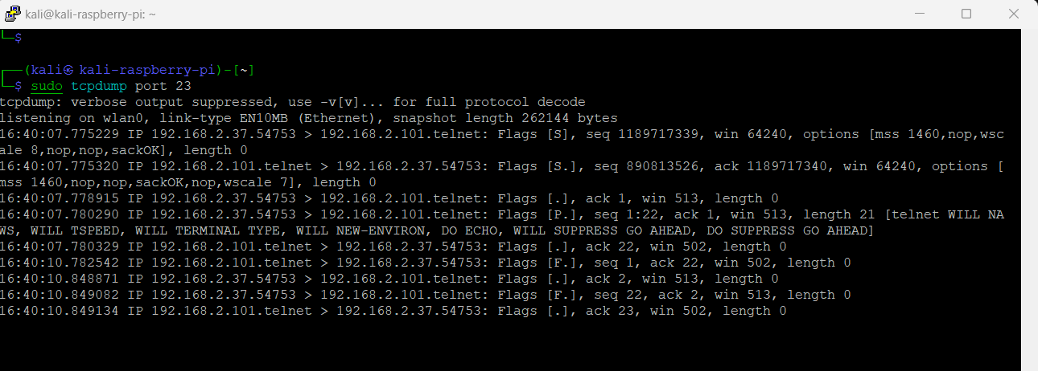
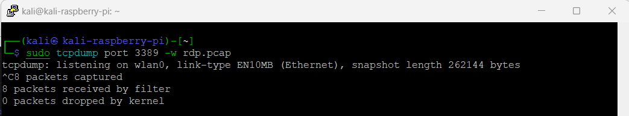
Seminar Conference 2023
Pavan Raj Seeramdas,
MEng in Internetworking (pv649022@dal.ca)
1333 South Park St. Halifax, NS. B3J 2K9
Protecting Network Structures by Deploying Honeypots
INTRODUCTION
WHY DO WE NEED HONEYPOT ?
TYPES OF HONEYPOTS
TYPES OF ATTACK VECTORS
STEPS IN PREVENTION OF ATTACKS
It is a computer security mechanism used to detect and trap unauthorized access attempts by hackers or malicious software.
It works by mimicking a vulnerable target network, luring attackers to interact with it, and then monitoring and analyzing their behavior to gather intelligence.
They provide valuable insight into the tactics, techniques, and procedures (TTPs) used by attackers.
They can identify vulnerabilities and weaknesses in a network that need to be addressed.
They can help improve incident response and help security professionals develop better defenses against future attacks.
Low-interaction honeypots: Emulates a few services, low risk, basic data collection.
High-interaction honeypots: Emulates an entire system, highest risk, most realistic environment.
Pure honeypots: Dedicated solely to honeypot purposes, no legitimate use.
Compromised Credentials: Stolen login information used for unauthorized access.
Issues In Misconfigurations: Security vulnerabilities due to improper setup.
SQL Injection Attacks: Injecting malicious code into SQL statements to manipulate data.
Man in the Middle Attacks: Intercepting and manipulating communication for unauthorized access.
Virtual Private Network: Secure connection over a public network that allows remote users to access private resources
Firewalls: Security system that monitors and controls incoming and outgoing network traffic based on predefined policies
Intrusion Detection & Prevention Mechanisms: System designed to monitor and analyze network traffic for signs of malicious activity and take action to prevent incidents.
IMPLEMENTATION
Initially I have downloaded the Kali Linux image on my local system.
With the help of mounting tool (Etcher) I have flashed the image on the SD Card.
Loaded the SD card into my Raspberry Pi and powered on to start the Kali Linux.
I have used installed the Pentbox , an open-source security tool for implementing honeypot on the micro board.
I have used SSH as connection type to connect to the device where I am accessing it using PuTTy terminal.
I have started the honeypot and performed various types of attacks.
TYPES OF ATTACKS IMPLEMENTED
PENTBOX
Selecting Honeypot from the network tools.
HTTP: Transmitting data over the internet, commonly used for websites and web applications.
Port Number – 80
TELNET: Remote access to computer over a network.
Port Number – 23
RDP: Remote access to a windows server.
Port Number - 3389
Connected to the Kali Linux running on the device using SSH with the IP Address and Port Number (22).
Two ways of running the honeypot:
Fast Auto Configuration
Manual Configuration
Fast Auto Configuration performed HTTP.
For this project I have used Raspberry Pi 4 to implement the Honeypot on my local network.
Manual Configuration gives more options performed TELNET and RDP.
HTTP ATTACK
TELNET ATTACK
RDP ATTACK
CONCLUSIONS
RECOMMENDATIONS
Honeypots provide a safe and controlled environment for studying attackers behavior and methods without compromising legitimate systems.
Honeypots can help organizations stay ahead of attackers by providing early warning signs of new attack vectors.
Helps in improving organizations incident response capabilities by providing an opportunity to practice responding to attacks.
I shall be using more advanced methods and protocols in designing the honeypot system.
Use a combination of different types of honeypots to create a more comprehensive and diverse network defense strategy.
Deploy honeypots strategically around critical assets, keep them up to date, and monitor the data collected to improve overall security posture.

