Slide 1
PROJECT TITLE SECURE DATA HIDING IN IMAGES USING STEGANOGRAPHY
CAPSTONE PROJECT
Presented By:
Student Name : SINGANABOINA PAVAN KRISHNA SAI
College Name & Department : KKR & KSR INSTITUTE OF TECHNOLOGY & SCIENCES, CSE

Slide 2
OUTLINE
Problem Statement
Technology used
Wow factor
End users
Result
Conclusion
Git-hub Link
Future scope

Slide 3
Problem Statement
The project aims to develop a Python-based application that securely hides text messages within images using steganography. Users will be able to upload an image, input a text message, and provide a key to encrypt and embed the message within the image. This ensures the confidentiality and integrity of the hidden data, making it accessible only to authorized users.

Slide 4
Technology used
OpenCV (cv2): Utilized for its robust image processing capabilities, OpenCV allows for the manipulation and embedding of data within images efficiently. It handles complex image transformations, making it essential for implementing steganography.
os Module: This module provides a way to interact with the operating system, allowing for seamless file handling operations. It is used to manage input/output operations, navigate directories, and handle file paths crucial for accessing and saving images.
string Module: The string module offers a collection of useful string operations. It is used for text manipulation, ensuring that the input text message is properly formatted and processed before being embedded within the image.

Slide 5
Wow factors
User-Friendly Interface: By enabling users to simply upload an image, input a text message, and provide a key, your project prioritizes ease of use and accessibility.
Enhanced Security: The use of a key for encryption ensures that the hidden data is secure and accessible only to authorized users, adding an extra layer of protection.
Versatile Application: The project is implemented in Python, which is widely used and highly versatile, making it easier for others to understand, modify, and extend.
Efficient Image Processing: Leveraging OpenCV for image processing provides robust and efficient handling of image data, ensuring high-quality results.
Modular Design: The use of the os and string modules for file handling and text manipulation adds modularity, making the code more organized and maintainable.

Slide 6
End users
Journalists and Whistleblowers
Business Professionals
Privacy Enthusiasts
Researchers and Educators

Slide 7
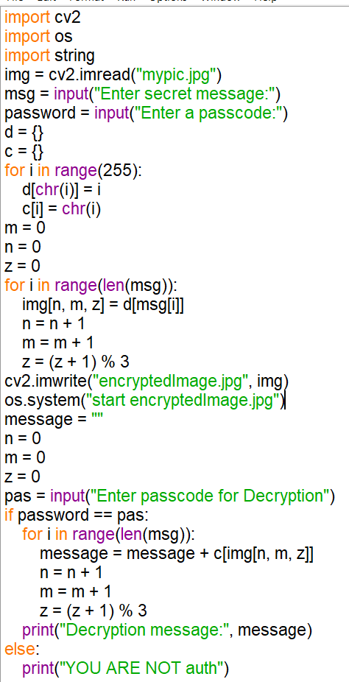


Results

Slide 8
Conclusion
In conclusion, this project demonstrates a novel approach to secure data hiding in images using steganography. It combines robust image processing with efficient file handling and text manipulation, ensuring a seamless user experience. The encryption of messages with a user-provided key enhances security, making the hidden data accessible only to authorized individuals. Catering to a diverse audience, this project stands out for its user-centric design and innovative application, representing a significant contribution to the field of data security.

Slide 9
GitHub Link
https://github.com/Pavan-627/Steganography.git

Slide 10
THANK YOU

