Slide 1

Transforming Career Development with AI and NLP: A Smart Placement Platform
Project Review Batch No :12
Presented By:
B. Kavya Samitha Reddy 21761A4207
B. Pavan Kumar 21761A4209
Sk. Sirajuddin 21761A4255
S. Manasa 21761A4256
Under Guidance of :
Mrs.K.V.SaiLavanya
Assistant Professor
DEPARTMENT OF COMPUTER SCIENCE & ENGINEERING (AI&ML)
LAKIREDDY BALI REDDY COLLEGE OF ENGINEERING
(AUTONOMOUS)
L.B.Reddy Nagar :: Mylavaram – 521 230 :: NTR Dist.:: A.P.

Slide 2
Contents
Abstract
Introduction
Existing System
Proposed System
Modules Of Project
Software Requirements
Hardware Requirements
References

Slide 3
Abstract
In today's competitive job market finding the right opportunities and preparing for them remains a significant challenge for students and professionals. Traditional placement and career development methods often lack personalization, leading to inefficiencies in candidate recruitment and preparation. The absence of tailored insights, automated resume screening, and targeted interview preparation strategies can hinder both recruiters and job seekers. Additionally, the growing demand for domain-specific expertise, coupled with the rapid evolution of job requirements, necessitates a system that leverages advanced technologies to bridge the gap between candidate potential and industry expectations. With the increasing complexity of recruitment processes, there is a pressing need for intelligent platforms that can analyze resumes, match candidates to job descriptions, provide comprehensive interview preparation strategies, and guide candidates in improving their skills effectively. To address these challenges, we propose an Intelligent Placement and Career Development Platform that integrates Artificial Intelligence (AI) and Natural Language Processing (NLP) for enhanced recruitment insights and personalized recommendations. This platform features a robust resume screening system using Logistic Regression and K-Nearest Neighbors (KNN), achieving accuracy levels of 95% and 89%, respectively. Candidate-job matching is powered by the BERT model, which identifies skill gaps and offers actionable feedback. The platform also includes a comprehensive interview preparation module that uses TF-IDF and cosine similarity to suggest preparation strategies and fetch relevant resources, including YouTube videos categorized by difficulty levels (Easy, Medium, High). Additionally, the system provides detailed insights into company-specific interview processes, ensuring candidates are well-prepared for each stage. By combining advanced machine learning techniques with user-friendly functionalities, this platform empowers students and professionals to navigate their career paths confidently and efficiently.

Slide 4
Introduction
Securing meaningful employment and career advancement is increasingly complex in today's job market. Traditional recruitment methods often lack personalization, making it difficult for candidates to identify strengths, address skill gaps, and navigate the hiring process. Employers seek technically proficient candidates who also understand domain-specific requirements, yet inefficiencies persist due to outdated placement systems.
AI and NLP technologies offer a transformative solution by analyzing resumes, job descriptions, and candidate-job compatibility. These intelligent systems can provide personalized insights, predict performance, and streamline recruitment. This project aims to develop an AI-driven career development platform to enhance job matching, optimize hiring, and empower job seekers and recruiters alike.

Slide 5
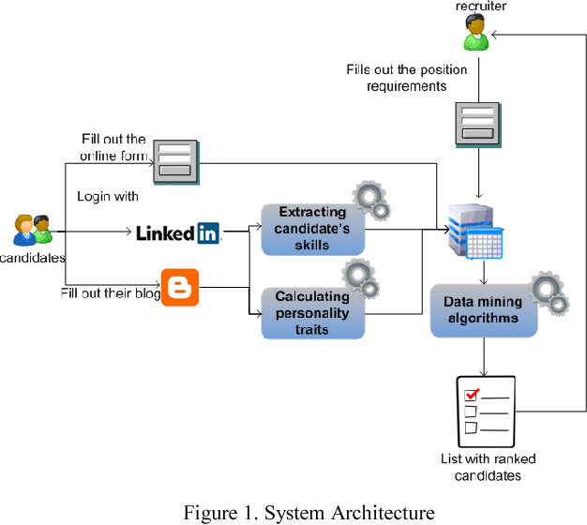
Existing System

Slide 6
Disadvantages / Limitations
Lack of Personalization: Existing systems often provide generic recommendations and do not tailor their suggestions or feedback to individual candidates based on their unique skills, experience, or job preferences.
Inefficient Resume Screening: Traditional resume screening systems rely on keyword matching, which overlooks the contextual relevance of a candidate’s skills and experience, leading to inaccurate shortlisting.
Limited Job Matching Accuracy: Many platforms use simple matching algorithms that fail to account for the complex nuances of job requirements, resulting in mismatches between candidates and job roles.
Fragmented Interview Preparation: Interview preparation resources are typically generalized and not customized to the candidate's skill level or the specific job role, reducing their effectiveness.
Outdated Technology: Most existing systems do not utilize advanced AI or machine learning techniques, such as deep learning or NLP, which are essential for accurate analysis, intelligent recommendations, and improving candidate-recruiter matching.

Slide 7
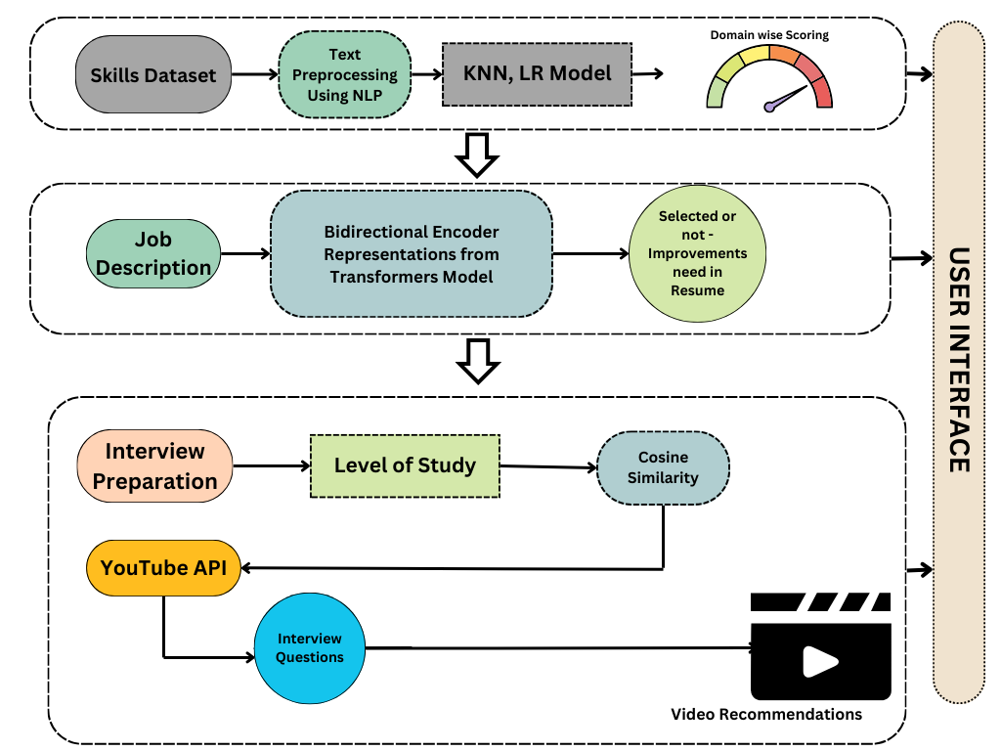
Proposed System

Slide 8
Advantages
Personalized Resume Screening and Evaluation By utilizing machine learning algorithms like Logistic Regression and K-Nearest Neighbors (KNN), the platform analyzes resumes beyond mere keyword matching. It assesses the contextual relevance of skills and experiences to specific job descriptions, enabling a more accurate and comprehensive evaluation of candidate profiles.
Advanced Candidate-Job Matching Employing pre-trained models such as BERT, the system understands and matches resumes with job descriptions based on semantic meaning. This approach ensures higher accuracy and relevance in candidate selection, aligning candidates' profiles with suitable job opportunities more effectively.
Domain-Specific Skill Assessment and Development The platform offers insights into areas where candidates excel and identifies areas requiring improvement. This feature provides personalized recommendations for skill development, aiding candidates in enhancing their competencies and increasing their employability.
Tailored Interview Preparation Tools By utilizing techniques like TF-IDF and cosine similarity, the system matches interview questions with a candidate's experience and job requirements, categorizing them into difficulty levels. This tailored approach ensures that candidates are well-prepared for the specific demands of their desired positions.
Integration of Multimedia Learning Resources The platform integrates the YouTube API to fetch video tutorials, mock interviews, and interview strategies based on the user's specified skill level and needs. This integration provides candidates with diverse learning materials, enhancing their preparation experience.
Comprehensive Interview Process Insights The system includes detailed information about common stages of the interview process for various companies, along with tips for each stage. This holistic approach ensures that candidates are well-prepared, with personalized feedback and resources throughout the recruitment journey.

Slide 9
Modules Of Project
TF-IDF (Term Frequency-Inverse Document Frequency) – Text processing for NLP.
Cosine Similarity – Measuring similarity between text documents.
BERT (Bidirectional Encoder Representations from Transformers) – Pre-trained NLP model for text understanding.
Logistic Regression – Classification algorithm in machine learning.
K-Nearest Neighbors (KNN) – Machine learning algorithm for classification.
Hyperparameter Tuning (Grid Search, Random Search) – Optimizing machine learning models.
Feature Scaling (Standardization, Normalization) – Data preprocessing in ML.
Cross-Validation – Model evaluation technique in ML.

Slide 10
Software Requirements
Operating System: Windows 10
Programming: Python
IDE: Visual Studio Code
Dataset: Kaggle
Libraries: Numpy, Pandas, Matplotlib, Sklearn, Keras, etc.,
Front End: Streamlit

Slide 11
Hardware Requirements
Processor: I5/ Intel Processor
RAM: 8GB
Hard Disk: 1TB

Slide 12
References
https://drive.google.com/file/d/1nQj1Ix7auBLcn62paM5diINFPIcEDVSf/view?usp=sharing

Slide 13
Thank Q

