Slide 1

Modern Database Mini Project
Student Information System
Presented By Pavan B N

Slide 2



Tech Stack

Slide 3
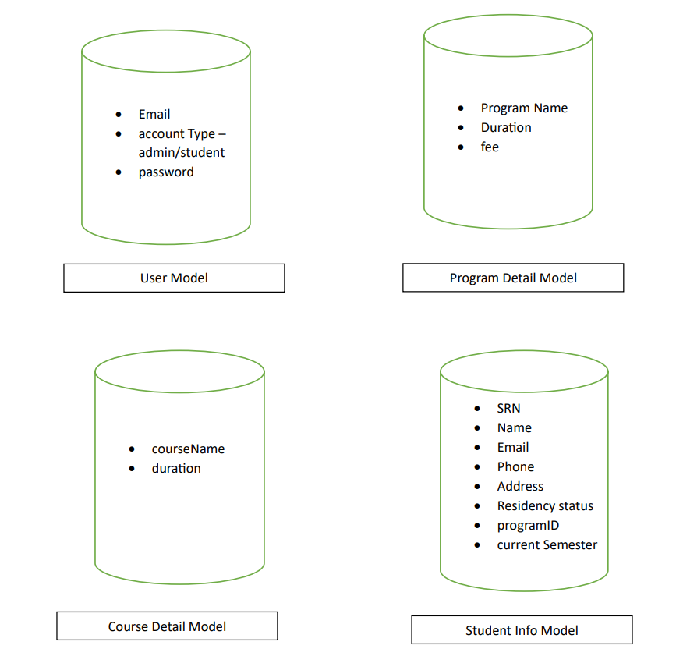
Database Design

Slide 4
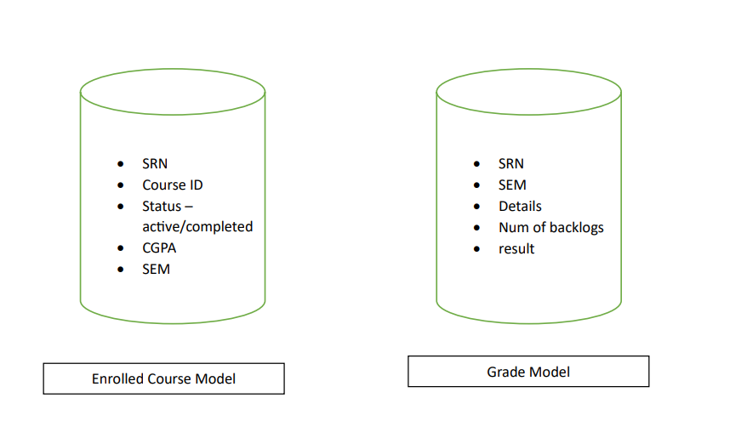

Slide 5
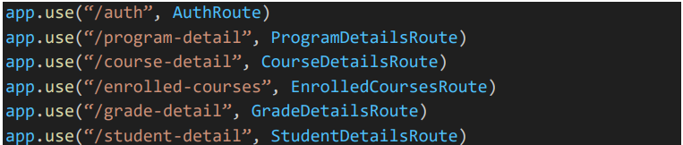
API Endpoints

Slide 6
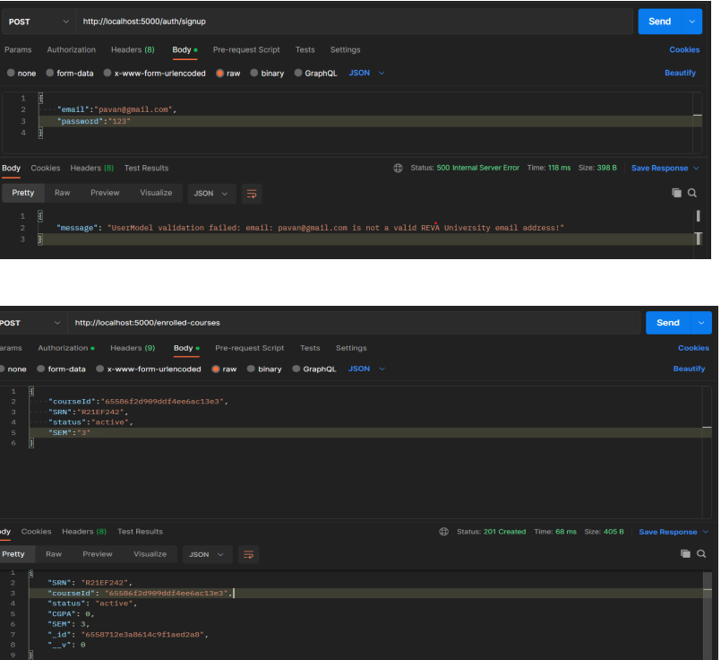
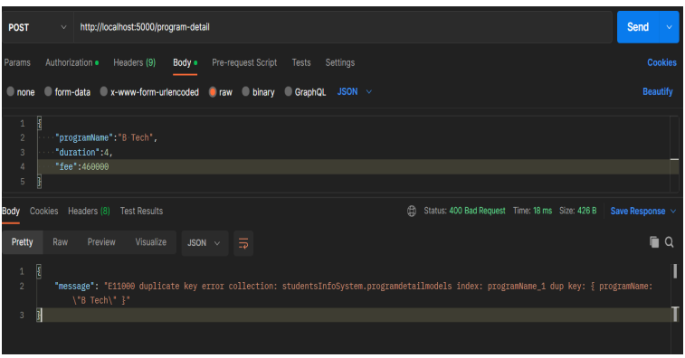
API Testing Using Postman

Slide 7
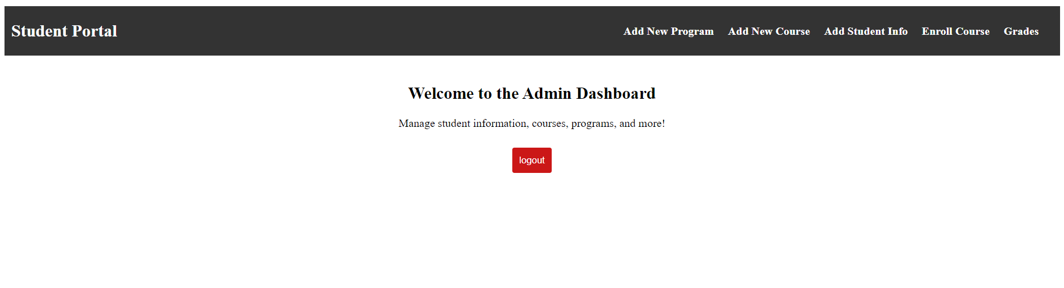
Application Interface React
Admin Dashboard

Slide 8
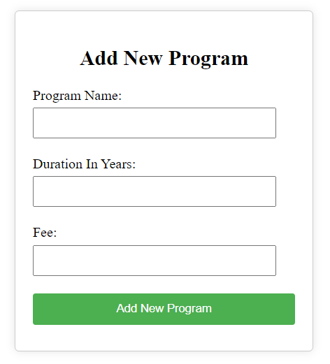
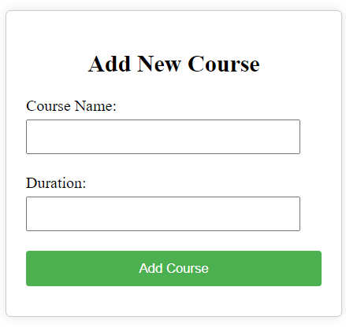
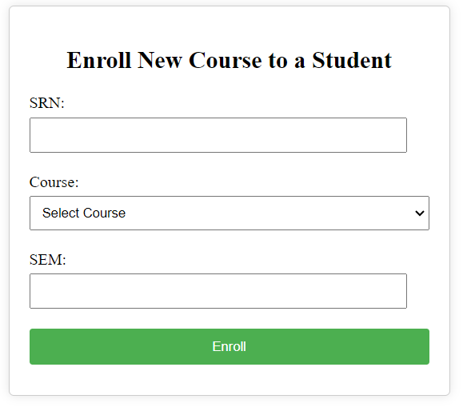
Admin has access to add new program, courses and enrol new course to a student.

Slide 9
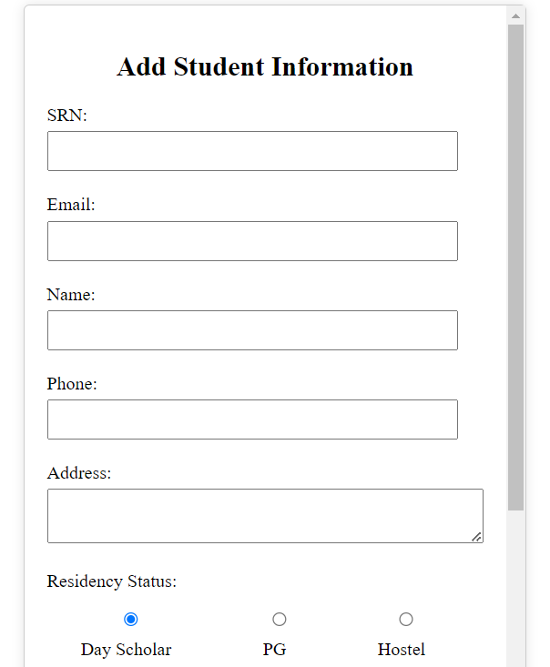
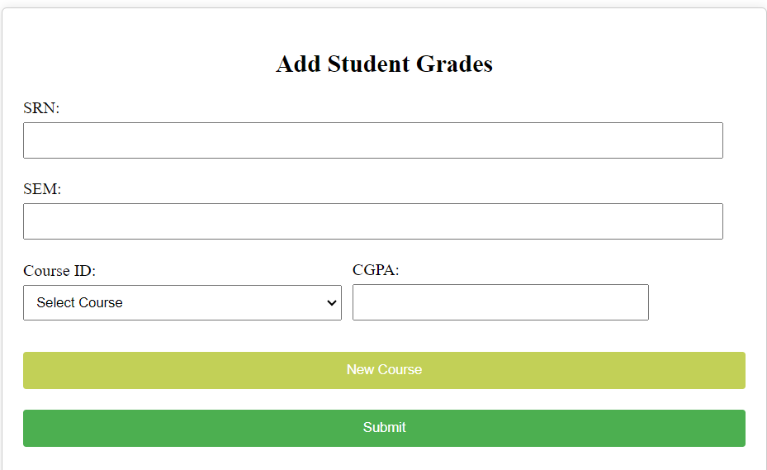
Admin also have access to add and update basic student information and declare the student academics grades

Slide 10
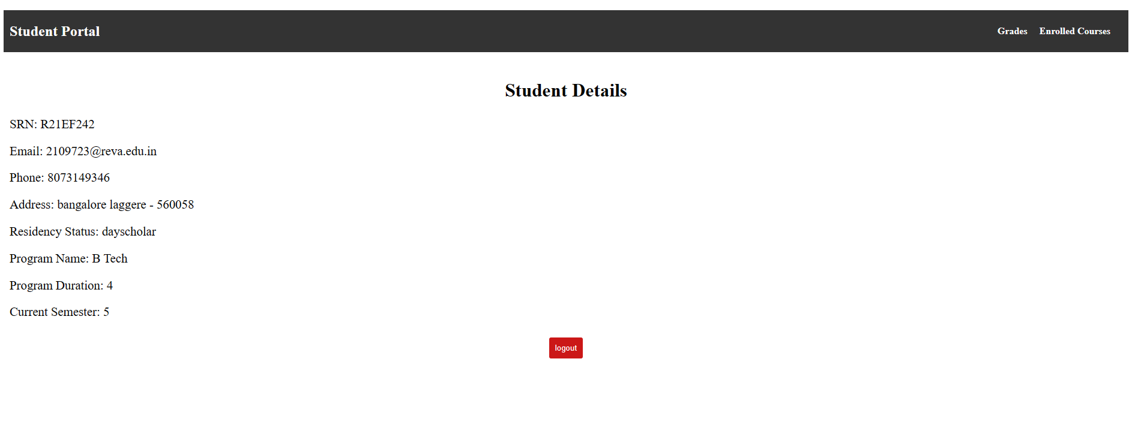
Student can access their information by logging in to the portal

Slide 11
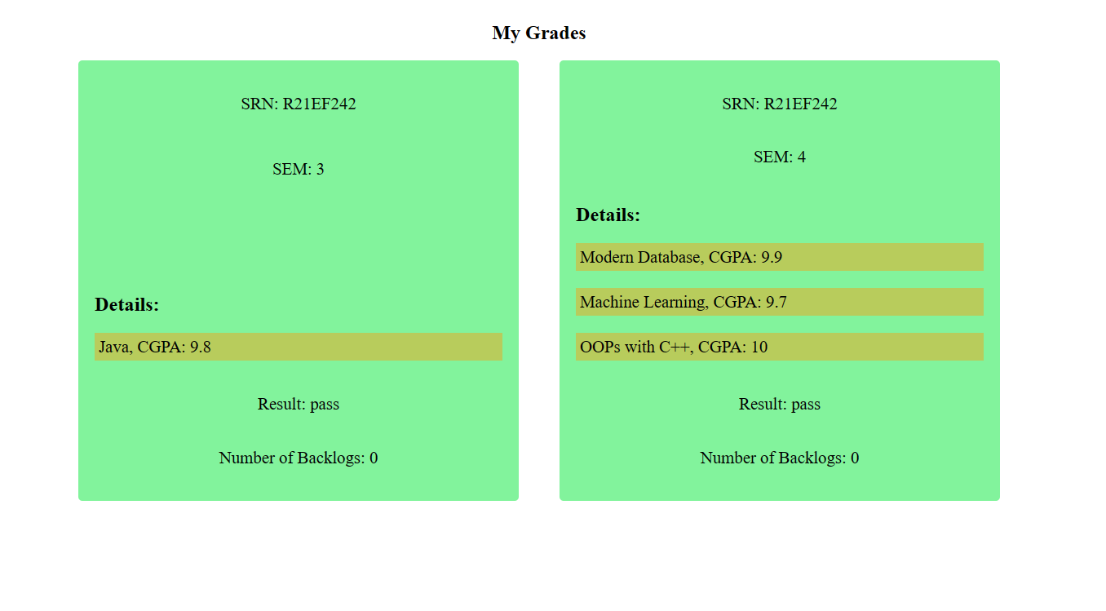
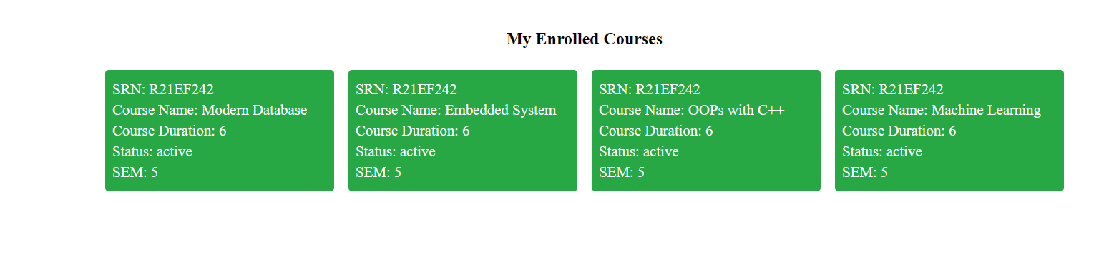

Slide 12

Thank You

